Slide 1
System Development
Scrum 1
Datamatiker /Computer Science
2nd Semester
PAB
2016
Scrum 1

Slide 2
Agenda for Scrum Days
Scrum
Process tool that describes how teams can work together to develop a product
Scrum Day 1
Overview of Scrum
  Requirement specification (customer view)
    How will it work with the traceability model?
  Requirement implementation (developer view)
Scrum day 2
Product backlog
  Poker game
  User stories
  Estimation
  Done criteria
Scrum Day 3
Sprint planning
  Tasks
  Daily scrum meeting
Scrum 1

Slide 3
Learning Objectives for Scrum
Knowledge of Scrum basic process model
  How to document and estimate customer requirements
  How to turn these requirements into an operational format the developers can use to control their daily work
  How to monitor and manage the development effort
  How to calculate team velocity, meaning how much work a team can handle in time-boxed period
  How to work in an iterative manner where software is build piece by piece
Scrum 1

Slide 4
Main literature
Henrik Kniberg Scrum and XP from the Trenches:
http://www.infoq.com/minibooks/scrum-xp-from-the-trenches
Pages : p. 1-41 (Scrum Day 2) + 43-71 (Scrum Day 3)
Scrum 1

Slide 5



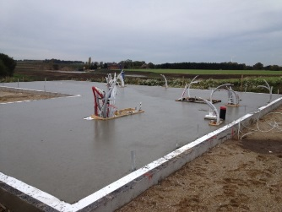
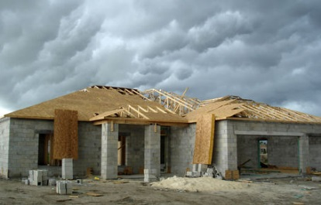
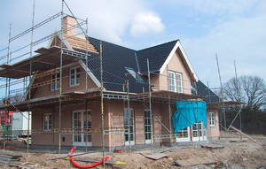
Traditional waterfall example
To build a house!
Fase 2 – design
Fase 1 – idé/analyse
Fase 3a – fundament
Fase 3b – mure/vægge
Fase 3c – tag
Fase 3 – konstruktion
Scrum 1

Slide 6
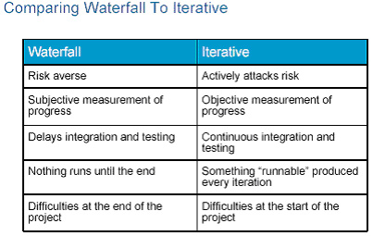
Traditional Waterfall vs. Iterative Approach
General comparison of two paradigms (i.e. methodology classifications)
Traditional “waterfall” development depends on a perfect understanding of the product requirements from the beginning and minimal errors made in each phase.
Source: http://www.ibm.com/developerworks/rational/library/4029.html
Scrum 1
Notes:
Averse – modvillig
http://en.wikipedia.org/wiki/Risk_aversion

Slide 7
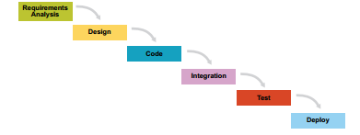
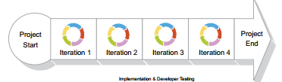
Scrum in a Nutshell 1
The Scrum is iterative process
  Many small water falls, called sprints
TRADITIONAL WATERFALL
SCRUM - ITERATIVE – MINI WATERFALLS
Scrum 1

Slide 8
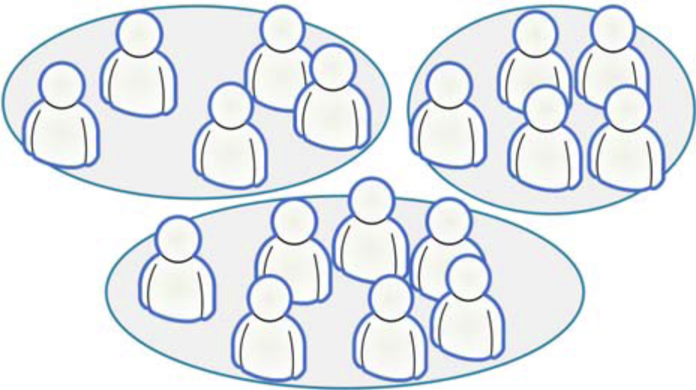
Scrum in a Nutshell 2
Split your organization into small, cross-functional, self organizing teams.
Source: Kniberg ” KANBAN AND SCRUM – MAKING THE MOST OF BOTH”
Scrum 1
Notes:
Size 3-12

Slide 9

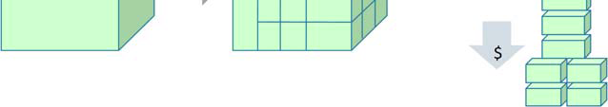
Scrum in a Nutshell 3
Split your work into a list of small, concrete deliverables.
  Sort the list by priority
  Estimate the effort of each item
Source: Kniberg ” KANBAN AND SCRUM – MAKING THE MOST OF BOTH”
Scrum 1

Slide 10
Scrum in a Nutshell 4
Split time into short fixed-length iterations (usually 1 – 4 weeks), with potentially shippable code demonstrated after each iteration.
Short sprints are good = short feedback cycle = more frequent deliveries = more frequent customer feedback = less time spent in the wrong direction = learn and improve faster.
Long sprints are good too. The team gets more time to build up momentum, they get more room to recover from problems and still make the sprint goal; less overhead for sprint planning meetings, demos etc. (Kniberg p.19-20)
Scrum 1
Notes:
3 uger (2 – 6 weeks)

Slide 11
Scrum in a Nutshell 5
After each iteration …
  Optimize the release plan and update priorities in collaboration with the customer, based on insights gained by inspecting the release
  Optimize the process by having a retrospective after each iteration.
Source: Kniberg ” KANBAN AND SCRUM – MAKING THE MOST OF BOTH”
Scrum 1

Slide 12
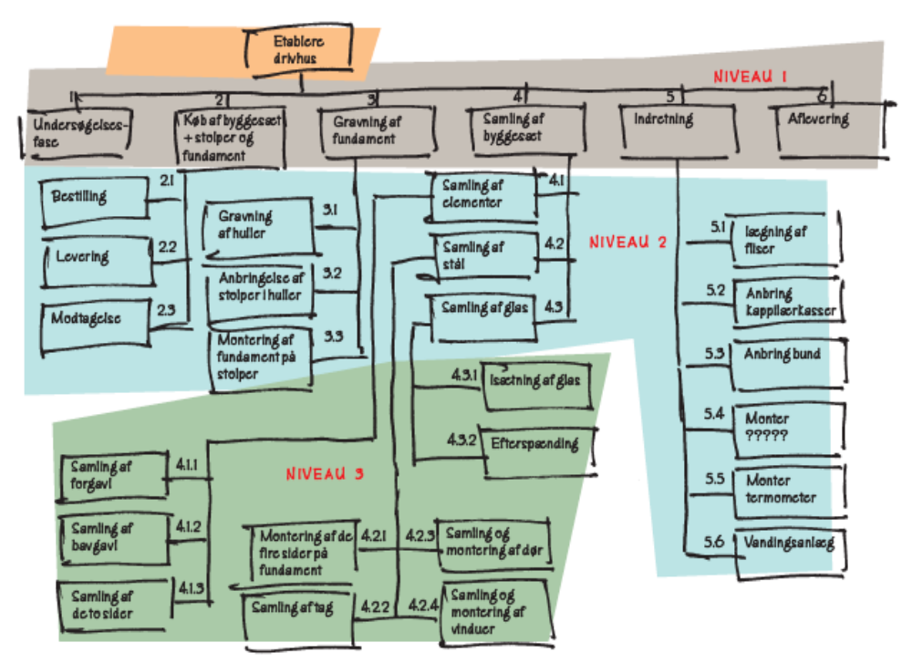
WBS for drivhus
- en anden vinkel på nedbrydning
Kousholt (2008: 233)

Slide 13
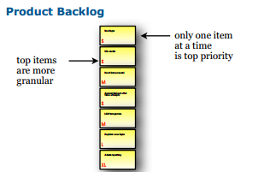
The Product Backlog
A prioritized list of everything that might be needed in the product
  requirements, features etc.
  Things that the customer wants, described using the customer’s terminology.
Scrum 1

Slide 14
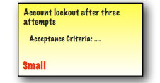
Product Backlog Item
Often called (user) story, or just PBI.
Example:
Scrum 1

Slide 15
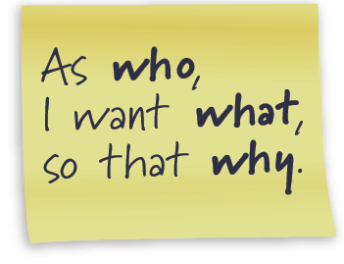
User Story
… is short, simple description of a feature told from the perspective of the person who desires the new capability (typically user or customer)
User stories can be written informally:
Registered users can reset their password
Or use a bit more formal template
As a registered user,
I want to reset my password,
so that I can get back into the site if I forget my password
Scrum 1

Slide 16
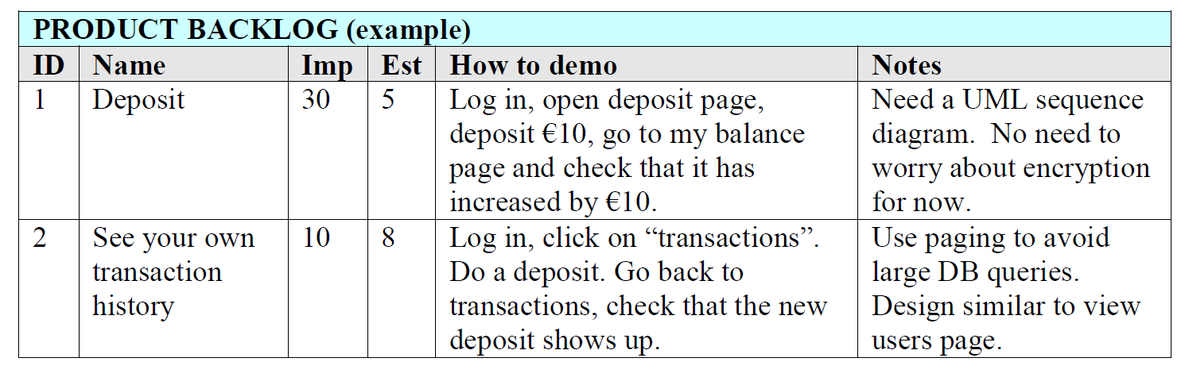
Product Backlog Example
Story example where feature description is specified in “How to demo” field, i.e. test steps description (acceptance criteria) (Kniberg p. 10)
Scrum 1

Slide 17
The traceability model & scrum!
Formål/vision
Gennem indførsel af nyt ordrehåndteringssystem at sikre:
Mål
Features
F.1: Bestilling via web
F.2: Online lager-opdatering
F.3: Online-hjælp
F.4:
F.X:
V.1: Øget kundetilfredshed
V.2: Større omsætning
V.3: Effektivisering
M.1: Kundetilfredshed stiger min. 0,5 ved næste tilfredsheds-undersøgelse
M.2: Gensalg til eksisterende kunder øges med 10% det første år efter installering af systemet.
M.3: 70% af alle kunder skal kunne benytte systemer uden problemer
M.X:
User Stories

Slide 18
Who is Responsible for Product Backlog?
The Product Owner!
  Represents the stakeholders, i.e. the voice of the customer.
Is responsible for maximizing product value
Is responsible for managing the PBL:
  Creating Product Backlog items (user stories)
  Prioritizes the items in the Product Backlog
  Ensuring the Development Team understands items to the level needed.
Scrum 1

Slide 19
Scrum Roles
Product Owner: responsible for the business value of the project
Development Team: self-organizes to get the work done
Scrum Master: ensures that the team is functional and productive
Scrum 1

Slide 20
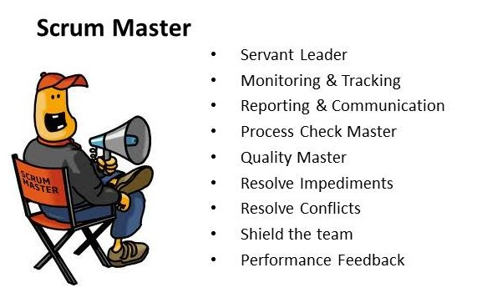
Scrum Master
The Scrum Master is the process owner ??
  responsible for ensuring Scrum is understood and enacted
  Helps the team perform at their highest level
  Protector of the team (coach)
Scrum 1
Notes:
Source: http://www.mountaingoatsoftware.com/scrum/scrummaster
Note: Many new to the ScrumMaster role struggle with the apparent contradiction of the ScrumMaster as both a servant & leader to the team and also someone with no authority.
The seeming contradiction disappears when we realize that although the ScrumMaster has no authority over Scrum team members, the ScrumMaster does have authority over the process. Although a ScrumMaster may not be able to say, “You’re fired,” a ScrumMaster can say, “I’ve decided we’re going to try two-week sprints for the next month.”

Slide 21
Hvad skal I have klar vedr. polygon?
Formål, mål, features – sat ind i SPORBARHEDSMODELLEN (traceability-model)
  Features giver input til mulige User Stories
Aktivitetsdiagram over væsentlige processer i ”Sunde Bygninger”-konceptet
  Swimlane ”IT-system” giver input til mulige User Stories
Apropos vores snak om teams, så skal alle grupper have lavet en gruppekontrakt!
På fredag skal alle grupper vise version 1 af deres PBL.
Scrum 1

Slide 22
Scrum in a nutshell
Let’s watch Introduction to Scrum video (17 minutes ++):
http://scrumtrainingseries.com/
Scrum 1
Notes:
Watch video http://blog.crisp.se/author/henrikkniberg

