Slide 1
System Development
Scrum 2
Datamatiker /Computer Science
2nd Semester
2016 efterår
Scrum 2

Slide 2
Agenda for Scrum Days
Scrum Day 1
Overview of Scrum
  Requirement specification (customer view)
  Requirement implementation (developer view)
Scrum day 2
Product backlog
  User stories
  Estimation
    Poker game
  Done criteria
Scrum Day 3
Sprint planning
  Tasks
  Daily scrum meeting
Scrum 2

Slide 3
Stories – how to write GOOD stories!
  How to identify stories (PO)
  How to write stories (PO)
  How to estimate stories (Team)
OBS! We must remember INVEST for each story
  I – Independent
  N – Negotiable
  V – Valuable
  E – Estimable
  S – Small
  T – Testable
To produce
Product Backlog
http://www.youtube.com/watch?v=L_NyCczp0Fk
Scrum 2
Notes:
Epic vs. stories (INVENT criteria)

Slide 4
Independent Stories
Stories are easiest to work with if they are independent.
We'd like them to not overlap in concept
We'd like to be able to schedule and implement them in any order.
Scrum 2

Slide 5
Negotiable… … and Negotiated Stories
A good story is negotiable.
It is not an explicit contract for features; Rather, details will be co-created by the Product Owner and Team.
A good story captures the essence, not the details.
Scrum 2

Slide 6
Valuable Stories 1
A story needs to be valuable to the customer
What about Tech Stories? (H. Kniberg p. 39)
  Examples:
    Install server
    Write a system design overview
    Refactor the data layer
  Transform into normal story
  Be a task in another story
  Define and keep in separate list
    Let Product Owner see, but not edit
    Negotiate with Product Owner
Scrum 2

Slide 7
Valuable Stories 2
Valuable – to who?
  Customer (purchaser & user)
  Secondarily developer
Examples:
Valued by purchaser, but maybe not individual users:
“All configuration information is read from a central location”
“The development team will produce the software in accordance with CMM Level 3”
Valued by both customer and developer… if changed from
“All error handling and logging is done through a set of common classes” into this text:
“All errors are presented to the user and logged in a consistent manner”
Scrum 2

Slide 8
Estimable Stories 1
A good story can be estimated.
We don't need an exact estimate, but just enough to help the Product Owner rank and schedule the story's implementation.
Being estimable is partly a function of being negotiated, as it's hard to estimate a story we don't understand.
It is also a function of size: bigger stories are harder to estimate.
And of the team: what's easy to estimate will vary depending on the team's experience
Scrum 2

Slide 9
Estimable Stories 2
Why difficult to estimate stories?
  Developers lack domain knowledge.
  Developers lack technical knowledge.
  The story is too big.
Solutions
  Discuss with customer
  Turn into two stories:
  a quick spike to gather information
  a story to do the real work.
  3. Disaggregate it into smaller, constituent stories
Scrum 2

Slide 10
Small Stories
Good stories tend to be small.
Stories typically represent at most a few person-weeks worth of work.
  Some teams restrict them to a few person-days of work.
Above this size, it seems to be too hard to know what's in the story's scope.
Scrum 2

Slide 11
Testable Stories
A good story is testable.
Writing a story card carries an implicit promise: "I understand what I want well enough that I could write a test for it."
Several teams have reported that by requiring customer tests before implementing a story, the team is more productive
Scrum 2

Slide 12

User Story
… is short, simple description of a feature told from the perspective of the person who desires the new capability (typically user or customer)
User stories can be written informally:
Registered users can reset their password
Or use a bit more formal template
As a registered user,
I want to reset my password,
so that I can get back into the site if I forget my password
Scrum 1

Slide 13
Øvelsesopgave: Formulér User Stories
I denne virksomhed kan en opgavestiller stille opgaver, som han ønsker andre skal løse. Når en sådan opgave er stillet tjekker et IT-system automatisk om opgavebeskrivelsen indeholder de relevante informationer. Såfremt dette ikke er tilfældet, vender opgaven tilbage til opgavestiller, som skal reformulere opgaven. Hvis opgaven indeholder informationer tjekker den kvalitetsansvarlige om opgaven er beskrevet på en måde, som er forståelig. Hvis dette ikke er tilfældet vender opgaver tilbage til opgavestiller. Såfremt beskrivelsen er god nok tilføjer den kvalitetsansvarlige en test til opgaven og sender opgaven og testen til en udvikler, som herefter estimerer hvor lang tid det vil tage at løse opgaven. Estimatet sendes til opgavestiller, som enten godkender estimatet og meddeler udvikleren, at han kan gå i gang med at kode opgaven eller afviser estimatet og trækker opgaven tilbage. Når udvikleren har løst opgaven, flytter IT systemet opgaven over til en tester, som tester om opgaven er godt nok løst. Hvis dette ikke er tilfældet går opgaven tilbage til udvikleren med en rapport om problemer i test. Såfremt opgaven klarer testen vender opgaven incl. løsningen af opgaven tilbage til opgavestiller.
Scrum 2

Slide 14
Acceptance Criteria …
Bring the project from ”It Works as Coded” to “It Works as Intended”
Are conditions that a story must satisfy to be accepted by a user, customer or other stakeholder (PO in Scrum)
Are a set of statements, each with a clear pass/fail result, that specify both functional and non-functional requirements
  Functional example: When a user clicks on the ‘Reports’ dropdown, a list of available reports will be displayed.
  Non-functional example: Form edit buttons will be blue, and Form workflow buttons will be green.
Source: http://www.seguetech.com/blog/2013/03/25/characteristics-good-agile-acceptance-criteria
Scrum 2

Slide 15
Story Estimation Tecknique
S, M, L and XXXXL
Each estimator have four cards S, M, L and XXXXL (epic)
Each estimator privately selects one card to represent their estimate for a story. All cards are revealed at the same time
If consensus, that will be the estimate
If not, discussion will lead to re-estimation until consensus
Scrum 2

Slide 16
Story Estimation Technique
Planning Poker is a consensus-seeking approach
Each estimator have a deck of Planning Poker cards with values like 1, 2, 5, 8, 13, 20, 40, 100 and ? (I don’t know), coffee cup (I want a break)
  The values represent number of story points, ideal days, hours, or other unit in which the team estimates.
Each estimator privately selects one card to represent their estimate for a story. All cards are revealed at the same time
If consensus, that will be the estimate
If not, discussion will lead to re-estimation until consensus
Scrum 2
Notes:
The number sequence is non-linear. For example there is nothing between 40 and 100. Why?
This is to avoid a false sense of accuracy for large time estimates. If a story is estimated at approximately 20 story points, it is not relevant to discuss whether it should be 20 or 18 or 21.
Want more detailed estimates? Split the story into smaller stories and estimate the smaller stories instead! Just make sure that the smaller stories still represent deliverables with business value

Slide 17
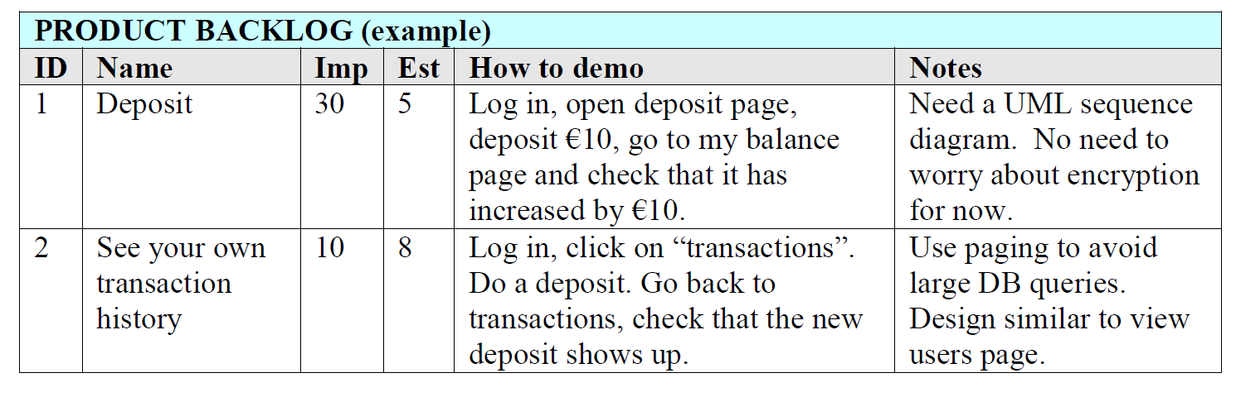
Product Backlog Example
Story example where feature description is specified in “How to demo” field, i.e. test steps description (acceptance criteria) (Kniberg p. 10)
Scrum 1

