Slide 1

Intro System Development
Tue Hellstern TUHE

Slide 2

Agenda - today
Intro module 4-5
Overview topics
Study Points
Dates
Exam
Project
Groups?
Requirement
Outsourcing
Presentation of SP task.
Working with SP task

Slide 3
System Development plan
 | Week 16 | Week 17 | Week 18, 19, 20 | Week 21
Mon |  | Agile software requirements | Project | Comparison of methods Areas of knowledge + Experiments SP: Areas of knowledge + Experiments
Tue | Outsourcing SP: Outsourcing | Unified Process (UP) + use cases SP: UP and Use Cases |  | Choosing and adjusting a method
Wed | Agile methods | Prototyping - Spikes SP: Prototyping |  | Present SP: Areas of knowledge + Experiments Report writing Exam prep. questions
Thu | Extreme Programming (XP) | Test and TFD/TDD |  | Aflevering af rapport
Fri | Present SP: Outsourcing Exam prep. questions | Present SP: UP and Use cases Prototyping Exam prep. Questions Sprint planning
Each SP is 7 point – 28 in total
Each SP has to be presented orally to the teacher
Deadline Friday end of class

Slide 4

Important dates
Tuesday 18/04 Start planning Outsourcing
Fredag 28/04 Sprint Planning – Official project start
Fredag 05/05 Sprint review + Sprint Planning
Mandag 15/05 Sprint review + Sprint Planning
Fredag 19/05 Sprint review
Torsdag 25/05 Report Hand-in on WiseFlow

Slide 5

System Development Exam
30 minutes examination – no preparation
Grade based on:
SIP project rapport
Oral examination - You draw a question

Slide 6
Groups
Are you all in a group?
Write group member names in Google Doc
https://docs.google.com/document/d/154LdWtT4Nh6Jq_bYr6Kg6SfKwLR18q42C5z9BCK6E9o/edit?usp=sharing

Slide 7
Project - Goals
Introduction
The focus of the project is to use an agile approach while developing a web application using a combination of XP and Scrum. The report must contain your reflections based on your experience with XP and Scrum.
Formalities
The work must be done in groups of 3-4 students
Each group will hand in a project of max. 20 pages (2.400 characters pr. page)
The Report
You must document your reflections on your practical experience with the XP’s practices and Scrum artefacts, - meetings and – roles
A good way to structure the report is to use the principle:
Plan – What do you intend to do?
Process – What did you do?
Reflection – What can you learn from this?

Slide 8
Project - Goals
XP Practices
Simple design
Testing
Collective Ownership
Refactoring
Continuous Integration
Pair Programming
Coding Standard
We have left out Metaphor and 40-hours week. On-site customer is replaced with Scrum’s Product Owner, a Planning Game is substituted with Scrum’s Sprint Planning meeting and Small Releases is substituted with Scrum’s Sprint Review meeting.
Evaluation criteria
Scope of experience gained
Depth of reflections
Validity of arguments and conclusions
Ability to communicate in general
See More: GitHub >> https://github.com/CphBusCosSem3/semester-project

Slide 9
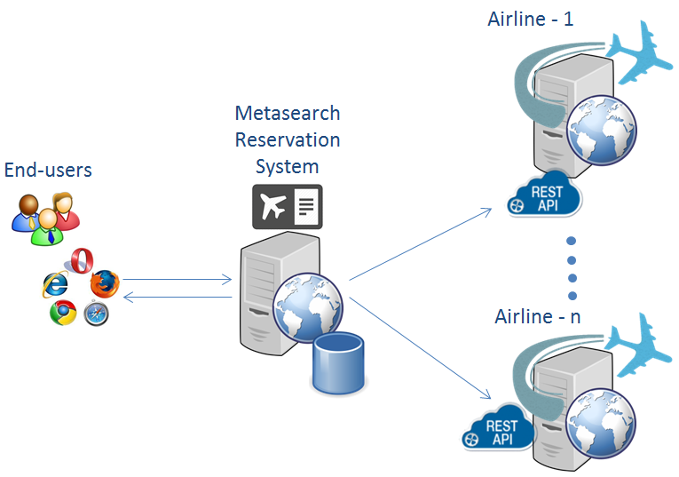
Semester Project
Online Reservation System
The task for this project is to create a Proof of Concept solution for an Online Reservation System, similar to Web sites like Momondo.com, Expedia.com and others.
The solution must include the following subsystems:
A Prototype for an actual airline that exposes its reservation system via a REST API - Airline 1-n
The Metasearch Reservation System

