Slide 1

Intro System Development
Primary – Teaching
Henrik Hauge (HAU)
Tue Hellstern (TUHE)
Only Planning and Review
Caroline (CHU)

Slide 2

Agenda
Intro module 4-5
Overview topics
Study Points
Dates
Exam
Ennova
Project
Groups?
Case options
Outsourcing
Presentation of SP task.
Working with SP task

Slide 3
System Development plan
 | Week 16 | Week 17 | Week 18, 19, 20 | Week 21
Mon |  | Agile software requirements | Project | Comparison of methods Areas of knowledge + Experiments SP: Areas of knowledge + Experiments
Tue | Outsourcing SP: Outsourcing | Unified Process (UP) + use cases SP: UP and Use Cases |  | Choosing and adjusting a method
Wed | Agile methods | Prototyping - Spikes SP: Prototyping |  | Present SP: Areas of knowledge + Experiments Report writing Exam prep. questions
Thu | Extreme Programming (XP) | Test and TFD/TDD
Fri | Present SP: Outsourcing Exam prep. questions | Present SP: UP and Use cases Prototyping Exam prep. questions
Each SP is 7 point – 28 in total
Each SP has to be presented orally to the teacher
Deadline Friday end of class

Slide 4

Important dates
Tuesday 18/04 Start planning Outsourcing
Friday 28/04 Sprint Planning – Official project start
Friday 05/05 Sprint review + Sprint Planning
Monday 15/05 Sprint review + Sprint Planning
Friday 19/05 Sprint review
Sunday / 23:59 - Report Hand-in on WiseFlow

Slide 5

System Development Exam
30 minutes examination – no preparation
Grade based on:
SIP project rapport
Oral examination - You draw a question

Slide 6
Groups
Are you all in a group?
Write group member names in Google Doc
https://docs.google.com/document/d/14JCgYPstjlkiQCeaxPHi54-rWwFzHKUC6im2Rd4s6q4/edit?usp=sharing

Slide 7
Project - Goals
Introduction
The focus of the project is to use an agile approach while developing a web application using a combination of XP and Scrum. The report must contain your reflections based on your experience with XP and Scrum.
Formalities
The work must be done in groups of 3-4 students
Each group will hand in a project of max. 20 pages (2.400 characters pr. page)
The Report
You must document your reflections on your practical experience with the XP’s practices and Scrum artefacts, - meetings and – roles
A good way to structure the report is to use the principle:
Plan – What do you intend to do?
Process – What did you do?
Reflection – What can you learn from this?

Slide 8
Project - Goals
XP Practices
Simple design
Testing
Collective Ownership
Refactoring
Continuous Integration
Pair Programming
Coding Standard
We have left out Metaphor and 40-hours week. On-site customer is replaced with Scrum’s Product Owner, a Planning Game is substituted with Scrum’s Sprint Planning meeting and Small Releases is substituted with Scrum’s Sprint Review meeting.
Evaluation criteria
Scope of experience gained
Depth of reflections
Validity of arguments and conclusions
Ability to communicate in general
See More: DATSTUD > Arkiv > 3. semester > fall2016Sem3-AllClasses > SIP
3. semester SYS project fall 2016 – Assignment.pdf

Slide 9
Project
You can chose between these three options for the semester project
Implement your own simple "Momondo" Server
Implement our business idea, described as "Buy and Sell it All"
Come up with your very own project proposal
Which one you choose depends on your personal, and group, ambitions and also on your current professional skills.
2 + 3 are the most challenging proposals and 1 the more straight forward proposal (but still challenging) with a guarantee to bring you through all the technologies we have been around this semester, one more time.
Se more:
DATSTUD > Arkiv > 3. semester > fall2016Sem3-AllClasses > SIP > Project > SemesterProject 2016.pdf

Slide 10
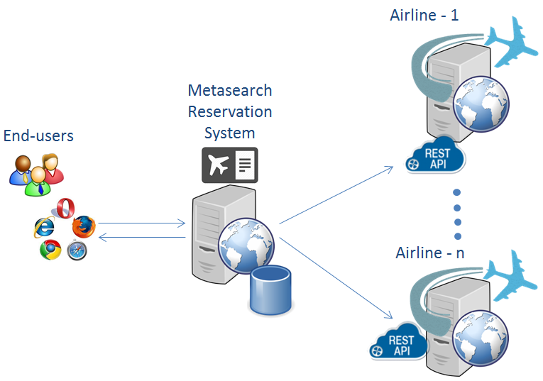
Semester Project
Online Reservation System
The task for this project is to create a Proof of Concept solution for an Online Reservation System, similar to Web sites like Momondo.com, Expedia.com and others.
The solution must include the following subsystems:
A Prototype for an actual airline that exposes its reservation system via a REST API - Airline 1-n
The Metasearch Reservation System

Slide 11
Buy and Sell it All
Someone else has probably already had the same idea, but come up with a great solution and put it on the market before them, and you could end up as millionaires ;-)
The idea is that you should create a site, somehow similar to sites like Pricerunner.dk, but with focus on items sold by private people.
If I for example, would like to buy an old and famous recording with the band "velvet underground" I would enter the request into your site, and your server will contact:
DBA.dk
GulogGratis.dk
ebay.com
Facebook.com
…
and make a response, built from the responses from these sites.
The architecture will end up similar to what was explained for proposal 1, but the task of contacting all these remote companies/servers will probably be challenging.

Slide 12
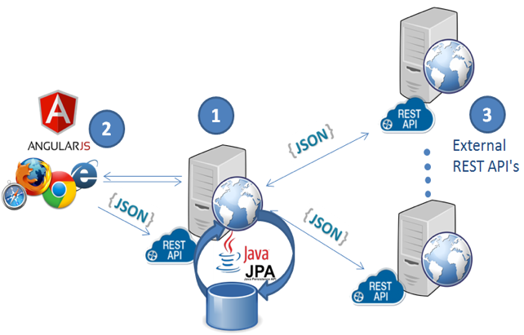
Come up with your own project proposal
This has to be approved by us, and should ideally include an architecture inspired by one of the other suggestions
We can accept much, given an exciting real-life project
Design a web-application (1) which uses JPA for data, provides end user pages with AngularJS that uses REST/JSON to update pages (2) and communicate with external servers in order to serve a request (think Momondo, Hotels.com, etc).
The idea could be one you come up with (you might have an idea that could turn into a great business idea), or an idea from an external company.

