Slide 1
Agile methods & Extreme Programming
Today:
How to do! (report)
Agile manifest
XP

Slide 2
Planen
23-apr | 24-apr | 25-apr | 43216 | 27-apr
 | PAB Agile Methods & XP |  | BORG Studypoint exercise (Scrum + XP ) samt TDD/CI | Store Bededag
PAB Agile Methods & XP |  | BORG TDD/CI
30-apr | 01-maj | 02-maj | 03-maj | 04-maj
PAB De skal have user stories klar i Taiga |  |  |  | PAB Sprint review

Slide 3
Planen
23-apr | 24-apr | 25-apr | 26-apr | 27-apr
 | PAB Agile Methods & XP |  | BORG Studypoint exercise (Scrum + XP ) samt TDD/CI | Store Bededag
PAB Agile Methods & XP |  | BORG TDD/CI
30-apr | 01-maj | 02-maj | 03-maj | 04-maj
PAB De skal have user stories klar i Taiga |  |  |  | PAB Sprint review
07-maj | 08-maj | 09-maj | 10-maj | 11-maj
PAB Sprint Planning |  |  | Kr. Himmelfart
14-maj | 15-maj | 16-maj | 17-maj | 18-maj
BORG Review og planning |  |  |  | BORG Sprint review
21-maj | 22-maj | 23-maj | 24-maj | 25-maj
Pinsedag | PAB: pensum + rapportskrivning |  | BORG: pensum + rapportskrivning
 |  | BORG: pensum + rapportskrivning |  | PAB: rapportskrivning
Rapport:
Plan
Proces
Reflektion

Slide 4
Agile development – for you!
Know
That systems development is an independent discipline
Inherent challenges in sw-development
Background for the agile movement
Intentions expressed in the agile manifesto and related works
Characteristics of agile approaches to software development
Be able to
Select appropriate means and tools when communicating in agile environments

Slide 5
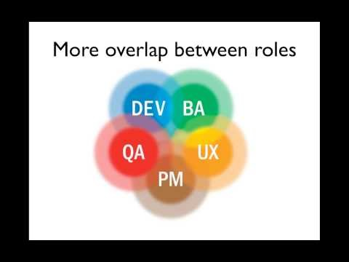
Agile In a Nutshell

Slide 6
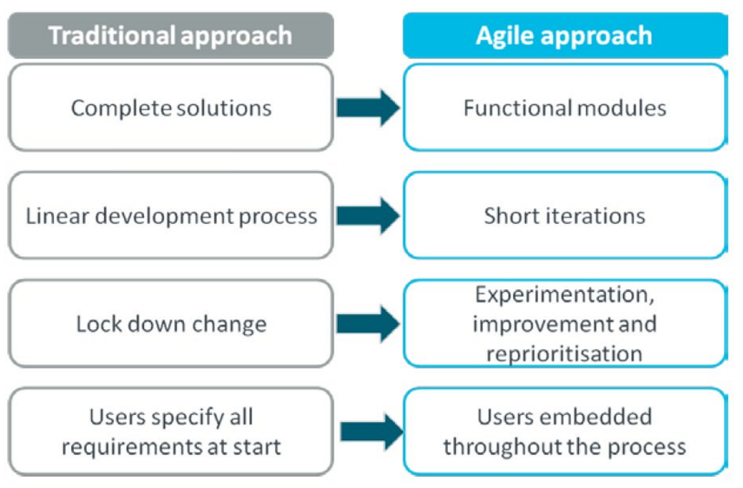
Agile overview

Slide 7
Manifesto for Agile Software Development
We are uncovering better ways of developing software by doing it and helping others do it.
Through this work we have come to value:
Individuals and interactions over processes and tools
Working software over comprehensive documentation
Customer collaboration over contract negotiation
Responding to change over following a plan
That is, while there is value in the items on the right, we value the items on the left more.
http://agilemanifesto.org

Slide 8

Principles behind the Agile Manifesto
Our highest priority is to satisfy the customer through early and continuous delivery of valuable software.
Welcome changing requirements, even late in development. Agile processes harness change for the customer's competitive advantage.
Deliver working software frequently, from a couple of weeks to a couple of months, with a preference to the shorter timescale.
Business people and developers must work together daily throughout the project.
Build projects around motivated individuals. Give them the environment and support they need, and trust them to get the job done.
The most efficient and effective method of conveying information to and within a development team is face-to-face conversation.
Working software is the primary measure of progress.
Agile processes promote sustainable development. The sponsors, developers, and users should be able to maintain a constant pace indefinitely.
Continuous attention to technical excellence and good design enhances agility.
Simplicity--the art of maximizing the amount of work not done--is essential.
The best architectures, requirements, and designs emerge from self organizing teams.
At regular intervals, the team reflects on how to become more effective, then tunes and adjusts its behavior accordingly.
http://agilemanifesto.org/principles.html

Slide 9
Extreme Programming – for you!
Know
The basics of XP as a development method
The 12 practices of XP
Be able to
Compare XP and Scrum (after tomorrow)
Describe differences and similarities
Describe conditions necessary for obtaining the stated benefits of XP
Explain how specific XP practices support the values in the agile manifesto
Explain how the individual XP practices can support each other

Slide 10
Resources
Kent Beck Extreme programming explained
Chap 1 Risk: The basic problem
Chap 4 Four Variables
Chap 10 A Quick Overview (practices)
Chap 11 How Could This Work?
Joshua Kerievsky The Extreme Programming Playbook https://www.industriallogic.com/wp-content/uploads/2005/09/xpplaybook.pdf

Slide 11
Economics of Software Development
We need to maximize the economic value of the project
Spend less - to save money
Earn more – make more money
Spending later and earning earlier
Pay less interest on the money spend
Increase the probability of project survival
The big problem is uncertainty
Therefore the strategy must be:
Accurate and frequent feedback about progress
Many opportunities to change the requirements
A smaller initial investment

Slide 12
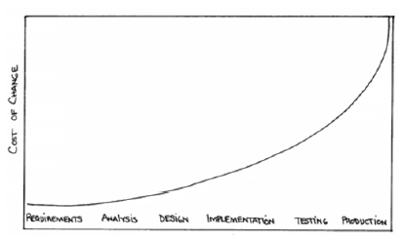
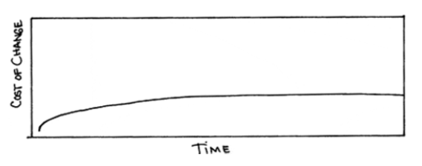
Cost of Change
Traditional view
XP view

Slide 13

Four Variables for Planning the Process
Cost
Scope
Time
Quality
Sees the "softness" of requirements as an opportunity, not a problem!
If we work in iterations with adaptable scope
Implement the customer's most important requirements first
We’ll be better at estimating
Be able to compare estimates with actual results

Slide 14
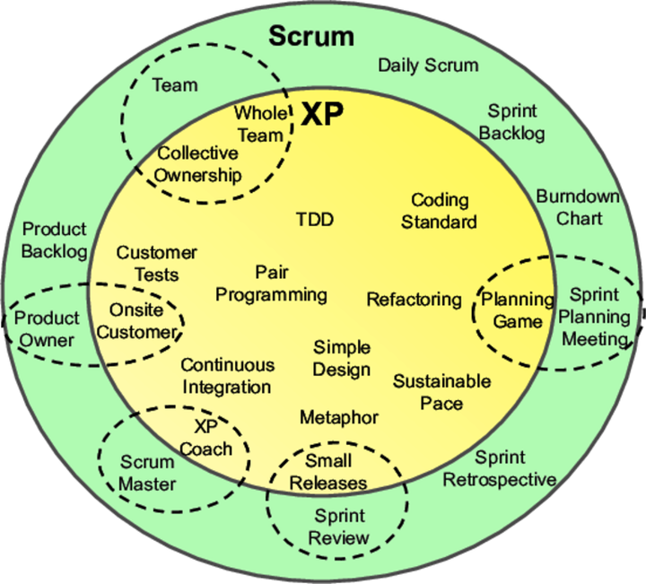
XP <> Scrum
Agile projects often use in combination
SCRUM for management
XP for development

Slide 15
XP <> Scrum
Scrum teams typically work in iterations (called sprints) that are from two weeks to one month long. XP teams typically work in iterations that are one or two weeks long.
Scrum teams do not allow changes into their sprints. Once the sprint planning meeting is completed and a commitment made to delivering a set of product backlog items, that set of items remains unchanged through the end of the sprint. XP teams are much more amenable to change within their iterations. As long as the team hasn’t started work on a particular feature, a new feature of equivalent size can be swapped into the XP team’s iteration in exchange for the un-started feature.
Extreme Programming teams work in a strict priority order. Features to be developed are prioritized by the customer (Scrum’s Product Owner) and the team is required to work on them in that order. By contrast, the Scrum product owner prioritizes the product backlog but the team determines the sequence in which they will develop the backlog items.
Scrum doesn’t prescribe any engineering practices XP does.
Scrum focuses more on the management side of projects, extreme programming would focus more on the actual engineering practice.

Slide 16
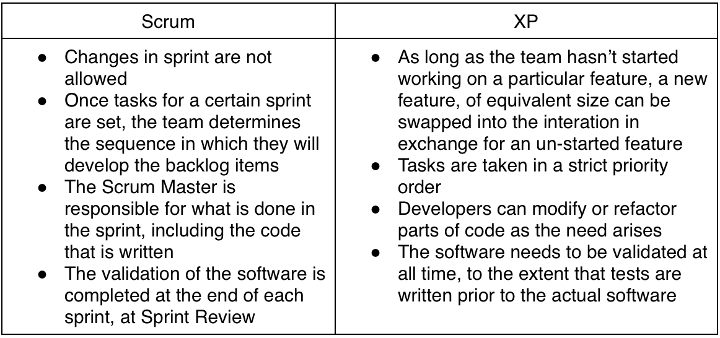
Differences Between Scrum and Extreme Programming

Slide 17
Extreme Programming - XP
Extreme Programming (XP) is a no nonsense, code first approach to software delivery that emphasizes four basic activities:
Coding
Testing
Listening
Designing
You code because if you do not code, you will haven’t done anything
You test because if you don’t test, you don’t know when you are done coding
You listen because if you don’t listen you don’t know what to code or what to test
You design so you can keep coding and testing and listening indefinitely

Slide 18
Overview
The Problem
Practices are concrete things that a team can do day-to-day
Values are the fundamental knowledge and understanding that underpins the approach
Values without practices are hard to apply and can be applied in so many ways that it's hard to know where to start
Practices without values are rote activities without a purpose.
The Metaphor
5 Values
Principles
4 Activities
12 Practices

Slide 19
4 (5)Values
The values must secure that the individual is oriented towards the interests of the project (common culture)
Communication
Make sure of continuous and relevant communication
XP practices are not possible without communication
Simplicity
Better to build simple solutions that will be changed than to build complex solutions that never are used
Feedback
“Optimism is an occupational hazard of programming” vs. “Don’t ask me – ask the system” (concrete feedback)
Courage
Be ready to change the system – even dramatically and late
Respect
Everyone gives and feels the respect they deserve as a valued team member

Slide 20
XP Practices 1-3
The Planning Game
The scope of the next release
Prioritized on the basis of business value and technical estimates
The costumer: Scope, prioritizing, sub deliveries
The developers: Estimates, technical consequences, a detailed plan (based on risk)
Small releases
Put simple system into production quickly
Small with large value for business
Metaphor
A shared understanding of the idea – substitutes architectures
Simple communication tool – naming concept of classes and methods

Slide 21
XP Practices 4-6
Simple Design
Use the simplest possible design that gets the job done.
The requirements will change tomorrow, so only do what's needed to meet today's requirements
Runs all tests
Avoids redundant code
Expresses important purposes
Has as few classes and methods as possible
Test
Continuously to reduce uncertainty
Programmers codeunit tests
Customers write acceptance/functional tests
Refactoring
Constant restructuring of the system without changing the behavior to improve code – to remove duplication, improve communication, simplify, add flexibility

Slide 22
XP Practices 7-9
Pair programming
Programming is a pair activity (driver & navigator roles)
Collective ownership
Not “no ownership”
Not “private” ownership
Anybody can change any code
Continuous integration
Integrate and build the system many times a day, every time a task is completed
Requires the tests to run after integration

Slide 23
XP Practices 10-12
40-hour week
Real productivity
On-site customer
Real live user on the team to answer questions
Coding standards
Eases communication through the code
Ideally, you shouldn't be able to tell by looking at it who on the team has touched a specific piece of code.

Slide 24
Focus in the Project on
Simple design
Testing
Collective Ownership
Refactoring
Continuous Integration
Pair Programming
Coding Standard

Slide 25
Exercises - Input to report
Plan – What do we intend to do?
Process - What did we do?
Make notes during the project!
Reflection – What have we and others learned from this?
Start making a plan for how to use the XP practices

Slide 26
PPR - example Simple design
Plan for simple design:
The XP practice Simple design states that…
In our project we have planned to handle simple design by …
Process regarding simple design:
I the first sprint of the project we had a hard time keeping the design simple because …
In the next sprint we refactored the design so that …
We ended up with a design that …
Reflection over simple design:
It was our intent (see paragraph regarding plan for simple design) that we would handle simple design by …
But in the project we ended up by …
If we were to do a similar project again we would …
Generally speaking our experience with simple design is that …

Slide 27
Relevant XP videos
Refactoring and test:
https://www.youtube.com/watch?v=vqEg37e4Mkw
Agile in general:
Small releases
Continuous integration
Pair programming
Feedback and communication
https://www.youtube.com/watch?v=GE6lbPLEAzc

Slide 28
Resources
Kent Beck Extreme programming explained
Chap 1 Risk: The basic problem
Chap 4 Four Variables
Chap 10 A Quick Overview (practices)
Chap 11 How Could This Work?
Joshua Kerievsky The Extreme Programming Playbook https://www.industriallogic.com/wp-content/uploads/2005/09/xpplaybook.pdf

