Slide 1


Remember Turn on Default Principal To Role Mapping in order to avoid mappings
Threads in Java

Slide 2
This week
Good news:
  Threads are fun!
  Threads are ridiculously useful
Bad news:
  Threads are hard ← but that’s why we’re here

Slide 3
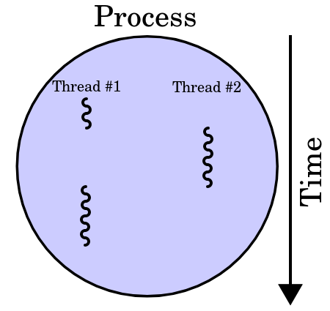
Why multithreading?
Responsiveness (Concurrency)
Performance (Parallelism)
Diagram on whiteboard
* Sequential execution
* Concurrent (tasks can start, run, complete in overlapping time e.g. processes on single core)
* Parallel (tasks can run simultaneaously e.g. multicore cpu)

Slide 4
Why multithreading?
Responsiveness (Concurrency)
Performance (Parallelism)
Diagram on whiteboard
Sequential execution on UI thread

Slide 5
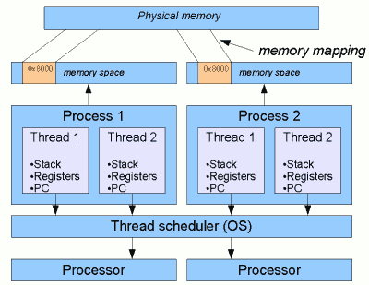
Typical relationship between Threads and Processes
Each process has its own memory space. When Process 1 accesses some given memory location, say 0x8000, that address will be mapped to some physical memory address1. But from Process 2, location 0x8000 will generally refer to a completely different portion of physical memory.
A thread is essentially a subdivision of a process that shares the memory space of its parent process.
Each thread however has its own private stack and registers, including program counter. These are essentially the things that threads need in order to be independent
http://www.javamex.com/tutorials/threads/how_threads_work.shtml

Slide 6
Creating a thread in java
By inheriting from thread
(Here with an anonymous class)
Thread t1 = new Thread() {
@Override
public void run() {
//Do stuff a new thread yall
}
};
t1.start();

Slide 7
Creating a thread in java
By inserting a Runnable object
(Here with an anonymous class)
Runnable r = new Runnable(){
@Override
public void run() {
//Do stuff a new thread yall
}
};
Thread t1 = new Thread(r);
t1.start();

Slide 8
Creating a thread in java
With a lambda (anonymous function) - from java 8 and forward
Thread t1 = new Thread(() -> {
//Do stuff in a separate thread!
});
t1.start();

Slide 9
Creating a thread in java
When we want one thread to wait for another, we can use the “join” method
Thread t1 = new Thread(() -> {
//Do stuff in a separate thread!
});
t1.start();
t1.join();
...
The calling thread will wait for t1 to finish before it continues.

Slide 10
Creating a thread in java
Implementing the Runnable Interface
public class Task implements Runnable
{
public void run() {
...
}
}
Task task1 = new Task();
Thread t1 = new Thread(task1); t1.start();

Slide 11
Creating a thread in java
Demo time!
Let’s print some numbers from different threads.

Slide 12
The Problem with Threads
Non-determinism
  Event order uncertain
  Visibility of data-changes uncertain
We can fix all of that!
But the solutions create new problems.

Slide 13


Race conditions
Interference happens when two operations, running in different threads, but acting on the same data, interleave. This means that the two operations consist of multiple steps, and the sequences of steps overlap.
class MutableInteger {
private int i = 0;
public int get() {
return i;
}
public void increment() {
this.i++;
}
}
Even simple statements can translate to multiple steps by the virtual machine
Retrieve the current value of i.
Increment the retrieved value by 1.
Store the incremented value back in i
Suppose both Thread A and Thread B invokes increment at about the same time
Thread A: Retrieve i.
Thread B: Retrieve i.
Thread A: Increment retrieved value; result is 1.
Thread B: Increment retrieved value; result is 1.
Thread A: Store result in i; i is now 1.
Thread B: Store result in i; i is now 1.
1

Slide 14
Race conditions
Demo time!

Slide 15
Synchronization
Threads communicate primarily by sharing access to fields and the objects reference fields refer to. This form of communication is extremely efficient, but makes two kinds of errors possible:
  Race conditions (interleaving access)
  Memory Consistency Errors.
The tool needed to prevent these errors is synchronization.

Slide 16
Synchronization
What we’ve seen in the demos so far are examples of race conditions.
Race condition: When the behaviour of a program depends on the ordering/interleaving of threads, and shouldn’t.
Race conditions can occur when multiple threads perform actions that are not atomic with respect to each other.

Slide 17
Synchronization
An operation is atomic if it has no “intermediary” state. It is either fully completed, or hasn’t begun at all.
Hardly anything is atomic in java.

Slide 18
Synchronization
Is integer increment atomic?
i++

Slide 19
Synchronization
Nope.
++i
But variable read and writes are ATOMIC:
int j = i;
j = i + 1;
i = j;
return i;

Slide 20
Synchronization
In Java, the following are atomic:
Reads/writes of pointers/ object references
Reads/writes of single precision primitive types
As always, consult the official specifications when you can’t afford to guess.
https://docs.oracle.com/javase/specs/jls/se7/html/jls-17.html

Slide 21
Synchronized Block
public synchronized void add(int value)
{
…
}
- Code in the Synchronized Block can only execute if the lock is free.
- If a Thread executes code inside the block the lock is taken, other callers will be blocked until the lock is free.

Slide 22
Synchronized Block
synchronized blocks are atomic with respect to other blocks that take the same lock!

Slide 23
Synchronized Block
Demo time!
https://github.com/HartmannDemoCode/Sem3

Slide 24
Multi-threading with Swing
Lengthy calculation can halt the GUI
when the calculation is done in the same thread as the GUI it can block the GUI in a way that makes it not responding to the user. Solution: do work in other thread.
private void btnCalculate2ActionPerformed(java.awt.event.ActionEvent evt) {
long in = Long.parseLong(txt1.getText());
FibCalc f = new FibCalc(in, this);
Thread t1 = new Thread(f);
t1.start();
}

Slide 25
Make objects accessable from threads
Use the constructor
public class MyThread extends Thread {
private Counter counter;
public MyThread(Counter counter) {
this.counter = counter;
}
@Override
public void run() {
counter.increment();
}
}

Slide 26
How to stop a running thread
Use a flag in the a while condition
public class MyThread extends Thread {
private boolean running;
public MyThread(boolean running) {
this.running = running;
}
@Override
public void run() {
While(running){
...
}
}
}

Slide 27
java.util.concurrent.atomic.*
This library provides atomic objects to use like:
Integer
Boolean
Reference

Slide 28
Presenting Thread1 exercise
Find the exercises and class material here:
https://github.com/Cphdat3sem2018f/week1-threads

