Slide 1


3. Semester
Distributed Systems & System Development
Thomas, Lars, Christian, Jan og Palle

Slide 2
Plan
The semester is (as usually) divided into 5 flows, three weeks each (module-2 → 4 weeks).
Software Development
Flow - 1
ORM +
REST+
JavaScript,
AJAX
Flow - 2
Network, HTTP+
Sockets+
Threads
Flow - 4
System Development
Flow - 3
Client Side Rendering with JavaScript and React
Multiplatform APP-dev with React Native
Flow-5
Semester Projekt

Slide 3
A Typical Period
Week 1 + 2
Mon Your Presentation of solutions to Exercises
Tue "
Wen "
Thu "
Fri Study Point Exercises
Week -3
Mon Your Presentation of solutions to Exercises
Tue CA
Wen CA
Thu CA
Fri CA

Slide 4
Overall comments
This semester is, and has always been, and always will be: hard
You will be introduced to many new concepts, methodologies and techniques.
We will do a lot of (but not only) programming.
We will draw on everything you have learned the last year.
It will be hard work and lots of fun ☺
Several of the topics we will dive into are new, thus they are not yet in a mature state and will change

Slide 5











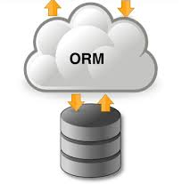
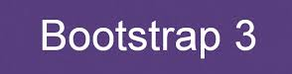







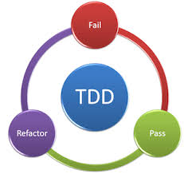


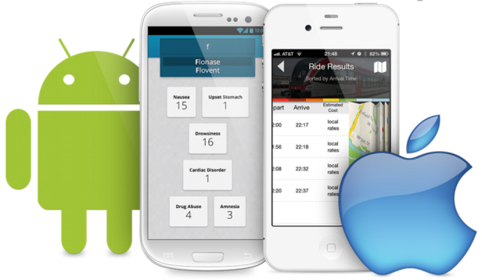
Topics

Slide 6
Study Points!!!
You need (as usually) the points to be approved for the exam
Even without this rule, attending the exam without the study points would be a waste of time, because:
You get most of the points from trying and doing – this is where you learn, not just from attending the lessons

Slide 7
How to get your points
Period 1 → 40 Points
  11 Attendance → one for each day
  19 points for CA-1 Review/Presentation
  11 points for Review/feedback of SP-1
Period 2 (4 weeks) → 50 Points
  12 Attendance → one for each day
  20 points for CA-2 Review/Presentation
  18 points for Review Presentations (SP2, SP3, SP4) (6 for each)
Period 3 → 40 Points
  11 Attendance → one for each day
  19 points for CA-3 Review/Presentation
  10 points for Friday exercise 8 +9 (5 for each) (Code hand-in or demo) Individual
Period 4+5 → SYS
Period 4+5 → Project (Programming)
  10 Points Sprint1 Technical review - code/db/test
  10 Points Sprint2 Technical review - code/db/test
  10 Points Sprint3 Technical review - code/db/test
Total 160 points. You need a minimum of 80% to be approved for the exam= 128

Slide 8

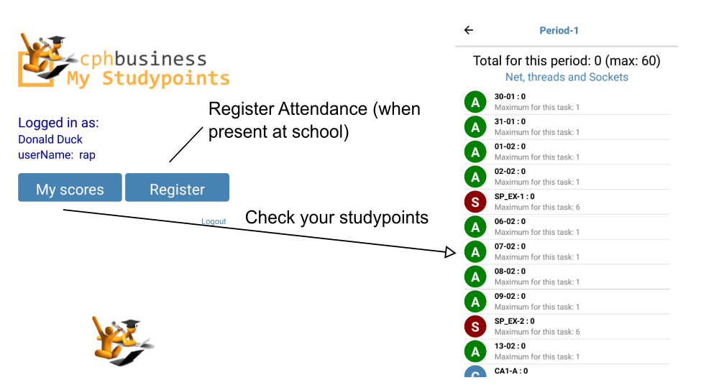
How to check your points
https://studypoints.dk

Slide 9
Monday Reviews
Mondays are usually reserved for feedback and reviews, and this is where MOST studypoints are given.
See here for details:

Slide 10
Groups
Friday exercises are meant as individual exercises, but CA’s and weekly reviews are done in groups.
It is YOUR responsibility to have formed, and be a member, of a group BEFORE Thursday Week-1.
It is the responsibility of the ENTIRE class, to ensure, that no one are left without a group.

Slide 11

Exam
This semester has two exams
Programming Exam
  120 min preparation and 40 min oral examination
  Three parts:
    Theory
    (Short presentation of a small part of a CA or the Semester Project)
    Programming
System Development Exam
  30 minutes examination – no preparation
  Grade based on:
    SYS project
    Oral examination

Slide 12
About Programming this semester
Every piece of code must be:
  (Tested – NO credits for untested source code)
  Versioned with Git → we use the commit log to assign individual study points
  All CA's must be hosted and include a WEB-Site with the required information about the CA
This is how you hand in ALL your CA's

Slide 13
Flow-1: Threads/Concurrence Network, HTTP and JavaScript-1.
Thread Programming
The HTTP protocol
Server Architectures
Security - 1 (adding the "s" to the HTTP-protocol)
JavaScript part-1
CA
For this flow you must BUY your own domain name

Slide 14
Flow-2 : ORM (JPA), Web services, Ajax and JavaScript continued
Introduction to Object Relational Mapping
Java persistence API (JPA)
Restful Web Services
JavaScript and Asynchronous Programming
JavaScript required for REACT - developers
Manipulating the DOM
AJAX
CA-2:

Slide 15
Flow-3 JavaScript, React and React Native
Introduction to the Single Page Application (SPA) Architecture
Implementing modern Single Page Applications (SPA) with ReactJS
Adding an App (IOS or Android) Front-end to our REST-backend, using React Native
More JavaScript
CA-3:

Slide 16
Flow - 4 (5). Systems Development
Introduction to systems development as a discipline
Different perspectives on how to develop systems
Different tools and techniques to use in order to support a successful development
Introduction to a new method eXtreme Programming
  To support Scrum
  To be used in the semester project in module 5
CA: An exam report - A theoretical project with reflections on systems development

Slide 17
Flow (4) 5: Semester project
A project that make up a distributed system using all the topics introduced in the semester.
That uses REST as the Backend and implements a SPA with React and an APP with React Native.
Outsourcing (120$ - 180$)

Slide 18




Books and Additional Costs?
We don’t expect you to buy any books this semester. We will provide links to readings, videos, tutorials etc.
We DO expect you to pay for a virtual machine in the cloud (as you did last semester).
This will cost you a minimum of $5++ a month.
We DO expect you buy your own domain name. Most of the Exam exercises, will assume you deploy to a droplet using this name
For the Semester Project you are expected to Outsource for real (that is specify, hire and communicate with external developers) a part of your project. This will cost you a minimum of 60$ (per team member)

Slide 19

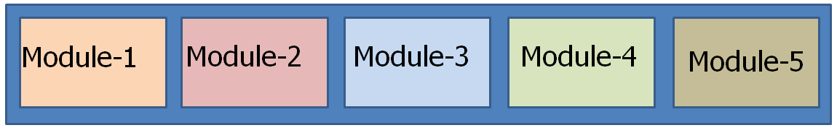
Internationalization
Throughout this semester we will focus on internationalization aspects relevant for software developers
Internationalization
All materials will be in English, including exam exercises
We will focus on problems related to outsourcing
You will actually have to outsource (and pay for) parts of the semester project

Slide 20

Internationalalization
Internationalization
120$
120$
We will provide you with web-links for all reading materials, so you are not expected to buy any books this semester
120$ - 240$
But this semester will cost your team
You have to describe and order parts of the semester project from an external company/developer.

Slide 21
Required Software for this Semester
For this semester you must have:
NetBeans (newest version + Tomcat)
An IDE for JavaScript Development (I suggest Visual Studio Code)
MySQL
GIT (NOT just the version shipped with NetBeans)
Maven
An account on Github
An account on Digital Ocean
+ probably more
We assumes everything above is already installed, if not read the info on github

