Slide 1


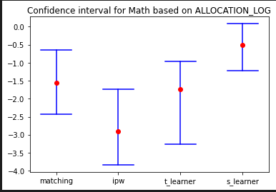
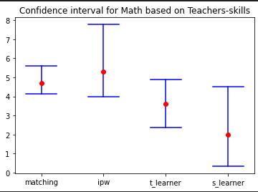
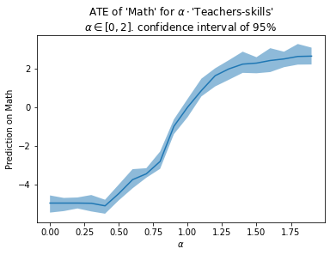
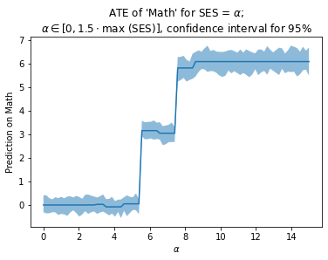
Investing in Education: Investigating the Causal Effects of Monetary Allocation and Teachers' Quality on Student Performance
Ori Meiraz, Cfir .A. Hadar
Goal
Results
Methodology
This study aims to identify the impact of local authority resource allocation on student performance and to analyze the causal effects of monetary allocation and teachers' quality on student performance after controlling for confounding factors such as socioeconomic status. By examining the effects of these variables on student performance, the study provides insights into how local authorities can allocate their resources to best support student achievement. The study's findings have the potential to inform policy decisions aimed at improving the quality of education and student outcomes, thereby contributing to the academic discourse on effective resource allocation in education.
Add your information, graphs and images to this section.
The majority of confidence intervals and ATEs calculated from the full dataset are negative, suggesting that investing less money may be more effective. This seemingly counterintuitive result could be due to several factors, such as the need for government-funded corporations to justify their budget or inefficient use of funding by municipalities with higher allocations. Additionally, there may be missing confounders, and it's essential to consider that intuition may be due to correlation rather than causality when interpreting the results.
Background
Education is a critical policy area for governments worldwide, with adequate funding for schools being essential for quality education.
However, the optimal allocation of resources remains unclear, and policymakers must make informed decisions to maximize their impact on student performance.
The socioeconomic status of students can significantly affect their academic performance, highlighting the need for policymakers to recognize and provide support to overcome these challenges.
The quality of teachers has been found to be a crucial factor in determining the academic performance of students, with effective teaching practices being linked to better learning outcomes.
Despite these findings, the causal effects of both teachers' quality and monetary allocation on student performance remain unclear, and more research is needed to provide empirical evidence to inform policy decisions.
This study aims to fill this gap by identifying the impact of local authority resource allocation on student performance.
The findings demonstrate a clear positive effect of teacher quality on student performance. The confidence intervals for all measurements consistently show a positive effect of teacher quality on student achievement.
The second graph shows a clear pattern of diminishing returns, with the impact of additional highly qualified teachers on student performance plateauing after an initial period of exponential growth. One possible explanation for this phenomenon is that highly qualified teachers may be promoted to leadership positions within the school, such as coordinators or principals, and thus have a greater impact on student performance through their administrative and mentoring roles rather than through direct teaching.
An interesting findings that align with the existing literature, where the jumps in student performance correspond to the socioeconomic status (SES) of the students. The categorization of students into lower class (SES 1-5), middle class (SES 6-8), and upper class (SES 8-10) is in line with previous research, indicating that SES is a crucial factor in determining academic performance. These results suggest that intervention programs aimed at supporting students from lower SES backgrounds may have a positive impact on their academic achievement.
Conclusion
This study suggests that the effects of monetary allocation on student achievement is rather correlative.
Policymakers should consider alternative approaches, such as interventions for lower and middle-class students or teacher training, instead of increasing funding.
This research provides valuable insights for policymakers seeking to maximize the impact of their investments in education.

