Slide 1


REACT
ESSENTIALS
MARCH 15 & MARCH 22
2026
TWO DAY REACT WORKSHOP

Slide 2
REACT WORKSHOP
REACT ESSENTIALS:
BUILDING INTERACTIVE WEB APPLICATIONS WITH APIs
First City Providential College
WORKSHOP OUTLINE
DAY 1 (MARCH 15, 2026) | ESTIMATED DURATION | DAY 2 (MARCH 22, 2026) | ESTIMATED DURATION
Environment Setup | ~ 10 minutes | Recap of Day 1 | ~ 5 minutes
Installing Node.js & Node Package Manager (NPM)
Creating your first React App (using Vite)
Organizing your project folder
Introduction to React Application | ~ 30 minutes | Environment Setup | ~ 10 minutes
Writing your first React page
 |  | Initialization of a new package
Understanding components
 |  | Installing relevant node packages
Event Handling
Utilizing React Hooks | ~ 30 minutes | Backend Fundamentals | ~ 30 minutes
Using useStates & Conditional Rendering
 |  | Setting up your first node server
Using useEffect
 |  | API and REST fundamentals
Other React Hooks
Navigating using React Router | ~ 30 minutes | Handling loading states, errors, and response data | ~ 30 minutes
Getting user inputs using Forms | ~ 30 minutes | AuthN and AuthZ using JWT | ~ 1 hour
 |  | Authentication using JWT
 |  | Protected Routes

Slide 3

REACT WORKSHOP
REACT ESSENTIALS:
BUILDING INTERACTIVE WEB APPLICATIONS WITH APIs
First City Providential College
ENVIRONMENT SETUP
MINIMUM SYSTEM REQUIREMENTS
Here are the minimum system requirements:
At least 8 GB of RAM
Substantial amount of Storage
Substantial CPU
INSTALLED APPLICATIONS:
Node JS - https://nodejs.org/en/download
Preferred Text Editor (i.e. Sublime Text, VS Code, etc.)
Preferred Browser (i.e. Google Chrome, Firefox, etc.)
Optionally:
Docker for Windows - https://www.docker.com/
Git - https://git-scm.com/install/windows
DAY 1

Slide 4
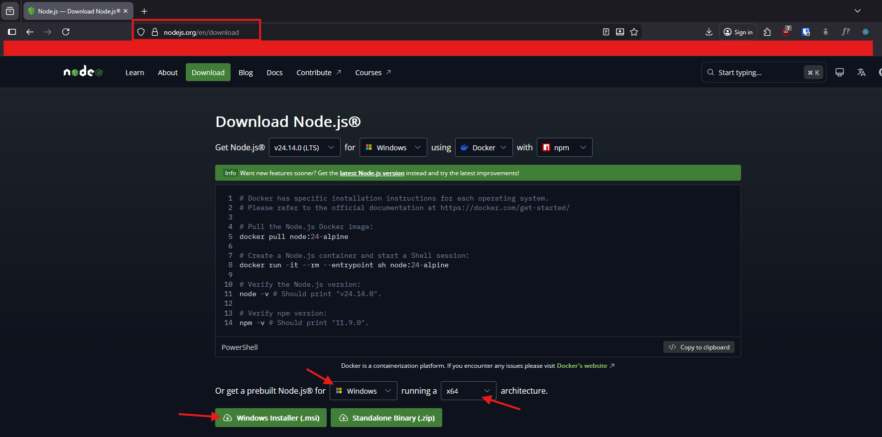
REACT WORKSHOP
REACT ESSENTIALS:
BUILDING INTERACTIVE WEB APPLICATIONS WITH APIs
First City Providential College
ENVIRONMENT SETUP
INSTALLATION
Go to https://nodejs.org/en/download
Select your OS and your Architecture
Click on the Installer Download button
Follow the installation instruction
Tip: To verify successful installation, run in the terminal node -v and npm -v
DAY 1

Slide 5
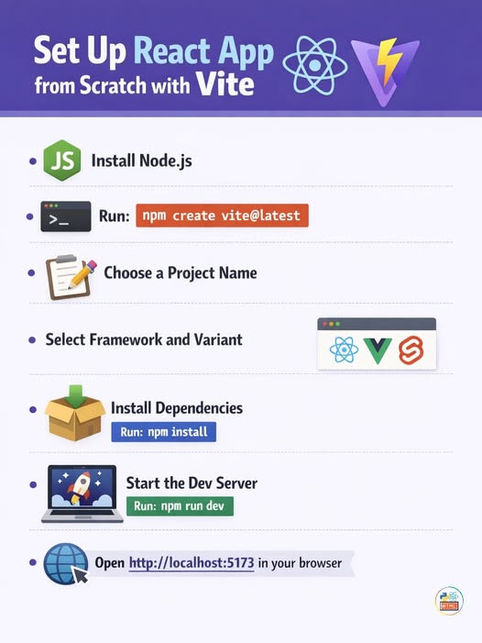
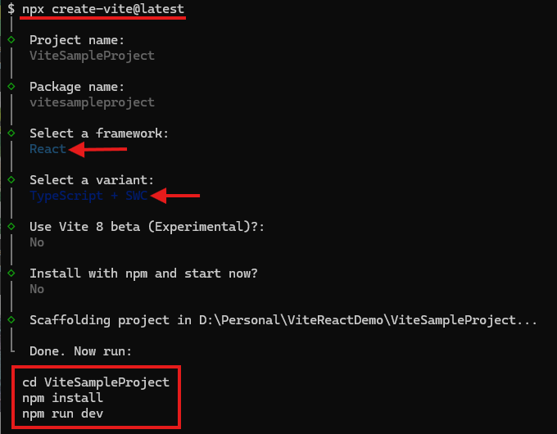
REACT WORKSHOP
REACT ESSENTIALS:
BUILDING INTERACTIVE WEB APPLICATIONS WITH APIs
First City Providential College
ENVIRONMENT SETUP
CREATING YOUR FIRST
REACT PROJECT
Run npx create-vite@latest command in your terminal
Name your First Project
Name your Package (or just press Enter to skip it)
Select your preferred variant (Recommended: Typescript + SWC)
DON’T use Vite 8 beta
You can optionally skip installation and start (Recommended: No)
Credits to: Coding with Parvez
DAY 1

Slide 6
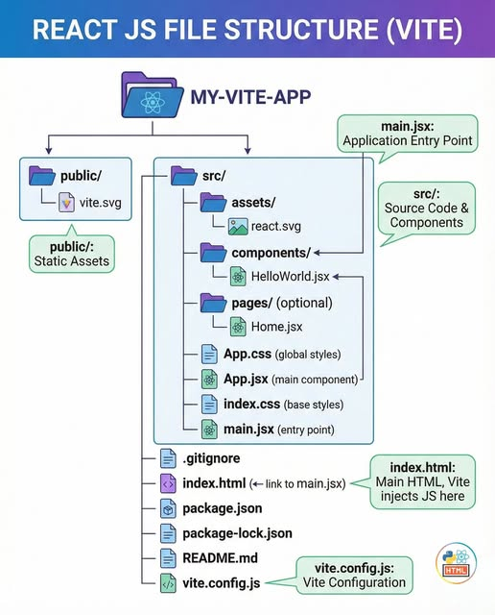
REACT WORKSHOP
REACT ESSENTIALS:
BUILDING INTERACTIVE WEB APPLICATIONS WITH APIs
First City Providential College
ENVIRONMENT SETUP
PROJECT FOLDER STRUCTURE
components/ - contains your React Components
pages/ - stores your Pages
assets/ - contains all your images and other file formats (i.e. Font Files)
Note: This is what typically project folder look like on small / micro sites (i.e. Personal Websites, etc.)
DAY 1
Credits to: Coding with Parvez

Slide 7
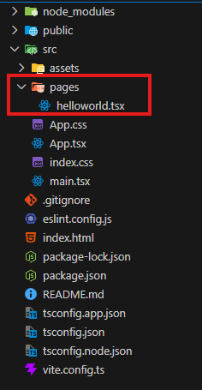
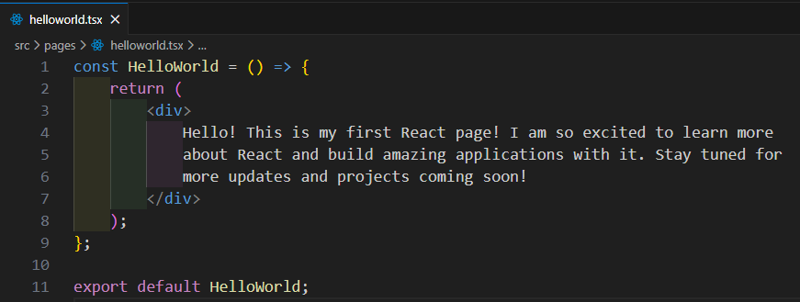
REACT WORKSHOP
REACT ESSENTIALS:
BUILDING INTERACTIVE WEB APPLICATIONS WITH APIs
First City Providential College
INTRODUCTION TO REACT APPLICATION
CREATING YOUR FIRST REACT PAGE
Create a new folder – name it pages
Within the pages/ folder, create a new .tsx file – name it helloworld.tsx
Note: At this point, you can follow the example code given here. Do not forget to EXPORT it so that it can be used by other components.
DAY 1

Slide 8
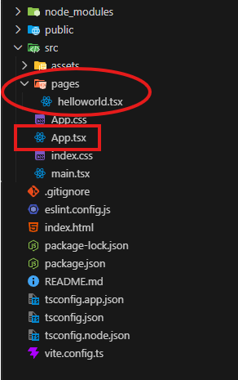
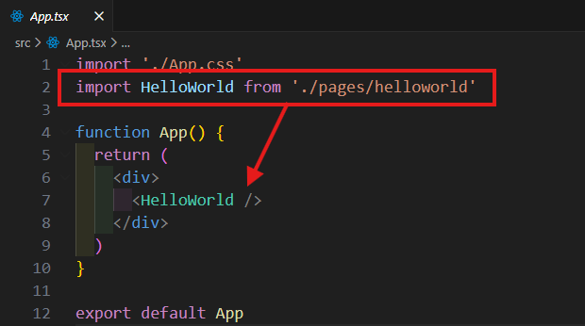
REACT WORKSHOP
REACT ESSENTIALS:
BUILDING INTERACTIVE WEB APPLICATIONS WITH APIs
First City Providential College
INTRODUCTION TO REACT APPLICATION
CREATING YOUR FIRST REACT PAGE
Import your newly created page (component) to App.tsx
Launch http://localhost:5173/ and see the result
DAY 1

Slide 9
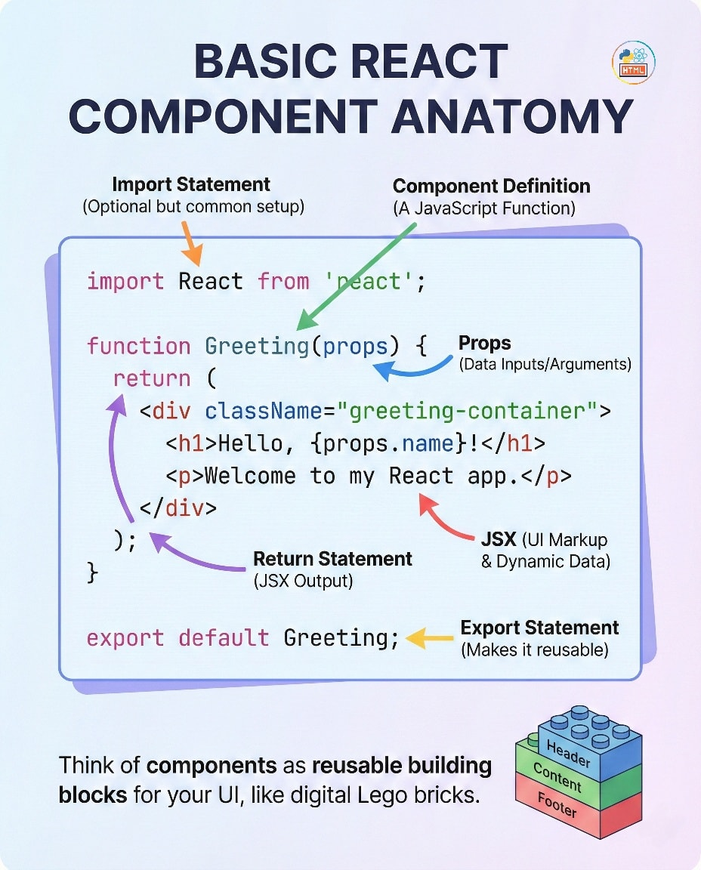
REACT WORKSHOP
REACT ESSENTIALS:
BUILDING INTERACTIVE WEB APPLICATIONS WITH APIs
First City Providential College
INTRODUCTION TO REACT APPLICATION
UNDERSTANDING COMPONENTS
Components are reusable pieces – instead of you copy-pasting the same UI repeatedly, you can just call the same code block
This allows you to follow DRY principle – Don’t Repeat Yourself
Try to imagine yourself copy pasting navigations or footers on every single page you create. Components remove that hassle completely.
DAY 1
Credits to: Coding with Parvez

Slide 10
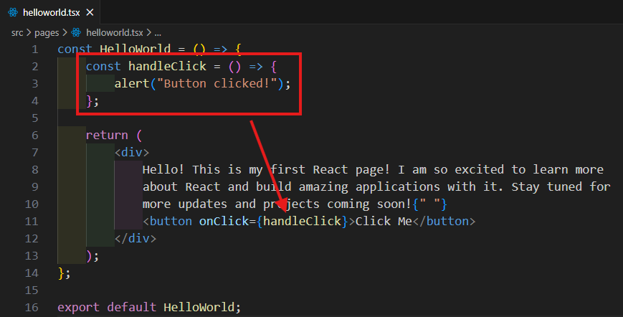
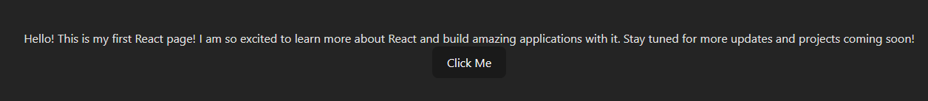
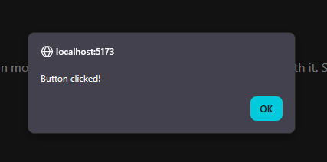
REACT WORKSHOP
REACT ESSENTIALS:
BUILDING INTERACTIVE WEB APPLICATIONS WITH APIs
First City Providential College
INTRODUCTION TO REACT APPLICATION
UNDERSTANDING EVENT HANDLERS
Just like in native JavaScript, React allows us to bind logic behind components such as clicks.
The upgrade to this, we can manipulate states – in a way that we can conditionally render certain components upon clicking a button – or maybe call APIs to fetch data.
Upon click the button, it should out an alert
DAY 1

Slide 11
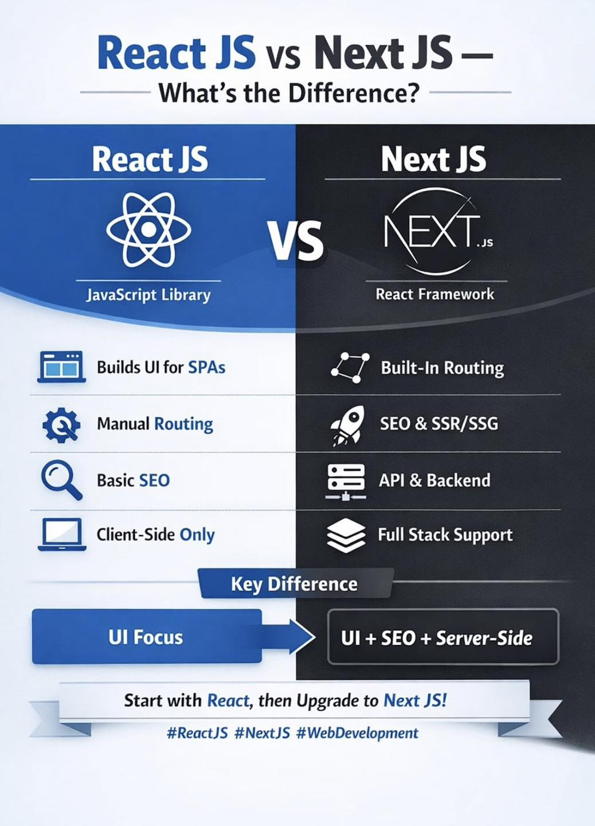
REACT WORKSHOP
REACT ESSENTIALS:
BUILDING INTERACTIVE WEB APPLICATIONS WITH APIs
First City Providential College
DAY 1

Slide 12
REACT WORKSHOP
REACT ESSENTIALS:
BUILDING INTERACTIVE WEB APPLICATIONS WITH APIs
First City Providential College
DAY 1

Slide 13
REACT WORKSHOP
REACT ESSENTIALS:
BUILDING INTERACTIVE WEB APPLICATIONS WITH APIs
First City Providential College

