Slide 1

A C++ PERFORMANCE STORY · 2026
Fix one bottleneck, create another.
A journey from DFS to lock-free work stealing.

Slide 2
01 / ORIGIN
It started simply enough.
I wanted to use C++23 modules.
I needed a small project to play with them.
I
must
use
So I built a directory scanner.
modules!!
Thought it would be simple… it wasn't.

Slide 3



02 / PROJECT
What is Phanes?
A small, self-contained directory scanner — three stages from disk to insight.
→
→
Scan filesystem
Build tree
Analyze
Walk directories
In-memory structure
Stats, sizes, extensions
Each stage feeds the next. The whole pipeline is gated by stage one.

Slide 4



03 / DIAGNOSIS
Everything depends on the scan.
→
→
Scan filesystem
Build tree
Analyze
The bottleneck
Waiting…
Waiting…
⚡
If scanning is slow, everything is slow.

Slide 5
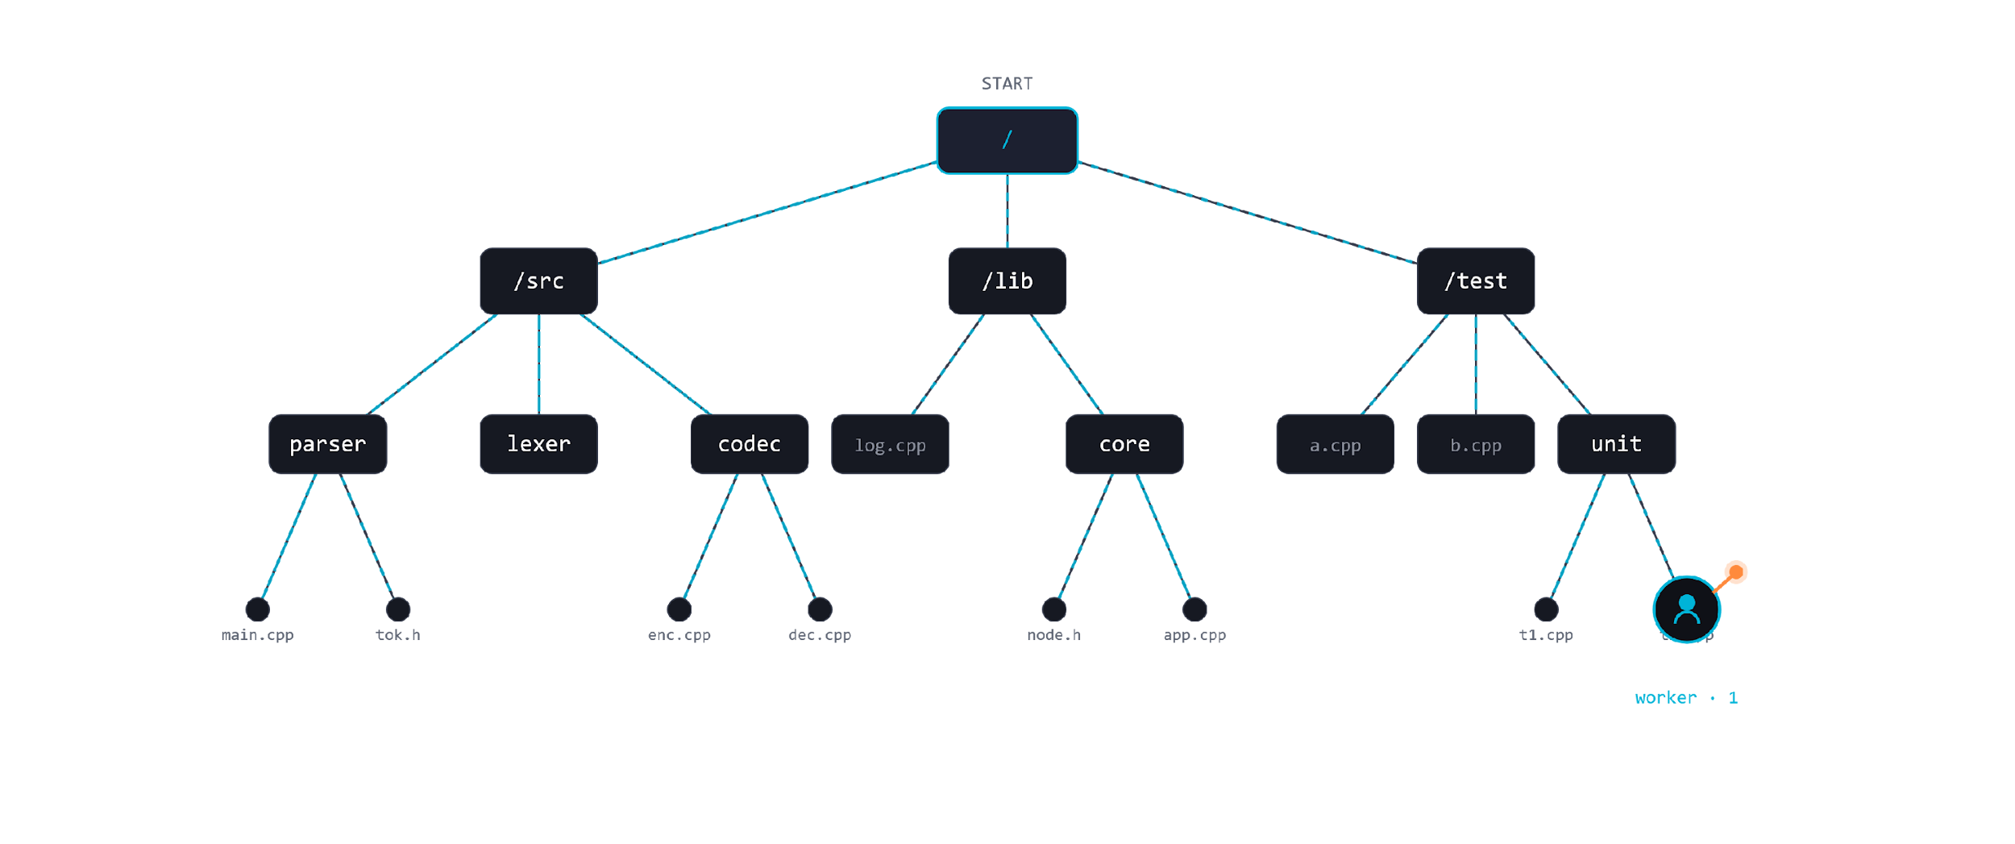
VERSION 1 · SINGLE THREAD
Iterative DFS.
One thread. One directory at a time.

Slide 6
BASELINE
The numbers.
🐧 LINUX
🪟 WINDOWS
15,660 ms
65,204 ms
directories
547,997
directories
223,414
files
1,937,334
files
1,225,260
Slow enough to be annoying.

Slide 7
04 / INSIGHT
Directories are independent.
📁 /A
📁 /B
📁 /C
⤍ ✕
⤍ ✕
main.cpp
parser.cpp
render.cpp
util.h
lexer.cpp
mesh.cpp
config.json
token.h
shader.glsl
The contents of one directory have nothing to do with the contents of another.

Slide 8




VERSION 2 · SHARED QUEUE
Thread pool.
/src
/lib
/test
PRODUCING TASKS
Global Task Queue
CONSUMING TASKS
worker · 1
worker · 2
worker · 3
⌐ Same threads are both producers and consumers — when a worker scans a directory, every subdirectory it finds becomes a new task pushed back into the queue.

Slide 9
VERSION 2 · RESULTS
Real improvement — on most platforms.
1.6× faster
9.2× faster
LINUX
WINDOWS
10,031 ms
7,058 ms
was
15,660 ms
was
65,204 ms
More threads hide I/O latency. But look at that one mutex…

Slide 10

PROBLEM #1
Everyone fights over one lock.
Global Task Queue
worker · 1
worker · 2
worker · 3
worker · 4
waiting…
waiting…
waiting…
waiting…
Mutex contention — every submit() and every pop() requires this lock. It's a tax on every unit of work.

Slide 11

FIX #1
Give each thread its own queue.
Global Queue (fallback)
T1
push
FRONT
BACK
pop
worker
fallback
T2
push
FRONT
BACK
pop
worker
fallback
T3
push
FRONT
BACK
pop
worker
fallback
Each thread talks to its own queue first — the shared queue only sees traffic when a worker has nothing left to do.

Slide 12
PROBLEM #2
Load imbalance.
worker · 1
worker · 2
worker · 3
worker · 4
12 tasks
z z z
z z z
z z z
The work exists. The threads exist. They are just in the wrong place.

Slide 13
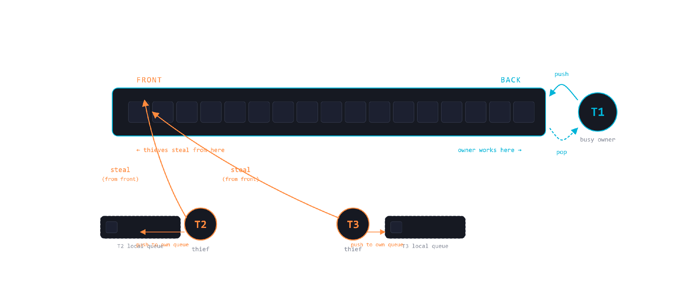
VERSION 3 · WORK STEALING
Idle threads steal from busy ones.
Idle threads reach into busy threads' queues from the opposite end.

Slide 14

PROBLEM #3
Stealing still uses locks.
— ZOOM · steal operation —
acquire_lock()
↓ worker · 1's deque ↓
a
b
c
d
e
FRONT
BACK
owned by worker · 1
worker · 2
worker · 3
steal_front() ↗
steal_front() ↖
Both thieves race for the same lock on worker 1's deque — the steal path acquires and releases mutexes in a tight loop.

Slide 15
VERSION 3 · RESULTS
Real improvement — on most platforms.
1.2× faster
1.8× slower
LINUX
WINDOWS
8,425 ms
12,450 ms
was
10,031 ms
was
7,058 ms
Linux loved it. Windows regressed — the steal path is hotter than expected.

Slide 16
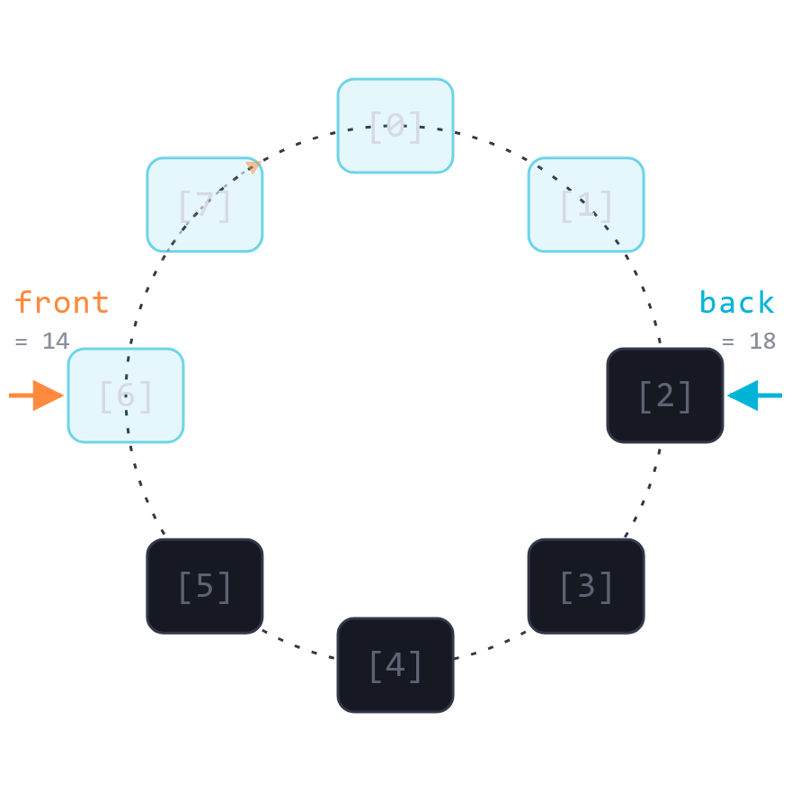


VERSION 4
Lock-free deque.
— WHAT CHANGED —
— THE CIRCULAR BUFFER INSIDE —
↓ worker · 1's deque ↓
a
b
c
d
e
FRONT
BACK
ATOMIC
ATOMIC
owned by worker · 1
FRONT END
BACK END
steal_front()
push_back() / pop_back()
one atomic CAS
no lock at all
Same front/back split as before. What changed is what happens inside — no mutex, just atomics and a circular buffer.

Slide 17
THE COST OF GOING LOCK-FREE
Removing mutexes creates new problems to solve.
🧠
⚛️
⚔️
PROBLEM · 1
PROBLEM · 2
PROBLEM · 3
False sharing
Memory ordering
The last item race
Different variables, same cache line — threads slow each other down without touching the same data.
Without mutexes, CPUs and compilers reorder operations — you have to tell them what they cannot move.
When one item remains, the owner and a thief can both reach for it simultaneously — CAS decides the winner.

Slide 18
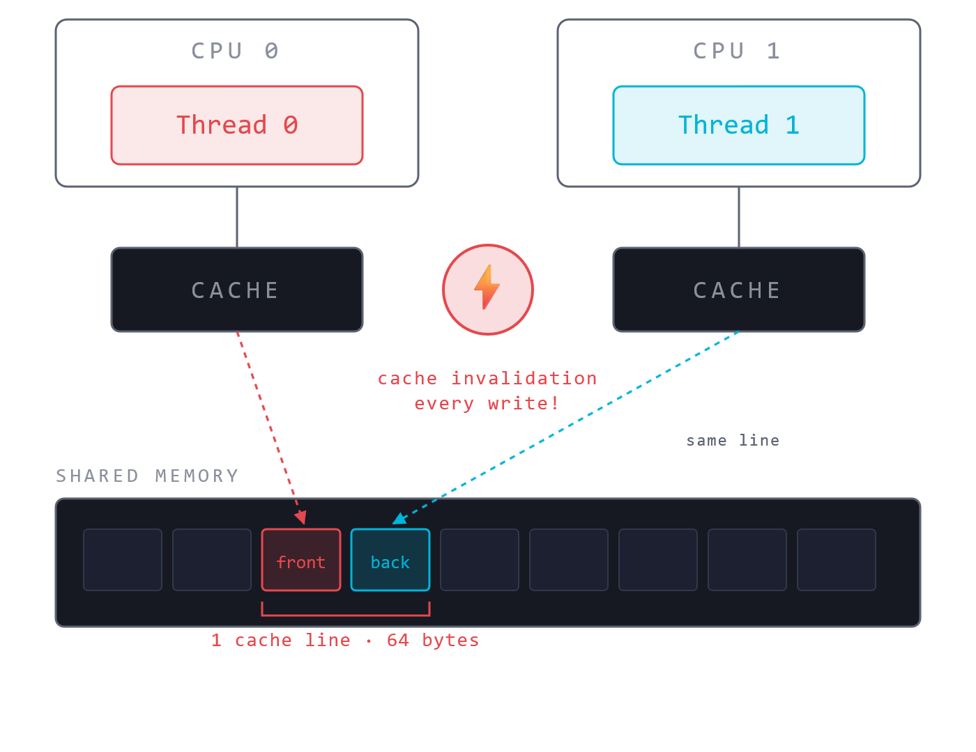
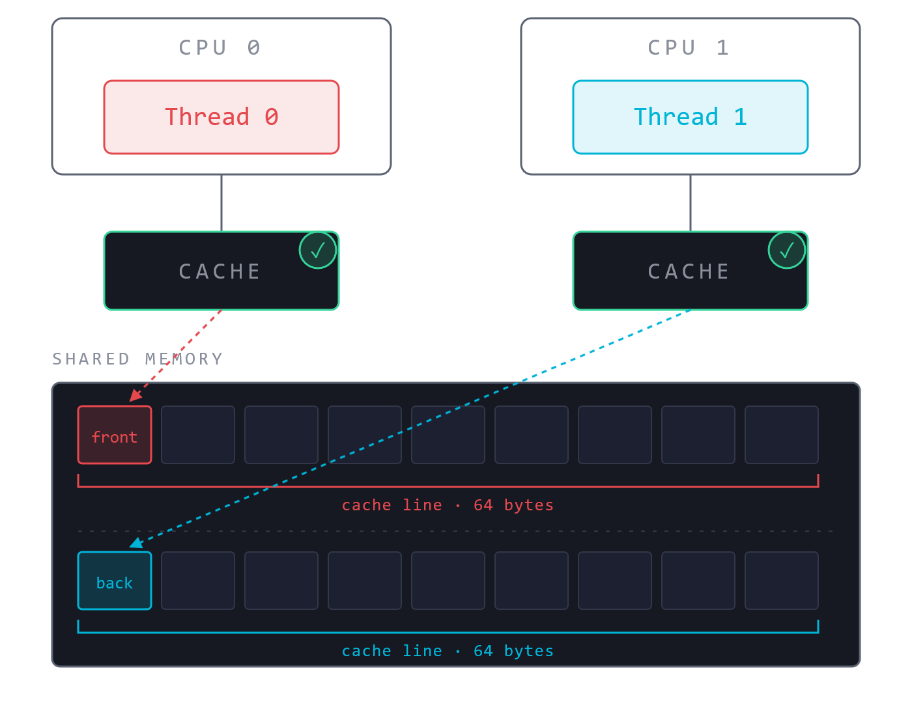
HARDWARE REALITY
Hardware problem: False sharing.
— THE PROBLEM —
— THE FIX · alignas(64) —
Thread 0 writes front. Thread 1 writes back. Different variables. Same cache line. Every write forces the other core to reload.
alignas(64) std::atomic<int64_t> front; alignas(64) std::atomic<int64_t> back;
Each variable gets its own cache line. Writes no longer interfere.

Slide 19
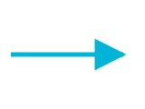
MEMORY ORDERING · PART 1
The compiler already reorders your code.
— WHAT YOU WROTE —
— WHAT MIGHT EXECUTE —
x = 1;
y = 2;
y = 2;
z = y;← moved up, computed early
w = 3;
compiler reorder
x = 1;
z = y;
w = 3;
On a single thread this is invisible . The result is always the same. You never notice.
z still equals 2. Nothing broke. The compiler is allowed to do this.

Slide 20
MEMORY ORDERING · PART 2
With two threads, reordering is no longer invisible.
THREAD A · WRITES
THREAD B · READS
x = 1;
while (!ready);
ready = true;← signals Thread B
print(x);← expects x == 1
SCENARIO 1 · WHAT YOU EXPECT
✅
SCENARIO 2 · WHAT CAN HAPPEN
❌
A: x=1 → ready=true
A: ready=true → x=1 (reordered!)
B: sees ready → reads x=1
B: sees ready → reads x=0
Thread A's reorder, invisible to itself, is catastrophic for Thread B.

Slide 21
MEMORY ORDERING · PART 3
Telling the CPU what it cannot move.
🌀
relaxed
A
store
?
B
load
// might see, might not
USE CASE counters, hints
Atomic. No ordering promise.
🤝
release / acquire
A
store(
release
)
→
B
load(
acquire
)
USE CASE passing data between threads
The handshake.
If B sees A's store, B sees everything A wrote before it.
📋
seq_cst
USE CASE when all threads must agree
One global timeline . All threads agree.
A
B
A
B
Pick the weakest ordering that keeps your code correct.

Slide 22
MEMORY ORDERING · PART 4
Why relaxed or acquire/release is not always enough.
std::atomic<bool> x{false}, y{false}; int r1, r2;
WRITER A
WRITER B
void writer_a() { x = true; }
void writer_b() { y = true; }
READER C
READER D
void reader_c() { while (!x ); r1 = y ; }
void reader_d() { while (!y ); r2 = x ; }
WITHOUT seq_cst
WITH seq_cst
C sees: X first, then Y → r1 = 0
D sees: Y first, then X → r2 = 0
X = true
Y = true
Both readers are wrong simultaneously.
Either X comes before Y for everyone, or Y before X for everyone. Either r1 or r2 must be 1.
No global order — each thread has its own view.
✓ Impossible for both to be 0.
seq_cst is the only ordering that prevents this. Acquire/release alone cannot — there is no global timeline.

Slide 23
THE LAST-ITEM RACE
Compare and Swap — the atomic decision maker.
— WHAT IT DOES —
— WHY IT MATTERS FOR THE DEQUE —
Owner and thief both see one item left. Both try:
if (current == expected) {
current = new_value;
CAS(front, f, f+1)
return true;// I won
} else {
TIMELINE
return false;// someone else got there first
owner
fires CAS → succeeds → gets item
✅
}
thief
fires CAS → fails → returns nullopt
✅
front already moved — the thief sees it and backs off cleanly.
One indivisible operation — the CPU does the check and the swap with no gap between them.
Only one can win. The loser knows immediately. No mutex needed.
CAS is how lock-free data structures make decisions without a lock.

Slide 24
ALL FOUR VERSIONS
How far we came.
Part 1 — DFS
🐧 LINUX
15,660 ms
single thread
🪟 WINDOWS
65,204 ms
Part 2 — Thread Pool
🐧 LINUX
10,031 ms
shared queue
🪟 WINDOWS
7,058 ms
Part 3 — Work Stealing
🐧 LINUX
8,452 ms
per-thread deques
🪟 WINDOWS
12,540 ms
Part 4 — Lock-free
🐧 LINUX
2,839 ms
CAS deque
🪟 WINDOWS
5,042 ms
Linux · ext4
Windows · NTFS
Linux: 16s → 3s · Windows: 65s → 5s

Slide 25

RESOURCES
Want to go deeper?
WATCH & READ
BROWSE THE CODE
A reading list.
Every stage is a commit.
🎬
Scott Meyers — CPU Caches and Why You Care
youtu.be/WDIkqP4JbkE
github.com/jnyfah/phanes
🎬
Fedor Pikus · CppCon 2017 — C++ atomics, basic to advanced
youtu.be/ZQFzMfHIxng
🎬
Herb Sutter · CppCon 2014 — Lock-Free Programming, Part I & II
youtu.be/c1gO9aB9nbs youtu.be/CmxkPChOcvw
Every optimization stage is a separate commit.
Check out any point in the journey to see what the code looked like — DFS, thread pool , work stealing, lock-free.
🎬
Alex Dathskovsky · C++Now 2024 — C++11 to C++23 in the Memory Model
youtu.be/VWiUYbtSWRI
🎬
Michael Wong · CppCon 2015 — C++11/14/17 atomics & memory model
youtu.be/DS2m7T6NKZQ
The blog series covers each stage in detail too.
📖
Mara Bos — Rust Atomics and Locks, Ch. 3: Memory Ordering
marabos.nl/atomics/ memory-ordering.html
📄
Chase & Lev (2005) — Dynamic Circular Work-Stealing Deque
dl.acm.org/doi/ 10.1145/1073970.1073974

