Slide 1
Visualize Time Enabled Data using ArcGIS Qt (C++) and Toolkit
Gela Malek Pour gmalekpour@esri.com

Slide 2
About Esri
We build mapping technology that our customers use to solve the world’s most complex challenges
We offer solutions to apply location-based analytics to business practices
Visualize and analyze data more effectively
Collaborate and share maps, apps and reports easily
Headquartered in Southern California
We have offices all around the world

Slide 3
Purpose of this talk
Showcase a quick way to create a desktop app to visualize time enabled data
Setup the development environment using Esri templates
Use the ArcGIS toolkit to use already existing UI components

Slide 4
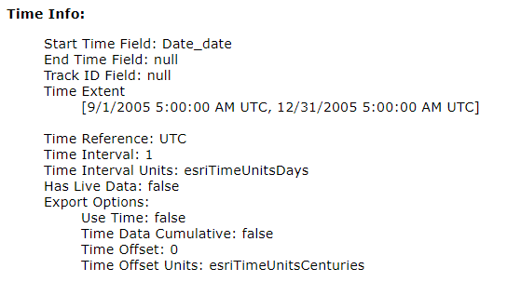
Time aware layer
We will be using a feature layer that include hurricane data as features
Each feature has a specific start time and end time in the feature table
We will use these start and end date values to draw and clear features on the map
The JSON of the feature layer includes all the necessary information for the time slider
Start and end dates, time interval, etc.
Feature layer URL

Slide 5
ArcGIS Runtime for Qt - SDK
The Qt SDK allows you to build cross platform desktop and mobile apps
Incorporate features such as mapping, geocoding, routing, geoprocessing, etc.
In this sample we will be using the C++ SDK

Slide 6
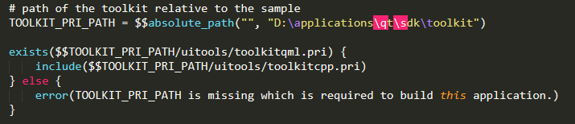

ArcGIS Runtime Toolkit for Qt
Open-source project
Contains UI components and utilities to help simplify Qt app development
Can plug and play various UI pieces
Where:
https://github.com/Esri/arcgis-runtime-toolkit-qt
How:
Clone the repository and import the path in .pro file in Qt Creator
Register your components in main.cpp

Slide 7
ArcGIS Runtime Toolkit for Qt
Time slider UI component:
Provides controls to visualize and step through temporal data
Set the current time extent manually or animate the time extent on GeoView
It initializes all required values using data from the layer
You can customize several UI elements

Slide 8
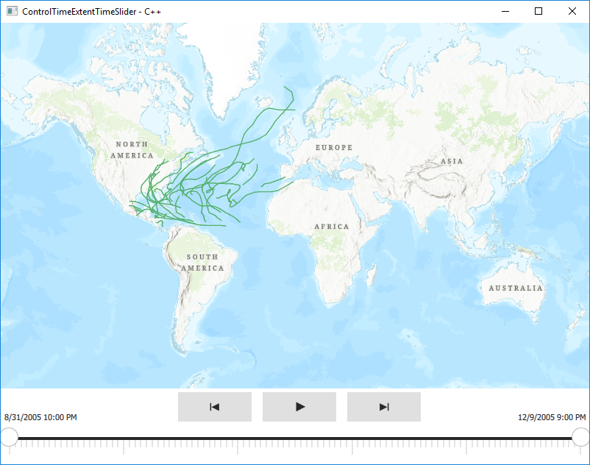

Slide 9
Resources
ArcGIS Runtime API for Qt
https://developers.arcgis.com/qt/
ArcGIS Runtime Toolkit for Qt API reference
https://developers.arcgis.com/qt/toolkit/api-reference/
ArcGIS Runtime Toolkit – Qt on GitHub
https://github.com/Esri/arcgis-runtime-toolkit-qt
How to setup the SDK
https://developers.arcgis.com/qt/get-started/
Esri Careers
https://www.esri.com/en-us/about/careers/overview

