Slide 1
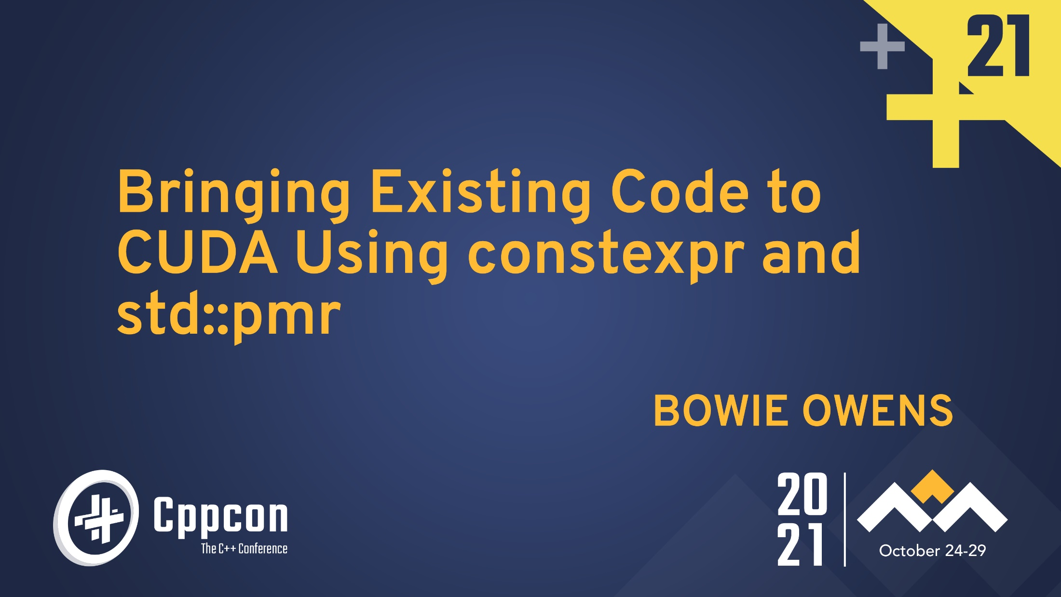

Slide 2
Outline
Introduction
Memory
Host vs Device Functions
Return on Investment
Concluding remarks
Notes:
The structure of the talk
I will begin with some introductory comments to set some context about who I am, what I’ve done and who I think this talk will be helpful for.
Then we will look bringing existing code to CUDA in two major sections.
First, issues relating to memory.
Second, issues relating to code organisation due to the distinction between host and device functions.
I will try to introduce the concepts as I go so if you are not familiar with the terminology.
Please note at the end of each section I have slides to remind me to stop and answer questions so please use the Q&A feature to do that.
Also, I have slide numbers in the bottom left corner which you can make use of if your question relates to a specific slide.

Slide 3
Introduction
I work the RiskLab team at CSIRO on applied mathematics for Financial Risk.
The aim of this talk is to:
Document some of the challenges in applying the principles from introductory CUDA examples to an existing project that has a meaningful amount of non-trivial code.
Provide some guidance to people about to embark on using CUDA to speed up existing software.
Notes:
I at Australia’s government funded research organisation CSIRO as part of the RiskLab team.
Our team makes software for managing Financial Risk.
Since we are small team my role on the team means I get to cover lots of different facets of software development.
Recently I have been working on accelerating some of our existing software using CUDA.
This is the perfect time to document the experience to help others because this is the time when you still remember what was not obvious as you learn.
Let’s look at what a about the simplest possible CUDA example looks like.

Slide 4
An Even Easier Introduction to CUDA
void add_cpu(int n, float* x, float* y) {
for (int i = 0; i < n; i++)
y[i] = x[i] + y[i];
}
TEST_CASE("cppcon-0", "[CUDA]") {
int N = 1 << 20;
float* x = new float[N];
float* y = new float[N];
for (int i = 0; i < N; i++) {
x[i] = 1.0f;
y[i] = 2.0f;
}
add_cpu(N, x, y);
delete[] x;
delete[] y;
}
Notes:
This example is based on one from a Nvidia blog post “An Even Easier Introduction to CUDA”
https://developer.nvidia.com/blog/even-easier-introduction-cuda/
We construct two vectors of floating point values, add them together and then clean up.
Let’s look at the steps required to use CUDA with this example.

Slide 5
An Even Easier Introduction to CUDA
TEST_CASE("cppcon-1", "[CUDA]") {
int N = 1 << 20;
float* x;
float* y;
cudaMallocManaged(&x, N*sizeof(float));
cudaMallocManaged(&y, N*sizeof(float));
// …
cudaFree(x);
cudaFree(y);
}
Notes:
From the blog post, first:
To compute on the GPU, I need to allocate memory accessible by the GPU. Unified Memory in CUDA makes this easy by providing a single memory space accessible by all GPUs and CPUs in your system.
To allocate data in unified memory, call cudaMallocManaged(), which returns a pointer that you can access from host (CPU) code or device (GPU) code.
To free the data, just pass the pointer to cudaFree().

Slide 6
An Even Easier Introduction to CUDA
__global__ void add_gpu(int n, float* x, float* y) {
for (int i = 0; i < n; i++)
y[i] = x[i] + y[i];
}
TEST_CASE("cppcon-1", "[CUDA]") {
// …
}
Notes:
Second, “I just have to turn our add function into a function that the GPU can run, called a kernel in CUDA. To do this, all I have to do is add the specifier __global__ to the function”

Slide 7
An Even Easier Introduction to CUDA
__global__ void add_gpu(int n, float* x, float* y) {
for (int i = 0; i < n; i++)
y[i] = x[i] + y[i];
}
TEST_CASE("cppcon-1", "[CUDA]") {
int N = 1 << 20;
float* x;
float* y;
// …
add_gpu<<<1, 1>>>(N, x, y);
// …
}
Notes:
Third, “I need to launch the add() kernel, which invokes it on the GPU. CUDA kernel launches are specified using the triple angle bracket syntax <<< >>>.”
A quick word about what goes inside the triple angle brackets.
Roughly speaking when multiplied together gives the number of threads that will work in parallel to perform the calculations.
Using 1, 1 will only create one thread and only use the tiniest fraction of the GPU’s hardware.
To fully utilise the GPU you need to divide up the work amongst many threads.
However, it does make the examples more verbose so I am going to omit this detail.
Lets bring all the changes back together.

Slide 8
Questions About the Introductory Example?
__global__ void add_gpu(int n, float* x, float* y) {
for (int i = 0; i < n; i++)
y[i] = x[i] + y[i];
}
TEST_CASE("cppcon-1", "[CUDA]") {
int N = 1 << 20;
float* x;
float* y;
cudaMallocManaged(&x, N*sizeof(float));
cudaMallocManaged(&y, N*sizeof(float));
for (int i = 0; i < N; i++) {
x[i] = 1.0f;
y[i] = 2.0f;
}
add_gpu<<<1, 1>>>(N, x, y);
cudaFree(x);
cudaFree(y);
}
Notes:
Here is the example complete and it is an excellent starting point.
However, its simplicity conceals an number of issues that present themselves when you try to apply the principles to existing code.
Next I am going to talk about issues relating to memory allocation for an existing program.
But first, are there any questions about the introductory example?

Slide 9
Ok, about the kernel parameters
TEST_CASE("cppcon-1", "[CUDA]") {
int N = 1 << 20;
float* x;
float* y;
// …
int block_size = 256;
int grid_size = (N + block_size - 1) / block_size;
add_gpu<<<grid_size, block_size>>>(N, x, y);
// …
}
Notes:
In CUDA a collection of threads is called a block and a collection of blocks is called a grid.
The two parameters control the number of threads per block and the number of blocks in the grid.
The block and grid sizes should be selected to optimise the performance of your calculations but in this example I just use 256 threads per block and then pick the number of blocks in the grid to ensure we have at least 1 thread per element in the vectors.

Slide 10
Ok, about the kernel parameters
__global__ void add_gpu(int n, float* x, float* y) {
int i0 = blockIdx.x * blockDim.x + threadIdx.x;
int stride = blockDim.x * gridDim.x;
for (int i = i0; i < n; i += stride)
y[i] = x[i] + y[i];
}
TEST_CASE("cppcon-1", "[CUDA]") {
// …
add_gpu<<<grid_size, block_size>>>(N, x, y);
// …
}
Notes:
Then we alter the kernel to use its thread identity and the total number of threads to process only a fraction of the inputs.
In this case, each thread uses it identity to determine a starting offset and the total number of threads as a stride.
On the previous slide I selected parameters to ensure that there is more threads than elements so each thread will execute one iteration of the loop.
However, if alter the grid or block sizes to have fewer threads this code will still work including the case where there is one thread and the stride is 1 so that thread processes all elements.

Slide 11
Memory

Slide 12
CPU vs GPU Memory
“In a typical PC or cluster node today, the memories of the CPU and GPU are physically distinct and separated by the PCI-Express bus.” -- https://developer.nvidia.com/blog/unified-memory-in-cuda-6/
System Memory
GPU Memory
Notes:
Why is there a challenge relating to memory at all?
Quoting from the Nvidia website “the memories of the CPU and GPU are physically distinct and separated by the PCI-Express bus”
As such the GPU cannot directly access the system memory nor can the CPU access the GPU memory.
Let’s look at the solution to this from the example we looked at, Unfiied Memory.

Slide 13
Unified Memory
“Unified Memory creates a pool of managed memory that is shared between the CPU and GPU, bridging the CPU-GPU divide. Managed memory is accessible to both the CPU and GPU using a single pointer. The key is that the system automatically migrates data allocated in Unified Memory between host and device...” -- https://developer.nvidia.com/blog/unified-memory-in-cuda-6/
System Memory
GPU Memory
Notes:
What is Unfied Memory?
Unified Memory creates a pool of managed memory that is shared between the CPU and GPU... Managed memory is accessible to both the CPU and GPU
Unified memory allows you to pretend there is no separation of CPU and GPU memory.
Lets go back to the example to see how memory is allocated.

Slide 14
Memory Allocation
// cpu
float* x = new float[N];
float* y = new float[N];
// …
delete[] x;
delete[] y;
// gpu
float* x;
float* y;
cudaMallocManaged(
&x, N*sizeof(float));
cudaMallocManaged(
&y, N*sizeof(float));
// …
cudaFree(x);
cudaFree(y);
Notes:
From the introductory blog post: “I just need to replace the calls to new in the code [on the left] with calls to cudaMallocManaged(), and replace calls to delete [] with calls to cudaFree.”
The first challenge in this example for an existing codebase.
In existing code it is unlikely that your memory allocation/deallocation is being done by raw new/delete statements.
“Guideline: Don’t use explicit new, delete, and owning * pointers, except in rare cases encapsulated inside the implementation of a low-level data structure.”
https://herbsutter.com/2013/05/29/gotw-89-solution-smart-pointers/

Slide 15
Memory Allocation
// cpu
std::vector<float> x(N);
std::vector<float> y(N);
// …
// gpu
// ???
// ???
// …
Notes:
Your memory is likely being managed by a type that conceals the allocation and deallocation.
For example, std::vector.
How do we “replace the calls to new in the code above with calls to cudaMallocManaged(), and replace calls to delete [] with calls to cudaFree?”

Slide 16
std::pmr
Added in C++17:
std::pmr::memory_resource
std::pmr::polymorphic_allocator
std::pmr::vector
std::pmr::monotonic_buffer_resource
…
Notes:
The mechanism starting in C++17 for controlling the allocation of memory for containers is std::pmr.
This is done by means of a number of new types and templates that were added in that version of the standard.
Such as:
std::pmr_memory_resource, std::pmr::polymorphic_allocator, std::pmr::vector, std::pmr::monotonic_buffer_resource and so on.
Since I had access to C++17, I did not investigate the pre C++17 style allocators.
If you cannot use std::pmr, the basic principles should similar between the two styles of allocators.
Let’s look at how we can use std::pmr to allocate Unified Memory.

Slide 17
Memory Allocation
// gpu
unified_memory_resource mem;
std::pmr::vector<float> x(N, &mem);
std::pmr::vector<float> y(N, &mem);
// …
Notes:
std::pmr allows us to control the memory allocation for elements of a std::pmr::vector.
We define a memory resource object that will allocate space within the Unified Memory and pass that memory resource object to the vectors.
Now the elements of the vectors will be allocated in memory accessible to the CPU and the GPU.
What does unified_memory_resource look like?

Slide 18
A Unified Memory Resource
struct unified_memory_resource :
std::pmr::memory_resource {
void* do_allocate(std::size_t, std::size_t);
void do_deallocate(
void* p, std::size_t, std::size_t);
bool do_is_equal(
const std::pmr::memory_resource& other)
const noexcept;
};
Notes:
A memory resource is a struct/class that inherits from std::pmr::memory_resource so that it can implement the memory_resource interface.

Slide 19
A Unified Memory Resource
struct unified_memory_resource :
std::pmr::memory_resource {
void* do_allocate(std::size_t, std::size_t) final;
void do_deallocate(
void* p, std::size_t, std::size_t) final;
bool do_is_equal(
const std::pmr::memory_resource& other)
const noexcept final;
};
Notes:
The unfied_memory_resource type implements an allocate function, a deallocate function and an equality comparison.

Slide 20
A Unified Memory Resource
void* unified_memory_resource::do_allocate(
std::size_t bytes, std::size_t /*alignment*/) {
void* x = nullptr;
auto const r = cudaMallocManaged(&x, bytes);
if (r != cudaError_t::cudaSuccess) {
throw std::bad_alloc();
}
return x;
}
void unified_memory_resource::do_deallocate(
void* p, std::size_t, std::size_t) {
cudaFree(p);
}
Notes:
To implement the allocation and deallocation functions we use cudaMallocManaged() to allocate memory and cudaFree() to deallocate memory as in the example.
For simplicity I have assumed:
that the memory is suitably aligned
That the caller will deallocate all allocations to avoid leaks
In the case of error, I throw bad_alloc.
Now that we know how to allocate/deallocate Unfied Memory lets go back to the recent example.

Slide 21
Memory Allocation
// gpu
unified_memory_resource mem;
std::pmr::vector<float> x(N, &mem);
std::pmr::vector<float> y(N, &mem);
// …
Notes:
The elements of the vectors will be allocated in memory accessible to the GPU and CPU.
However, the objects x and y are allocated on the stack and therefore inaccessible to the GPU.
Since the objects x and y and inaccessible there is something we want to avoid.

Slide 22
Avoid References to Objects Not in Unified Memory
void add_cpu(
int n,
vector<float> const& x,
vector<float>& y) {
for (int i = 0; i < n; i++)
y[i] = x[i] + y[i];
}
__global__
void add_gpu(
int n,
gsl::span<float const> x,
gsl::span<float> y) {
for (int i = 0; i < n; i++)
y[i] = x[i] + y[i];
}
Notes:
If the vector object is on the stack instead of Unified Memory, we need to avoid passing it by reference to kernel functions.
Instead we can convert the vector into a span that we can pass by value.
In general copy by value parameters will help you avoid this issue, however you still need to be careful, why?

Slide 23
Avoid References to Objects Not in Unified Memory
template <class callable>
void add(int n, callable f, gsl::span<float> y)
{ for (int i = 0; i < n; i++) y[i] += f(i); }
struct add_ref {
std::vector<double> const& a_;
std::vector<double> const& b_;
auto operator()(index i) const
{ return a_[i] + b_[i]; }
};
struct add_span {
gsl::span<double const> a_;
gsl::span<double const> b_;
auto operator()(index i) const
{ return a_[i] + b_[i]; }
};
Notes:
In general copy by value parameters will help you avoid this issue, however you need to be careful to avoid hiding references in your objects.
In this example the add function takes a callable object which may contain references to other objects.
We can apply the same technique as in the previous slide to make the code more agreeable to working with CUDA.
Now that we have an approach that lets us use Unified Memory lets take a step back and consider if we always want to use unified memory.

Slide 24
Unified Memory
“Unified Memory creates a pool of managed memory that is shared between the CPU and GPU, bridging the CPU-GPU divide. Managed memory is accessible to both the CPU and GPU using a single pointer. The key is that the system automatically migrates data allocated in Unified Memory between host and device….” -- https://developer.nvidia.com/blog/unified-memory-in-cuda-6/
System Memory
GPU Memory
Notes:
Unified memory allows you to pretend there is no separation of CPU and GPU memory.
It doesn’t remove the physical separation it makes it less visible by automatically migrating the data between the two memories.
Is there a reason why you would want to avoid using Unified Memory?
Synchronising values between System and GPU memory negatively affects performance.
To get the best performance you want to avoid alternating between host and device calculations.
Using memory accessible only to the device makes very clear if have not successfully limited your calculations to the device.
It is easy to define a pmr memory resource that allocates memory accessible to the device only.
Let’s look at how to do that.

Slide 25
A Device Only Memory Resource
struct device_memory_resource :
std::pmr::memory_resource {
void* do_allocate(
std::size_t bytes, std::size_t);
void do_deallocate(
void* p, std::size_t, std::size_t);
bool
do_is_equal(const std::pmr::memory_resource&)
const noexcept;
};
Notes:
We define a new memory resource for device only memory.
Very similar to what we saw before.

Slide 26
A Device Only Memory Resource
void* device_memory_resource::do_allocate(
std::size_t bytes, std::size_t) {
void* x = nullptr;
auto const r = cudaMalloc(&x, bytes);
if (r != cudaError_t::cudaSuccess) {
throw std::bad_alloc();
}
return x;
}
void device_memory_resource::do_deallocate(
void* p, std::size_t, std::size_t) {
cudaFree(p);
}
Notes:
This time we use cudaMalloc() to allocate memory.
We still use cudaFree() to deallocate memory.

Slide 27
Device Only Memory Allocation
device_memory_resource mem;
std::pmr::vector<float> x(N, &mem);
std::pmr::vector<float> y(N, &mem);
// …
Notes:
All very similar to what we saw before.
The important difference is that the elements of the vectors will be allocated in memory accessible only to the GPU.
The elements of the vectors are inaccessible to the CPU.
As a result, this example will fail, why?
Because constructor for the vector objects will use the std::pmr::polymorphic_allocator to default construct the elements, setting them to zero.
This is done by the CPU, how can we avoid that?

Slide 28
A Non-Initialising Allocator
template <class T>
struct no_init_allocator : std::pmr::polymorphic_allocator<T> {
// constructors
template <typename U> void construct(U* p) {
::new (static_cast<void*>(p)) U;
}
};
template <class T>
using vector = std::vector<T, no_init_allocator<T>>;
Notes:
We define an allocator that default initialises primitive types when asked to construct them.
An easy way to do this is to reuse most of std::pmr::polymorphic_allocator but replace the construct() member function to use the placement new operator without any additional arguments.

Slide 29
A Non-Initialising Allocator
template <class T>
struct no_init_allocator : std::pmr::polymorphic_allocator<T> {
// constructors
template <typename U> void construct(U* p) {
::new (static_cast<void*>(p)) U;
}
};
template <class T>
using vector = std::vector<T, no_init_allocator<T>>;
Notes:
An alias avoids repeatedly mentioning the name of the allocator.
Lets return to our recent example and consider how this helps.

Slide 30
Device Only Memory Allocation
device_memory_resource mem;
vector<float> x(N, &mem);
vector<float> y(N, &mem);
// …
Notes:
Using a vector with a non-initialising allocators solves the problem of writing to memory inaccessible to the CPU.
As the constructor calls of the vectors will not touch the memory for the elements.
Let’s say we watch some youtube videos by Alisdair Meredith and/or Pablo Halpern and get excited about using more of std::pmr,
can we go on our way using std::pmr without any further problems?

Slide 31
Intermediate Memory Resources
device_memory_resource mem;
std::pmr::monotonic_buffer_resource chunk(&mem);
vector<float> x(N, &chunk);
vector<float> y(N, &chunk);
// …
Notes:
Let’s say we want to reduce the number of calls to the allocator by using std::pmr::monotonic_buffer_resource.
Seems reasonable, std::pmr::monotonic_buffer_resource is there to pre-allocate chunks of memory and then efficiently hand out smaller parcels as required.
Unfortunately, this example may fail for reasonable implementations of the std library.
Why?
Typically, the std memory resource objects store book keeping information so that they can clean up properly even if the caller does not deallocate everything it allocated.
This book keeping information is usually placed in memory allocated by the upstream memory resource.
When the CPU touches this memory the program will fail.
Since you can’t know what the implementation of the std memory resources will do, I have shied away from using them in combination with device memory resources.
Instead I have written a couple of helpful memory resources that allocate their book keeping information using new/delete.
Let’s wrap this up with one final example.

Slide 32
Memory Allocation Across Functions
std::pmr::vector<float>
get_x(std::pmr::memory_resource* mem);
TEST_CASE("cppcon-6", "[CUDA]") {
unified_memory_resource unified_mem;
device_memory_resource device_mem;
auto const x = get_x(&unified_mem);
auto const N = x.size();
vector<float> y(N, &device_mem);
}
Notes:
Use unified memory if you are not sure what will be done with the memory resource.
In particular this is useful for objects that are allocated in one part of your system that is going to remain oblivious the presence of CUDA.
Use device memory if you have complete control over how the memory resource is used and you want to eliminate the possibility of operations on the CPU.

Slide 33
Questions About Memory Allocation?
Notes:
Next I am going to talk about host vs device functions and how this relates to existing code.
But first, are there any questions about memory allocation?

Slide 34
Host vs Device Functions

Slide 35
Execution Space Specifiers
// cpu
void add_cpu(int n, float* x, float* y) {
for (int i = 0; i < n; i++)
y[i] = x[i] + y[i];
}
// gpu
__global__ void add_gpu(int n, float* x, float* y) {
for (int i = 0; i < n; i++)
y[i] = x[i] + y[i];
}
Notes:
From the blog post: “I just have to turn our add function into a function that the GPU can run, called a kernel in CUDA. To do this, all I have to do is add the specifier __global__ to the function”
The next challenge is that the GPU can only execute functions that have been made accessible to it.
In this slide the GPU would be able execute add_gpu but not add_cpu.
In a realistic program we will not want to duplicate logic for execution on the GPU as it is likely the operations are complex.
Typically we want to preserve the old behaviour (calculating on the CPU) as we add new behaviour (calculating on the GPU).
CUDA extends C++ with three “Execution Space Specifiers” that allow us to organise code naturally and control what functions are available to the host and the device.

Slide 36
Execution Space Specifiers
The __global__ execution space specifier declares a function as being a kernel. Such a function is:
Executed on the device,
Callable from the host.
The __device__ execution space specifier declares a function that is:
Executed on the device,
Callable from the device only.
https://docs.nvidia.com/cuda/cuda-c-programming-guide/index.html#function-declaration-specifiers
Notes:
The specifier we have seen so far is __global__ it declares a kernel function.
The important details for each specifier is where the function is callable and where is it executed.
Kernel functions are callable from the host (cpu) but execute on the device (gpu).
__device__ functions are executed on the device and callable only from the device.
That is, they can be called from __global__ functions or other __device__ functions.

Slide 37
Execution Space Specifiers
The __host__ execution space specifier declares a function that is:
Executed on the host,
Callable from the host only.
It is equivalent to declare a function with only the __host__ execution space specifier or to declare it without any of the __host__, __device__, or __global__ execution space specifier; in either case the function is compiled for the host only.
https://docs.nvidia.com/cuda/cuda-c-programming-guide/index.html#host
Notes:
The last specifier is __host__.
A __host__ function is executed on the host (cpu) and is callable only from the host.
If we omit a specifier, __host__ is assumed.

Slide 38
Example Annotated Code
__host__ __device__ void _add(std::size_t n, float const* x, float* y) {
for (std::size_t i = 0; i < n; ++i) {
y[i] = x[i] + y[i];
}
}
void add_cpu(std::size_t n, float const* x, float* y) {
_add(n, x, y);
}
__global__ void add_gpu(int n, float const* x, float* y) {
_add(n, x, y);
}
Notes:
So we can put our logic into a function which is available both to the host and the device.
It is permissible to use both host and device specifiers together.
This function is used to avoid duplicated code.
Note though, that this kind of annotation is viral.
To execute on the device all the functions called must also be available as device functions.
That is they must also be annotated with __device__.
This is an inconvenience for your own code but there is a bigger problem.

Slide 39
Libraries Not Under Your Control
template <std::size_t m> void _add(
std::size_t n,
std::array<float, m> const* x,
std::array<float, m>* y) {
for (std::size_t i = 0; i < n; ++i)
for (std::size_t j = 0; j < m; ++j)
y[i][j] = x[i][j] + y[i][j];
}
Notes:
What is the problem here?
std::array is a class and indexing into it is a function call.
If we try to annotate, _add as __host__ __device__ this will fail because we are calling __host__ functions.
You may not be able to alter the definitions of the libraries you use to add __host__ __device__ to the functions you need.
There are a couple of solutions to this problem.
First and least desirable, is to rewrite your code not to use third party libraries.
Second, is to switch to libraries that are CUDA aware.
CUDA provides a substantial fraction of the std library and the thrust library that may meet your needs.
I went with a different approach that may help some.

Slide 40
Using constexpr
4.2.3.17. --expt-relaxed-constexpr (-expt-relaxed-constexpr)
Experimental flag: Allow host code to invoke __device__constexpr functions, and device code to invoke __host__constexpr functions.
Note that the behavior of this flag may change in future compiler releases.
https://docs.nvidia.com/cuda/cuda-compiler-driver-nvcc/index.html#options-for-altering-compiler-linker-behavior-expt-relaxed-constexpr
Notes:
The nvidia compiler has a flag that allows constexpr functions to be treated as if they were annotated with __host__ and __device__.

Slide 41
Using constexpr
constexpr void _add(std::size_t n, float const* x, float* y) {
for (std::size_t i = 0; i < n; ++i) {
y[i] = x[i] + y[i];
}
}
void add_cpu(std::size_t n, float const* x, float* y) {
_add(n, x, y);
}
__global__ void add_gpu(int n, float const* x, float* y) {
_add(n, x, y);
}
Notes:
Going back to our simpler example.
Instead of marking _add as __host__ and __device__ we now mark it as constexpr.
Let us consider what that means for the more complicated example.

Slide 42
Using constexpr
template <std::size_t m> constexpr void _add(
std::size_t n,
std::array<float, m> const* x,
std::array<float, m>* y) {
for (std::size_t i = 0; i < n; ++i)
for (std::size_t j = 0; j < m; ++j)
y[i][j] = x[i][j] + y[i][j];
}
Notes:
Enabling this flag means we can call any other constexpr function from within _add().
It happens to be the case that operator[] on std::array is constexpr in C++17.
So now our example is good.
Admittedly we have not solved the problem in general but rather we have traded one annotation for another.
But constexpr has a big advantage.

Slide 43
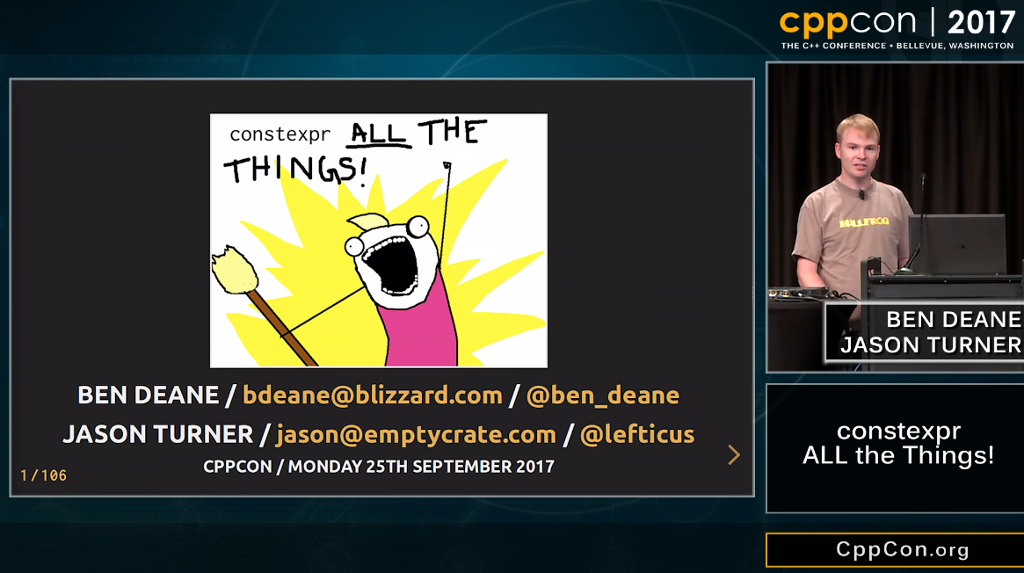
constexpr ALL the Things!
Notes:
Because constexpr serves its own, useful purpose there is enthusiasm for adding constexpr to functions.
This includes enthusiasm for adding constexpr to functions in the standard library.
Lets consider why using this makes life substantially easier for bringing existing code to CUDA.

Slide 44
constexpr Opens Up Third Party Libraries
std library
GSL Guidelines Support Library
…
Notes:
Some very useful types are now available for use on the GPU immediately such as std::array.
In the code I work on gsl::span has also been incredibly useful and it is member functions are constexpr.
I have kept this list short because I don’t want to comment on libraries I have not tested myself.
However, there should be plenty more to add to the list.
Also, if the library is not presently using constexpr, they might be willing to accept patches to make it so.
This save time because you do not need to replace types either with new types (which can be problematic if it is used widely in your code) or with a mapping type (eg span).

Slide 45
No Work is Less Work Than Some Work
Your existing code should be tested and known to work.
The fewer lines of code you add the less you need to debug.
You do need to test that your code is appropriately marked constexpr.
Add tests that execute at compile time and fail to compile if the test fails. This ensures:
You do not call a non-constexpr function from a constexpr function.
That the behavior of your constexpr function matches your runtime behaviour (they can diverge).
Notes:
A big saver of time is that you code should be tested and known to work.
The less you change the less you need to test and debug.
You do need to test that your code is appropriately marked constexpr.
You do this by adding tests that execute at compile time.
This ensues you do not call a non-constexpr function from a constexpr function.
It also verifies the behaviour of your functions is correct for both compile time and runtime as they can diverge.

Slide 46
Questions About constexpr/Execution Space Specifiers?
Notes:
Next I want to talk about return on investment.
I wanted to talk about specific performance improvements to the software I work on but I had it pointed out to me that this was unlikely to be meaningful since the work is proprietary.
Instead I am going to speak more generally about what you get from applying these techniques in your code.
But first are there any questions about constexpr and execution space specifiers?

Slide 47
Return on Investment

Slide 48
std::pmr
Allows control over allocation of memory necessary for access by GPU.
May improve performance of your CPU code by:
Reducing the number of calls to the allocator.
Improving locality of objects.
Providing a way to instrument your code and identify inefficiencies.
Requires your std library support std::pmr.
Notes:
std::pmr I found to be an easy way to control memory allocation which is necessary for access by the GPU.
The good thing is using std::pmr and may allow you to reduce the number of calls to the allocator and improve the locality of objects by using intermediately memory resources like monotonic_buffer_resource.
It also provides a way to instrument your code to identify inefficiencies.
Let me tell you if you replace the default allocator with one that prints a message every time you allocate memory you get very motivated to reduce the number of calls to the allocator.
The downside is that it requires your std library support std::pmr.

Slide 49
constexpr
constexpr expands the set of functions available to the GPU.
May improve performance by:
Moving work from runtime to compile time.
Making dimensions of vectors/matrices available at compile time.
Notes:
Constexpr in combination with the compiler flag provides a way to greatly expand the set of functions available for use on the GPU.
Investing in appropriately marking your functions constexpr may improve performance by moving work from runtime to compile time.
We haven’t seen a lot of benefit from that but I do see opportunities in our code to better identify dimensions of vectors and matrices at compile time.

Slide 50
Concluding Remarks
Notes:
I have spent most of the time in this talk on things that are not specific to CUDA that is std::pmr and constexpr.
I see this as an incredibly positive thing.
It means that you can pave the way in your existing code to use CUDA by taking steps that have their own individual merit.
That way if you get interrupted before you can achieve substantial benefit from CUDA you achieve some improvement anyway.

Slide 51
Questions?
Bowie Owens
bowie.owens@csiro.au

