Slide 1
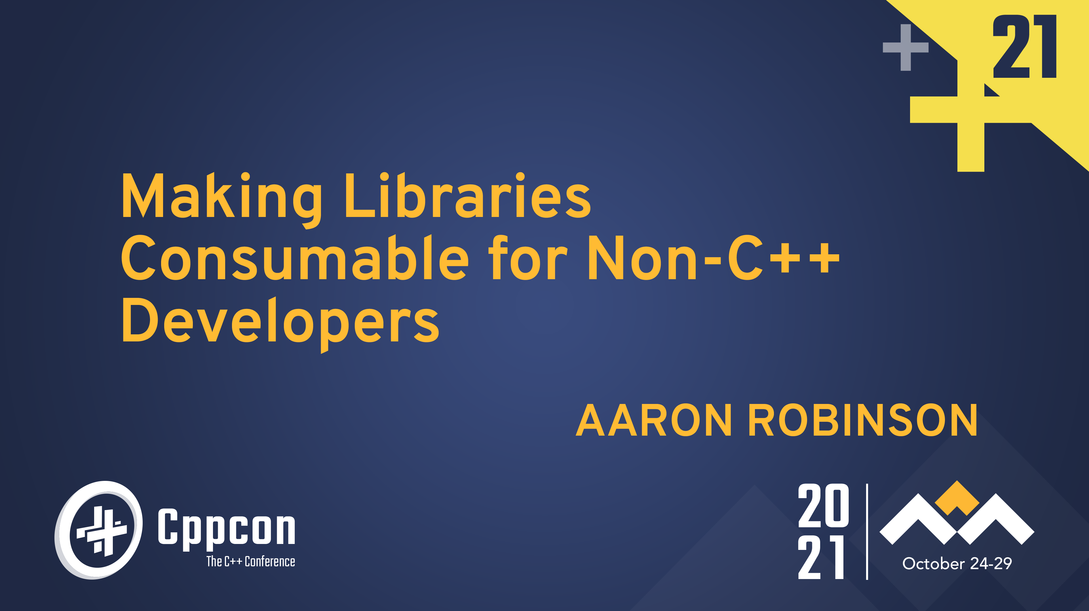
Notes:
It’s Friday.
Simpler talk – not a lot of code.
Consumable “from a non-C++ environment”
Why only libraries? Windows EXE vs DLL

Slide 2




Who am I?
Still at Microsoft, now on the .NET Core runtime team.
https://github.com/dotnet/runtime
Notes:
Education:
MATH
Social Work
Computer Science

Slide 3
What is interoperability?
Enabling two or more disparate entities to work together.
Glue code?
Boiler plate?
A nightmare?
Don’t touch it!
Notes:
When speaking to people, often we hear things like…

Slide 4
What is interoperability?
Enabling two or more disparate entities to work together.
Glue code?
Application binary interface (ABI)
Boiler plate?
Calling conventions
A nightmare?
Marshalling
Don’t touch it!
Was I supposed to free that?
Was I not supposed to free that?
Notes:
When working in this area, often we talk about or ask…

Slide 5
Why interoperability?
No language or platform is good for everything.
Fast inner loop
Makes UX easy
Has tooling for workload
High performance
Avoids costly abstractions
What the vendor provides

Slide 6
A quick note on the details in this talk.
Where is the process boundary?
Focus on in-process interoperability.

Slide 7
Run down of some approaches
Just be like C? – post-1972
Common Object Model (COM) – 1993
Foreign function interface (libffi) – 1996
Simplified Wrapper and Interface Generator (SWIG) – 1996
JVM – Java Native Interface (JNI) – 1997
.NET – Platform Invoke (P/Invoke), COM interop, C++/CLI – 2002, 2005
JVM – Java Native Access (JNA) – 2007
Go – cgo – permit C in the .go source file – 2009
Swift – share a runtime and be like C – 2014
Notes:
“Source of truth”
- COM – IDL
- SWIG – C/C++ headers

Slide 8
There is no one approach. Make it suck less by recognizing assumptions.

Slide 9
What assumptions are being made?
/* Opens the device with name ‘dev’.
On failure to open, returns SIZE_MAX. */
size_t open_device(char const* dev);
size_t open_device(std::wstring_view const dev);
The types char and wchar_t do not indicate encoding.
The size of wchar_t:
Windows, sizeof(wchar_t) == 2
Non-Windows, sizeof(wchar_t) == 4
std::basic_string<CharT> has memory implications. More on that later.
Notes:
Encoding
Many talks at CppCon about string encoding – watch them.

Slide 10
What assumptions are being made?
void get_size(size_t dev, long* size);
Non-C/C++ language.
Caller of get_size().
C/C++ binary.
Provides get_size().
gcc and clang, sizeof(long) == sizeof(size_t)
MSVC, sizeof(long) == 4
Cygwin compile of gcc, sizeof(long) == sizeof(size_t)
MSYS2 compile of gcc, sizeof(long) == 4
Notes:
Is this Windows just being difficult again?
Raise of hands, who uses Cygwin on Windows?
Raise of hands, who uses MSYS2 on Windows?

Slide 11
You can make interop suck less by…
Explicitly state/document argument content.
Instead of long or int, use int64_t or int32_t.
String encoding is not the same as “width”.
Notes:
Next, Calling conventions/ABI

Slide 12
What isn’t being declared?
struct data_t {
int a; int b;
};
/* Get data from device ‘dev’. */
data_t get_data_from(size_t dev);
What defines how dev is passed or data_t is returned?
Calling conventions… sigh.
Which one is being used here?
data_t d = get_data_from(dev);
return d.a + d.b;
Caller cleanup (cdecl)
Callee cleanup (stdcall)
push ...
call data_t get_data_from(unsigned int)
add esp, 4
add eax, edx
push ...
call data_t get_data_from(unsigned int) add eax, edx

Slide 13
What isn’t being declared?
struct data_t {
int a; int b;
};
/* Get data from device ‘dev’. */
data_t get_data_from(size_t dev);
class dev_t {
public:
/* Get data from this device. */
virtual data_t get_data_from() = 0;
};
data_t d = get_data_from(dev);
return d.a + d.b;
data_t d = dev->get_data_from();
return d.a + d.b;
Assuming callee cleanup and focusing on data_t, is its return location consistent?

Slide 14
What isn’t being declared?
push [esp-4]
call data_t get_data_from(unsigned int) add eax, edx
sub esp, 8
mov eax, [esp+4]
lea edx, [esp+8]
push edx
push eax
mov ecx, [eax]
call [ecx]
mov eax, [esp+12]
add eax, [esp+8]
data_t d = get_data_from(dev);
return d.a + d.b;
data_t d = dev->get_data_from();
return d.a + d.b;
The get_data_from() function returns the struct in registers, but the get_data_from() member function returns in caller provided memory.
This is often unexpected but occurs using the MSVC compiler for x86 with stdcall (callee cleanup) or cdecl (caller cleanup).
For non-MSVC, data_t is always returned in a caller provided memory.

Slide 15
What else isn’t being declared?
struct data_t {
int a; int b;
};
/* Get data from device ‘dev’. */
data_t get_data_from(size_t dev);
How does this function fail?
What compiler flags (clang) were used by the library? By the library consumer?
-fsjlj-exceptions?
-fignore-exceptions?
-fdwarf-exceptions?
-fseh-exceptions?
etc.
C++ exceptions have no universal binary contract.
Meaning the consumer may not be prepared for a C++ exception – of any sort.
The typical result is ... undefined.

Slide 16
What is being declared?
OBJC_EXPORT id objc_msgSend(id self, SEL op, ...);
Notes:
macOS does weird things too.

Slide 17
What is being declared?
OBJC_EXPORT id objc_msgSend(id self, SEL op, ...);
Indicates variadic arguments… but does it in this case?
// Incorrect usage – not really variadic argument signature.
objc_msgSend(_id, _op, 10, 1.f);
// Correct signature and usage.
((void(*)(id,SEL,int,float))objc_msgSend)(_id, _op, 10, 1.f);
2018: objc_msgSend() doc – id objc_msgSend(id self, SEL op, ...);
2019+: objc_msgSend() doc – void objc_msgSend(void);

Slide 18
You can make interop suck less by…
Explicitly state/document argument content.
Instead of long or int, use int64_t or int32_t.
String encoding is not the same as “width”.
Explicitly state/document/reference function conventions.
Defining a macro for calling conventions is a great start. For example, MYLIB_CCONV.
Reference: llvm - CallingConv.h
Don’t throw exceptions across the boundary.
Notes:
Next, memory patterns

Slide 19
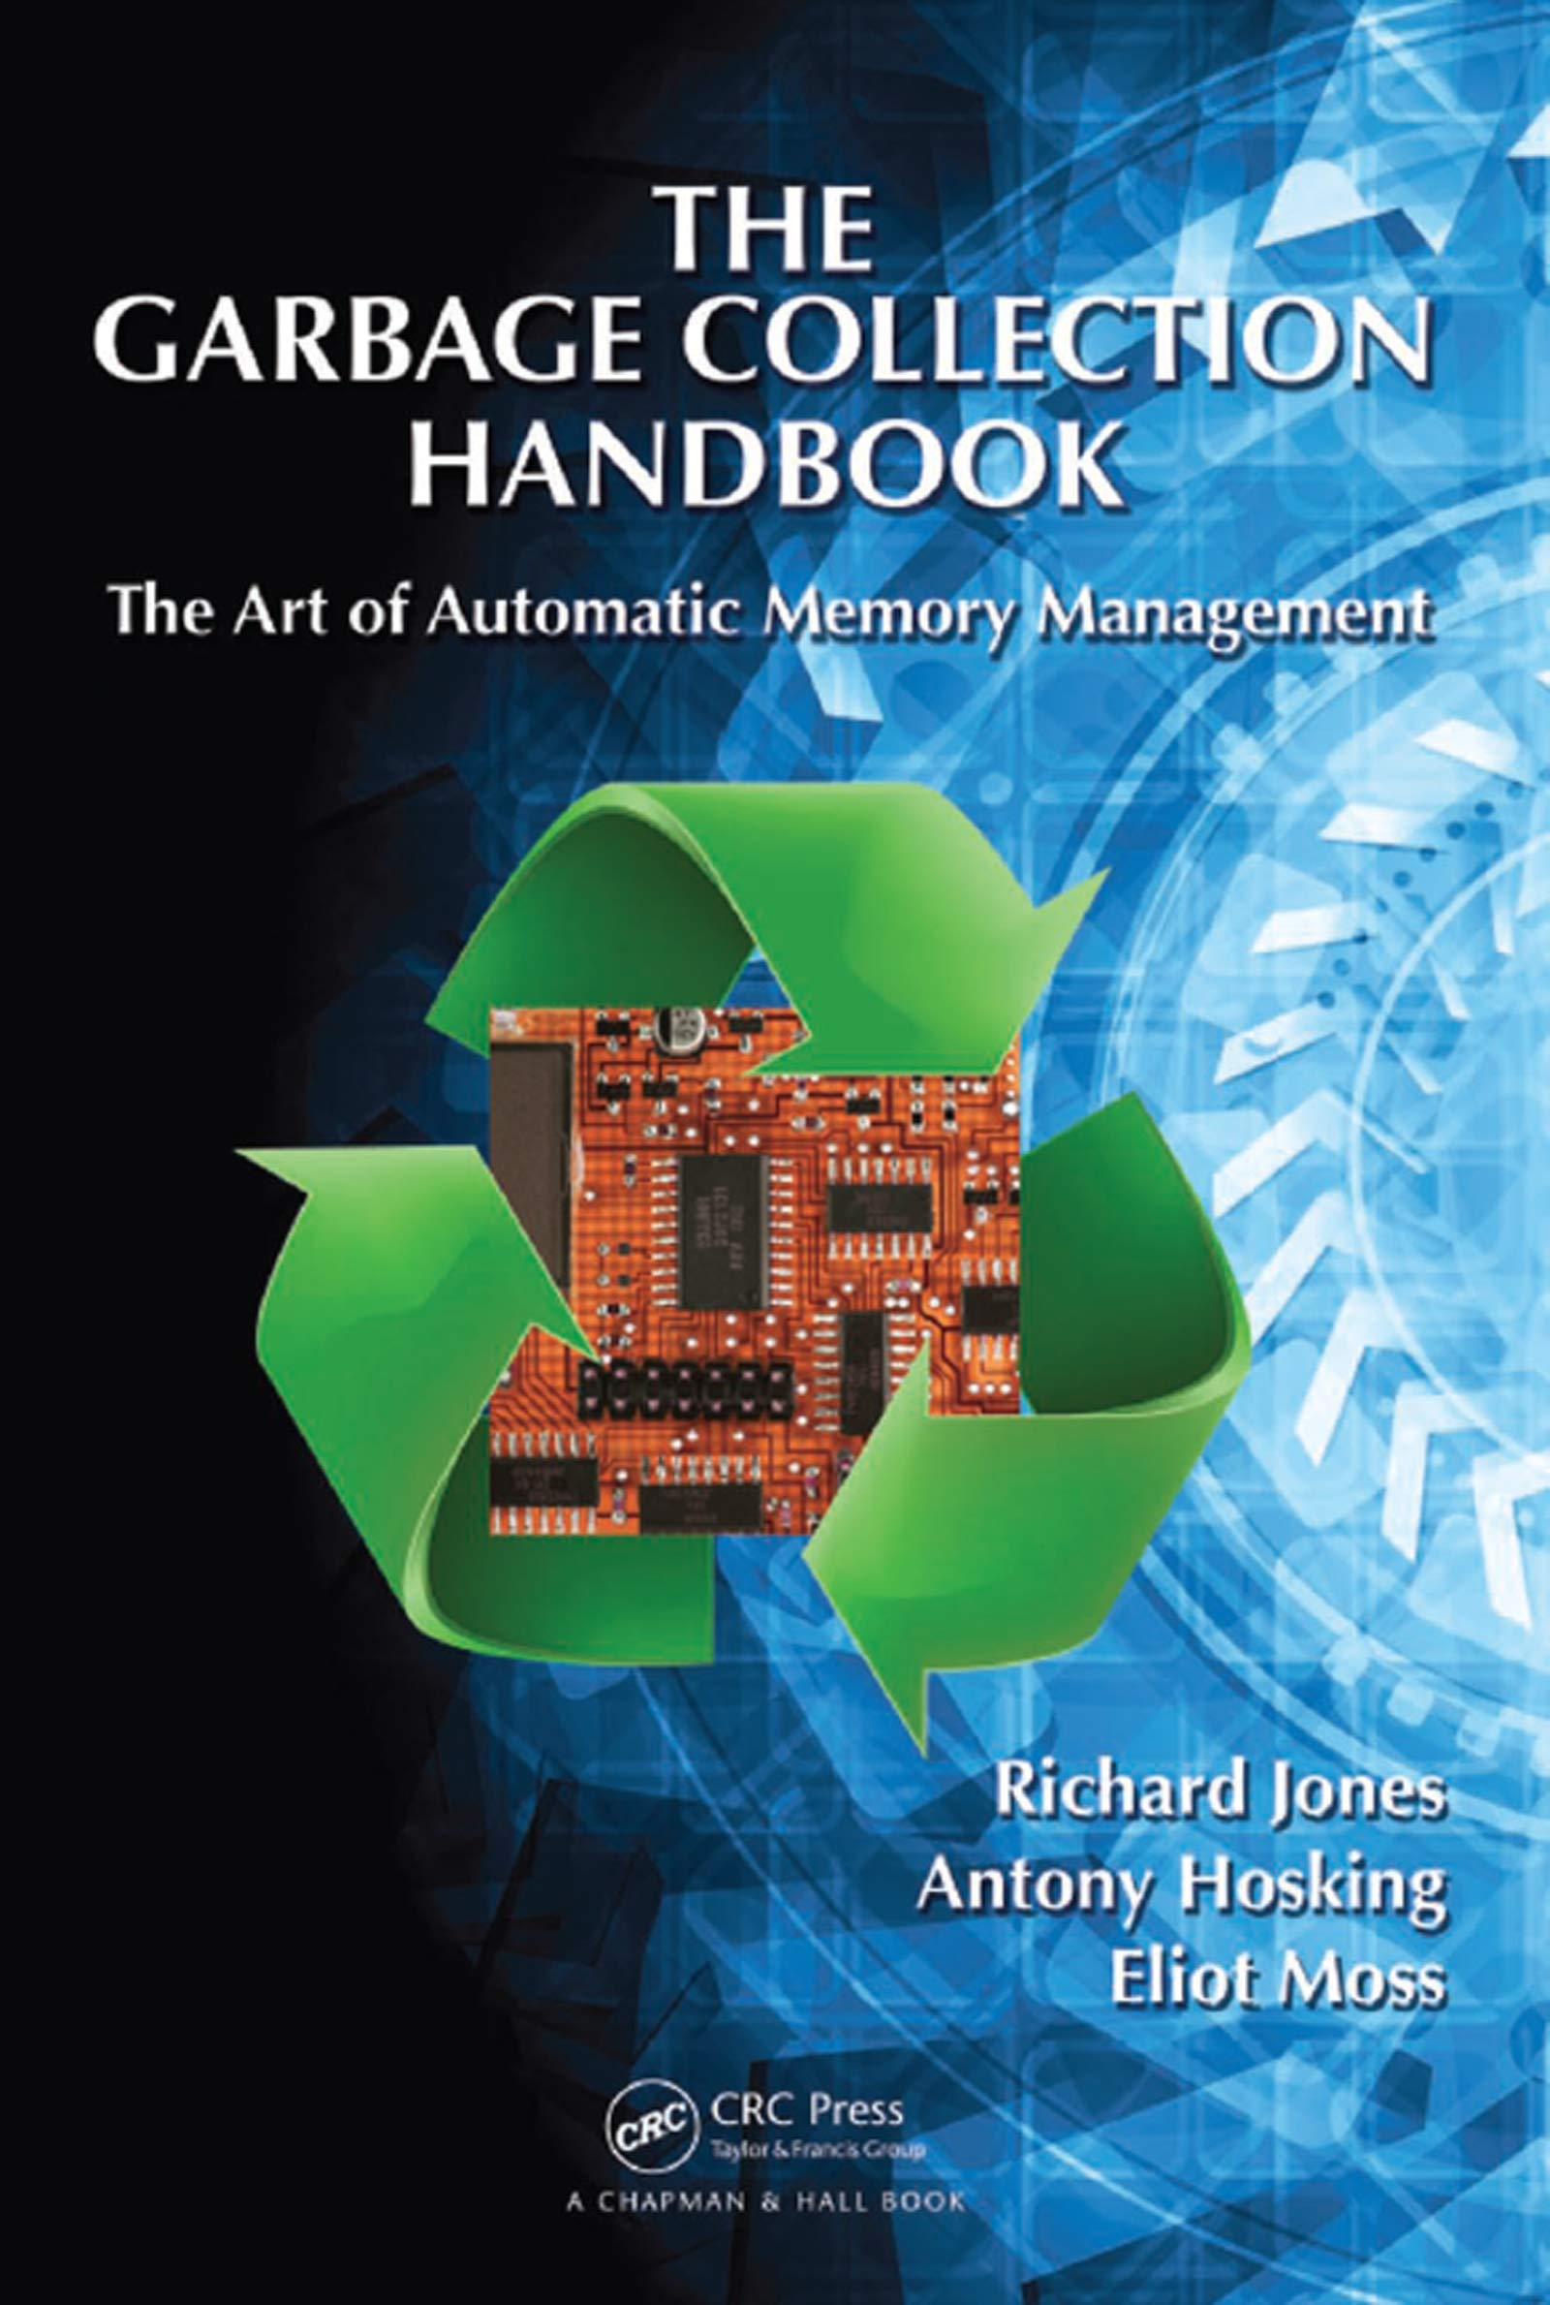
Memory model
Manual memory management is rarely advocated for anymore.
Garbage collection is really “automatic memory management”.
Reference counted
C++ – std::shared_ptr<T>
Python
Objective-C (manual or automatic – see ARC)
Swift
COM – AddRef()/Release()
Non-Reference counted
.NET
JVM
JavaScript
https://gchandbook.org/
Notes:
The “Dragon book” for garbage collection.
The “Cinderella book”.

Slide 20
Memory model – Manual
Memory is allocated and deallocated directly.
Allocation locations are static.
ptr = new int[10]; // 0x2600
ptr
Could have been deleted here, if allocator was known.
delete[] ; // 0x2600

Slide 21
Memory model – Reference Counted
Memory lifetime is tracked explicitly through reference counting.
This typically means allocation locations are static.
// 0x5200, ref 1
obj = create();
obj
// 0x5200, ref 2
[obj AddRef];
// 0x5200, ref 3
obj->add_ref();
// 0x5200, ref 2
[obj Release];
// 0x5200, ref 1
obj->rel_ref();
// 0x5200, ref 0
obj->rel_ref();
Notes:
Common debate is “what is the initial ref count?” We are starting with 1 in this case.

Slide 22
Memory model – Non-Reference Counted
Memory lifetime is tracked implicitly based on the type itself.
Allocated memory can be moved and must be indirectly accessed during interop scenarios.
// 0x7800
obj = new();
// 0x9200
hnd = Handle.New(obj);
// 0x9200 -> 0x7800
Sys_Query( );
hnd
// Collection occurs.
// Copy, compacting, etc.
// obj now at 0x6800.
// 0x9200 -> 0x6800
Sys_Query(hnd);
// 0x9200 –> 0x????
Sys_Query(hnd);
// Collection occurs.
// obj now at 0x7200.
Handle.Free( );
// 0x9200 -> 0x7200
Sys_Done(hnd);
hnd
// Collection occurs.
// obj now “free”.
This is only one possible sequence.
Notes:
What facilities exist for address this?
Implicit tracking doesn’t mean you can’t trick that system, but it is operating independent of your logic.

Slide 23
Memory model – Non-Reference Counted
Common ways of facilitating interop scenarios with a Garbage Collector (GC).
Handles – Level of indirection.
Usually requires a “platform” API to use the memory.
.NET has GCHandle.
JVM, through JNI, exposes most memory as a handle – jobject, jstring, jintArray, etc.
Pinning – Tell GC to not move object.
The platform needs to provide a mechanism.
.NET has GCHandle and C# has fixed keyword.
Conforming JVM implementations have the option.

Slide 24
Memory model
Control of “shared” memory needs to be documented and/or agreed upon.
GCs make this far more complicated since they are typically non-deterministic – possible even if Reference Counting is used.
Consider accepting alloc/dealloc callbacks.
Notes:
Reference counting can also be non-deterministic to avoid the cascading releasing of memory.

Slide 25
You can make interop suck less by…
Explicitly state/document argument content.
Instead of long or int, use int64_t or int32_t.
String encoding is not the same as “width”.
Explicitly state/document/reference function conventions.
Defining a macro for calling conventions is a great start. For example, MYLIB_CCONV.
Reference: llvm - CallingConv.h
Don’t throw exceptions across the boundary.
Explicitly state/document memory ownership rules.
Consider accepting memory alloc/dealloc callbacks – recall previous recommendation.
Limit implicit models that force memory to have thread affinity at interop boundaries.
Consider how the consumer’s tools work with your library’s memory model.

Slide 26
Conclusion
Document what you want and assume.
Understand assumptions and be precise when possible.
C++ now has many types that express precisely what is meant – integer sizes, string encoding, etc.
Interop scenarios often aren’t using a C++ compiler to read the header, humans are.
Kate Gregory’s “What Do We Mean When We Say Nothing At All?”

Slide 27
Thank you.
Email: arobins@microsoft.com
GitHub: @AaronRobinsonMSFT, https://github.com/AaronRobinsonMSFT

Slide 28
Recent Interop ABI fun
struct blub_t {
size_t a; int b;
};
size_t DoTheThing(blub_t b);
Switch .NET call from
nint DoTheThing(BlubT b);
to
nint DoTheThing(in BlubT b);
Result:
Windows – everything passed.
Linux – everything failed.
Why?

Slide 29
Making Libraries Consumable for Non-C++ Developers
Aaron R Robinson
arobins@microsoft.com
https://github.com/AaronRobinsonMSFT

