Slide 1

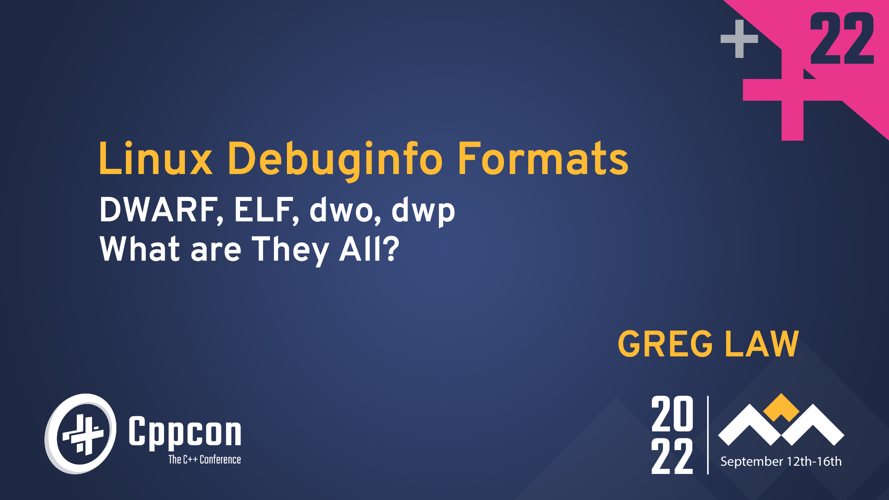
Title goes here

Slide 2
Abstract
Many different Linux debugging tools are available - as well as the traditional debuggers (GDB, LLDB) we have checkers (Valgrind, the sanitizers), tracing tools (strace, ltrace), time-travel debuggers (rr, UDB). They all rely on debug info to map from the executable back to the source-code. Most of us know to pass the -g option to gcc to generate debuggable binaries, but there is much more to it than that.
This talk covers what exactly is in debug info, the different compiler options to control its generation, and the different kind of object files and why you might want them (e.g. split dwarf files for quicker loading). We also introduce ways to manage this information, including the new debuginfod service.

Slide 3
Abstract
Many different Linux debugging tools are available - as well as the traditional debuggers (GDB, LLDB) we have checkers (Valgrind, the sanitizers), tracing tools (strace, ltrace), time-travel debuggers (rr, UDB). They all rely on debug info to map from the executable back to the source-code. Most of us know to pass the -g option to gcc to generate debuggable binaries, but there is much more to it than that.
This talk covers what exactly is in debug info, the different compiler options to control its generation, and the different kind of object files and why you might want them (e.g. split dwarf files for quicker loading). We also introduce ways to manage this information, including the new debuginfod service.

Slide 4
What does -g mean?

Slide 5
=> a.out
gcc -g3 hello.c
process
text (i.e. code)
GDB
PROT_READ|PROT_EXEC
data (e.g. non-zero globals)
rodata (e.g. strings)
PROT_READ|PROT_WRITE
symbol table
debug info
PROT_READ
Source code

Slide 6
readelf & addr2line

Slide 7
Debug info is not free
-g doesn’t impact the generated code - at all.
-g doesn’t increase the runtime footprint of your program (much).
-g does impact the size of your binaries - a LOT.
-g can increase your compile and link times.

Slide 8
Wait, link times?
Linker needs to apply relocations to all translation units.
This means the linker needs to parse all debug info of all translation units.
Really?

Slide 9
Split DWARF to the rescue
-gsplit-dwarf means:
In the resulting .dwo file, all debug info related to:
Types, classes
Identifiers
And in the .o, just
Anything relative to a PC address.

Slide 10
“Debug symbols” vs “debug info”
Debug symbols
Debug info

Slide 11
So many utilities
readelf eu-readelf
objdump eu-objdump
dwarf-dump
BFD

Slide 12
debuginfod
debuginfod serves debug information over HTTP
(a bit like Microsoft Symbol Server)
sudo apt install debuginfod
debuginfod
DEBUGINFOD_URLS=localhost:8002 gdb a.out

Slide 13
debuginfod servers
https://debuginfod.elfutils.org/
Ubuntu, Debian, OpenSUSE and CentOS run debuginfod servers.
Client support in GDB, Valgrind, SystemTap

Slide 14
Backtrace
0000119d <foo>:
119d: 55 push %ebp
119e: 89 e5 mov %esp,%ebp
...
11ab: 5d pop %ebp
11ac: c3 ret

Slide 15
Backtrace
0000119d <foo>:
119d: 55 push %ebp
119e: 89 e5 mov %esp,%ebp
...
11ab: 5d pop %ebp
11ac: c3 ret
BP
SP

Slide 16
Backtrace
0000119d <foo>:
119d: 55 push %ebp
119e: 89 e5 mov %esp,%ebp
...
11ab: 5d pop %ebp
11ac: c3 ret
BP
SP

Slide 17
Backtrace
0000119d <foo>:
119d: 55 push %ebp
119e: 89 e5 mov %esp,%ebp
...
11ab: 5d pop %ebp
11ac: c3 ret
SP & BP

Slide 18
Backtrace
0000119d <foo>:
119d: 55 push %ebp
119e: 89 e5 mov %esp,%ebp
...
11ab: 5d pop %ebp
11ac: c3 ret
BP
SP

Slide 19
Backtrace
0000119d <foo>:
119d: 55 push %ebp
119e: 89 e5 mov %esp,%ebp
...
11ab: 5d pop %ebp
11ac: c3 ret
BP
SP

Slide 20
Backtrace
0000119d <foo>:
119d: 55 push %ebp
119e: 89 e5 mov %esp,%ebp
...
11ab: 5d pop %ebp
11ac: c3 ret
BP
SP

Slide 21
But the compiler knows!
CFI - Call Frame Instructions
Can see this in the assembly generated by gcc
CFI is in both the .debug_frame and the .eh_frame sections.
gcc usually emits only .eh_frame (mandatory on x86-64)
unless you say -fno-asynchronous-unwind-tables

Slide 22
@gregthelaw

