Slide 1
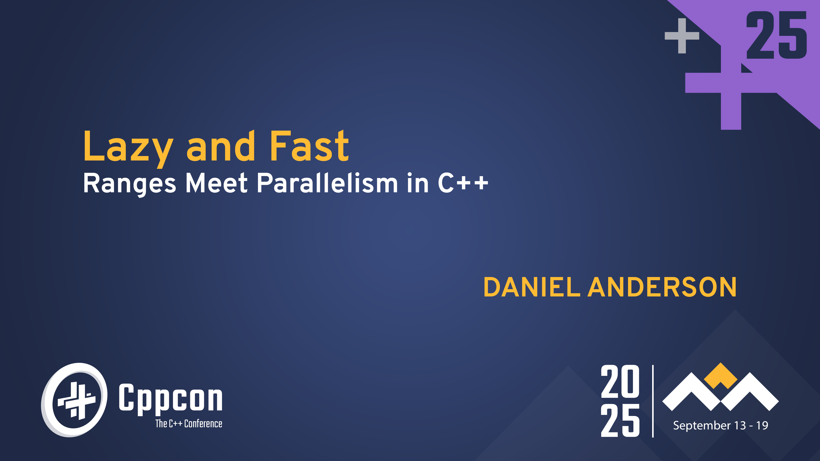

Slide 2
What we'll learn today
🧱 What causes parallel algorithms to stop scaling?
⏳ Laziness as a cure
🔗 Why parallelism and ranges don't play well (yet)
📦 How to fix it!
🛠️ Algorithms for parallel lazy range adapters
🚀 Some applications and benchmarks

Slide 3
Scalability

Slide 4
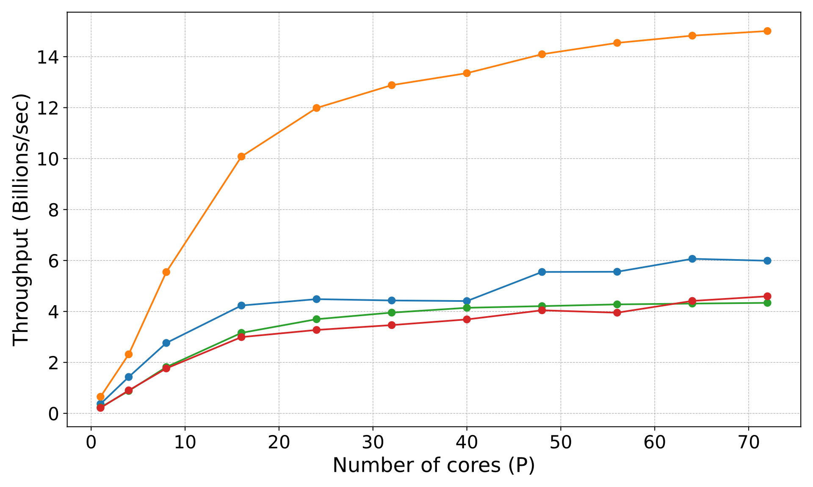
Performance of parallel algorithms
reduce
transform
scan
filter

Slide 5
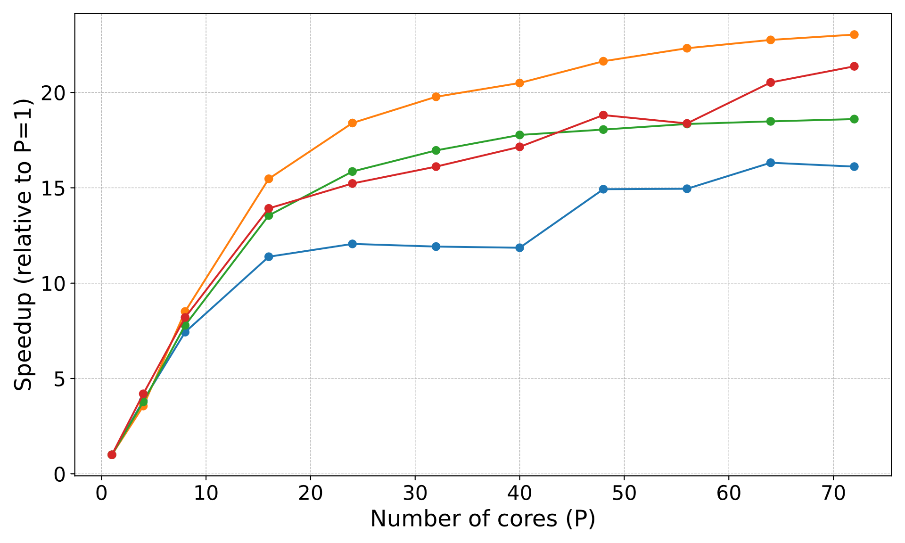
Performance of parallel algorithms
reduce
transform
scan
filter

Slide 6
What bottlenecks scalability?
Compute operations?
Nope, these algorithms are work efficient
Parallelizabilty?
Nope, these algorithms are highly parallel
In theory, they should scale well to thousands of cores
Ah, cache!!?
Nope, these algorithms are all cache efficient! But, close…
Memory bandwidth
Our algorithms are saturating the machine's memory bandwidth!

Slide 7
Memory-bound algorithms
An algorithm is called memory bound (or bandwidth bound) if the primary bottleneck for its scalability is memory bandwidth
Reducing the number of operations won't help (unless we are reducing shared-memory-related operations)
Making the algorithm more parallel won't help
As a rule of thumb, most simple parallel algorithms are memory bound

Slide 8
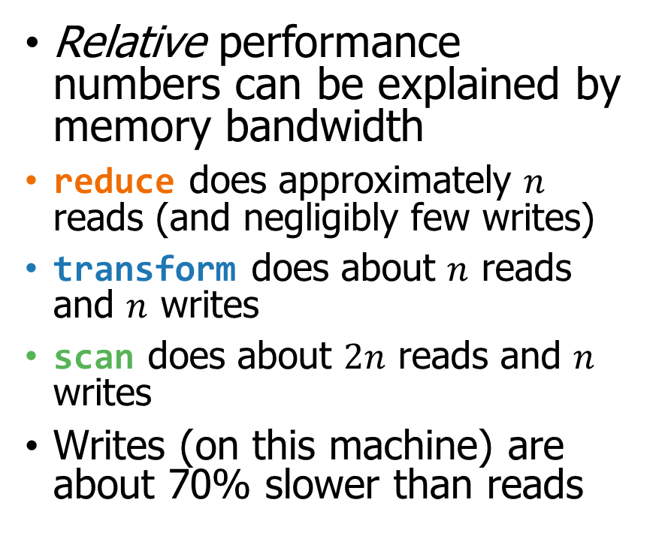
Memory bandwidth & performance
Relative performance numbers can be explained by memory bandwidth
reduce does approximately $n$ reads (and negligibly few writes)
transform does about $n$ reads and $n$ writes
scan does about $2n$ reads and $n$ writes
Writes (on this machine) are about 70% slower than reads
reduce
transform
scan
filter

Slide 9
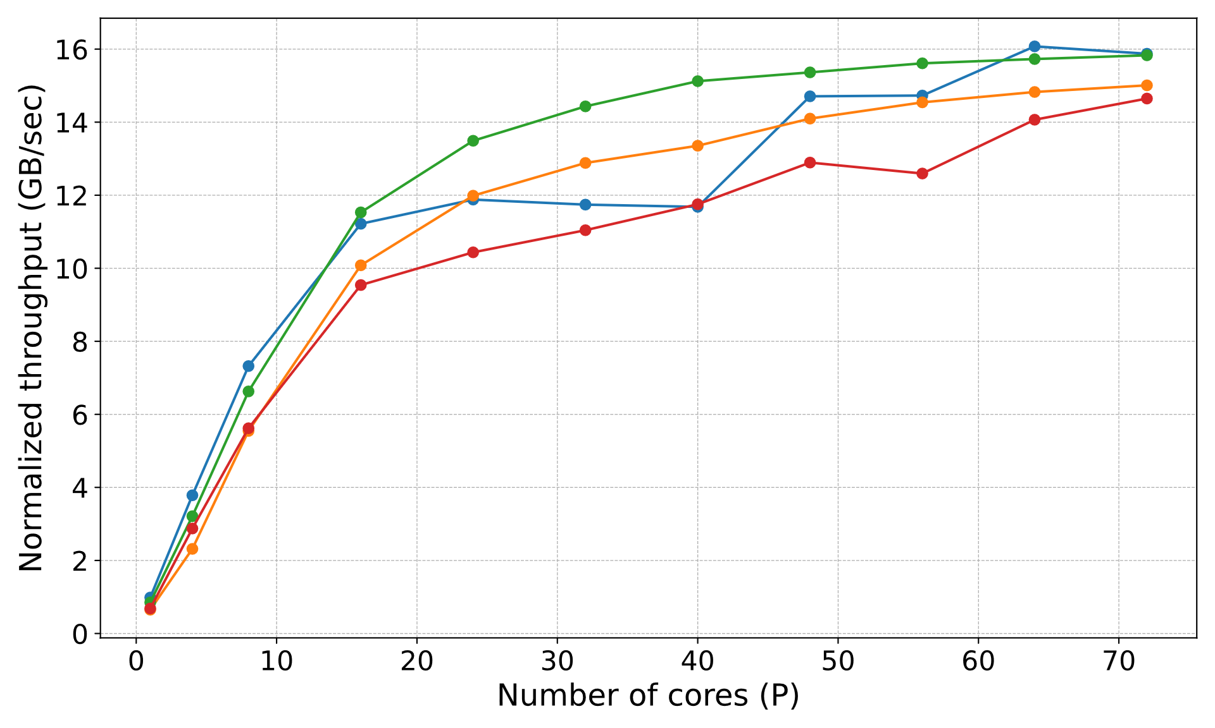

Memory bandwidth & performance
Relative performance numbers can be explained by memory bandwidth
reduce does approximately $n$ reads (and negligibly few writes)
transform does about $n$ reads and $n$ writes
scan does about $2n$ reads and $n$ writes
Writes (on this machine) are about 70% slower than reads
reduce
transform
scan
filter

Slide 10
Fusion and Laziness

Slide 11
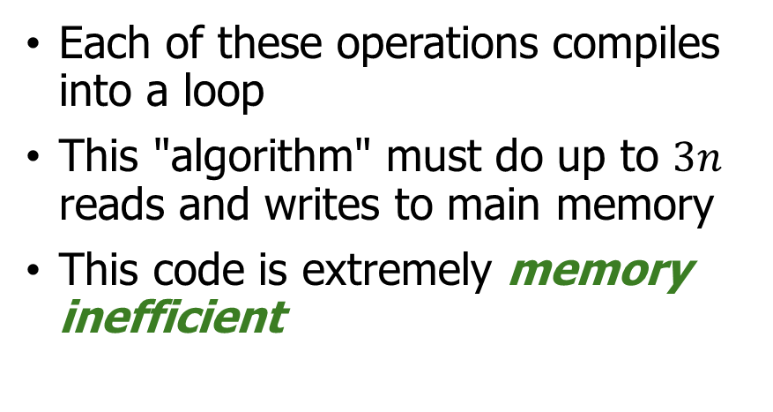
Composing sequence operations
std::vector a{…}, b(n), c(n), d(n);
transform(begin(a), end(a), begin(b), [](auto x) { return 2*x + 1; });
exclusive_scan(begin(b), end(b), begin(c), 0);
copy_if(begin(c), end(c), begin(d), [](auto x) { return x % 3 == 0; });
a
1 | 2 | 3 | 4 | 5 | 6 | 7 | 8
Each of these operations compiles into a loop
This "algorithm" must do up to $3n$ reads and writes to main memory
This code is extremely memory inefficient
transform
b
3 | 5 | 7 | 9 | 11 | 13 | 15 | 17
exclusive_scan
c
0 | 3 | 8 | 15 | 24 | 35 | 48 | 63
copy_if
d
0 | 3 | 15 | 24 | 48 | 63

Slide 12
"Loop fusion"
for (size_t i = 0; i < n; i++) {
b[i] = 2*a[i]+1;
}
int total = 0;
for (size_t i = 0; i < n; i++) {
c[i] = total;
total += b[i];
}
for (size_t i = 0, j = 0; i < n; i++) {
if (c[i] % 3 == 0) {
d[j++] = c[i];
}
}
int total = 0;
size_t j = 0;
for (auto x : a) {
auto b = 2*x + 1;
auto c = total;
total += b;
if (c % 3 == 0) {
d[j++] = c;
}
}
1 | 2 | 3 | 4 | 5 | 6 | 7 | 8
0
3
15
24
48
63
The fused version does up to $n$ reads and writes instead of $3n$

Slide 13
Views and lazy evaluation
Views are cheap-to-copy ranges, introduced in C++20
Most views are implemented using lazy evaluation
a | ranges::views::transform([](auto x) { return 2*x+1; })
| ranges::views::exclusive_scan(std::plus<>{})
| ranges::views::filter([](auto x) { return x % 3 == 0; });
This code only does $n$ memory reads and writes instead of $3n$!
Lazy evaluation essentially results in automatic fusion for eligible operations, and reduces bandwidth consumption

Slide 14
Parallel algorithms and fusion
Two key messages so far…
Most simple parallel algorithms are memory bound
Lazy evaluation essentially results in automatic fusion for eligible operations, and reduces bandwidth consumption
So, let's just use lazy views for parallel algorithms!?

Slide 15
Range Categories

Slide 16
Range and iterator categories
Ranges and iterators have categories, which define what operations we can perform on them
  contiguous: Underlying elements are stored in contiguous memory.
  random_access: Index into any element of the range in constant time
  bidirectional: Iterate front to back or back to front
  forward: Iterate only front to back
Most parallel algorithms need these
Most lazy views produce these

Slide 17
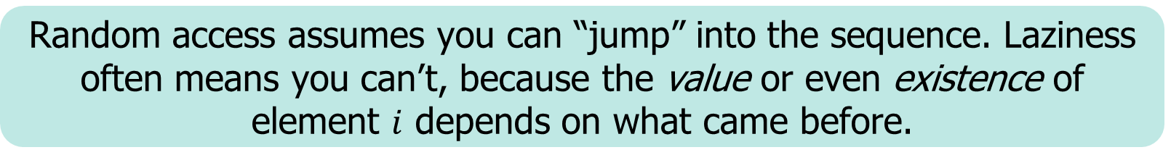
Laziness and random access
Laziness and random access are usually incompatible
E.g., lazy scan. Need to know sum of the previous elements
3 | 5 | 7 | 9 | 11 | 13 | 15 | 17
 |  |  |  | ?
scan
E.g., lazy filter. Need to know how many were filtered out
0 | 3 | 8 | 15 | 24 | 35 | 48 | 63
 |  |  |  |  | ?
filter
Random access assumes you can “jump” into the sequence. Laziness often means you can’t, because the value or even existence of element $i$ depends on what came before.

Slide 18
What we need
Ranges and iterators have categories, which define what operations we can perform on them
  contiguous: Underlying elements are stored in contiguous memory.
  random_access: Index into any element of the range in constant time
  bidirectional: Iterate front to back or back to front
  forward: Iterate only front to back
We need a middleground: stronger than forward/bidirectional so we can split work across threads, but weaker than random_access so we can be lazy

Slide 19
Insight from algorithms: Scan
Block 1
Block 2
Block 3
Block 4
Block 5
1 | 7 | 5 | 2 | 3 | 1 | 3 | 2 | 5 | 4 | 3 | 1 | 3 | 2 | 5 | 7 | 3 | 3 | 2 | 4 | 1 | 2 | 3 | 2
1 | 7 | 5 | 2 | 3 | 1 | 3 | 2 | 5 | 4 | 3 | 1 | 3 | 2 | 5 | 7 | 3 | 3 | 2 | 4 | 1 | 2 | 3 | 2
Block sums
18
15
14
19
8
Prefix sums
0
18
33
47
66
0 | 1 | 8 |  |  | 18 | 19 | 22 |  |  | 33 | 36 | 37 |  |  | 47 | 54 | 57 |  |  | 66 | 67 | 69
0 | 1 | 8 | 13 |  | 18 | 19 | 22 | 24 |  | 33 | 36 | 37 | 40 |  | 47 | 54 | 57 | 60 |  | 66 | 67 | 69 | 72
0 | 1 | 8 | 13 | 15 | 18 | 19 | 22 | 24 | 29 | 33 | 36 | 37 | 40 | 42 | 47 | 54 | 57 | 60 | 62 | 66 | 67 | 69 | 72
0 |  |  |  |  | 18 |  |  |  |  | 33 |  |  |  |  | 47 |  |  |  |  | 66
0 | 1 |  |  |  | 18 | 19 |  |  |  | 33 | 36 |  |  |  | 47 | 54 |  |  |  | 66 | 67

Slide 20
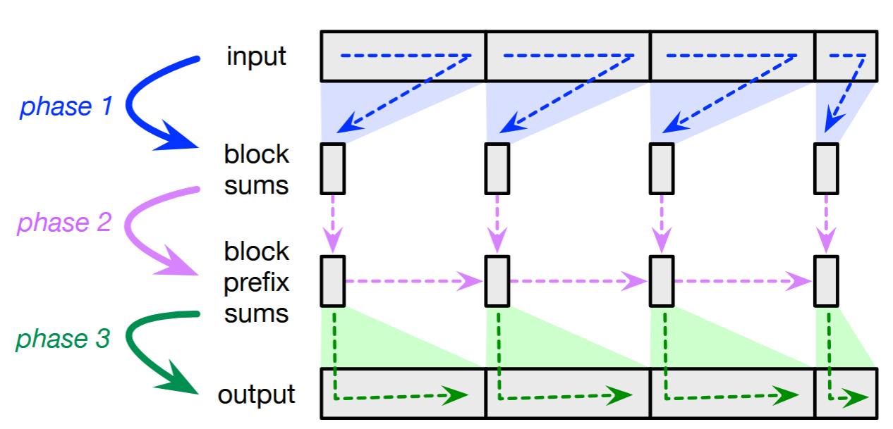
Insight from algorithms
Example: Parallel Scan
Insight: Many sequence algorithms naturally break input into blocks:
Local pass: process blocks in parallel, each block sequentially
Global aggregation: combine per-blocks summaries
Second local pass: revisit each blocks to determine result
Key insight: Blocks are the unit of parallelism, not individual elements

Slide 21

Making blocks the focus
A block_iterable range is a forward_range with random-access to a set of sparse, evenly-spaced checkpoints
Think of it as a random-access to the set of blocks, each block covering the interval between two checkpoints
  Each block is a forward range, processed sequentially
  Parallel algorithms can parallelize across blocks
r
begin_block(r, i)
begin(r)
end_block(r, i) $→$ begin_block(r,i+1)
end(r)

Slide 22
Why block-iterable ranges?
Enable parallelism without losing laziness
  Threads can work on separate blocks in parallel
  Each block can still generate elements lazily on demand
Match the structure of real algorithms
  Many sequence algorithms are naturally “two-pass per block”
  Block summaries → global aggregation → fix-up
Composable & bandwidth-efficient
  Adapters (transform, filter, scan, etc.) preserve block-iterable
  Adjacent stages can fuse their iterations into a single iteration

Slide 23
Implementation

Slide 24
Our library
Adapters (composable):
transform (a.k.a. map) – apply a function to each element
scan – prefix sums over any associative function
flatten (a.k.a. join) – concatenate nested ranges
filter – keep elements that satisfy the given predicate
zip – view multiple ranges in lockstep
Terminals:
reduce – fold over an associative operation
to_sequence – materialize into a non-lazy range

Slide 25
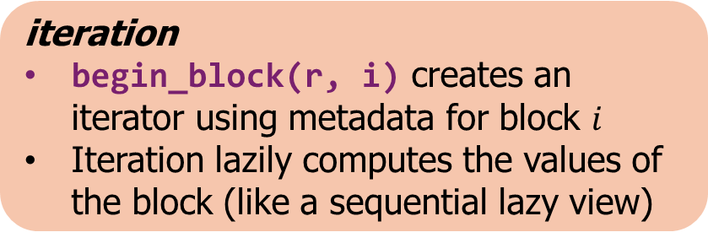
Typical pattern
Adapter constructor
Process blocks in parallel
Compute per-block metadata
Aggregate metadata across blocks
Store aggregate metadata in adapter
Local pass: process blocks in parallel, each block sequentially
Global aggregation: combine per-blocks summaries
Second local pass: revisit each blocks to determine result
Immediately
Lazily
iteration
begin_block(r, i) creates an iterator using metadata for block $i$
Iteration lazily computes the values of the block (like a sequential lazy view)
Note: Because construction precomputes metadata, creation is not O(1). Our adapters therefore aren't views in the strict C++ standard sense!

Slide 26
Block-iterable transform (map)
Adapter State:
The transformation function
fun
Construction
Just store the function
Iterator State:
Iterator into underlying view
Pointer to transformation function
Comment: Transform is one of the few adapters that preserves random-access.
Increment operation:
Increment underlying iterator

Slide 27
Block-iterable scan
Adapter State:
Block starting value (prefix sum)
totals
Construction
Compute total sum of each block
Compute prefix sum of block sums
prefix
sums
construction
Iterator State:
Iterator into underlying view
Prefix sum so far
iteration
Increment operation:
Increment underlying iterator
Add value to prefix sum

Slide 28
Block-iterable flatten (join)
Adapter State:
Iterators pointing to the outer range and inner range in which each block begins
sizes
Construction
Compute prefix sums of sizes of inner ranges
Use prefix sums to identify starting element for each block based on block size
prefix
sums
Iterator State:
Inner iterator
Outer iterator
iters
construction
Increment operation:
Advance inner; if it reaches the end, advance outer and reset inner to new beginning
iteration

Slide 29
Block-iterable filter
Naïve filter:
Mark survivors with predicate
Compute per-block survivor counts
Prefix sum counts and search for offsets to make equal sized output blocks
Sounds just like flatten…
✔
✔
✔
✔
✔
✔
✔
✔
✔
flatten
Filter as a second-class adapter!
No need for a separate “first-class” filter
Filter just produces blocks containing survivors then hand off to flatten
transform([](auto&& it)
-> decltype(auto) { return *it; })
Once we have a few first-class adaptors, it becomes easier to build new ones by composition rather than from scratch!
To support non-copyable types, filter hands out iterators as survivors
Final step: pipe through a transformation that dereferences the iterators

Slide 30
Example Applications

Slide 31

Parallel Breadth-first Search
Given a graph and a start vertex $s$, label each vertex with its distance from $s$.
3
4
5
2
2
3
5
1
4
3
1
2
4
$$s$$
2
3
1

Slide 32
Parallel BFS algorithm
Each vertex $u$ has an atomic label, label[u]
auto next_frontier = frontier
| transform([&](vertex u) { return neighbors(u); })
2
2
| flatten()
| filter([&](vertex u) {
return label[u].compare_exchange(-1, distance); })
1
1
| to_sequence()
2
2
This is just a composition of a few lazy adapters!
1

Slide 33
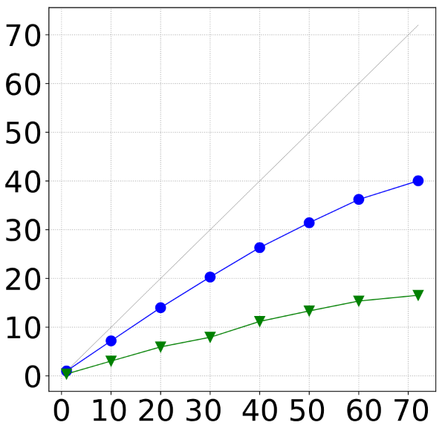
Parallel BFS speedup
Speedup vs threads
Array-materialized pipeline:
Every stage writes an intermediate array; at least four writes per vertex, possibly more with duplicates
Block-lazy pipeline:
Still does multiple reads per element
But most intermediate writes are fused away
Fused version only needs two writes per vertex instead of four
Result is roughly 2x better scalability
Block-lazy
Non-lazy

Slide 34
Parallel big integer addition
Given two integers represented as ranges of digits, compute their sum
3 1 6 4 2 3 2
+ 2 7 3 5 8 8 4
Carries "jump" over streaks of 9s
Pairwise add
5 8 9 9 10 11 6
Carry
+0 +1 +1 +1 +1 +0 +0
Add carry
(mod 10)
5 9 0 0 1 1 6
Note: Using base-10 for simplicity. In real life use a (much) bigger base for efficiency

Slide 35
Big integer addition algorithm
5 8 9 9 10 11 6
auto sums = zip_with(std::plus<>{}, A, B);
8 10 10 10 11 6 0
auto carries = sums | scan(0, [](auto prev, auto x) {
return x == 9 ? prev : x; });
5 9 0 0 1 1 6
auto result = zip_with([](auto carry, auto s) {
return ((carry >= 10) + s) % 10; }, carries, sums);
Complicated to understand, but its just another composition of adapters!!
Note: zip_with(f, A, B) is syntactic sugar for
zip(A,B) | transform([&](auto t) -> decltype(auto) { return std::apply(f, t); });

Slide 36
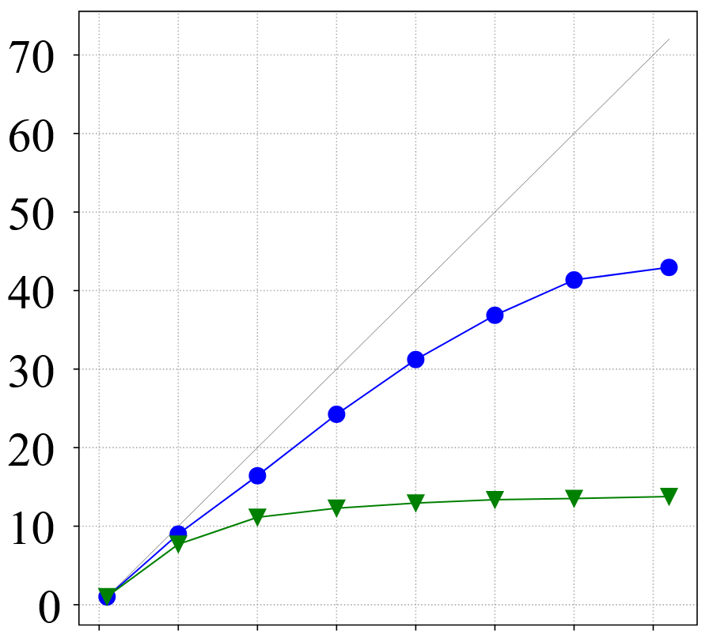

Big integer addition speedup
Speedup vs threads
Array-materialized pipeline:
Every stage writes an intermediate array, so, we do three writes per digit
Block-lazy pipeline:
All intermediate writes, except tiny per-block metadata is fused away.
We just directly write the result, which is one write per digit
Result is roughly 3x better scalability
Block-lazy
Non-lazy

Slide 37

Check out my implementation
https://github.com/cmuparlay/parlaylib
https://cmuparlay.github.io/parlaylib/algorithms/delayed.html

Slide 38
What did we learn?
Bandwidth matters a lot for parallel algorithms. Writing to unnecessary intermediate arrays hurts performance and kills scalability
Lazy evaluation enables fusion of adjacent operations, piping the output of one directly into the next to avoid the unnecessary intermediate
Parallelism and lazy evaluation don't play well with standard iterators. We invent block-iterable ranges with their own composable adapter algorithms that can express both parallelism and lazy evaluation
Block-iterable adapter algorithms can result in a big improvement in throughput and speedup compared to their memory-inefficient counterparts

