Slide 1
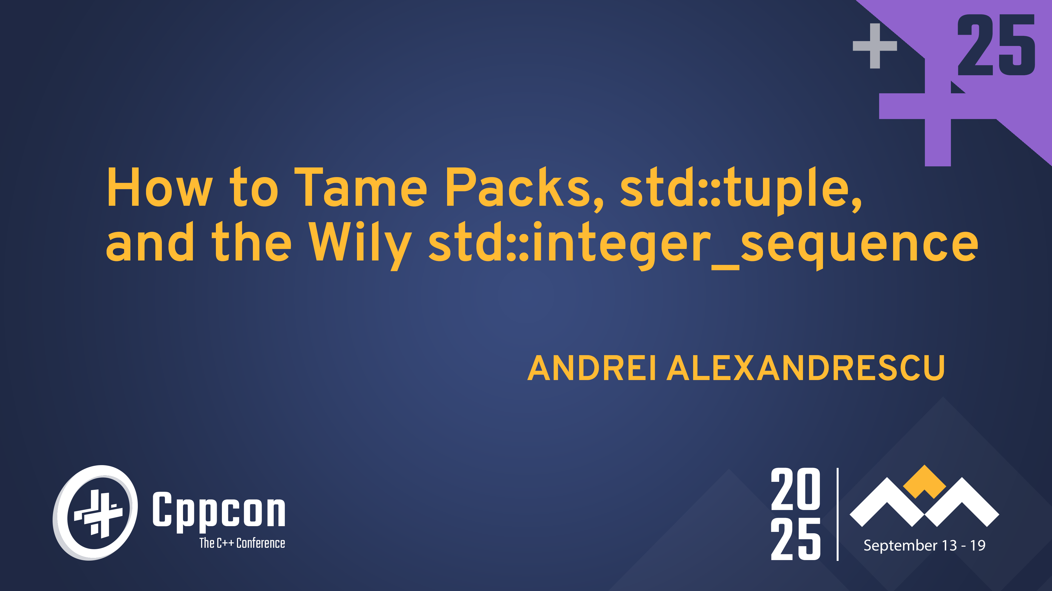

Slide 2
How to Tame Packs, std::tuple, and the Wily std::integer_sequence
Andrei Alexandrescu | CppCon 2025

Slide 3
Your Rights as a Conference Attendee
Things you can ask about any conference talk
Does this material help my AI coding assistant?
Does this material help me work with my AI coding assistant?
Can this material help with coding actual AI artifacts?
Reference: Forum for the Adjudication of Relevant Talks (FART), The Hague, Directive 2025/CPP-12, “Code of Rights: Attendee Protection”

Slide 4
MSB:
Please Stop Using Chatbots!
Evidence: https://github.com/NVIDIA/cccl/pull/5671

Slide 5
Motivation
Tuples instrumental to AI, scientific code, accelerated math kernels
Parameter pack: a distinct kind with pariah status
Can’t assign a name to a pack, can’t treat it as a unit
Historically no means to iterate during compilation
  However stay tuned for P1306 to land in C++26
std::integer_sequence an awkward stopgap solution
  All disadvantages of packs, plus a few more
Notes:
Most familiar programming techniques are inoperant
Packs must be “pushed” into functions, can’t be “pulled” (declared locally, returned, renamed)

Slide 6
Hello, template for
In the future (C++26):
// T can be an expression list, a destructurable (std::tuple, std::array),
// or a range with compile-time size
template <class T>
void print_all(const T& t) {
template for (auto&& elem : t) { // or {t...} for packs
std::println("{}", elem);
}
}

Slide 7
And Hello, Um, “Structured Bindings can introduce a Pack“
Also in the future (C++26):
template <class T>
void print_all(const T& t) {
auto& [...elem] = t;
(std::println("{}", elem), ...);
}

Slide 8
Motivation
General metaprogramming facilities (recommended): Boost.MP11, Boost.Hana
Simple, easy to integrate primitives for iteration of packs and tuples
Optimal CPU and GPU code generation (small /fast, minimize register usage)
Compatibility (std::tuple and others on CPU, cuda::std::tuple on GPU)
Idioms to teach AI to use
Notes:
Include support for tuples and packs
We’re not competing!
High leverage: 50 lines you and your bot will love and reuse forever

Slide 9
Iterating a Tuple
To iterate a pack, you need a “parallel” std::integer_sequence in tow
All AI models currently recommend code as follows:
namespace detail {
template <typename Tuple, size_t... Is>
void print_tuple_impl(const Tuple& t, std::index_sequence<Is...>) {
((std::cout << (Is == 0 ? "" : ", ") << std::get<Is>(t)), ...);
}
}
template<typename... Args>
void print_tuple(const std::tuple<Args...>& t) {
detail::print_tuple_impl(t, std::index_sequence_for<Args...>{});
}

Slide 10
Trick for Tuple Iteration (C++20+)
There is a “simple” way without a helper function
template <typename Tuple>
void print_tuple(const Tuple& t) {
return [&]<std::size_t... Is>(std::index_sequence<Is...>) {
((std::cout << (Is == 0 ? "" : ", ") << std::get<Is>(t)), ...);
}(std::make_index_sequence<std::tuple_size_v<Tuple>>());
}
Push the indexes pack into the local lambda
Cuts in half the number of function definitions needed for manipulating packs
(You could even put that in a… macro?!)

Slide 11
Trick for Tuple Iteration (C++17)
Use a defaulted argument
template <typename Tuple, size_t... Is>
void print_tuple(const Tuple& t, std::index_sequence<Is...> = {}) {
if constexpr (sizeof...(Is) != std::tuple_size_v<Tuple>) {
print_tuple(t, std::make_index_sequence<std::tuple_size_v<Tuple>>())
} else {
((std::cout << (Is == 0 ? "" : ", ") << std::get<Is>(t)), ...);
}
}
Pushes the sequence reflexively by means of a pseudo-recursive call

Slide 12
Disposition
AI tools recommend the verbose version
  Generally: AI is bad at creating new idioms, great at using them
Workarounds still quite bulky
Disposition:
  Stay as far from std::integer_sequence as possible
  Build simple iteration primitives
  Use primitives for fun and profit

Slide 13
For Now: Hello, unroll
First take
template <size_t n, typename F>
constexpr auto unroll(F&& f) {
#pragma unroll n
for (size_t i = 0; i < n; ++i) {
f(i);
}
}
To use: unroll<8>([](size_t i) { std::cout << i; });
Nonstandard
Compiler still has latitude, subject to vendor, version, flags…
Cannot use iteration index as a compile-time constant – e.g., no tuple iteration

Slide 14
unroll, Second Take
Still bad!
template <size_t n, typename F, size_t... i>
constexpr void unroll(F&& f, std::index_sequence<i...> = {}) {
if constexpr (sizeof...(i) != n) {
return unroll<n>(std::forward<F>(f), std::make_index_sequence<n>());
} else {
(f(i), ...);
}
}
...
auto t = std::tuple{1, “two”};
unroll<2>([&](auto i) { std::cout << i; }); // fine
unroll<2>([&](auto i) { std::cout << std::get<i>(t); }); // ERROR!

Slide 15
Working unroll
µidea: pass an std::integral_constant – conversion operator is constexpr!
template <size_t n, typename F, size_t... i>
constexpr void unroll(F&& f, std::index_sequence<i...> = {}) {
if constexpr (sizeof...(i) != n) {
return unroll<n>(std::forward<F>(f), std::make_index_sequence<n>());
} else {
(f(std::integral_constant<size_t, i>()), ...);
}
}
...
auto t = std::tuple{1, “two”};
unroll<2>([&](auto i) { std::cout << i; }); // OK!
unroll<2>([&](auto i) { std::cout << std::get<i>(t); }); // OK!!

Slide 16
Exactly thirty-five people had this idea at exactly the same time.
Barry Revzin

Slide 17
TMI: Too Much Iteration (Sometimes)
Consider finding a matching element in an std::array:
auto a = std::array<5>{1, 5, 2, 4, 3};
auto i = a.size();
unroll<a.size()>([&](auto j) { if (a[j] == 42) i = j; });
Will iterate all elements of the array compulsively
Matches the last element (extra testing or backward iteration needed to match first)
Upon return must check i once again to figure whether there was a match
Hardly a pinnacle of efficiency!

Slide 18
Alternative unroll: bool-returning lambda
Terminate iteration by returning false, information passed upstream
template <size_t n, typename F, size_t... i>
constexpr auto unroll(F&& f, std::index_sequence<i...> = {}) {
if constexpr (sizeof...(i) != n) {
return unroll<n>(std::forward<F>(f), std::make_index_sequence<n>());
} else {
return (f(std::integral_constant<size_t, i>()) && ...);
}
}
...
if (!unroll<a.size()>([&](auto j) { return a[j] == 42 ? (i = j, false) : true; }) {
... found ...
}

Slide 19
µidea: Lambda Return Type Decides Early Exit
¿Porque No Los Dos?
Could define two 99% identical functions: unroll and unroll_while 🤮
Introspect the lambda to figure out if it “wants” to end early or not
  void: “Go all the way!”
  bool: “Stop if I return false!”
“Poor person’s introspection” can do that today
Imagine what we can do with true introspection!
  Define and use annotations on the lambda
  Novel combinations of lambda parameters
  Different ways of iteration (backwards, spiral, …)

Slide 20
µidea: Lambda Return Type Decides Early Exit
¿Porque No Los Dos?
template <size_t n, typename F, size_t... i>
constexpr auto unroll(F&& f, std::index_sequence<i...> = std::index_sequence<>()) {
if constexpr (sizeof...(i) != n) {
return unroll<n>(std::forward<F>(f), std::make_index_sequence<n>());
} else {
using result_t = decltype(f(std::integral_constant<size_t, 0>()));
if constexpr (std::is_void_v<result_t>) {
return (f(std::integral_constant<size_t, i>()), ...);
} else {
return (f(std::integral_constant<size_t, i>()) && ...);
}
}
}

Slide 21
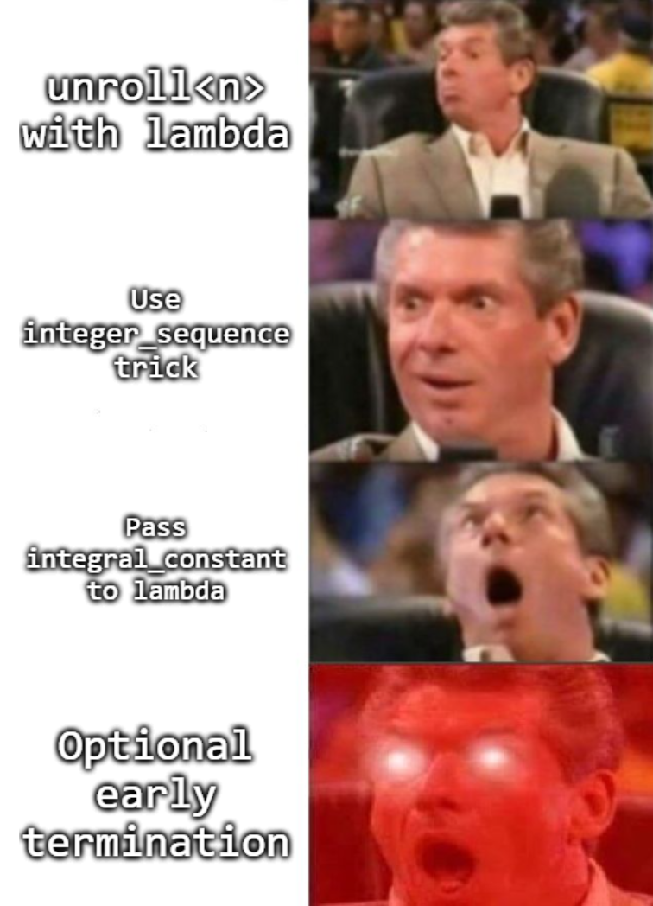

Slide 22
Let’s Also Create Some

Slide 23
A Filtering make_tuple
µidea: define and use a type that refuses to be a field!
Difficult to “filter” a pack while putting in a tuple
  Inefficient to filter it after already in the tuple
struct null_field {};
template <typename... Ts> auto make_tuple([[maybe_unused]] Ts&&... vs) {
auto one_or_none = []([[maybe_unused]] auto&& x) {
if constexpr (std::is_convertible_v<decltype(x), const null_field&>) {
return std::make_tuple();
} else {
return std::make_tuple(std::forward<decltype(x)>(x));
}
};
return std::tuple_cat(one_or_none(std::forward<Ts>(vs))...);
}
make_tuple(1, null_field(), 2) same as std::make_tuple(1, 2)

Slide 24
Aside
Bottom/unit types: an interesting design pattern
Null Object Pattern: defines an interface, but performs no operation at all
  “Black hole” – accepts any input, returns default
  “White hole” – rejects any input, always throws
“None”/”bottom” type, the subtype of all types in some languages
std::nullptr_t: does not point to any valid object
std::monostate – the absence of meaningful value (e.g. in an std::variant)
std::ignore – the absence of mutation
std::nullopt_t – unengaged std::optional object
std::ranges::dangling, std::ranges::empty_view
Notes:
Tradition of singular types
Define themselves by a lack, not presence, of specific capability

Slide 25
Unrolling Into Tuple
µidea: build on the “success” of unroll
Often parameters come already packed in tuples, not as packs
template <size_t n, typename F, size_t... i>
constexpr auto unroll_to_tuple(F&& f, std::index_sequence<i...> = {}) {
if constexpr (sizeof...(i) != n) {
return unroll_to_tuple<n>(std::forward<F>(f), std::make_index_sequence<n>());
} else {
return make_tuple(f(std::integral_constant<size_t, i>())...);
}
}
We use our make_tuple, so return null_field() to weed out elements

Slide 26
Use Case: Insert/Remove
Index manipulation offers great flexibility
// Remove the first element of a tuple
auto t = std::tuple{“meh”, 1, 2};
auto u = unroll_to_tuple<3>([&](auto i) {
if constexpr (i > 0) return std::get<i>(t);
else return null_field();
});
// Insert an element in the second position into a tuple
auto t = std::tuple{3.14, 1, 2};
auto u = unroll_to_tuple<4>([&](auto i) {
if constexpr (i != 1) return std::get<i – (i > 1)>(t);
else return 42;
});
assert(u == std::make_tuple(3.14, 42, 1, 2));

Slide 27
Use Case: Sizes and Strides
// Iterate over dimensions in an array
std::array<size_t, rank()> sizes;
unroll<rank()>([&](auto i) { sizes[i] = extents.extent(i); });
// Iterate over a tuple
size_t product_sizes = 1;
unroll<rank()>([&](auto i) {
if /* constexpr */ (i == 0) {
std::get<i>(strides) = std::get<0>(sizes) != 0;
} else {
product_sizes *= extent(i - 1);
std::get<i>(strides) = product_sizes;
}
});

Slide 28
Use Case: Flexible std::tuple/array Iteration
“Do something for each element. I may or may not need the index.”
template <typename Tuple, typename F>
constexpr void each_in_tuple(Tuple&& t, F&& f) {
constexpr size_t n = std::tuple_size_v<::std::remove_reference_t<Tuple>>;
return unroll<n>([&](auto i) {
if constexpr (std::is_invocable_v<F, decltype(i),
decltype(std::get<i>(std::forward<Tuple>(t)))>) {
return f(i, std::get<i>(::std::forward<Tuple>(t)));
} else {
return f(std::get<i>(std::forward<Tuple>(t)));
}
});
}
Lambda may take index and tuple element, or just tuple element
Iterate all or stop early, reuse work from unroll
Can move from the source element-wise

Slide 29
(The C++20 Way)
“Do something for each element. I may or may not need the index.”
template <typename Tuple, typename F>
constexpr void each_in_tuple(Tuple&& t, F&& f) {
constexpr size_t n = std::tuple_size_v<::std::remove_reference_t<Tuple>>;
return unroll<n>([&](auto i) {
if constexpr (requires{f(i, std::get<i>(::std::forward<Tuple>(t)));}) {
return f(i, std::get<i>(::std::forward<Tuple>(t)));
} else {
return f(std::get<i>(std::forward<Tuple>(t)));
}
});
}
Lambda may take index and tuple element, or just tuple element
Iterate all or stop early, reuse work from unroll
Can move from the source element-wise

Slide 30
Use Case: Convert Array to Tuple
auto a = std::array{1, 2, 3};
auto t = unroll_to_tuple<3>([&](auto i) { return a[i]; });
Many annoying chores become simple
Can define similar small primitives such as tuple_to_array etc.

Slide 31
Finally: small_vector
https://github.com/NVIDIA/cccl/blob/main/cudax/include/cuda/experimental/__stf/utility/memory.cuh#L369
small_vector in NVIDIA/cccl – falls back to std::vector if big
small_vector<Widget, 7> widgets;
Implemented in 2h with ChatGPT!
Uses total unrolling if small size is small
Uses iteration if small size is still kinda big

Slide 32
…Which Takes Us to Partial Unrolling

Slide 33
Partial Unrolling
Given a dynamic number m, unroll code in chunks of a given static size n
Use a traditional loop around the inlined code
Unroll remaining iterations (anywhere from 0 through n-1)
  Make sure generated code isn’t too big
  Disproportionately important in GPU code
The lambda being unrolled needs access to the current counter
This is… harder than it may seem

Slide 34
Implementation, Take One
Looking great! Or does it?
template <size_t n, typename F>
constexpr void unroll(size_t m, F&& f) {
size_t i = 0;
for (;;) {
size_t j = i + n;
if (j > m) break;
unroll<n>([&](auto k) { f(i + k); });
i = j;
}
// Unroll leftovers
unroll<n>([&](auto k) { return (i + k < m) && (f(i + k), true); });
}

Slide 35
Problem with Take One
Our unroll issues one test for each leftover element
No problem if many iterations
Big problem if many threads, few iterations
  Frequent case in some kernels, such as FHE
  Can add very significantly (up to ~2x!) to execution time
Duff’s device doesn’t help much here
  Counter incremented with each iteration – dependencies galore
  No jump tables available in GPU code

Slide 36
Use Bisection for log(n) Tests!
For e.g. 16-way unrolling:
  Test against 8 ➛ if ≥, then carry 8 iterations with no further test, fall through
  Test against 4 ➛ if ≥, then carry 4 iterations with no further test, fall through
  Test against 2 ➛ if ≥, then carry 2 iterations with no further test, fall through
  Test against 1 ➛ if ≥, then carry 1 iteration
4 tests instead of 16
Let’s code that good stuff

Slide 37
Implementation, Take Two
template <size_t n, typename F>
constexpr void unroll(size_t m, F&& f) {
size_t i = 0;
for (;;) {
size_t j = i + n;
if (j > m) break;
unroll<n>([&](auto k) { f(i + k); });
i = j;
}
// Unroll leftovers
unroll_leftovers<0, n>(i, m - i, [&](auto k) { f(i + k); });
}

Slide 38
Implementation, Take Two (cont’d)
What are the pros and cons?
template <size_t B, size_t E, typename F, size_t... i>
void unroll_leftovers(size_t base, size_t n, F&& f, std::index_sequence<i...> = {}) {
if constexpr (E - B <= 1) {
static_assert(E - B == 1);
if (n) f(base + B);
} else {
constexpr auto M = (E - B) / 2;
if constexpr (sizeof...(i) != M) {
unroll_leftovers<B, E>(base, n, f, std::make_index_sequence<M>());
} else {
if (n >= M) {
(f(base + i + B), ...);
unroll_leftovers<B + M, E>(base, n - M, std::forward<F>(f));
} else {
unroll_leftovers<B, E - M>(base, n, std::forward<F>(f));
}
}
}
}

Slide 39
Problem with Take Two
Subtler, but just as bad
Indeed log(n) tests for each path taken
However, generated code is big!
For n=16:
  2 basic blocks of length 8, one on each side of the test
  4 basic blocks of length 4
  8 basic blocks of length 2
  16 basic blocks of length 2
128 total calls to the lambda!
Compiler can (and does) help with this, still not a great way to go
Need to generate each length exactly once

Slide 40
Implementation, The Perfect Shade
Subtler than one might think
template <size_t n, typename F, size_t... i>
void unroll_leftovers(size_t base, size_t m, F&& f, std::index_sequence<i...> = {}) {
if constexpr (n > 0) {
if constexpr (sizeof...(i) != n / 2) {
unroll_leftovers<n>(base, m, f, std::make_index_sequence<n / 2>());
} else {
auto m2 = m >= n / 2 ? m - n / 2 : m;
unroll_leftovers<n / 2>(base, m2, std::forward<F>(f));
if (m >= n / 2) {
(f(base + m2 + i), ...);
}
}
}
}

Slide 41
Summary
Effective partial/total unrolling by combining a few simple µideas
  Use variadic expansion to effect unrolling
    Fold expressions obviate the need for multiple template instantiations
  Encapsulate/hide use of std::index_sequence
Leverage std::integral_constant and the null type pattern
    Take advantage of generic lambdas
    Usable as a true compile-time constant inside the lambda
Use simple introspection to assess whether the lambda “wants” to exit early
    Generate optimal code in all cases

Slide 42
AI Notes
Please stop using browser chatbots!
Current agents
  Helpful
  Prolific
  Not great at generating µideas
  Great at following them (“using unroll, implement…”)
Generated code must still be human-inspected/maintained in production systems
  Need to curb models’ tendency to generate massive amounts of code
Good context is a cheap form of training

