Slide 1
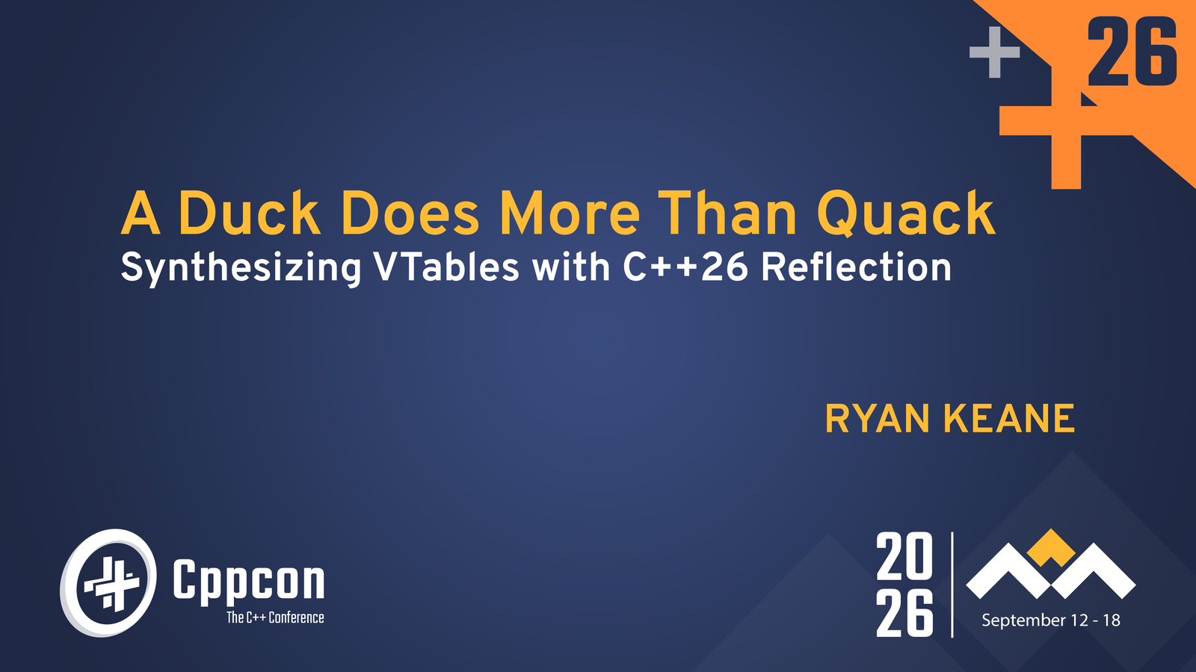

Slide 2
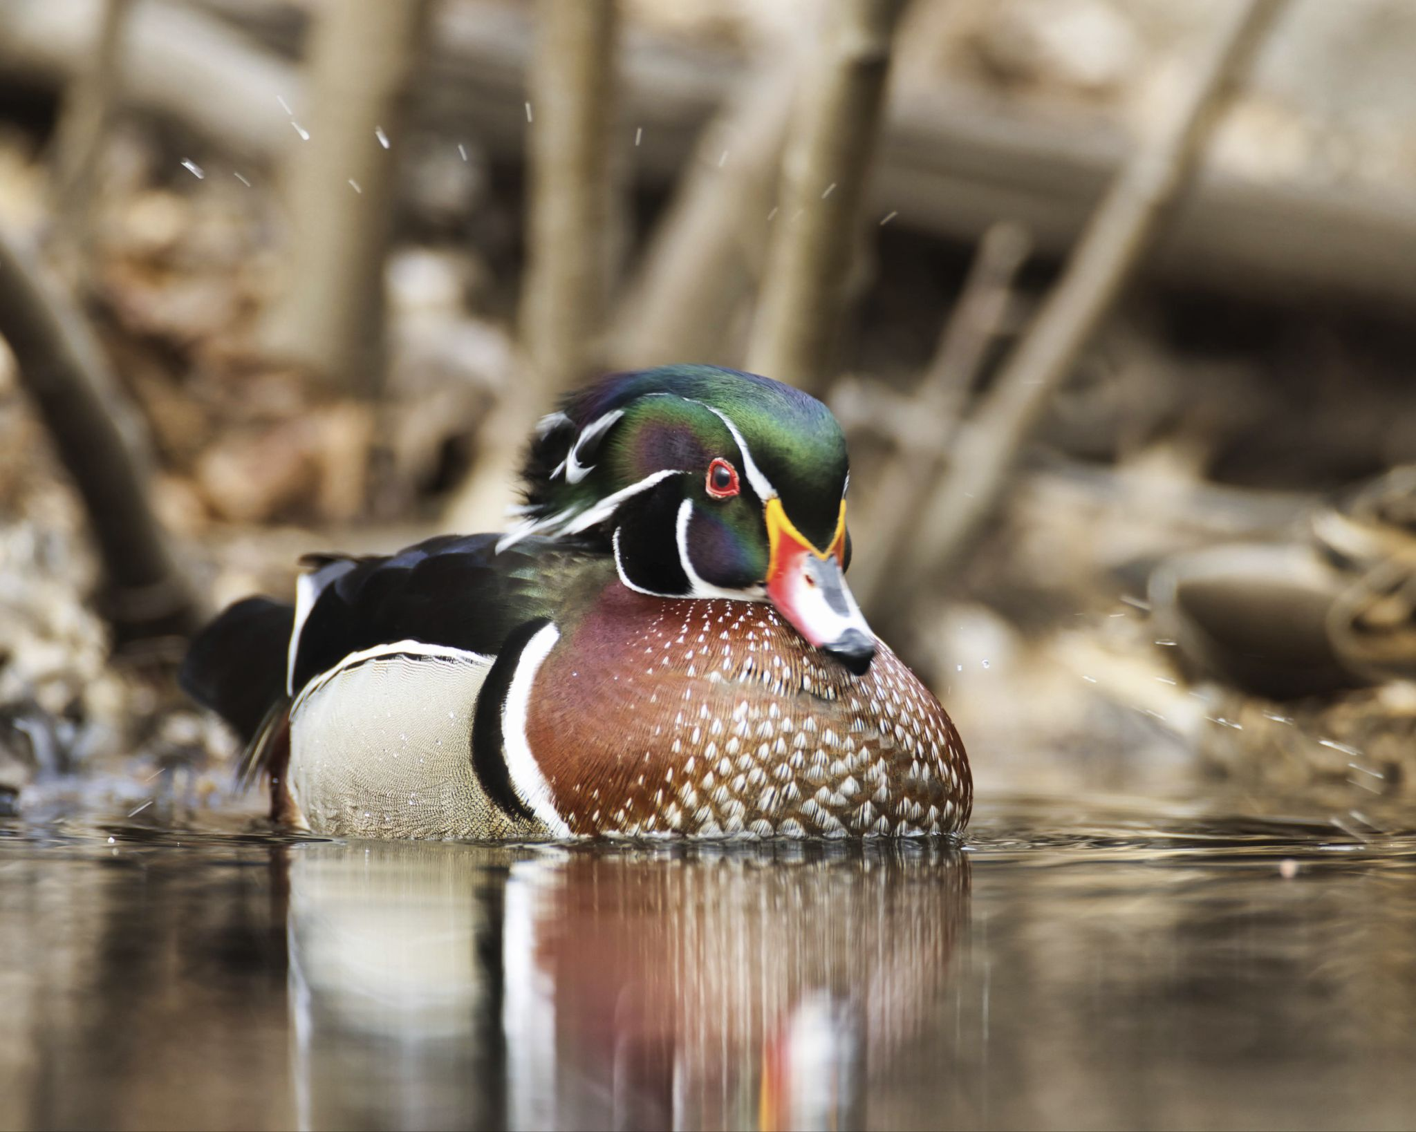
If it looks like a duck,
and quacks like a duck,
then treat it like a duck.
Notes:
Hi, my name is Ryan.
Today, I’m here to talk to you about a library I built that solves one of the oldest problems in C++ using one of its newest features.
Duck typing is an old idea in programming. Sometimes we want to look at different types at runtime, but treat them as though they are the same type.

Slide 3
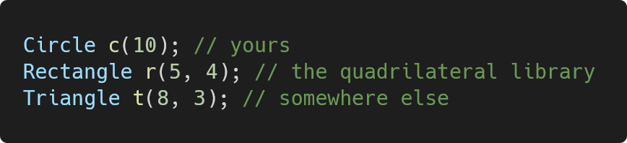
Three types with no common base class.
Each defines area().
Notes:
While I was learning C++,

Slide 4
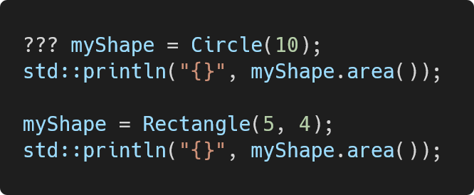
Why can’t we change the type at runtime?

Slide 5
What does C++ give you?
Inheritance | Intrusive.
std::function | Only works for operator().
std::any | No interface.
Type Erasure Libraries | Macro-heavy.

Slide 6
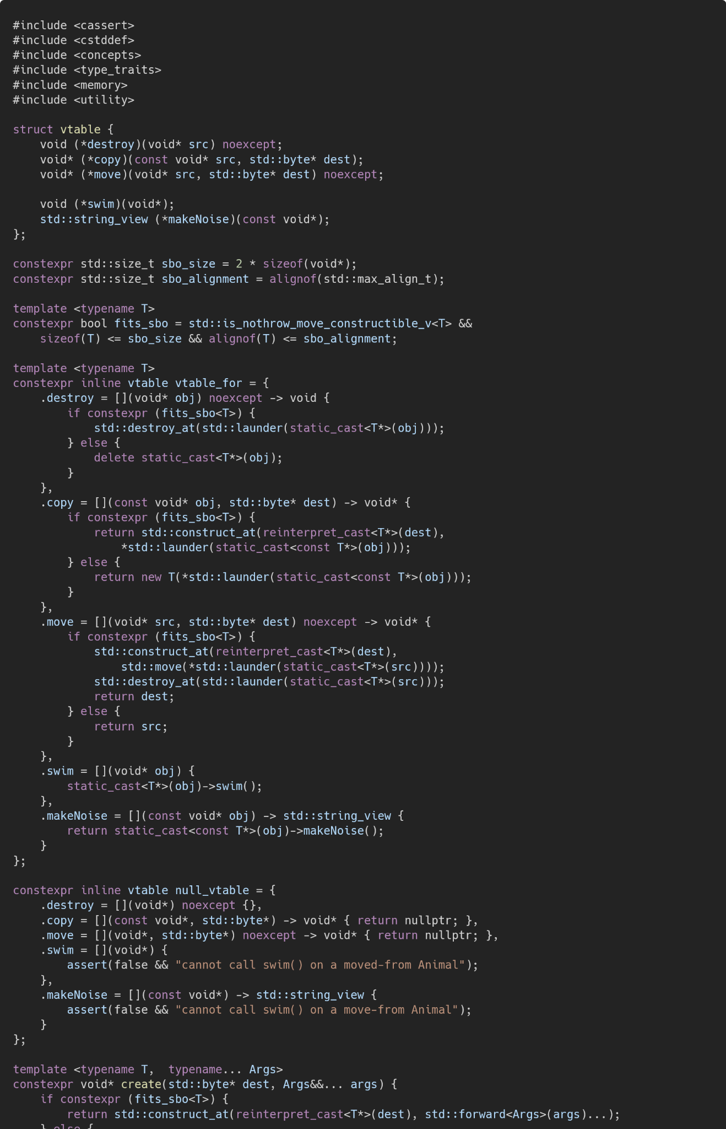
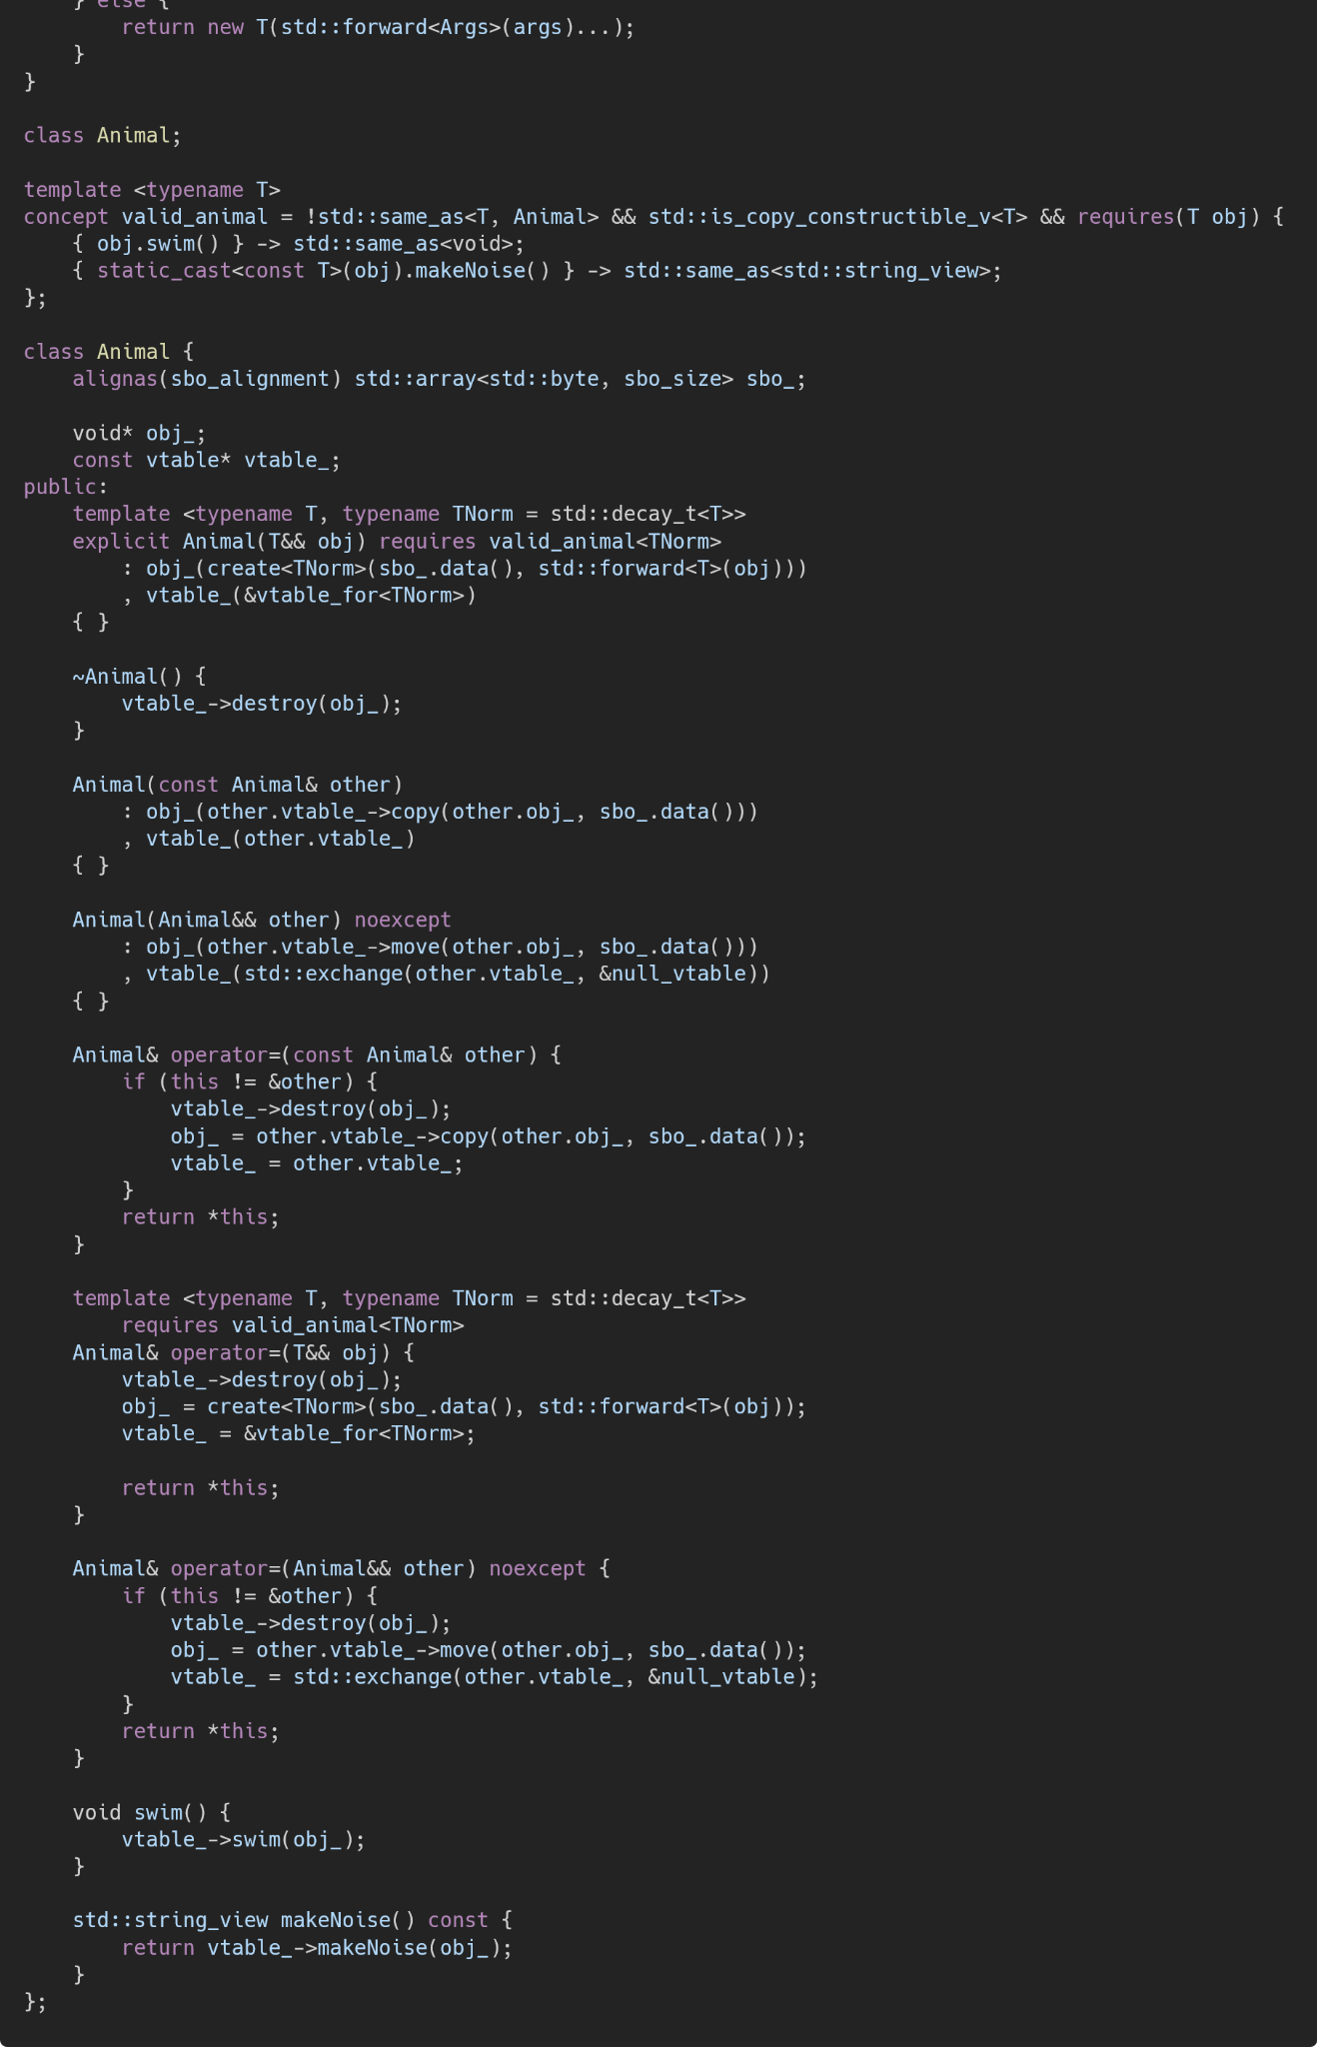
Hand-write type erasure?

Slide 7
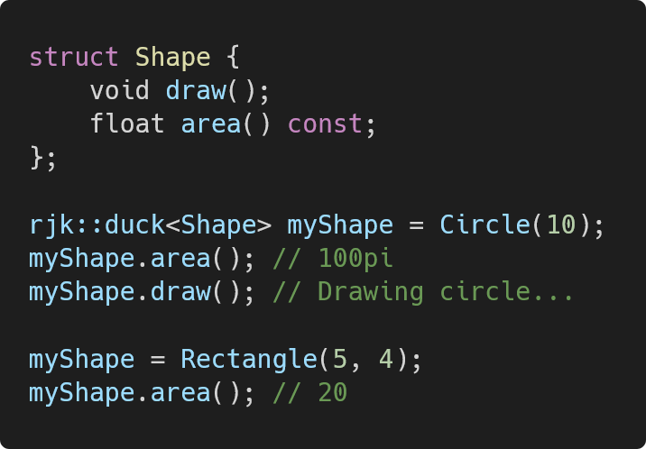
rjk::duck
Reflection
Non-intrusive
Same performance
Zero boilerplate.

Slide 8
Community Response
Made a blog post in the morning
Invited to CppCon in the afternoon
Invited to a WG21 proposal two hours later

Slide 9
“This is definitely one of those cases where I didn’t even think this was possible with the limitations we have in C++26, but somebody really clever figured out how to do it anyway.”
-Barry Revzin, co-author of “Reflection for C++26”

Slide 10
The journey of developing rjk::duck
Sophomore at Rensselaer Polytechnic Institute
Started learning C++ last Fall in Data Structures.
Learned the basics of C++, but went online to learn more.
CppCon talks, C++ weekly.
I wasn’t just new to C++26 or reflection, I was new to C++.

Slide 11
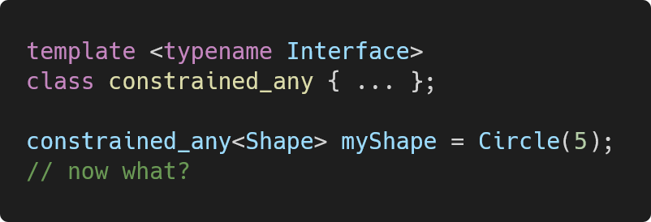
Experiments with type erasure

Slide 12
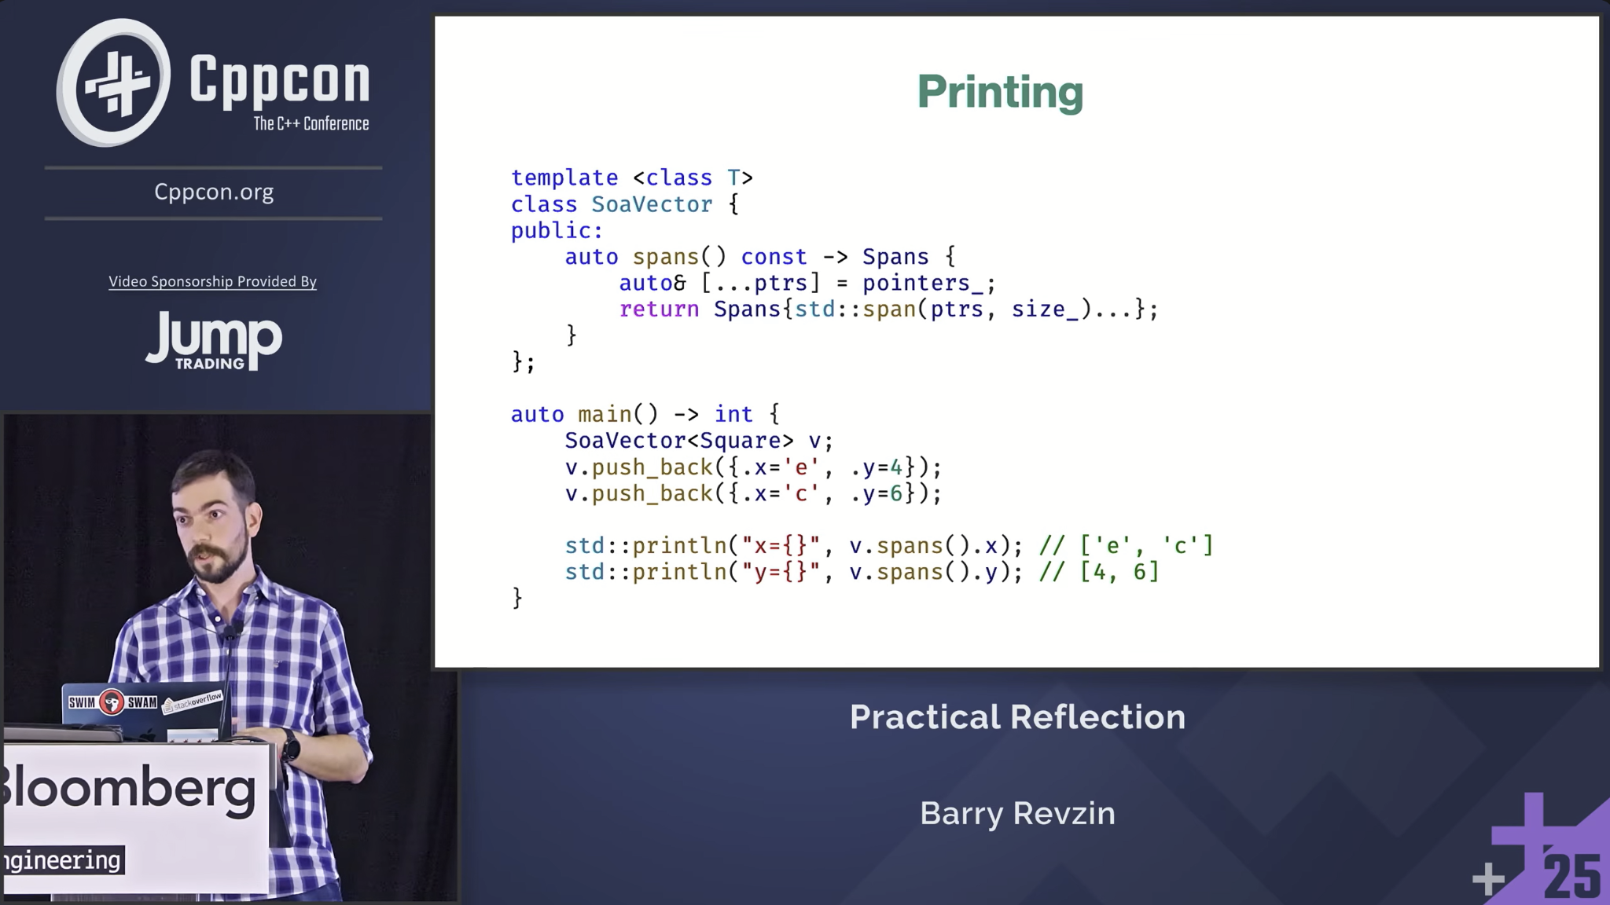

Inspiration
Iceland, with my dad

Slide 13
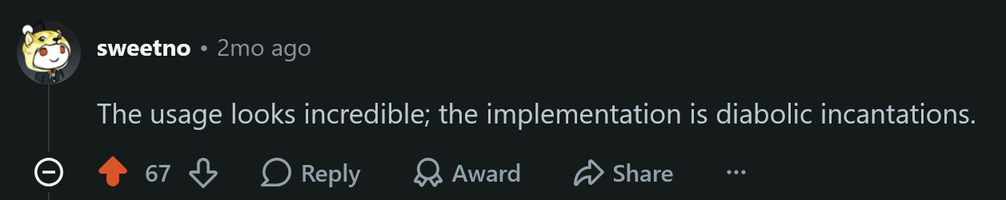

Slide 14
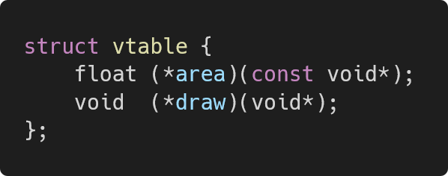
Generating a vtable
NOTE: For an owning duck, we also need lifecycle function pointers like copy and destroy.

Slide 15
define_aggregate
Data members only!

Slide 16
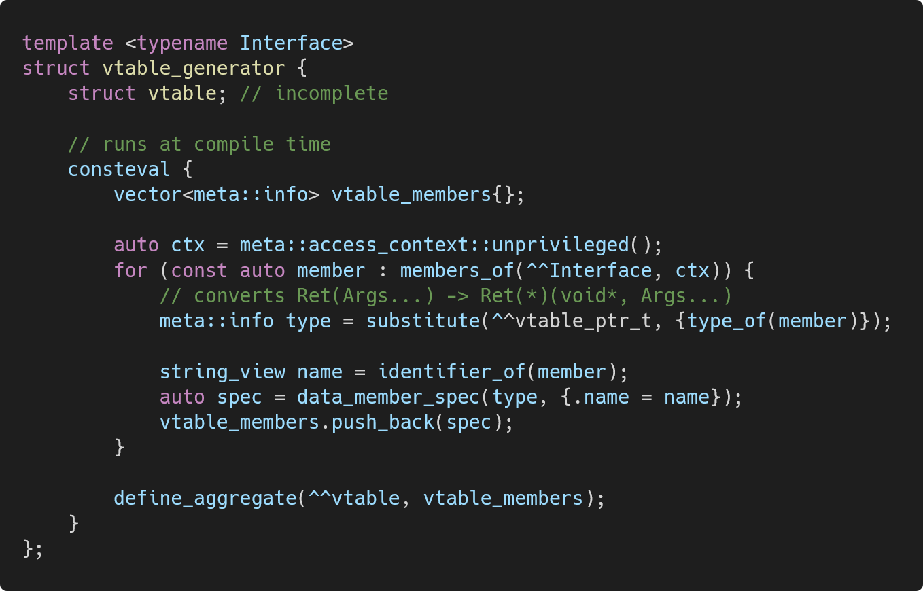
Generating a vtable
https://godbolt.org/z/1joPY6W9Y

Slide 17
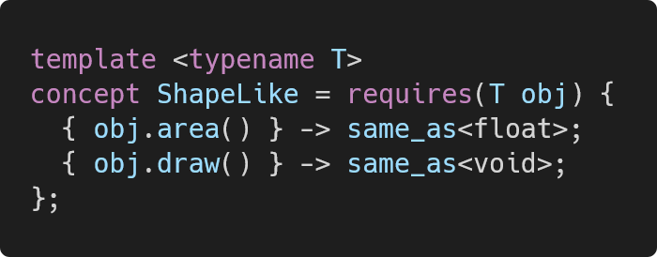
Checking Conformance

Slide 18
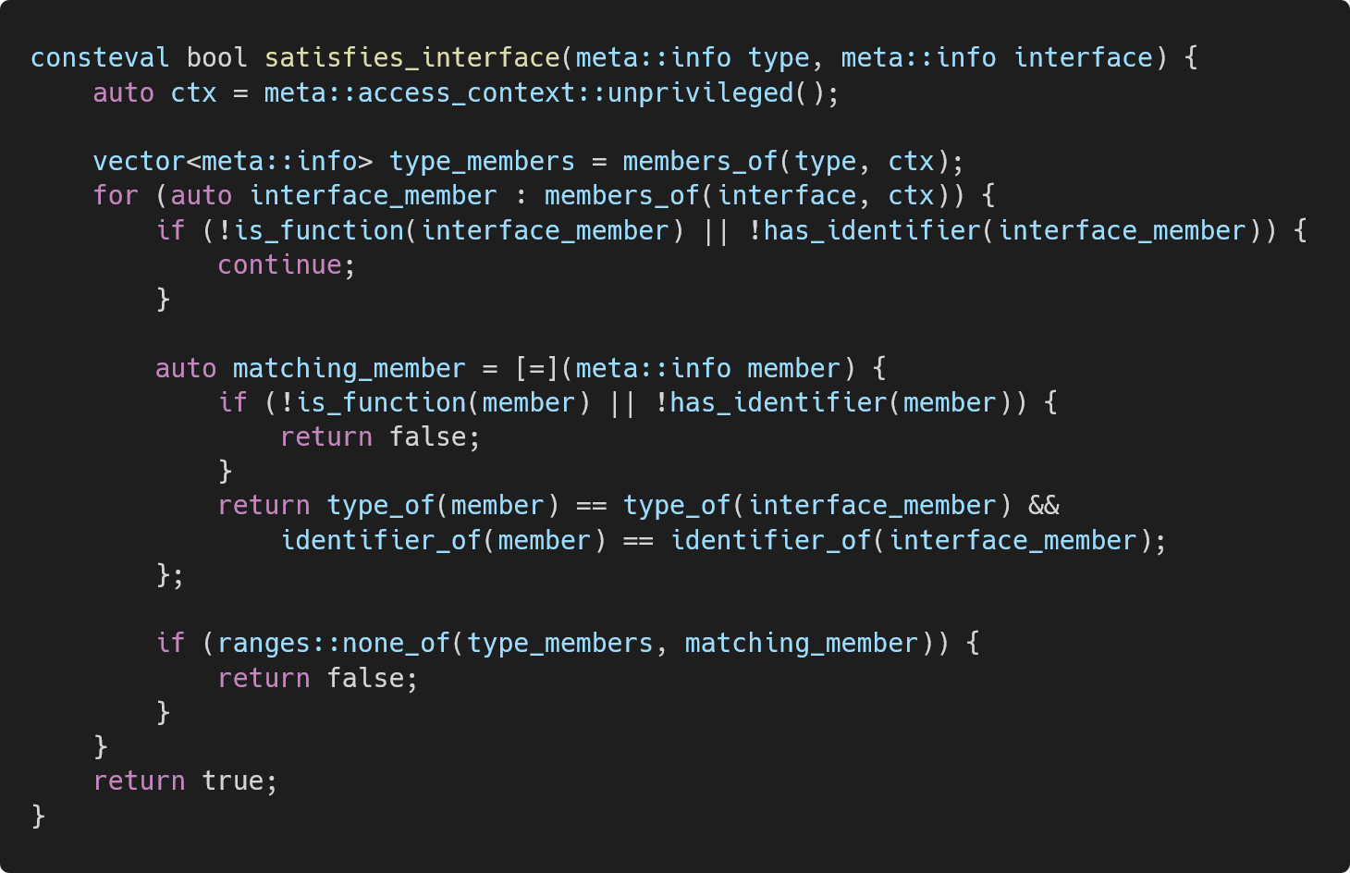
https://godbolt.org/z/4sxnjWje9

Slide 19
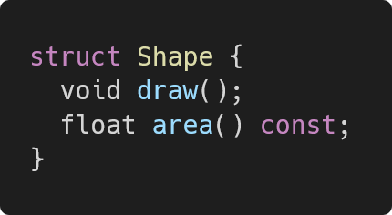
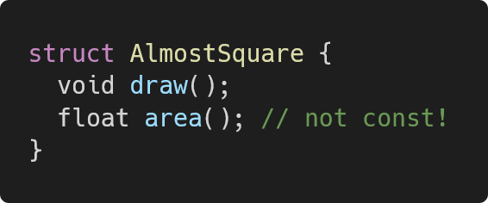
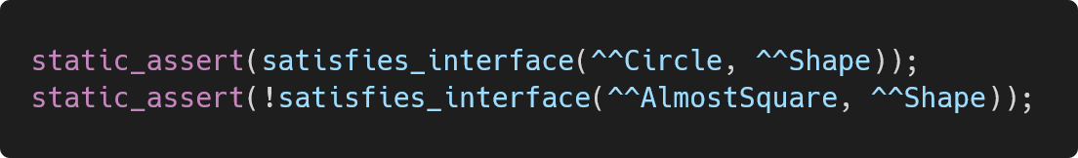
Checking Conformance

Slide 20
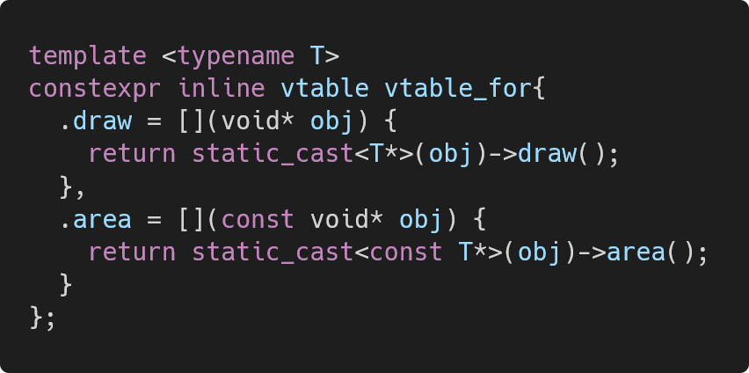
Filling in the vtable

Slide 21
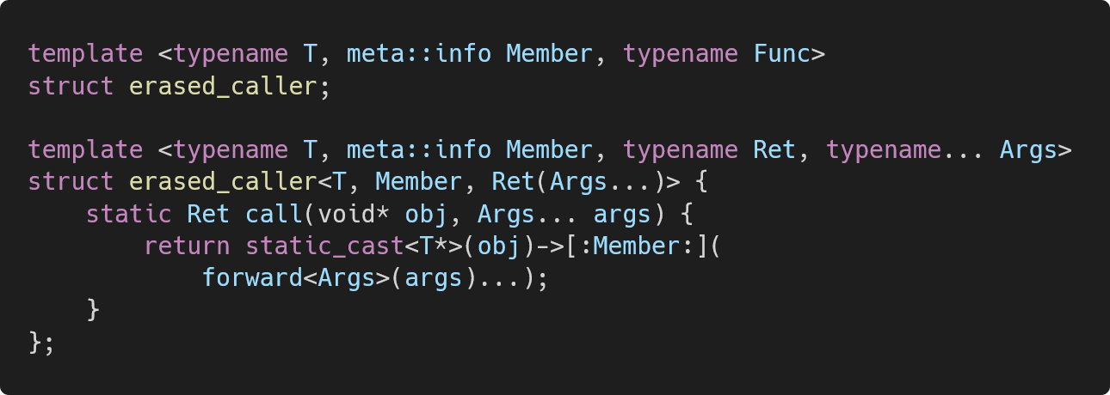
Filling in the vtable

Slide 22
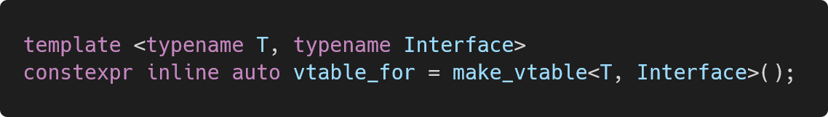
Filling in the vtable

Slide 23
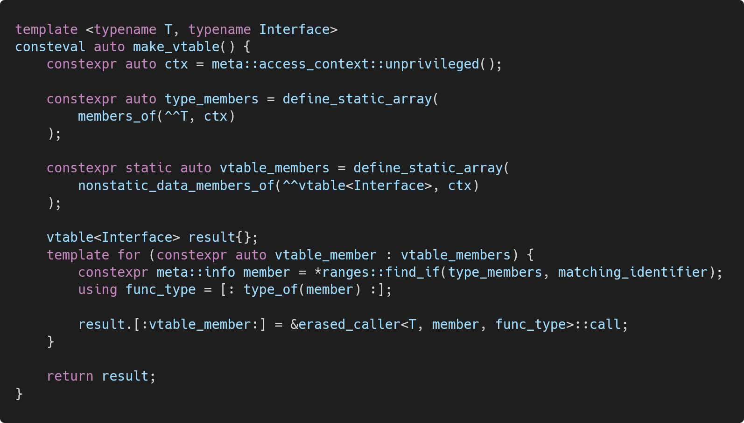
https://godbolt.org/z/rsE9zq9e7

Slide 24
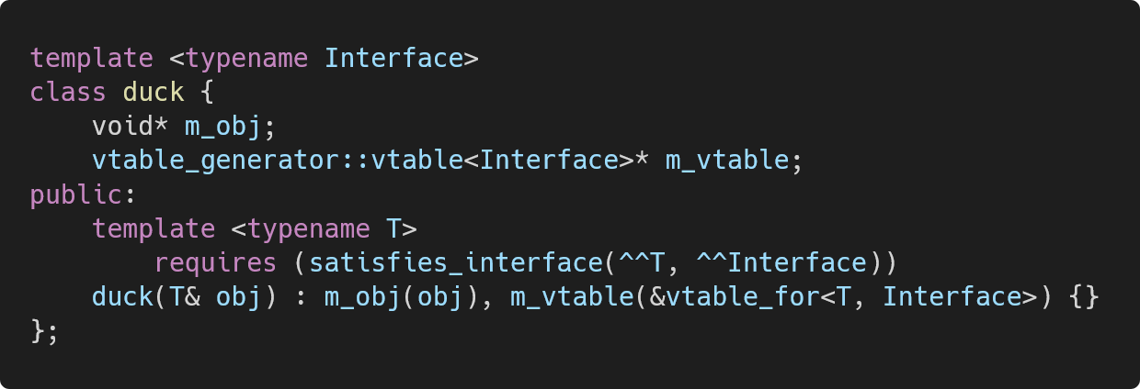
Recap

Slide 25
Are we there yet?
How do we get myShape.area()?

Slide 26
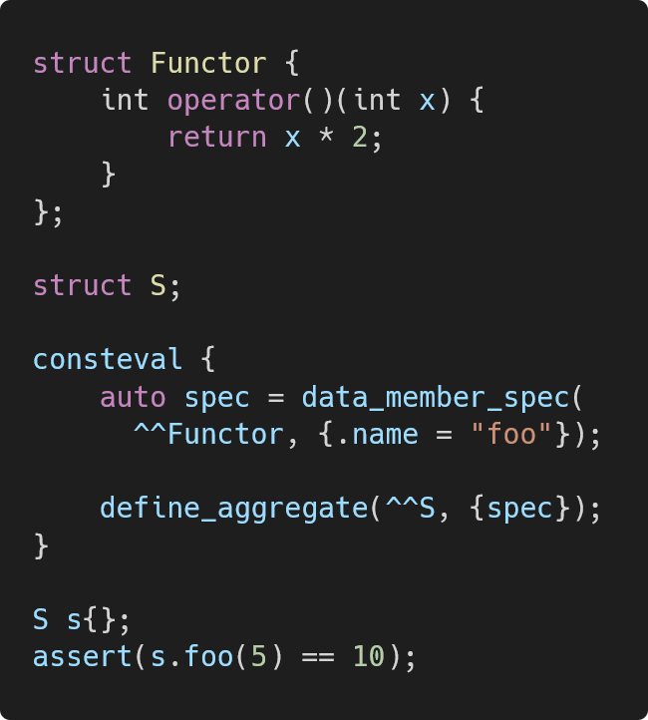
Let’s get creative.
No member functions with define_aggregate.
Try define_aggregate with functors.
https://godbolt.org/z/nMfEzf9nv

Slide 27
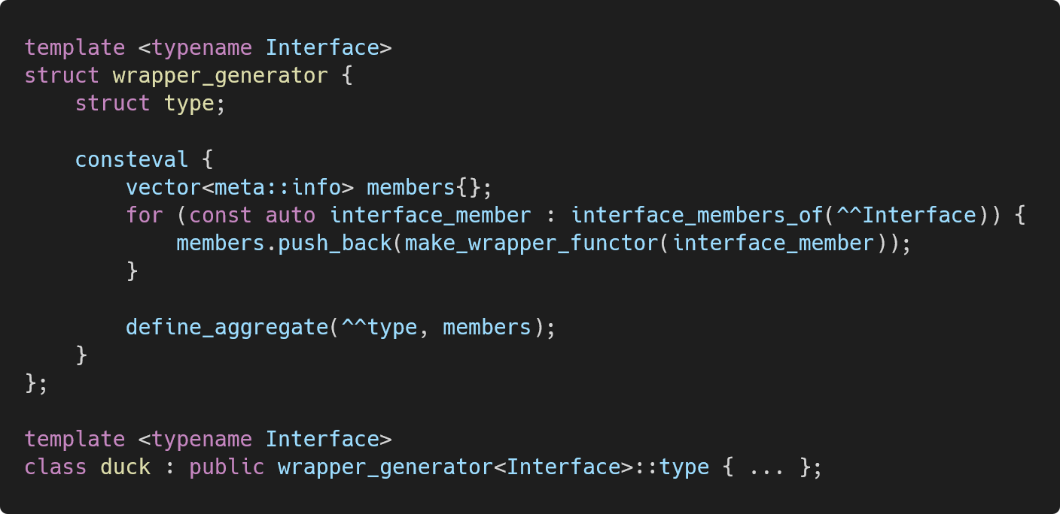
Inheriting from a generated aggregate
https://godbolt.org/z/v58vaaPM4

Slide 28
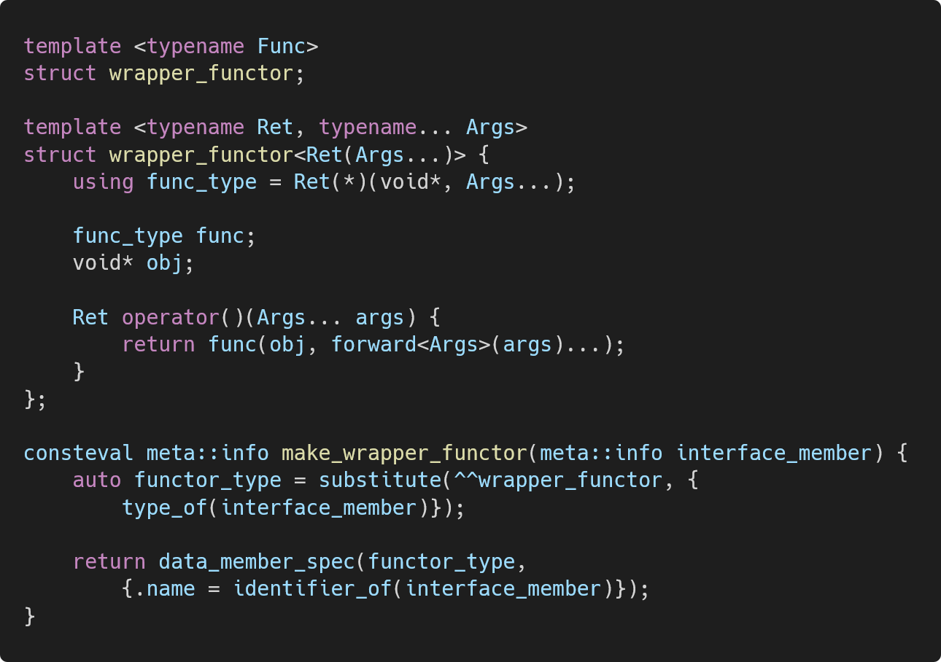
Implementing wrapper_functor
Did we do it?
Fill the func_type* on construction
Refill the void* on construction, reassignment, etc.
https://godbolt.org/z/v58vaaPM4

Slide 29
16 bytes
per interface member

Slide 30
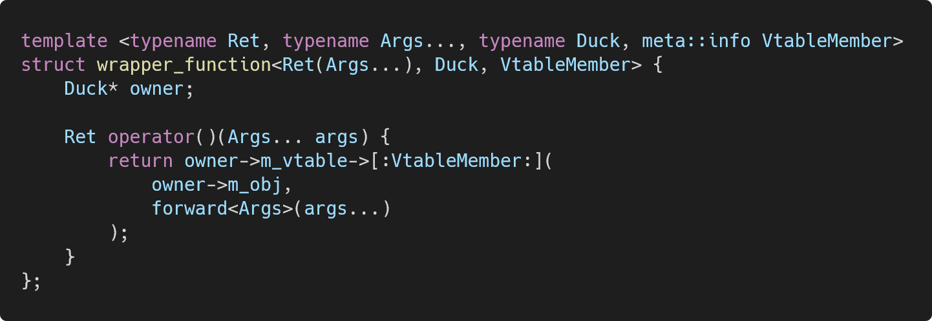
Storing a back-pointer
8 bytes per interface member.
https://godbolt.org/z/eT9T1fTxd

Slide 31
Is there a way to derive the duck* without storing it?

Slide 32
Possible Approaches
Pointer Arithmetic | Undefined behavior.
[[no_unique_address]] and reinterpret_cast | Technically UB.
Pointer Interconvertibility?

Slide 33
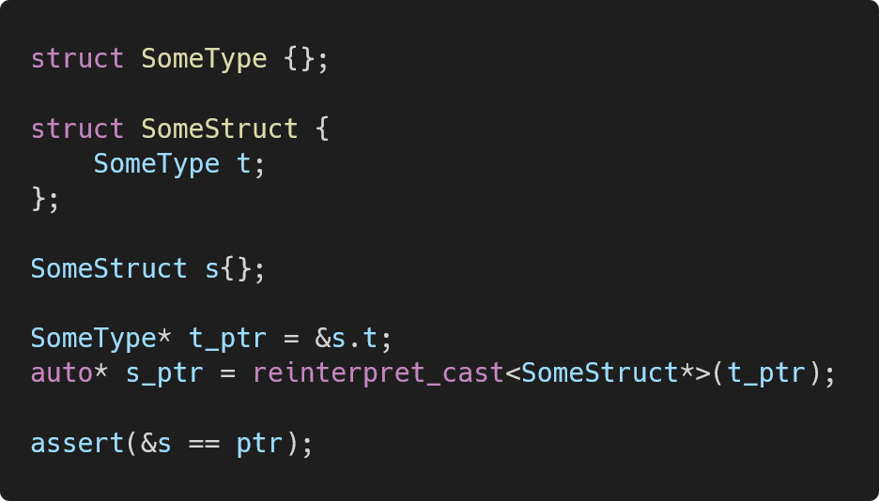
Pointer Interconvertibility
A pointer to the first data member of a class can be cast to a pointer to the class itself.
NOTE: SomeStruct must be a standard layout type for this to work.

Slide 34
Instead of this…
What about this?
wrapper_generator::type
wrapper_functor for area()
wrapper_functor for draw()
wrapper_base
wrapper_functor for area()
wrapper_base
wrapper_functor for draw()
duck
wrapper_generator::type
duck

Slide 35
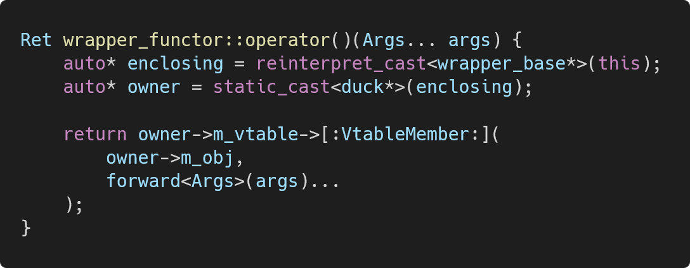
Because each base class has one data member, we can reinterpret_cast to the base class, then all the way down to duck.
wrapper_base
wrapper_functor for area()
wrapper_base
wrapper_functor for draw()
wrapper_generator::type
duck

Slide 36
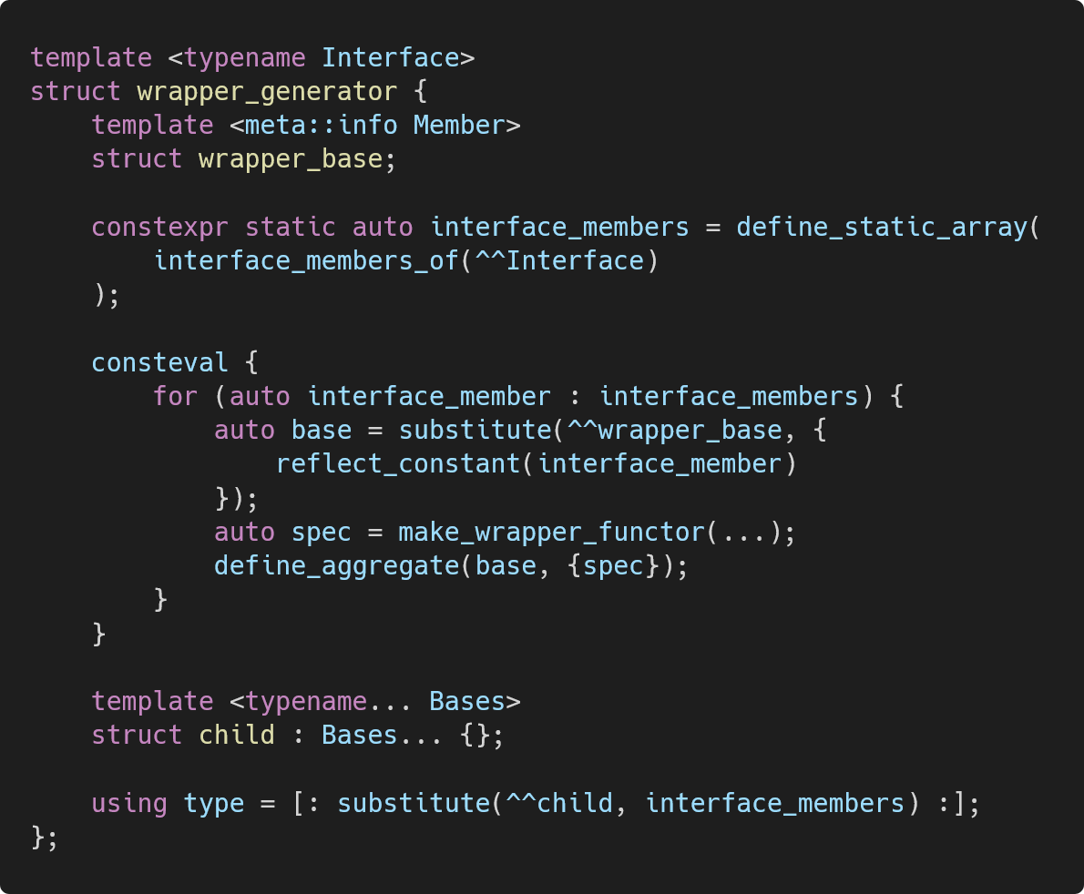
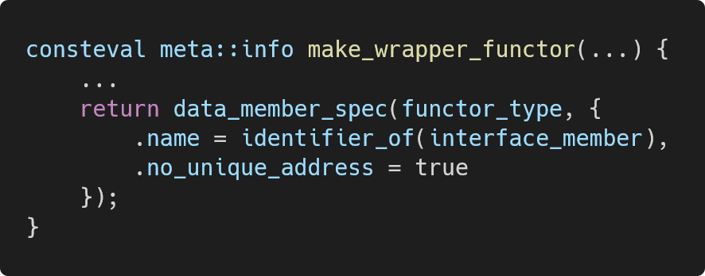
no_unique_address and the empty base optimization make this take zero bytes of space.
https://godbolt.org/z/ndv4seqoG
Notes:
Fix this slide

Slide 37


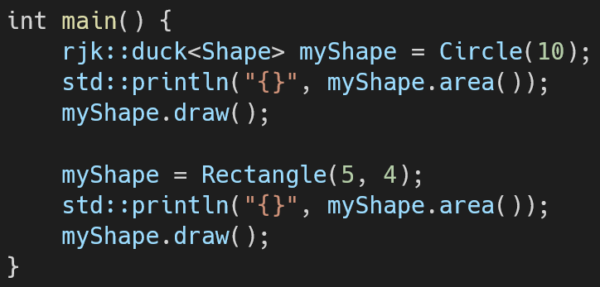
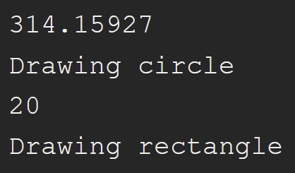
And now it works.
https://godbolt.org/z/9jPez5aGK

Slide 38
Is it fast?

Slide 39
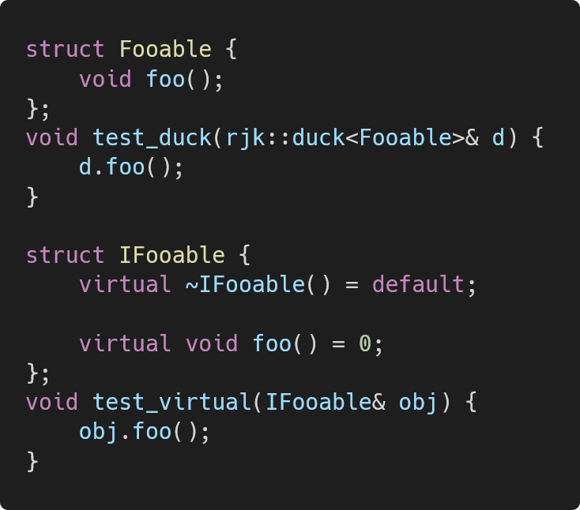
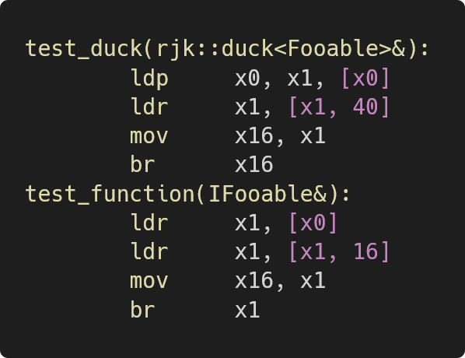
Assembly comparison
https://godbolt.org/z/s4ePhT1eK
Both are two loads.

Slide 40
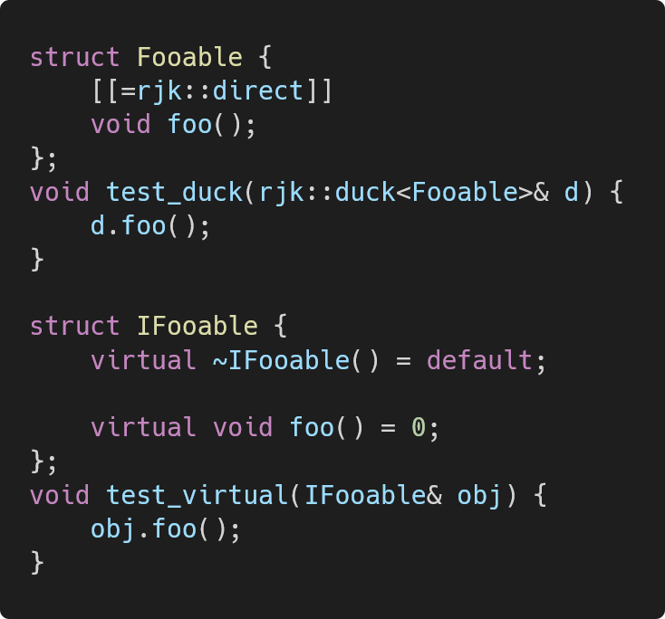
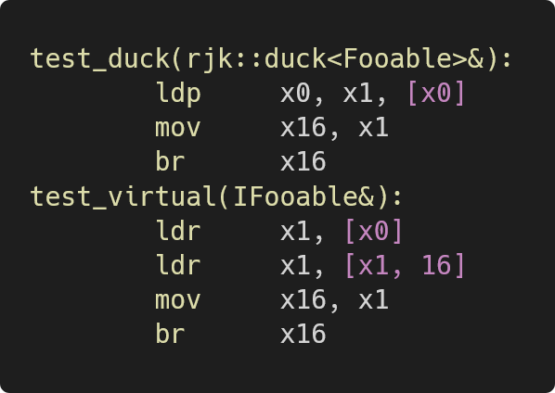
Removing an indirection
+8 bytes
https://godbolt.org/z/5vvfKcbrW
duck is just one load.

Slide 41
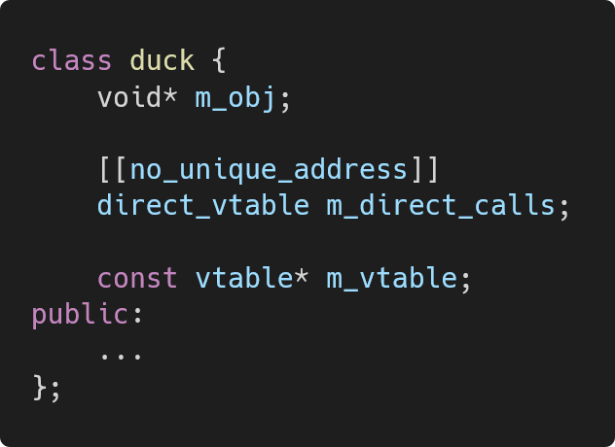
Removing an indirection
Also built with define_aggregate.
NOTE: duck also uses a small buffer, not shown in this slide.

Slide 42
What’s next?
Compiler support
constexpr support (compile-time pointer interconvertibility)
More performance customization, default implementations, open variants…

Slide 43
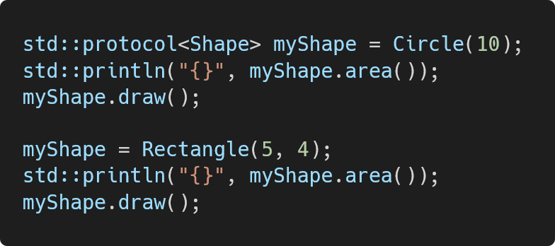

What’s next? (for C++29)
protocol and protocol_view
Allocator support
Slightly different shape and rules
Same implementation as duck
Jonathan Coe
Hana Dusikova
Antony Peacock
Philip Craig
Neelofer Banglawala
P4148: Structural Subtyping for C++

Slide 44
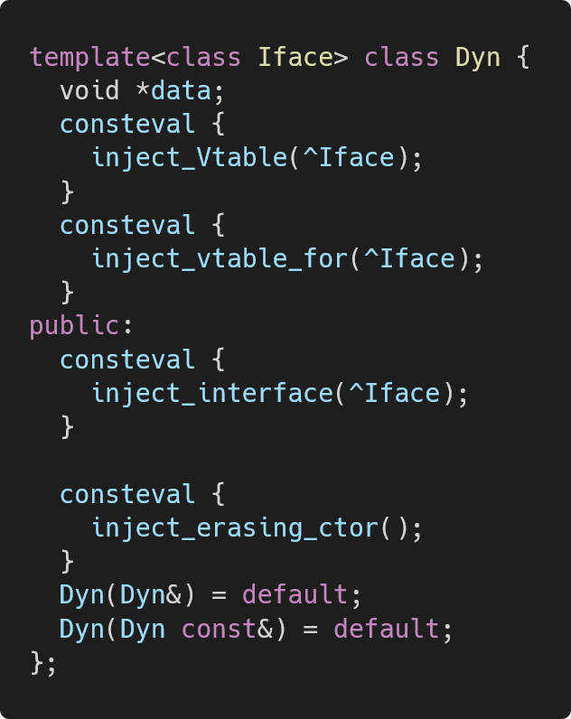
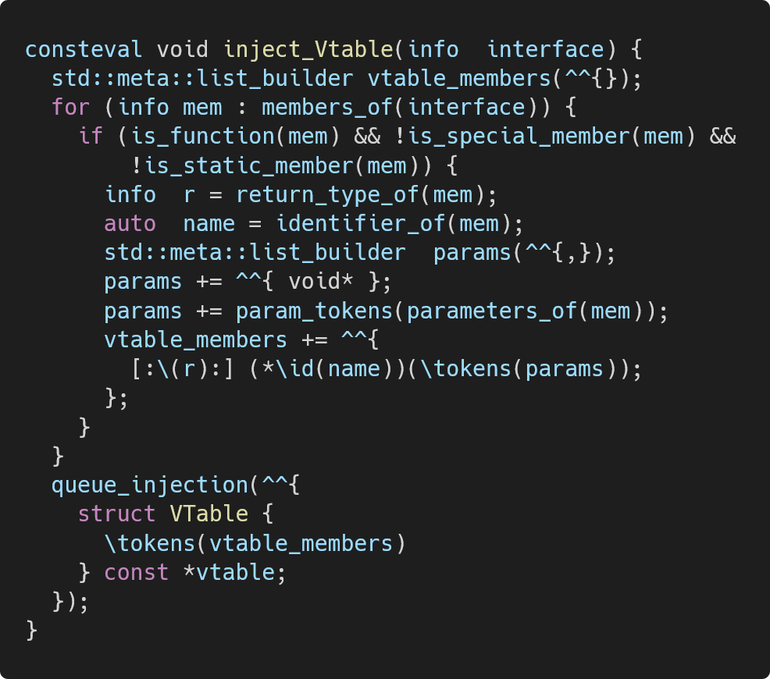
What’s next? (for C++29)
Token Injection
No inheritance trick
Simpler code
Solves overload resolution
P3294: Code Injection with Token Sequences
Notes:
Not the paper I’m working on

Slide 45

Thank you
Contact: keaner@rpi.edu
Contribute to duck!
Questions?

