Slide 1
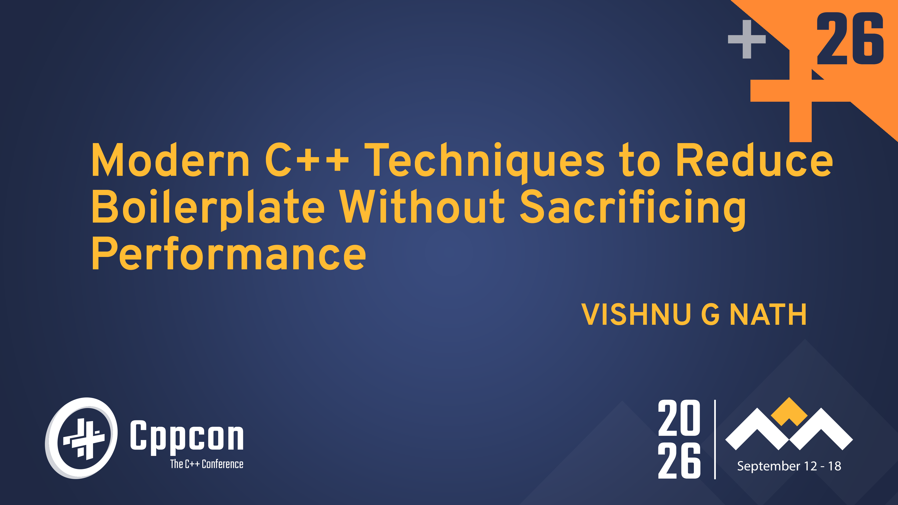
1

Slide 2
Quote of the Day
Just because it works,
doesn’t mean it can’t be better.

Slide 3
A Familiar Piece of Code
std::vector<Employee>::iterator it = employees.begin();
for (; it != employees.end(); ++it)
{
}
if (it->salary > limit)
{
}
Process(*it);
CppCon 2026 · Modern C++: Reducing Boilerplate Without Sacrificing Performance
2

Slide 4
BUSINESS LOGIC
Process(*it);
Everything else…
is language ceremony.
CppCon 2026 · Modern C++: Reducing Boilerplate Without Sacrificing Performance
3

Slide 5
Boilerplate
Code that satisfies the language.
Not the problem.
CppCon 2026 · Modern C++: Reducing Boilerplate Without Sacrificing Performance
4

Slide 6
A Pattern Emerged
WE KEPT WRITING…
MODERN C++ ANSWERED WITH…
Pointer + size
std::span
nullptr
std::optional
Iterator loops
Ranges
SFINAE
Concepts
Manual cleanup
RAII
Explicit types
auto
CppCon 2026 · Modern C++: Reducing Boilerplate Without Sacrificing Performance
5

Slide 7
The Evolution of Modern C++
Problem
Repeated Pattern
Standard Library
Language Feature
Compiler
Less Boilerplate
CppCon 2026 · Modern C++: Reducing Boilerplate Without Sacrificing Performance
6

Slide 8
THE CENTRAL IDEA
Modern C++ doesn’t
remove complexity.
It relocates it.
Developer → Compiler
CppCon 2026 · Modern C++: Reducing Boilerplate Without Sacrificing Performance
7

Slide 9
HOW WE’LL EVALUATE
Every technique in this talk
will answer the same question.
What did we gain…
and what did we pay?
CppCon 2026 · Modern C++: Reducing Boilerplate Without Sacrificing Performance
8

Slide 10
Every Comparison
Traditional C++
Modern C++
Measured on Runtime · Compile Time · Assembly · Binary Size
CppCon 2026 · Modern C++: Reducing Boilerplate Without Sacrificing Performance
9

Slide 11
ENGINEERING PRINCIPLES
By the end of this talk, you’ll leave with more
than a list of language features.
Leave with a set of
engineering principles.
CppCon 2026 · Modern C++: Reducing Boilerplate Without Sacrificing Performance
10

Slide 12
Before reducing boilerplate…
we need to answer one question.
Why are we writing it
in the first place?
CppCon 2026 · Modern C++: Reducing Boilerplate Without Sacrificing Performance
11

Slide 13
TECHNIQUE
Type Deduction
Eliminating Redundant Type Information
CppCon 2026 · Modern C++: Reducing Boilerplate Without Sacrificing Performance
12

Slide 14
Before C++11
std::vector<Employee>::iterator it = employees.begin(); std::map<int, Employee>::const_iterator employeeIt =
employees.find(id);
CppCon 2026 · Modern C++: Reducing Boilerplate Without Sacrificing Performance
13

Slide 15
What Are We Really Saying?
std::vector<Employee>::iterator it = employees.begin();
The compiler already knows what begin() returns.
CppCon 2026 · Modern C++: Reducing Boilerplate Without Sacrificing Performance
14

Slide 16
Redundant Information
std::vector<Employee>::iterator it = employees.begin();
auto it = employees.begin();
CppCon 2026 · Modern C++: Reducing Boilerplate Without Sacrificing Performance
15

Slide 17
One Source of Truth
BEFORE
AFTER
× Type appears twice
× Manual synchronization
× Verbose declarations
✓ Type appears once
✓ Automatic deduction
✓ Intent-focused code
CppCon 2026 · Modern C++: Reducing Boilerplate Without Sacrificing Performance
16

Slide 18
What The Compiler Sees
auto it = employees.begin();
OR
std::vector<Employee>::iterator it = employees.begin();
Identical machine code
CppCon 2026 · Modern C++: Reducing Boilerplate Without Sacrificing Performance
17

Slide 19
Zero-Cost?
We’ll verify.
CppCon 2026 · Modern C++: Reducing Boilerplate Without Sacrificing Performance
18

Slide 20
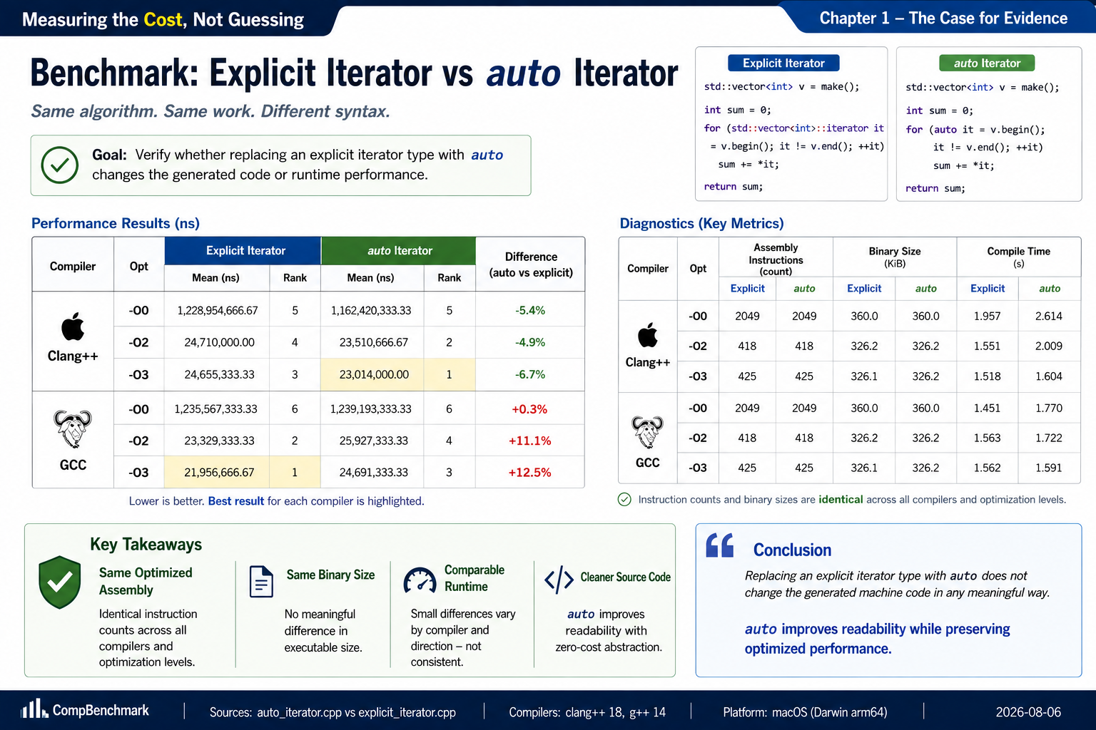
Measuring The Cost
CppCon 2026 · Modern C++: Reducing Boilerplate Without Sacrificing Performance
19

Slide 21
BUT…
Should we use
auto
everywhere?
CppCon 2026 · Modern C++: Reducing Boilerplate Without Sacrificing Performance
20

Slide 22
Good Uses
✓
Long iterator types
✓
Template-heavy code
✓
Obvious local variables
✓
Generic programming
CppCon 2026 · Modern C++: Reducing Boilerplate Without Sacrificing Performance
21

Slide 23
Be Careful
!
Public interfaces
!
Ownership semantics
!
Smart pointers
!
When the type communicates intent
CppCon 2026 · Modern C++: Reducing Boilerplate Without Sacrificing Performance
22

Slide 24
1
ENGINEERING PRINCIPLE
Eliminate Redundant Information
Don’t repeat what the compiler already knows.
CppCon 2026 · Modern C++: Reducing Boilerplate Without Sacrificing Performance
23

Slide 25
If the compiler can deduce types…
why are we still describing
how to iterate?
CppCon 2026 · Modern C++: Reducing Boilerplate Without Sacrificing Performance
24

Slide 26
TECHNIQUE
Iteration
Express Intent, Not Mechanics
CppCon 2026 · Modern C++: Reducing Boilerplate Without Sacrificing Performance
25

Slide 27
Before C++11
for (std::vector<Employee>::iterator it = employees.begin();
it != employees.end(); ++it)
{
}
Process(*it);
CppCon 2026 · Modern C++: Reducing Boilerplate Without Sacrificing Performance
26

Slide 28
What Is The Intent?
THE INTENT
NOT…
Process every employee.
Increment an iterator.
CppCon 2026 · Modern C++: Reducing Boilerplate Without Sacrificing Performance
27

Slide 29
C++11
for (auto& employee : employees)
{
}
Process(employee);
CppCon 2026 · Modern C++: Reducing Boilerplate Without Sacrificing Performance
28

Slide 30
What Changed?
BEFORE
AFTER
× Describe iteration mechanics
× Manual iterator management
× More opportunities for mistakes
✓ Describe iteration intent
✓ Compiler-generated iteration
✓ Less surface area for bugs
CppCon 2026 · Modern C++: Reducing Boilerplate Without Sacrificing Performance
29

Slide 31
Behind The Language
for (auto& employee : employees) { ... }
the compiler expands this to
for (auto it = begin(employees); it != end(employees); ++it)
{
auto& employee = *it;
...
}
CppCon 2026 · Modern C++: Reducing Boilerplate Without Sacrificing Performance
30

Slide 32
ENGINEERING QUESTION
Did we pay anything?
CppCon 2026 · Modern C++: Reducing Boilerplate Without Sacrificing Performance
31

Slide 33
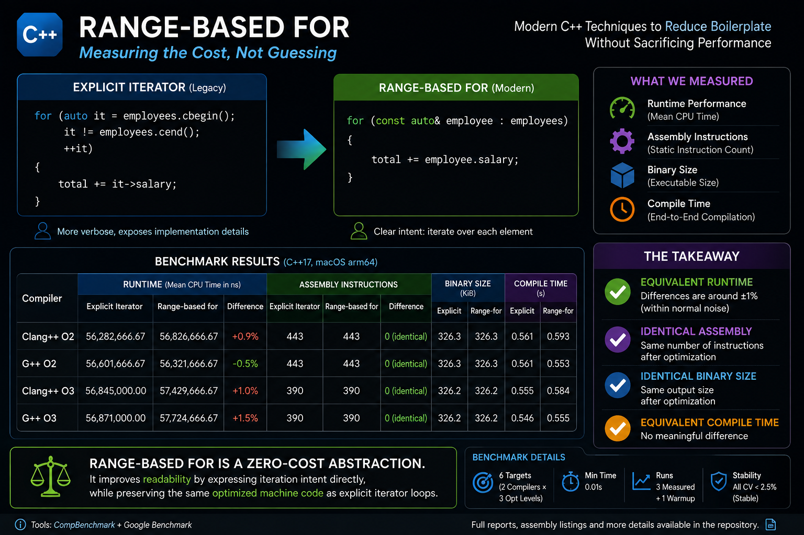
Measuring The Cost
CppCon 2026 · Modern C++: Reducing Boilerplate Without Sacrificing Performance
32

Slide 34
When An Iterator Is Still Better
●
Modifying the container while iterating
●
Using multiple iterators
●
Iterator arithmetic
●
Algorithms requiring explicit ranges
CppCon 2026 · Modern C++: Reducing Boilerplate Without Sacrificing Performance
34

Slide 35
2
ENGINEERING PRINCIPLE
Express Intent,
Not Mechanics
CppCon 2026 · Modern C++: Reducing Boilerplate Without Sacrificing Performance
35

Slide 36
ONE STEP FURTHER…
If we no longer need to describe
how to iterate…
do we even need to write the loop?
CppCon 2026 · Modern C++: Reducing Boilerplate Without Sacrificing Performance
36

Slide 37
TECHNIQUE
Algorithms
Express What, Not How
CppCon 2026 · Modern C++: Reducing Boilerplate Without Sacrificing Performance
37

Slide 38
Before Algorithms
Employee*result = nullptr;
for {
(const
auto& employee : employees)
if {
(employee.id == targetId)
result = &employee; break;
}
}
CppCon 2026 · Modern C++: Reducing Boilerplate Without Sacrificing Performance
38

Slide 39
What Is The Intent?
THE INTENT
NOT…
Find an employee.
Implement a search loop.
CppCon 2026 · Modern C++: Reducing Boilerplate Without Sacrificing Performance
39

Slide 40
The Standard Library Already Knows
auto it = std::find_if(
employees.begin(), employees.end(), [&](const auto& employee)
{
});
return employee.id == targetId;
CppCon 2026 · Modern C++: Reducing Boilerplate Without Sacrificing Performance
40

Slide 41
A Vocabulary Of Intent
INTENT
ALGORITHM
Find
std::find_if
Count
std::count_if
Transform
std::transform
Sort
std::sort
Copy
std::copy_if
Accumulate
std::accumulate
CppCon 2026 · Modern C++: Reducing Boilerplate Without Sacrificing Performance
41

Slide 42
Behind The Library
Your Intent
Standard Algorithm
Optimized Implementation
CppCon 2026 · Modern C++: Reducing Boilerplate Without Sacrificing Performance
42

Slide 43
ENGINEERING QUESTION
Does abstraction
cost performance?
CppCon 2026 · Modern C++: Reducing Boilerplate Without Sacrificing Performance
43

Slide 44
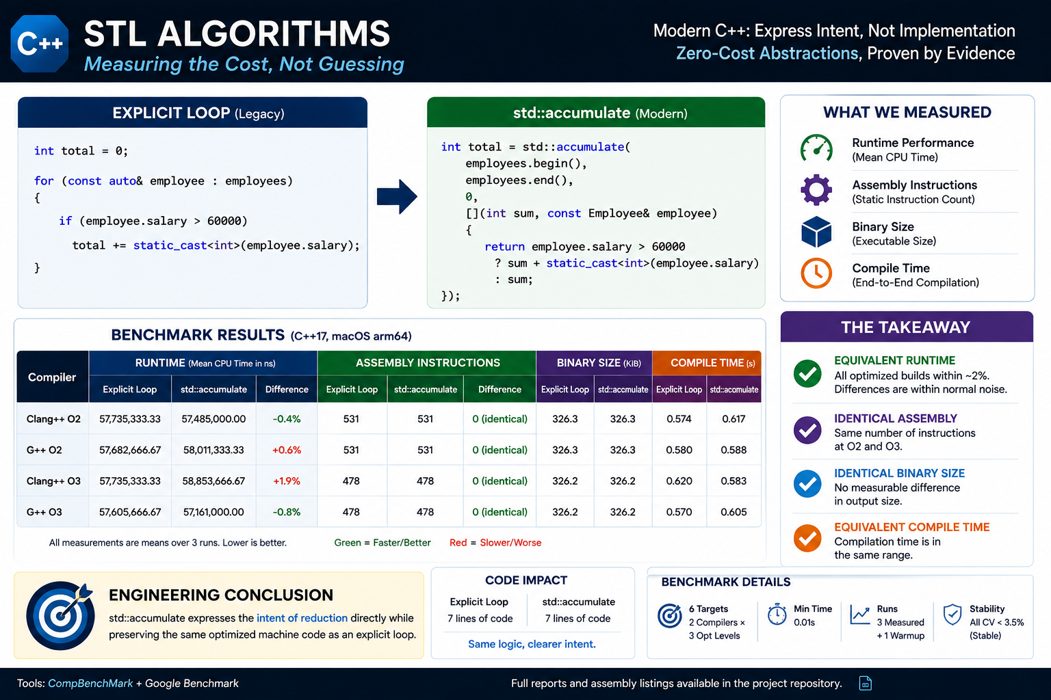
Measuring The Cost
CppCon 2026 · Modern C++: Reducing Boilerplate Without Sacrificing Performance
44

Slide 45
More Than Performance
✓
Reusable
✓
Well tested
✓
Self-documenting
✓
Easier to review
CppCon 2026 · Modern C++: Reducing Boilerplate Without Sacrificing Performance
45

Slide 46
When A Loop Is Better
for (...)
{
}
...
CppCon 2026 · Modern C++: Reducing Boilerplate Without Sacrificing Performance
46

Slide 47
3
ENGINEERING PRINCIPLE
Standardize
Common Patterns
CppCon 2026 · Modern C++: Reducing Boilerplate Without Sacrificing Performance
47

Slide 48
One Thing We Ignored...
[&](const auto& employee)
{
}
return employee.id == targetId;
CppCon 2026 · Modern C++: Reducing Boilerplate Without Sacrificing Performance
48

Slide 49
TECHNIQUE
Lambdas
Behavior Without Boilerplate
CppCon 2026 · Modern C++: Reducing Boilerplate Without Sacrificing Performance
49

Slide 50
Before C++11
struct EmployeeMatcher {
EmployeeMatcher(int id)
: targetId(id)
{
}
bool operator()(const Employee& employee) const
{
}
return employee.id == targetId;
private:
};
auto it = std::find_if(
int targetId;
employees.begin(),
employees.end(),
EmployeeMatcher(targetId));
CppCon 2026 · Modern C++: Reducing Boilerplate Without Sacrificing Performance
50

Slide 51
What Is The Intent?
THE INTENT
NOT…
employee.id == targetId
Everything else just
supports the comparison.
CppCon 2026 · Modern C++: Reducing Boilerplate Without Sacrificing Performance
51

Slide 52
C++11
auto it = std::find_if(
employees.begin(), employees.end(), [&](const auto& employee)
{
});
return employee.id == targetId;
CppCon 2026 · Modern C++: Reducing Boilerplate Without Sacrificing Performance
52

Slide 53
Behind The Language
Lambda Expression
Unnamed Function Object
operator()
Compiler-Generated Type
CppCon 2026 · Modern C++: Reducing Boilerplate Without Sacrificing Performance
53

Slide 54
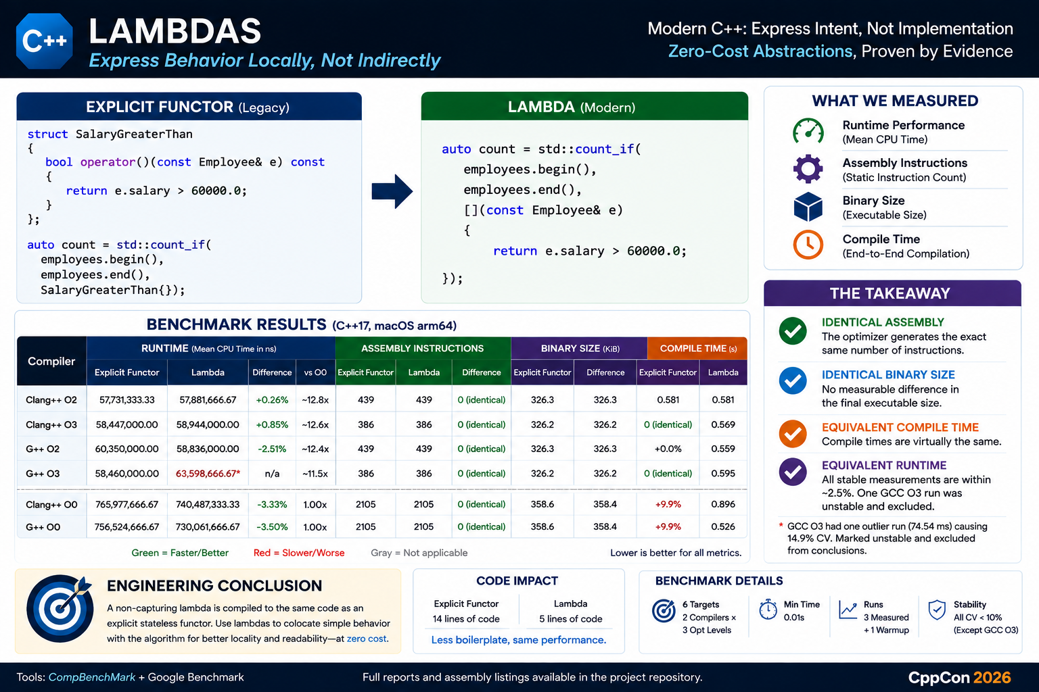
Measuring The Cost
CppCon 2026 · Modern C++: Reducing Boilerplate Without Sacrificing Performance
54

Slide 55
4
ENGINEERING PRINCIPLE
Express Behavior,
Not Infrastructure
CppCon 2026 · Modern C++: Reducing Boilerplate Without Sacrificing Performance
55

Slide 56
NEXT QUESTION…
If lambdas made algorithms easier…
can we also make
iterator pairs disappear?
CppCon 2026 · Modern C++: Reducing Boilerplate Without Sacrificing Performance
56

Slide 57
TECHNIQUE
Ranges
Composing Operations, Not Loops
CppCon 2026 · Modern C++: Reducing Boilerplate Without Sacrificing Performance
57

Slide 58
Before C++20
std::vector<Employee> seniorEmployees;
for (const auto& employee : employees)
{
}
std::sort(
if (employee.experience > 10)
{
}
seniorEmployees.push_back(employee);
seniorEmployees.begin(), seniorEmployees.end(), CompareSalary);
CppCon 2026 · Modern C++: Reducing Boilerplate Without Sacrificing Performance
58

Slide 59
What Is The Intent?
Employees
Filter
Sort
Result
CppCon 2026 · Modern C++: Reducing Boilerplate Without Sacrificing Performance
59

Slide 60
C++20
auto result =
employees
| std::views::filter(
[](const auto& employee)
{
})
return employee.experience > 10;
| std::views::transform(
[](const auto& employee)
{
});
return employee.name;
CppCon 2026 · Modern C++: Reducing Boilerplate Without Sacrificing Performance
60

Slide 61
A Pipeline
Source
Filter
Transform
Take
Output
CppCon 2026 · Modern C++: Reducing Boilerplate Without Sacrificing Performance
61

Slide 62
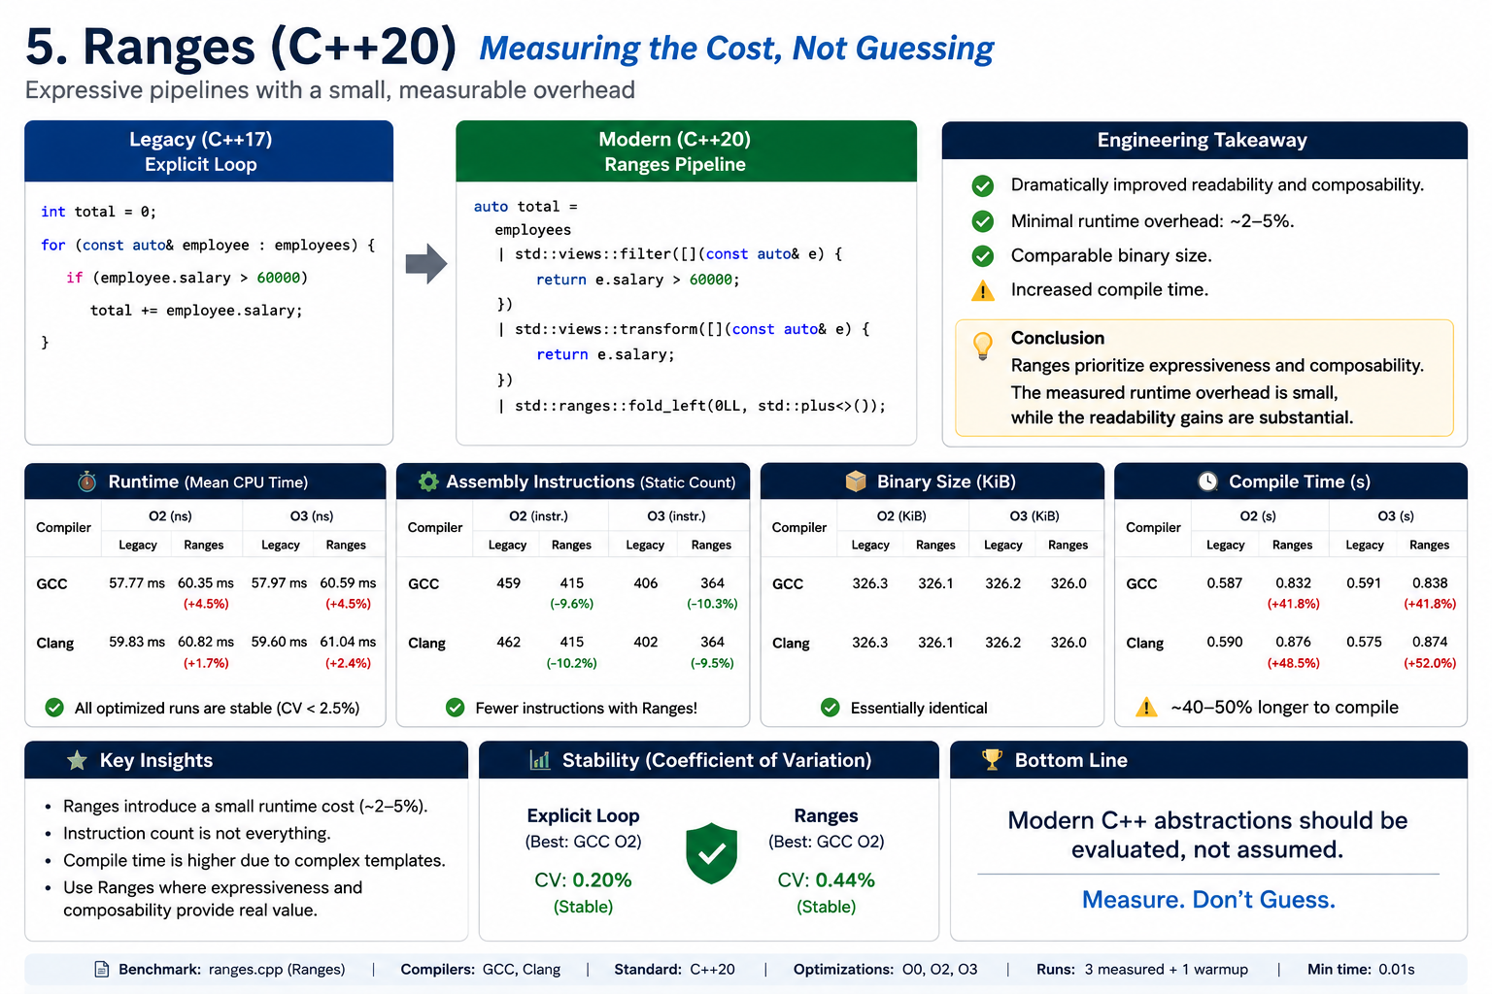
Measuring The Cost
CppCon 2026 · Modern C++: Reducing Boilerplate Without Sacrificing Performance
63

Slide 63
5
ENGINEERING PRINCIPLE
Compose Operations,
Don’t Orchestrate Them
CppCon 2026 · Modern C++: Reducing Boilerplate Without Sacrificing Performance
64

Slide 64
ONE PROBLEM REMAINS…
Sometimes…
there simply isn’t a value.
CppCon 2026 · Modern C++: Reducing Boilerplate Without Sacrificing Performance
65

Slide 65
TECHNIQUE
std::optional
Representing “No Value”
CppCon 2026 · Modern C++: Reducing Boilerplate Without Sacrificing Performance
66

Slide 66
Before C++17
Employee* FindEmployee(int id) {
}
for (const auto& employee : employees)
{
if (employee.id == id)
}
return nullptr;
return &employee;
CppCon 2026 · Modern C++: Reducing Boilerplate Without Sacrificing Performance
67

Slide 67
Another Common Pattern
int FindEmployeeIndex(int id) {
...
return -1;
}
CppCon 2026 · Modern C++: Reducing Boilerplate Without Sacrificing Performance
68

Slide 68
WHAT IS THE INTENT?
Either we have a value…
…or we don’t.
CppCon 2026 · Modern C++: Reducing Boilerplate Without Sacrificing Performance
69

Slide 69
C++17
std::optional<Employee> FindEmployee(int id)
{
}
for (const auto& employee : employees)
{
if (employee.id == id)
return employee;
}
return std::nullopt;
CppCon 2026 · Modern C++: Reducing Boilerplate Without Sacrificing Performance
70

Slide 70
Usage
auto employee = FindEmployee(id); if (employee)
{
}
Process(*employee);
CppCon 2026 · Modern C++: Reducing Boilerplate Without Sacrificing Performance
71

Slide 71
Behind The Language
Value
std::optional<T>
Contains a value?
Yes → holds T
No → empty (nullopt)
CppCon 2026 · Modern C++: Reducing Boilerplate Without Sacrificing Performance
72

Slide 72
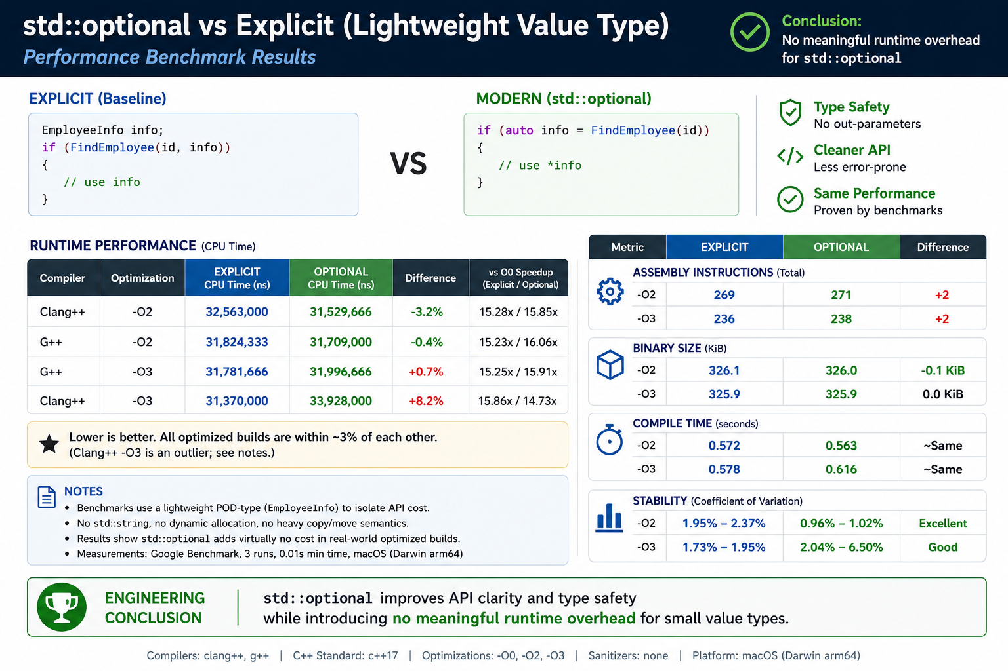
Measuring The Cost
CppCon 2026 · Modern C++: Reducing Boilerplate Without Sacrificing Performance
73

Slide 73
6
ENGINEERING PRINCIPLE
Make Invalid States
Impossible to Ignore
CppCon 2026 · Modern C++: Reducing Boilerplate Without Sacrificing Performance
74

Slide 74
NEXT QUESTION…
Sometimes…
a function can return
more than one valid type.
CppCon 2026 · Modern C++: Reducing Boilerplate Without Sacrificing Performance
75

Slide 75
TECHNIQUE
std::variant
Modeling Alternatives Explicitly
CppCon 2026 · Modern C++: Reducing Boilerplate Without Sacrificing Performance
76

Slide 76
Before C++17
struct Result {
bool isError;
Employee employee; std::string errorMessage;
};
CppCon 2026 · Modern C++: Reducing Boilerplate Without Sacrificing Performance
77

Slide 77
Another Common Design
class Shape {
public:
virtual void Draw() = 0;
};
class Circle : public Shape { ... };
class Rectangle : public Shape { ... };
CppCon 2026 · Modern C++: Reducing Boilerplate Without Sacrificing Performance
78

Slide 78
What Is The Intent?
THE INTENT
NOT…
One of several
valid possibilities.
flags,
magic values,
or unnecessary polymorphism.
CppCon 2026 · Modern C++: Reducing Boilerplate Without Sacrificing Performance
79

Slide 79
C++17
using Result =
std::variant<Employee, Error>;
Result FindEmployee(int id);
CppCon 2026 · Modern C++: Reducing Boilerplate Without Sacrificing Performance
80

Slide 80
Handling The Result
std::visit(
[](const auto& value)
{
},result);
Handle(value);
CppCon 2026 · Modern C++: Reducing Boilerplate Without Sacrificing Performance
81

Slide 81
Behind The Language
Alternatives A / B / C
std::variant
Exactly one active
CppCon 2026 · Modern C++: Reducing Boilerplate Without Sacrificing Performance
82

Slide 82
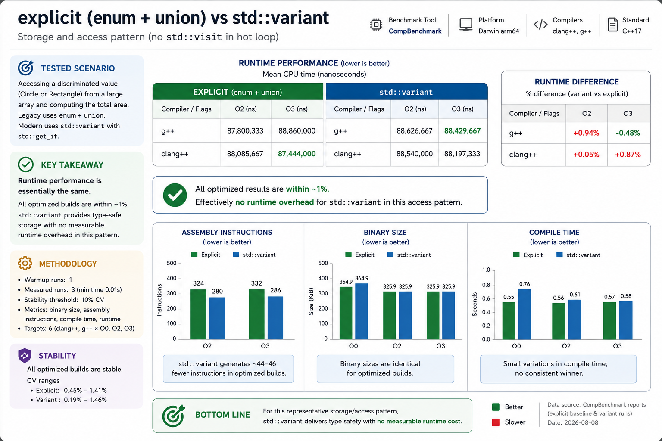
Measuring The Cost
CppCon 2026 · Modern C++: Reducing Boilerplate Without Sacrificing Performance
83

Slide 83
7
ENGINEERING PRINCIPLE
Model States in
the Type System
CppCon 2026 · Modern C++: Reducing Boilerplate Without Sacrificing Performance
84

Slide 84
NEXT QUESTION…
We’re still unpacking objects
one member at a time…
CppCon 2026 · Modern C++: Reducing Boilerplate Without Sacrificing Performance
85

Slide 85
TECHNIQUE
Structured Bindings
Unpacking Objects Naturally
CppCon 2026 · Modern C++: Reducing Boilerplate Without Sacrificing Performance
86

Slide 86
Before C++17
std::pair<int, std::string> employee = GetEmployee();
int id = employee.first;
std::string name = employee.second;
CppCon 2026 · Modern C++: Reducing Boilerplate Without Sacrificing Performance
87

Slide 87
What Is The Intent?
Employee
{ id, name }
CppCon 2026 · Modern C++: Reducing Boilerplate Without Sacrificing Performance
88

Slide 88
C++17
auto [id, name] = GetEmployee();
CppCon 2026 · Modern C++: Reducing Boilerplate Without Sacrificing Performance
89

Slide 89
Another Example
for (const auto& [id, employee] : employees)
{
}
Process(employee);
CppCon 2026 · Modern C++: Reducing Boilerplate Without Sacrificing Performance
90

Slide 90
Behind The Language
pair / tuple / struct
Structured Binding
Individual Variables
CppCon 2026 · Modern C++: Reducing Boilerplate Without Sacrificing Performance
91

Slide 91
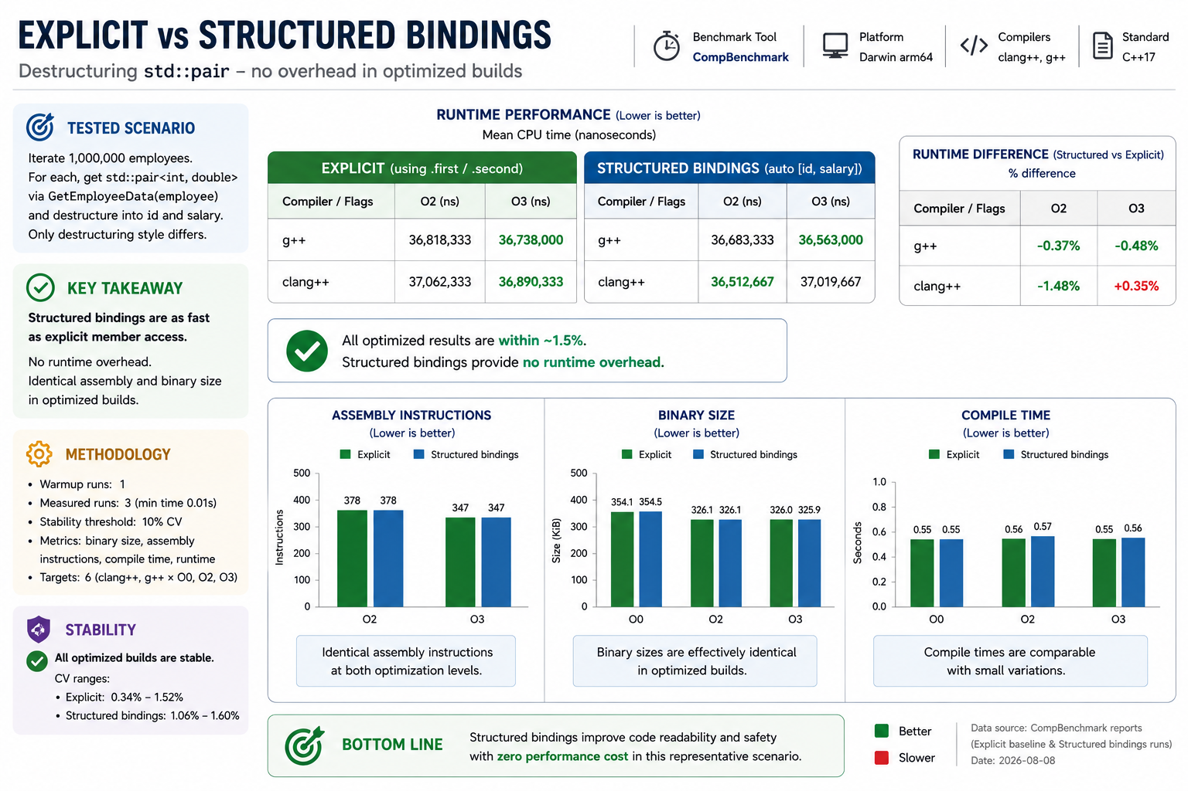
Measuring The Cost
CppCon 2026 · Modern C++: Reducing Boilerplate Without Sacrificing Performance
92

Slide 92
8
ENGINEERING PRINCIPLE
Name Concepts,
Not Storage
CppCon 2026 · Modern C++: Reducing Boilerplate Without Sacrificing Performance
93

Slide 93
NEXT QUESTION…
We’re still making decisions…
at runtime.
CppCon 2026 · Modern C++: Reducing Boilerplate Without Sacrificing Performance
94

Slide 94
TECHNIQUE
RAII
Resource Lifetime Is Not Business Logic
CppCon 2026 · Modern C++: Reducing Boilerplate Without Sacrificing Performance
95

Slide 95
Before RAII
FILE* file = fopen("employees.txt", "r");
if (file == nullptr)
{
}
ReadEmployees(file);
fclose(file);
return;
CppCon 2026 · Modern C++: Reducing Boilerplate Without Sacrificing Performance
96

Slide 96
The Real Problem
Acquire
Use
Release
The programmer must remember to release.
CppCon 2026 · Modern C++: Reducing Boilerplate Without Sacrificing Performance
97

Slide 97
Modern C++
std::ifstream file("employees.txt"); ReadEmployees(file);
CppCon 2026 · Modern C++: Reducing Boilerplate Without Sacrificing Performance
98

Slide 98
Behind The Language
Object Created
Constructor
Resource Acquired
Destructor
Resource Released
CppCon 2026 · Modern C++: Reducing Boilerplate Without Sacrificing Performance
99

Slide 99
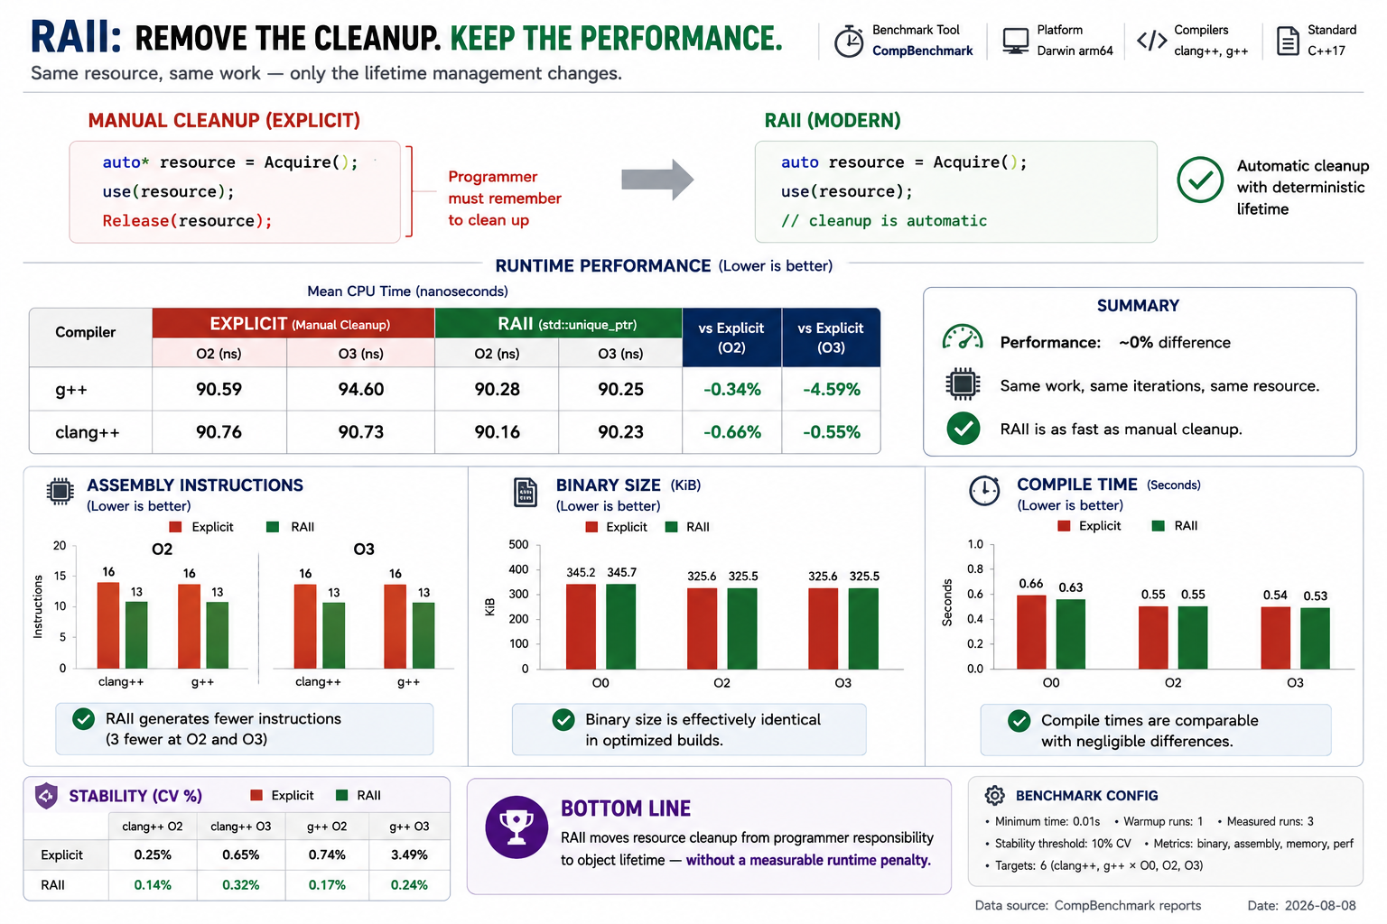
Measuring The Cost
CppCon 2026 · Modern C++: Reducing Boilerplate Without Sacrificing Performance
100

Slide 100
9
ENGINEERING PRINCIPLE
Tie Resource Lifetime
to Object Lifetime
CppCon 2026 · Modern C++: Reducing Boilerplate Without Sacrificing Performance
101

Slide 101
ONE MORE OBSERVATION…
We’ve moved types, loops, algorithms,
resources… to compile time.
Can we move computation
there too?
CppCon 2026 · Modern C++: Reducing Boilerplate Without Sacrificing Performance
102

Slide 102
TECHNIQUE
constexpr
Moving Computation To Compile Time
CppCon 2026 · Modern C++: Reducing Boilerplate Without Sacrificing Performance
103

Slide 103
Before C++11
double CircleArea(double radius)
{
}
double area = CircleArea(10.0);
return 3.141592653589793 * radius * radius;
CppCon 2026 · Modern C++: Reducing Boilerplate Without Sacrificing Performance
104

Slide 104
What Is The Intent?
Known Input
Known Result
CppCon 2026 · Modern C++: Reducing Boilerplate Without Sacrificing Performance
105

Slide 105
Modern C++
constexpr double CircleArea(double radius)
{
}
constexpr auto area = CircleArea(10.0);
return 3.141592653589793 * radius * radius;
CppCon 2026 · Modern C++: Reducing Boilerplate Without Sacrificing Performance
106

Slide 106
Behind The Language
Known Inputs
constexpr Function
Compiler Evaluation
Constant Value
CppCon 2026 · Modern C++: Reducing Boilerplate Without Sacrificing Performance
107

Slide 107
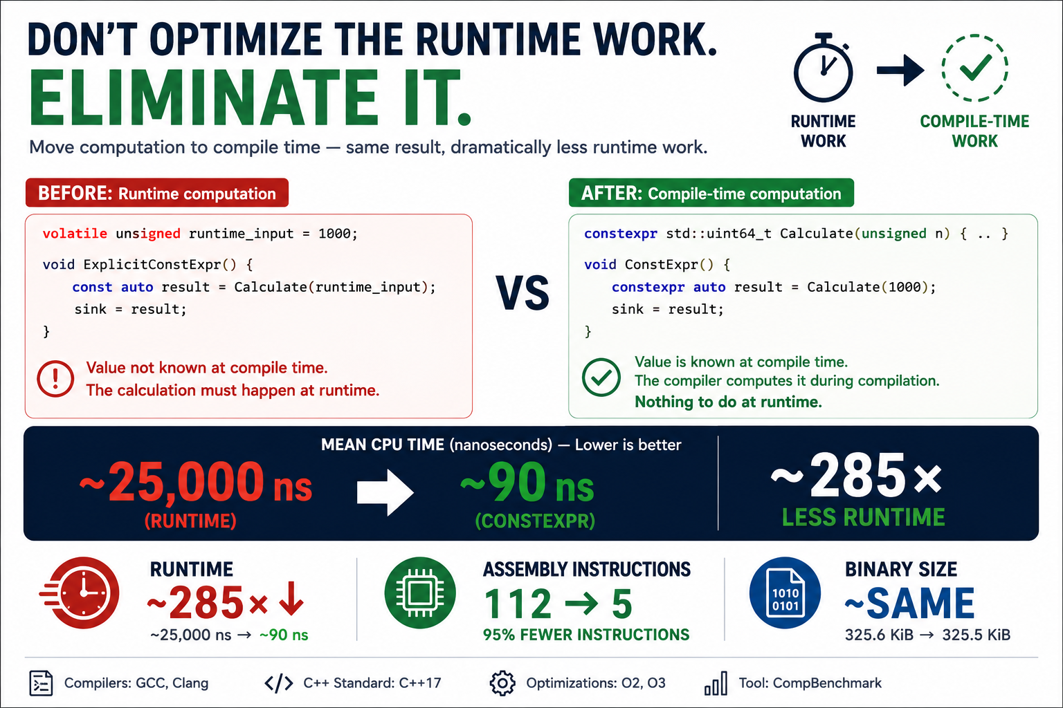
Measuring The Cost
CppCon 2026 · Modern C++: Reducing Boilerplate Without Sacrificing Performance
108

Slide 108
10
ENGINEERING PRINCIPLE
Perform Work as
Early as Possible
CppCon 2026 · Modern C++: Reducing Boilerplate Without Sacrificing Performance
109

Slide 109
WE’VE COME FULL CIRCLE…
From types… to computation…
the compiler has gradually taken
over repetitive work.
CppCon 2026 · Modern C++: Reducing Boilerplate Without Sacrificing Performance
110

Slide 110
TECHNIQUE
Putting It All Together
Refactoring Legacy C++
CppCon 2026 · Modern C++: Reducing Boilerplate Without Sacrificing Performance
111

Slide 111
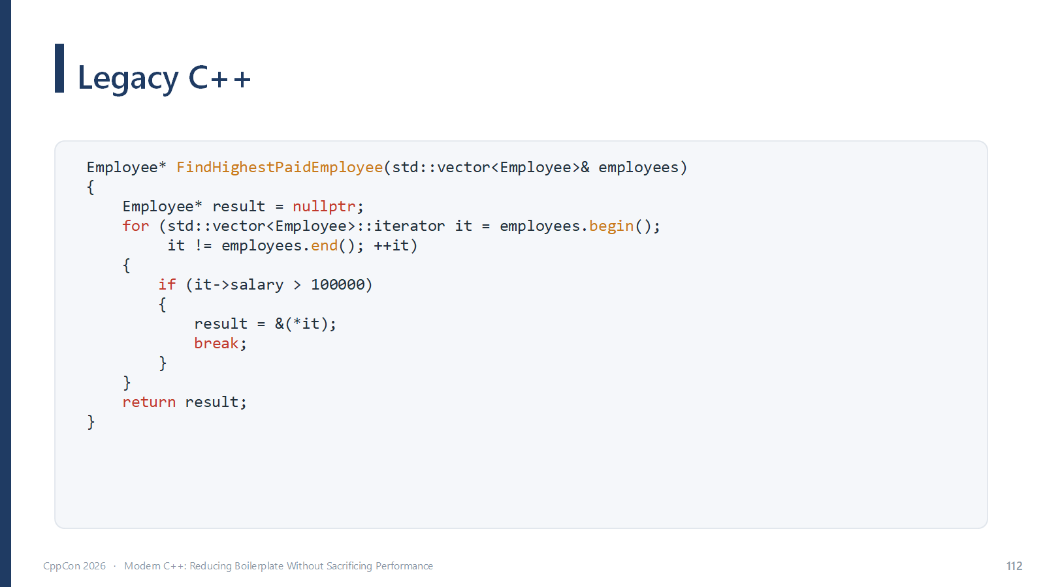
Legacy C++
Employee* FindHighestPaidEmployee(
std::vector<Employee>& employees)
Employee* result = nullptr;
for (std::vector<Employee>::iterator it = employees.begin();
{
}
it != employees.end(); ++it)
{
if (it->salary > 100000)
{
result = &(*it); break;
}
}
return result;
CppCon 2026 · Modern C++: Reducing Boilerplate Without Sacrificing Performance
112

Slide 112
WHAT DO WE REALLY WANT?
Find the first employee
earning more than 100,000.
CppCon 2026 · Modern C++: Reducing Boilerplate Without Sacrificing Performance
113

Slide 113
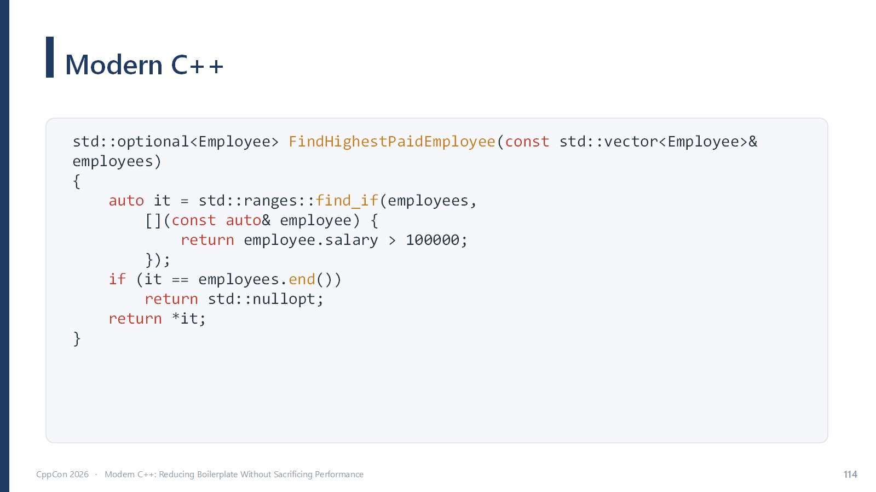
Modern C++
std::optional<Employee> FindHighestPaidEmployee(
const std::vector<Employee>& employees) auto it = std::ranges::find_if(
{
}
employees,
[](const auto& employee)
{
});
return employee.salary > 100000;
if (it == employees.end())
return std::nullopt;
return *it;
CppCon 2026 · Modern C++: Reducing Boilerplate Without Sacrificing Performance
114

Slide 114
What Changed?
BEFORE
AFTER
× Explicit iterator type
× Manual loop
× Function object
× nullptr sentinel
✓ auto
✓ std::ranges::find_if
✓ Lambda
✓ std::optional
CppCon 2026 · Modern C++: Reducing Boilerplate Without Sacrificing Performance
115

Slide 115
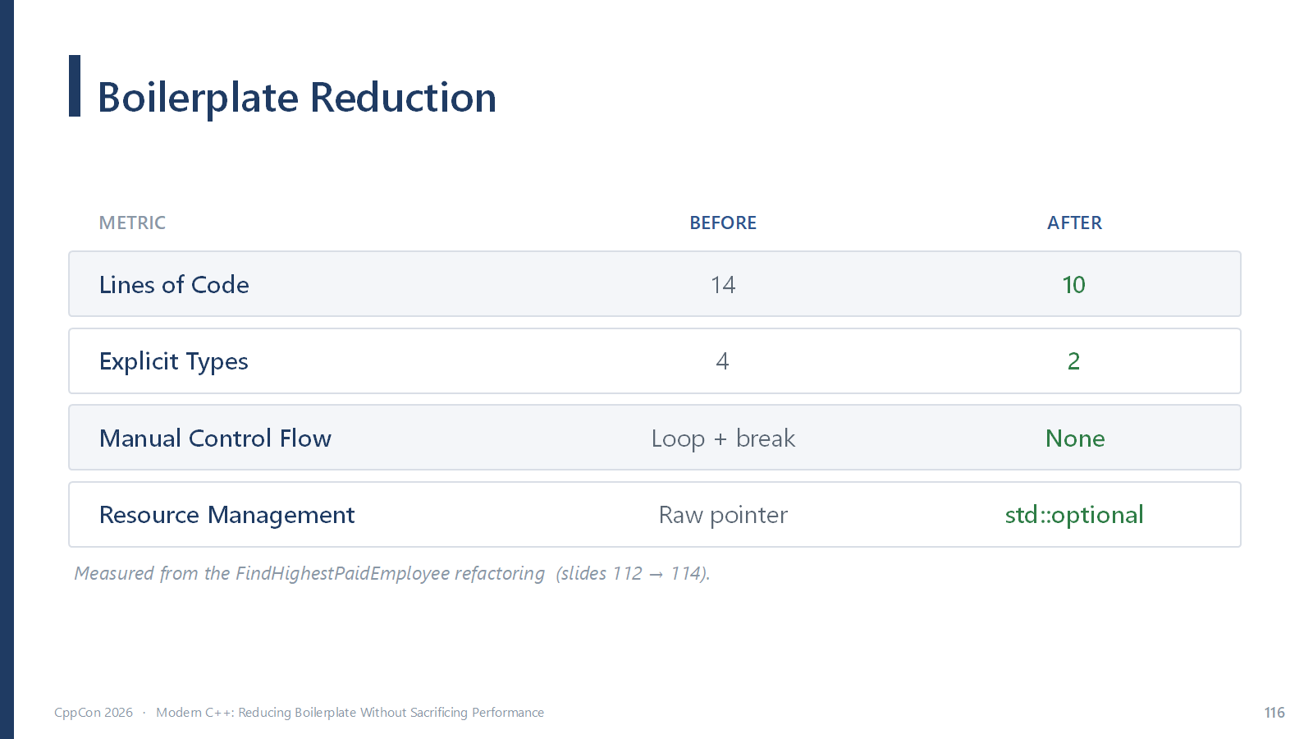
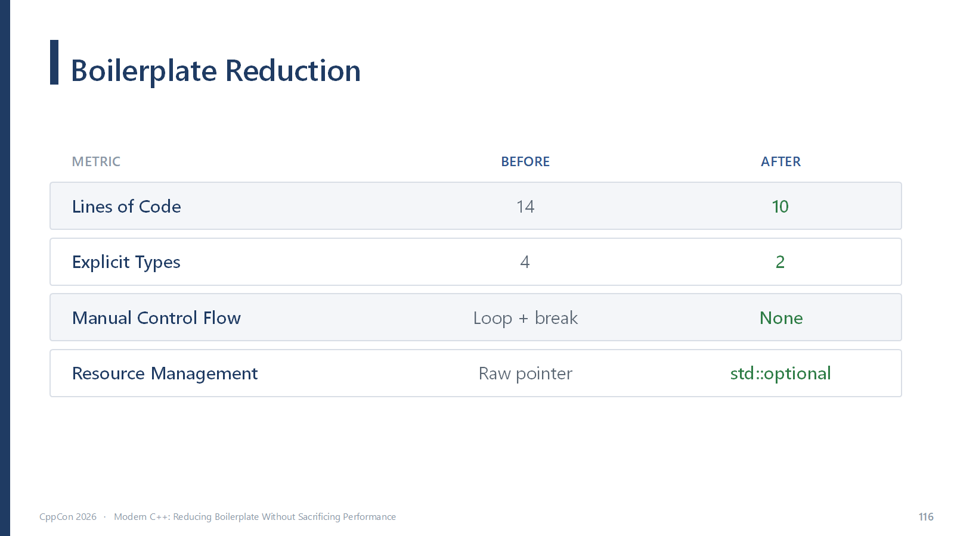
Boilerplate Reduction
METRIC
BEFORE
AFTER
Lines of Code
—
—
Explicit Types
—
—
Manual Control Flow
—
—
Resource Management
—
—
Populate with real measurements later.
CppCon 2026 · Modern C++: Reducing Boilerplate Without Sacrificing Performance
116

Slide 116
Engineering Principles
1
Eliminate Redundant Information
2
Express Intent, Not Mechanics
3
Standardize Common Patterns
4
Express Behavior, Not Infrastructure
5
Compose Operations
6
Make Invalid States Impossible to Ignore
7
Model States in the Type System
8
Name Concepts, Not Storage
9
Tie Resource Lifetime to Object Lifetime
10
Perform Work As Early As Possible
CppCon 2026 · Modern C++: Reducing Boilerplate Without Sacrificing Performance
118

Slide 117
ONE QUESTION REMAINS…
How were all these results
measured consistently?
CppCon 2026 · Modern C++: Reducing Boilerplate Without Sacrificing Performance
119

Slide 118
BEHIND THE NUMBERS
How were these
measurements collected?
CppCon 2026 · Modern C++: Reducing Boilerplate Without Sacrificing Performance
120

Slide 119
Every Benchmark
Source Code
Build
Execute
Collect Results
Compare
CppCon 2026 · Modern C++: Reducing Boilerplate Without Sacrificing Performance
121

Slide 120
CompBenchmark
Lightweight Benchmarking Framework
Runtime Benchmarks
Generated Assembly
Binary Size
GCC · Clang
CppCon 2026 · Modern C++: Reducing Boilerplate Without Sacrificing Performance
122

Slide 121
Why I Built It
✓
Repeatable measurements
✓
Cross-compiler comparisons
✓
Consistent methodology
✓
Evidence over assumptions
CppCon 2026 · Modern C++: Reducing Boilerplate Without Sacrificing Performance
123

Slide 122
11
ENGINEERING PRINCIPLE
Measure Before
You Optimize
Evidence beats intuition.
CppCon 2026 · Modern C++: Reducing Boilerplate Without Sacrificing Performance
124

Slide 123
There’s Much More…
●
Concepts
●
Coroutines
●
Modules
●
std::expected
●
std::mdspan
●
Executors
●
●
Reflection
Contracts
CppCon 2026 · Modern C++: Reducing Boilerplate Without Sacrificing Performance
130

Slide 124
One Common Theme
Less Repetition
Clearer Intent
Stronger Type System
Compiler Assistance
Better Software
CppCon 2026 · Modern C++: Reducing Boilerplate Without Sacrificing Performance
131

Slide 125
Modern C++
Less Ceremony.
More Intent.
Same Performance.
CppCon 2026 · Modern C++: Reducing Boilerplate Without Sacrificing Performance
132

Slide 126
Thank You!
Questions welcome — let's talk Modern C++.
EMAIL
vishnug97@email.com
LINKEDIN
https://www.linkedin.com/in/vishnu-gopinath-831376108/
CppCon 2026 · Modern C++: Reducing Boilerplate Without Sacrificing Performance
133

