Slide 1
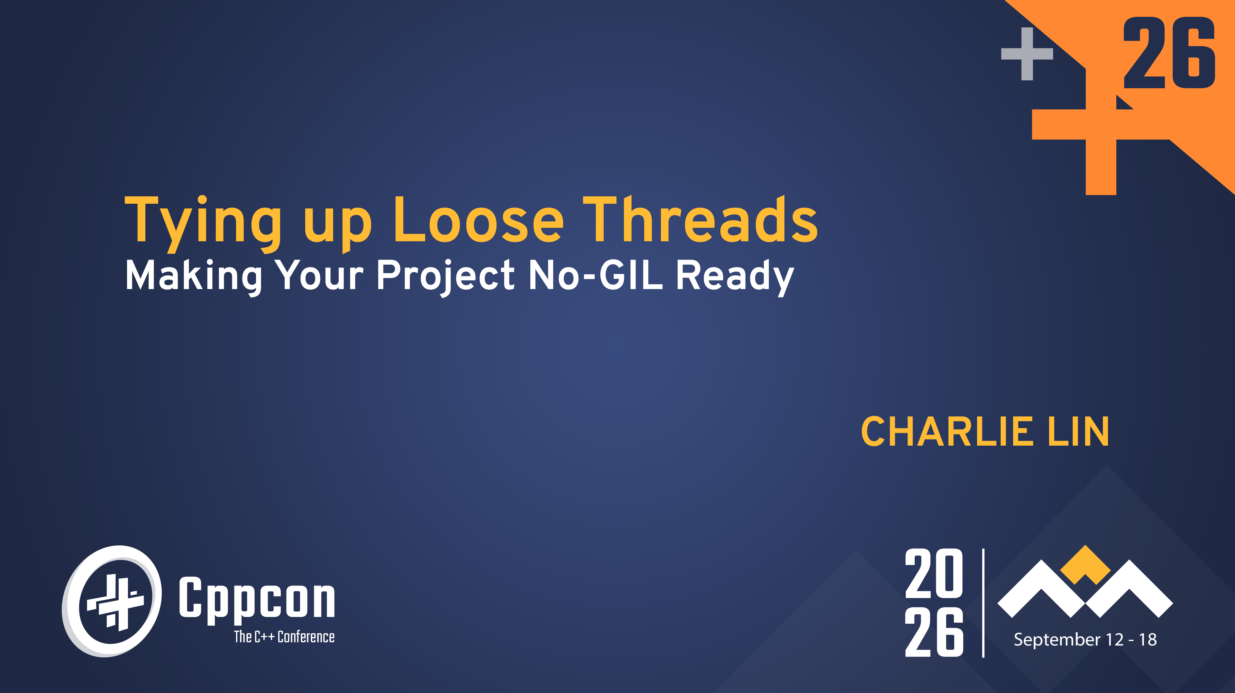

Slide 2

TYING UP LOOSE THREADS: MAKING YOUR PROJECT NO-GIL READY
(CppCon Edition)
Charlie Lin

Slide 3
Introduction
Sample in C++: gist.github.com/clin1234/60a028bbc78c5e258bf221ed31072a95
C version: gist.github.com/clin1234/ad871297b397c4859f230a3e5367a759

Slide 4
What is the GIL?
Only 1 thread can run Python code
  Concurrent access to objects
Extensions can manually release GIL
Notes:
The mechanism used by the CPython interpreter to assure that only one thread executes Python bytecode at a time. This simplifies the CPython implementation by making the object model (including critical built-in types such as dict) implicitly safe against concurrent access through serialization access. Locking the entire interpreter makes it easier for the interpreter to be multi-threaded, at the expense of much of the parallelism afforded by multi-processor machines.
Protect global state in extension code without explicit locking
However, some extension modules, either standard or third-party, are designed so as to release the GIL when doing computationally intensive tasks such as compression or hashing. Also, the GIL is always released when doing I/O.
As of Python 3.13, the GIL can be disabled using the --disable-gil build configuration. This feature enables improved performance for multi-threaded applications and makes it easier to use multi-core CPUs efficiently. For more details, see PEP 703.

Slide 5
Reasons to Rid the GIL
Existing appraches:
  Multiprocessing: overhead of starting interpreter per subprocess, serialization to shared memory required
  Manual release through C-API: not scalable
Difficult to scale for nunber-crunching, cumbersome to workaround (bottleneck with single-digit threads)
Notes:
PyTorch, Numpy, DeepMind: Python’s Global Interpreter Lock (GIL) creates several systemic challenges in scientific and high-performance computing:
Limited scalability for orchestration: Even when compute-heavy work runs in optimized native code, the Python layer that coordinates GPUs, threads, and tasks becomes a bottleneck as hardware scales (tens to thousands of devices).
Forced reliance on multiprocessing: To bypass the GIL, developers often use multiple processes instead of threads, which introduces significant complexity in coordination, inter-process communication, and resource management.
Poor multithreaded CPU utilization: Native extensions may release the GIL, but overall application-level parallelism remains limited. This leads to underutilization of multi-core systems or reliance on external libraries with their own threading models.
Fragmented parallelism model: Different components (e.g., numerical libraries, parallel frameworks) manage threads independently, causing issues like oversubscription, inconsistent performance, and the need for manual tuning.
Inefficient abstractions: Higher-level parallel frameworks introduce additional layers that complicate usage and reduce efficiency compared to straightforward multithreaded execution.
High IPC overhead: When using subprocesses, communication costs can outweigh the benefits of parallelism, especially for large data or frequent synchronization.
Many C and C++ libraries support access from multiple threads but do not support access or use across multiple processes.

Slide 6
Free-threading

Slide 7
What is the free-threaded interpreter?
Many simultaneous threads! PEP 703
minmalloc: GC objects without linked list & lighter locks for builtin types
Refcount changes
Container thread-safety
C API additions
Notes:
A threading model where multiple threads can run Python bytecode simultaneously within the same interpreter.

Slide 8
Memory allocator change
Pymalloc (regular)
Mimalloc (no-GIL)
PyObject_Malloc -> pymalloc -> arenas → pools → size classes → blocks
Freeing: last reference disappears -> object deallocated -> memory immediately returned to allocator freelist
Freeing
  Deferred reclaimation (quiescent-state based reclaimation)
  object becomes unreachable -> put it on delayed-free machinery -> wait until relevant threads have passed a quiescent-state barrier -> return memory
Notes:
pymalloc is CPython's specialized allocator for small allocations. It obtains large arenas, divides them into pools, and divides pools into fixed-size blocks.
The GIL supplies an important implicit property here: allocator metadata and Python object lifetime operations don't have to be designed around arbitrary simultaneous access by multiple Python threads. The allocator can therefore use relatively simple thread-local/global structures and reclaim blocks immediately.
Mimalloc: per-thread mimalloc heaps:
QSBR: page becomes reclaimable -> record qsbr_goal -> threads continue running -> _Py_qsbr_poll(...) -> safe to reclaim? If yes, free/recycle page
Prevents use-after-free during concurrent object/container operations
Cross-thread freeing: atomic cross-thread free list and CAS ops to publish blocks onto a page's thread-free list or a heap's delayed-free list.

Slide 9
Reference counting
Regular
Free-threaded
ob_refcnt member
Py_IncRef(),Py_DecRef()
  Refcnt == 0: free obj
Py_REFCNT(): return ob_refcnt
ob_ref_local, ob_ref_shared members
Special Py_DecRef()
Py_RefCnt(): sum of two members
Notes:
Free-threaded
current thread owns object, increment/decrement ob_ref_local, ordinary relaxed atomic load/store
Thread A owns object, Thread B acquires reference, B cannot modify A's local count, B increments ob_ref_shared
Check if threads own obj
Yes: ob_ref_local--: local == 0 shared == 0 → object really dies, local == 0 shared != 0 → somebody else still owns references → merge/transfer state
No: ob_ref_shared—
Both 0: deferred free

Slide 10
C API – Thread Safety & Critical Sections
list, set, dict, bytearray, memoryview: internal fine-grained per-object lock
# NOT thread-safe: iteration while modifying
for item in objlist:
process(item) # another thread may modify objlist
# NOT atomic: read-modify-write
map[key] = map[key] + 1
# NOT atomic: check-then-act (TOCTOU)
if num in numset:
s.remove(num)
Critical section: Python thread acquires lock to acquire (implicit) PyMutex
// read the count, returns new reference to internal count value
PyObject *result;
Py_BEGIN_CRITICAL_SECTION(obj);
result = Py_NewRef(obj->count);
Py_END_CRITICAL_SECTION();
return result;
// write the count, consumes reference from new_count
Py_BEGIN_CRITICAL_SECTION(obj);
obj->count = new_count;
Py_END_CRITICAL_SECTION();
Notes:
Read or wite: acquire per-object lock
Py_BEGIN_CRITICAL_SECTION and Py_END_CRITICAL_SECTION - For locking a single object
Py_BEGIN_CRITICAL_SECTION2 and Py_END_CRITICAL_SECTION2 - For locking two objects simultaneously
Critical sections: most useful for custom types to be exported to Python
automatically release and reacquire locks around potential blocking operations
Critical sections help avoid deadlocks in two ways:
If a thread tries to acquire a lock that’s already held by another thread, it first suspends all of its active critical sections, temporarily releasing their locks
When the blocking operation completes, only the top-most critical section is reacquired first
Do not use on operations involving built-in types, do not nest critical sections

Slide 11
Pybind11’s scoped_critical_section
#include <pybind11/critical_section.h>
#include <pybind11/pybind11.h>
namespace py = pybind11;
PYBIND11_MODULE(example, m, py::mod_gil_not_used()) {
m.def("nextnoo", []() {
size_t old; py::dict g = py::globals();
py::scoped_critical_section guard(g);
if (!g.contains(“noo")) g[“noo"] = 0;
old = g[“noo"];
g[“noo"] = (old * 3) % 100;
return old;
});
}
Notes:
Can lock up to 2 objs, same caveats apply

Slide 12
C API – Borrowed References
// Returns borrowed instance
PyObject *item = PyList_GetItem(list, idx);
// Another thread may modify “item”, even destroy it
// Borrowed -> new strong instance
Py_INCREF(item);
No GIL: C API functions returning borrowed reference not thread-safe when they reference objects subject to concurrent modification
Not all functions returning borrowed instances are thread-unsafe without GIL:
  PyTuple_GetItem() : immutable
  C API Reference Manual: thread-safe without GIL
Notes:
Borrowed reference: reference to object when code using object doesn’t own it
Dangling when object is destroyed (due to GC)
Strong reference: reference to object owned by code using object
Py_INCREF and Py_DECREF
No need to fret in pybind11:

Slide 13
Porting tips

Slide 14
C/C++/Rust code…
pybind11
PyO3
#include <pybind11/pybind11.h>
namespace py = pybind11;
PYBIND11_MODULE(example, m, py::mod_gil_not_used()) {
...
}
#[pymodule(gil_used = false)]
fn my_module(py: Python, m: &Bound<'_, PyModule>) -> PyResult<()> {
...
}

Slide 15
C/C++/Rust code…
Global cache
Global to thread-local state
Disable if not performance-critical
Cache in PyInit (single-phase only)
#ifdef Py_GIL_DISABLED
static PyMutex cache_lock = {0};
#define LOCK() PyMutex_Lock(&cache_lock)
#define UNLOCK() PyMutex_Unlock(&cache_lock)
#else
#define LOCK()
#define UNLOCK()
#endif
static int *cache = NULL;
static PyObject *global_table = NULL;
int initialize_table(void) { // called during module initialization
global_table = PyDict_New(); return; }
int function_accessing_the_cache(void) { LOCK(); // use the cache
UNLOCK(); }
Python and Cython: threading.local.
C/C++: Py_tss API: thread-local Python objects or thread_local for native objects
Notes:
Threading.local: GIL limits the performance gains of threading when it comes to CPU-bound tasks, as only one thread can execute Python bytecode at a time
C/C++: Py_tss for exporting data within extension to Python (threading.local uses this)

Slide 16
C/C++/Rust code…
setuptools
meson
from Cython.Compiler.Version import version as cython_version
from packaging.version import Version
compiler_directives = {}
if Version(cython_version) >= Version("3.1.0"): compiler_directives["freethreading_compatible"] = True
setup( ext_modules=cythonize( extensions, compiler_directives=compiler_directives, ) )
cy = meson.get_compiler('cython’)
if cy.version().version_compare('>=3.1.0’) add_project_arguments('-Xfreethreading_compatible=true', language : 'cython’)
endif
Notes:
Cython gives you the combined power of Python and C to let you
write Python code that calls back and forth from and to C or C++ code natively at any point.
easily tune readable Python code into plain C performance by adding static type declarations, also in Python syntax.
use combined source code level debugging to find bugs in your Python, Cython and C code.
interact efficiently with large data sets, e.g. using multi-dimensional NumPy arrays.
quickly build your applications within the large, mature and widely used CPython ecosystem.
integrate natively with existing code and data from legacy, low-level or high-performance libraries and applications.

Slide 17
C/C++/Rust code…
Multi-phase
Single-phase
static PyModuleDef_Slot module_slots[] = {
...
#ifdef Py_GIL_DISABLED
{Py_mod_gil, Py_MOD_GIL_NOT_USED},
#endif
{0, NULL},
};
static struct PyModuleDef moduledef = {
PyModuleDef_HEAD_INIT,
.m_slots = module_slots,
...
};
PyMODINIT_FUNC PyInit__module(void) {
PyObject *mod = PyModule_Create(&module);
if (mod == NULL) { return NULL; }
#ifdef Py_GIL_DISABLED PyUnstable_Module_SetGIL(mod, Py_MOD_GIL_NOT_USED);
#endif
return mod;
}
Notes:
Single: The module initialization function may create and return the module object directly
Multi: Initialization is split between the creation phase, when the module object is created, and the execution phase, when it is populated..
Expected to support sub-interpreters In parallel, separate GIL per interpreter in same shared process
Each instance of an extension module should be isolated: changes to one instance should not implicitly affect the others, and all state, including references to Python objects, should be specific to a particular module instance.
Pybind11 only supports multi-phase

Slide 18
CI
Setup/actions
cibuildwheel
jobs:
free-threaded:
runs-on: ubuntu-latest
steps:
- uses: actions/checkout@...
- uses: actions/setup-python@...
with:
python-version: 3.14t
freethreading: true
- name: Build wheels
uses: pypa/cibuildwheel@...
env:
CIBW_ENABLE: cpython-freethreading

Slide 19
Tests
Force disabling of GIL: -X gil=0 or environment variable PYTHON_GIL=0
Unit testing: pytest-run-parallel, unittest-ft
Functionality that is known not to be thread-safe includes:
pytest.warns on Python 3.13 and older, it relies on warnings.catch_warnings, which is not thread-safe until Python 3.14, and even then only on the free-threaded build by default.
The tmp_path and tmpdir fixtures, since they rely on the filesystem
The capsys fixture, because of shared use of sys.stdout and sys.stderr.
The monkeypatch fixture, since monkeypatching inherently modifies global state in a class or module.
TSan, ASan
Cpython_sanity: Docker images of Python interpreters with TSan and ASan
Notes:
Pytest is not thread-safe!
Tsan: checks for data races (>2 threads access the same variable concurrently and at least one of the accesses is writing)
Asan:
Use after free (dangling pointer dereference)
Heap buffer overflow
Stack buffer overflow
Global buffer overflow
Use after return
Use after scope
Initialization order bugs
Memory leaks

Slide 20
Other helpful stuff
github.com/iskandergaba/free-threading.git: wraps threading (no-GIL) and multiprocessing (GIL)
  github.com/devdanzin/ft-review-toolkit: Claude Code plugin to test no-GIL for C/C++ extensions: thread-safety bugs, triaging ThreadSanitizer reports.
Notes:
TLDR: scipy is mostly thread-safe, some synchronization of global vars helpful

Slide 21

_{Closing remarks}

Slide 22

Current progress
61% of most popular wheels in PyPI is free-threaded compatible!

Slide 23

Closing remarks
Bump dependencies!
https://py-free-threading.github.io/
https://docs.python.org/3/howto/free-threading-extensions.html#freethreading-extensions-howto
https://peps.python.org/pep-0703/#overview-of-cpython-changes
https://docs.python.org/3/howto/free-threading-python.html#freethreading-python-howto
C API Extension Support for Free Threading — Python 3.14.4 documentation
C/C++ extensions reports generated with https://github.com/devdanzin/cext-review-toolkit
Free-thread toolkit reports, generated with https://github.com/devdanzin/ft-review-toolkit
Proof:

Slide 24

Q & A
PLEASE ASK AWAY!

