Slide 1
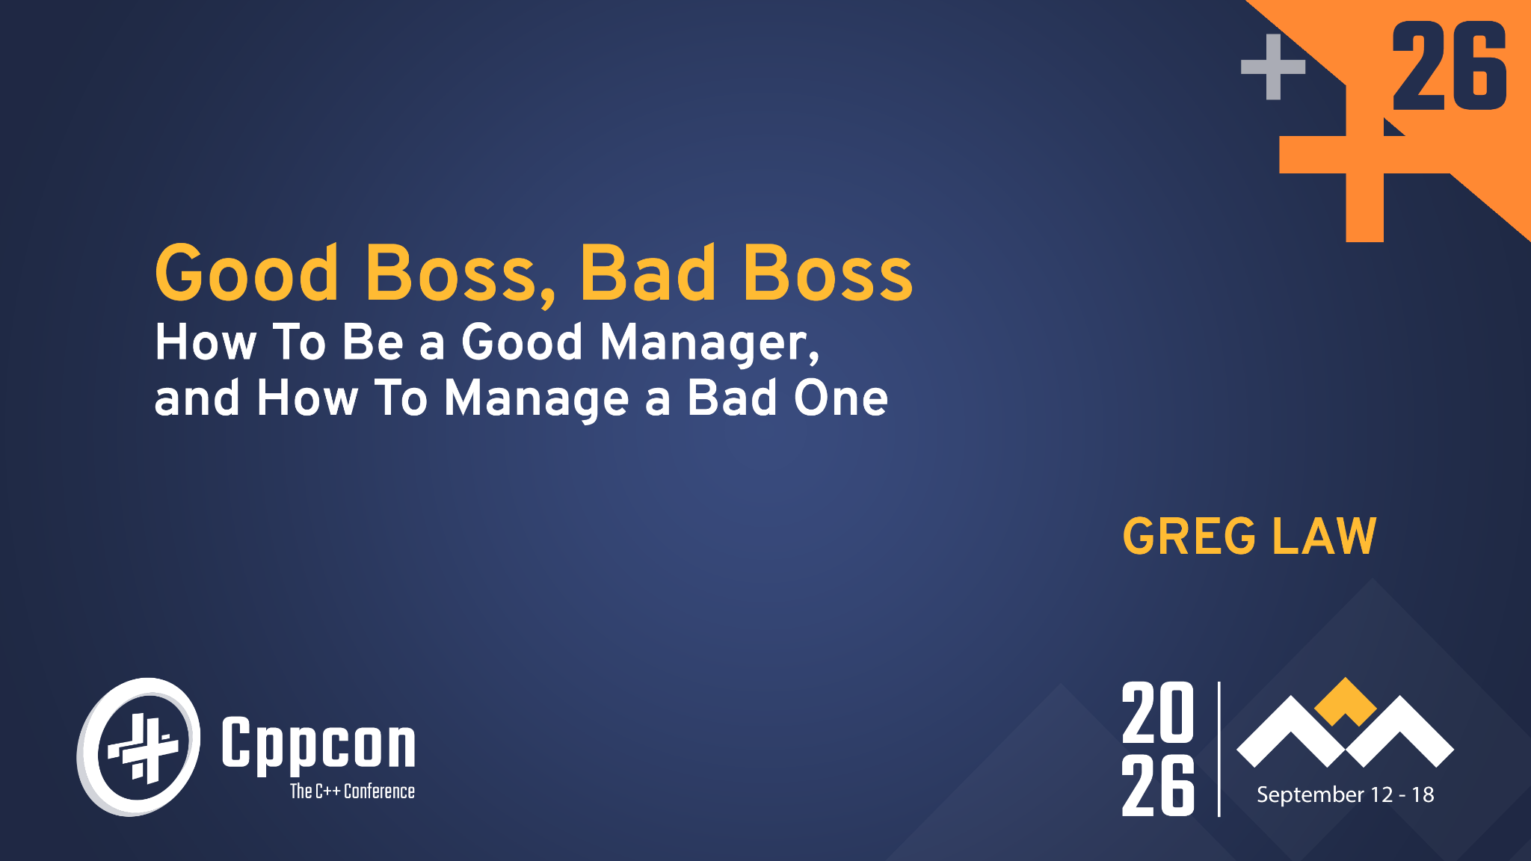
TIME TRAVEL DEBUGGING
RECORD. REPLAY. RESOLVE.

Slide 2
ABOUT ME
Programmer
Architect
Manager
Founder/CEO
CTO
CEO

Slide 3
ABOUT YOU
Maybe you’re:
Recently or about to step into line management.
In a leadership position.
Managing a bad boss.

Slide 4
IC vs MANAGEMENT TRACKS
8
8
7
7
6
6
5
5
4
4
3
Management
2
1
Individual
contributor

Slide 5

WHAT GOT YOU HERE WON’T GET YOU THERE
Old World | New World
Speak up | Shut up
Be right | Be effective
What you say | How you say it
Be smart | Empathise
Provide answers | Ask questions
Have good ideas | Create energy

Slide 6

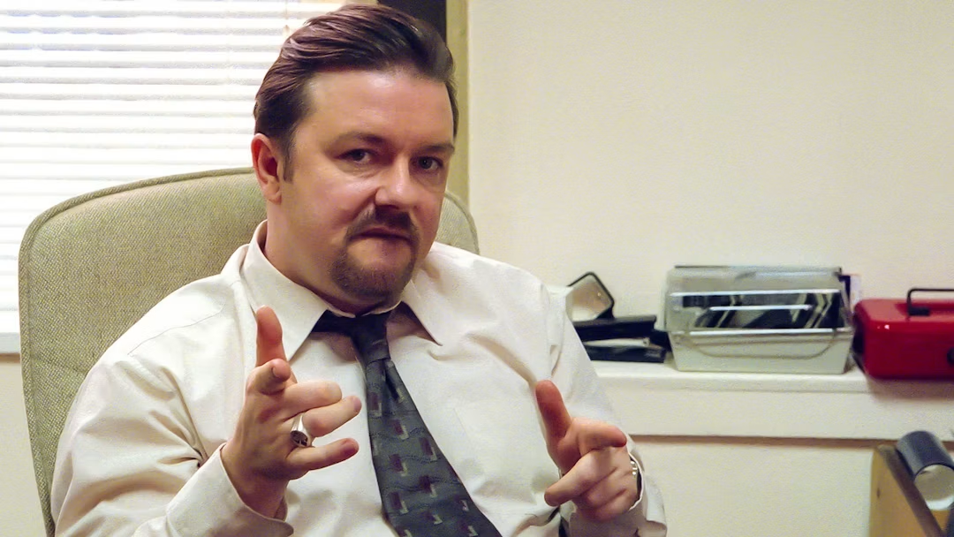
CONFIDENCE

Slide 7
DAVID BRENT & MICHAEL SCOTT ARE BAD BOSSES
Uncomfortable in own skin.
Lack of confidence.
Need to be liked.
Try too hard.
Micromanaging.
Lack of empathy / awareness.

Slide 8
DAVID BRENT & MICHAEL SCOTT ARE NOT BAD BOSSES
Authentic self.
Caring about people.

Slide 9
CARING TOO MUCH & TRYING TOO HARD
Leads to:
Inauthenticity
Micro-management
Ignore people’s needs
“Be the leader that only you can be”

Slide 10
TEAMS

Slide 11

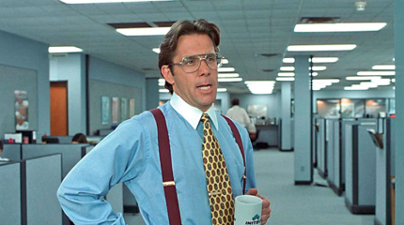
COACH OR CAPTAIN?
To code or not to code?

Slide 12
TEAMS
Everyone on the team:
Shares a common, non-trivial goal.
Has the ability and desire to achieve that goal.
Is needed to achieve that goal.
Feels accountable.
Holds each other accountable (see trust).
Succeeds or fails together, as a team.

Slide 13
CREATING A TRUE TEAM IS REALLY EXPENSIVE!
Need to optimise for the long-term not near-term objectives.
Often it just isn’t worth the cost - you need to decide when to do it.
Know what timeline you are optimising for.

Slide 14
OBJECTIVES
Cannot be a team without clear objectives.
Ideally quantifiable but only where possible:
  Goodhart’s Law
    A measure ceases to be a good measure when it becomes a target.
  Can be mitigated by one or two balancing targets.

Slide 15
OBJECTIVES AND KEY RESULTS (OKRs)
Objective: Achieve Product-Market Fit for our new website
Key results:
Increase conversion rate of free trials to paid from 10% to 25%
Maintain number of trials at least 200 per month.

Slide 16
TRUST
Actions
Motives
Judgement
Groupthink: When amiability and agreement-seeking prevent independent critical thinking

Slide 17
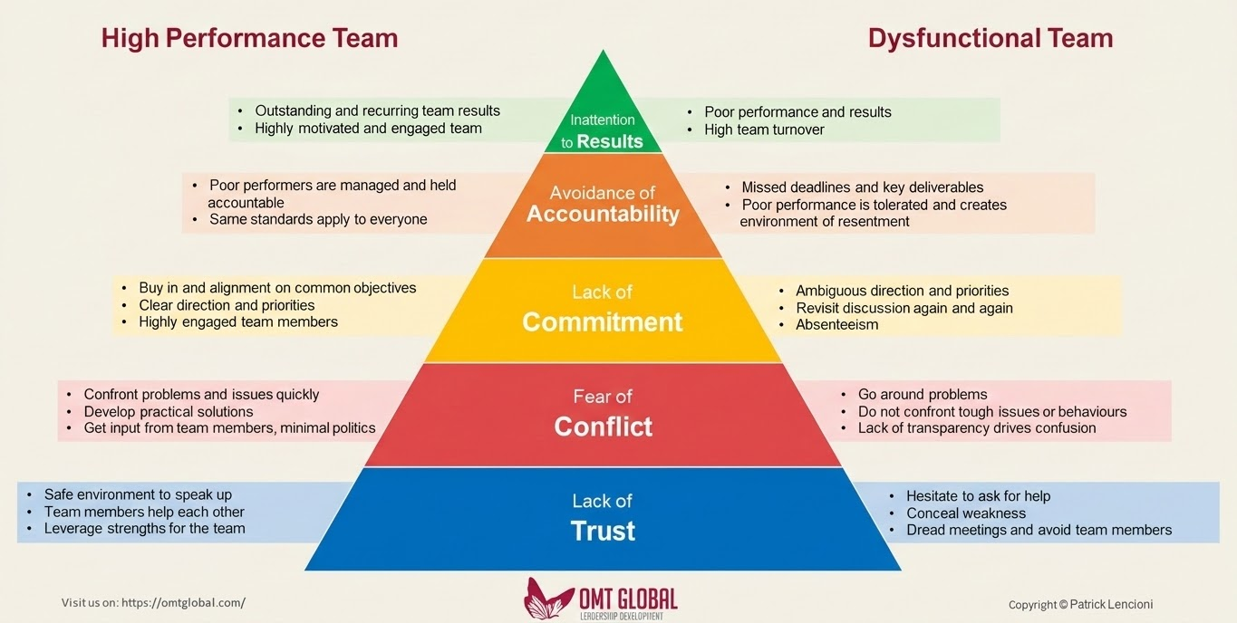
FIVE DYSFUNCTIONS OF A TEAM

Slide 18
MICRO MANAGEMENT
Set clear team-level objectives, let others decide the best way to achieve them.
Tell someone how to achieve a goal, and you remove their accountability.
Know when to step in (“I have control”).

Slide 19
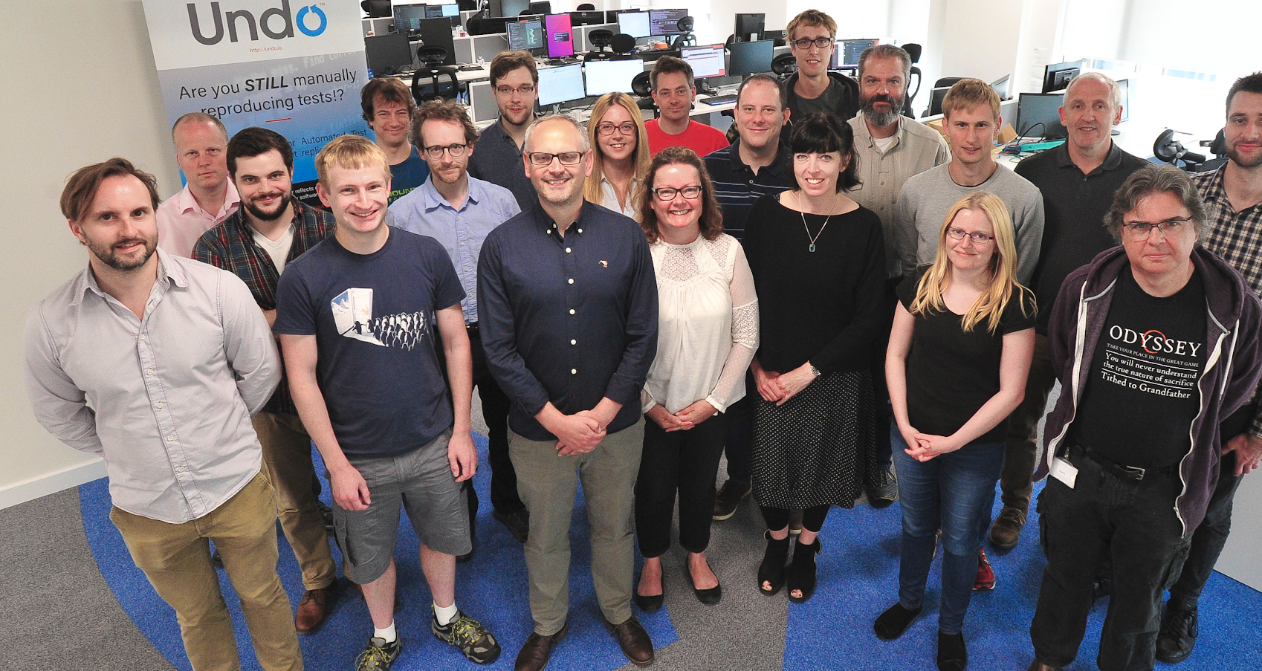

Slide 20
UNCERTAINTY AND LACK OF CONTROL
The more senior you are, the less control you have
but you’re still accountable for the outcomes

Slide 21
HIRING & FIRING

Slide 22
HIRING PEOPLE
What are you selecting for?
Not someone who interviews well.
Get “backdoor” references.

Slide 24
FIRING PEOPLE
Being a great place to work means working with great people.
Mediocrity is the killer of great teams.
It should not be a surprise to them - or to you.
Be respectful to them.
Think about the team.
“No-one ever got fired too soon”

Slide 25
COACHING PEOPLE
Do not lead the witness
Very hard when you’re invested in the outcome

Slide 26
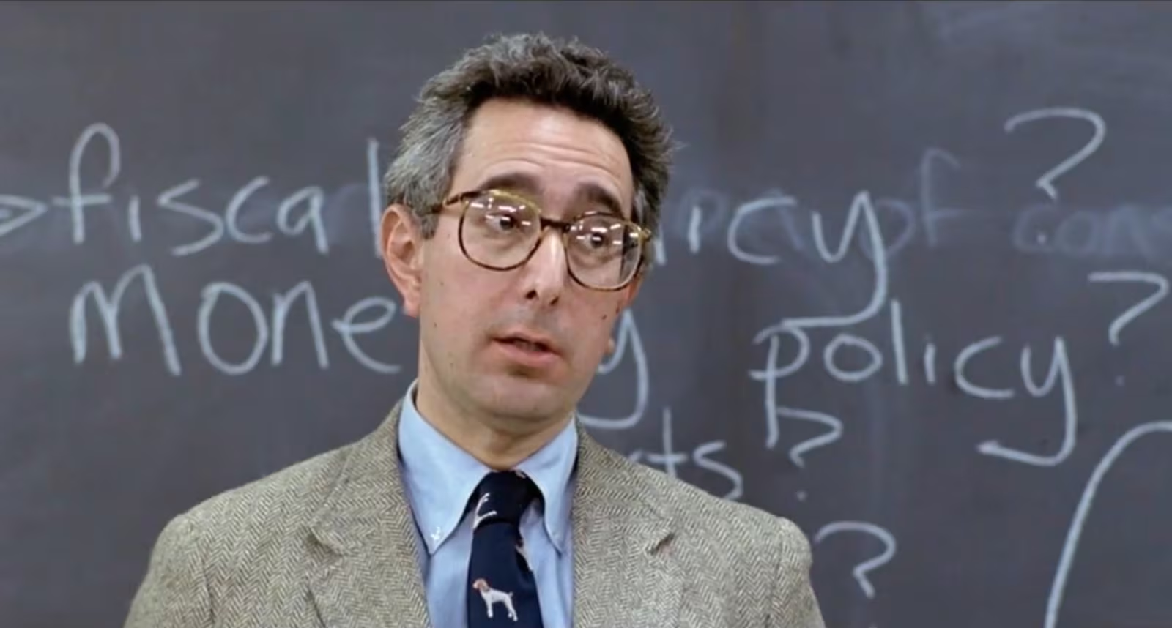

Slide 27

PICARD MANAGEMENT TIPS

Slide 28
TIPS FOR BEING A GOOD BOSS

Slide 29
FAILING OPENLY
Own your mistakes.
React well to others’ mistakes.

Slide 31
POWER DYNAMICS ARE A THING
You cannot be ‘one of the guys’ anymore.
This doesn’t mean you should be aloof.
Be authentic at all times.

Slide 32
LEADERSHIP & ‘WHY?’
A leader is someone who others choose to follow.
Cannot be done by asserting authority.
Make sure people understand why.
CAUTION: avoid using the word!

Slide 33


Slide 34


Slide 36
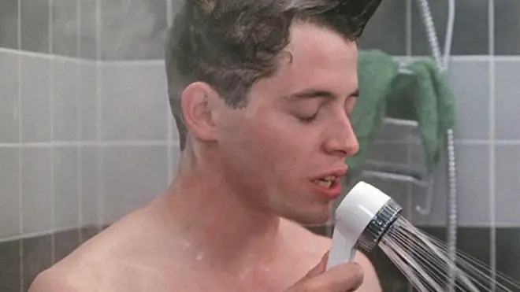

Slide 37
FEEDBACK

Slide 38
HOW TO GIVE FEEDBACK
When it’s good:
Immediate
Specific
Public
When it’s bad:
Later
Generic
Private

Slide 39
APPRAISAL TIME
Don't’ wait for the appraisal.
No critical feedback in an appraisal should be a surprise.

Slide 40
MANAGING A BAD BOSS

Slide 41
BE THE BETTER HUMAN
All bosses are fundamentally bad at being human
Lack of confidence.
Ego getting in the way.
Imposter syndrome / trying to be something they’re not.
humans

Slide 42
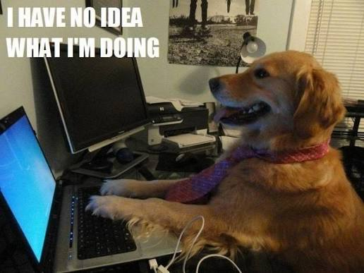
MANAGING A BAD BOSS
How to train your dragon
If your boss is irredeemably bad: quit.
Are you in the very best place for your development?
Tell their boss, after you quit
Otherwise:
Tell them
  “I feel …” rather than “You ….”)

Slide 43
MANAGING A BAD BOSS
Empathise
Identify what is driving the behaviour (it probably isn’t you!)
You cannot control what others do to you, only your reactions.
Do not seek their approval.
If they’re being mean it may be a good sign.

Slide 44
MANAGING UP
We teach people how to treat us.
Give clear answers (and don’t worry about being wrong)
Don’t hedge.
Don’t give in to time estimate pressures: everyone can hate you now, or at the end.
Don’t try to explain to them why their question doesn’t make sense.
When you don’t know, just say so.
Be clear that you own it.
Don’t be defensive.

Slide 45
KNOW WHEN TO ‘CHUCK THEM A BONE’
Try to understand what is driving their behaviour but know that you probably won’t.
When someone smart says or does something obviously stupid, it usually means there is context you’re not aware of.
Can you make them feel more confident?
Teach them this content.

Slide 46
WRAPPING UP

Slide 47
MOST IMPORTANT
Trust.
Let go.
Never start a presentation with an apology.

Slide 48


Slide 49
MOST IMPORTANT
Trust.
Let go.
Never start a presentation with an apology.
It’s not what you do it’s the way that you do it.

Slide 50
VISIT UNDO.IO TO LEARN MORE

