Slide 1
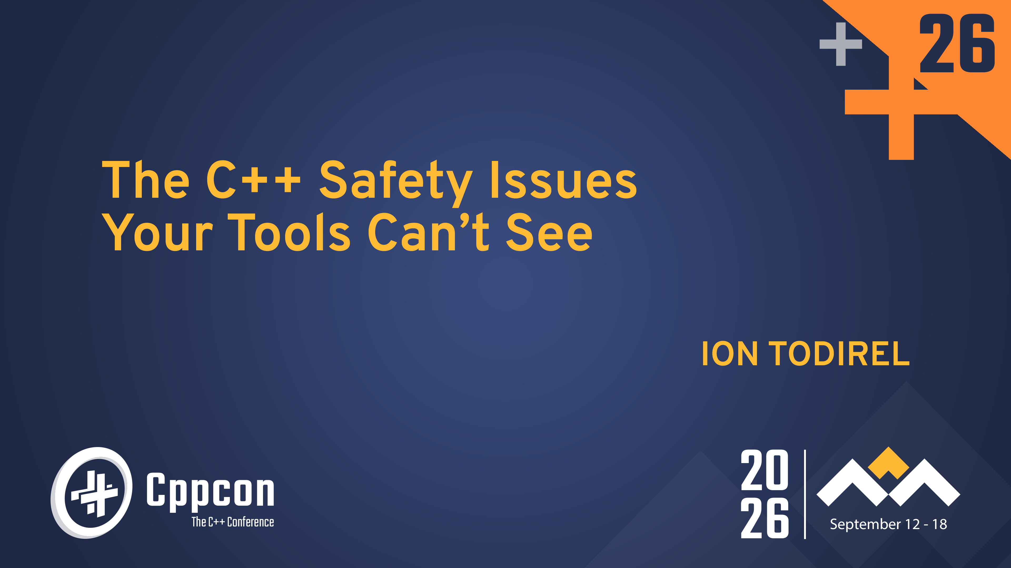
Notes:
<introduction>
Welcome folks. My name is Ion Todirel, I’m an engineering lead at Microsoft in the C++ team.
Thank you for coming to my talk!

Slide 2
The C++ Safety Issues
Your Tools Can’t See
CppCon 2026
Ion Todirel
Engineering lead at Microsoft
Notes:
Title slide in the style of the deck.

Slide 3
Microsoft at CppCon 2026
Five sessions from Microsoft and the C++ team. Come find us at the booth.
MON
Sep 14
15:15 - 16:15
The journey to "/W4 /WX": How hard could it be?
Keith Stockdale · GameDev
MON
Sep 14
16:45 - 17:45
C++ in the Age of AI: How Visual Studio Is Evolving
David Li, Augustin Popa · Performance, Safety, Security, Standard Library, Tooling/Utilities
TUE
Sep 15
09:00 - 10:00
What's New for C++ in Visual Studio Code: C++ and AI Tooling for Your Build, Your Code, Your Workflow
Sinem Akinci, Ben McMorran · Tooling & Ecosystem
WED
Sep 16
14:00 - 15:00
Turbocharging Native Code Performance: Compiler Optimizations, Profile-guided Optimizations, and Beyond
Eric Brumer · Tooling & Ecosystem
THU
Sep 17
15:15 - 16:15
The C++ Safety Issues Your Tools Can't See
Ion Todirel · Future C++, Safety, Security, Software Quality
You are here
cppcon2026.sched.com
Notes:
Microsoft had 5 talks this year. This is the last talk in the series. I hope you had a great cppcon experience so far.
Come find us at the booth.

Slide 4
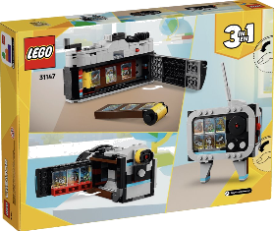
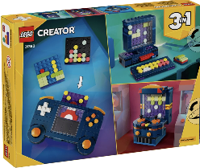



Take the survey,
win a LEGO set
Scan the code with your phone. Takes about two minutes.
LEGO Creator 3-in-1
Retro camera
LEGO Creator 3-in-1
Game console
LEGO Botanicals
Orchid
LEGO Art
Milky Way galaxy

Slide 5
Why another safety talk
Part I

Slide 6


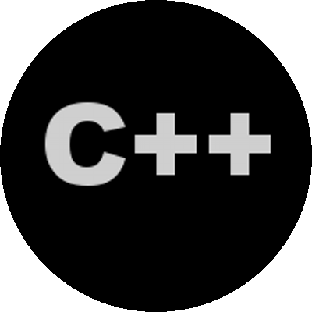


A decade of C++ safety talks
A. Tzur-El The Dangers of C++: Write Safe C++ (2025)
youtu.be/6eYCMcOYbYA
K. Iglberger The Real Problem of C++ (2025)
youtu.be/gHarUq_k-_Y
B. Moczulski Shadow Stack: Ultimate C/C++ Safety (2025)
youtu.be/-Qg0GaONwPE
Martin & Fairhurst Validating Contracts with Static Analysis (2025)
youtu.be/3DDqDKaKmio
J. Lakos Making C++ Safe, Healthy, and Efficient (2025)
youtu.be/p52mNWsh-qs
V. G. Nath Sanitize It Before You Ship It: Concurrency Bugs (2025)
youtu.be/jzcGATR78Mk
H. Sutter The Joy of C++26 Contracts (2025)
youtu.be/oitYvDe4nps
H. Sutter Peering Forward — C++’s Next Decade (2024)
youtu.be/FNi1-x4pojs
M. Svetkin Harnessing constexpr: A Path to Safer C++ (2025)
youtu.be/2WDPizKCaZo
A. Rousseau An Adversarial Mindset for C++ Security (keynote) (2024)
youtu.be/glkMbNLogZE
J. Lakos What C++ Needs to be Safe (2025)
youtu.be/3eqhtK3hV9A
M. Hoffmann Security Beyond Memory Safety (2024)
youtu.be/mv0SQ8dX7Cc
T. Doumler Contracts, Safety & Cat Herding (keynote) (2025)
youtu.be/gtFFTjQ4eFU
T. Doumler Contracts for C++ (2024)
youtu.be/u73ZB_vml_c
J. Lakos What C++ Needs to be Safe (2025)
youtu.be/6-MrKxsR__I
L. Lippincott Perspectives on Contracts for C++ (2024)
youtu.be/yhhSW-FSWkE
A. Williams Software and Safety (keynote) (2025)
youtu.be/wKGkOmpUTH8
T. Doumler Contracts for C++ (2024)
youtu.be/lHRyuTFig0U
H. Penne Rust is not about memory safety (keynote) (2025)
youtu.be/ngTZN09poqk
H. Sutter Peering Forward (keynote) (2024)
youtu.be/sbcOdb37n8o
A. S. Knatten Real-time Safety — Guaranteed by the Compiler (2025)
youtu.be/IEgn25DzEMM
H. Penne The existential threat against C++ (2024)
youtu.be/gG4BJ23BFBE
Notes:
We’ve got a lot of discussion about C++ safety in the last 10 years
I’ve counted over 50 talks at various conferences. And the number of talks on safety has only been increasing recently.

Slide 7
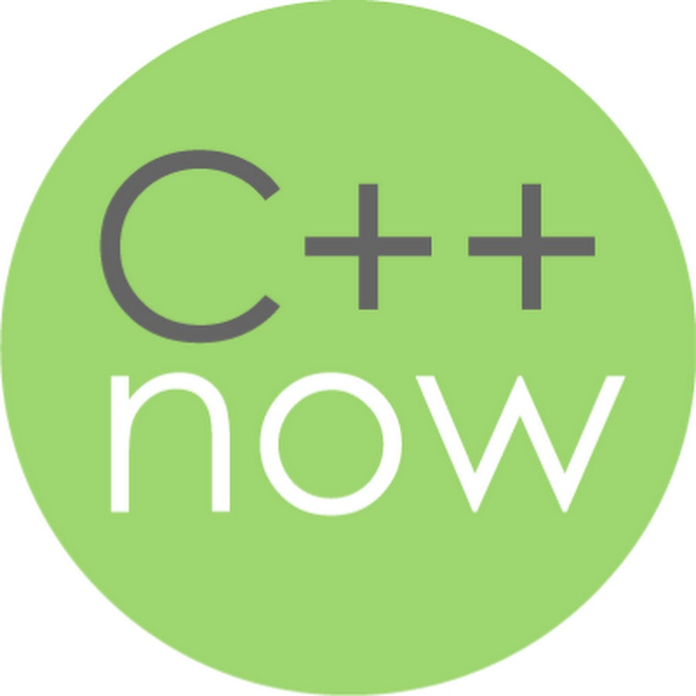


A decade of C++ safety talks
R. Seacord Correct Use of Integers in Safety-critical Systems (2024)
youtu.be/E8p5ASNglKc
C. Carruth Carbon’s Successor Strategy (keynote) (2023)
youtu.be/1ZTJ9omXOQ0
S. Baxter Safe C++ (P3390) (2024)
youtu.be/5Q1awoAwBgQ
Panel Coding for Safety, Security, Sustainability (2023)
youtu.be/jFi5cILjbA4
Apple & Trevelyan LLVM’s Realtime Safety Revolution (2024)
youtu.be/KvhgNdxX6Uw
T. Doumler C++ and Safety (2023)
youtu.be/WsswOOTxlIM
M. Pusz Safety With a Quantities & Units Library (2024)
youtu.be/pPSdmrmMdjY
S. Parent All the Safeties! (keynote) (2023)
youtu.be/BaUv9sgLCPc
B. Stroustrup Delivering Safe C++ (keynote) (2023)
youtu.be/I8UvQKvOSSw
JF Bastien *(char*)0 = 0; (2023)
youtu.be/dFIqNZ8VbRY
H. Sutter Cooperative C++ Evolution (2023)
youtu.be/8U3hl8XMm8c
T. Doumler C++ and Safety (2023)
youtu.be/iCP2SFsBvaU
F. Pikus Undefined Behavior: Know and Fear (2023)
youtu.be/k9N8OrhrSZw
T. Doumler Contracts, Testing & Well-defined Behaviour (keynote) (2023)
youtu.be/jTuIzSUxYDc
Wong et al. Safety and Security Panel (2023)
youtu.be/R10pXWHpPn4
CORE
B. Stroustrup Approaching C++ Safety (keynote) (2023)
youtu.be/eo-4ZSLn3jc
T. Brindle A Safer Iteration Model for C++ (2023)
youtu.be/4dADc4RRC48
H. Penne Secure development with C++ (2023)
youtu.be/U2CIi-CyGY4
S. Parent All the Safeties (2023)
youtu.be/MO-qehjc04s
P. Sommerlad Safer C++ with MISRA-C++ 2023 (2023)
youtu.be/f3xUJkxEtBo
JF Bastien Safety & Security: The Future of C++ (keynote) (2023)
youtu.be/Gh79wcGJdTg
S. Baxter Circle Fixes Defects, Makes C++ Safer (2023)
youtu.be/x7fxeNqSK2k

Slide 8
A decade of C++ safety talks
G. Horvath Lifetime Safety in C++: Past, Present and Future (2023)
youtu.be/PTdy65m_gRE
Geller & Sermersheim Back to Basics: Undefined Behavior (2021)
youtu.be/NpL9YnxnOqM
E. Tomusk Error Handling in Safety-Critical SYCL (2023)
youtu.be/ZUAPHTbxnAc
Wong, Weis, Burylov MISRA Safety-critical Guidelines (2021)
youtu.be/hVv7Nc3f4Jo
H. Sutter Can C++ be 10x Simpler & Safer? (2022)
youtu.be/ELeZAKCN4tY
M. Godbolt Correct by Construction (2020)
youtu.be/nLSm3Haxz0I
S. Dargo Undefined Behavior in the STL (2022)
youtu.be/fp45k9gsnUo
K. Serebryany Memory Tagging for C++ Memory Safety (2018)
youtu.be/lLEcbXidK2o
F. Pikus UB: A Performance Viewpoint (2022)
youtu.be/BbMybgmQBhU
Gehre & Horvath Lifetime Safety Profile in Clang (2018)
youtu.be/sjnp3P9x5jA
J. Radigan -memory-safe C++ (2022)
youtu.be/ml4t-6bg9-M
R. Ramey Safe Numerics (2018)
youtu.be/93Cjg42bGEw
R. Leahy Avoiding Punning by Starting Lifetimes (2022)
youtu.be/pbkQG09grFw
J. Regehr Undefined Behavior in 2017 (2 parts) (2017)
youtu.be/v1COuU2vU_w
R. Michaels Purging UB in a Legacy Codebase (2022)
youtu.be/vEtGtphI3lc
B. Stroustrup Writing Good C++14 (keynote) (2015)
youtu.be/1OEu9C51K2A
D. Abrahams Value Semantics: Safety, Independence, Projection (2022)
youtu.be/QthAU-t3PQ4
H. Sutter Writing Good C++14… By Default (2015)
youtu.be/hEx5DNLWGgA
B. Stroustrup Type-and-resource Safety in Modern C++ (2021)
youtu.be/l3rvjWfBzZI
K. Serebryany Beyond Sanitizers: Fuzzing & Hardening (2015)
youtu.be/qTkYDA0En6U

Slide 9
Why another C++ safety talk
Top 10
Nov 2022
5.6%
Rust in TIOBE, and in Linux, Windows and Android
NSA tells the industry to leave C and C++
of four standards worth of new wording is about safety. 11.1% of features
AI
2×
+73%
ChatGPT, Anthropic, Opus 5, Fable 5, Astra.
CVEs per year, 25K in 2022 to 48K in 2025. A record every year since 2017
C++ developers, 9.4M to 16.3M, 2022 to 2025
Notes:
<rust entered>
Four things changed in the last 10 years.
Rust entered the TIOBE top 10 and got adopted in many large organizations. Most notably the Linux kernel and Windows.
The NSA tells the industry to leave C/C++ for memory safe alternatives, like Rust.
The numbers of reported CVE, doubled 25K in 2022 and 48K in 2025. A new record.
ChatGPT lunches, Anthropic gets funded, both delivering frontier models that allow writing code at scale.
C++ developers grew 73 percent, 9.4 million to 16.3 million according to Slashdot.
Meanwhile 5.6 percent of four standards’ (C++17, C++20, C++23, C++26) worth of new wording is about safety.
As long as C++ is unsafe, I think we must talk about safety.

Slide 10
Where are we
Part II

Slide 11
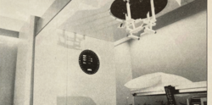
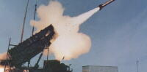

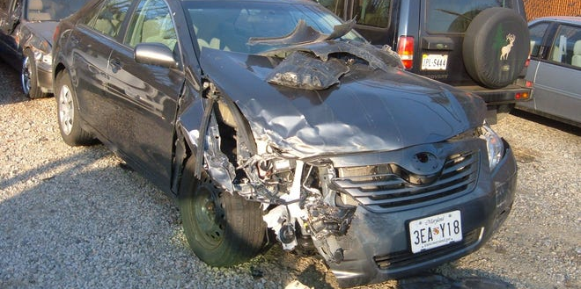
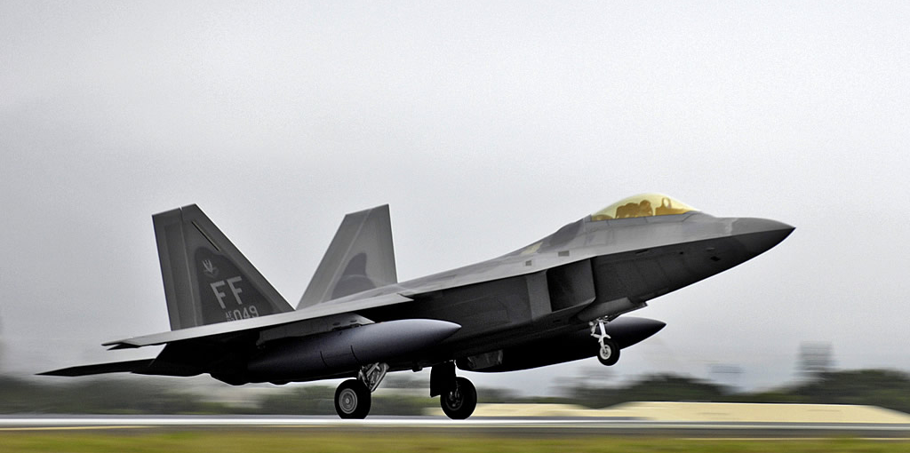
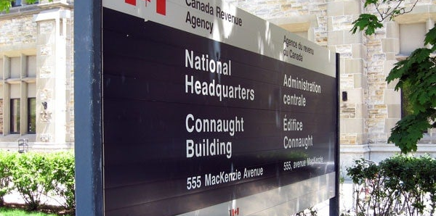
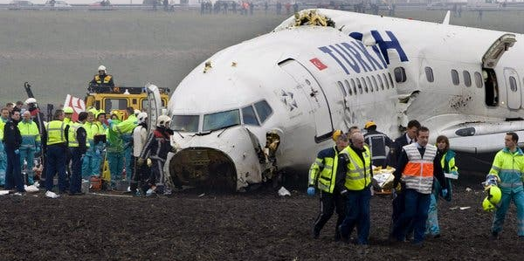
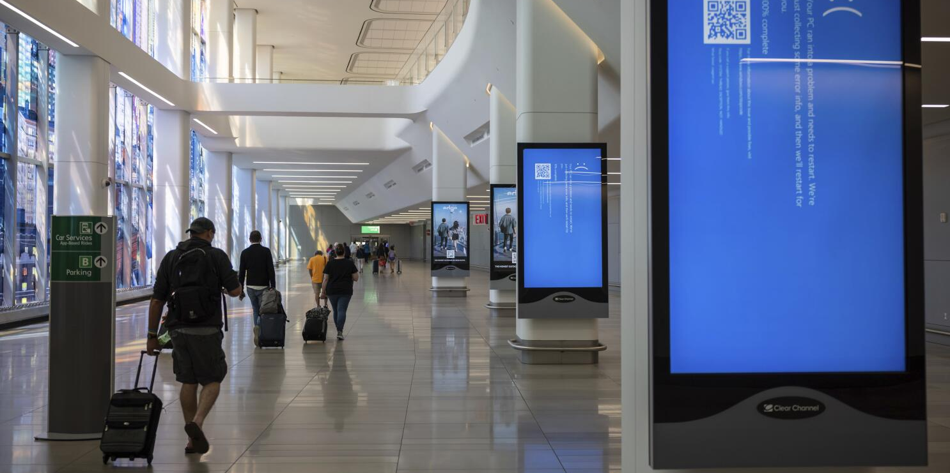
Software bugs have real consequences
Therac-25
1985-87
Race condition and 8-bit counter rollover, six radiation overdoses, three deaths
Patriot
1991
Clock drift from 24-bit fixed-point time after 100 hours, missed a Scud, 28 soldiers killed
Ariane 5
1996
64-bit float to 16-bit int overflow, $370M rocket destroyed 37 seconds in
Toyota acceleration
2009-2014
Stack overflow, spaghetti code, at least 89 deaths linked, $1.2B fine plus $1B+ in settlements
F-22
2007
Date line crossing crashed nav and comms on six F-22s, tankers led them back to Hawaii
Heartbleed
2014
Missing bounds check in OpenSSL heartbeat, 900 SINs stolen from the CRA
Boeing 737 MAX
2018-19
MCAS trusting one AoA sensor, two crashes, 346 deaths, $20B+
CrowdStrike
2024
Out-of-bounds read in a kernel driver, 8.5M Windows machines, $5B+ in losses
Notes:
<we have to care about safety>
We have to care about safety.
Bad software and software bugs have real world consequences.
You might not be in an industry where safety has a big impact, but one way or another it is impacting or will be impacting your customers.
Therac-25 and Ariane 5 are the classics that everyone knows.

Slide 12
What everyone knows about safety
70%
Buffer overflow
Memory safe languages
of vulnerabilities are memory bugs
is the classic one
fix it
Notes:
Here's the story we all know.
70 percent of vulnerabilities are memory bugs, buffer overflow is the classic, memory safe languages fix it.
It is not wrong, but it is incomplete.

Slide 13
The 100 products with the most CVEs
What it is
Count
CVEs
% of exploited
Inspectable
Operating systems
Windows, macOS, iOS, tvOS, watchOS, iPadOS, Android, Linux
Debian, Fedora, Ubuntu, openSUSE, RHEL
34
19,923
53.3%
partial
Browsers
Chrome, Edge, Safari, Firefox
4
4,256
18.9%
partial
Other applications
Acrobat, M365, iTunes, Foxit, Thunderbird
8
3,406
3.8%
partial
Hardware and chipset firmware
Qualcomm
54
1,540
2.1%
no
Total
100
26,618
63.9%
Everything else
26,407
31,415
36.1%
CVEs published 2016–2026, grouped by affected product. “% of exploited” is each group’s share of known-exploited CVEs.
Counts are not adjusted for product age, usage, or codebase size.
Notes:
<I pulled>
I pulled every CVE from 2016 to 2026 and grouped them by product.
This table shows the top 100 products with most CVE reports.
Operating systems alone take a 53% share.
And if we look at the products where we see vulnerabilities are, this seems to scale with popularity.
Operating systems and browsers are products everyone is using.

Slide 14
The top 25 defect types
Memory safety 68%
Out-of-bounds access 74%
50.4%
Interface and data 15%
Improper input validation 76%
11.1%
Memory safety 68%
Use after free 14%
9.4%
Memory safety 68%
NULL pointer dereference 9%
6.2%
Resource management 10%
Uncontrolled resource use 41%
3.9%
Type and value 5%
Integer overflow 79%
3.8%
Interface and data 15%
Unsafe deserialization 24%
3.6%
CVEs published 2016–2026.
Group share is the category's percentage of all classified CVEs.
The percentage inside each box is the defect's share within its category.
The percentage after each bar is the defect's share of all classified CVEs.
Bars are on a square-root scale so small defects remain visible next to out-of-bounds.
“Improper input validation” (CWE-20) is often a generic fallback classification, not the underlying defect.
Resource management 10%
Allocation without limits 27%
2.6%
Concurrency 4%
Race condition 60%
2.6%
Resource management 10%
Memory leak 22%
2.1%
Memory safety 68%
Use of uninitialized resource 1%
1.0%
Memory safety 68%
Double free 1%
1.0%
Type and value 5%
Type confusion 21%
1.0%
Control flow 2%
Infinite loop 42%
1.0%
Resource management 10%
Improper resource shutdown 9%
0.9%
Concurrency 4%
TOCTOU race 21%
0.9%
Concurrency 4%
Improper locking 19%
0.8%
Control flow 2%
Unchecked unusual condition 29%
0.7%
Control flow 2%
Bad exception handling 29%
0.7%
Notes:
Now by defect. Out-of-bounds is half of everything classified, memory safety as a group is 68 percent.
But look at the rest. Resource exhaustion, integer overflow, races, infinite loops.
A third of the problem is not memory.

Slide 15
The top 25 defect types
Memory safety 68%
Out-of-bounds access 74%
50.4%
Interface and data 15%
Improper input validation 76%
11.1%
Memory safety 68%
Use after free 14%
9.4%
Memory safety 68%
NULL pointer dereference 9%
6.2%
Resource management 10%
Uncontrolled resource use 41%
3.9%
Type and value 5%
Integer overflow 79%
3.8%
Interface and data 15%
Unsafe deserialization 24%
3.6%
CVEs published 2016–2026.
Group share is the category's percentage of all classified CVEs.
The percentage inside each box is the defect's share within its category.
The percentage after each bar is the defect's share of all classified CVEs.
Bars are on a square-root scale so small defects remain visible next to out-of-bounds.
“Improper input validation” (CWE-20) is often a generic fallback classification, not the underlying defect.
Resource management 10%
Allocation without limits 27%
2.6%
Concurrency 4%
Race condition 60%
2.6%
Resource management 10%
Memory leak 22%
2.1%
Memory safety 68%
Use of uninitialized resource 1%
1.0%
Memory safety 68%
Double free 1%
1.0%
Type and value 5%
Type confusion 21%
1.0%
Control flow 2%
Infinite loop 42%
1.0%
Resource management 10%
Improper resource shutdown 9%
0.9%
Concurrency 4%
TOCTOU race 21%
0.9%
Concurrency 4%
Improper locking 19%
0.8%
Control flow 2%
Unchecked unusual condition 29%
0.7%
Control flow 2%
Bad exception handling 29%
0.7%

Slide 16
The top 25 defect types
Memory safety 68%
Out-of-bounds access 74%
50.4%
Interface and data 15%
Improper input validation 76%
11.1%
Memory safety 68%
Use after free 14%
9.4%
Memory safety 68%
NULL pointer dereference 9%
6.2%
Resource management 10%
Uncontrolled resource use 41%
3.9%
Type and value 5%
Integer overflow 79%
3.8%
Interface and data 15%
Unsafe deserialization 24%
3.6%
CVEs published 2016–2026.
Group share is the category's percentage of all classified CVEs.
The percentage inside each box is the defect's share within its category.
The percentage after each bar is the defect's share of all classified CVEs.
Bars are on a square-root scale so small defects remain visible next to out-of-bounds.
“Improper input validation” (CWE-20) is often a generic fallback classification, not the underlying defect.
Resource management 10%
Allocation without limits 27%
2.6%
Concurrency 4%
Race condition 60%
2.6%
Resource management 10%
Memory leak 22%
2.1%
Memory safety 68%
Use of uninitialized resource 1%
1.0%
Memory safety 68%
Double free 1%
1.0%
Type and value 5%
Type confusion 21%
1.0%
Control flow 2%
Infinite loop 42%
1.0%
Resource management 10%
Improper resource shutdown 9%
0.9%
Concurrency 4%
TOCTOU race 21%
0.9%
Concurrency 4%
Improper locking 19%
0.8%
Control flow 2%
Unchecked unusual condition 29%
0.7%
Control flow 2%
Bad exception handling 29%
0.7%
Notes:
<but another 17% is about data and interface, 1/3 is not memory safety>

Slide 17
The most exploited defects
Interface and data 34%
Improper input validation 23%
7.8%
Interface and data 34%
OS command injection 21%
7.1%
Memory safety 22%
Out-of-bounds write 31%
6.7%
Memory safety 22%
Use after free 28%
6.2%
Memory safety 22%
Buffer operation errors 26%
5.6%
Interface and data 34%
Path traversal 15%
5.2%
Interface and data 34%
Unsafe deserialization 14%
4.7%
Interface and data 34%
Code injection 13%
4.6%
App security 20%
Improper authentication 14%
2.8%
App security 20%
Missing authentication 13%
2.6%
Type and value 4%
Type confusion 70%
2.5%
App security 20%
Improper access control 12%
2.3%
CVEs published 2016–2026.
“Improper input validation” (CWE-20) is often a generic fallback classification, not the underlying defect.
Share of the CISA KEV catalog ~1,500 CVEs with confirmed exploitation in the wild.
Authentication and authorization beyond language safety.
App security 20%
Cross-site scripting 11%
2.2%
App security 20%
Permissions and privileges 10%
2.0%
Memory safety 22%
Heap buffer overflow 9%
2.0%
Interface and data 34%
Command injection 6%
2.0%
Interface and data 34%
SQL injection 6%
2.0%
App security 20%
Sensitive info exposure 8%
1.6%
Memory safety 22%
Out-of-bounds read 5%
1.1%
Notes:
Now filter to the 1,500 CVEs CISA confirmed were exploited in the wild.
Interface and data issues are 34 percent, memory safety drops to 22 percent, app security is 20 percent.
Attackers don't care about our categories.
Memory unsafety is what gets exploited when nothing easier is available.

Slide 18
The most exploited defects
Interface and data 34%
Improper input validation 23%
7.8%
Interface and data 34%
OS command injection 21%
7.1%
Memory safety 22%
Out-of-bounds write 31%
6.7%
Memory safety 22%
Use after free 28%
6.2%
Memory safety 22%
Buffer operation errors 26%
5.6%
Interface and data 34%
Path traversal 15%
5.2%
Interface and data 34%
Unsafe deserialization 14%
4.7%
Interface and data 34%
Code injection 13%
4.6%
App security 20%
Improper authentication 14%
2.8%
App security 20%
Missing authentication 13%
2.6%
Type and value 4%
Type confusion 70%
2.5%
App security 20%
Improper access control 12%
2.3%
CVEs published 2016–2026.
“Improper input validation” (CWE-20) is often a generic fallback classification, not the underlying defect.
Share of the CISA KEV catalog ~1,500 CVEs with confirmed exploitation in the wild.
Authentication and authorization beyond language safety.
App security 20%
Cross-site scripting 11%
2.2%
App security 20%
Permissions and privileges 10%
2.0%
Memory safety 22%
Heap buffer overflow 9%
2.0%
Interface and data 34%
Command injection 6%
2.0%
Interface and data 34%
SQL injection 6%
2.0%
App security 20%
Sensitive info exposure 8%
1.6%
Memory safety 22%
Out-of-bounds read 5%
1.1%

Slide 19
The most exploited defects
Interface and data 34%
Improper input validation 23%
7.8%
Interface and data 34%
OS command injection 21%
7.1%
Memory safety 22%
Out-of-bounds write 31%
6.7%
Memory safety 22%
Use after free 28%
6.2%
Memory safety 22%
Buffer operation errors 26%
5.6%
Interface and data 34%
Path traversal 15%
5.2%
Interface and data 34%
Unsafe deserialization 14%
4.7%
Interface and data 34%
Code injection 13%
4.6%
App security 20%
Improper authentication 14%
2.8%
App security 20%
Missing authentication 13%
2.6%
Type and value 4%
Type confusion 70%
2.5%
App security 20%
Improper access control 12%
2.3%
CVEs published 2016–2026.
“Improper input validation” (CWE-20) is often a generic fallback classification, not the underlying defect.
Share of the CISA KEV catalog ~1,500 CVEs with confirmed exploitation in the wild.
Authentication and authorization beyond language safety.
App security 20%
Cross-site scripting 11%
2.2%
App security 20%
Permissions and privileges 10%
2.0%
Memory safety 22%
Heap buffer overflow 9%
2.0%
Interface and data 34%
Command injection 6%
2.0%
Interface and data 34%
SQL injection 6%
2.0%
App security 20%
Sensitive info exposure 8%
1.6%
Memory safety 22%
Out-of-bounds read 5%
1.1%
Notes:
<Interface and data issues are 34 percent>

Slide 20
A safety taxonomy
26,618
CVEs across the 100 most affected products
Memory safety
Bounds, Initialization, Lifetime, Null, Alignment, Aliasing
Type and value safety
2
vulnerability sources, NVD and MSRC
Type, Arithmetic, Conversion, Const, Enum, Floating point, Comparison, Object model
?
Control flow and error safety
64
C++ safety talks from the last decade
Exception safety, Error handling, Signal/Reentrancy, Forward progress, Control-flow integrity, Evaluation order
Concurrency safety
Data races, Atomicity/Ordering, Liveness
3,722
compiler and analyzer diagnostics
Resource safety
Allocation, Stack, Non-memory resources
Structural and build safety
940
weakness types in the CWE catalog
ODR/IFNDR, ABI, Toolchain/Optimizer
Interface and data safety
Strings, Variadic, Units, Deserialization
Notes:
7 groups
33 categories
1 taxonomy

Slide 21
A taxonomy of C/C++ safety
Memory safety
Bounds
Initialization
Lifetime
Null
Alignment
Aliasing
Type and value safety
Type
Arithmetic
Conversion
Const
Enum
Floating point
Comparison
Object Model
Control flow and error safety
Exception safety
Error handling
Signal/Reentrancy
Forward progress
Control-flow integrity
Evaluation order
Concurrency safety
Data races
Atomicity/Ordering
Liveness
Resource safety
Allocation
Stack
Non-Memory resources
Structural and build safety
ODR/IFNDR
ABI
Toolchain/Optimizer
Interface and data safety
Strings
Variadic
Units
Deserialization
Notes:
I built a taxonomy.
Seven groups, 33 categories.
Memory safety is one group of seven.
<Talk more here>

Slide 22
A taxonomy of C/C++ safety
out of bounds reads and writes
uninitialized variables
null dereferencing
Memory safety
Bounds
Initialization
Lifetime
Null
Alignment
Aliasing
integer overflow
narrowing conversions
object slicing
Type and value safety
Type
Arithmetic
Conversion
Const
Enum
Floating point
Comparison
Object Model
Exception safety
Error handling
infinite loops
argument evaluation order
Control flow and error safety
Signal/Reentrancy
Forward progress
Control-flow integrity
Evaluation order
Concurrency safety
race conditions and hangs
Data races
Atomicity/Ordering
Liveness
leaking file and
network handles
Resource safety
Allocation
Stack
Non-Memory resources
Structural and build safety
ODR/IFNDR
ABI
Toolchain/Optimizer
Interface and data safety
string formatting
Deserialization
Strings
Variadic
Units

Slide 23

A taxonomy of C/C++ safety
Memory safety
Bounds
Initialization
Lifetime
Null
Alignment
Aliasing
Type and value safety
Type
Arithmetic
Conversion
Const
Enum
Floating point
Comparison
Object Model
Control flow and error safety
Exception safety
Error handling
Signal/Reentrancy
Forward progress
Control-flow integrity
Evaluation order
Concurrency safety
Data races
Atomicity/Ordering
Liveness
Resource safety
Allocation
Stack
Non-Memory resources
Structural and build safety
ODR/IFNDR
ABI
Toolchain/Optimizer
Interface and data safety
Strings
Variadic
Units
Deserialization
Notes:
Now overlay the CVE counts.
The heat is in bounds, lifetime and null, exactly where everyone expects.
But it's not zero anywhere.
Every cell on this grid has real CVEs behind it.

Slide 24
CVE share by issue class and provider
0.1%
1%
10%
50%
Memory
Bounds
Memory
Lifetime
Memory
Null
Resource
Non-memory resources
Type and value
Arithmetic
Resource
Allocation
Interface and data
Deserialization
Concurrency
Data races
Memory
Initialization
Type and value
Type
Control flow and error
Forward progress
Control flow and error
Error handling
Control flow and error
Exception safety
min to max across 7 sources
Concurrency
Atomicity/ordering
middle half
Resource
median
Stack
NVD
Interface and data
Strings
Type and value
Conversion
CVEs published 2016–2026.
Share of each source’s mapped CVEs, log scale. Seven sources: NVD, CVE List, CISA Vulnrichment, GitHub Advisory, MSRC, Big-Vul, DiverseVul.
Notes:
<variation, is data lie to us>
Fair question, does this depend on who classified the data.
This graph shows there is variation across providers, but our taxonomy hot spot holds.
NVD and MSRC classify vulnerabilities independently, and the other five providers build on the CVE corpus with their own enrichment and filtering.

Slide 25
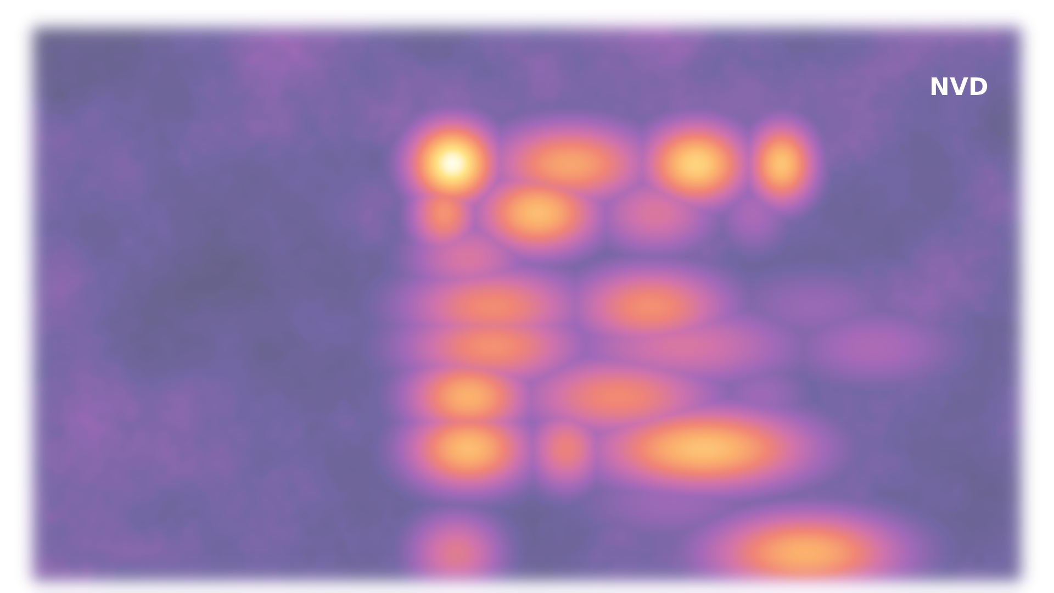
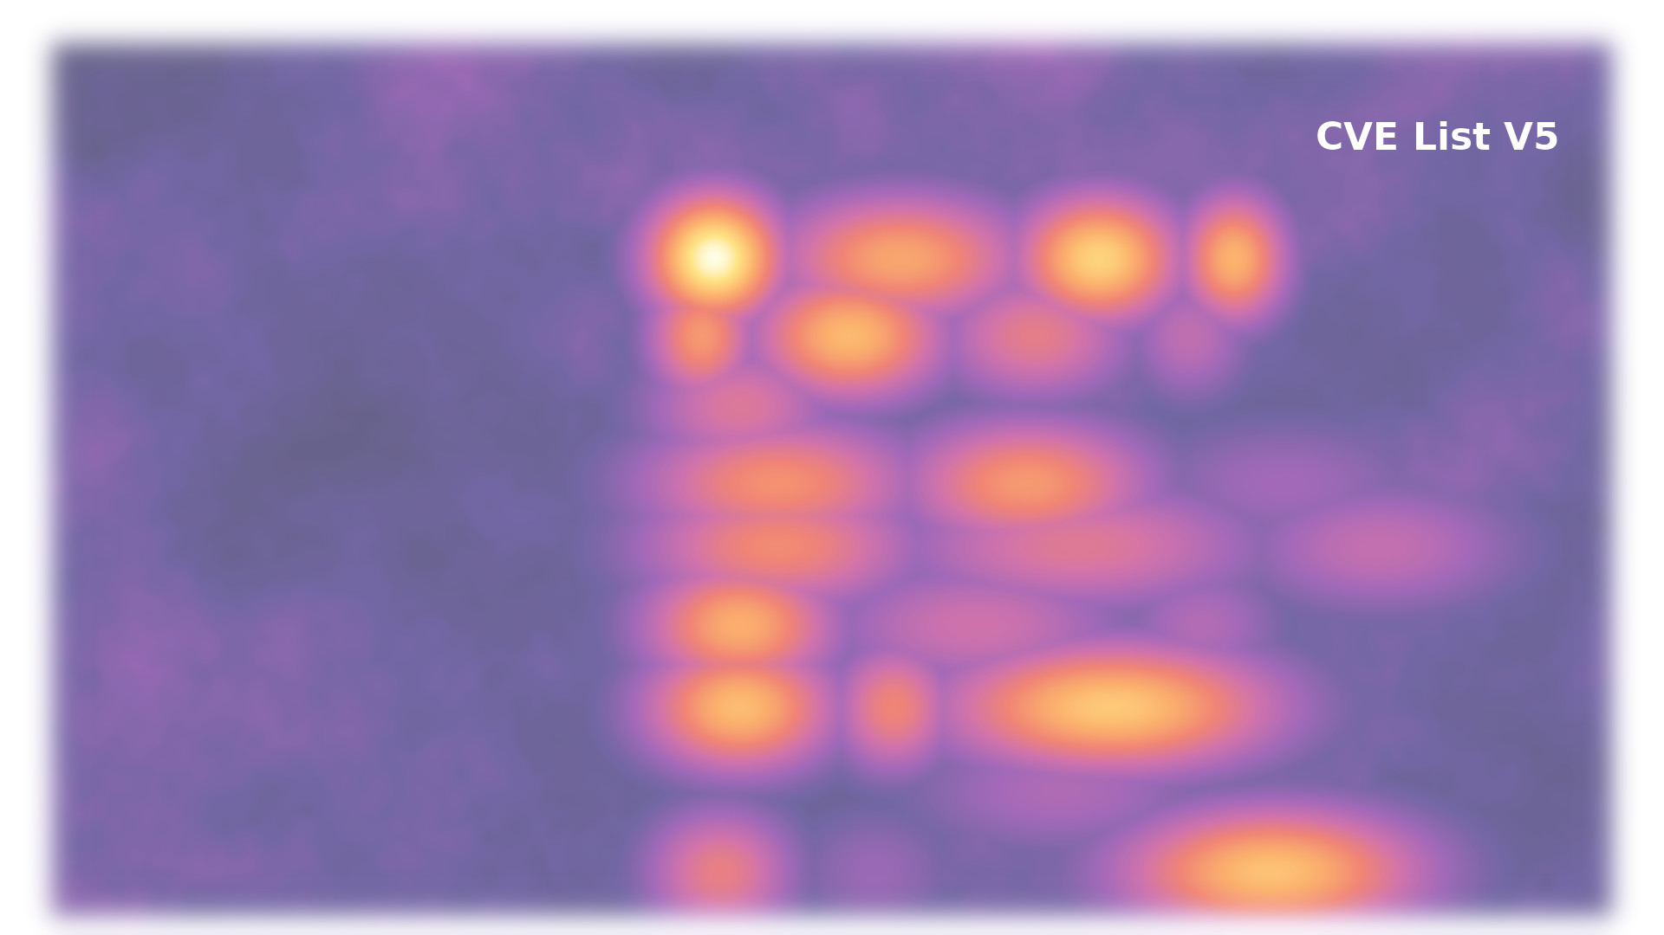
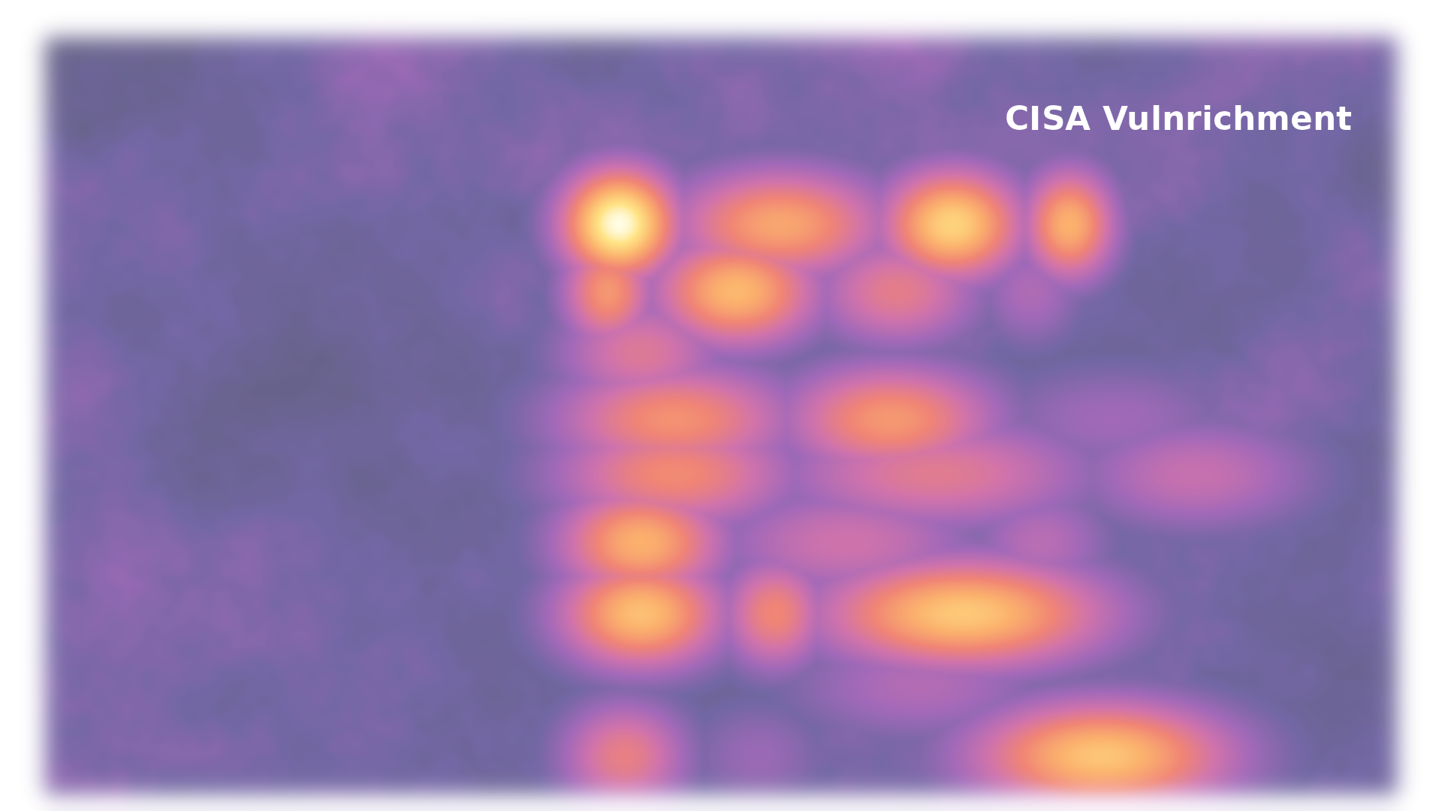
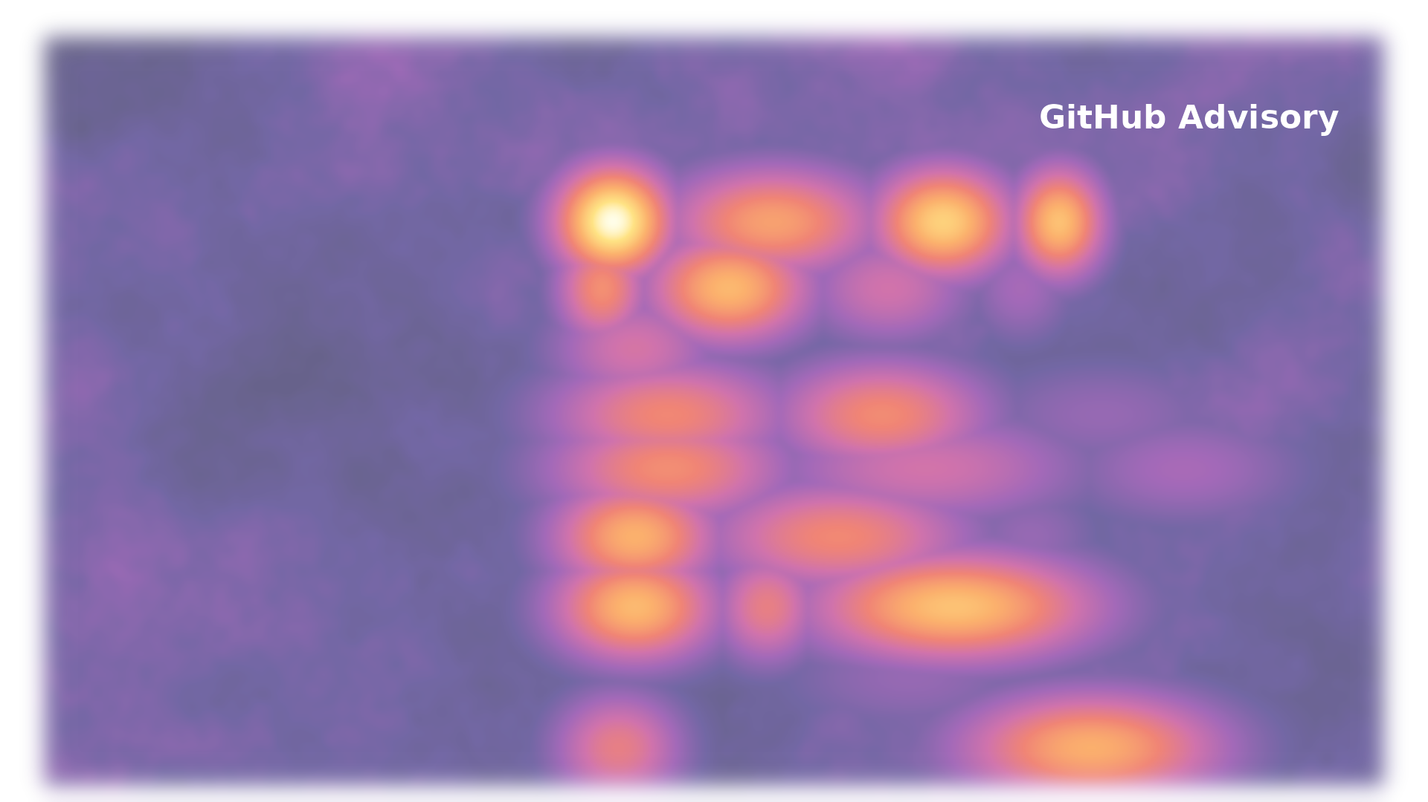
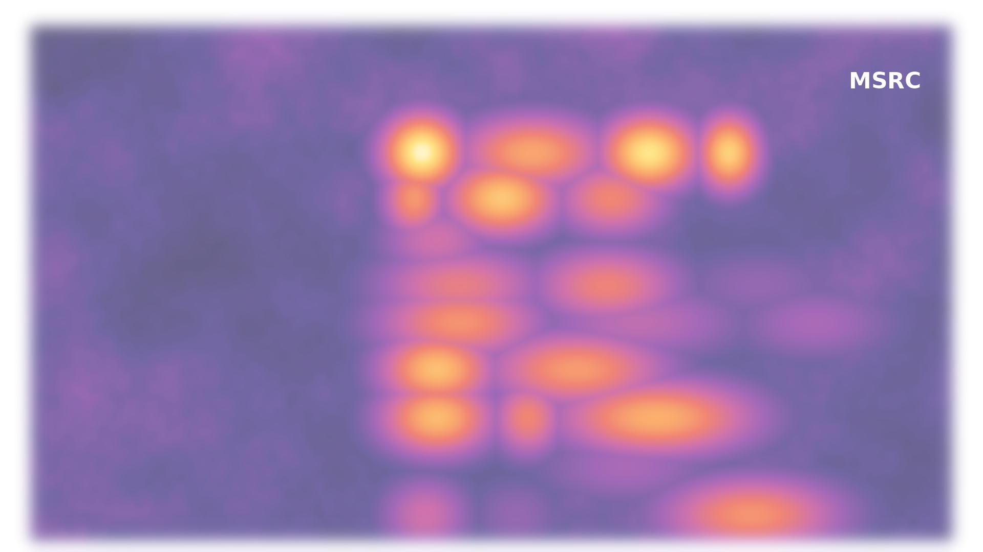
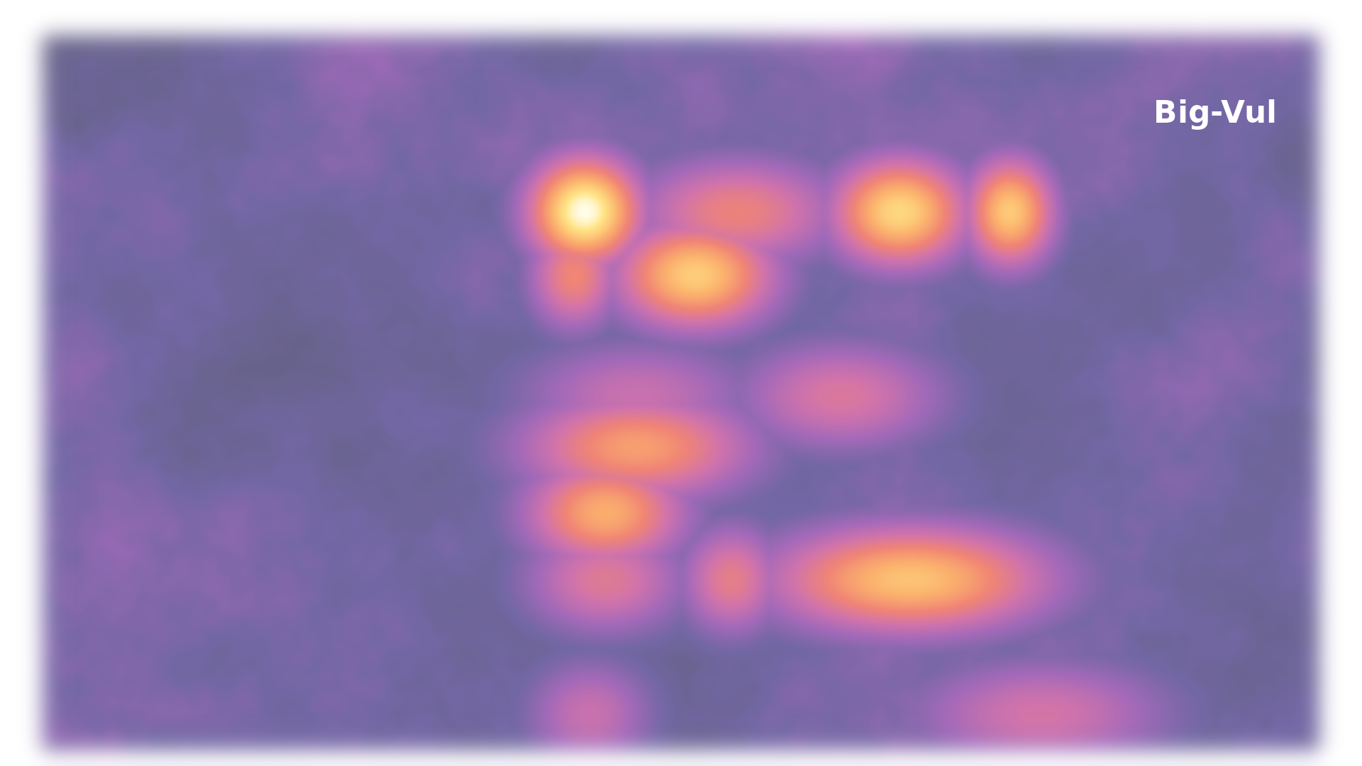
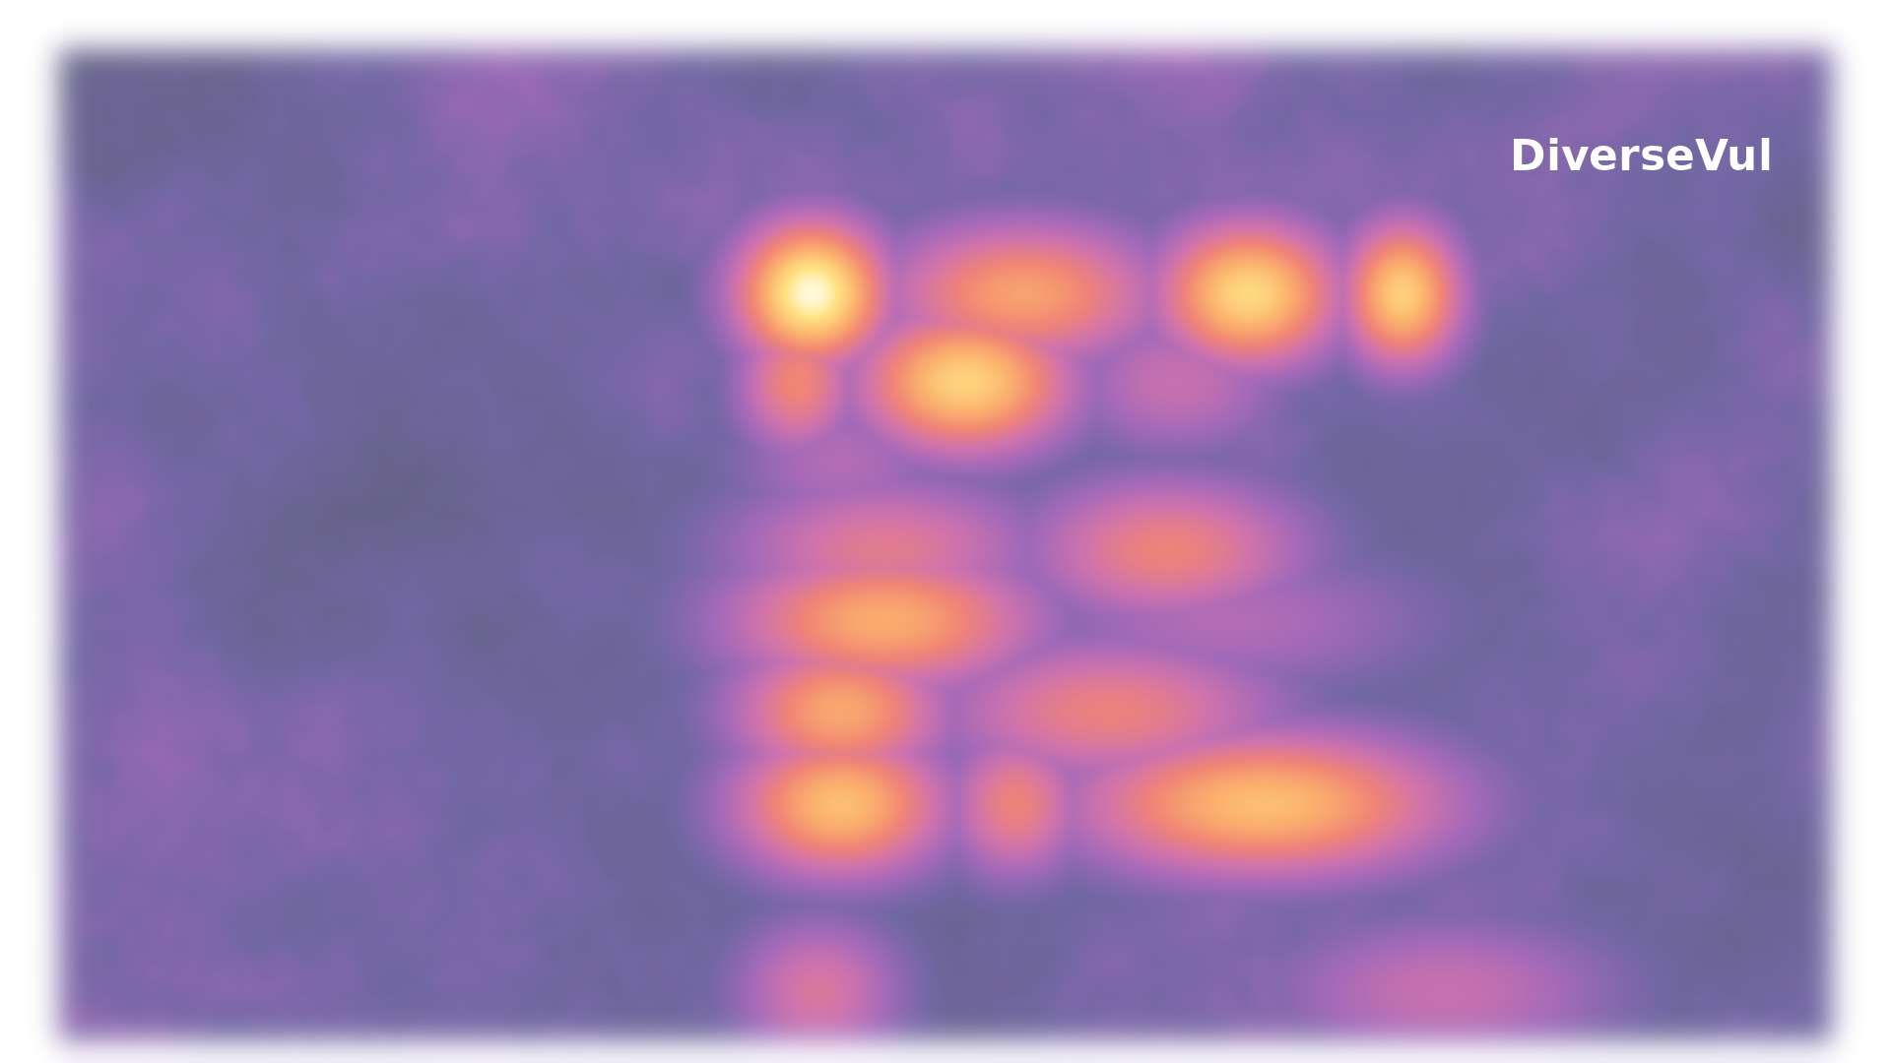
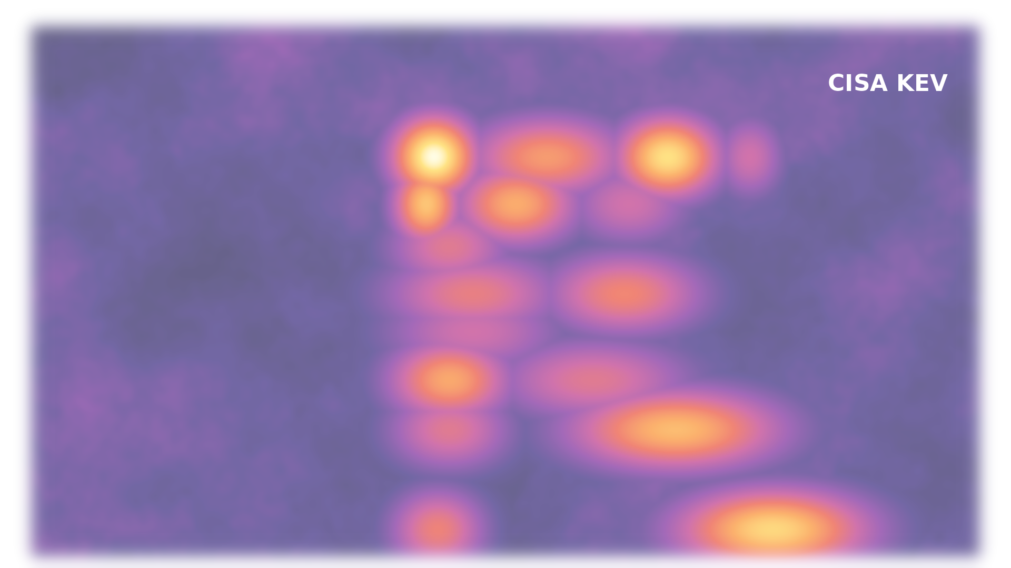
A taxonomy of C/C++ safety
Memory safety
Bounds
Initialization
Lifetime
Null
Alignment
Aliasing
Type and value safety
Type
Arithmetic
Conversion
Const
Enum
Floating point
Comparison
Object Model
Control flow and error safety
Exception safety
Error handling
Signal/Reentrancy
Forward progress
Control-flow integrity
Evaluation order
Concurrency safety
Data races
Atomicity/Ordering
Liveness
Resource safety
Allocation
Stack
Non-Memory resources
Structural and build safety
ODR/IFNDR
ABI
Toolchain/Optimizer
Interface and data safety
Strings
Variadic
Units
Deserialization
Notes:
And here we look at the hot spot variation across the providers.

Slide 26
A taxonomy of C/C++ safety
Bounds
Out-of-bounds write
Out-of-bounds read
Unknown direction
Bad index
Pointer arithmetic
Lifetime
Use-after-free
Double-free
Dangling stack pointer
Null
Null dereference
Unchecked null return
Non-memory resources
Exhaustion, no limit
Leaked handle
Arithmetic
Integer overflow
Divide by zero
Wrong calculation
Allocation
No allocation limit
Memory leak
Deserialization
Untrusted deserialization
Data races
Data race
Check-then-use race
Initialization
Uninitialized read
Insecure defaults
Type
Type confusion
Bad cast
Weak typing
Notes:
Drill one level down, based on data from NVD.

Slide 27

A taxonomy of C/C++ safety
Bounds
Out-of-bounds write
Out-of-bounds read
Unknown direction
Bad index
Pointer arithmetic
Lifetime
Use-after-free
Double-free
Dangling stack pointer
Null
Null dereference
Unchecked null return
Non-memory resources
Exhaustion, no limit
Leaked handle
Arithmetic
Integer overflow
Divide by zero
Wrong calculation
Allocation
No allocation limit
Memory leak
Deserialization
Untrusted deserialization
Data races
Data race
Check-then-use race
Initialization
Uninitialized read
Insecure defaults
Type
Type confusion
Bad cast
Weak typing
Notes:
These ten are where the volume is.
Out-of-bounds write and read, use after free, null deref, resource exhaustion, integer overflow, allocation without limits, untrusted deserialization, data races, uninitialized reads, type confusion.

Slide 28
A taxonomy of C/C++ safety
Bounds
50%
Out-of-bounds write
Out-of-bounds read
Unknown direction
Bad index
Pointer arithmetic
Lifetime
10%
Use-after-free
Double-free
Dangling stack pointer
Null
6%
Null dereference
Unchecked null return
Non-memory resources
5%
Exhaustion, no limit
Leaked handle
Arithmetic
4%
Integer overflow
Divide by zero
Wrong calculation
Allocation
5%
No allocation limit
Memory leak
Deserialization
4%
Untrusted deserialization
Data races
4%
Data race
Check-then-use race
Initialization
1.0%
Uninitialized read
Insecure defaults
Type
1.0%
Type confusion
Bad cast
Weak typing

Slide 29
C/C++

Slide 30
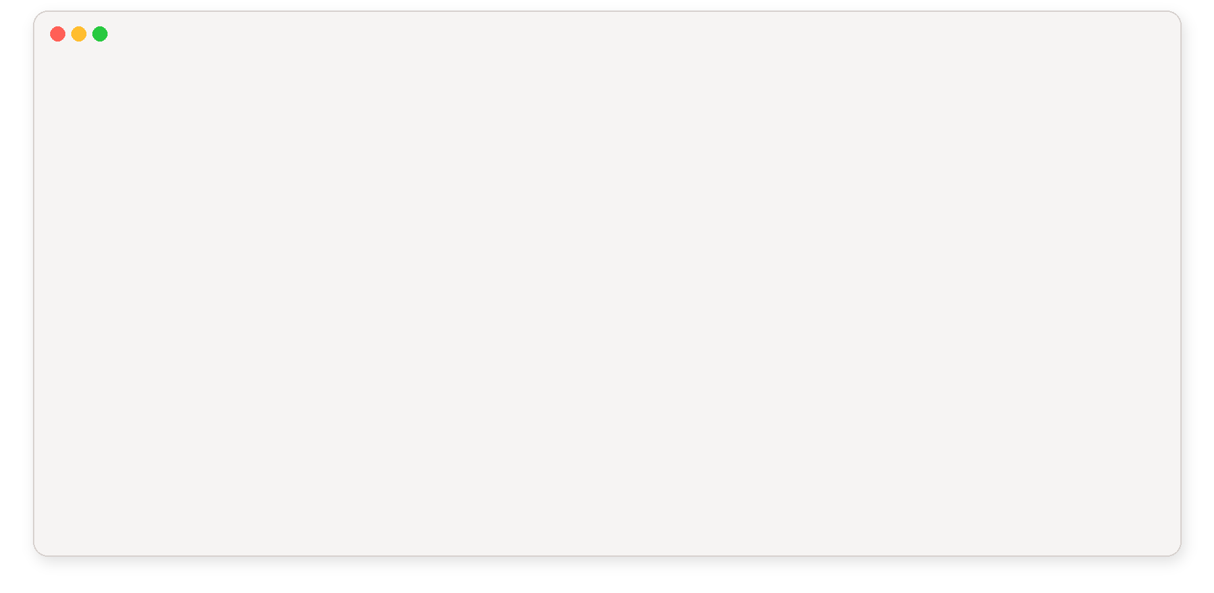
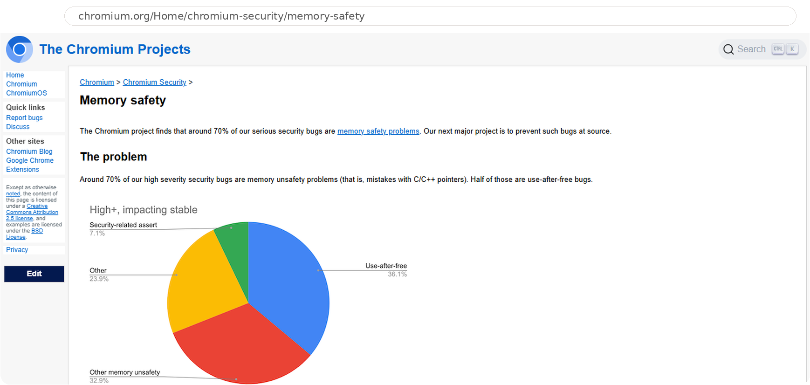
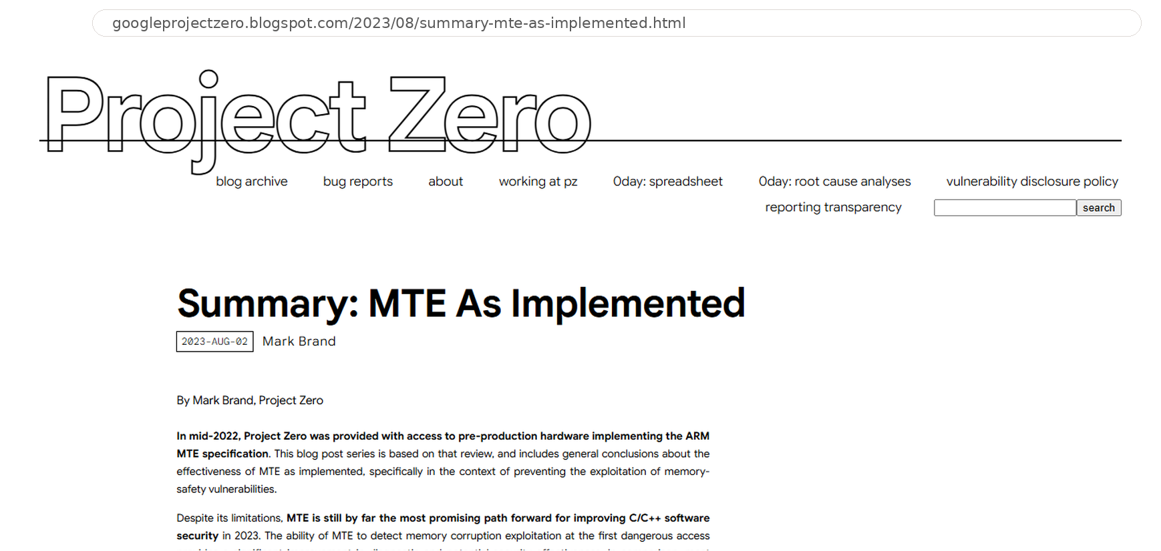
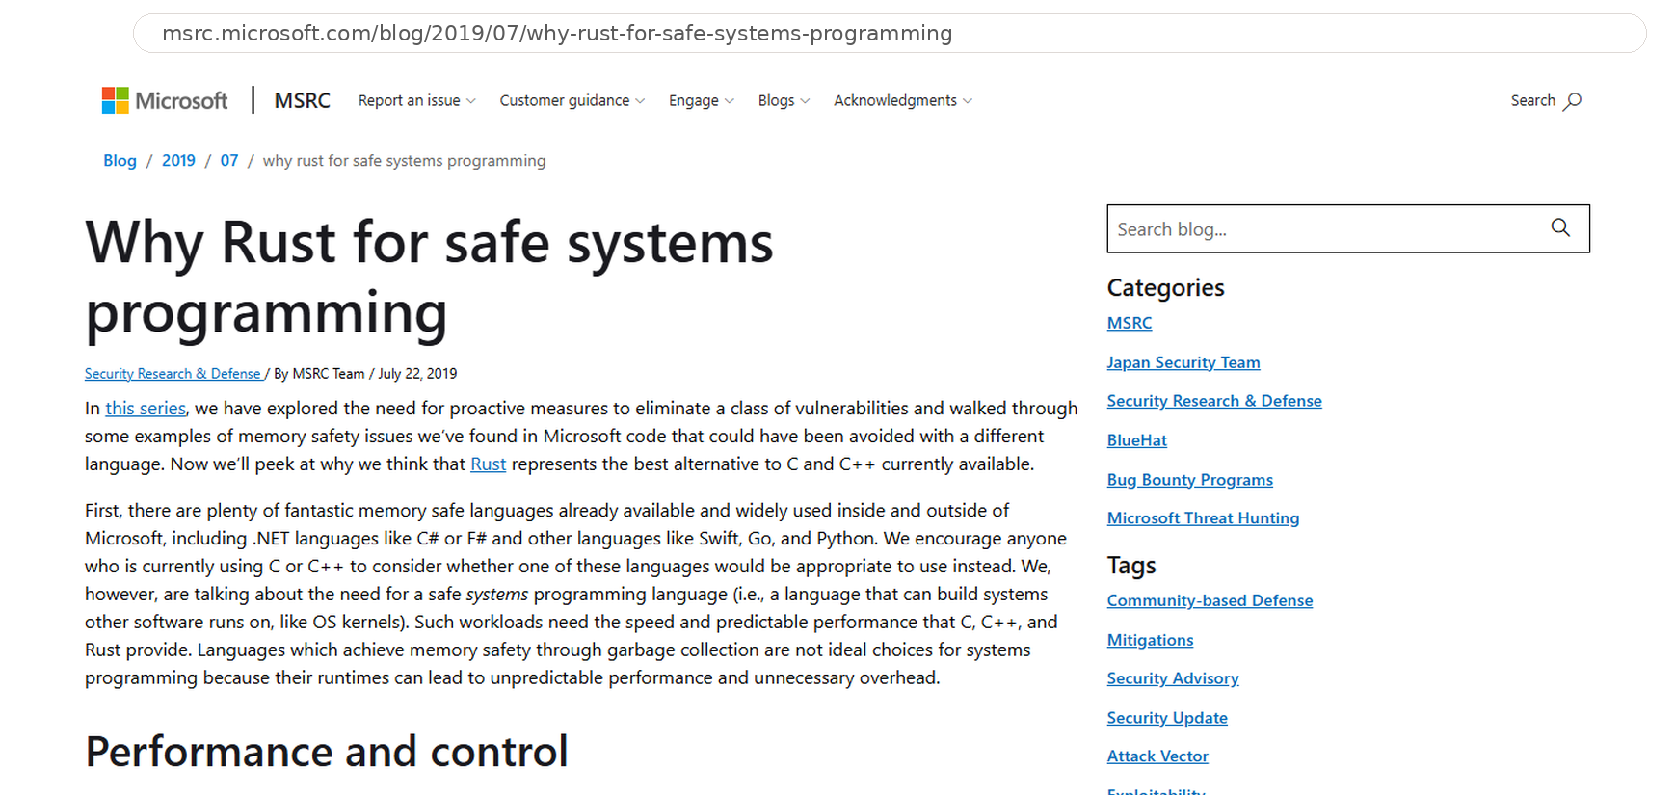
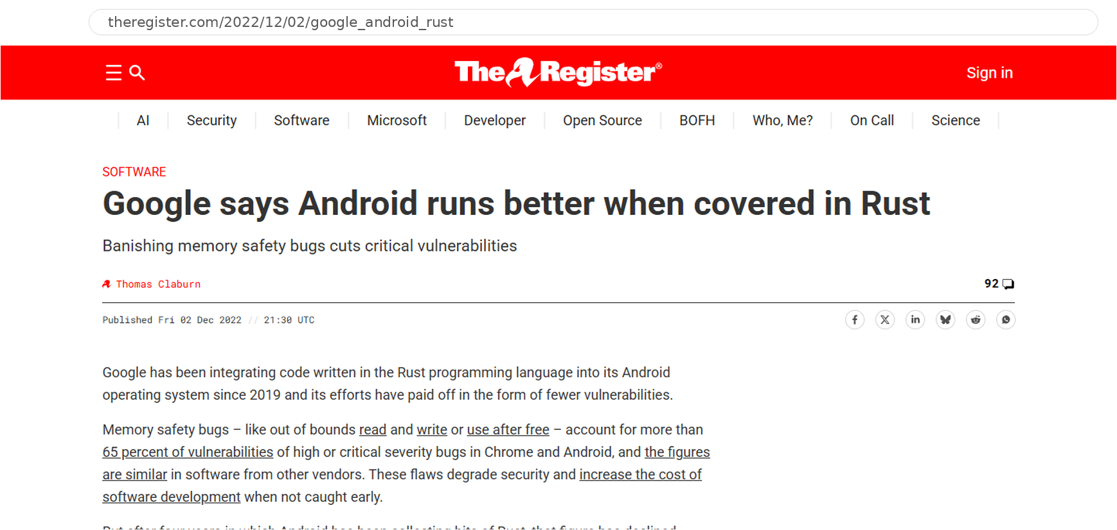
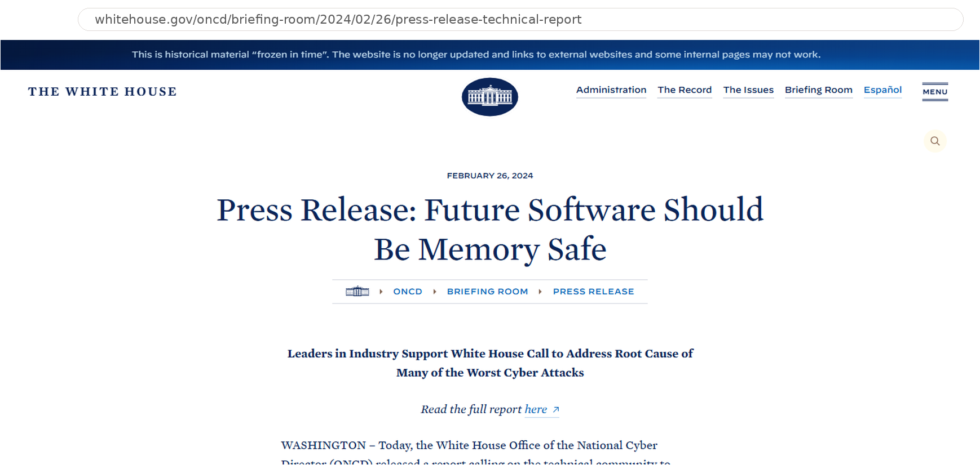
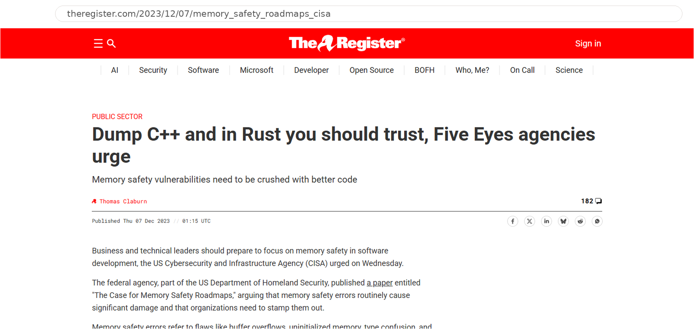
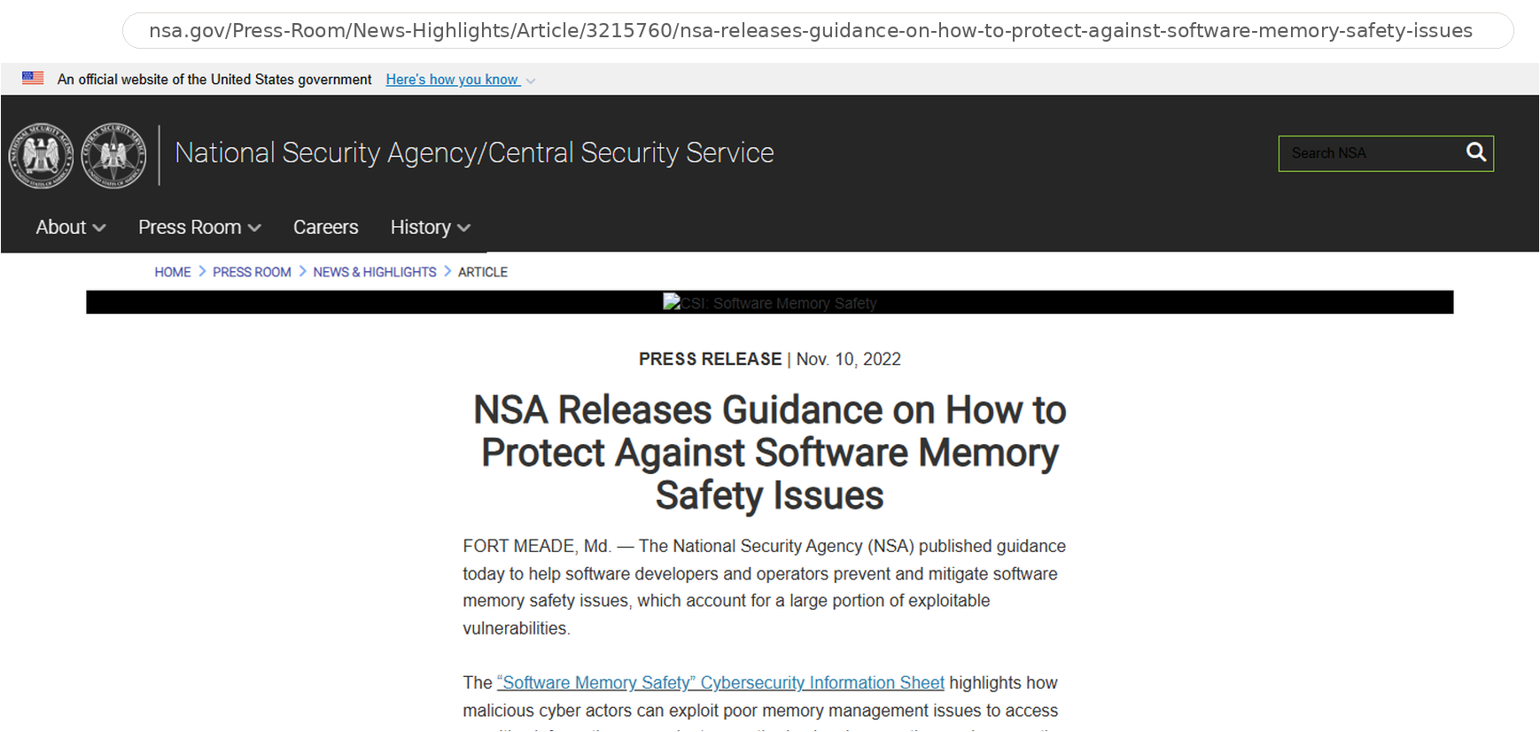
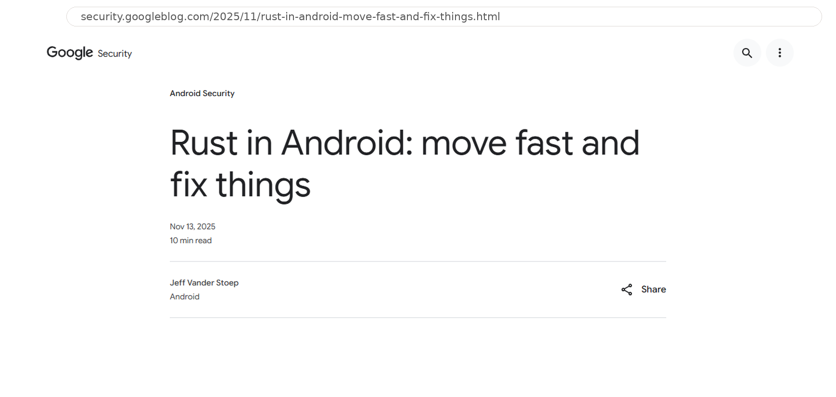
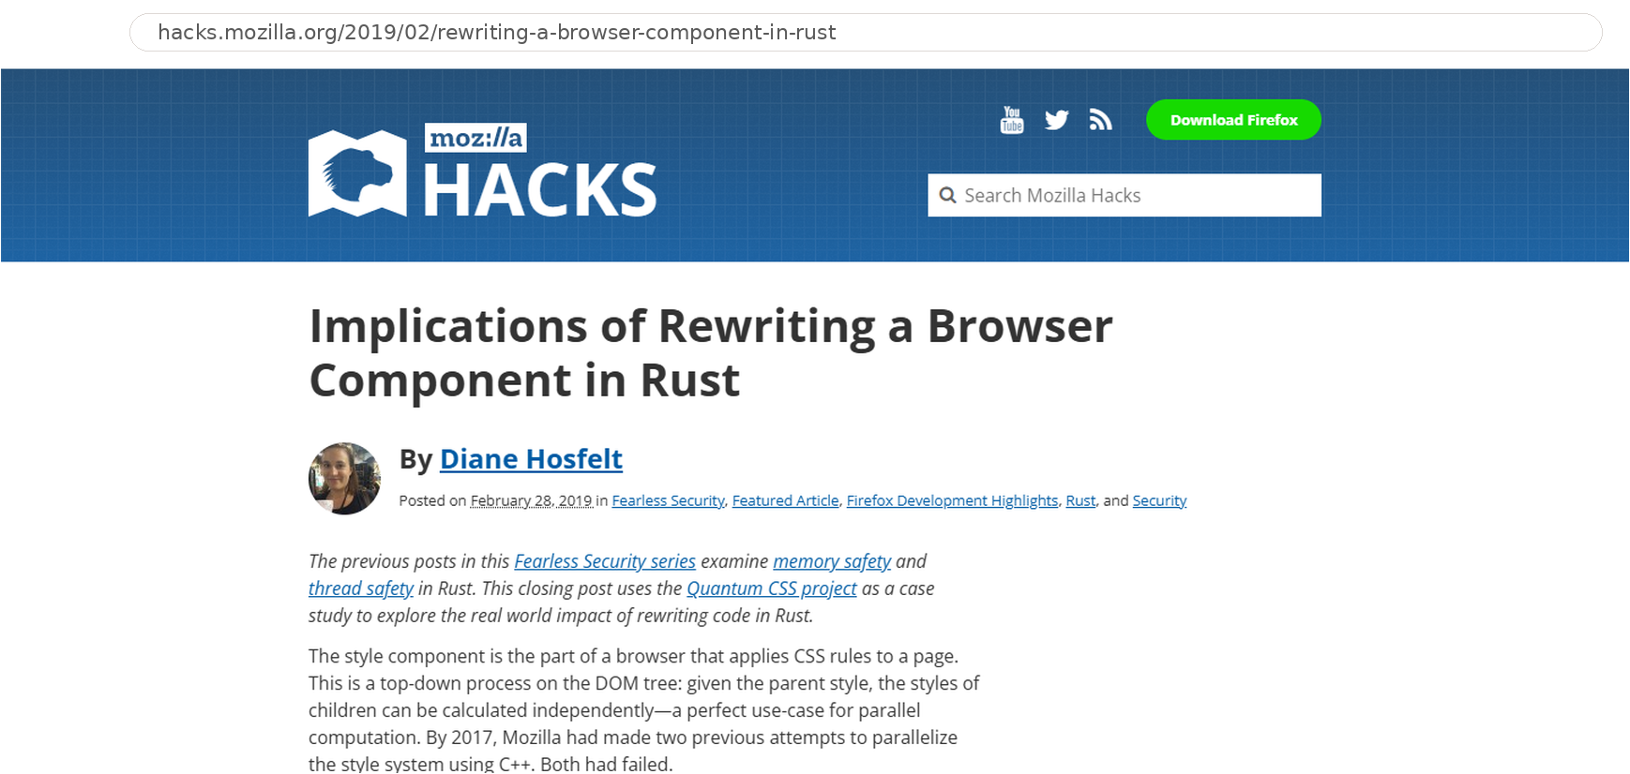
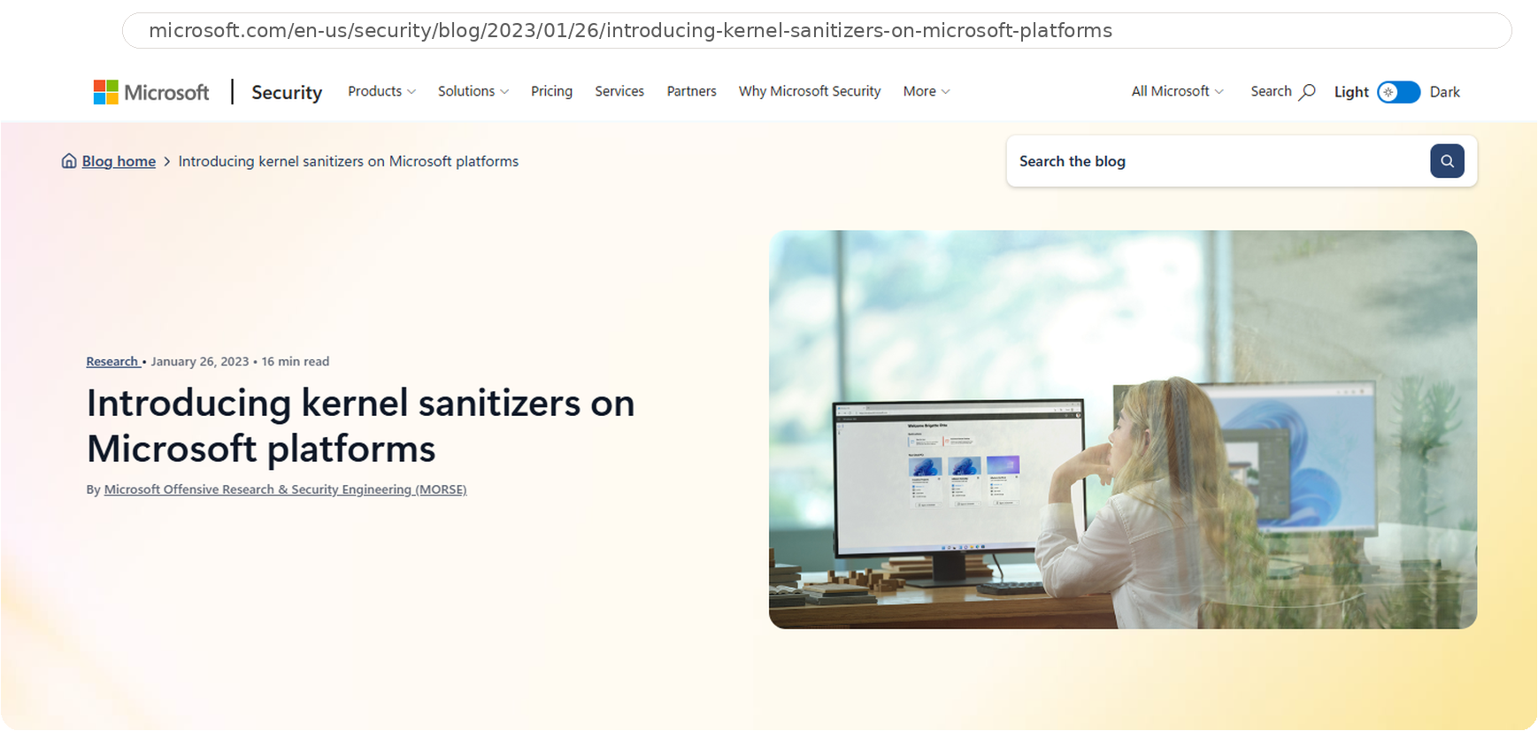

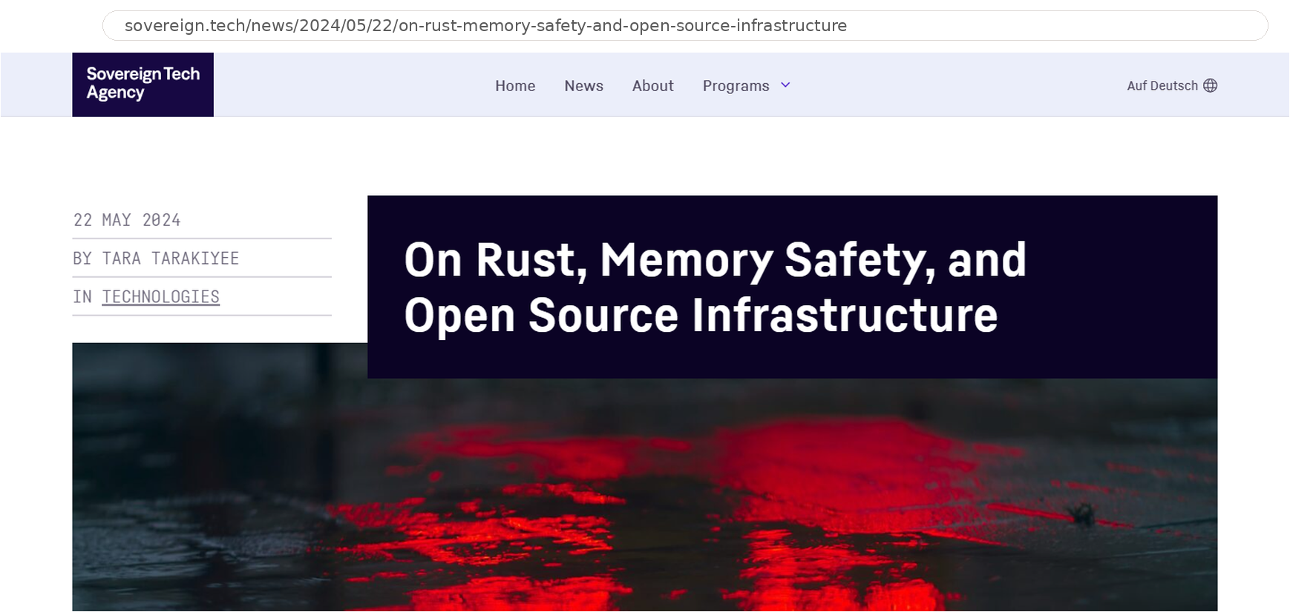
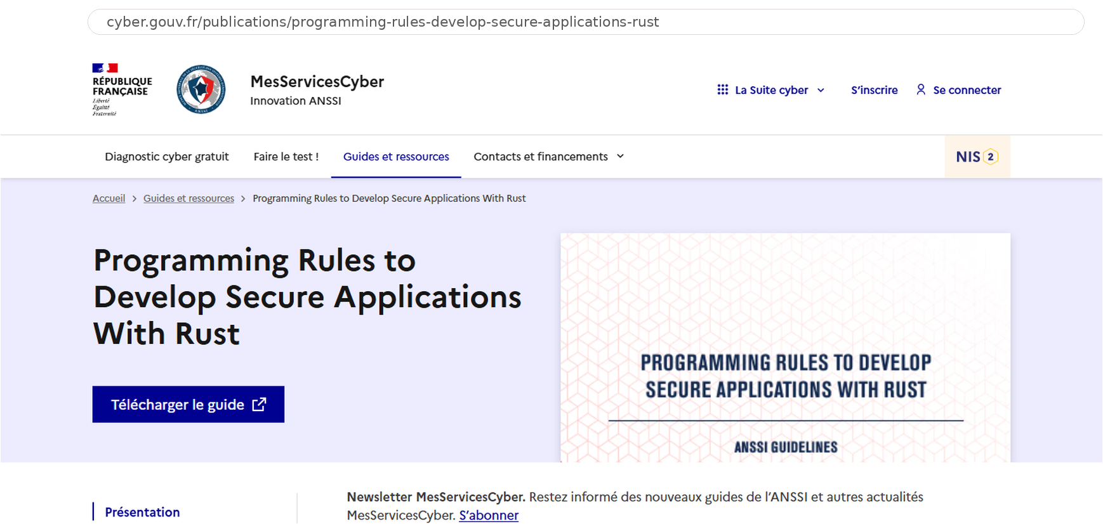
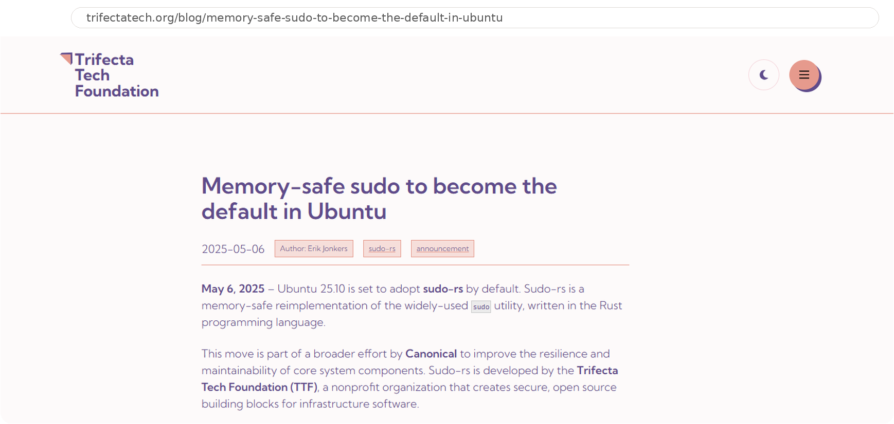
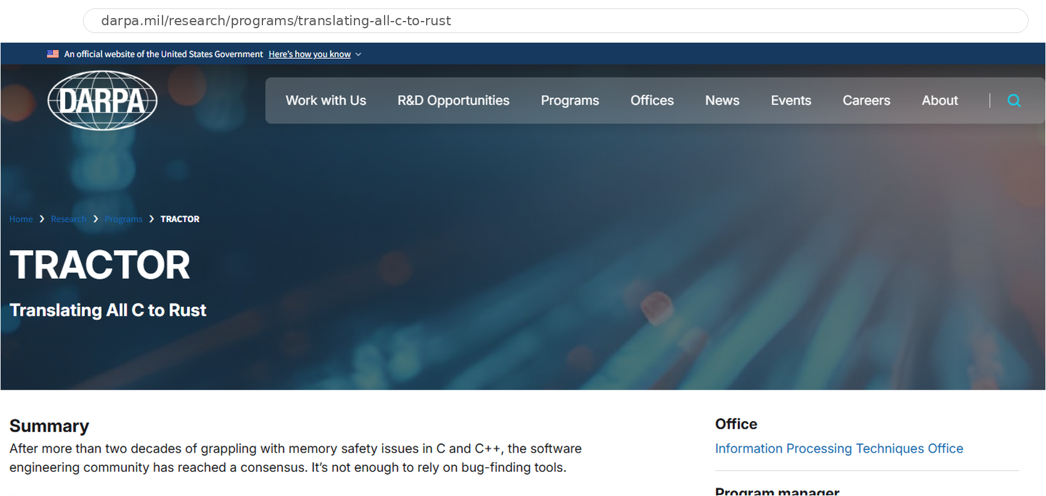
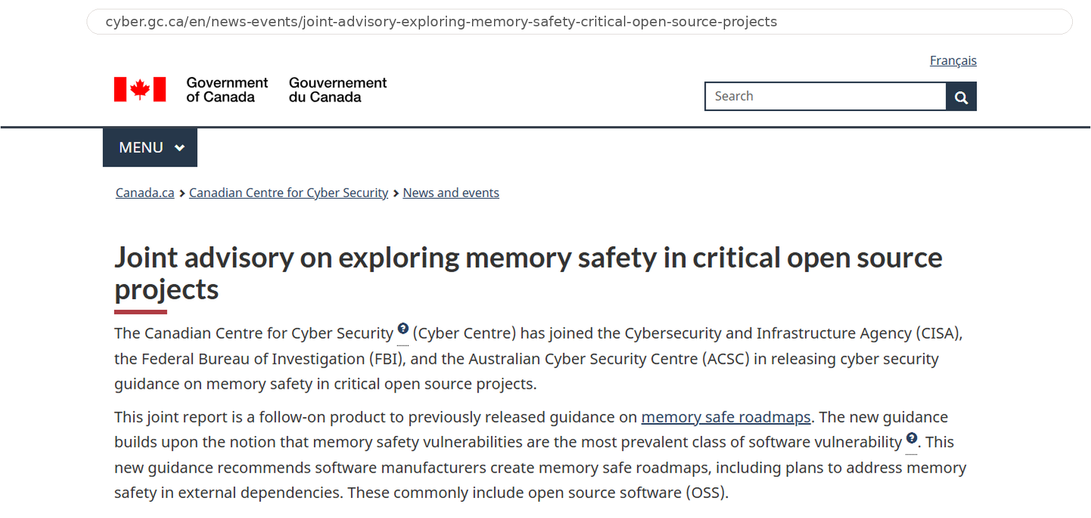
C/C++ in the news
Notes:
C/C++ has been in the news a lot lately.
Governments recommending memory safe alternatives.
DARPA project tractor to convert unsafe C code to Rust.
Rust adoption stories , like Google and Microsoft adopting it in Android and Windows kernel.
Various memory safety stats from the Chromium project.

Slide 31
C++ is not C

Slide 32
C++ is not C
#include <stdlib.h>
const int limit = 10;
struct point { int x, y; };
struct rect { struct point lo, hi; };
int main(void)
{
int n = limit;
int *p = malloc(n * sizeof *p);
enum color { red, green } c = 1;
char *s = "text";
char name[4] = "abcd";
struct point pt = { .y = 2, .x = 1 };
struct rect r = { .hi.x = 3 };
int a[3] = { [1] = 5 };
int v[n];
goto done;
int later = 5;
done:
free(p);
return sizeof('a');
}
C: external linkage, C++: internal
error: void* does not convert to int*
error: int does not convert to enum
error: string literals are const
error: C might omit ‘\0’
error: designators out of order
error: nested designator
error: array designator
error: no variable-length arrays
error: jump bypasses an initialization
C: returns sizeof(int) typically 4, C++: returns 1
Notes:
This is valid C23 program and it compiles cleanly in C.
But not in C++.
Eight lines are errors in C++.
void* to int*, int to enum, non-const string literal, char[4] with no terminator, out-of-order and nested designators, VLAs, goto past an init.

Slide 33
C++ is not C
C23 against the C++26 working draft
C core
shared facilities
Types and Functions
Storage and Control
C Library
Preprocessing
Later Additions
functions, prototypes, pointers, void*, arrays, structs, unions, enum, typedef, long long, stdint.h, inttypes.h, bool, __func__
static, extern, thread_local, const, volatile, operators, switch, goto
malloc, free, printf, scanf, string functions
preprocessor, digraphs, variadic macros, #elifdef, #warning, __VA_OPT__, #embed
hex floats, static_assert, enum : T, binary literals, digit separators, empty {} initializer; converged in C23: nullptr, constexpr objects, auto
C not adopted
not in C++
Arrays and Aliasing
Type Features
Syntax Forms
VLAs, flexible array members, int a[static n]; restrict
_Generic, typeof, _Complex, _Imaginary, _BitInt, the _Atomic qualifier
compound literals, anonymous struct members, _Noreturn
C++ modified
same spelling, different rules
Literals
Expressions and Conversions
Declarations and Linkage
Initialization and Lifetime
Objects and Scope
'a' is char; string literals are const; u8, char16_t, char32_t
void* to int*; int to enum; value categories of =, ?: and comma; bool comparisons; &*p on null; built-in array comparison; narrowing in braces; evaluation order
const linkage; const needs an initializer; inline; int f() before C23; main not callable; tentative definitions; types in casts, sizeof, parameters; ODR
designator order and nesting; char[4]="abcd"; empty struct; non-constant static init; goto past an initialized local; falling off a function; object lifetime and aliasing model
typedef vs tag names; alignas placement; atomics, threads; struct scope; tag hiding; bit-field signedness; volatile struct copies; union punning; attributes; NULL; realloc(p,0)
C++ added
more mechanisms, libraries
Object Model
Generic and Compile-time
Control and Errors
Organization
Library
Systems Library
classes and RAII, single and multiple inheritance, virtual functions, references, new and delete, overloading, default arguments, named casts, RTTI, move semantics
templates, alias templates, concepts, lambdas, auto, decltype, constexpr and consteval functions, constinit, if constexpr, if consteval, user-defined literals, fold expressions, CTAD, reflection
exceptions, noexcept, range-based for, structured bindings, three-way comparison, coroutines, contracts, erroneous behaviour, enum class, override, final, deducing this, pack indexing, name-independent _ declarations, expansion statements
namespaces, modules, extern "C" language linkage
string, containers, algorithms, iterators, ranges, smart pointers, allocators, pmr, span, string_view, optional, variant, expected, tuple, any, function, type_traits, format, print, iostreams, chrono, filesystem, regex, random, complex
thread, jthread, mutexes, futures, parallel policies, senders and receivers, simd, linalg, mdspan, flat_map, stacktrace, generator, bit_cast, source_location, hazard pointers, RCU, saturating arithmetic, optional hardened preconditions
C++ removed
C forms, later dropped
Dropped
register (C++17), auto as a storage class (C++11), gets (C++14), trigraphs (C++17)

Slide 34
C++ is not C
C23 against the C++26 working draft
types
printf
preprocessor
C core
shared facilities
Types and Functions
Storage and Control
C Library
Preprocessing
Later Additions
functions, prototypes, pointers, void*, arrays, structs, unions, enum, typedef, long long, stdint.h, inttypes.h, bool, __func__
static, extern, thread_local, const, volatile, operators, switch, goto
malloc, free, printf, scanf, string functions
preprocessor, digraphs, variadic macros, #elifdef, #warning, __VA_OPT__, #embed
hex floats, static_assert, enum : T, binary literals, digit separators, empty {} initializer; converged in C23: nullptr, constexpr objects, auto
functions
malloc, free
structs
C not adopted
not in C++
Arrays and Aliasing
Type Features
Syntax Forms
VLAs
_Generic
compound literals
VLAs, flexible array members, int a[static n]; restrict
_Generic, typeof, _Complex, _Imaginary, _BitInt, the _Atomic qualifier
compound literals, anonymous struct members, _Noreturn
C++ modified
same spelling, different rules
Literals
Expressions and Conversions
Declarations and Linkage
Initialization and Lifetime
Objects and Scope
'a' is char; string literals are const; u8, char16_t, char32_t
void* to int*; int to enum; value categories of =, ?: and comma; bool comparisons; &*p on null; built-in array comparison; narrowing in braces; evaluation order
const linkage; const needs an initializer; inline; int f() before C23; main not callable; tentative definitions; types in casts, sizeof, parameters; ODR
designator order and nesting; char[4]="abcd"; empty struct; non-constant static init; goto past an initialized local; falling off a function; object lifetime and aliasing model
typedef vs tag names; alignas placement; atomics, threads; struct scope; tag hiding; bit-field signedness; volatile struct copies; union punning; attributes; NULL; realloc(p,0)
'a' is char
const linkage
ODR
modules
C++ added
more mechanisms, libraries
Object Model
Generic and Compile-time
Control and Errors
Organization
Library
Systems Library
operator overloading
exceptions
smart pointers
classes and RAII, single and multiple inheritance, virtual functions, references, new and delete, overloading, default arguments, named casts, RTTI, move semantics
templates, alias templates, concepts, lambdas, auto, decltype, constexpr and consteval functions, constinit, if constexpr, if consteval, user-defined literals, fold expressions, CTAD, reflection
exceptions, noexcept, range-based for, structured bindings, three-way comparison, coroutines, contracts, erroneous behaviour, enum class, override, final, deducing this, pack indexing, name-independent _ declarations, expansion statements
namespaces, modules, extern "C" language linkage
string, containers, algorithms, iterators, ranges, smart pointers, allocators, pmr, span, string_view, optional, variant, expected, tuple, any, function, type_traits, format, print, iostreams, chrono, filesystem, regex, random, complex
thread, jthread, mutexes, futures, parallel policies, senders and receivers, simd, linalg, mdspan, flat_map, stacktrace, generator, bit_cast, source_location, hazard pointers, RCU, saturating arithmetic, optional hardened preconditions
classes and RAII
lambdas
namespaces
thread
move semantics
templates
contracts
span
concepts
coroutines
hardened preconditions
C++ removed
C forms, later dropped
Dropped
gets
register (C++17), auto as a storage class (C++11), gets (C++14), trigraphs (C++17)
Notes:
C++ is not C.
We started with a portable C core: functions, basic data types, structs, preprocessor, C library.
We did not take everything from C: VLAs is the classic one.
We added powerful abstractions: classes with single and multiple inheritance, operator overloading, ctor/dtor and move semantics, smart pointers, etc.

Slide 35
History of safety in C++
Pre-98
C++98/03
C++11
C++14
C++17
C++20
C++23
C++26
1985
1998
2011
2014
2017
2020
2023
2026
Added
Type-checked arguments, constructors and destructors, const, references, virtual, abstract classes, exceptions, templates, named casts, bool
string, vector, at(), exception safety guarantees, value initialization, auto_ptr
Memory model, nullptr, enum class, brace init, override, final, =default, =delete, constexpr, range-for, static_assert, noexcept, move, lambdas, unique_ptr, shared_ptr, array, lock_guard, atomic
make_unique, extended constexpr, [[deprecated]]
Evaluation order, copy elision, structured bindings, if constexpr, [[nodiscard]], [[fallthrough]], optional, variant, string_view, byte, scoped_lock, parallel algorithms
Concepts, modules, constinit, consteval, designated initializers, three-way comparison, span, ranges, jthread, safe integer compare, format, bit_cast, latches, barriers, atomic wait
expected, start_lifetime_as, mdspan, print, stacktrace, out_ptr, to_underlying, deducing this, range-for temporaries
Erroneous behaviour, contracts, hardening, saturating arithmetic, hazard pointers, RCU, =delete("reason")
Modified
Narrowing in braces ill-formed, data races are UB, literal to char* gone
Evaluation order defined, noexcept part of the type
Two’s complement mandated, [=] this capture deprecated
Uninitialized reads erroneous, infinite loops defined, enum and float arithmetic ill-formed
Removed or deprecated
auto_ptr, throw()
gets; random_shuffle
auto_ptr, throw(X), random_shuffle, bind1st, ptr_fun, mem_fun
not1, not2; volatile compound assignment
GC support; aligned_storage
codecvt, strstream, wstring_convert
Hazards introduced
new and delete dangle, references dangle, reinterpret_cast, operator[] unchecked, auto_ptr moves on copy
auto hides types, lambdas capture dangling, moved-from objects, shared_ptr cycles, thread terminates unjoined, range-for over temporary
string_view dangles, optional deref UB
span and mdspan unchecked, coroutines dangle, assume_aligned UB
[[assume]], unreachable()
[[indeterminate]], hardening is library only, contracts contested to the last ballot

Slide 36
History of safety in C++
Pre-98
C++98/03
C++11
C++14
C++17
C++20
C++23
C++26
1985
1998
2011
2014
2017
2020
2023
2026
Added
exceptions
unique_ptr
optional, variant
expected
Type-checked arguments, constructors and destructors, const, references, virtual, abstract classes, exceptions, templates, named casts, bool
string, vector, at(), exception safety guarantees, value initialization, auto_ptr
Memory model, nullptr, enum class, brace init, override, final, =default, =delete, constexpr, range-for, static_assert, noexcept, move, lambdas, unique_ptr, shared_ptr, array, lock_guard, atomic
make_unique, extended constexpr, [[deprecated]]
Evaluation order, copy elision, structured bindings, if constexpr, [[nodiscard]], [[fallthrough]], optional, variant, string_view, byte, scoped_lock, parallel algorithms
Concepts, modules, constinit, consteval, designated initializers, three-way comparison, span, ranges, jthread, safe integer compare, format, bit_cast, latches, barriers, atomic wait
expected, start_lifetime_as, mdspan, print, stacktrace, out_ptr, to_underlying, deducing this, range-for temporaries
Erroneous behaviour, contracts, hardening, saturating arithmetic, hazard pointers, RCU, =delete("reason")
templates
Memory model
span
contracts
auto_ptr
shared_ptr
ranges
hardening
constructors and destructors
structured bindings
Modified
STL
Narrowing in braces ill-formed, data races are UB, literal to char* gone
Evaluation order defined, noexcept part of the type
Two’s complement mandated, [=] this capture deprecated
Uninitialized reads erroneous, infinite loops defined, enum and float arithmetic ill-formed
data races are UB
Uninitialized reads erroneous
Removed or deprecated
auto_ptr, throw()
gets; random_shuffle
auto_ptr, throw(X), random_shuffle, bind1st, ptr_fun, mem_fun
not1, not2; volatile compound assignment
GC support; aligned_storage
codecvt, strstream, wstring_convert
gets
operator[] unchecked
span and mdspan unchecked
Hazards introduced
new and delete dangle, references dangle, reinterpret_cast, operator[] unchecked, auto_ptr moves on copy
auto hides types, lambdas capture dangling, moved-from objects, shared_ptr cycles, thread terminates unjoined, range-for over temporary
string_view dangles, optional deref UB
span and mdspan unchecked, coroutines dangle, assume_aligned UB
[[assume]], unreachable()
[[indeterminate]], hardening is library only, contracts contested to the last ballot
references dangle
string_view dangles
lambdas capture dangling
hardening is library only
Notes:
We also did a lot of work on safety.
Ctor/dtor enable RAII, which enables safe memory allocations, and non memory management.
Smart pointers can remove an entire class of memory issues.
Span and String view allow non owning views over types.
Contracts
STL Hardening, Uninitialized reads

Slide 37
WG21 papers on safety by area
5
11
5
14
4
25
2
3
7
2
17
Memory safety
Bounds
Initialization
Lifetime
Null
Alignment
Aliasing
1
9
2
7
3
6
1
2
Type and value safety
Type
Arithmetic
Conversion
Const
Enum
Floating point
1
4
2
13
Comparison
Object Model
2
8
23
211
1
Control flow and error safety
Exception safety
Error handling
Signal/Reentrancy
1
4
10
5
Forward progress
Control-flow integrity
Evaluation order
4
2
6
24
8
Concurrency safety
Data races
Atomicity/Ordering
Liveness
6
23
4
Resource safety
Allocation
Stack
Non-Memory resources
1
6
1
1
55
Structural and build safety
ODR/IFNDR
ABI
Toolchain/Optimizer
1
7
2
1
3
Interface and data safety
Strings
Variadic
Units
Deserialization
Notes:
I tried to fetch all published papers that I could find. And overlayed it on the safety taxonomy.
Red means not adopted, Green means adopted.

Slide 38
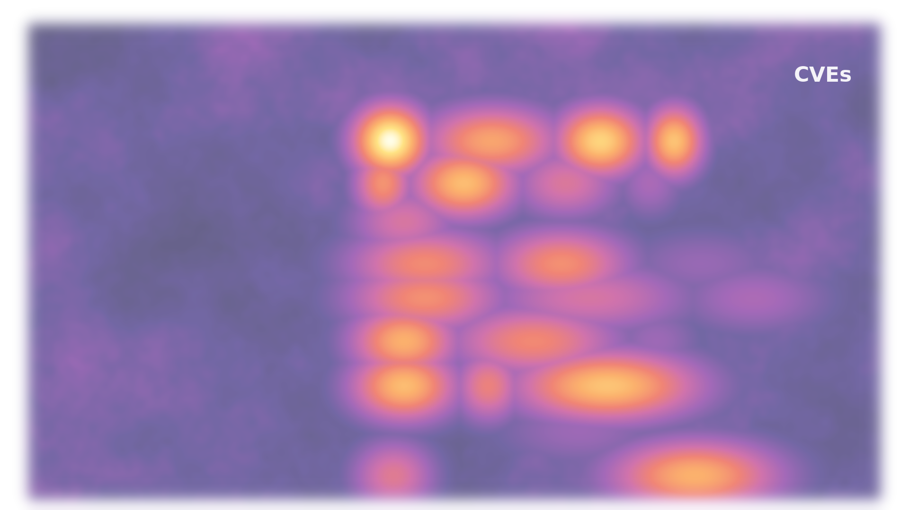
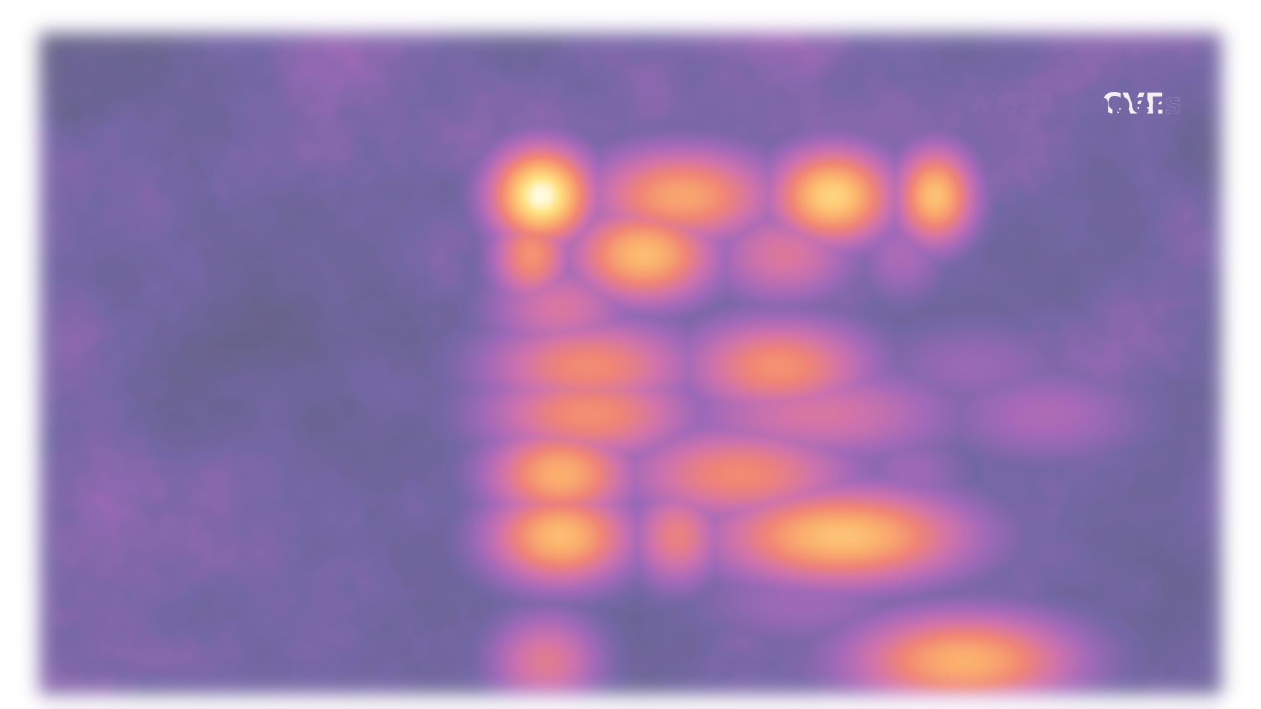
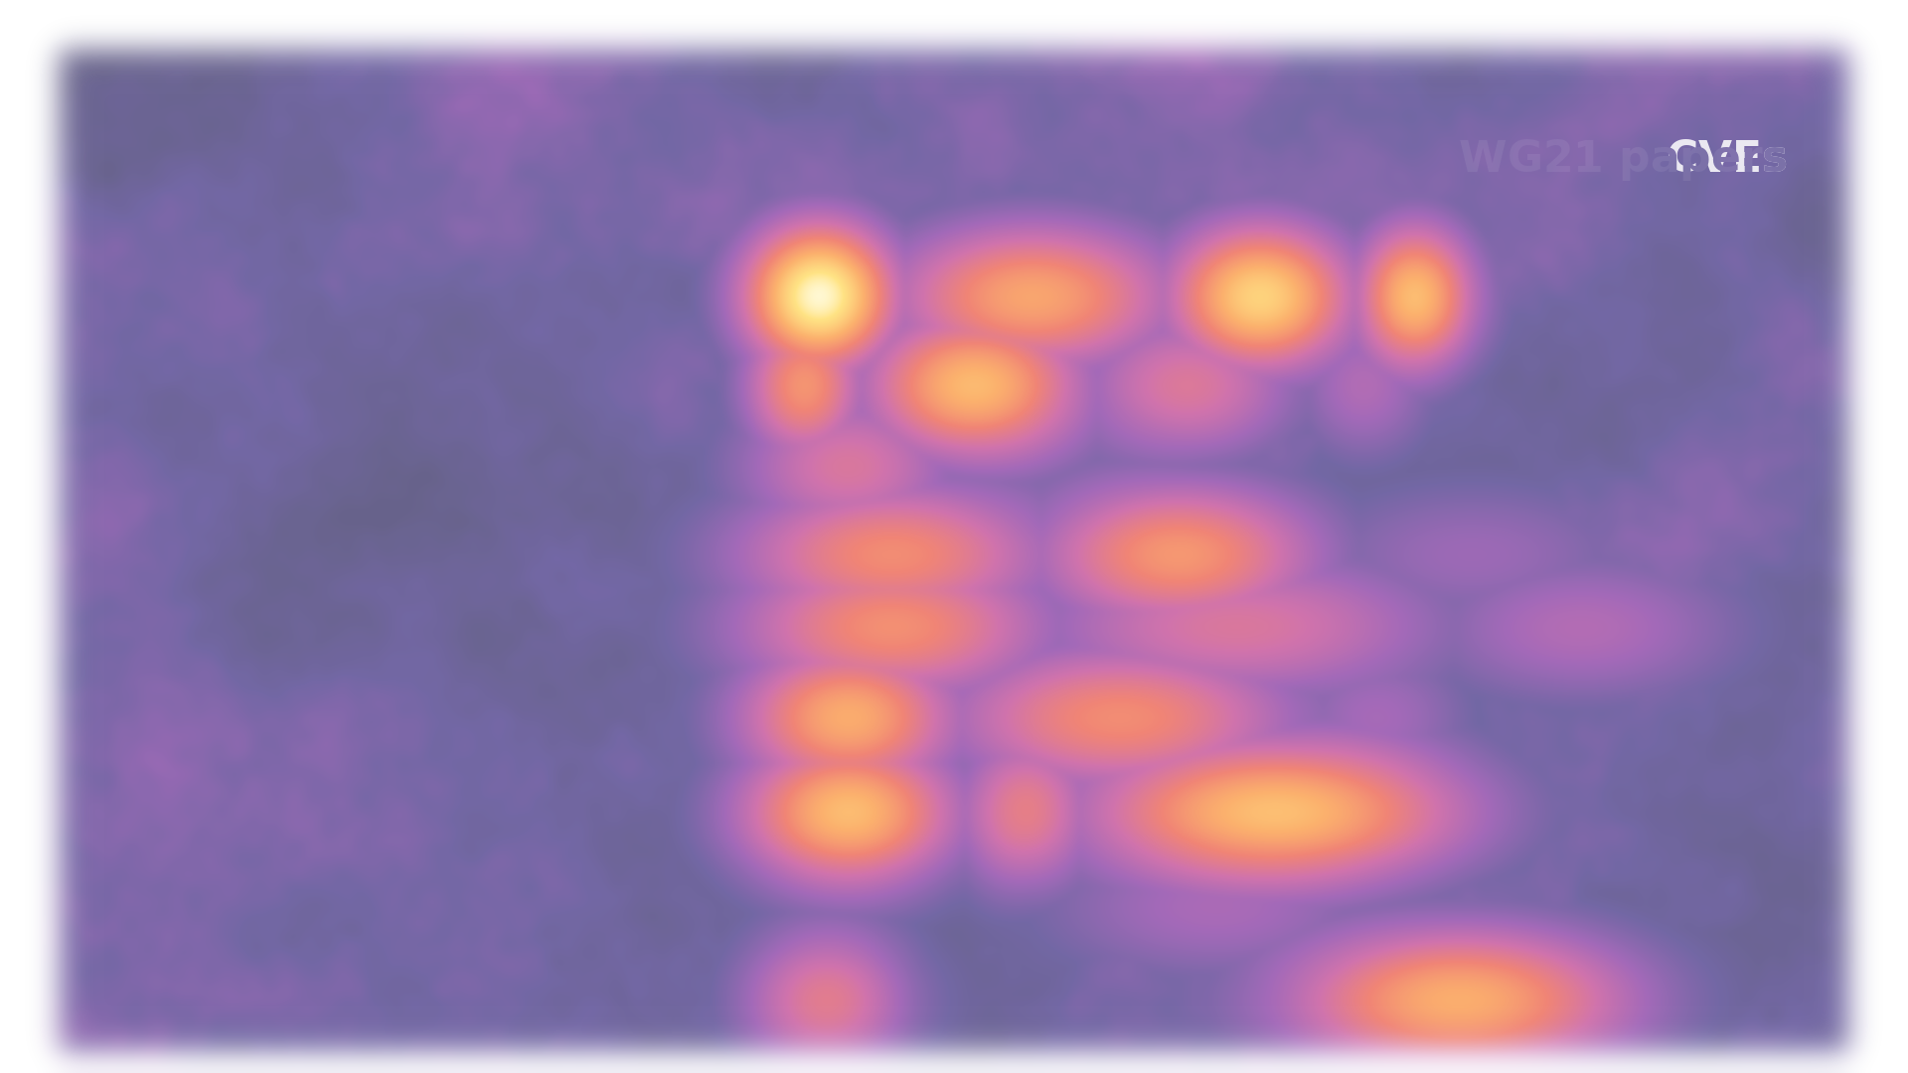
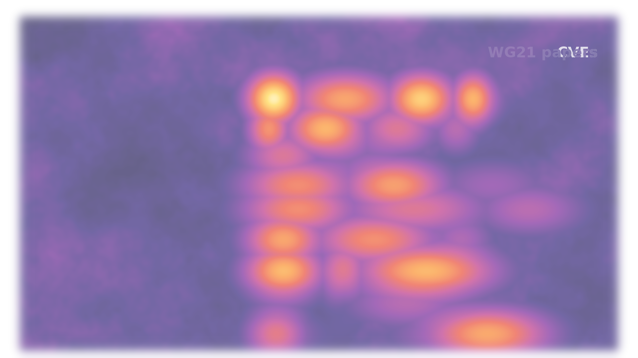
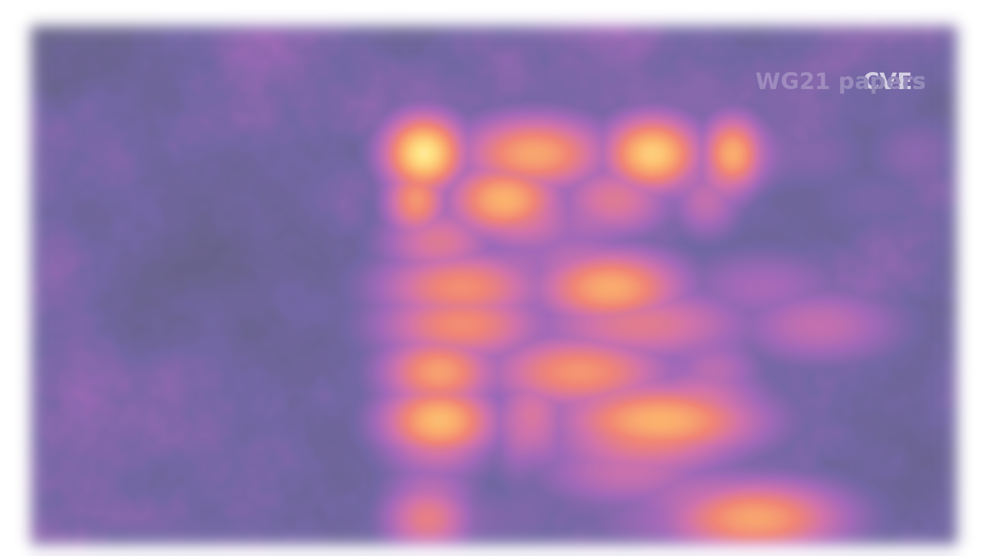
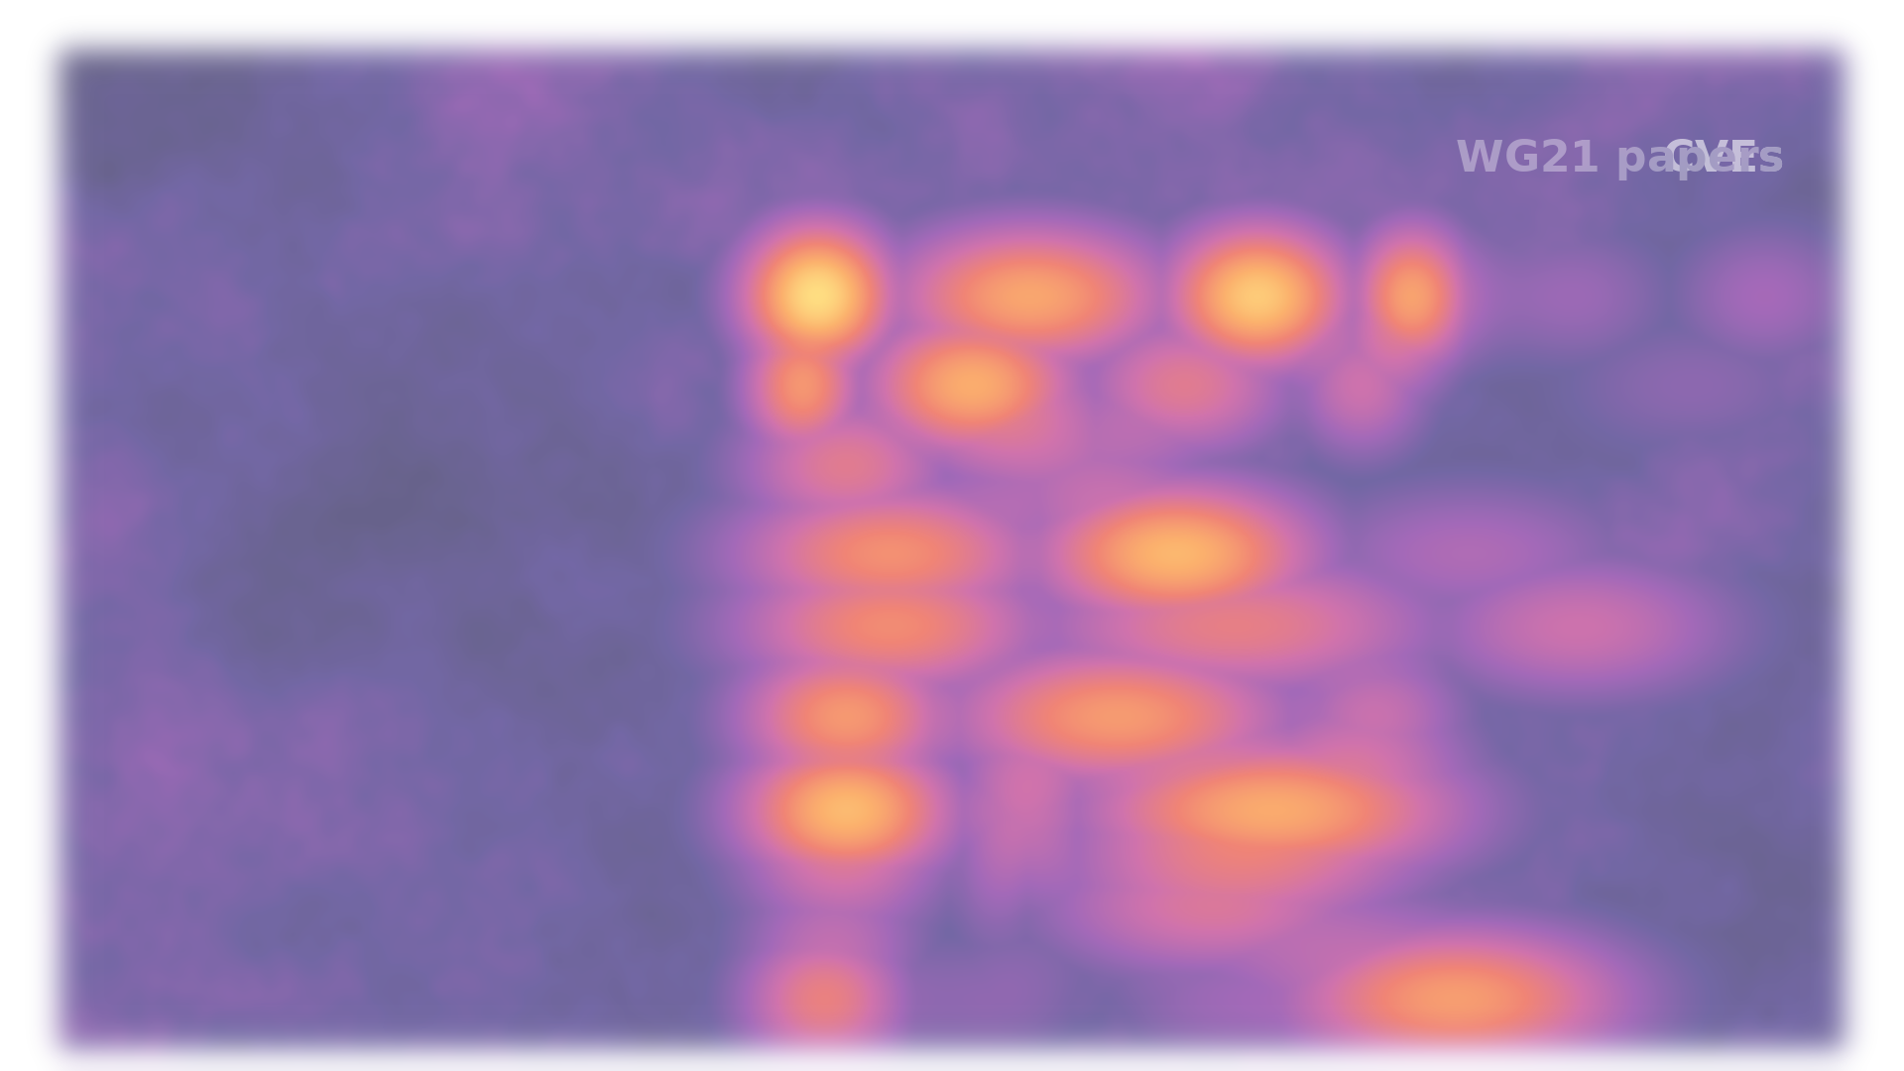
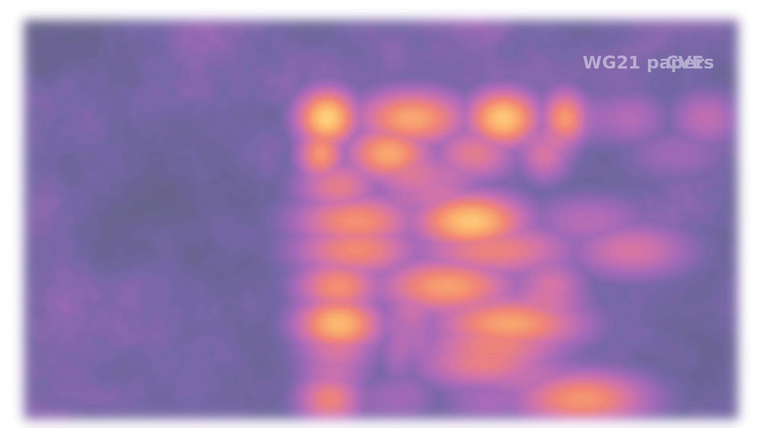
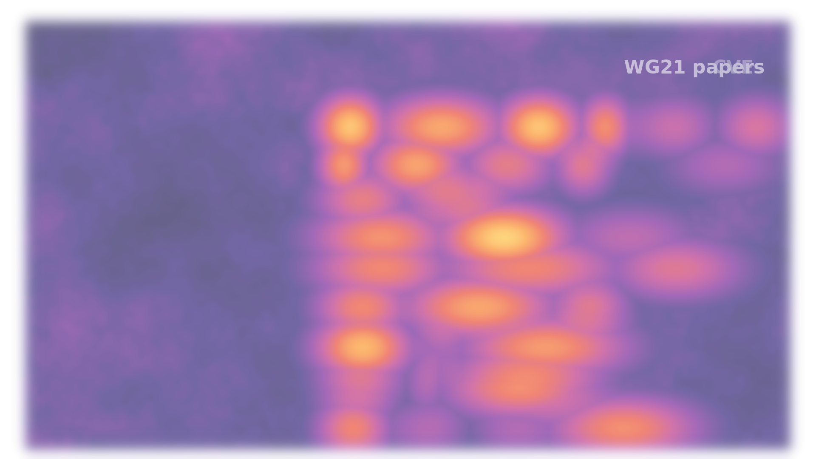
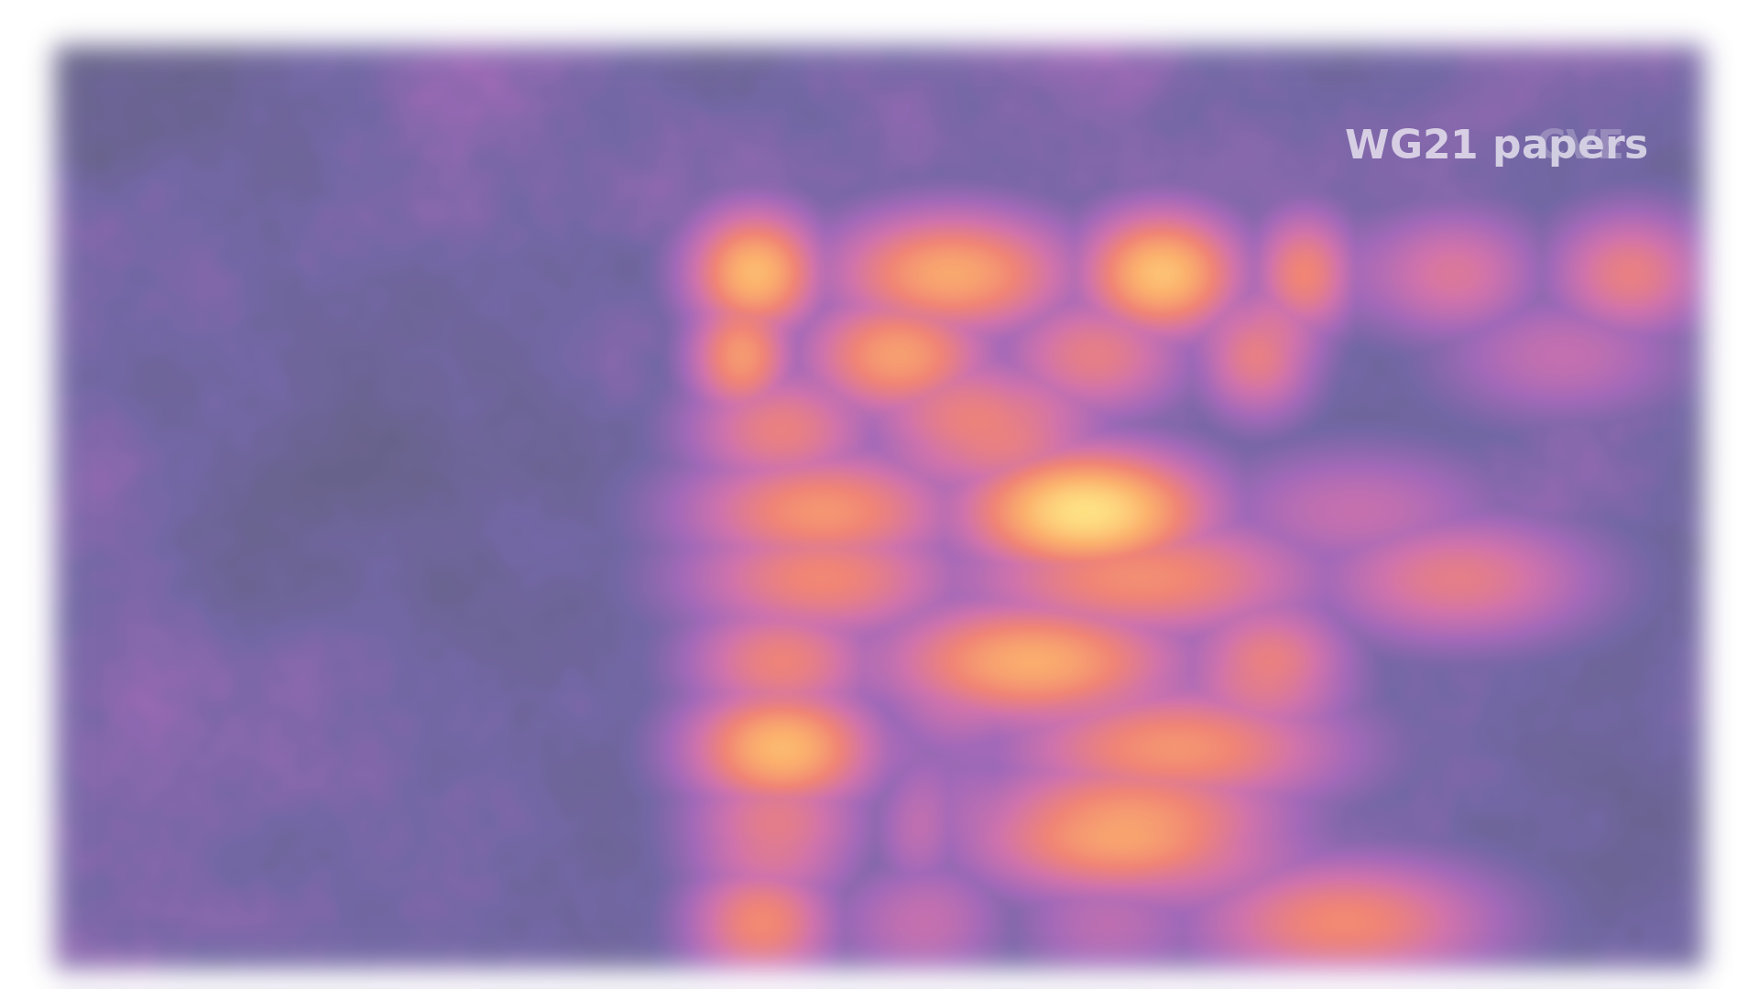


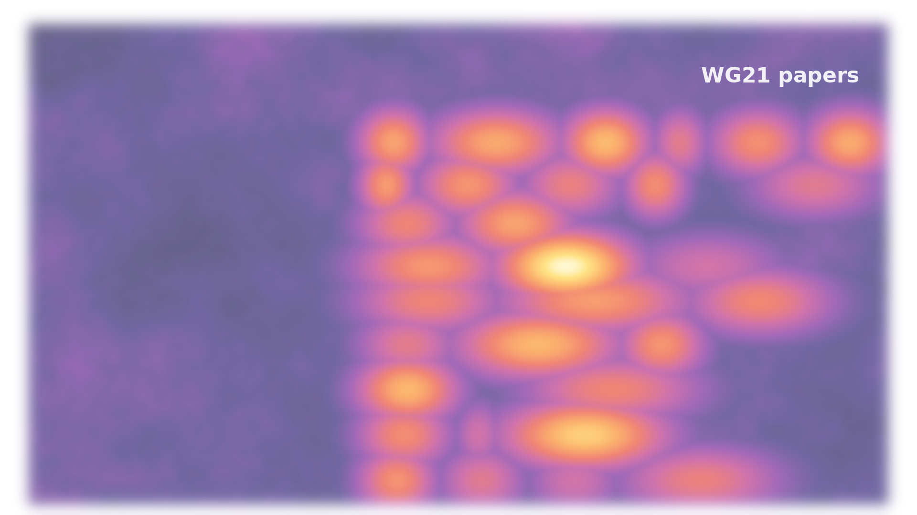
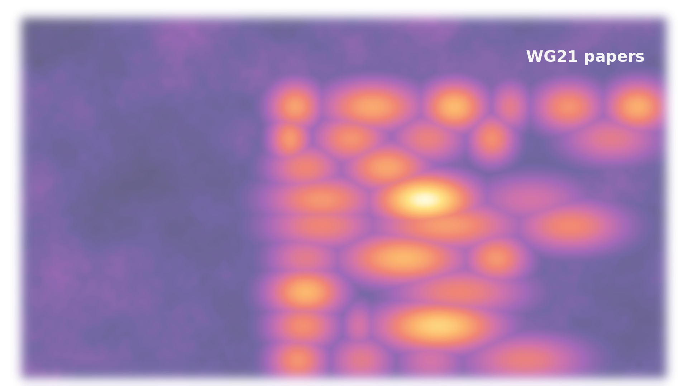


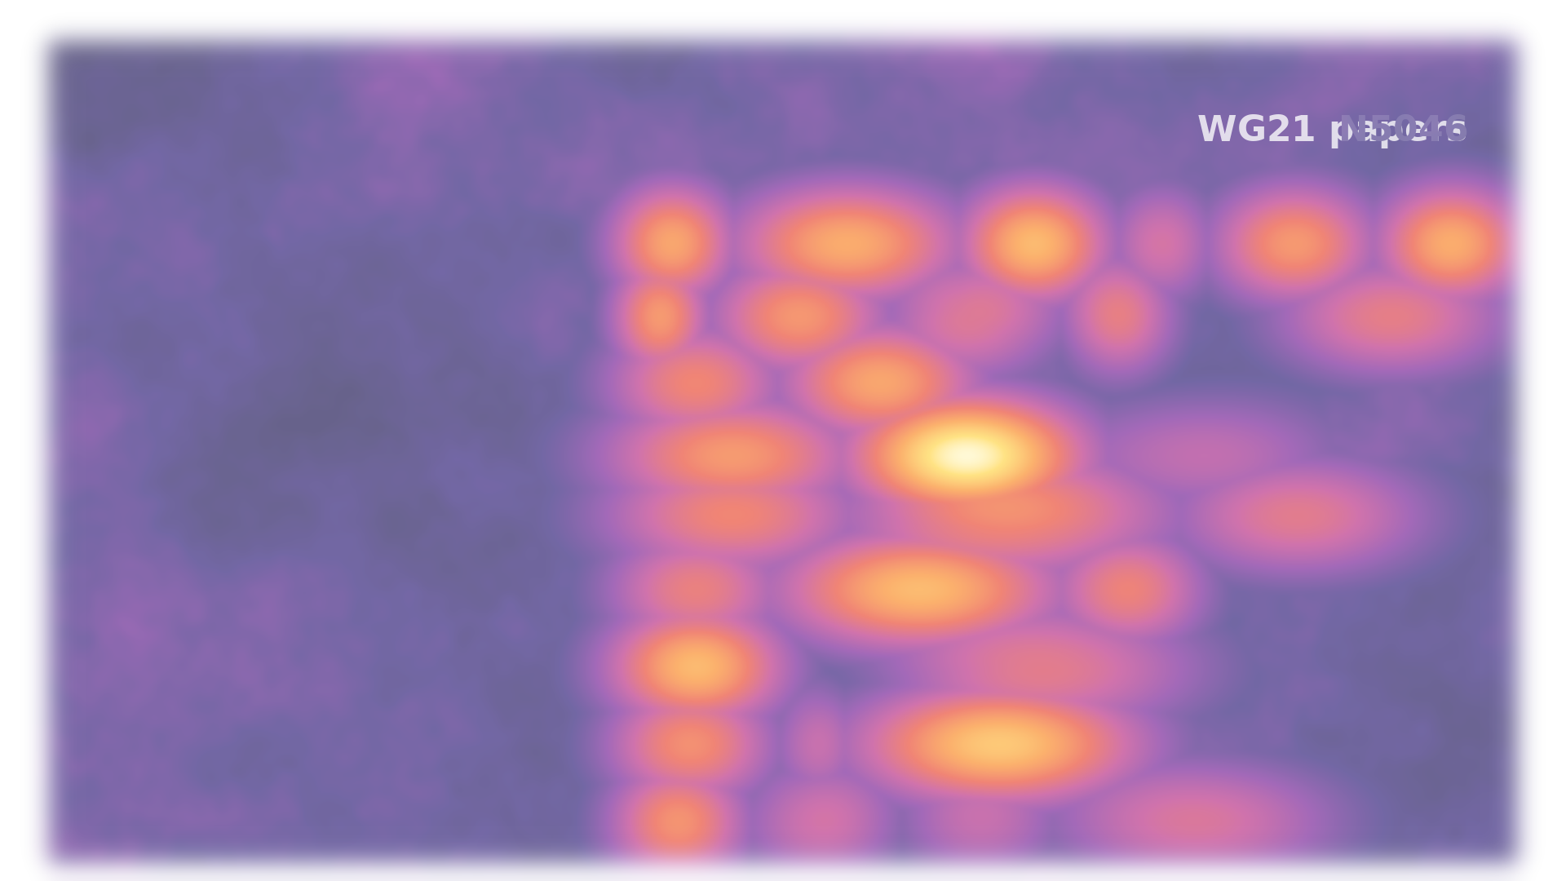

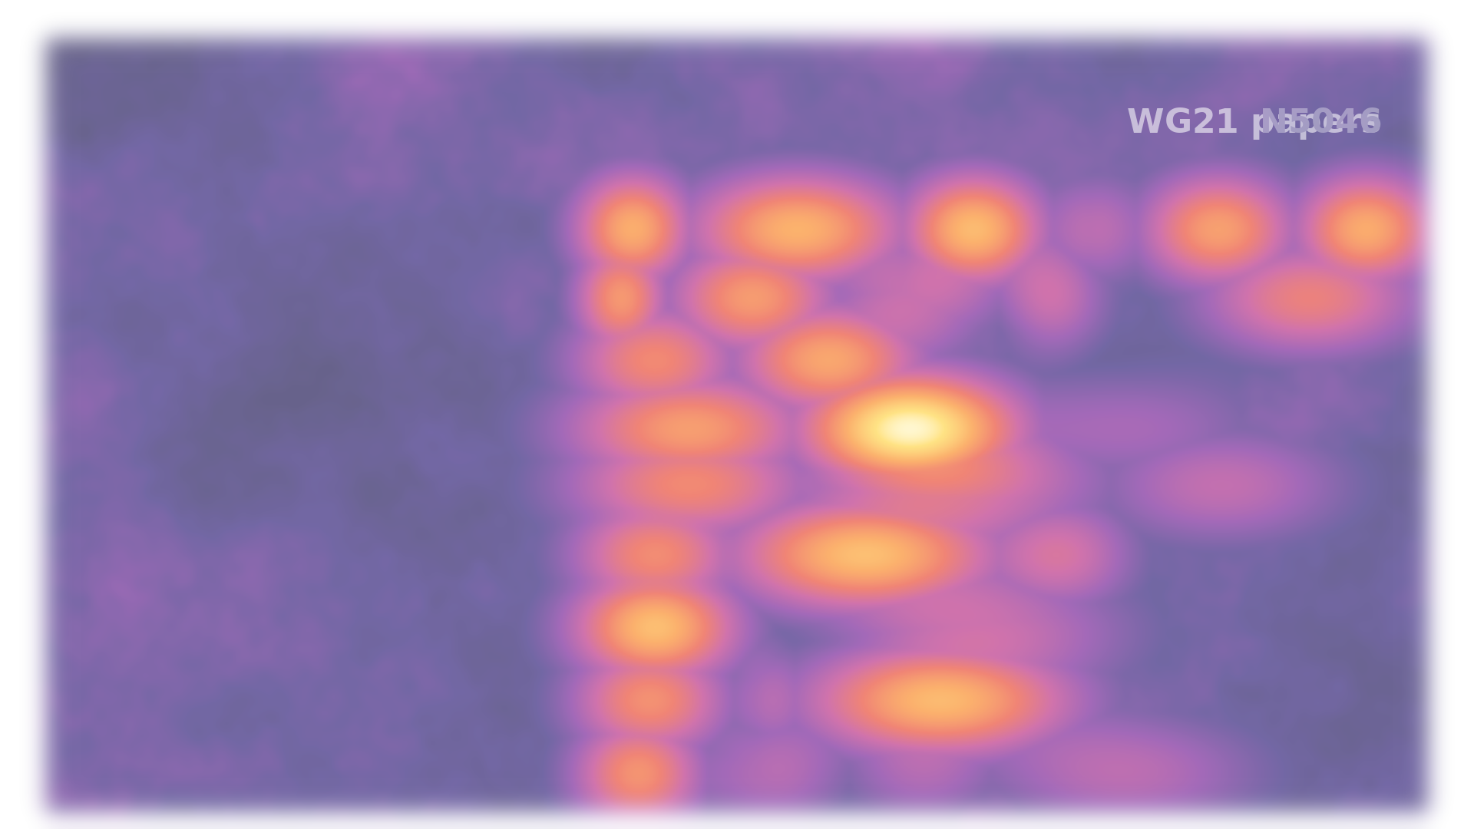
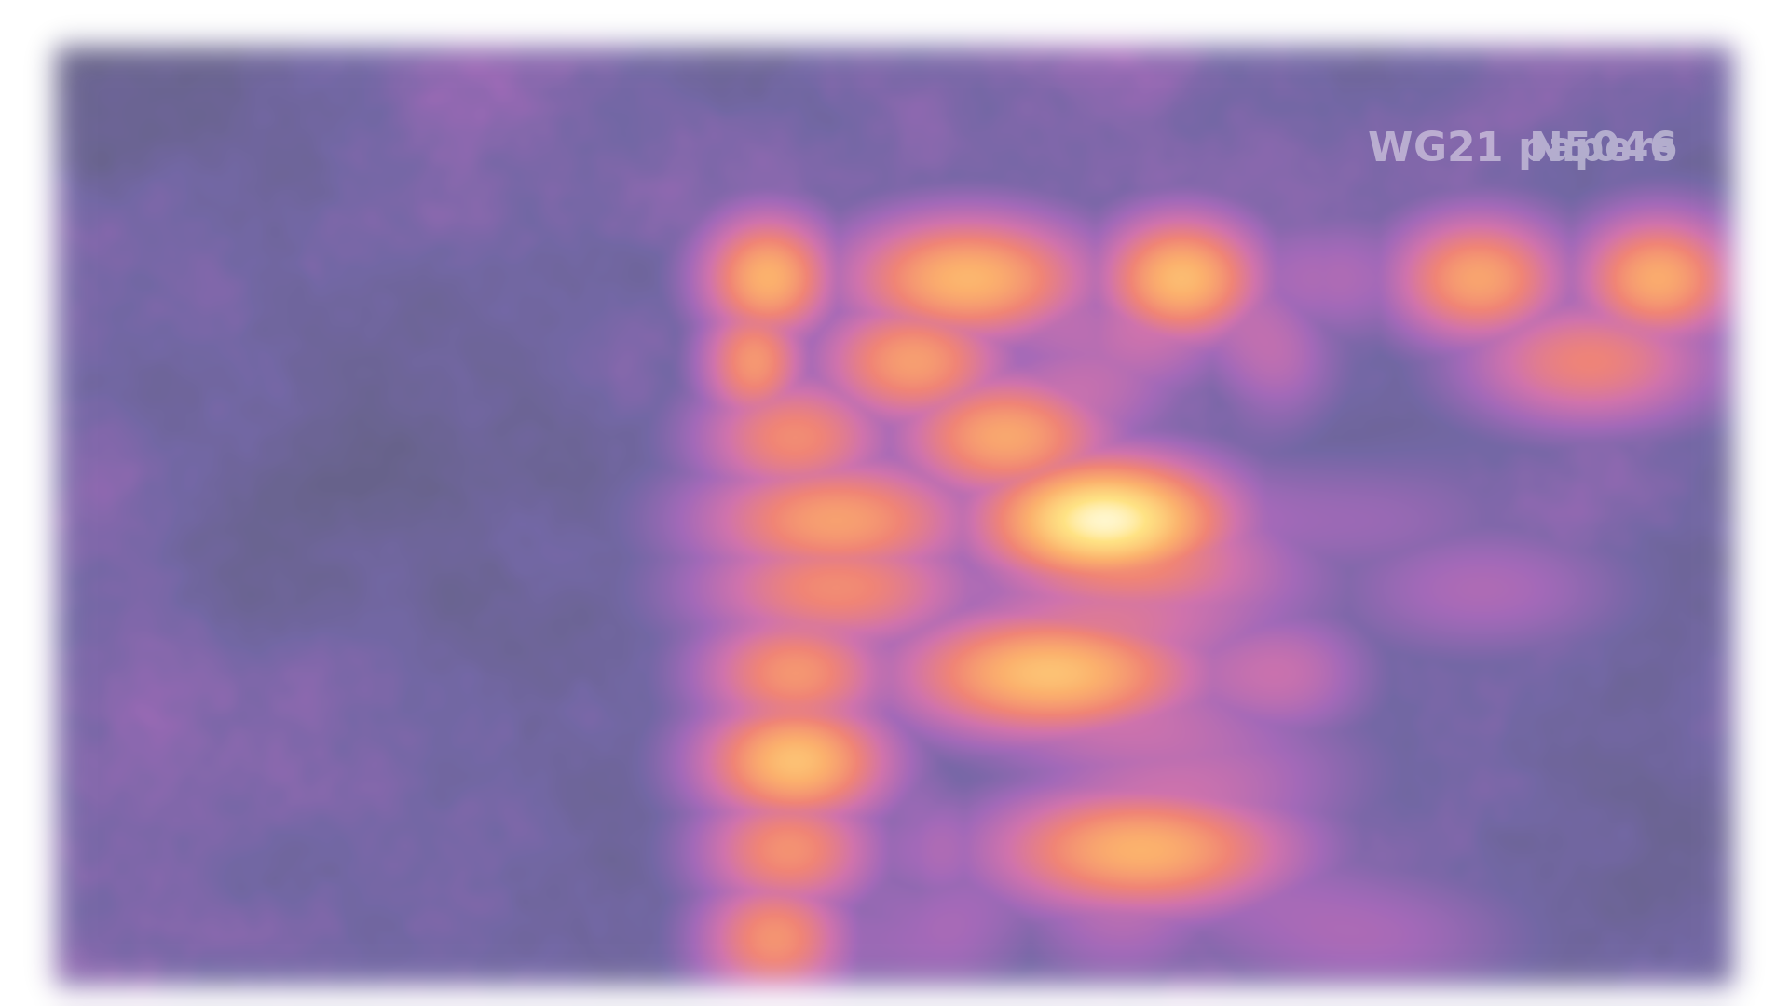

















A taxonomy of C/C++ safety
Memory safety
Bounds
Initialization
Lifetime
Null
Alignment
Aliasing
Type and value safety
Type
Arithmetic
Conversion
Const
Enum
Floating point
Comparison
Object Model
Control flow and error safety
Exception safety
Error handling
Signal/Reentrancy
Forward progress
Control-flow integrity
Evaluation order
Concurrency safety
Data races
Atomicity/Ordering
Liveness
Resource safety
Allocation
Stack
Non-Memory resources
Structural and build safety
ODR/IFNDR
ABI
Toolchain/Optimizer
Interface and data safety
Strings
Variadic
Units
Deserialization
Notes:
Watch the grid morph from CVE heat to WG21 paper heat.
Until very recently we had almost no work on bounds.
We did a huge amount of work on error handling, that's contracts, 211 papers.
And we did almost nothing on lifetime, which is the second biggest bucket of CVEs.

Slide 39
The C++ safety issues
Notes:
So which issues are actually C++ issues, not C issues. I compared C++ against Rust, Go and Swift, category by category, using only the safe subset of each language.

Slide 40
The C++ safety issues
1/6
C++
Rust
Go
Swift
Bounds
Opt-in
at(), hardened STL
Runtime trap
panic; get → Option
Runtime trap
panic
Runtime trap
trap; Span
Bounds
Undefined
narrow contracts; 26
Runtime trap
documented panics
Runtime trap
panics
Runtime trap
precondition traps
Lifetime
Undefined
views and refs dangle
Compile error
borrow checker
By design
GC keeps targets
By design
ARC; unowned traps
Lifetime
Undefined
iterators invalidate
Compile error
borrow checker
By design
ranges; slice aliasing
Runtime trap
index traps
Lifetime
Undefined
coroutine frames
By design
Pin; drop cancels
By design
real stacks
Runtime trap
continuation misuse
Lifetime
None
getters expose ptrs
Compile error
borrow rules
Partial
aliasing possible
Partial
classes alias
Null
Undefined
null deref
By design
no null; unwrap panics
Runtime trap
nil deref panics
By design
optionals; ! traps
Initialization
Runtime trap
erroneous (26)
Compile error
definite init
By design
zero values
Compile error
definite init
Notes:
Bounds is opt-in, at() and hardened STL, everyone else traps. What happens is implementation defined for C++.
Lifetime is four rows and every one is Undefined, views and references dangle, iterators invalidate, coroutine frames, getters exposing pointers.
Rust is a compile error, Go and Swift are by design.
Null is Undefined for C++, and by design or a trap for everyone else.
Initialization is the one bright spot.

Slide 41
The C++ safety issues
1/6
C++
Rust
Go
Swift
Bounds
bounds checks are opt-in
at() or hardened STL
50% of CVEs
everyone else traps
Opt-in
at(), hardened STL
Runtime trap
panic; get → Option
Runtime trap
panic
Runtime trap
trap; Span
Bounds
Undefined
narrow contracts; 26
Runtime trap
documented panics
Runtime trap
panics
Runtime trap
precondition traps
Lifetime
Undefined
views and refs dangle
Compile error
borrow checker
By design
GC keeps targets
By design
ARC; unowned traps
string_view, span, iterators dangle silently
9% of CVEs, 6% of exploits
Lifetime
Undefined
iterators invalidate
Compile error
borrow checker
By design
ranges; slice aliasing
Runtime trap
index traps
GC and ARC
Lifetime
Undefined
coroutine frames
By design
Pin; drop cancels
By design
real stacks
Runtime trap
continuation misuse
borrow checker
Lifetime
None
getters expose ptrs
Compile error
borrow rules
Partial
aliasing possible
Partial
classes alias
Null
null deref is UB, 6% of CVEs
no optional in the type
Optionals, or a defined trap
Undefined
null deref
By design
no null; unwrap panics
Runtime trap
nil deref panics
By design
optionals; ! traps
Initialization
C++26 erroneous behaviour, reads trap
Runtime trap
erroneous (26)
Compile error
definite init
By design
zero values
Compile error
definite init

Slide 42
The C++ safety issues
2/6
C++
Rust
Go
Swift
Initialization
Undefined
static init order
By design
constant statics
By design
dependency order
By design
lazy, once
Arithmetic
Undefined
signed overflow
Partial
panic; release wraps
None
wraps, defined
Runtime trap
traps; &+ wraps
Data races
Undefined
unsynchronized access
Compile error
Send and Sync
Undefined
-race at test time
Compile error
actors, Sendable (6)
Allocation
By design
RAII; cycles leak
By design
Drop; cycles leak
By design
GC
By design
ARC; cycles leak
Allocation
Partial
implicit owner copies
By design
Clone explicit
By design
copies share under GC
By design
copy on write
Non-memory resources
By design
RAII; jthread (20)
By design
RAII; scope joins
Partial
defer, WaitGroup
Compile error
~Copyable; task groups
Non-memory resources
By design
RAII destructors
By design
Drop
None
finalizers unreliable
By design
deinit
Deserialization
n/a
no standard facility
Opt-in
serde
Opt-in
encoding/json
Opt-in
Codable
Notes:
Static init order Undefined for us, by design elsewhere. Signed overflow Undefined, Go wraps, Swift traps. Data races Undefined for us and for Go, compile error in Rust.
Allocation, non-memory resources, RAII is by design and it's as good as anyone's.

Slide 43
The C++ safety issues
2/6
C++
Rust
Go
Swift
Initialization
Undefined
static init order
By design
constant statics
Defined
by design or a trap
init order, overflow and races, UB in C++, 7% of CVEs
By design
dependency order
By design
lazy, once
Arithmetic
Undefined
signed overflow
Partial
panic; release wraps
None
wraps, defined
Runtime trap
traps; &+ wraps
Data races
Undefined
unsynchronized access
Compile error
Send and Sync
Undefined
-race at test time
Compile error
actors, Sendable (6)
UB in Go too
Allocation
By design
RAII; cycles leak
By design
Drop; cycles leak
By design
GC
By design
ARC; cycles leak
RAII holds up everywhere
Swift by refcount, Go by hand
leaks are 2% of CVEs
Allocation
Partial
implicit owner copies
By design
Clone explicit
By design
copies share under GC
By design
copy on write
Non-memory resources
By design
RAII; jthread (20)
By design
RAII; scope joins
Partial
defer, WaitGroup
Compile error
~Copyable; task groups
destructors are the model the others copied
Non-memory resources
By design
RAII destructors
By design
Drop
None
finalizers unreliable
By design
deinit
Deserialization
n/a
no standard facility
Opt-in
serde
Opt-in
encoding/json
Opt-in
Codable
deserialization, 4.7% of exploits, every language opts in

Slide 44
The C++ safety issues
3/6
C++
Rust
Go
Swift
Type
Opt-in
dynamic_cast opt-in
By design
downcast → Option
Runtime trap
assertion panics
Runtime trap
as? nil, as! traps
Type
Partial
slicing; dtor UB
By design
no state inheritance
By design
no inheritance
By design
classes are refs
Conversion
Opt-in
braces reject narrow
Compile error
explicit only
Compile error
explicit only
Runtime trap
traps on narrowing
Conversion
None
ADL, overloads pick
By design
no ADL, no overloads
By design
none
By design
static, fixed set
Error handling
Opt-in
nodiscard; contracts
Partial
must_use warns
None
errors ignorable
Compile error
try required
Object model
Undefined
union punning
By design
enum; union unsafe
By design
no unions
By design
enums
Object model
Partial
moved-from unspecified
Compile error
use after move
By design
no moves
Compile error
consume (~Copyable)
Strings
Partial
no encoding
By design
UTF-8 invariant
None
bytes
Compile error
opaque indices
Notes:
Type confusion is opt-in with dynamic_cast, slicing is partial. Narrowing is opt-in with braces.
Union punning Undefined. Moved-from is partial.

Slide 45
The C++ safety issues
3/6
C++
Rust
Go
Swift
Type
Opt-in
dynamic_cast opt-in
checked casts
Option or a trap
dynamic_cast is opt-in, type confusion is 2.5% of exploits
By design
downcast → Option
Runtime trap
assertion panics
Runtime trap
as? nil, as! traps
Type
Partial
slicing; dtor UB
By design
no state inheritance
By design
no inheritance
By design
classes are refs
Conversion
Opt-in
braces reject narrow
Compile error
explicit only
Compile error
explicit only
Runtime trap
traps on narrowing
implicit conversions
only {} init checks
narrowing is rejected or trapped, never silent
Conversion
None
ADL, overloads pick
By design
no ADL, no overloads
By design
none
By design
static, fixed set
Error handling
Opt-in
nodiscard; contracts
Partial
must_use warns
None
errors ignorable
Compile error
try required
Object model
Undefined
union punning
By design
enum; union unsafe
By design
no unions
By design
enums
Object model
Partial
moved-from unspecified
Compile error
use after move
By design
no moves
Compile error
consume (~Copyable)
moved-from is valid but unspecified
use after move is a compile error
Strings
Partial
no encoding
By design
UTF-8 invariant
None
bytes
Compile error
opaque indices
strings carry bytes, encoding is a convention

Slide 46
The C++ safety issues
4/6
C++
Rust
Go
Swift
Variadic
Opt-in
format (20); printf
Compile error
compile-time format
Opt-in
vet
Compile error
typed interpolation
Aliasing
Undefined
strict aliasing
Compile error
&mut is unique
By design
unsafe.Pointer rules
By design
unsafeBitCast named
Alignment
Undefined
misaligned read UB
By design
refs aligned by type
By design
allocator aligns
Runtime trap
load traps
Const
Opt-in
const; const_cast
Compile error
immutable by default
None
no immutability
Compile error
let; exclusivity
Enum
Undefined
any value valid
Compile error
closed, exhaustive
None
typed constants
Compile error
exhaustive switch
Exception safety
By design
RAII; dtor throws
By design
Drop on unwind
By design
defer
By design
defer
Signal/Reentrancy
Undefined
convention
Undefined
convention
By design
channels
By design
dispatch sources
Forward progress
By design
trivial loops (26)
By design
loops defined
By design
loops defined
By design
loops defined
Notes:
Format in 20 helped variadic.
Strict aliasing, misaligned reads, out-of-range enums are all Undefined. Const is opt-in and const_cast removes it.
Exception safety with RAII is by design and Rust, Go and Swift do the same thing.
Forward progress is fixed in 26, trivial infinite loops are now defined, but only for trivial loops.

Slide 47
The C++ safety issues
4/6
none of these reach 1% of CVEs, not measured
C++
Rust
Go
Swift
std::format is opt-in (C++20)
printf is still there
checked at compile time, go vet in Go
Variadic
Opt-in
format (20); printf
Compile error
compile-time format
Opt-in
vet
Compile error
typed interpolation
Aliasing
Undefined
strict aliasing
Compile error
&mut is unique
By design
unsafe.Pointer rules
By design
unsafeBitCast named
pointer punning is UB
std::bit_cast is defined
punning is named unsafe
alignment is guaranteed or traps
Alignment
Undefined
misaligned read UB
By design
refs aligned by type
By design
allocator aligns
Runtime trap
load traps
misaligned reads are UB
Const
Opt-in
const; const_cast
Compile error
immutable by default
None
no immutability
Compile error
let; exclusivity
const_cast writes through const
Enum
Undefined
any value valid
Compile error
closed, exhaustive
None
typed constants
Compile error
exhaustive switch
Exception safety
By design
RAII; dtor throws
By design
Drop on unwind
By design
defer
By design
defer
Signal/Reentrancy
Undefined
convention
Undefined
convention
By design
channels
By design
dispatch sources
Forward progress
By design
trivial loops (26)
By design
loops defined
all loops defined
only trivial loops, C++26
By design
loops defined
By design
loops defined

Slide 48
The C++ safety issues
5/6
C++
Rust
Go
Swift
Control-flow integrity
Undefined
longjmp skips dtors
By design
no goto, no longjmp
By design
no longjmp
By design
no goto
Control-flow integrity
None
if (a = b); no break
Compile error
() is not bool
Compile error
syntax error
Compile error
error
Evaluation order
Undefined
args unsequenced
By design
left to right
By design
left to right, one gap
By design
left to right
Atomicity/Ordering
Partial
orderings unchecked
Compile error
ordering required
By design
seq-cst only
Opt-in
Atomic; actors
Liveness
None
deadlocks unseen
None
deadlocks unseen
Runtime trap
global deadlock only
None
deadlocks unseen
Stack
Undefined
overflow unchecked
Runtime trap
abort
By design
growable stacks
Runtime trap
crash
ODR/IFNDR
Undefined
silent
By design
crates
By design
packages
By design
modules
ABI
None
no standard ABI
Opt-in
repr(C)
By design
one toolchain
By design
stable ABI (Apple)
Notes:
Argument evaluation order is still unsequenced. Memory orderings are unchecked.
Stack overflow Undefined for us, a trap for others.

Slide 49
The C++ safety issues
5/6
C++
Rust
Go
Swift
Control-flow integrity
Undefined
longjmp skips dtors
By design
no goto, no longjmp
By design
no longjmp
By design
no goto
Control-flow integrity
None
if (a = b); no break
Compile error
() is not bool
Compile error
syntax error
Compile error
error
arguments are unsequenced
left to right
Evaluation order
Undefined
args unsequenced
By design
left to right
By design
left to right, one gap
By design
left to right
Atomicity/Ordering
Partial
orderings unchecked
Compile error
ordering required
By design
seq-cst only
Opt-in
Atomic; actors
weaker orders are unchecked
ordering required, or seq-cst only
Liveness
None
deadlocks unseen
None
deadlocks unseen
Runtime trap
global deadlock only
None
deadlocks unseen
Stack
Undefined
overflow unchecked
growable stacks or trap
stack overflow is unchecked UB
Runtime trap
abort
By design
growable stacks
Runtime trap
crash
ODR/IFNDR
Undefined
silent
By design
crates
By design
packages
By design
modules
ODR violations are silent
ABI
None
no standard ABI
one toolchain, or a stable ABI
no standard ABI
Opt-in
repr(C)
By design
one toolchain
By design
stable ABI (Apple)

Slide 50
The C++ safety issues
6/6
C++
Rust
Go
Swift
Toolchain/
Optimizer
Undefined
assume; UB-driven
By design
hints are unsafe
By design
no macros, no assume
Partial
-Ounchecked
Toolchain/
Optimizer
None
macros, unhygienic
By design
hygienic
By design
none
By design
hygienic
Toolchain/
Optimizer
Compile error
constexpr rejects UB
Compile error
const fn, same
Partial
limited
Partial
limited
Floating point
None
IEEE; NaN flows
Partial
f64 is not Ord
None
IEEE
None
IEEE
Comparison
Undefined
bad comparator, UB
Partial
derive; sort checks
None
unchecked
Partial
synthesized
Units
Opt-in
chrono typed
Opt-in
libraries
None
int64 ns wraps
Opt-in
Duration 128-bit
Notes:
Unhygienic macros.
constexpr rejecting UB is a compile error and Rust's const fn is the same.
A bad comparator is UB for us.
Of the 33 categories, C++ is Undefined in about half, and the other languages are compile error or by design in almost all of those.

Slide 51
The C++ safety issues
6/6
C++
Rust
Go
Swift
Toolchain/
Optimizer
Undefined
assume; UB-driven
By design
hints are unsafe
By design
no macros, no assume
Partial
-Ounchecked
assume and UB drive the optimizer
Toolchain/
Optimizer
None
macros, unhygienic
By design
hygienic
By design
none
By design
hygienic
macros are unhygienic text substitution
hygienic or none
Toolchain/
Optimizer
Compile error
constexpr rejects UB
Compile error
const fn, same
Partial
limited
Partial
limited
constexpr rejects UB
Floating point
None
IEEE; NaN flows
Partial
f64 is not Ord
None
IEEE
None
IEEE
Comparison
a bad comparator makes std::sort UB
Undefined
bad comparator, UB
Partial
derive; sort checks
None
unchecked
Partial
synthesized
Units
Opt-in
chrono typed
Opt-in
libraries
None
int64 ns wraps
Opt-in
Duration 128-bit

Slide 52
What is actually really hard

Slide 53
Lifetime and data races
Memory safety
Bounds
Initialization
Lifetime
Null
Alignment
Aliasing
Type and value safety
Type
Arithmetic
Conversion
Const
Enum
Floating point
Comparison
Object Model
Control flow and error
safety
Exception safety
Error handling
Signal/Reentrancy
Forward progress
Control-flow integrity
Evaluation order
Concurrency safety
Data races
Atomicity/Ordering
Liveness
Resource safety
Allocation
Stack
Non-Memory resources
Structural and build safety
ODR/IFNDR
ABI
Toolchain/Optimizer
Interface and data safety
Strings
Variadic
Units
Deserialization
Notes:
<we can solve all of the other issues>

Slide 54
A dangling reference
Lifetime. A reference into a vector, used after push_back. GCC and Clang give no warning.
C++
Rust
// compiles with no warning
std::vector<int> v{1, 2, 3};
int& first = v[0];
v.push_back(4); // may reallocate
std::cout << first; // use after free
// does not compile
let mut v = vec![1, 2, 3];
let first = &v[0];
v.push(4);
// error[E0502]: cannot borrow `v` as
// mutable because it is also borrowed
// as immutable
println!("{first}");
C++ finds this at run time, if a test gets there. Rust refuses to compile it.

Slide 55
A view that outlives its owner
Lifetime. A string_view into a temporary string. Nothing in the signature says so.
C++
Rust
// compiles with no warning
std::string_view trim(const std::string&);
std::string_view name = trim(read_line());
// the temporary string is destroyed here
std::cout << name; // use after free
// does not compile
fn trim(s: &str) -> &str { ... }
// the result cannot outlive s
let name = trim(&read_line());
// error[E0716]: temporary value dropped
// while borrowed
println!("{name}");
In C++ the signature does not say how long the result lives. In Rust it does.

Slide 56
A released unique_ptr
Lifetime. release turns the unique_ptr back into a raw pointer, and nothing tracks who frees it.
C++
Rust
// compiles with no warning
// consume takes ownership and deletes
void consume(Node* n);
auto node = std::make_unique<Node>();
Node* raw = node.release();
consume(raw);
std::cout << raw->value; // use after free
// does not compile
fn consume(node: Box<Node>) { ... }
let node = Box::new(Node { value: 42 });
consume(node); // ownership moves
println!("{}", node.value);
// error[E0382]: borrow of moved value:
// `node`
In C++ one call gives up ownership. In safe Rust a moved value cannot be used again.

Slide 57
An invalidated iterator
Lifetime. erase invalidates the iterator the loop is still using. GCC and Clang give no warning.
C++
Rust
// compiles with no warning
std::vector<int> v{3, -1, 4, -5};
for (auto it = v.begin();
it != v.end(); ++it)
if (*it < 0)
v.erase(it); // it is invalid
// does not compile
let mut v = vec![3, -1, 4, -5];
for (i, x) in v.iter().enumerate() {
if *x < 0 {
v.remove(i);
// error[E0502]: cannot borrow `v`
// as mutable because it is also
// borrowed as immutable
}
}
v.retain(|x| *x >= 0); // ok
In Rust nothing can change the vector while the loop is borrowing it.

Slide 58
A data race
Data races. Two threads increment one int. ThreadSanitizer finds it only if a test runs both.
C++
Rust
// compiles with no warning
int hits = 0;
{
std::jthread a([&] { ++hits; });
std::jthread b([&] { ++hits; });
} // threads joined
std::cout << hits; // data race
// does not compile
let mut hits = 0;
std::thread::scope(|s| {
s.spawn(|| hits += 1);
s.spawn(|| hits += 1);
// error[E0499]: cannot borrow `hits`
// as mutable more than once at a time
});
println!("{hits}");
In safe Rust two threads cannot both hold a mutable reference to the same data.

Slide 59
Solution space
Part III
Notes:
I'm going to be critical, and I want to say up front that the people who built these tools are world class and we'd be in real trouble without them.

Slide 60
Solution space
1
Use a memory safe language
Rust, Swift, Go, C#, Java, Carbon, Cpp2
5
Change the language
Profiles, Contracts, Safe C++, others
2
Harden the implementation
STL, zero-init, allocators, CFI, MTE, Fill-C
6
Process and people
MISRA, AUTOSAR, CERT, Core Guidelines, Tool and Process adoption
3
Detection at test time
/W4 /WX, -Wall, ASan, static analysis, Valgrind, fuzzing
7
Contain and patch
Sandboxing, process isolation, RLBox, microVMs, least privilege, auto-update, telemetry, bounties
4
Write C++ differently
Modern C++ over C in C++, RAII, span, GSL, SafeInt
8
Prove it correct
Frama-C, Astrée, CBMC, TrustInSoft, Contracts, SPARK, seL4

Slide 61
Solution space
1
Use a memory safe language
Rust, Swift, Go, C#, Java, Carbon, Cpp2
5
Change the language
Profiles, Contracts, Safe C++, others
2
Harden the implementation
STL, zero-init, allocators, CFI, MTE, Fill-C
6
Process and people
MISRA, AUTOSAR, CERT, Core Guidelines, Tool and Process adoption
3
Detection at test time
/W4 /WX, -Wall, ASan, static analysis, Valgrind, fuzzing
7
Contain and patch
Sandboxing, process isolation, RLBox, microVMs, least privilege, auto-update, telemetry, bounties
4
Write C++ differently
Modern C++ over C in C++, RAII, span, GSL, SafeInt
8
Prove it correct
Frama-C, Astrée, CBMC, TrustInSoft, Contracts, SPARK, seL4

Slide 62
Use a memory safe language
Leave
Stay
Rust, Swift and Go are safe by design
5M Rust developers and climbing, TIOBE top 10
Write new code safe, leave old code alone
Rewrite old code to memory safe languages
Nobody can rewrite tens of billions of lines
Memory safety is one problem out of a dozen
Today's bugs stay right where they are
C++ gained more developers last year than Rust ever had
Notes:
Rust, Swift and Go are safe by design, five million Rust developers and climbing, TIOBE top 10.
Large organizations have adopted Rust and are writing new code in memory safe alternatives.
Some organizations are exploring converting C and C++ to Rust.
The other side.
Nobody rewrites tens of billions of lines.
Memory safety is one problem out of a dozen on the grid.
Today's bugs stay right where they are.
And C++ gained more developers last year than Rust has in total.

Slide 63
Tooling

Slide 64
The tooling space
Code
Compile
Test
Run
Annotations
Attributes, pragmas, SAL, GSL, SafeInt
Static analysis
Warnings, analyzers, rule checkers, plugins
Dynamic analysis
Sanitizers (ASAN, UBSan others), fuzzing, Valgrind, instrumentation
Hardening
Runtime checks, auto-init, canaries, CFI, cast guards
Notes:
<Program construction sections>

Slide 65
Hardening the implementation

Slide 66
What is hardening
Checks that the compiler, the library, the OS and the hardware add to a shipping binary, so that a bug which does happen is caught before it can be exploited.
01
It lives in the implementation, not the source
The same C++ is rebuilt with different flags, a hardened library, a different allocator or a newer CPU. No source changes, no changes to the standard.
02
It stays on in production
A sanitizer runs in the test lab and reports. Hardening runs in production, terminates the program when a check fails, and may have a performance overhead.
03
It is chosen by the vendor, not the developer
Microsoft, Apple, Google and the Linux distributions decide what is on by default. Most developers never touch these switches, and many do not know which ones are on.
Notes:
<runtime checks… give examples><bound checks, stack canaries>
Hardening is checks the compiler, library, OS and hardware add to the binary you ship.
The bug stays in your source. Hardening makes sure that when it fires, the program dies instead of getting taken over.
It lives in the implementation, same source, different flags, library, allocator or CPU. It stays on in production and terminates on failure.
And the vendor picks it, not you. Microsoft, Apple, Google and the distros decide what's on, and most developers might not know which switches are set.

Slide 67
Hardening
1/3
Area
Technique
How
Availability
Initialization
Zero-init
-ftrivial-auto-var-init=zero
/sdl
C++26 P2795
Bounds
Hardened STL
libc++
libstdc++
MSVC STL
MSVC
Bounds
libc
_FORTIFY_SOURCE=3
Windows
-fstrict-flex-arrays=3
Bounds
Traps
-fsanitize=bounds -fsanitize-trap
Android
Bounds
Bounds-safe C
-fexperimental-bounds-safety
Apple
Bounds
Stack canaries
/GS
-fstack-protector-strong
Lifetime
Quarantine
MiraclePtr
MSVC destructor tombstones
Lifetime
Hardened allocators
Scudo
PartitionAlloc
Segment Heap
Windows
Notes:
The availability of these tools vary by platform, hardware or default.

Slide 68
Hardening
1/3
Area
Technique
How
Availability
Initialization
Zero-init
1% of CVEs, opt-in until C++26
-ftrivial-auto-var-init=zero
/sdl
C++26 P2795
bounds checks are opt-in
at() or hardened STL
50% of CVEs
Bounds
Hardened STL
libc++
libstdc++
MSVC STL
MSVC
Bounds
libc
out-of-bounds, 50% of CVEs
containers and arrays trap
raw pointers still UB
_FORTIFY_SOURCE=3
Windows
-fstrict-flex-arrays=3
Bounds
Traps
-fsanitize=bounds -fsanitize-trap
Android
Bounds
Bounds-safe C
-fexperimental-bounds-safety
C only
Apple
Bounds
Stack canaries
return address guarded, but the access is not
/GS
-fstack-protector-strong
Lifetime
Quarantine
MiraclePtr
use-after-free, 9% of CVEs
double free and corruption abort
MSVC destructor tombstones
Lifetime
Hardened allocators
Scudo
PartitionAlloc
Segment Heap
Windows

Slide 69
Hardening
2/3
Area
Technique
How
Availability
Lifetime
Hardware tagging
Arm MTE
Apple MIE
CHERI
iPhone
Null
Zero page
unmapped page 0
Alignment
Alignment trap
-fsanitize=alignment
-fsanitize-trap
MSVC
Aliasing
Defined aliasing
-fno-strict-aliasing
MSVC
Type and value
Integer and float traps
Android
-fsanitize=integer
-fsanitize-trap
MSVC
Type and value
Wrapping arithmetic
-fwrapv
MSVC
Type and value
Type confusion
Android
-fsanitize=cfi-vcall,cfi-cast-strict
MSVC
Control flow
Forward edge
/guard:cf
-fcf-protection
MSVC

Slide 70
Hardening
2/3
Area
Technique
How
Availability
Lifetime
Hardware tagging
most use-after-free becomes a crash
on by default on iPhone
iPhone
Arm MTE
Apple MIE
CHERI
Null
Zero page
unmapped page 0
6% of CVEs, the OS makes it a crash
Alignment
Alignment trap
-fsanitize=alignment
-fsanitize-trap
MSVC
Aliasing
Defined aliasing
-fno-strict-aliasing
MSVC
Type and value
Integer and float traps
integer overflow, 3.8% of CVEs
traps or wraps
Android
-fsanitize=integer
-fsanitize-trap
MSVC
Type and value
Wrapping arithmetic
Android ships these in production
no equivalent in other toolchains
-fwrapv
MSVC
Type and value
Type confusion
Android
type confusion, 2.5% of exploits
bad casts and vcalls trap, needs LTO
-fsanitize=cfi-vcall,cfi-cast-strict
MSVC
Control flow
Forward edge
/guard:cf
-fcf-protection
MSVC

Slide 71
Hardening
3/3
Area
Technique
How
Availability
Control flow
Backward edge
Intel CET
Arm GCS
x86
ShadowCallStack
Control flow
Exceptions
/guard:ehcont
/SAFESEH
Control flow
Pointer auth, BTI
-mbranch-protection=standard
x86
Structural
Code pages and layout
DEP
W^X
ASLR
PIE
RELRO
Resource
Stack
-fstack-clash-protection
guard pages
Resource
Allocation
HeapEnableTerminationOnCorruption
Interface
Strings
_FORTIFY_SOURCE
std::format
Windows
Toolchain
Flag sets
-fhardened
OpenSSF guide
MSVC
Notes:
The list is likely incomplete.

Slide 72
Hardening
3/3
Area
Technique
How
Availability
Control flow
Backward edge
Intel CET
Arm GCS
x86
ShadowCallStack
Control flow
Exceptions
hijacked returns and calls now fault
in the CPU
/guard:ehcont
/SAFESEH
Control flow
Pointer auth, BTI
-mbranch-protection=standard
x86
Structural
Code pages and layout
injected code cannot run
so attackers reuse existing code
DEP
W^X
ASLR
PIE
RELRO
Resource
Stack
-fstack-clash-protection
running out of stack is a crash
it cannot overwrite other memory
guard pages
Resource
Allocation
HeapEnableTerminationOnCorruption
Interface
Strings
_FORTIFY_SOURCE
std::format
Windows
UB becomes a trap or a defined value
by your vendor’s choice, not the standard’s
Toolchain
Flag sets
-fhardened
OpenSSF guide
MSVC
Notes:
The list is likely incomplete.

Slide 73
SQL Slammer, 2003
CVE-2002-0649
A patch existed in July 2002. The worm arrived in January 2003, and most servers still did not have it.
376 bytes
// one UDP packet, port 1434
BOOL SsrpEnumCore(LPSTR szInstanceName, ...)
{
char szregKey[512];
sprintf(szregKey, "%s%s\\MSSQLServer\\...",
INSTREGKEY, szInstName);
}
the name comes off a UDP
packet, no length anywhere
the whole worm, one packet
8.5 seconds
sprintf into char[512],
nothing checks the size
to double the infected hosts
75,000 hosts
infected within ten minutes
caught by
Annotations
Static analysis
Dynamic analysis
Hardening
ASan on one packet, /GS makes it a crash
Every line still compiles as C++26
std::string has existed since 1998, and like every safe alternative since, it is opt-in.

Slide 74
How effective is hardening
01
It contains, it does not prevent
Every default mitigation acts after the bug has already occurred. A stack canary, a trap instruction or a page fault turns a takeover into a crash.
02
It barely reaches lifetime
Use after free is 9.4% of CVEs. Nothing on by default stops the access. The one real answer, memory tagging, needs hardware most machines don’t have.
03
Availability is inconsistent
Hardened STL is on for Apple and Android and off for MSVC. Fortify is on for Fedora and Ubuntu and off for plain -O2. The same source gets different safety from different vendors.
Notes:
It contains, it doesn't prevent. It barely reaches lifetime, use after free is 9.4 percent of CVEs and only memory tagging stops it, on hardware most machines lack.
And availability is inconsistent, hardened STL on for Apple and Android, off for MSVC.
World class engineers have dedicated their careers and time for stunning work in these spaces
We would be in a word of trouble without this work.

Slide 75
Hardening coverage
Memory safety
Bounds
Initialization
Lifetime
Null
Alignment
Aliasing
Type and value safety
Type
Arithmetic
Conversion
Const
Enum
Floating point
Comparison
Object Model
Control flow and error safety
Exception safety
Error handling
Signal/Reentrancy
Forward progress
Control-flow integrity
Evaluation order
Concurrency safety
Data races
Atomicity/Ordering
Liveness
Resource safety
Allocation
Stack
Non-Memory resources
Structural and build safety
ODR/IFNDR
ABI
Toolchain/Optimizer
Interface and data safety
Strings
Variadic
Units
Deserialization
Notes:
Thanks to erroneous behavior and the format library we can call these areas green.

Slide 76
Detection at test time

Slide 77
Detection at test time
Tools that look for the bug before the binary ships. They read the source or run an instrumented build on the developer's machine or in CI, and report what they find.
01
It runs on a test build, not the shipped one
Warnings and static analysis read the source. ASan, TSan and Valgrind instrument a separate build. The binary the customer gets carries none of it.
02
It reports, it does not stop anything
A finding is a line in a log. Someone has to read it, believe it and fix it. Nothing prevents the build from shipping with the finding still open.
03
It sees what you compile and what you run
Static tools see the code you point them at. Dynamic tools see the paths your tests execute. Everything else is invisible to them.
Notes:
<opposite shape>
Detection is the opposite shape from hardening. It runs on a test build, so the binary the customer gets carries none of it.
It reports, it doesn't stop anything, a finding is a line in a log that someone has to read, believe and fix, and nothing prevents shipping with it open.
And it only sees what you compile and what you run.
Static tools see the code you point them at.
Dynamic tools see the paths your tests execute. Everything else is invisible.

Slide 78
Detection at test time
Area
Technique
How
Availability
All
Compiler warnings
/W4 /WX
-Wall -Wextra -Werror
All
Static analysis
/analyze
clang-tidy
CodeQL
opt-in
Bounds
Debug STL, RTC
_ITERATOR_DEBUG_LEVEL=2
_GLIBCXX_DEBUG
/RTC1
-fsanitize=bounds
Lifetime
AddressSanitizer
-fsanitize=address
HWASan
2x cost
Lifetime
Binary checkers
Linux
Valgrind
Dr. Memory
AppVerifier
Windows
Initialization
MemorySanitizer
Linux
-fsanitize=memory
MSVC
Type and value
UBSan
-fsanitize=undefined
MSVC
Concurrency
ThreadSanitizer
Linux
-fsanitize=thread
Helgrind
MSVC
Interface
Fuzzing
libFuzzer
AFL++
OSS-Fuzz
needs harness
Notes:
Warnings are pattern matching inside one function at compile time.
-Wdangling catches a reference bound to a temporary, -Wconversion catches narrowing
Static analysis is path sensitive, it knows the null check on line 40 doesn't guard line 62, but it stops at library boundaries and virtual calls and reports false positives.
ASan checks every load and store against shadow memory, so overflow, use after free and double free are detected reliably. But at a 2x runtime cost.

Slide 79
Detection at test time
Compiler warnings
conversions, sign compares, format strings
at best 2,142 CVEs and 15 exploited, under 3%
Area
Technique
How
Availability
All
Compiler warnings
/W4 /WX
-Wall -Wextra -Werror
All
Static analysis
/analyze
clang-tidy
CodeQL
opt-in
Static analysis
pattern matching, misses 47 to 80% of real bugs
guaranteed only for conversions, 225 CVEs and 1 exploited
Bounds
Debug STL, RTC
_ITERATOR_DEBUG_LEVEL=2
_GLIBCXX_DEBUG
/RTC1
-fsanitize=bounds
AddressSanitizer
overflow, use after free, double free
could see 49,676 CVEs and 342 exploited, 61% of each
Lifetime
AddressSanitizer
-fsanitize=address
HWASan
2x cost
Lifetime
Binary checkers
Linux
Valgrind
Dr. Memory
AppVerifier
Windows
Initialization
MemorySanitizer
Linux
-fsanitize=memory
MSVC
Type and value
UBSan
-fsanitize=undefined
MSVC
Concurrency
ThreadSanitizer
Linux
-fsanitize=thread
Helgrind
MSVC
Interface
Fuzzing
libFuzzer
AFL++
OSS-Fuzz
needs harness
Notes:
Warnings are pattern matching inside one function at compile time.
-Wdangling catches a reference bound to a temporary, -Wconversion catches narrowing
Static analysis is path sensitive, it knows the null check on line 40 doesn't guard line 62, but it stops at library boundaries and virtual calls and reports false positives.
ASan checks every load and store against shadow memory, so overflow, use after free and double free are detected reliably. But at a 2x runtime cost.

Slide 80
Android Stagefright, 2015
CVE-2015-3864
libstagefright, the C++ media parser in Android. A video in one text message ran code on the phone.
950 M phones
// MPEG4Extractor.cpp, Android 5.1, simplified
uint64_t chunk_size = ntohl(hdr[0]);
uint8_t *buffer = new uint8_t[chunk_size];
size_t size = chunk_size - 8;
mDataSource->readAt(offset, buffer + 8, size);
chunk_size comes from the
file, no bound is checked
95% of Android at the time
1 message
the subtraction underflows,
the copy runs off the heap
an MMS, no tap needed
2 patches
the first fix was wrong too
caught by
Annotations
Static analysis
Dynamic analysis
Hardening
UBSan on the subtraction, ASan on the write
One text message reached 950 million phones.
The size came from the file, the subtraction underflowed, and new[] trusted the result.

Slide 81
Static analysis coverage
Memory safety
Bounds
Initialization
Lifetime
Null
Alignment
Aliasing
Type and value safety
Type
Arithmetic
Conversion
Const
Enum
Floating point
Comparison
Object Model
Control flow and error safety
Exception safety
Error handling
Signal/Reentrancy
Forward progress
Control-flow integrity
Evaluation order
Concurrency safety
Data races
Atomicity/Ordering
Liveness
Resource safety
Allocation
Stack
Non-Memory resources
Structural and build safety
ODR/IFNDR
ABI
Toolchain/Optimizer
Interface and data safety
Strings
Variadic
Units
Deserialization
Notes:
<conversion is very reliable>

Slide 82
Address Sanitizer coverage
Memory safety
Bounds
Initialization
Lifetime
Null
Alignment
Aliasing
Type and value safety
Type
Arithmetic
Conversion
Const
Enum
Floating point
Comparison
Object Model
Control flow and error safety
Exception safety
Error handling
Signal/Reentrancy
Forward progress
Control-flow integrity
Evaluation order
Concurrency safety
Data races
Atomicity/Ordering
Liveness
Resource safety
Allocation
Stack
Non-Memory resources
Structural and build safety
ODR/IFNDR
ABI
Toolchain/Optimizer
Interface and data safety
Strings
Variadic
Units
Deserialization

Slide 83
How effective is detection
01
It only covers what runs
Sanitizers check the code the tests execute. A bug on an untested path is not found.
Fuzzing helps, but each entry point needs its own harness.
02
It is off by default and easy to ignore
clang-tidy runs 0 checks out of the box. /analyze is opt in. /W4 warnings do not fail the build unless /WX is set. Most projects never turn these on.
03
None of it is a guarantee
Warnings and static tools match known patterns and produce false positives. Sanitizers are accurate, but only on the paths the tests ran. Chromium and Microsoft run all of this at scale and still report that about 70% of their serious security bugs are memory safety bugs.
Notes:
It only covers what runs.
A bug on an untested path isn't found.
It's off by default and easy to ignore, clang-tidy runs zero checks out of the box, /analyze is opt-in, /W4 doesn't fail the build without /WX, most projects never turn these on.
And none of it is a guarantee.
Chromium and Microsoft run all of this at scale, and still report about 70 percent of serious security bugs are memory safety.

Slide 84
What if we had full test coverage?

Slide 85
Address Sanitizer coverage
Memory safety
Bounds
Initialization
Lifetime
Null
Alignment
Aliasing
Type and value safety
Type
Arithmetic
Conversion
Const
Enum
Floating point
Comparison
Object Model
Control flow and error safety
Exception safety
Error handling
Signal/Reentrancy
Forward progress
Control-flow integrity
Evaluation order
Concurrency safety
Data races
Atomicity/Ordering
Liveness
Resource safety
Allocation
Stack
Non-Memory resources
Structural and build safety
ODR/IFNDR
ABI
Toolchain/Optimizer
Interface and data safety
Strings
Variadic
Units
Deserialization
Notes:
The full taxonomy, with the ASan error list mapped onto it. Green is a category ASan covers on an executed path, and that is Bounds and Lifetime, ten of the 17 reports and 2 of the 33 categories. The other seven reports are checks at a library call and do not cover a category. Allocation stays grey because there is no leak detection on Windows, alloc-dealloc-mismatch is off by default there, and the size checks only catch a wrapped or negative size. Strings stays grey because a missing terminator or an overflowing strcpy is already counted as a Bounds report, and the two overlap reports check one precondition. Object Model stays grey because new-delete-type-mismatch only fires when the derived class is bigger than the base.

Slide 86
Address Sanitizer coverage
Bounds
Out-of-bounds write
Out-of-bounds read
Unknown direction
Bad index
Pointer arithmetic
Lifetime
Use-after-free
Double-free
Dangling stack pointer
Null
Null dereference
Unchecked null return
Non-memory resources
Exhaustion, no limit
Leaked handle
Arithmetic
Integer overflow
Divide by zero
Wrong calculation
Allocation
No allocation limit
Memory leak
Deserialization
Untrusted deserialization
Data races
Data race
Check-then-use race
Initialization
Uninitialized read
Insecure defaults
Type
Type confusion
Bad cast
Weak typing

Slide 87
Change the language

Slide 88
Change the language
Two proposals. One shipped in C++26, the other is proposed for C++29.
01
in C++26
02
proposed for C++29
Contracts
Profiles
Say what a function expects and what it promises.
Rule sets for type, bounds, lifetime and arithmetic, enforced by the compiler.
pre(...) post(r: ...) contract_assert(...)
[[profiles::enforce(std::bounds)]];
Who writes the rules
you, per function
Who writes the rules
the standard
When they are checked
at run time
When they are checked
compile time and run time
Who turns them on
the build decides
Who turns them on
Opt-in, per file
Your rules, or the standard’s rules. Either way, someone has to ask for the check.
Notes:
Contracts: expectations and promises; or requirements
Profiles: policies or rule-sets

Slide 89
Contracts
// AX.25 address field: 6 shifted callsign bytes, then byte 6 packs H/C, reserved, SSID, last.
// The preconditions replace the assert() calls at the top: https://github.com/iontodirel/libmodem
std::array<uint8_t, 7> encode_address(std::string_view address, const int ssid,
const bool cr_or_h_bit, const bool last, const std::array<uint8_t, 2> reserved_bits)
pre(address.size() <= 6)
pre(ssid >= 0 && ssid <= 15)
pre(reserved_bits[0] <= 1 && reserved_bits[1] <= 1)
post(r: (r[6] & 0x01) == (last ? 1 : 0)) // bit 0 last address in path
post(r: ((r[6] >> 1) & 0x0F) == ssid) // bits 4..1 SSID
post(r: ((r[6] >> 5) & 0x01) == reserved_bits[0]) // bit 5 reserved
post(r: ((r[6] >> 6) & 0x01) == reserved_bits[1]) // bit 6 reserved
post(r: (r[6] >> 7) == (cr_or_h_bit ? 1 : 0)) // bit 7 H bit (used) or C/R bit
{
std::array<uint8_t, 7> data = {};
for (size_t i = 0; i < 6; i++) // callsign, space padded, each char << 1
data[i] = i < address.size() ? static_cast<uint8_t>(address[i] << 1) : (' ' << 1);
data[6] = (reserved_bits[0] << 5) | (reserved_bits[1] << 6);
data[6] |= ssid << 1;
if (last) data[6] |= 0x01;
if (cr_or_h_bit) data[6] |= 0x80;
contract_assert(((data[6] >> 1) & 0x0F) == ssid);
return data;
}
byte 6
7
6
5
4
3
2
1
0
H/C
R
R
S
S
S
S
L

Slide 90
Profiles
// Profiles as proposed for C++29 (P3081, P3589): fixed by the standard, checked by the compiler.
[[profiles::enforce(std::type)]];
[[profiles::enforce(std::bounds)]];
[[profiles::enforce(std::arithmetic)]];
// Simplified from libmodem, bitstream.cpp (github.com/iontodirel/libmodem)
std::array<uint8_t, 7> encode_address(std::string_view address, int ssid)
{
std::array<uint8_t, 7> data; // error: std::type
// data is not initialized
for (size_t i = 0; i < 6; ++i)
data[i] = address[i] << 1; // error: std::arithmetic
// int narrows to uint8_t
// checked: std::bounds
// i < address.size(), at run time
data[6] |= ssid << 1; // error: std::arithmetic
// int narrows to uint8_t
return data;
}

Slide 91
Contracts coverage
Memory safety
Bounds
Initialization
Lifetime
Null
Alignment
Aliasing
Type and value safety
Type
Arithmetic
Conversion
Const
Enum
Floating point
Comparison
Object Model
Control flow and error safety
Exception safety
Error handling
Signal/Reentrancy
Forward progress
Control-flow integrity
Evaluation order
Concurrency safety
Data races
Atomicity/Ordering
Liveness
Resource safety
Allocation
Stack
Non-Memory resources
Structural and build safety
ODR/IFNDR
ABI
Toolchain/Optimizer
Interface and data safety
Strings
Variadic
Units
Deserialization
Notes:
<what you can express in the code>

Slide 92
Profiles coverage
Memory safety
Bounds
Initialization
Lifetime
Null
Alignment
Aliasing
Type and value safety
Type
Arithmetic
Conversion
Const
Enum
Floating point
Comparison
Object Model
Control flow and error safety
Exception safety
Error handling
Signal/Reentrancy
Forward progress
Control-flow integrity
Evaluation order
Concurrency safety
Data races
Atomicity/Ordering
Liveness
Resource safety
Allocation
Stack
Non-Memory resources
Structural and build safety
ODR/IFNDR
ABI
Toolchain/Optimizer
Interface and data safety
Strings
Variadic
Units
Deserialization

Slide 93
What if we applied all the existing test detection and hardening tools?

Slide 94
Profiles and Contracts coverage
Memory safety
Bounds
Initialization
Lifetime
Null
Alignment
Aliasing
Type and value safety
Type
Arithmetic
Conversion
Const
Enum
Floating point
Comparison
Object Model
Control flow and error safety
Exception safety
Error handling
Signal/Reentrancy
Forward progress
Control-flow integrity
Evaluation order
Concurrency safety
Data races
Atomicity/Ordering
Liveness
Resource safety
Allocation
Stack
Non-Memory resources
Structural and build safety
ODR/IFNDR
ABI
Toolchain/Optimizer
Interface and data safety
Strings
Variadic
Units
Deserialization

Slide 95
How effective are profiles and contracts
01
They enforce what tools already find
Profiles turn bounds, initialization, casts and narrowing into compile errors. Contracts add run-time checks for null and arithmetic. Warnings, hardening and sanitizers already reach all of these.
02
They miss lifetime and data races
Lifetime is the second largest group of CVEs, and neither one can stop a dangling view, reference or iterator. Nothing covers data races. Of 82 cases of core language UB, only 18 can be checked locally.
03
They only cover code that opts in
A profile applies to the files that enforce it, and one attribute opts a statement back out. A contract has to be written by hand, and the build can ignore it. Profiles are still a proposal for C++29.
04
Contracts can start a safety culture
Contracts put what a function expects into its declaration, where callers, reviewers and tools can see it. That habit is worth building, but a contract is only as good as the person who wrote it.

Slide 96
The C++ lifetime and data race examples

Slide 97
What catches each example
01
A dangling reference
int& first = v[0];
v.push_back(4);
std::cout << first;
Static analysis
AddressSanitizer
02
A view that outlives its owner
std::string_view name =
trim(read_line());
std::cout << name;
AddressSanitizer
03
A released unique_ptr
Node* raw = node.release();
consume(raw);
std::cout << raw->value;
AddressSanitizer
04
An invalidated iterator
for (auto it = v.begin();
it != v.end(); ++it)
if (*it < 0) v.erase(it);
Static analysis
Debug iterators
05
A data race
std::jthread a([&] { ++hits; });
std::jthread b([&] { ++hits; });
std::cout << hits;
ThreadSanitizer
Green is caught before the code runs. Amber needs a test that reaches the line.

Slide 98
Where do we go from here
Part IV

Slide 99
Questions we need to answer
World class language design, or world class safety solutions?
01
How many of the 26,618 CVEs would profiles or contracts have caught?
Are we sufficiently data driven? The record never says which construct failed, so no fix can be checked against it.
05
As C++ gets safer, what do we do about the C subset?
Much of the record is C-shaped code. A safer C++ still has to say what happens to it.
02
Others check data races and lifetimes at compile time. What is our answer?
Rust proves both. C++ has lifetime checkers in some tools and nothing for data races yet.
06
Regulators asked for memory safety roadmaps. What is ours?
CISA wanted roadmaps by January 2026. CRA reporting duties started this month.
03
Every stage has a tool. How do we get org standards to require all of them?
Each tool sees one slice and most orgs run one. Adoption is an org standard, not a tool feature.
07
Can AI make C++ safer, and how would we know?
Build a tagged defect dataset and define evals against it. Today nobody measures the net.
04
Why is safe not the default, and how much UB can we retire?
Bounds checks and hardened runtimes exist and ship off. Flipping them breaks code, so say so up front.
THE ASK
SG23 owns safety and meets all year. A tagged defect dataset would let profiles and evals target what actually fails.

Slide 100
Data quality
What a record carries, and what it does not
01
A record names a product, not code.
ID, description, product, versions, references. File and function fields sit unused.
CVE-YYYY-NNNNN
DESCRIPTION
Out-of-bounds write in the image decoder allows remote code execution via a crafted file.
02
CWE names the weakness, not the construct.
Raw array, pointer arithmetic, vector operator[] or C library, all filed as CWE-787.
AFFECTED
vendor / product
1.2.0 to 1.4.7
WEAKNESS
CWE-787
Out-of-bounds write
SEVERITY
CVSS 8.8
High
03
Since April 2026 most records get no second look.
263% more CVEs since 2020. NIST enriches only exploited, federal and critical software.
REFERENCES
advisory
fix commit
OPTIONAL, UNUSED
File
Function
NO FIELD
Language
Construct
Language is inferred from the project, the file paths and the fix.

Slide 101
Make it data driven
01
Prove it on real code
02
Build the data sets
Every proposed solution should show what it stops on a large corpus of real world defects, not on hand picked examples.
CVE records do not say which language or construct failed. Create new data sets and enrich the ones we have.
03
Prototype and move fast
04
Work in the open
Get a working prototype into real compilers and measure it. Three years per standard is too slow for a moving target.
Publish the data, the method and the results, including the misses, so anyone can check them and repeat them.
05
Answer every report
06
Replay every vulnerability
When a new safety report comes out, the committee should analyze it and answer with a counterpoint or a plan.
Do not only estimate what a fix would cost. Take each known vulnerability and actually make it secure with the proposed solution.
We benchmark performance before we ship it. Safety deserves even more.
Notes:
Understand cost

Slide 102
Process and people

Slide 103
Process and people
01
Make the tools the default in every repo
Static analysis, sanitizers and hardening are reliable and find real bugs today. Put them in a standard pipeline that every organization starts from, instead of each team turning them on one by one.
02
Let AI write the tests the sanitizers need
Sanitizers only see the code the tests run. Google let AI write fuzz targets. It added coverage to 272 C and C++ projects and found 26 new bugs, one of them twenty years old in OpenSSL.
03
Get the new standard built and adopted
A fix in C++26 protects nobody who still builds as C++17. Compilers have to ship new standards fast and organizations have to move to them, or the work never reaches the code.
Some of the technology exists. Getting everyone to use it is part of the work.

Slide 104
Organizational standards
01
Enable all warnings and treat them as errors
02
Run static analysis with a comprehensive rule set
03
Enforce a coding standard and ban unsafe APIs
04
Keep adding test coverage and consider AI tools to help
05
Run sanitizers and fuzzers, backed by good test coverage
06
Enable as many hardening features as you can
07
Require code review on every change
08
Use the latest C++ standard and keep your tools up to date
09
Know your supply chain and keep third party code patched
None of this is new. Make it the rule in every repo and pipelines.

Slide 105
New language features

Slide 106
New language features
01
Pick Safe C++ back up
02
Copy what Rust already proved
It is the one proposal with an answer for both grey rows, a borrow checker for lifetime and send and sync for data races.
Borrow checking has ten years of production use and a published soundness proof. C++ has always taken good ideas from other languages.
03
Let the data decide
04
Prototype first, standardize second
Android went from 76% memory safety bugs to 24% as new code moved to a safe language. Measure every design against defects like that.
Safety moves faster than a three year standard. Ship it in a real compiler and a TS first. Do not freeze a half answer into the standard.
05
Fund the compiler work
06
Say what it costs
Safe C++ was one author and one closed compiler, and it stopped in 2024. This needs paid engineers in the compilers people use.
It needs new reference types, annotations and a second standard library. The committee has a principle against that.
Go pays for lifetime safety with a GC, Swift with ARC, Rust with a borrow checker. C++ has not picked one.

Slide 107
What profiles and contracts still need
01
A real syntax, not an attribute
02
One standard, not one per vendor
A compiler that does not know the attribute ignores it and builds anyway. The opt-out should be a keyword you can search for, like unsafe.
Same rules, same switch, same default on every compiler. Hardening and contract checking already differ by vendor.
03
On by default, opt out
04
Proof on real defects
A new language version turns the profiles on and code opts out where it must. C++26 already did this for uninitialized reads.
Run every rule against known CVEs and their fixes before it ships. Publish what it would have stopped and what it missed.
05
Ship the fixes with the rules
06
A safety tool, nothing else
Enforcing a profile breaks the build until the code changes. The automatic rewrites were cut from the proposal and should come back.
Do not make profiles the way to break compatibility. Where a defined answer exists, like left to right evaluation, fix the language.
Neither one has an answer for lifetime or data races. That needs its own plan.

Slide 108
And then
Part V

Slide 109
The future with AI
What the AI bug finders have in common
Mythos Preview
“Mythos Preview identified several other important vulnerabilities [...] because we have a perfect crash oracle in ASan, we have not yet encountered a false positive.”
Anthropic, April 2026
CyberGym
“We deploy agents to analyze the latest codebases without prior knowledge of existing vulnerabilities, generating PoCs to probe for potential vulnerabilities that are then validated against the latest software versions with sanitizers [like ASan] enabled.”
UC Berkeley
AI finds the bug. A sanitizer proves it.
Notes:
<feedback loop and boundary conditions>

Slide 110








Necessary not sufficient
Language safety alone cannot reach the design, the deployment, or the decisions.
Therac-25
Patriot
Ariane 5
Toyota acceleration
Code
Architecture
Code
Code
Architecture
Code
F-22
Heartbleed
Boeing 737 MAX
CrowdStrike
Code
Architecture
Code
Architecture
Deployment

Slide 111
Help make C++ safer
I
C++

