Slide 1

HPX For Dummies
Nikunj Gupta (CppIndia 2021)
Material From: Nikunj Gupta + Hartmut Kaiser, John Biddiscombe, Thomas Heller, Giannis Gonidelis And Many Other Hpx Contributors

Slide 2
Brief Introduction
About Nikunj:
CS undergrad from India
Core member of the STE||AR Group
Actively contributes to the Open-Source project HPX
About STE||AR Group
Research Group led by Prof. Hartmut Kaiser
An internationalized group with collaborators across the globe
HPX – A C++ standards library for Concurrency and Parallelism
Phylanx – An Asynchronous Distributed Array Computing Toolkit

Slide 3
Outline
Need for Task-Based models
Tasking using futures
HPX
Hello World!
Futures and other basic primitives in HPX
Quicksort: Serial to Asynchronous
What Next?

Slide 4
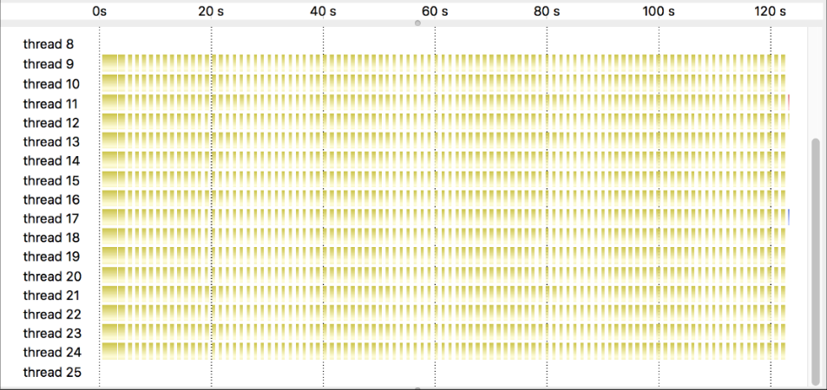
Chapter 1: Need for Task-Based models

Slide 5
Current Day Problems
Insufficient parallelism imposed by the programming model
OpenMP: enforced barrier at the end of parallel loop
Over-synchronization of more things that required by algorithm
MPI: Lock-step between nodes
Insufficient coordination between on-node and off-node parallelism
Distinct programming models for different types of parallelism
Off-node: MPI; On node: OpenMP, CUDA etc.

Slide 6
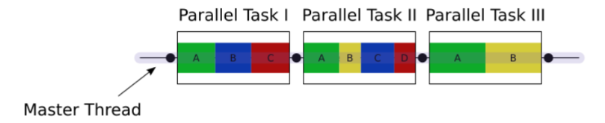
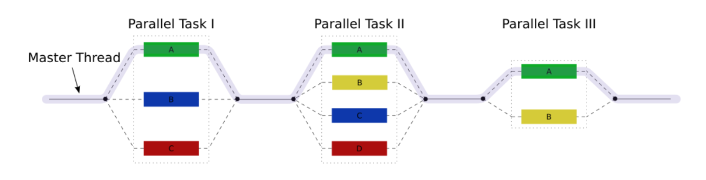
Current Day Parallel Programs
Most parallel applications follow fork-join semantics
Even C++17 parallel algorithms enforce fork-join parallelism
Fig: Fork-Join semantics in most real world problems
Image courtesy: Wikipedia

Slide 7
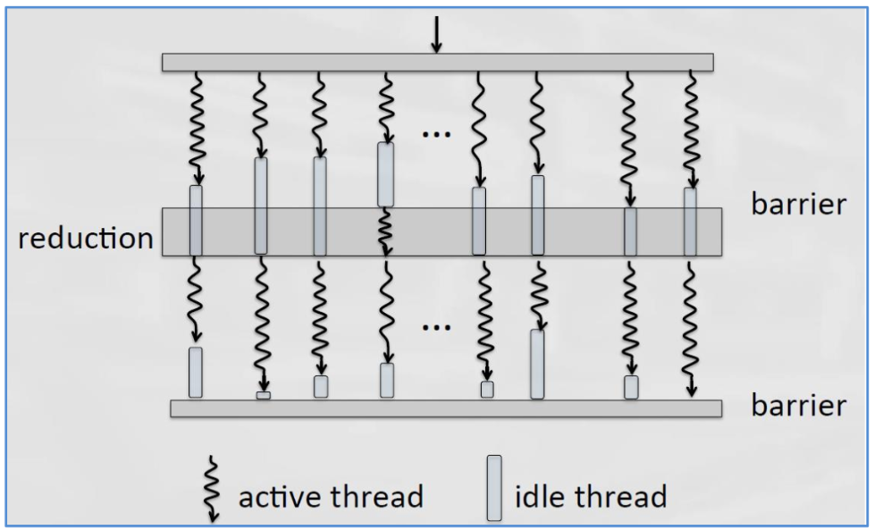
You can have high idle times!
Image courtesy: CppCon 2017 – Asynchronous C++ Programming Model

Slide 8
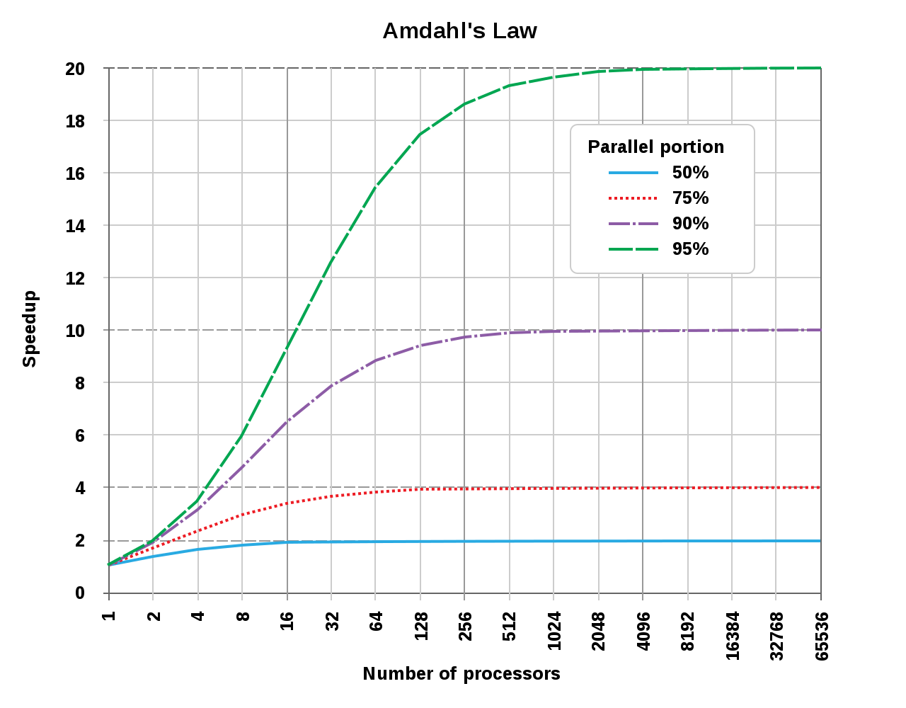
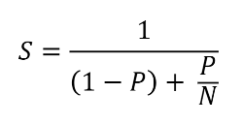
Over-Synchronization, a Problem: Amdahl’s Law (Strong Scaling)
S: Speedup
P: Proportion of parallel code
N: Number of processors
Image courtesy: Wikipedia

Slide 9
Solution: Task-Based Programming
Break work in form of tasks and define flow of execution through these tasks
Let runtime extract as much or as little parallelism, provided they follow the user constraints
Use scheduler (runtime) to coordinate between tasks
Maximum core throughput and minimum wait times through scheduling
Use tasks to hide details of multi-threading
Let runtime handle synchronization within tasks
Create and Connect tasks, not threads
Less locking/races/waiting in user code
1
4
2
3
5
7
6
8
9

Slide 10
Chapter 2: Tasking through futurization

Slide 11
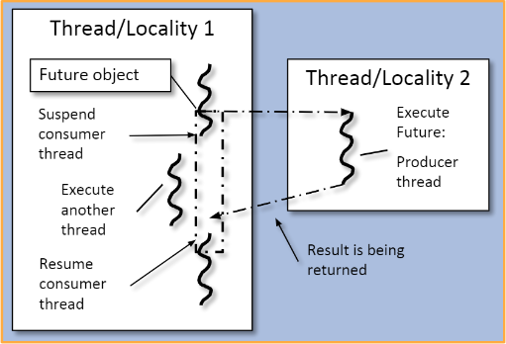
Creating Tasks through Futurization
A future is an object representing a result which has not been calculated yet.
Transparent synchronization with producer
Thread A sets value, thread B gets it
Hides notion of dealing with threads
No explicit synchronization from user’s end!
Makes asynchrony manageable
Easy composing several asynchronous
Attaching continuation to tasks

Slide 12
Future: Example code
int universal_answer() { return 42; }
void deep_thought()
{
hpx::future<int> promised_answer = hpx::async(&universal_answer);
// do other things for another 7.5 million years
std::cout << promised_answer.get() << std::endl; // prints 42
}

Slide 13
Chapter 3: HPX

Slide 14
HPX – Task-Based Runtime system
General purpose parallel runtime system for applications of any scale
Standards conforming APIs for ease of programming parallel, distributed, and heterogeneous applications
Fully asynchronous code that can use millions of threads
Similar syntax and semantics for local and remote operations
HPX makes concurrency manageable with dataflow and future based synchronization.
It’s an Open-Source project under Boost license

Slide 15
HPX – C++ Replacement APIs
As close as possible to current C++ standards (including proposals) where appropriate, for instance:
std::thread hpx::thread
std::mutex hpx::mutex
std::future hpx::future (including Concurrency TS)
std::async hpx::async (including support for executors)
std::bind hpx::bind
std::function hpx::function
std::tuple hpx::tuple (including support for GPUs)
std::cout hpx::cout
std::for_each (C++17) hpx::for_each (including support for executors)
std::vector hpx::vector, hpx::partitioned_vector
Extensions to APIs wherever necessary while keeping standards conformance

Slide 16
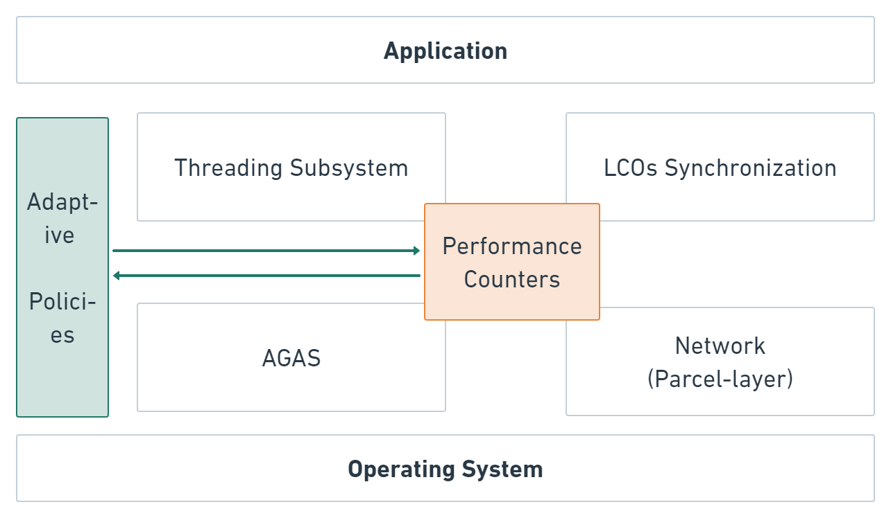
HPX Architecture
HPX – allows wait-free asynchronous parallel programming
Active Global Address Space (AGAS)
Threading subsystem
Lightweight Control Objects Synchronization
Parcelport

Slide 17
Chapter 4: Hello World!

Slide 18
Hello World! in HPX
#include <hpx/hpx_init.hpp>
#include <iostream>
int hpx_main(hpx::program_options::variables_map& vm)
{
std::cout << "Hello World!" << std::endl;
return hpx::finalize();
}
int main(int argc, char* argv[])
{
return hpx::init(argc, argv);
}
Finalize the runtime
Initializes the runtime
(Using hpx_init)

Slide 19
Hello World! in HPX
We use linker magic to initialize and finalize things for you
#include <hpx/hpx_main.hpp>
#include <iostream>
int main(int argc, char* argv[])
{
std::cout << "Hello World!" << std::endl;
return 0;
}
(Using hpx_main)

Slide 20
Chapter 5: Futures and Other Basic Primitives in HPX

Slide 21
Futures in HPX
Member functions as of C++11
get – returns the result
valid – checks if the future has a shared state
wait – waits for results to become available
wait_for – blocks until specified timeout duration has elapsed or result becomes ready
wait_until – blocks until specified timeout time has been reached or result becomes available
With Concurrency TS, you add:
then – attach continuations to a future
is_ready – checks if the shared state is ready

Slide 22
Generating futures
hpx::async(func, args…)
Can take launch policies as the first argument
By default everything launches on a new HPX thread
Only policy worth noting is hpx::launch::sync
Others:
Returned from all algorithm with parallel/sequential task policies
Concurrency TS APIs

Slide 23
Concurrency TS features in HPX
Additional helper functions in HPX from Concurrency TS:
hpx::when_all – returns a future that becomes ready when all given futures are ready
hpx::when_any – returns a future that becomes ready when at least one given future is ready
hpx::make_ready_future – produces a future that is ready immediately and holds given value
Native to HPX
hpx::dataflow – optimized equivalent of hpx::when_all(args…).then()
hpx::wait_all – wait until all futures are ready

Slide 24
Waiting on tasks
std::vector<hpx::future<std::size_t>> results_f;
results_f.reserve(128);
for (auto i : boost::irange(0u, 128u))
{
results_f.emplace_back(hpx::async(&some_algorithm));
}
hpx::wait_all(results_f);

Slide 25
Dataflow
std::vector<hpx::future<std::size_t>> results_f;
results_f.reserve(128);
for (auto i : boost::irange(0u, 128u))
{
results_f.emplace_back(hpx::async(&some_algorithm));
}
hpx::future<void> f = hpx::dataflow(
hpx::launch::sync,
[](std::vector<hpx::future<std::size_t>>&& results_f) {
for (auto&& result_f : results_f)
std::cout << "Result returned: " << result_f.get() << std::endl;
},
std::move(results_f));

Slide 26
Serial vs Asynchronous
hpx::future<std::string> make_string()
{
hpx::future<int> f = hpx::async(&some_algorithm);
// Some other work
return f.then(hpx::launch::sync, [](hpx::future<int>&& f) {
return std::to_string(std::move(f.get()));
});
}
std::string make_string()
{
int result = some_algorithm();
// Some other work
return std::to_string(result);
}

Slide 27
Parallel Algorithms
Support for C++ standard algorithms
Add execution policy as first argument (C++17)
Various execution policies supported:
par -> parallel execution policy
seq -> sequence execution policy
par(task) -> parallel task execution policy
seq(task) -> sequence task execution policy
datapar / par_unseq -> Vectorized/SIMD
datapar(task) / par_unseq(task) -> task versions
Use of executors when using execution policy
std::vector<int> vec(1000);
hpx::parallel::fill(hpx::execution::par,
vec.begin(), vec.end(), 0.0);

Slide 28
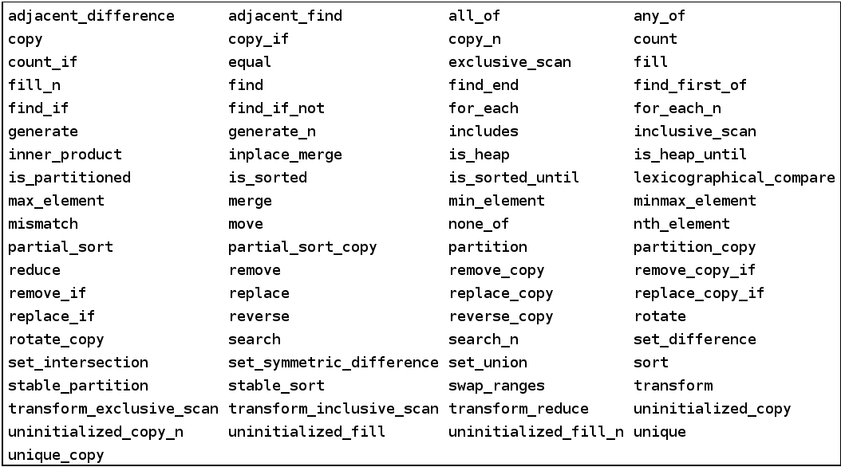
Parallel Algorithms

Slide 29
Putting it all together

Slide 30
Chapter 6: Quicksort – From Serial to Asynchronous

Slide 31
Quicksort (Serial)
template <typename RandomIt>
void quicksort(RandomIt first, RandomIt last)
{
std::ptrdiff_t size = last - first;
if (size > 1)
{
RandomIt pivot = std::partition(
first, last, [p = first[size / 2]](auto v) { return v < p; });
quicksort(first, pivot - 1);
quicksort(pivot, last);
}
}
Understanding adding continuations to futures and the use of dataflow

Slide 32
Quicksort (Parallel)
template <typename RandomIter>
void quicksort(RandomIter first, RandomIter last)
{
std::ptrdiff_t size = last - first;
if (size > threshold)
{
RandomIter pivot = hpx::parallel::partition(hpx::execution::par, first,
last, [p = first[size / 2]](auto v) { return v < p; });
quicksort(first, pivot - 1);
quicksort(pivot, last);
}
else if (size > 1)
hpx::parallel::sort(hpx::execution::seq, first, last);
}

Slide 33
Quicksort (Asynchronous)
template <typename RandomIter>
hpx::future<void> quicksort(RandomIter first, RandomIter last)
{
using hpx::execution;
std::ptrdiff_t size = last - first;
if (size > threshold)
{
hpx::future<RandomIter> pivot = hpx::parallel::partition(par(task), first,
last, [p = first[size / 2]](auto v) { return v < p; });
return pivot.then([=](auto pf) {
auto pivot = pf.get();
return when_all(quicksort(first, pivot - 1), quicksort(pivot, last));
});
}
else if (size > 1)
hpx::parallel::sort(seq, first, last);
return make_ready_future();
}

Slide 34
Chapter 7: What Next?

Slide 35
HPX has much more to offer!
Executors
Extension of P0443R4
Prototype senders and receivers implementation available
Allocators
NUMA architectures, Distributed systems, GPU, etc.
Distributed Computing
Actions and components
Distributed execution policies
Task communications
Channels and Local Control Synchronizations
C++20 Ranges – parallel algorithm on ranges
And a lot more!

Slide 36

Getting started with HPX
We have a documentation available at:
https://hpx-docs.stellar-group.org/latest/html/index.html
Join our IRC: ste||ar on irc.freenode.net
Mail us with your doubts on hpx-users@stellar.cct.lsu.edu
If you wish to contribute: https://github.com/STEllAR-GROUP/hpx

Slide 37
HPX talks and tutorials
Talks:
CppCon 2019: Hartmut Kaiser “Asynchronous Programming in Modern C++”
CppCon 2017: Hartmut Kaiser “The Asynchronous C++ Parallel Programming Model”
CppCon 2014: Hartmut Kaiser "Asynchronous Computation in C++"
Keynote Meeting C++ 2014: Hartmut Kaiser “Plain Threads are the GOTO of todays computing”
Hartmut Kaiser and Vinay Amatya: HPX: A C++ Runtime System For Parallel And Distributed Computing
C++Now 2021: Giannis Gonidelis “Parallelism on Ranges: Should We?”
C++Now 2021: Nikunj Gupta “Executors: The Art of Generating Composable APIs”
Tutorials:
HPX Tutorials Repo: https://github.com/STEllAR-GROUP/tutorials/
HPX Examples: https://github.com/STEllAR-GROUP/hpx/tree/master/examples

