Slide 1
Secure C++ principles from the Automotive industry
Sabariesh Ganesan
Mbition GmbH(Mercedes Benz R&D)

Slide 2
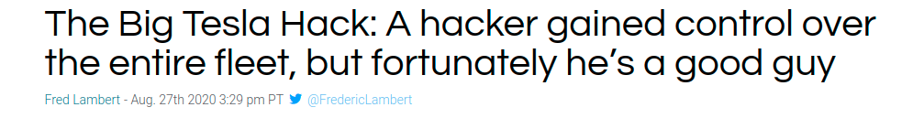

Introduction to Automotive security

Slide 3
Safety vs security
What is the difference between Safety and Security
  Safe: Protection from unintentional incidents eg. Airbags, Seat belt etc.
  Secure: Protection from intentional incidents eg: Hacking.

Slide 4
Threat vs Security features
STRIDE
Threat | Security features
Spoofing | Authencity
Tampering | Integrity
Repudiation | Non-repudiation
Information disclosure | Confidentiality
Denial of Service | Availability
Elevation of privelege | Authorization

Slide 5
Threat modeling
One of the ways to visualize the security threat is through modeling. There are various tools available, one of the tools we use is open source fork of https://github.com/izar/pytm
Threat Modeling approach =
  Model the application → Threat Analysis → Threat Prioritization

Slide 6
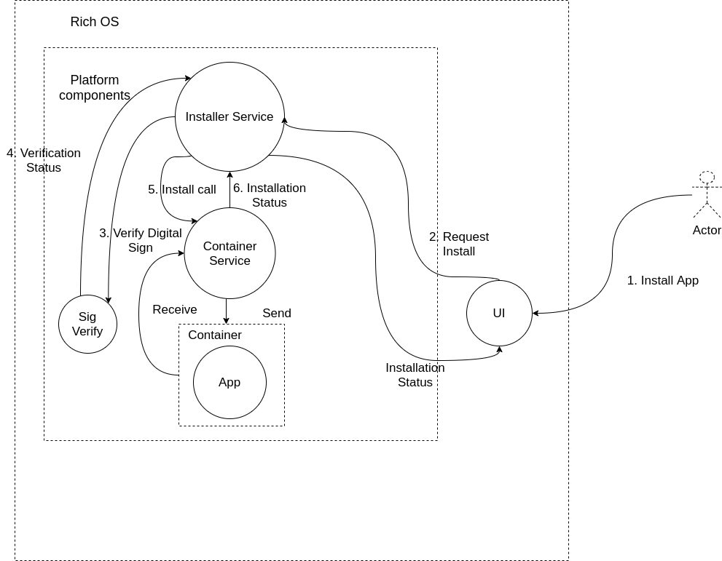
Threat Model

Slide 7
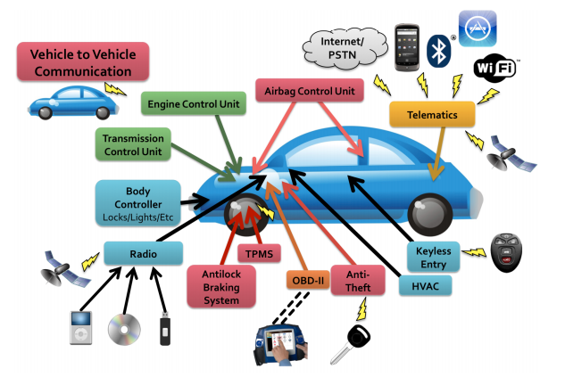
Automotive attack surface
Source: https://www.usenix.org/legacy/events/sec11/tech/full_papers/Checkoway.pdf

Slide 8
Coding standards in automotive
MISRA C
MISRA C++(C++ 03)
AUTOSAR (C++ 11/14)

Slide 9
C/C++ Vulnerabilities

Slide 10
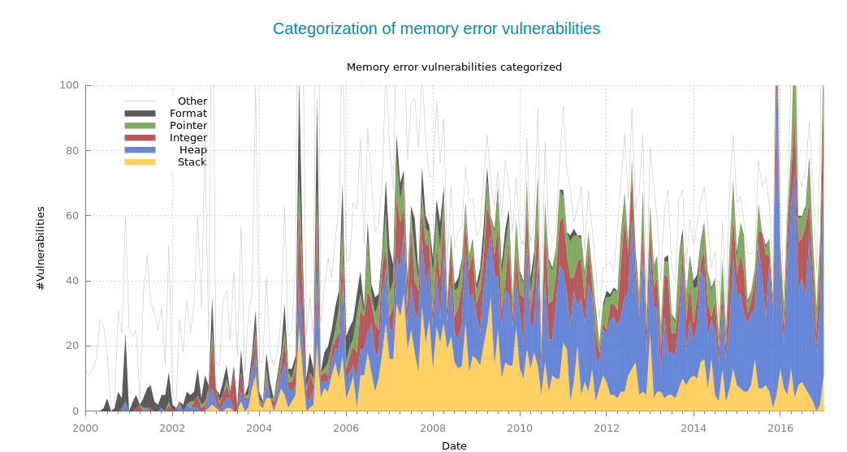
Memory management vulnerabilities - 1/2
Source: https://www.vvdveen.com/memory-errors/

Slide 11
Memory management vulnerabilities - 2/2
Buffer overflow
Pointer Manipulation
Integer Handling
Format string issue
Microsoft: 70 Percent of All Security Bugs Are Memory Safety Issues
Source: https://it.slashdot.org/story/19/02/11/2019247/microsoft-70-percent-of-all-security-bugs-are-memory-safety-issues

Slide 12
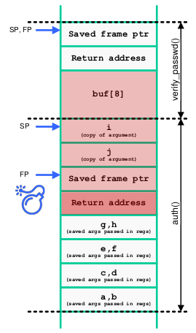
Buffer overflow on stack
If there is a buffer overflow vulnerability on a local buffer
  The attacker can write past the end of that buffer...
  overwriting other elements in the stack
  and eventually the return address of the caller!
This attack is also called stack smashing
int verify_passwd() { char buf[8]; gets(buf); return strcmp(buf, "secret"); } int auth(int a, int b, int c, int d, int e, int f, int g, int h, int i, int j) { printf("a:%d b:%d c:%d d:%d e:%d f:%d g:%d h:%d i:%d j:%d", a,b,c,d,e,f,g,h,i,j); printf("Please enter password: "); return verify_passwd(); }
Source: Balázs Kiss
Shellcode: Instructions typically spawns a remotely-accessible shell process
Smashing The Stack for Fun And Profit (1996): http://phrack.org/issues/49/14.html#article

Slide 13
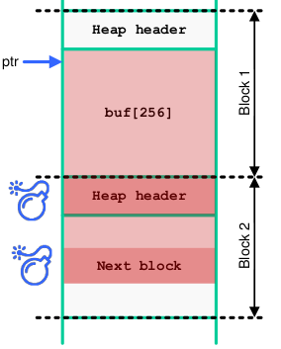
Buffer overflow on heap
Can we exploit overflows in dynamically allocated buffers
  Overwriting data on the heap is, of course, still possible
  But there is no return address on the heap…
However, there may be some pointers in the heap as well
  Code pointers defined by you, or e.g. vftables
  Or in the heap management structures (heap headers)
This is an example of a WWW attack (Write-What-Where)
char* add_data(char* dat, int len) { char* buf = (char*)malloc(256); memcpy(buf, dat, len); ... }
Source: Balázs Kiss

Slide 14
Case study of BOF Stack and Heap
struct _HostCmd_DS_COMMAND { u16 Command; u16 Size; u16 SeqNum; u16 Result; union { HostCmd_DS_GET_HW_SPEC hwspec; HostCmd_CMD_WMM_ADDTS_REQ; //……. } }
Vulnerability in the Marvell 88W8688 WLAN/Bluetooth SoC used in the Model S
in the wlan_process_cmdresp() function of the firmware
It stores the received response in the buffer it receives
It will copy Size-4 bytes – but what happens if Size<=3, the length needs to copy is 0xffffffff
In the kernel, wlan_enable_11d() calls wlan_prepare_cmd() on a local var
> wlan_prepare_cmd() calls wlan_process_cmdresp() on it →
kernel stack BOF!
int wlan_enable_11d(wlan_private * priv, state_11d_t flag) { wlan_adapter *Adapter = priv->adapter; wlan_802_11d_state_t *state = &Adapter->State11D; int ret; state_11d_t enable = flag; // Local variable – stored on the stack! ENTER(); state->Enable11D = flag; ret = wlan_prepare_cmd(priv, HostCmd_CMD_802_11_SNMP_MIB, HostCmd_ACT_GEN_SET, HostCmd_OPTION_WAITFORRSP, Dot11D_i, &enable);
Writeup: https://keenlab.tencent.com/en/2020/01/02/exploiting-wifi-stack-on-tesla-model-s/

Slide 15
Case Study Heartbleed
Heartbleed was a bug in OpenSSL, announced in April 2014
It exploits an optional TLS extension called heartbeat
  The client comes up with a random binary string (the payload)
  The client sends a message to the server with the payload
  The server sends back a response with the same payload (re-encrypted)
  However, the server did not verify the provided payload length
The leaked memory could contain TLS keys, plaintext user passwords, credit card details, ...
unsigned int padding = 16; //Minimum padding unsigned char *buffer, *bp; //Allocate memory for the response... buffer = OPENSSL_malloc(1+2+payload+padding); bp = buffer; //Normally, the size is 35, but… *bp++ = TLS1_HB_RESPONSE; //Write two header bytes s2n(payload, bp); //Convert length and put it into header memcpy(bp, pl, payload); //Copy the payload from the input //Buffer over-read!
SHODAN Heartbleed report, July 2019: https://www.shodan.io/report/0Wew7Zq7

Slide 16
Pointer manipulation
Many other code pointers could be targeted as well
  E.g. a function pointer that's part of a struct
Jump tables:
  Global Offset Table(GOT)
  Virtual function table(vftable)

Slide 17
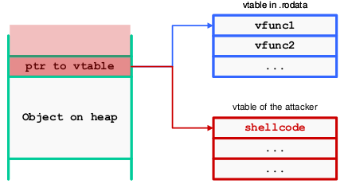
Smashing vftable
Table entries pointing to a function address can be overwritten in several ways
- Via memory corruption and heap overflow vulnerabilities (for entries on the heap)
Virtual function tables (vtable / vftable) in C++ are prime targets
- vftables are not in the standard, so implementation is compiler-specific
- Each class with a virtual method has such a table stored somewhere in memory
- When an object is created, a pointer to
this table is added as a member
Source: Balázs Kiss
Smashing C++ VPTRs (2000, first technique): http://phrack.org/issues/56/8.html

Slide 18
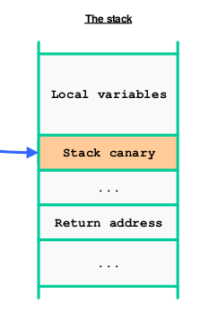
Memory Management hardening
Stack smashing protection
A stack canary is an unpredictable (random) value put in each stack frame
  Between the local variable and the metadata (e.g. return address)
Cannot overwrite metadata by buffer overflow without
"killing" the canary
  This can be detected before returning
Source: Balázs Kiss
Source: https://www.elttam.com/blog/playing-with-canaries/#content

Slide 19
Address Sanitizers
Compile-time instrumentation of memory-affecting operations (by Google)
Detects various memory corruption errors such as BOF and use-after-free
  On the heap, stack, and data segments
  Also many other run-time issues
-fsanitize=address # Main option for using ASan -fsanitize=kernel-address # Kernel-specific UAF and OoB detection (faster) -fsanitize=pointer-compare # detect comparing pointers from diff objects -fsanitize=pointer-subtract # detect subtracting pointers from diff objects -fsanitize=leak # enable LeakSanitizer to detect memory leaks -fsanitize=undefined # detect undefined behaviors (e.g. NULL deref) -fsanitize-address-use-after-scope # detect if local var is used outside # Some ASan options useful for detecting security issues detect_stack_use_after_return=1 # variable used outside scope detect_invalid_pointer_pairs=1 # see pointer-compare/subtract strict_string_checks=1 # non-terminated string check_initialization_order=1 # initialization order issues

Slide 20
Integer Handling problems
Implicit integer type conversions defined in the C standard
Each integer type has a rank:
    E.g. signed integers: char < short int < int < long int < long long int
Promotion: Small integer types are temporarily promoted for operations
  The operation is done on the promoted types, then truncated as needed
Security implications: Potentially tricky bugs (and thus vulnerabilities) due to signed-unsigned conversion or bitwise operations
int totalcost; int cost = atoi(msg.data); // cost is derived from user input unsigned int mincost = 1; if (cost < mincost) { return -1; } totalcost += cost;
MISRA C++
Rule 5-0-3 (required): A cvalue expression shall not be implicitly converted to a different underlying type.

Slide 21
Integer Handling problems
Avoid implicit conversions as much as possible
Assignment should not force implicit promotion
unsigned short a, b; unsigned int c; // Initialize a and b... c = a + b; // implicit conversion
When casting, don't perform promotion or cast as a different essential type
unsigned short a, b; unsigned int c; // Initialize a and b... c = (uint32_t) (a + b); // promotion

Slide 22
Best practice 1/2
Checks should be performed before assigning
int product_count = get_product_count(product_id); ... unsigned short count = (unsigned short)product_count;
int product_count = get_product_count(product_id); if (product_count <= USHRT_MAX) { ... unsigned short count = (unsigned short)product_count; ... }
Precondition test: check in advance if an overflow will occur
if (a + b <= INT_MAX) {return a + b;} else {handle_err();}
if ( b > 0 ? a <= INT_MAX - b: a >= INT_MIN -b ) {return a + b;} else handle_err();
Postcondition test: check if an overflow has occurred in the last arithmetic
operation
int add(int a, int b, int* result) // returns 1 on success, 0 on overflow { int res = a + b; if (b >= 0 ? res < a : res > a) return 0; *result = res; return 1; }

Slide 23
Best practices 2/2
GCC, some examples:
  -Wsign-conversion, -Wstrict-overflow – can help in localizing integer overflow
  -Wsign-promo – warns if overload resolution converts an unsigned to a signed
  -ftrapv – will instrument each operation with a post-check and abort() on fail
GCC and Clang
  IOC (Integer Overflow Checker) for runtime overflow checking, now part of UBSan
  Significant overhead (0-50%; up to 200% for math code) – not for production use
  Built-in GCC functions for safer integer handling

Slide 24
Format string issues
printf() – along with its variants, e.g. sprintf() – is a variadic function
On a design level, the main issue is implicit trust for the format string
  Using incorrect specifiers is always a problem
However, it gets a lot worse if the attacker can manipulate the format string
  Controlled format string vulnerability
const char *error_msg = "Resource not available to user."; int error_type = 3; printf("Error (type %s): %d\n", error_type, error_msg);
static const char msg_format[] = "%s cannot be authenticated.\n"; size_t len = strlen(user) + sizeof(msg_format); char *msg = (char *)malloc(len); if (msg == NULL) { /* Handle error */ } ret = snprintf(msg, len, msg_format, user); if (ret >= 0 && ret < len) fprintf(stderr, msg);

Slide 25
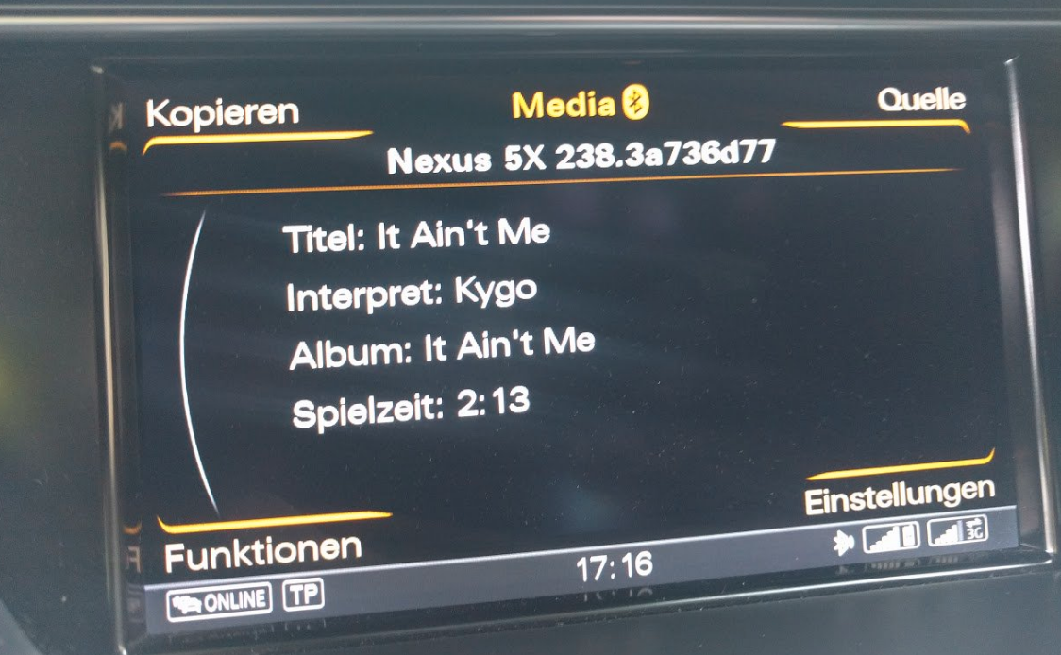
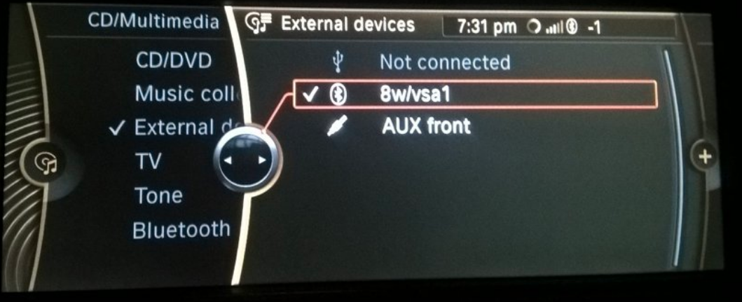
Format string issues
Consequences of printf format string exploitation:
  Confidentiality: Can be used to dump memory (mainly the stack)
  Example: %x %x %x ... allows the attacker to learn memory addresses, defeating ASLR
  Can also dereference heap pointers with %s to learn passwords and other valuable data
Source: https://twitter.com/kcotsneb/status/869938196263694338/photo/1
Source: https://twitter.com/0xRaindrop/status/864705389383761920/photo/2

Slide 26
Exception Handling
An application should be prepared to encounter exceptional situations, and should catch the appropriate exception and attempt to recover the system to a stable state
Exceptions are for exceptional situations!(out of disk space, failing to open a file, losing network connection, etc.)
void host_lookup(char *user_supplied_addr){ struct hostent *hp; in_addr_t *addr; char hostname[64]; in_addr_t inet_addr(const char *cp); /*routine that ensures user_supplied_addr is in the right format for conversion */ validate_addr_form(user_supplied_addr); addr = inet_addr(user_supplied_addr); hp = gethostbyaddr( addr, sizeof(struct in_addr), AF_INET); strcpy(hostname, hp→h_name); //might cause buffer overflow }
CWE: https://cwe.mitre.org/data/definitions/754.html

Slide 27
Exception Handling
Improperly handled (or uncaught) exceptions can cause security problems. Uncaught exceptions might reveal information about the system. Aiding adversaries in launching a successful attack
An empty exception handling block is very dangerous. The developer's assumption can be wrong, and the exception may be thrown. Attackers are very good at forcing edge cases to prove assumptions wrong!
try { myObject.processData(); } catch ( RareException& e ) { // This can never happen! }
CWE
CWE-391: Unchecked Error Condition
CWE-1069: Empty Exception Block

Slide 28
Best practices Exception Handling 1/2
Do not throw across execution boundaries (e.g. a library using a different ABI) Just use error codes instead.
Handle exceptions thrown before main()
  Initializers, constructors must not throw uncaught exceptions
struct S { S() noexcept(false); }
static S globalS; // If an exception is thrown in the S constructor, it // cannot be caught and will cause abnormal termination
// Constructor will be invoked at runtime, so exceptions // can be caught and handled normally S &globalS() { try { static S s; return s; } catch (...) { /* Handle error */ } }

Slide 29
Best Practices 2/2
class S : public std::exception { std::string m; //Copy constructor of std::string may throw an exception public: S(const char *msg) : m(msg) {} const char *what() const noexcept override { return m.c_str(); } };
class S : public std::exception { std::runtime_error m; // Guaranteed to not throw an exception public: S(const char *msg) noexcept : m(msg) {} const char *what() const noexcept override { return m.what(); } };
When throwing an exception, a new copy of the exception object will be
initialized via its copy constructor
If an exception is thrown in that constructor, it results in std::terminate()
Therefore, exception objects must be nothrow copy constructible!
MISRA C++:
Rule 15-1-2 (required): NULL shall not be thrown explicitly.
Rule 15-3-1 (required): Exceptions shall be raised only after start-up and before termination of the program.
Rule 15-4-1 (required): If a function is declared with an exception-specification, then all declarations of the same
function (in other translation units) shall be declared with the same set of type-ids.

Slide 30
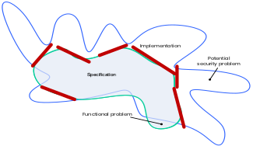
Input Validation
All successful attacks start with breaking some of the developer's assumptions
about the behavior of the code – or the data being processed
These assumptions are typically broken by the attackers feeding in some unexpected inputs to the application
Syntactically: invalid structure (e.g. broken XML)
Semantically: inappropriate value in the given context
Causing undesired behavior of the code

Slide 31
Best practice
Blacklist: enlist and define the bad cases
Whitelist: enlist and define the good cases
Type validation: is it the right type?
Range / constraint validation: is it in the expected range?
Cross-reference check: does the referenced data exist?
Structured check: is the data accurate and does it "make sense"?

Slide 32
Files and Streams
Can occur when the application relies on path name for access control instead of the file system's services
Absolute path traversal – direct file name manipulation via the attack surface
Relative path traversal – file name is typically concatenated to a hard-coded path assuming that this way the access is restricted to a pre-defined directory
char* filename = getenv("dictionaryFile"); FILE dictionary = fopen(filename, "r");
char rname[256]; char* path = "/opt/reportmgr/reports/"; printf("Please enter the filename of the report to delete"); memcpy(rname, path, 23); fgets(rname+23, 232, stdin); unlink(rname);

Slide 33
Files and Streams
Archive-based directory traversal
  Also called 'ZIP entry override' and 'Zip Slip'
  Problem: unzipping files without checking their path arbitrary file overwrite!
  allows remote attackers to write to arbitrary files via crafted path in a CAB file
// CVE-2015-0552: path traversal vulnerability in gcab (only showing the relevant parts of the function) for (f = files; f != NULL; f = f->next) { GCabFile *file = f->data; if (file_callback && !file_callback (file, callback_data)) continue; gchar *fname = g_strdup (gcab_file_get_extract_name (file)); GFile *gfile = g_file_resolve_relative_path (path, fname); GFile *parent = g_file_get_parent (gfile); if (!g_file_make_directory_with_parents (parent, cancellable, &my_error)) { /* Handle possible errors... */ } // clean up objects... out = g_file_replace (gfile, NULL, FALSE, G_FILE_CREATE_REPLACE_DESTINATION, cancellable, error); // read the file and write it into 'out' }
Source: gcab vulnerability (CVE-2015-0552) - https://nvd.nist.gov/vuln/detail/CVE-2015-0552

Slide 34
Best practices 1/2
open with O_NOFOLLOW (symlink-only)
stat-fopen-fstat: use lstat() before and fstat() after you open it, and compare st_dev and st_ino attributes of the stat structure returned by them to see if the file is the same
For hard links, distinguishing is impossible, but one can still check if a file has more than one hard link with lstat()
int fd = open(file_name, O_RDWR | O_NOFOLLOW); // Do not follow symlinks when opening file
struct stat orig_st; if (lstat( file_name, &orig_st) != 0) { /* handle error */ }
if (st.st_nlink <= 1) //Then open the file, otherwise don't

Slide 35
Best practices 2/2
First of all, don't rely on path (string) checks for authorization
  All file systems apply access control – use that!
Apply a canonicalization function before any authorization or validation checks
  std::filesystem::canonical() and POSIX realpath()
Most importantly: use a whitelist
  Blacklists can be easily circumvented – just think about all possible encoding types you should take into account (Unicode, URL encoding, etc.)
  Checking if the path starts with, or contains "../" is blacklisting
    E.g. .../ – triple dot is/was a synonym for ../.. on some Windows versions
  Finally, replacing "../" with "" – what happens when the input is " ....// "?
CWE
CWE-551: Incorrect Behavior Order: Authorization Before Parsing and Canonicalization

Slide 36
Initialization and Clean up
Non-trivially constructable objects need to have explicit ctors and dtors
  Otherwise data members may not be correctly initialized when used
Do not invoke virtual functions from ctors or dtors – undefined behavior!
struct Base { Base() { alloc(); } virtual ~Base() { dealloc(); } protected: virtual void alloc() = 0; // pure virtual functions virtual void dealloc() = 0; // calling these from ctor/dtor: undefined behavior! }; struct Derived : Base { virtual ~Derived() = default; protected: void alloc() override { // Allocate resources for Derived... } void dealloc() override { // Deallocate resources for Derived... } private: // Derived-specific member variables that need to be allocated... }
struct Base { Base() { alloc_priv(); } virtual ~Base() { dealloc_priv(); } protected: virtual void alloc() { alloc_priv(); } virtual void dealloc() { dealloc_priv(); } private: void alloc_priv(); // Allocate resources for Base... void dealloc_priv(); // Deallocate resources for Base... }; struct Derived: Base { Derived() { alloc_priv(); } virtual ~Derived() { dealloc_priv(); } protected: void alloc() override { Base::alloc(); alloc_priv(); } void dealloc() override { Base::dealloc(); dealloc_priv(); } private: void alloc_priv(); // Allocate resources for Derived... void dealloc_priv(); // Deallocate resources for Derived... }
MISRA C++
Rule 12-1-1 (required): An object's dynamic type shall not be used from the body of its constructor or destructor.

Slide 37
Initialization and Clean up
Do not delete polymorphic objects without a virtual dtor Can result in DoS and resource leaks – even if using smart pointers!
Declare ctor member initializers in their canonical order Only applies to ctors with member initializers, of course
Do not reference base classes or class members in ctor or dtor catch blocks Those are destroyed before entering the exception handler → undefined behavior
struct Base { virtual void f(); }; struct Derived : Base {}; void f() { std::unique_ptr<Base> b = std::make_unique<Derived()>(); }
struct Base { virtual ~Base() = default; virtual void f(); } struct Derived : Base {}
class X { int j; int i; public: X(int x) : i(x), j(i+1) {} // Will use 'i' before it's initialized }
struct Y { std::string name; Y(const std::string &s) try: str(s) { /* ... */ } catch (...) { if (!name.empty()) { /* ... */ } } } }
struct Y { std::string name; Y(const std::string &s) try: str(s) { /* ... */ } catch (...) { if (!s.empty()) { /* ... */ } } } }

Slide 38
Some additional mentions
Denial of service attacks
Regular expression Denial of service
Hash table collision
Unreleased resources

Slide 39
Thank you!
Questions?

