Slide 1
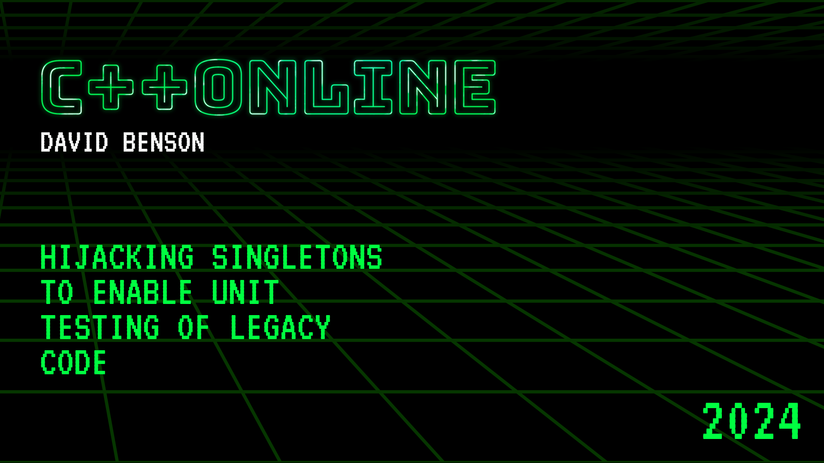
Hijacking singletons to enable unit testing of legacy code
David Benson
S&P Global

Slide 2

About me
30 years of industry experience
20 years with S&P Global through various acquisitions
Technical Architect with the Fincentric division, where we focus primarily on the individual or retail investor. I work with our teams to deliver real-time financial information
Notes:
Having been at the same place for 20 years, my code is part of the legacy problem. My younger self hadn’t been introduced to unit tests.
I didn’t appreciate unit tests until my wife went on sabbatical and I worked with a team in Amsterdam, while they were using Java, they fully embraced unit tests.

Slide 3
Disclosures
I’m not selling or promoting a commercial tool
I’m not promoting an open-source tool
Notes:
In the financial industry, we love disclosures

Slide 4
Unit testing of legacy code
You need to make changes to legacy code to either fix bugs or add features
You own the code and can make changes to facilitate unit testing
Goal: Leave the existing calling code as unchanged as possible
Notes:
Talk about domain of distributed services making calls to each other
Christopher Di Bella talked about unit testing of the standard library in his talk yesterday. Unfortunately I missed Jan’s talk this morning due to time zones, but testing is important.

Slide 5
What are attributes of legacy code?
Age
Original designers and/or implementers are not available
Classes/methods violate single responsibility principle
Large methods, comingling data and logic
Minimal/no unit tests
Outdated tool chain/language version
Singletons
Notes:
My examples uses modern C++ but the concepts could be adapted to C++98
Singletons typically make it hard to unit tests because once created, can’t be changed or substituted.

Slide 6
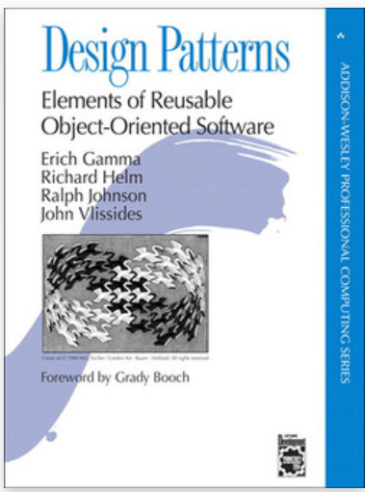
Singletons
One of the most commonly used design patterns from the Gang of Four book "Design Patterns"
Now referred to as an anti-pattern
Singletons allow for accessing functionality without having to pass dependencies
Difficult to use with mocking frameworks like Google Mock

Slide 7
Use case: Logging
Timestamps, thread id
Log levels and thresholds
Formatting
Log to file, network, etc
File limits – size, time, etc
Duplicate suppression

Slide 8
Trivial logger – legacy singleton
void example() {
debug("Legacy singleton logger");
}
void debug(string_view message) {
Logger::instance()->debug(message);
}
static mutex g_mutex;
struct Logger {
static Logger * instance() {
if (!m_singleton) {
lock_guard lock(g_mutex);
if (!m_singleton)
m_singleton = new Logger();
}
return m_singleton;
}
private:
Logger() = default;
ofstream m_file{"log.txt"};
static Logger * m_singleton;
};
Logger * Logger::m_singleton = nullptr;

Slide 9
Trivial logger – Meyer singleton
struct Logger {
static Logger & instance() {
static Logger logger;
return logger;
}
void debug(string_view message) {
m_file << message << "\n";
}
private:
Logger() = default;
ofstream m_file{"log.txt"};
};
void example() {
debug("Trivial logger");
}
void debug(string_view message) {
Logger::instance().debug(message);
}
Notes:
C++11 simplified singleton construction with Meyer singleton or function static approach

Slide 10
Lifetime - manually controlled
struct Logger {
static unique_ptr<Logger> & instance() {
static unique_ptr<Logger> logger =
make_unique<Logger>();
return logger;
}
};
void setLogger(unique_ptr<Logger> logger) {
Logger::instance().swap(logger);
}
TEST(LifetimeLogger, lifetime) {
debug("Lifetime logger");
setLogger(nullptr);
// read and verify log contents
}

Slide 11
Lifetime with weak pointers
struct Logger {
static shared_ptr<Logger> instance() {
static mutex mutex;
static weak_ptr<Logger> logger;
lock_guard lock(mutex);
if (logger.expired()) {
auto result =
make_shared<Logger>();
logger = result;
return result;
}
return logger.lock();
}
};
TEST(RAIILifetimeLogger, single_instance) {
auto logger1 = Logger::instance();
auto logger2 = Logger::instance();
ASSERT_EQ(logger1, logger2);
}
TEST(RAIILifetimeLogger, scoped_lifetime) {
{
auto logger = Logger::instance();
}
{
auto logger = Logger::instance();
}
}
Notes:
We can control lifetimes, but can’t guarantee that someone else hasn’t already created an instance. Nor can we mock it.

Slide 12
Mockable singleton with inheritance
struct Logger : public Interface {
static unique_ptr<Interface> & instance() {
static unique_ptr<Interface> logger;
return logger;
}
};
// Once in main setLogger(make_unique<Logger>());
void example() {
debug("Mockable logger");
}
TEST(MockableLogger, message) {
auto mock =
make_unique<MockableLoggerMock>();
EXPECT_CALL(*mock, debug(_));
setLogger(move(mock));
debug("Mockable logger");
}
Notes:
Intentionally choosing not to have a default implementation! If the default object has network or database dependencies, we don’t want those to be hit in unit tests. Would need to code defensively to handle potential null pointer.

Slide 13
Use case: Database Access
Connection pooling
Logical to physical mapping of servers, databases and stored procedures
Protection from SQL injection attacks
Caching
Replication
1M LoC: 900 database calls

Slide 14
Modern approach
vector<OpenHighLowClose> getPrices(IDatabasePool & pool) {
auto connection = pool.getConnection();
auto response = connection->execute(PricingQuery);
vector<OpenHighLowClose> prices;
// parse response fields into object
return prices;
}
Notes:
Have to pass IDatabasePool down through call stack.
Java/C# have dependency injection frameworks which can handle dynamic binding to avoid needing to pass through call stack. Introduces a level of runtime risk of failed binding.
PricingQuery is an int identifier, which allows for logical separation from physical configuration

Slide 15
Test with GMock
TEST(ModernPrices, getPrices) {
// GIVEN: mock pricing data
ConnectionMock connection;
EXPECT_CALL(connection, Execute(_)).WillRepeatedly(Return(R"([{"Date":"2024-03-01T09:30:00",
"Open":123.45}])"_json));
DatabasePoolMock pool;
EXPECT_CALL(pool, getConnection()).WillRepeatedly(Return(&connection));
// WHEN: we ask for prices
auto response = getPrices(pool);
// ...
}

Slide 16
Unit testing without Inheritance
GMock requires inheritance
Switching to templates isn’t viable
Notes:
Not polymorphic solution
Gmock requires inheritance

Slide 17
Existing code we want to test
vector<OpenHighLowClose> getPrices() {
Query query;
Response response;
auto ok = query.execute(PricingQuery, response);
vector<OpenHighLowClose> prices;
// parse response fields into object
return prices;
}
bool Query::Execute(int query_id, Response & response) {
auto connection = ConnectionPool::instance().getConnection();
return connection.Execute(query_id, response);
}

Slide 18
Injecting behavior
using CommandHandler = function<bool(int, Response &)>;
struct Connection {
Connection(CommandHandler handler) : m_handler(move(handler)) {}
bool Execute(int query_id, Response & response) {
if (m_handler) {
return m_handler(query_id, response);
}
// regular implementation
return true;
}
private:
CommandHandler m_handler;
};

Slide 19
Injecting behavior
struct ConnectionPool {
static ConnectionPool & instance() {
static ConnectionPool pool;
return pool;
}
void setHandler(CommandHandler handler) {
m_handler = move(handler);
}
Connection getConnection() {
return Connection(m_handler);
}
private:
CommandHandler m_handler;
};

Slide 20
Mock response
struct MockResponse {
MockResponse() {
ConnectionPool::instance().setHandler(
[this](int query_id, Response & results) {
auto it = m_service_responses.find(query_id);
if (it != m_service_responses.end()) {
results = it->second;
return true;
}
return false;
});
}
private:
std::unordered_map<std::int32_t, Response> m_service_responses;
};

Slide 21
Example unit test
TEST(Prices, getPrices) {
// GIVEN: mock pricing data
auto mock = MockResponse();
mock.add(PricingQuery, R"([{"Date":"2024-03-01T09:30:00",
"Open":123.45}])"_json);
// WHEN: we ask for prices
auto prices = getPrices();
//...
}
Notes:
Using Pythonesque mocking

Slide 22
Mock capabilities
Can mock multiple calls, each with different reponses
Can mock a call with different inputs, each with different reponses
Different responses for first and subsequent calls
Once you have defined a mock, all subsequent calls are mocked. The destructor will remove all configurations. We fail on empty

Slide 23
Example unit test – scope creep
TEST(Prices, getPricesExtended) {
auto mock = testing::MockResponse();
mock.add(PricingQuery, R"([{"Date":"2024-03-01T09:30:00","Open":123.45}])"_json);
mock.add(SymbolTranslation, R"({"RIC":"SPGI.K","XID":123})"_json);
auto symbol = Symbol("SPGI.K"); // Looks up symbol mapping
mock.add(ExchangeHours, R"([{"Date":"2024-03-01","Open":"9:30",
"Close":"16:00"}])"_json);
// Looks up exchange hours
auto [startTime, endTime] = symbol.exchange().getOpenCloseTimes("2024-03-01");
auto prices = getPrices(symbol, startTime, endTime);
//...
}

Slide 24
Test data
Once you have the capability of mocking calls, the next question is how to get live responses to put into unit tests
Add a tracing facility
Enabled via request for a limited duration
Enabled via command line switch
Intended for collecting test data locally, not designed to scale for production use

Slide 25
Use case: API calls
Service discovery
Connection pooling
Serialization/deserialization
1M LoC: 300+ API calls

Slide 26
Existing code we want to test
struct Lookup {
Lookup() {
m_client.Init("XrefServer");
}
Symbol translate(string const & ticker,
string const & symbolSet) {
//...
auto status = m_client.Execute("Translate", request, response);
//...
}
Client m_client;
};

Slide 27
Solution: Add a singleton
struct SharedLookup {
Symbol translate() {
Response response;
m_client.Execute("Translate", response);
//...
return {};
}
ISharedClient & m_client{getClient("XrefServer")};
};
Notes:
Reinforce changing construction vs call site change

Slide 28
Solution: Add a singleton
ISharedClient & getClient(string const & pool) {
return getPool()->getClient(pool);
}
unique_ptr<ISharedClientPool> & getPool() {
static unique_ptr<ISharedClientPool> pool;
return pool;
}
void setPool(unique_ptr<ISharedClientPool> pool) {
getPool().swap(pool);
}
struct ISharedClientPool {
virtual ~ISharedClientPool() = default;
virtual ISharedClient & getClient(string const &) = 0;
};
struct ISharedClient {
virtual ~ISharedClient() = default;
virtual bool Execute(string const &, Response &) = 0;
};

Slide 29
Example unit test
TEST(MockableApi, translation) {
Response data = R"({"RIC":"SPGI.K","XID":123})"_json;
SharedClientMock client;
EXPECT_CALL(client, Execute(_, _))
.WillOnce(DoAll(SetArgReferee<1>(data), Return(true)));
auto pool = make_unique<SharedClientPoolMock>();
EXPECT_CALL(*pool, getClient(_)).WillRepeatedly(ReturnRef(client));
setPool(std::move(pool));
// WHEN: we ask for ticker translation
SharedLookup lookup;
auto symbol = lookup.translate();
//...
}

Slide 30
The hard part: Adoption
Code is easy, people are hard
Creating a unit testing mechanism for legacy code is a bounded problem
Convincing your peers to use it
Notes:
Not trying to unit everything.
Test changes.

Slide 31
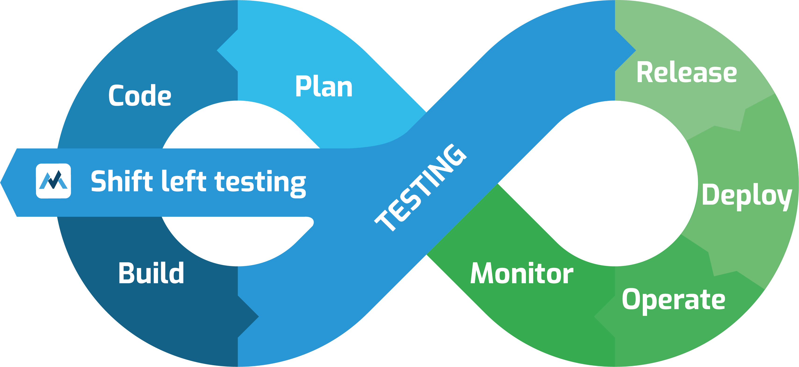
Adoption: Senior leadership
Shift left

Slide 32
Adoption: Product owners
Natural tension between features, schedule and quality
Changing the definition of done to include unit testing

Slide 33
Adoption: developers
Code reviews
Review the tests first. Ensures the API is testable and usable
Link to unit test documentation and examples
Missing tests become tasks which block merging
SonarQube quality gate enforcements on new code
Testing needs to be scoped as part of the original ticket, not relegated to a future ticket
Notes:
Slow path to adoption
Uptake has been inconsistent between teams, but getting better

Slide 34
Questions?
Key points:
Mockable singleton
struct Logger : public Interface {
static unique_ptr<Interface> & instance() {
static unique_ptr<Interface> logger;
return logger;
}
};

Slide 36
Database w/ GMock

Slide 37
Existing code we want to test
vector<OpenHighLowClose> getPrices() {
Query query;
Response response;
auto ok = query.execute(PricingQuery, response);
vector<OpenHighLowClose> prices;
// parse response fields into object
return prices;
}
Notes:
Explain PricingQuery

Slide 38
Implementation – hidden singleton
vector<OpenHighLowClose> getPrices() {
Query query;
Response response;
auto ok = query.execute(PricingQuery, response);
vector<OpenHighLowClose> prices;
// parse response fields into object
return prices;
}
bool Query::execute(int query_id, Response & response) {
auto connection = getPool()->getConnection();
return connection->execute(query_id, response);
}
unique_ptr<IDatabasePool> & getPool() {
static unique_ptr<IDatabasePool> pool;
return pool;
}
void setPool(unique_ptr<IDatabasePool> pool) {
getPool().swap(pool);
}

Slide 39
Unit test with GMock
TEST(LegacyMockable, getPrices) {
ConnectionMock connection;
Response data = R"([{"Date":"2024-03-01T09:30:00", "Open":123.45}])"_json;
EXPECT_CALL(connection, execute(_, _))
.WillOnce(DoAll(SetArgReferee<1>(data), Return(true)));
auto pool = make_unique<DatabasePoolMock>();
EXPECT_CALL(*pool, getConnection()).WillRepeatedly(Return(&connection));
setPool(std::move(pool));
// WHEN: we ask for prices
auto response = getPrices();
}

