Slide 1

Concurrency – All the way down
Ofek Shilon
C++Online 2026

Slide 2
Example Program
Writer Core
Reader Core
Store1: NEW → data
Load1: reg1 ← ready
Store2: TRUE → ready
Branch1: if !reg1 goto Load1
Load2: reg2 ← data

Slide 3
Sequential Consistency (SC)
Writer Core
Reader Core
Store1: NEW → data
Load1: reg1 ← ready
Store2: TRUE → ready
Branch1: if !reg1 goto Load1
Load2: reg2 ← data

Slide 4
Sequential Consistency (SC)
Store1: NEW → data
Store2: TRUE → ready
Load1: reg1 ← ready=true
Load2: reg2 ← data

Slide 5
Sequential Consistency (SC)
Load1: reg1 ← ready=false
Store1: NEW → data
Load1: reg1 ← ready=false
Load1: reg1 ← ready=false
Store2: TRUE → ready
Load1: reg1 ← ready=true
Load2: reg2 ← data

Slide 6
Initial System Model
Main Memory
L2/L3: Shared Caches
L1:
Private Cache
L1: Private Cache
Core
Core

Slide 7
Initial System Model
Caches + Memory
Core
Core

Slide 8
Hardware Optimizations
That mess with perceived order

Slide 9
#1: FIFO write buffers
Caches + Memory
Write buffer
data ← NEW
Core

Slide 10
#1: FIFO write buffers
Caches + Memory
data ← NEW
Core
Core
data?
NEW
data?
OLD

Slide 11
#1: FIFO write buffers
Caches + Memory
data? OLD
ready? FALSE
data ← NEW
ready ← TRUE
Core
Core

Slide 12
#1: FIFO write buffers
Caches + Memory
data ← NEW
ready ← TRUE
data? NEW
ready? FALSE
Core
Core

Slide 13
#1: FIFO write buffers
Caches + Memory
ready ← TRUE
data? NEW
ready? TRUE
Core
Core

Slide 14
Total Store Order (TSO)
All cores agree on the order of stores-initiated-by-a-given-core
Implemented in all x86-64 systems

Slide 15
#2: Coalescing write buffers
Coalesce writes to the same cache line

Slide 16
Cache Lines
Memory
L1 Cache
L1 Cache
deadcafe
deadc9fe
deadcafe
deadcafe
Core
Core

Slide 17
#2: Coalescing write buffers
Coalesche writes to the same cache line

Slide 18
#2: Coalescing write buffers
Caches + Memory
A ← 1
C ← 1
B ← 1
Core

Slide 19
#2: Coalescing write buffers
Caches + Memory
A, B ← 1
C ← 1
Core

Slide 20
#2: Coalescing write buffers
Caches + Memory
A? 0 B? 0 C? 0
A ← 1
B ← 1
C ← 1
Core
Core

Slide 21
#2: Coalescing write buffers
Caches + Memory
A, C ← 1
B ← 1
A? 0 B? 0 C? 0
Core
Core

Slide 22
#2: Coalescing write buffers
Caches + Memory
B ← 1
A? 1 B? 0 C? 1
Core
Core

Slide 23
#2: Coalescing write buffers
Caches + Memory
dummy? 0 data? OLD ready? FALSE
ready ← TRUE
dummy ← 1
data ← NEW
Core
Core

Slide 24
#2: Coalescing write buffers
Caches + Memory
dummy ← 1 ready ← TRUE
data ← NEW
dummy? 0 data? OLD ready? FALSE
Core
Core

Slide 25
#2: Coalescing write buffers
Caches + Memory
data ← NEW
dummy? 1 data? OLD ready? TRUE
Core
Core

Slide 26
#3: Invalidate queues
Memory
L1 Cache
L1 Cache
deadcafe
deadc9fe
deadcafe
deadcafe
Core
Core

Slide 27
#3: Invalidate queues
L1 Cache
L1 Cache
Invalidate
queue
deadcafe
deadcafe
deadc9fe
data? deadcafe
data? deadc9fe
Core
Core

Slide 28
#4: non multi-copy atomicity
L1 Cache
L1 Cache
L1 Cache
OLD
NEW
?
OLD
OLD
Core
Core
Core

Slide 29
#5: Out-of-Order Execution
Writer Core
Reader Core
Store1: NEW → data
Store2: TRUE → ready
Load1: reg1 ← ready
(=TRUE)
Load2: reg2 ← data
Load2’: reg2’ ← data (=OLD)
(=OLD!)

Slide 30
#6: Speculative Execution
Memory/Caches
_{if (ready) {}
_{local_data = data}
…
TRUE
OLD

Slide 31
Counter Measures
Fences, load-acquire, store-release, RMW

Slide 32
Fences: Full
x86/64: MFENCE (Memory Fence)
ARM: DSB (Data Store Barrier)
Drain store buffer
Wait until previous stores are visible everywhere and previous loads retired
Acts as a reorder/speculation barrier
Safest + most expensive

Slide 33
Fences: Full
x86/64: MFENCE (Memory Fence)
ARM: DSB (Data Store Barrier)
ARM: DMB SY (Data Memory Barrier, System-wide)
Operation:
Enforce ordering, not completion
At: Reorder buffers, write buffers, load queues
Cheaper alternative with mostly-compatible semantics
store
store
load
load

Slide 34
Fences: Store
x86/64: SFENCE
Controls completion
Drain store buffer, stall until older stores are visible everywhere
Reorder barrier
Regular stores are already ordered! Empty pessimization
Impacts special non-cached store instructions (MOVNT*).
store
store

Slide 35
Fences: Load
x86/64: LFENCE
Block a younger read from issuing until all older reads have completed
Completed = issued + resolved cache misses + retired
Block speculative execution past the fence
only in recent generations – 2018+ (since Spectre)
load
load

Slide 36
ARM: Acquire / Release
dmb ld
dmb st
store
load
load
store
store
load

Slide 37
ARM: Acquire / Release
dmb ld
dmb st
ldar – Load Acquire
store
load
load
stlr – Store Release
store
store
load

Slide 38
ARM: Acquire / Release
Writer Core
Reader Core
Store1: NEW → data
Load1: ldar reg1, ready
Store2: TRUE → ready
Load1: reg1 ← ready
Store2: stlr ready, TRUE
Branch1: if !reg1 goto Load1
Load2: reg2 ← data

Slide 39
ARM: Acquire / Release
Store1: NEW → data
Load1: ldar reg1, ready
Store2: stlr ready, TRUE
Branch1: if !reg1 goto Load1
Load2: reg2 ← data
int data = 0;
std::atomic<bool> ready = 0;
int read() {
while
(!ready.load(memory_order_acquire));
return data;
}
void write() {
data = NEW;
ready.store(true,
memory_order_release);
}

Slide 40
C++ std::memory_order
For stores:
memory_order_release
For loads:
memory_order_acquire
(==memory_order_consume)
For Read-Modify-Write (RMW) ops, such as +=:
memory_order_relaxed: no order guarantees
memory_order_acq_rel: acquire AND release
For all:
memory_order_seq_cst: full sequential consistency
?

Slide 41
Read-Modify-Write
C++ atomic<> ops:
+=, -=, &=, |=, ^=
fetch_add(), fetch_sub(), fetch_and(), fetch_or(), fetch_xor()
exchange()
compare_exchange_weak(), compare_exchange_strong()
X86-64: LOCK prefix
ARM: LL/SC
+ dedicated instructions, in ARM v8.1+

Slide 42
Read-modify-write: x86-64
L1 Cache
L1 Cache
deadcafe
deadc9fe
deadcafe
Core

Slide 43
Read-modify-write: x86-64
L1 Cache
L1 Cache
L1 Cache
deadcafe
deadc9fe
deadcafe
beadcafe
Core

Slide 44
Read-modify-write: ARM
L1 Cache
deadcafe
X
deadc9fe
LDXR
STXR
Core

Slide 45

Read-modify-write: ARM
L1 Cache
L1 Cache
X
deadcafe
beadcafe
LDXR
STXR
STR
Core
Core

Slide 46
Read-modify-write: ARM
L1 Cache
compare_exchange_weak(), compare_exchange_strong()
X
deadcafe
LDXR
STXR
Core

Slide 47
Read-modify-write: ARM
LDXR/STXR extension:
LDAXR – load-acquire exclusive register
STLXR – store-release exclusive register
Additionally enforce acquire/release ordering, same as LDAR/STLR
Necessary to actually be usable in locks
Riddle: why is the exclusive monitor needed?

Slide 48
Cache Coherence Protocols
Cache line states:
Valid
Invalid

Slide 49
Cache Coherence Protocols
Cache line states:
Modified
Exclusive
Shared
Invalid
MESI
(MESIF)
(MOESI)

Slide 50
Summary
Different cores can have different views of memory because:
Reasons
More reasons
Other reasons
Software solves these problems by:
Fences
RMW
OS level locks: futexes, mutexes etc.

Slide 51
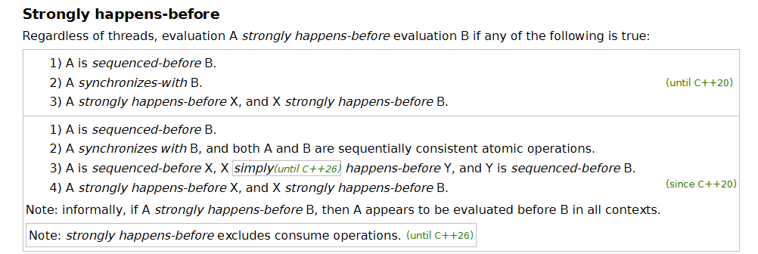
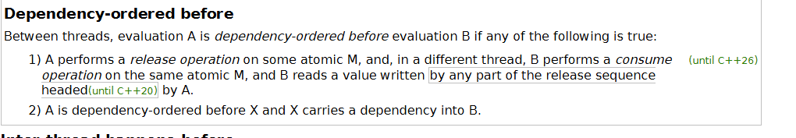
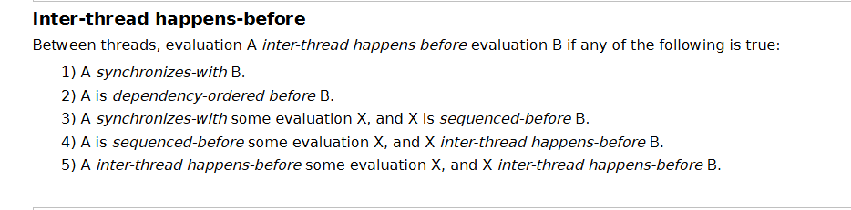
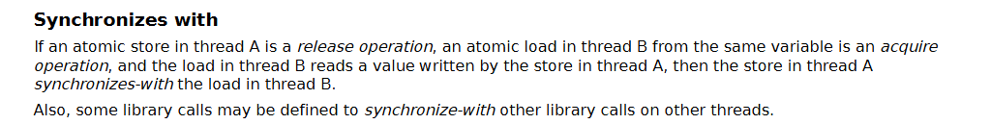
Final Thoughts
Good chance you care only about x64 (?)
Doubtful the C++ standard phrasing is any simpler.

Slide 52



Thanks for listening!
Questions and comments are welcome, in gather town or discord.
Ofek Shilon
OfekShilon @

Slide 54
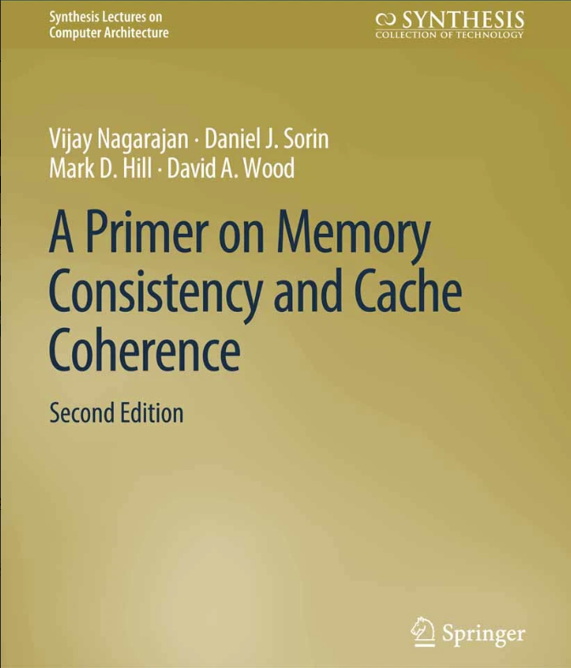
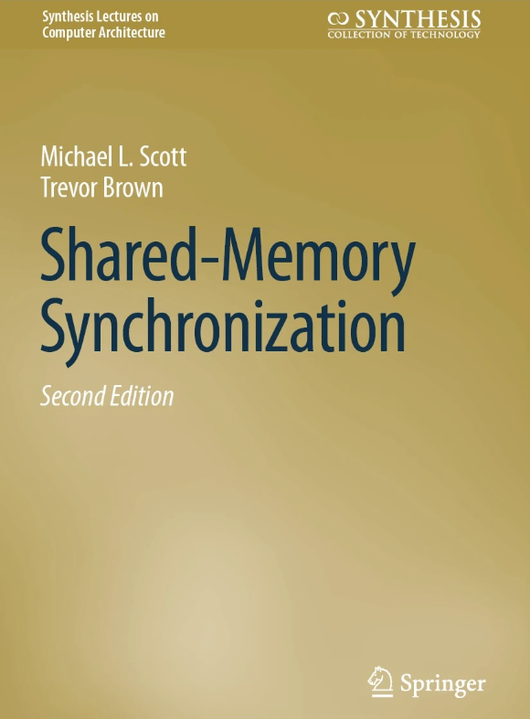


Resources

Slide 55
NT writes, Write-Combine Buffers
(Canonical) Example use case: zero a memory page
Telling the processor it is about to overwrite full cache lines
WCB: collect multiple writes before sending to the cache coherency system
Avoid the inefficient dance of RFO (Read-For-Ownership) request + modification + writeback.
MOVNT* instructions, do not undergo the usual coherency route – may be visible only some time in the future.

Slide 56
Fences: Implicit
Instructions with some order-serialization side effects:
x86/64:
CPUID, IRET, RSM, LOCK *, …
ARM:
MSR, MRS, ERET, SVC, HVC, SMC …

