Slide 1
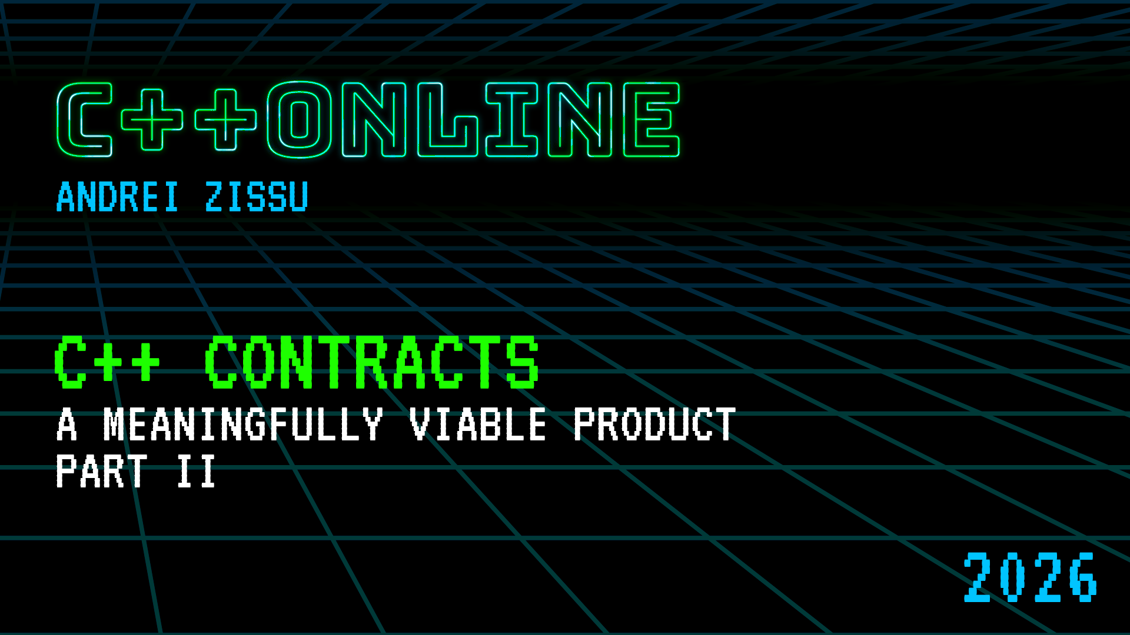

Slide 2
C++ Contracts – a Meaningfully Viable Product Part II
Andrei Zissu
Semperis – identity protection and resilience
WG21 member for the last 4 years
Active in SG21
Not one of the main authors of the Contracts proposal (P2900)

Slide 3
Syntactic restrictions, and how they came to be

Slide 4
Defaulted and Deleted Functions – because life is far from trivial
pre/post not allowed on member functions defaulted on first declaration
a.k.a =default in class header
rationale: =default on first declaration makes them trivial, any extra code would break that
also: throwing violation handlers (see later)

Slide 5
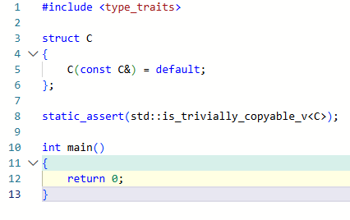
Defaulted and Deleted Functions – because life is far from trivial
trivially copyable:

Slide 6
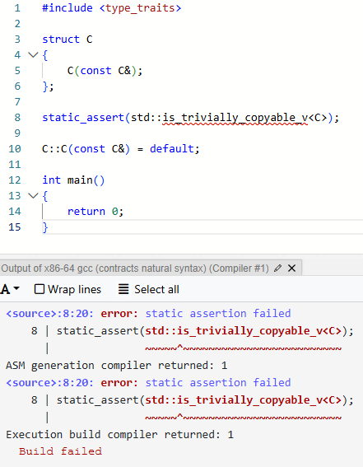
Defaulted and Deleted Functions – because life is far from trivial
not trivially copyable if defaulted only on redeclaration:

Slide 7

Defaulted and Deleted Functions – because life is far from trivial
Rejected solutions:
Allow contract to break triviality
=default silences contract
In general, making undecided things ill-formed leaves room for future resolutions, making it a popular SG21 strategy, as well as a stated P2900 Principle:

Slide 8
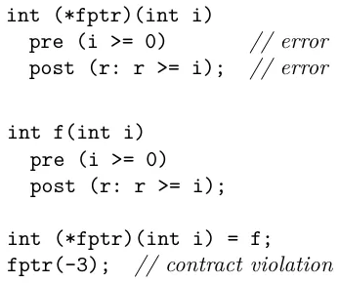
Pointers to Functions – can you point us to a solution?
TLDR: pre/post ill-formed on pointer to function or member function
Allowed to point to functions with pre/post
checked when evaluated on callee side

Slide 9

Pointers to Functions – can you point us to a solution?
yet again, ill-formed since no solution could be agreed on in the C++26 timeframe
obstacles to such a solution (P3327R0):
Where to store function contracts?
as part of the pointer type (type system)
different template instantiation per different contracts (code bloat)
different name mangling (ABI break)
and many other issues, currently with no good answers
as part of the pointer value (run-time overhead in both space and time)
thunks
wide pointers
ABI break

Slide 10
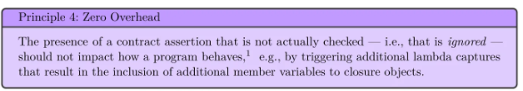
Pointers to Functions – can you point us to a solution?
Avoiding ongoing ABI incompatibilities would require using the type system after all
any approach based on pointer value would incur some runtime overhead

Slide 11
Pointers to Functions – can you point us to a solution?
as a property of the pointer variable declaration (hard to keep track and propagate)
not part of the type
would require some backchannel instead
impossible for templates to deliver expected results without ODR violations

Slide 12
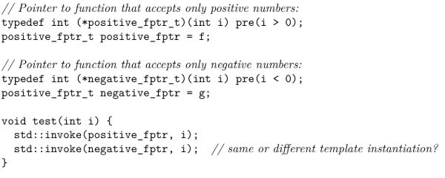
Pointers to Functions – can you point us to a solution?
both pointer types are identical since contracts are not part of the type system
therefore the 2 invocations will either fail to check the correct (different) contracts, or constitute an ODR violation

Slide 13
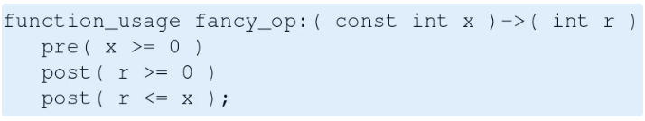
Pointers to Functions Possible future solution – function usage types
Lisa Lippincott P3271R1 - Function Types with Usage (Contracts for Function Pointers)
will be discussed for C++29
will introduce function types as a kind of strong type alias, which may have contract specifiers (pre/post) attached
these types can then be used via pointers or references, which are distinct from their contract-less counterparts
could be quite revolutionary, therefore couldn’t be considered so late in the C++26 cycle

Slide 14
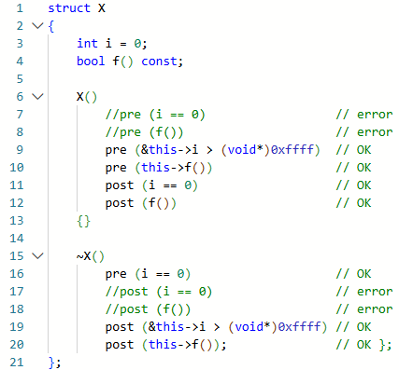
Constructors and Destructors - this and that
pre in constructors
and post in destructors
can only reference this explicitly:

Slide 15

Constructors and Destructors - this and that
Rationale:
Objects are not yet/anymore in a valid state in constructor/destructor pre/post – respectively
Evaluation being done before/after constructor/destructor body
Yet we can’t outright ban this use, as sometimes it’s OK - e.g. when checking object/member addresses
But since we don’t want to implicitly add new UB - any such use must require an explicit opt-in

Slide 16
Semantics

Slide 17
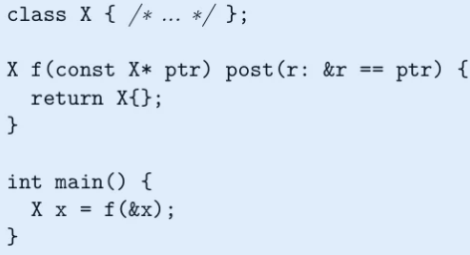
Objects Passed and Returned in Registers – hey, where’s my object?
C++ standard allows some types of objects to be passed and return via registers
Based on constructor and destructor traits - generally trivially copyable and trivially destructible types
Object in register is treated as a temporary
pre/post may observe either temp copy or final object
Which therefore cannot be expected to have the same identity (a.k.a address) as in other parts of the code
post below may fail if (and only if) X is a type eligible to be passed via registers:

Slide 18
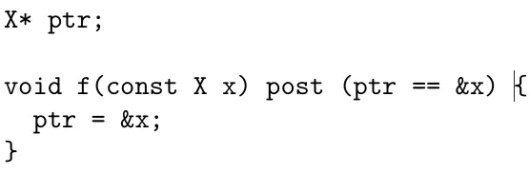
Objects Passed and Returned in Registers – hey, where’s my object?
same for function parameters – post may fail:
As to object value
In both cases temp & final object will be equal (although their addresses might not be)
Which should be good enough due to the const by-value param requirement
However…

Slide 19
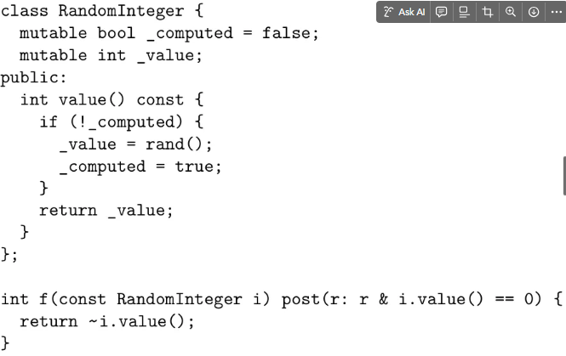
Objects Passed and Returned in Registers – hey, where’s my object?
code is well-formed since i is const
internal state does change though due to the mutable members
class is trivially copyable and trivially destructible, thus eligible to be passed via registers
internal computed value is only set after the temp→final copy, i.e. i.value() will be invoked once in the copy and once in final object, generating different values
causing the post check to fail

Slide 20
Objects Passed and Returned in Registers – hey, where’s my object?
This remains possible in the final contracts version. It was decided this case is rare enough to not justify the serious tradeoffs of preventing it.
Tradeoffs such as:
Disallow post altogether
Forbid odr-using function parameters in post
Or just by-val parameters
Or just those by-val parameters eligible to be passed via register
Or the ones which also have mutable members (does this feel patchy by now?)
Or allow just scalar types
post not allowed to see caller-side parameter version (which could possibly be the temporary passed via register) - would break ABI

Slide 21
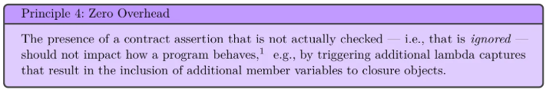
No Implicit Lambda Captures – you must really mean it!
TLDR: no implicit lambda captures, unless capture would have occurred even without the contract/s

Slide 22
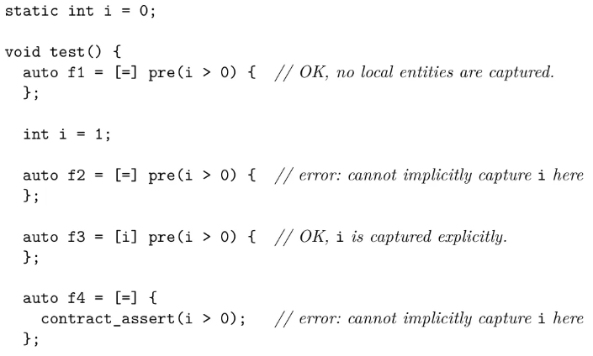
No Implicit Lambda Captures – you must really mean it!

Slide 23
No Implicit Lambda Captures – you must really mean it!
capture may affect behavior by modifying lambda (closure type) traits:
physical dimensions
size
alignment
type traits
trivially copyable
standard-layout

Slide 24
Evaluation and Contract-Violation Handling

Slide 25
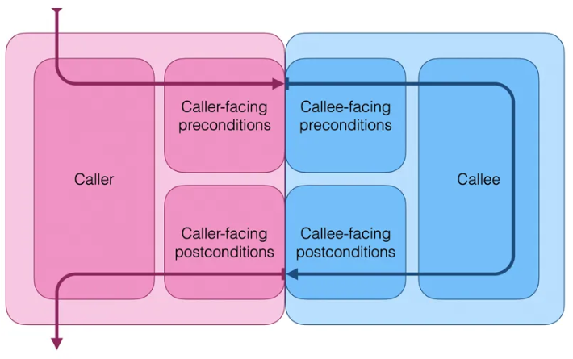
Caller-Facing and Callee-Facing Function Contract Assertions
Point of view matters
We’ll be seeing this mentioned throughout the presentation

Slide 26

Virtual Function Calls – am I an interface or an implementation?
TLDR: no support in C++26 - removed from P2900 after initial inclusion
Deemed high priority, but ultimately too complicated to reach a consensus in this time frame.
Contracts in other languages (D, Eifel) - inherited from base classes (classic model)
overriding function can add further stipulations
preconditions widened (conjunction - OR)
postconditions narrowed (disjunction - AND)
C++ cannot follow this model (P3097R0)
was deemed in violation of principle 1:

Slide 27
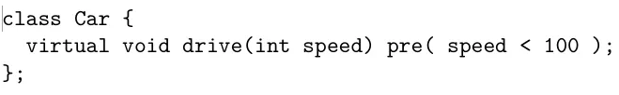
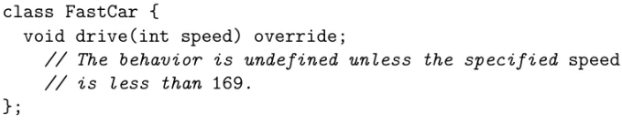
Virtual Function Calls – am I an interface or an implementation?
FastCar is overly limited by the basic Car pre.
Cars frequently emerged in these discussions for some reason.
It also has compatibility issues with mixins and facades.

Slide 28
Virtual Function Calls – am I an interface or an implementation?
General line of thought - C++ multiverse is abundant with use cases where inheritance doesn’t imply substitutability
therefore contracts cannot be automatically inherited
Another example:
Driving a car requires it be fueled.
But an electric car doesn’t need refueling
Does it break the contract?
Not really
Might also be seen as a design flaw
Car operational status should be a virtual function
By refueling,
Or recharging,
Or always for a solar powered car.
But then comes the night…

Slide 29

Virtual Function Calls – am I an interface or an implementation?
multiple inheritance
base class expecting odd numbers
base class expecting even numbers
oops…
Bottom line - it’s complicated… Too complicated in fact to get it right in time for C++26.
as in other similar cases, we opt to leave it ill-formed for now

Slide 30
Virtual Function Calls – am I an interface or an implementation?
proposed solutions
only CAs defined directly on function apply, no implicit contract inheritance
might be confusing for those expecting inheritance to apply to contracts too
pre+post to be evaluated for both implementation (callee side) and interface (caller side) - but not for any other point in the inheritance hierarchy
Initially included in P2900 but later taken out
“interface” was later renamed “indirect”
there were endless arguments over which default was more appropriate: implementation, indirect, or neither (always have to specify)
this would have been a novel model vs other languages, raising major objections over lack of field experience

Slide 31
Compile-Time Evaluation – down to the very core
also known as constant evaluation
contract semantics
ignore - as expected…
observe - compilation warning upon detected violation
enforce and quick_enforce - program is ill-formed (a.k.a compilation error) upon detected violation

Slide 32
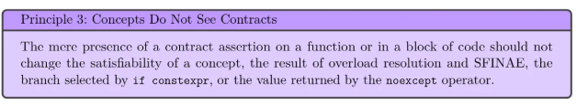
Compile-Time Evaluation – down to the very core
contract violation scenarios
predicate returns false
CA is not a core constant expression – i.e. cannot be evaluated at compile time
normally this would cause run time evaluation
but being a constant expression is itself a trait which can be branched or overloaded on at compile time (via SFINAE), which is something we don’t want for contracts
this principle is crucial to having contracts applied to the actual business logic
having them check some divergent logic would render them useless
in following with this principle – compile time contract violation is a hard error, in both cases

Slide 33
Coroutines – come see us move the mighty consts!
contract_assert evaluated as usual, pre/post are trickier
“function” is actually “ramp function”
Returns coroutine control object, e.g. generator
pre may inspect parameters of initial call
post can only see the returned control object
Contracts on yields are currently not supported
May be added indirectly by manually implementing the coroutine framework
post is of limited use – mainly to inspect control object properties
and that’s where it gets worse…

Slide 34
Coroutines – come see us move the mighty consts!
Because const non-reference parameters may actually be moved into the coroutine frame!
const comes back in coroutine body – out of scope for post
Left with a reference to a moved-from object
contract_asserts in coroutine body may see different parameter bodies than pre

Slide 35
Coroutines – come see us move the mighty consts!
Further complicating factor:
Coroutines from the outside - normal functions
Coroutines from the inside – coroutines, as an implementation detail
Which may change at any time
pre/post evaluated on the caller side doesn’t know it’s a coroutine
but callee side still does

Slide 36
Coroutines – come see us move the mighty consts!
Ultimate outcome – we do have contracts in coroutines!
contract_assert and pre – same as in normal functions
Post - here be dragons!
There is currently no straightforward way of inspecting yielded values - that’s for future proposals

Slide 37
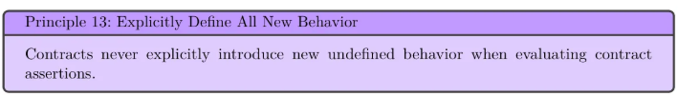
Undefined Behavior During Contract Checking – because all you really wanted was to blow up the universe!
concerns regarding UB in CAs:
observe semantic only - time travel backwards from UB in subsequent code into CA may result in CA being optimized out
resolved with observable checkpoints (P1495R5)
all semantics (other than ignore) - UB in CA itself affecting / optimizing out CA
SG21 decided not to act on this, to avoid creating a C++ dialect for contracts
however, observable checkpoints will also prevent UB within a CCA from getting subsequent production code optimized out

Slide 38
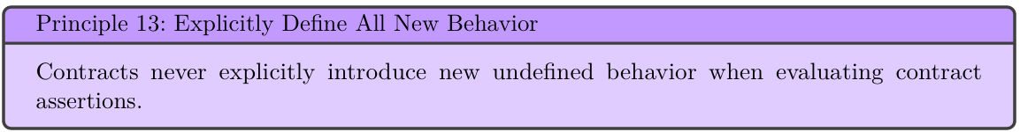
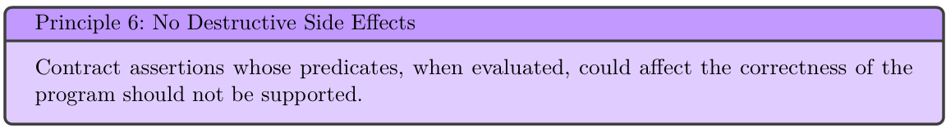
Predicate Side Effects and UB – how do we convey that?
Controversy
Ban UB and side effects in CAs,
we don’t want contracts introducing new UB
side effects means we’re not checking the same program
and may also discourage contracts adoption

Slide 39
Predicate Side Effects and UB – how do we convey that?
Controversy
On the other hand
Can lack of side effects be effectively enforced in C++?
Can UB be reliably detected?
UBs are just a part of normal C++ - should we make sweeping language changes applying only to contract predicates?
Now let’s see some suggested solutions

Slide 40
Predicate Side Effects and UB – how do we convey that?
conveyor functions (p3285R0) – partial list of restrictions
no side effects outside of own body
does not modify the parameters
does not do anything with potential for UB
[[conveyor]] attribute - enforces the respective syntactic restrictions
only kind of function invocable from strict CAs
no such restriction on relaxed CAs
can only call other conveyor functions
either explicitly [[conveyor]] or deduced
can only have strict CAs
parameters may only be passed by value (not move) or by const ref
cannot reinterpret_cast, cast away const, downcast, do narrowing conversions, etc
no new or delete

Slide 41
Predicate Side Effects and UB – how do we convey that?
For *e, the operand e must satisfy std::object_address(e)
I.e. *e must be a valid object
May not be implementable in many cases, as it would require tracking all objects
Even if implementable, pointer provenance might be unprovable in most cases, rendering most such code ill-formed
Would hinder optimizations, and in particular [[no_unique_address]]
std::object_address is required to compare pointers of doubtful origin, which may itself ironically introduce new UB
Were rebutted as impractical for compilers to implement, as well as:
Too many restrictions, making them unusable in practice
E.g. no calls to non-static member functions since this cannot consistently be proven valid
Huge effort required to adapt existing codebases
Forcing many places to default to relaxed contracts, defeating the purpose of contracts

Slide 42
Predicate Side Effects and UB – how do we convey that?
“Exploring strict contract predicates” - P3499R1
written over lunch break in Hagenberg (February 2025)
intended to show all options are being explored
also trying to demonstrate what strict and relaxed contracts would entail
concluded that lack of UB would require a practically useless subset of the language
Assuming a practical UB-free language subset could be found after all
Should strict CAs be the default or an explicit (opt-in)?

Slide 43
Thank You!
Let’s get in touch!
andrziss@gmail.com
https://www.linkedin.com/in/andreizissu/
Questions?

