Slide 1

Polymorphic Input Iterators
C++ Usergroup Karlsruhe
Januar 9th 2019
David Faragó

Slide 2
Iterator DeSign Pattern
Gang of Four
Intent
... access the elements ...without exposing its underlying representation.
Motivation
...the client commits to a particular collection. It would be better if we could change the collection without changing client code. We can do this by generalizing the iterator concept to support polymorphic iteration.
Bjarne Stroustrup
Polymorphism
Providing a single interface to entities of different types.

Slide 3
Input Iterator Concepts
Legacy
std::experimental::ranges
Dereferenceable, Readable
WeaklyInc->Semiregular->Copyable->CopyConstructible
WeaklyInc->Semiregular->Copyable->Assignable
WeaklyInc->Semiregular->Copyable->Movable
WeaklyInc->Semiregular->Copyable->Assignable
WeaklyInc
WeaklyInc
WeaklyInc->Semiregular->DefaultConstructible
Dereferenceable, Dereference
->
WeaklyInc->Semiregular->Copyable->Movable->Swappable
CopyConstructible, ConversionConstructible to const
CopyAssignable
Destructible
equality-comparable
inequality-comparable
pre-incrementable, pre-increment
post-increment
Swappable
std::iterator_traits<II> has the 5 member typedefs
std::iterator_traits<II> has the 5 member typedefs

Slide 4
Motivation at QPR
algorithm classes
data classes<X>
alternative classes <X>
InputIterate <X>
<class _InputIterator>
DB<V>
...
...
...
...
...
Acollection<V>
...
...
Sparse<V>
...
...
Dense<V>
...
...
<class _InputIterator>
...
...
...
...
...
...
...
...
...
...
...
...
...
...
...
...
...
...
...
...
...
...
...
...
...
...
...
...
...
...
<class _InputIterator>
...
...
...
...
...
...
...
...
...
...
...
...
...
...
...
...
...
...

Slide 5
Motivation at QPR
algorithmen classes
data classes <X>
alternative classes <X>
<<Interface>>A
begin(),end():PolymorphicInputIterator<V>
...
InputIterate <X>
...
...
...
Acollection<V>
...
...
Sparse<V>
...
...
Dense<V>
...
...
DB<V>
...
...
...
...
...
...
...
...
...
...
...
...
...
...
...
...
...
...
...
...
...
...
...
...
...
...
...
...
...
...
...
...
...
...
...
...
...
...
...
...
...
...
...
...
...
...
...
...
...
...
Notes:
existential types

Slide 6
ImplementATION
Polymorphism in C++ (but not macros, overloading, coersion)
templates (e.g. CRTP)
std::variant (std::visit)
OOP (virtual)
ad-hoc vs. parametric
☺
☺
with lambda type deduction
☺
semantics
☺
value sematics, copying
☺
value sematics, copying
☹
reference sem., dyn. alloc.
change to existing code
☹
☺
☺
optimizations, runtime
☺
iff no code bloat
☺
but less, see next slides
☹
dynamic polymorphism
code complexity (readabilty, error messages, compile time)
☹
☺
☺

Slide 7
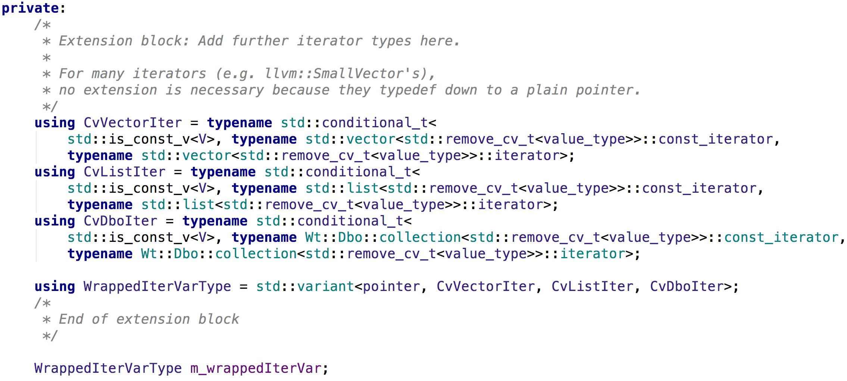
data member

Slide 8
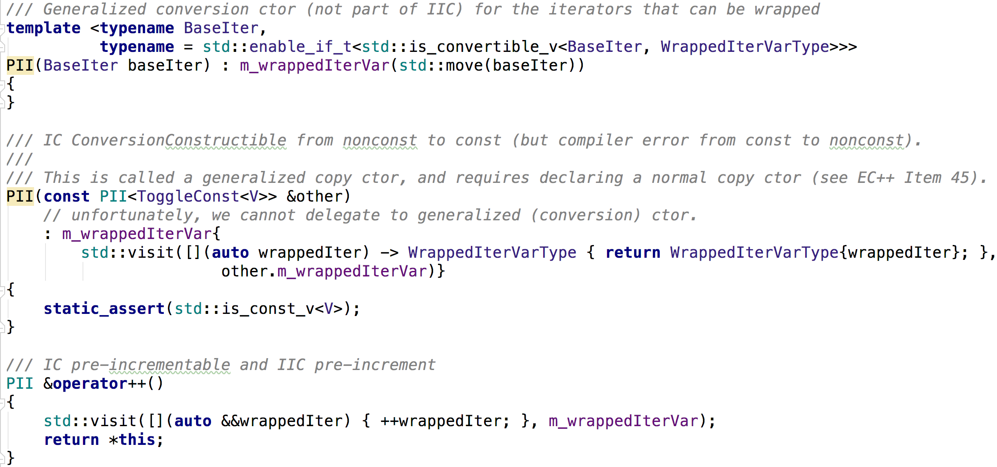
Significant methods
Notes:
TODO: bessere implementierung für generalized copy ctor

Slide 9
Performance
measured runtime of accumulating a vector with 3e+7 doubles (into double or ULL):
dynamically in ms (wall clock time),
statically in k cpu cycles (LLVM Machine Code Analyzer, see godbolt.org/z/H9bXPs)
with –ffast-math
w/o –ffast-math
0.0
0ULL
0.0
0ULL
wrapped
212
277
wrapped
196
279
clang (trunk)
-march=broadwell –O3
20.5
22.4
20.5
22.4
direct
17
217
direct
32
218
5.7
14.4
4.3
25.4
0.0
ULL
0.0
ULL
wrapped
166
186
wrapped
166
204
2.2
4.2
2.2
4.0
gcc (trunk)
direct
14
117
direct
44
119
2.9
2.5
2.4
2.7
Notes:
bei direct (3gcc, 2clang) und wrapped (11gcc&clang): warning: found a return instruction in the input assembly sequence.
nur bei wrapped (7gcc, 18clang): warning: found a call in the input assembly sequence.
note: call instructions are not correctly modeled. Assume a latency of 100cy.
-> erklärt geringere cycles bei wrapped

Slide 10

Feedback
?

Slide 11
LLVM-MCA von Vector-Tests
double with gcc (trunk) with -std=c++17 -O3 -march=broadwell
Wrapped:
Runtime for vector size 30.000.000: TODO
MCA: [0] Code Region - stopwatchedAccumulate
Iterations: 100
Instructions: 4200
Total Cycles: 2196
Total uOps: 5000
Dispatch Width: 6
uOps Per Cycle: 2.28
IPC: 1.91
Block RThroughput: 8.3
Resource pressure per iteration:
[0] [1] [2] [3] [4] [5] [6] [7] [8] [9]
- - 7.62 7.95 5.70 5.72 7.00 7.81 7.62 4.58
Wrapped for accumulationition into ULL:
Runtime for vector size 30.000.000: TODO
MCA: [0] Code Region - stopwatchedAccumulate
Iterations: 100
Instructions: 8200
Total Cycles: 4020
Total uOps: 9300
Dispatch Width: 6
uOps Per Cycle: 2.31
IPC: 2.04
Block RThroughput: 15.5
Resource pressure per iteration:
[0] [1] [2] [3] [4] [5] [6] [7] [8] [9]
- - 18.38 19.54 6.02 6.32 6.00 17.76 18.32 4.66
Direct:
Runtime: TODO
MCA: [0] Code Region - stopwatchedAccumulate
Iterations: 100
Instructions: 4900
Total Cycles: 2407
Total uOps: 6400
Dispatch Width: 6
uOps Per Cycle: 2.66
IPC: 2.04
Block RThroughput: 10.7
Resource pressure per iteration:
[0] [1] [2] [3] [4] [5] [6] [7] [8] [9]
- - 12.03 12.02 4.00 4.00 - 12.04 11.91 -
Direct for accumulationition into ULL:
Runtime: TODO
MCA: [0] Code Region - stopwatchedAccumulate
Iterations: 100
Instructions: 4200
Total Cycles: 2705
Total uOps: 5100
Dispatch Width: 6
uOps Per Cycle: 1.89
IPC: 1.55
Block RThroughput: 8.5
Resource pressure per iteration:
[0] [1] [2] [3] [4] [5] [6] [7] [8] [9]
- - 11.98 12.02 2.50 2.50 - 10.02 11.98 -
double with gcc (trunk) with -std=c++17 -O3 -march=broadwell -ffast-math
Wrapped:
Runtime: TODO
MCA: [0] Code Region - stopwatchedAccumulate
Iterations: 100
Instructions: 4200
Total Cycles: 2196
Total uOps: 5000
Dispatch Width: 6
uOps Per Cycle: 2.28
IPC: 1.91
Block RThroughput: 8.3
Resource pressure per iteration:
[0] [1] [2] [3] [4] [5] [6] [7] [8] [9]
- - 7.62 7.95 5.70 5.72 7.00 7.81 7.62 4.58
Wrapped for accumulationition into ULL:
Runtime: TODO
MCA: [0] Code Region - stopwatchedAccumulate
Iterations: 100
Instructions: 7800
Total Cycles: 4156
Total uOps: 8900
Dispatch Width: 6
uOps Per Cycle: 2.14
IPC: 1.88
Block RThroughput: 14.8
Resource pressure per iteration:
[0] [1] [2] [3] [4] [5] [6] [7] [8] [9]
- - 17.37 19.29 6.16 6.18 6.00 16.98 16.36 4.66
Direct:
Runtime: TODO
MCA: [0] Code Region - stopwatchedAccumulate
Iterations: 100
Instructions: 4500
Total Cycles: 2906
Total uOps: 6100
Dispatch Width: 6
uOps Per Cycle: 2.10
IPC: 1.55
Block RThroughput: 10.2
Resource pressure per iteration:
[0] [1] [2] [3] [4] [5] [6] [7] [8] [9]
- - 11.53 11.54 3.50 3.50 - 11.03 11.90 -
Direct for accumulationition into ULL::
Runtime: TODO
MCA: [0] Code Region - stopwatchedAccumulate
Iterations: 100
Instructions: 3700
Total Cycles: 2505
Total uOps: 4600
Dispatch Width: 6
uOps Per Cycle: 1.84
IPC: 1.48
Block RThroughput: 7.7
Resource pressure per iteration:
[0] [1] [2] [3] [4] [5] [6] [7] [8] [9]
- - 11.01 10.98 2.50 2.50 - 9.01 10.00 -
double with clang (trunk) with -std=c++17 -O3 -march=broadwell
Wrapped:
Runtime: 209ms
MCA: 0] Code Region - stopwatchedAccumulate
Iterations: 100
Instructions: 14800
Total Cycles: 20488
Total uOps: 27600
Dispatch Width: 6
uOps Per Cycle: 1.35
IPC: 0.72
Block RThroughput: 46.0
Resource pressure per iteration:
[0] [1] [2] [3] [4] [5] [6] [7] [8] [9]
- - 38.99 38.00 34.98 34.99 38.00 38.01 40.00 20.03
Wrapped for accumulationition into ULL:
Runtime: 279ms
MCA: [0] Code Region - stopwatchedAccumulate
Iterations: 100
Instructions: 16900
Total Cycles: 22386
Total uOps: 31700
Dispatch Width: 6
uOps Per Cycle: 1.42
IPC: 0.75
Block RThroughput: 52.8
Resource pressure per iteration:
[0] [1] [2] [3] [4] [5] [6] [7] [8] [9]
- - 46.98 44.99 38.48 38.49 39.00 48.02 47.01 21.03
Direct:
Runtime: 32ms
MCA: [0] Code Region - stopwatchedAccumulate
Iterations: 100
Instructions: 3500
Total Cycles: 4305
Total uOps: 4800
Dispatch Width: 6
uOps Per Cycle: 1.11
IPC: 0.81
Block RThroughput: 8.0
Resource pressure per iteration:
[0] [1] [2] [3] [4] [5] [6] [7] [8] [9]
- - 9.58 9.57 5.50 5.50 - 8.50 9.35 -
Direct for accumulationition into ULL:
Runtime: 218ms
MCA: [0] Code Region - stopwatchedAccumulate
Iterations: 100
Instructions: 14000
Total Cycles: 25427
Total uOps: 19300
Dispatch Width: 6
uOps Per Cycle: 0.76
IPC: 0.55
Block RThroughput: 40.0
Resource pressure per iteration:
[0] [1] [2] [3] [4] [5] [6] [7] [8] [9]
- - 44.98 54.02 9.50 9.50 - 47.99 27.01 -
double with clang (trunk) with -std=c++17 -O3 -march=broadwell -ffast-math
Wrapped:
Runtime: 212ms
MCA: [0] Code Region - stopwatchedAccumulate
Iterations: 100
Instructions: 14800
Total Cycles: 20488
Total uOps: 27600
Dispatch Width: 6
uOps Per Cycle: 1.35
IPC: 0.72
Block RThroughput: 46.0
Resource pressure per iteration:
[0] [1] [2] [3] [4] [5] [6] [7] [8] [9]
- - 38.99 38.00 34.98 34.99 38.00 38.01 40.00 20.03
Wrapped for accumulationition into ULL:
Runtime: 277ms
MCA: [0] Code Region - stopwatchedAccumulate
Iterations: 100
Instructions: 16900
Total Cycles: 22386
Total uOps: 31700
Dispatch Width: 6
uOps Per Cycle: 1.42
IPC: 0.75
Block RThroughput: 52.8
Resource pressure per iteration:
[0] [1] [2] [3] [4] [5] [6] [7] [8] [9]
- - 46.98 44.99 38.48 38.49 39.00 48.02 47.01 21.03
Direct:
Runtime: 17ms
MCA: [0] Code Region - stopwatchedAccumulate
Iterations: 100
Instructions: 8500
Total Cycles: 5709
Total uOps: 11300
Dispatch Width: 6
uOps Per Cycle: 1.98
IPC: 1.49
Block RThroughput: 18.8
Resource pressure per iteration:
[0] [1] [2] [3] [4] [5] [6] [7] [8] [9]
- - 23.06 23.05 11.50 11.50 - 20.99 18.90 -
Direct for accumulationition into ULL:
Runtime: 217ms
MCA: [0] Code Region - stopwatchedAccumulate
Iterations: 100
Instructions: 7700
Total Cycles: 14425
Total uOps: 10900
Dispatch Width: 6
uOps Per Cycle: 0.76
IPC: 0.53
Block RThroughput: 18.2
Resource pressure per iteration:
[0] [1] [2] [3] [4] [5] [6] [7] [8] [9]
- - 24.07 31.94 9.50 9.50 - 18.01 15.98 -

