Slide 1


The Concepts of concepts
Sandor DARGO
2nd December 2021
CPPP

Slide 2

Who Am I?
Sándor DARGÓ
Principal Engineer in Amadeus
Enthusiastic blogger https://www.sandordargo.com
(A former) Passionate traveller
Curious home baker
Happy father of two
‹#›
Notes:
‹#›

Slide 3
Agenda
Why do we need something like concepts?
What are concepts and constraints?
How to use concepts with functions?
How to use concepts with classes?
How to write concepts?
Real-life examples

Slide 4
Why do we need something like concepts?

Slide 5
Overloads don’t scale
Tedious to write all
Verbose
Difficult to maintain
double add(double a, double b) {
return a+b;
}
int add(int a, int b) {
return a+b;
}
int main() {
add(42, 66);
add(4.2, 6.6);
}

Slide 6
Templates allow just anything
No constraints
Potentially unexpected behaviour
Is that really what you want?
template <typename T>
T add(T a, T b) {
return a+b;
}
int main() {
add(42, 66);
add(42.42L, 66.6L);
add('a', 'b');
}

Slide 7
Forbid template specializations
Works
But doesn’t scale!
#include <string>
template <typename T>
T add(T a, T b) { return a+b; }
template<>
std::string add(std::string, std::string) = delete;
int main() { // ERROR
add(std::string{"a"}, std::string{"b"});
}

Slide 8
What about type traits?
Nice(r) error messages!
Less overhead
Everything is at one place
Not intuitively easily reusable
Hidden requirements
template <typename T>
T add(T a, T b) { static_assert(std::is_integral_v<T> || std::is_floating_point_v<T>, "Call add only with numbers!");
return a+b;
}
int main() {
add(std::string{"a"}, std::string{"b"});
}

Slide 9
concepts to the rescue
Readable
Reusable
Scalable
Safer
template <typename T>
concept number = std::integral<T> || std::floating_point<T>;
template <number T>
auto add(T a, T b) {
return a+b;
}
int main() {
add(1, 2);
}
Notes:
Make templates more safe
Make generic programming scalable
Allow putting more domain knowledge into code

Slide 10
What are concepts and constraints?

Slide 11
What are concepts?
One of the new major features of C++20
Concepts
Coroutines
Modules
Ranges

Slide 12
Extension for templates
Compile-time booleans to validate template arguments
template <typename T> bool concept Any = true;
template <typename T> concept any = true;
Notes:
Naming guidelines http://www.open-std.org/jtc1/sc22/wg21/docs/papers/2019/p1851r0.html

Slide 13
Concepts as constraints
Template arguments can be constrained
A concept can be used as a constraint
A concept is a set of requirements

Slide 14
Concepts appearing at different positions
Requires clause
Type-constraint
Trailing requires clause
template<c_1 T> requires c_2<T> c_3 auto foo(c_4 auto param) requires c_5<T>;
Constrained placeholder type

Slide 15
4 ways to use concepts with functions

Slide 16
Disclaimer: concept incomplete!
We are going use the concept number
It’s incomplete!
Bear with me
#include <concepts>
template <typename T>
concept number = std::integral<T> || std::floating_point<T>;

Slide 17
Using the requires clause
requires following the template parameter list
After requires write your concept(s) to be satisfied
template <typename T>
requires number<T>
auto add(T a, T b) {
return a+b;
}

Slide 18
Concepts can be combined in different ways
In fact not only concepts
Type traits
Any boolean expression
Compile-time values
template <typename T>
requires std::integral<T> || std::floating_point<T>
auto add(T a, T b) {
return a+b;
}

Slide 19
Function calls as usual with better error messages
add(2, 3);
add(2, 3.14);
no matching function for call to 'add(int, double)'
17 | std::cout << add(2, 3.14);
candidate: 'template<class T> requires number<T> auto add(T, T)'
9 | auto add(T a, T b) {
template argument deduction/substitution failed:
deduced conflicting types for parameter 'T' ('int' and 'double')
17 | std::cout << add(2, 3.14);

Slide 20
Trailing requires clause
requires comes after cv qualifiers
Apart from that, same as “normal” requires clause
Supports complex constraints
template <typename T>
auto add(T a, T b) requires number<T> {
return a+b;
}

Slide 21
Constrained template parameter
No more requires clause
typename is replaced by the concept
Doesn’t support complex constraints
template <number T>
auto add(T a, T b) {
return a+b;
}

Slide 22
Abbreviated function templates
No requires, no template parameter list
Use concept_name auto in the parameter list
T.12: Prefer concept names over auto for local variables
Parameter types can be implicitly different
No support for requires expressions
number auto add(number auto a, number auto b){ return a+b; }

Slide 23
How to choose among the 4 ways?
Do you have a complex requirement?
Choose requires or trailing requires!
Only a simple requirement?
T.13: Take abbreviated function templates!
Simple requirements? Want to keep it short and want to control to binded types of the parameters?
Go with the constrained template parameter!

Slide 24
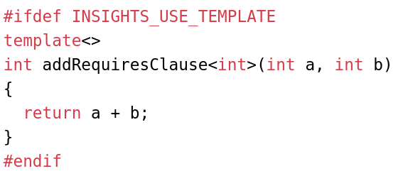
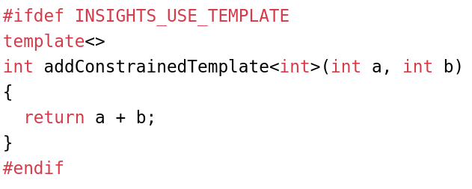
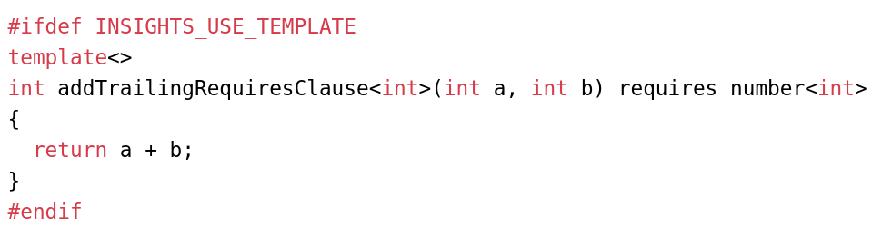
Are they all the same after all?

Slide 25
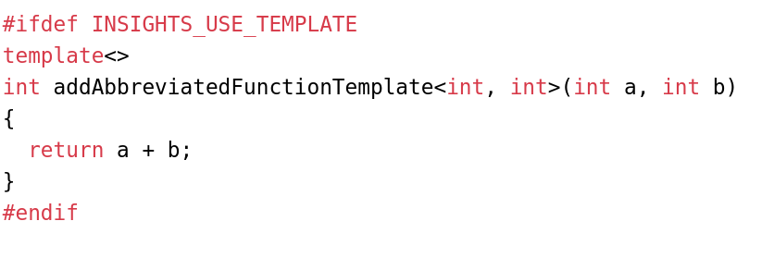
There is an expected difference

Slide 26
How to use concepts with classes

Slide 27
Fewer syntactical choices
Abbreviated function templates wouldn’t make sense
Trailing requires clause only in certain circumstances

Slide 28
The requires clause
template <typename T>
requires number<T>
class WrappedNumber {
public:
WrappedNumber(T num): m_num(num) {}
private:
T m_num;
};
requires following the template parameter list
After requires write your concept(s) to be satisfied
You can use complex constraints

Slide 29
Constrained template parameters
Instead of typename keyword use simply a concept
No complex constraints
template <number T>
class WrappedNumber {
public:
WrappedNumber(T num): m_num(num) {}
private:
T m_num;
};

Slide 30
Overload by constraints
template <typename T> class MyNumber { public:
T divide(const T& divisor) requires std::integral<T> { // … }
T divide(const T& divisor) requires std::floating_point<T> { // … } };
Class level templates with concepts on functions
Provide different overloads for different parameter types

Slide 31
Functions are available based on constraints
template <typename T> concept car = requires (T car) { car.startEngine(); car.openDoor(); }; template <typename T> concept is_convertible = car<T> && requires (T car) { car.openRoof(); }; template<car C> class VacationDriver { public: void cruise() { /* .. */ } void openRoof() requires is_convertible<C> { /* .. */} private: C m_car; };
class SUV { public: void openDoor() {} void startEngine() {} };
int main(){ VacationDriver<SUV> vd; // error // invalid reference to function 'openRoof': // constraints not satisfied vd.openRoof() }
Notes:
https://godbolt.org/#g:!((g:!((g:!((h:codeEditor,i:(filename:'1',fontScale:14,fontUsePx:'0',j:1,lang:c%2B%2B,selection:(endColumn:20,endLineNumber:41,positionColumn:20,positionLineNumber:41,selectionStartColumn:20,selectionStartLineNumber:41,startColumn:20,startLineNumber:41),source:'%23include+%3Ciostream%3E%0A%23include+%3Carray%3E%0A%23include+%3Cconcepts%3E%0A%0A%0Atemplate+%3Ctypename+T%3E%0Aconcept+car+%3D+requires+(T+car)+%7B%0A++++car.startEngine()%3B%0A++++car.openDoor()%3B%0A%7D%3B%0A%0Atemplate+%3Ctypename+T%3E%0Aconcept+is_convertible+%3D+car%3CT%3E+%26%26+requires+(T+car)+%7B%0A++++car.openRoof()%3B%0A%7D%3B%0A%0A%0Atemplate%3Ccar+C%3E%0Aclass+VacationDriver+%7B%0A+public:%0A++void+cruise()+%7B%0A++++//+..%0A++%7D%0A++%0A++void+openRoof()+requires+is_convertible%3CC%3E+%7B%0A++%7D%0A+%0Aprivate:%0A++C+m_car%3B%0A%7D%3B%0A%0Aclass+SUV+%7B%0A+public:%0A++void+openDoor()+%7B%7D%0A++void+startEngine()+%7B%7D%0A%7D%3B%0A%0A%0Aint+main()%7B%0A++VacationDriver%3CSUV%3E+vs%3B%0A//+++vs.openRoof()%3B%0A%7D'),l:'5',n:'0',o:'C%2B%2B+source+%231',t:'0')),k:53.27301756253328,l:'4',n:'0',o:'',s:0,t:'0'),(g:!((g:!((h:compiler,i:(compiler:clang_trunk,filters:(b:'0',binary:'1',commentOnly:'0',demangle:'0',directives:'0',execute:'0',intel:'0',libraryCode:'1',trim:'1'),flagsViewOpen:'1',fontScale:14,fontUsePx:'0',j:1,lang:c%2B%2B,libs:!(),options:'-std%3Dc%2B%2B20+-O2',selection:(endColumn:1,endLineNumber:1,positionColumn:1,positionLineNumber:1,selectionStartColumn:1,selectionStartLineNumber:1,startColumn:1,startLineNumber:1),source:1,tree:'1'),l:'5',n:'0',o:'x86-64+clang+(trunk)+(C%2B%2B,+Editor+%231,+Compiler+%231)',t:'0')),k:35.708682560477136,l:'4',m:45.97156398104265,n:'0',o:'',s:0,t:'0'),(g:!((h:output,i:(compiler:1,editor:1,fontScale:14,fontUsePx:'0',wrap:'1'),l:'5',n:'0',o:'Output+of+x86-64+clang+(trunk)+(Compiler+%231)',t:'0')),header:(),k:50,l:'4',m:54.02843601895735,n:'0',o:'',s:0,t:'0')),k:46.726982437466745,l:'3',n:'0',o:'',t:'0')),l:'2',n:'0',o:'',t:'0')),version:4

Slide 32
How to write concepts?

Slide 33
How to write a simple concept?
List all template parameters
After the keyword concept comes the name
Then the requirements
template<typename T>
concept any = true;
Notes:
Template < template-parameter list>
Concept concept-name = constraint-expression;

Slide 34
What kind of requirements can we express?
Expectations on the public interface
Syntactic requirements
Also semantic requirements
T.20: Avoid “concepts” without meaningful semantics
template <typename C> concept car = requires (C c) { c.openDoor(); c.closeDoor(); c.startEngine(); c.stopEngine(); c.accelerate(); c.brake(); }; class Tank { // … }; // syntactically valid but // a car is still not a tank… static_assert(car<Tank>);

Slide 35
Combine already defined concepts
T.11: Whenever possible use standard concepts
User defined ones are also OK
Use them in any logical combination*
#include <concepts>
template<typename T>
concept number = std::integral<T> || std::floating_point<T>;

Slide 36
What does combining concepts mean?

Slide 37
Conjunctions (&&) and disjunctions (||) are OK
You are free to combine
concepts
bool literals
bool expressions
type traits (::value, _v)
requires expressions
Beware of the !
#include <concepts> #include <type_traits>
template <typename T>
concept number = std::integral<T> || (std::is_floating_point_v<T> == true);

Slide 38
What does the ! say?
For boolean expressions, subexpressions
Are well-formed
Compile
Return false
For concepts, a subexpression
Might return false
Can be ill-formed
The rest can be still satisfied

Slide 39
The opposite of true is not false
template <typename T, typename U> requires std::unsigned_integral< typename T::Blah> || std::unsigned_integral< typename U::Blah> void foo(T bar, U baz) { /*...*/ }
class MyType { public: using Blah = unsigned int; // … }; foo(MyType{}, 42);
It doesn’t have to be compilable
It might return false
Expecting false is possible
With a cast to bool
Or with a more explicit way

Slide 40
There is always another way
template <typename T, typename U>
requires (bool(std::unsigned_integral< typename T::Blah> || std::unsigned_integral< typename U::Blah>))
void foo(T bar, U baz) { /*...*/ }
template <typename T, typename U> requires ( requires {typename T::Blah;} && requires { typename U::Blah;}) && (std::unsigned_integral< typename T::Blah> || std::unsigned_integral< typename U::Blah>) void foo(T bar, U baz) { /*...*/ }

Slide 41
How to find the most constrained constraint?

Slide 42
A few words on overload resolution
The best candidate is the most constrained one
A more constrained concept is based on another one
Multiple overloads with the same priority => ambiguity
Notes:
It’s different as with std::enable_if, there multiple might be generated

Slide 43
The constrained one will be automatically chosen
The right path will be chosen based on the template parameter type’s characteristics
template <typename Key> class Ignition {
public:
void start(Key key) requires (!Smart<Key>) { // … }
void start(Key key) requires Smart<Key> { // … } };
T.25: Avoid complementary constraints

Slide 44
The most constrained will be automatically chosen
The most appropriate overload will be chosen at compile-time
All this happens via concepts subsumption
template <typename Key> class Ignition {
public:
void start(Key key){}
void start(Key key) requires Smart<Key> {} void start(Key key) requires Smart<Key> && Personal<Key> {} };

Slide 45


Negations bring ambiguity - use named concepts
template <typename Key> class Ignition {
public:
void start(Key key){}
void start(Key key) requires (!Smart<Key>) {} void start(Key key) requires (!Smart<Key>) && Personal<Key> {} };
template <typename Key> class Ignition {
public:
void start(Key key){}
void start(Key key) requires NotSmart<Key> {} void start(Key key) requires NotSmart<Key> && Personal<Key> {} };

Slide 46
So how to write concepts?

Slide 47
Simple requirements on the interface
Use wishful writing!
Write down the operation you expect to be compiled
List all the variables used in the requirements after the requires keyword
T.21: Require a complete set of operations for a concept
T.26: Prefer to define concepts in terms of use-patterns rather than simple syntax
template <typename T>
concept test_concept = requires (T a, T b, int exponent) {
a + b; t.square(); t.power(exponent);
};

Slide 48
Requirements on return types (compound requirements)
Constraint the return types with:
std::convertible_to<From, To>
std::same_as<T, U>
template <typename T> concept has_square = requires (T t) { {t.square()} -> std::convertible_to<int>; };
Don’t forget the braces!
No bare type for future generalizations
Notes:
No bare type for future generalizations speak about that

Slide 49
Type requirements
A certain nested type exists
A class template specialization names a type
An alias template specialization names a type

Slide 50
Require nested types
std::vector has inner member type value_type
int doesn’t have any member type =>
error: deduced initializer does not satisfy placeholder constraints ... the required type 'typename T::value_type' is invalid
template<typename T> concept type_requirement = requires { typename T::value_type; };
int main() { type_requirement auto myVec = std::vector<int>{1, 2, 3}; type_requirement auto myInt{3}; }

Slide 51
Require nested template specializations
Make sure that a type can be used as a template parameter for another type
Error: the required type 'Other<T>' is invalid ... constraints not satisfied ... 'template<class T> requires !(same_as<T, int>) struct Other [with T = int]'...
#include <concepts>
template <typename T> requires (!std::same_as<T, int>) struct Other {};
template<typename T> concept type_requirement = requires { typename Other<T>; };
int main() { type_requirement auto c = 'c'; type_requirement auto i = 4; }

Slide 52
Requirements on alias template specializations
To make sure that an alias template specialization names a type
template<typename T> using Reference = T&;
template<typename T>
concept type_requirement = requires {
typename Reference<T>;
};

Slide 53
Nesting is often overcomplication
Use nested requirements on local variables without declaring named concepts
Nested requirement to check what clonable returns
But...
#include <concepts>
struct Droid { Droid clone() { return {}; } }; struct DroidV2 { Droid clone() { return {}; } };
template <typename C> concept cloneable = requires (C cloneable) { cloneable.clone(); requires std::same_as<C, decltype(cloneable.clone())>; };
int main() { cloneable auto c = Droid{}; // nested requirement 'same_as<C, decltype (cloneable.clone())>' // is not satisfied [with C = DroidV2] // cloneable auto c2 = DroidV2{}; }

Slide 54
But there is often a simpler option
template<typename C>
concept clonable = requires (C clonable) {
{ clonable.clone() } -> std::same_as<C>;
};

Slide 55
Nest to simulate boolean expressions
template <typename T, typename U> requires ( requires {typename T::Blah;} && requires { typename U::Blah;}) && (std::unsigned_integral< typename T::Blah> || std::unsigned_integral< typename U::Blah>) void foo(T bar, U baz) { /*...*/ }
template <typename T, typename U>
requires (bool(std::unsigned_integral< typename T::Blah> || std::unsigned_integral< typename U::Blah>))
void foo(T bar, U baz) { /*...*/ }

Slide 56
Real-life examples

Slide 57
Numbers, nothing else, please
Some integral types are not numbers:
bool
char et al.
#include <concepts> #include <iostream> template <typename T> concept number = std::integral<T> || std::floating_point<T>;
auto add(number auto a, number auto b) { return a + b; } int main() { std::cout << add(1, 2) << '\n'; std::cout << add(1, 2.14) << '\n'; std::cout << add('1', '2') << '\n'; std::cout << add(true, false) << '\n'; }
Notes:
3
3.14
99 = 49 + 50
1

Slide 58
Let’s forbid unwanted types
No bools
No chars
#include <concepts>
template <typename T> concept number = (std::integral<T> || std::floating_point<T>) && !std::same_as<T, bool> && !std::same_as<T, char> && !std::same_as<T, unsigned char> && !std::same_as<T, char8_t && !std::same_as<T, char16_t> && !std::same_as<T, char32_t> && !std::same_as<T, wchar_t>;
number auto add(number auto a, number auto b) { return a+b; } int main() { // constraints not satisfied, [with auto:11 = bool; // auto:12 = bool]': the expression '!(same_as<T, bool>) // [with T = bool]' evaluated to 'false' add(true, false); // ERROR }

Slide 59
Turn poorly documented utility functions...
Usually taking any type
No static assertions
Bad template parameter names (T, U, etc.)
No documentation
template <typename BusinessObjectT>
void encodeSomeStuff( BusinessObjectT iBusinessObject) {
// ...
}

Slide 60
… into self-documenting code
template <typename BOWithEncodeableStuff_t> concept bo_with_encodeable_stuff = requires (BOWithEncodeableStuff_t bo) { bo.interfaceA(); bo.interfaceB(); { bo.interfaceC() } -> std::same_as<int>; };
void encode(bo_with_encodeable_stuff auto iBusinessObject) { /*...*/ }
No more naked Ts
No more unconstrained typenames
T.10: Specify concepts for all template arguments

Slide 61
Even if some concepts are not for reuse
Concept can be “inlined”
Cannot use a parameter in an unnamed context
Hence the nested requires clause
template <typename BOWithEncodeableStuff_t> requires requires (BOWithEncodeableStuff_t bo) {
bo.interfaceA(); bo.interfaceB(); { bo.interfaceC() } -> std::same_as<int>; } void encodeSomeStuff(BOWithEncodeableStuff_t iBusinessObject) { /*...*/ }

Slide 62
How to test whether your class models a concept?
Use static_assert to make sure your class models the desired concepts
You can similarly test your concepts too!
template <typename C> concept car = requires (C c) { c.startEngine(); c.stopEngine(); c.accelerate(); c.brake(); // ... }; class Tank { /* … */ }; static_assert(!car<Tank>);
class SUV { /* … */ }; static_assert(car<SUV>);

Slide 63
Conclusion

Slide 64
Key takeaways
Concepts help validate template arguments at compile-time
Concepts provide a reusable and scalable way to constrain templates
The standard library gives dozens of generic concepts
There are plenty of ways to define our concepts

Slide 65


Call to action
Start using concepts as soon as you switch to C++20
Use them for your applications
No more naked Ts and typenames

Slide 66
The Concepts of concepts
Sandor DARGO
2nd December 2021
CPPP

