Slide 1
INKAR-based vulnerability index
Germany scaling check for the GFZ meeting
March 2026

Slide 2
1. What does the thesis do?
Study area: German part of the Elbe river basin
Core goal: analyse the social distribution of flood exposure and socio-economic vulnerability
Justice angle: are more vulnerable municipalities also more exposed to flood hazards?
Data logic:
flood exposure from BfG HQ100-based processing
socio-economic vulnerability from municipality-level INKAR indicators
protection context currently informed by EU flood-protection data
Current task for the meeting:
assess whether the INKAR-based vulnerability component can be scaled up to Germany

Slide 3
2. Why INKAR matters for national scaling
INKAR 2025 is not Elbe-specific from the start
Raw dataset structure:
long-format CSV
63,426,864 rows
45 spatial-reference categories
top-level areas: EU, LRB, SDG, ZOM
Germany-wide municipal subset used for the check:
Bereich = LRB
Raumbezug = Gemeinden
10,978 municipalities
176 municipality-level indicators

Slide 4
3. Germany-wide availability on AGS level
Municipality-level indicators in total: 176
Present in all 16 federal states: 173
Fully complete on AGS level in all 16 federal states: 32
Not present in all 16 states: 3
q_sach
q_schluesselzuw
q_investZ
These correspond to:
capital-investment expenditure
key allocations
grants for investment support measures
Main message:
the socio-economic part is broadly available nationwide
but absolute municipality completeness is much stricter than state-level presence

Slide 5
4. Why strict full coverage alone is not enough
If I only keep variables with full AGS-level completeness, the pool becomes too narrow and too structural.
What remains is mostly:
minijob structure
broadband availability
accessibility to central places
density and structural counts
land-use context
What largely drops out:
social transfers
low income
long-term unemployment
ageing and dependency
single-person households
everyday health-access indicators
Conclusion:
strict full coverage only is clean in data terms
but weak in substantive vulnerability terms

Slide 6
5. Proposed nationwide shortlist
Best current compromise: variables that
are present in all 16 federal states
have very high AGS-level availability
still represent meaningful vulnerability dimensions
Core shortlist:
Deprivation:
a_ALGII_SGBII
a_Unterkunft_SGBII
a_aloLang
q_alo_u25_einw
q_kaufkraft
a_hheink_niedrig
Demographic sensitivity:
a_bev65um
a_bev75um
q_abhg_alt
Household structure:
q_HH1
Accessibility:
m_OEV20_DIST
m_Q07_HA_DIST
m_Q01_APO_DIST

Slide 7
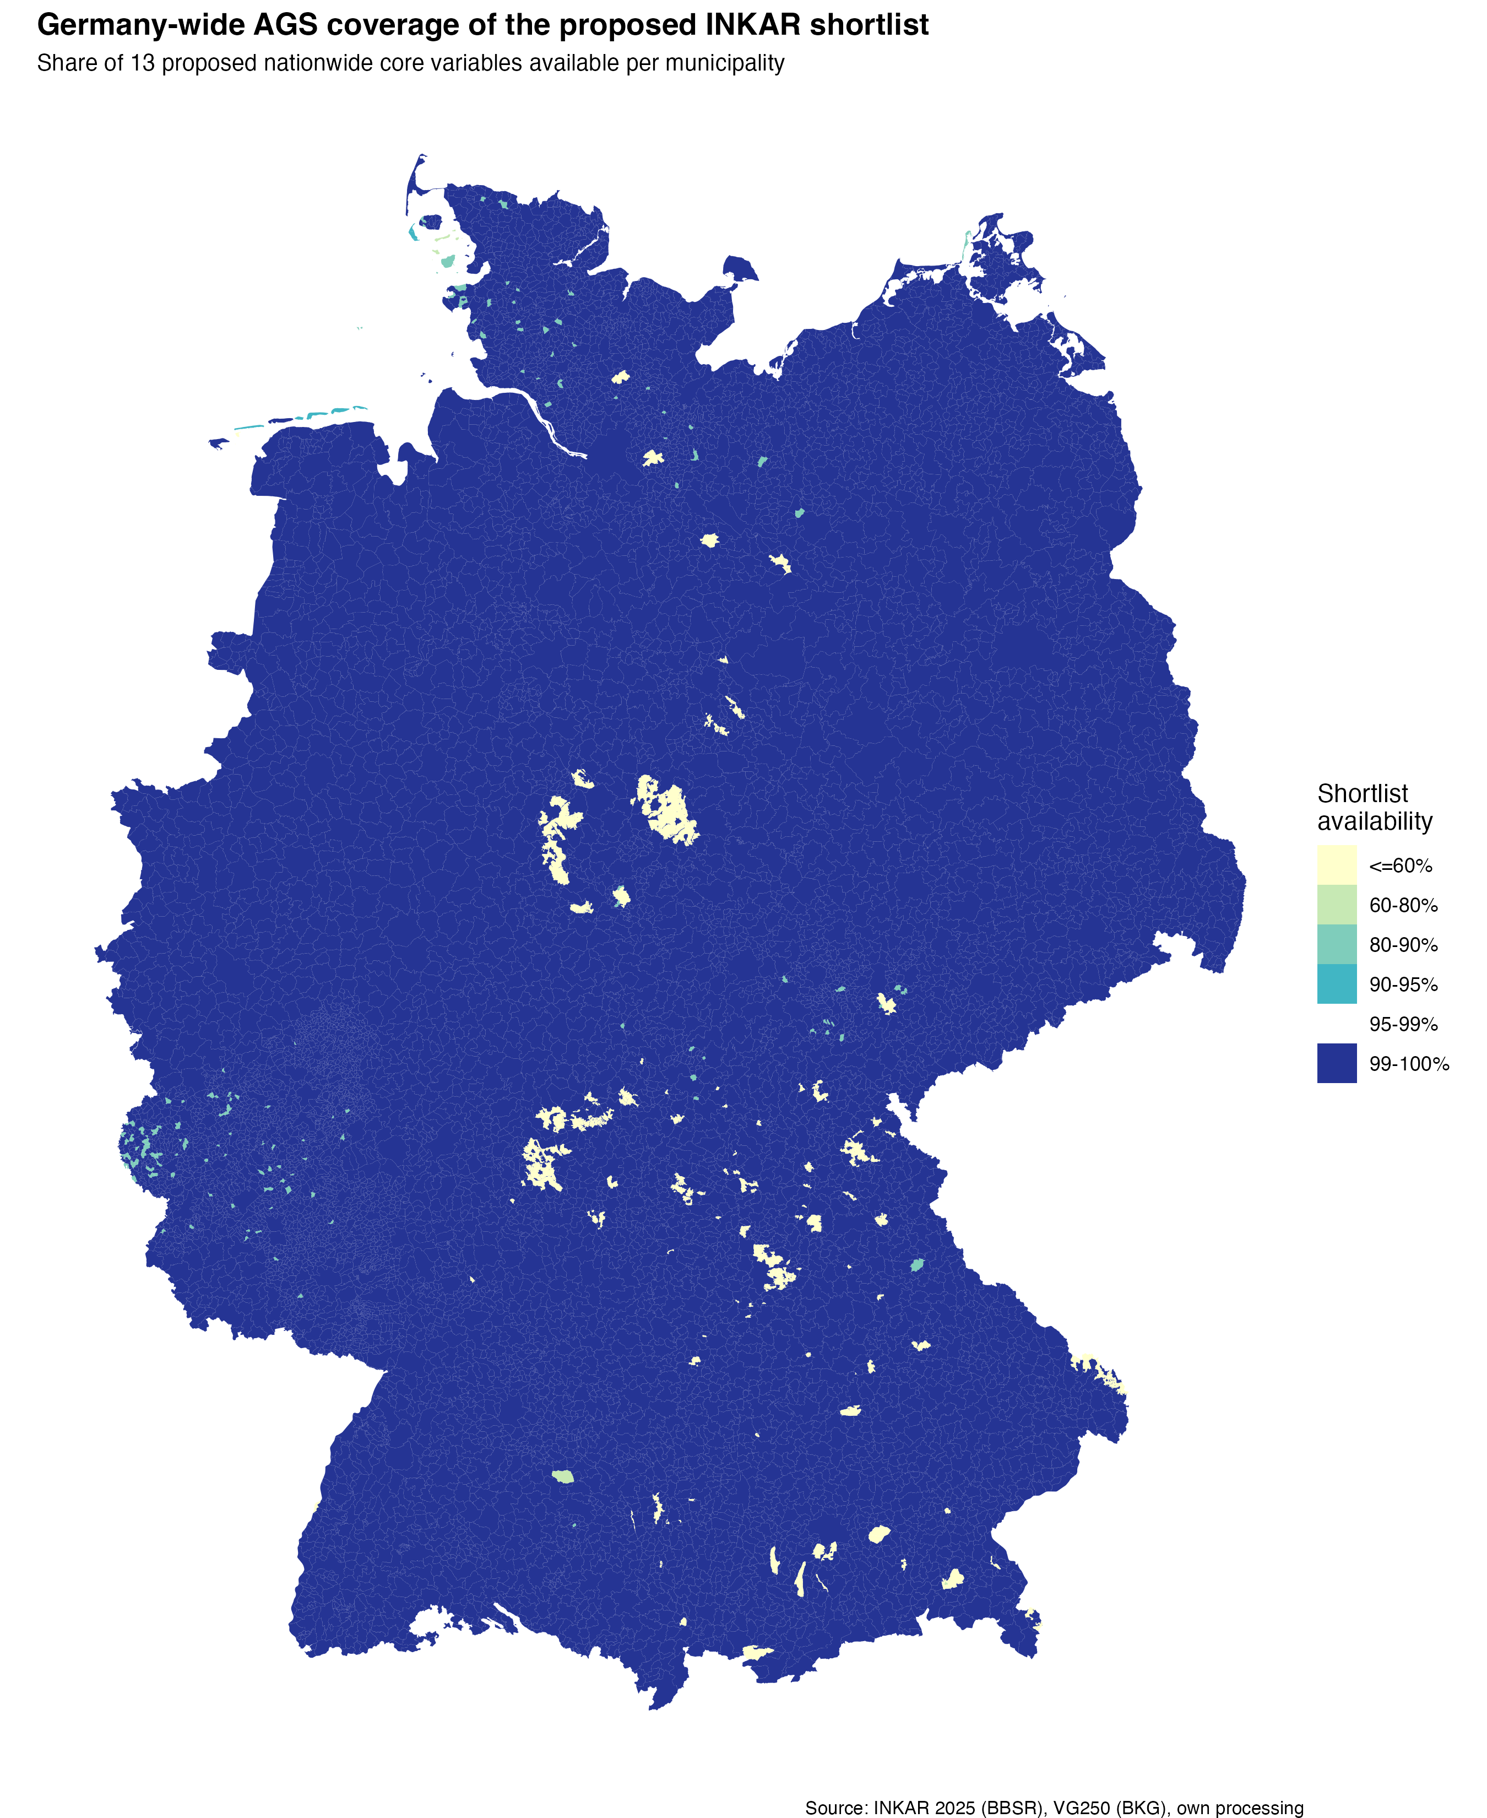
6. AGS coverage of the proposed shortlist

Slide 8
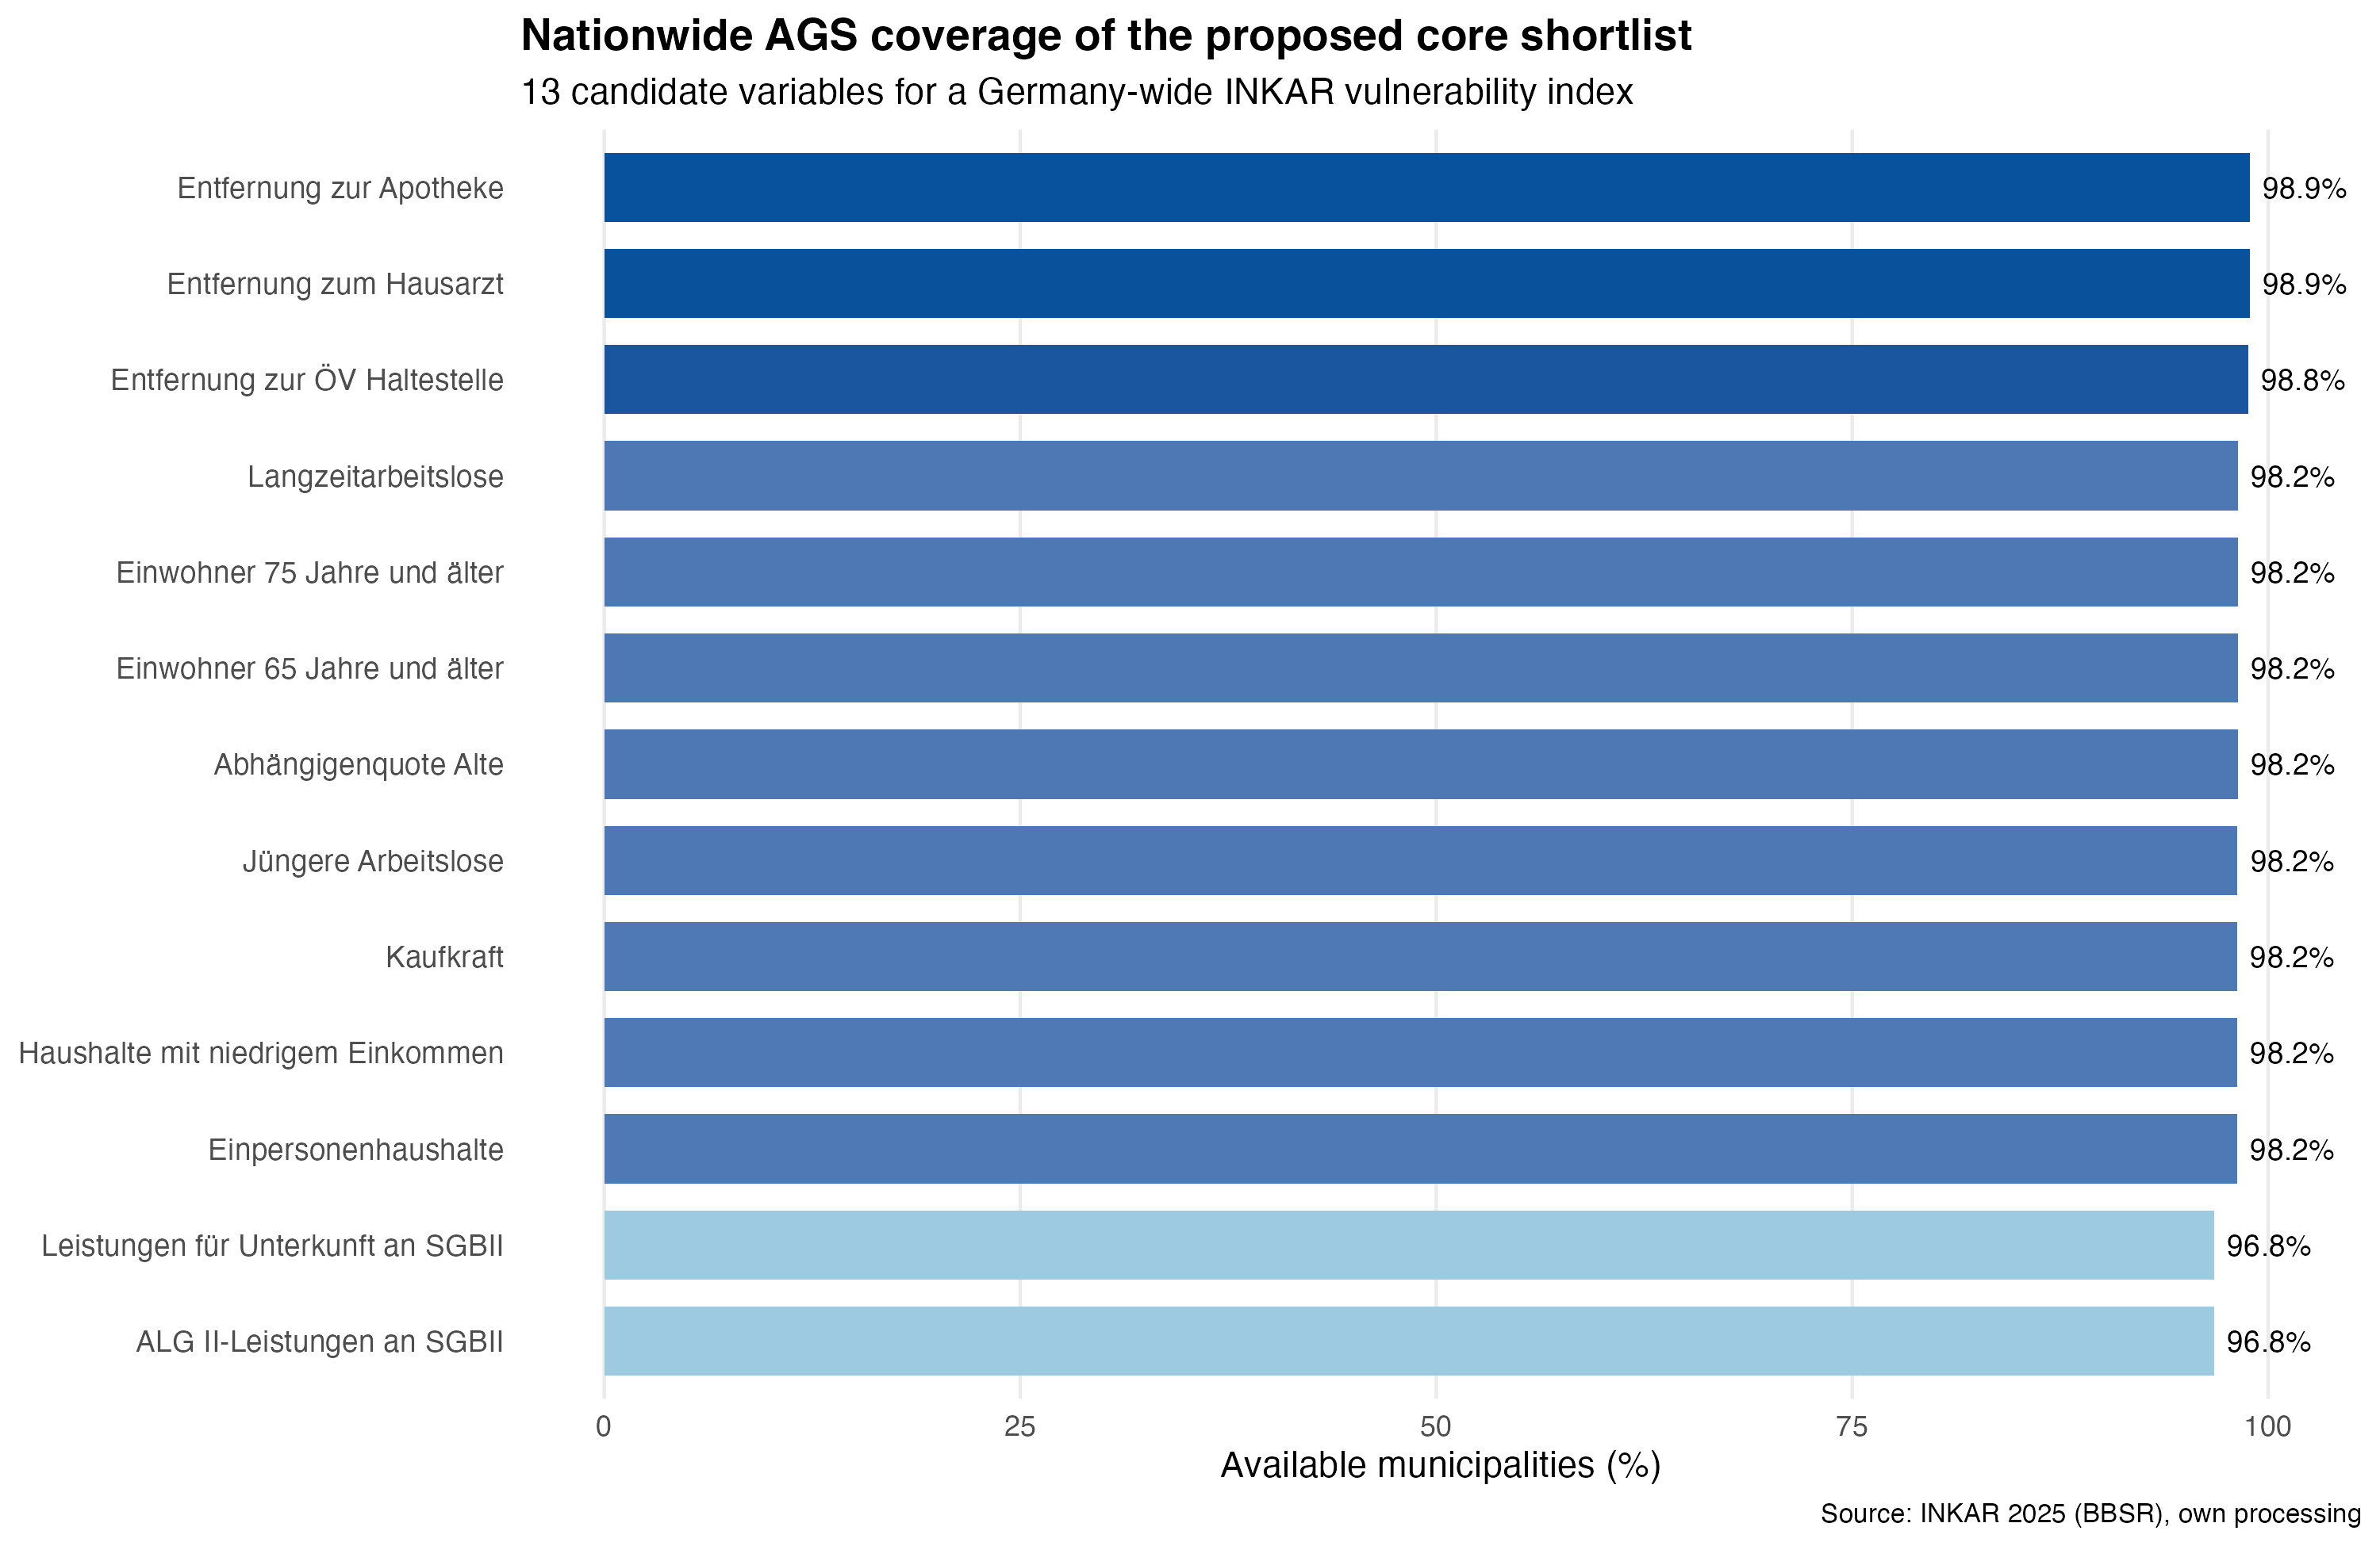
7. Coverage rates of the shortlist variables

Slide 9
8. First wide PCA: why I started there
Initial version in Analyse_CLEAN.R:
one global PCA across 52 variables
intentionally exploratory
broad indicator pool:
deprivation
labour market
age structure
household structure
education
health provision
digital access
service distances
density and structural indicators
first 8 PCs retained for the main index
variance-weighted aggregation
sign anchored to ALG II / SGB II
Why that was useful:
good first scan of the municipality-level socio-economic space
good for identifying redundancy and latent structure

Slide 10
9. What changed in the redesign
Redesign in Analyse_PROTOCOL_REDESIGN.R:
narrower and theory-led indicator set
PCA kept, but applied more selectively
indicators grouped into domains before reduction
PC1 used within each domain
domains combined into the redesigned main index
additional reduced-set PCA kept only as sensitivity check
Redesigned main domains:
deprivation
demographic sensitivity
household / social structure
accessibility / adaptive capacity
Why this is better for the thesis:
more interpretable
less driven by structural overlap
easier to defend conceptually in a supervisor meeting

Slide 11
10. Bottom line for the meeting
My current position:
yes, an INKAR-based socio-economic vulnerability component can in principle be scaled up to Germany
no, I would not base that on strict full coverage only
the proposed shortlist is the strongest current compromise between:
nationwide availability
AGS-level coverage
substantive vulnerability relevance
the stronger scaling bottleneck is not INKAR itself, but the national consistency of hazard and protection data
One caveat that should remain visible:
a_BG1P = single-person benefit units (official INKAR category)
this does not match the current project label share_bg_single_parent
I would not use that variable in a national shortlist unless the naming and interpretation are cleaned up first

