Slide 1
The OSGi first software artifact repository

Slide 2






JENS REIMANN
+JensReimann
jens.reimann
@ctron
dentrassi.de

Slide 3
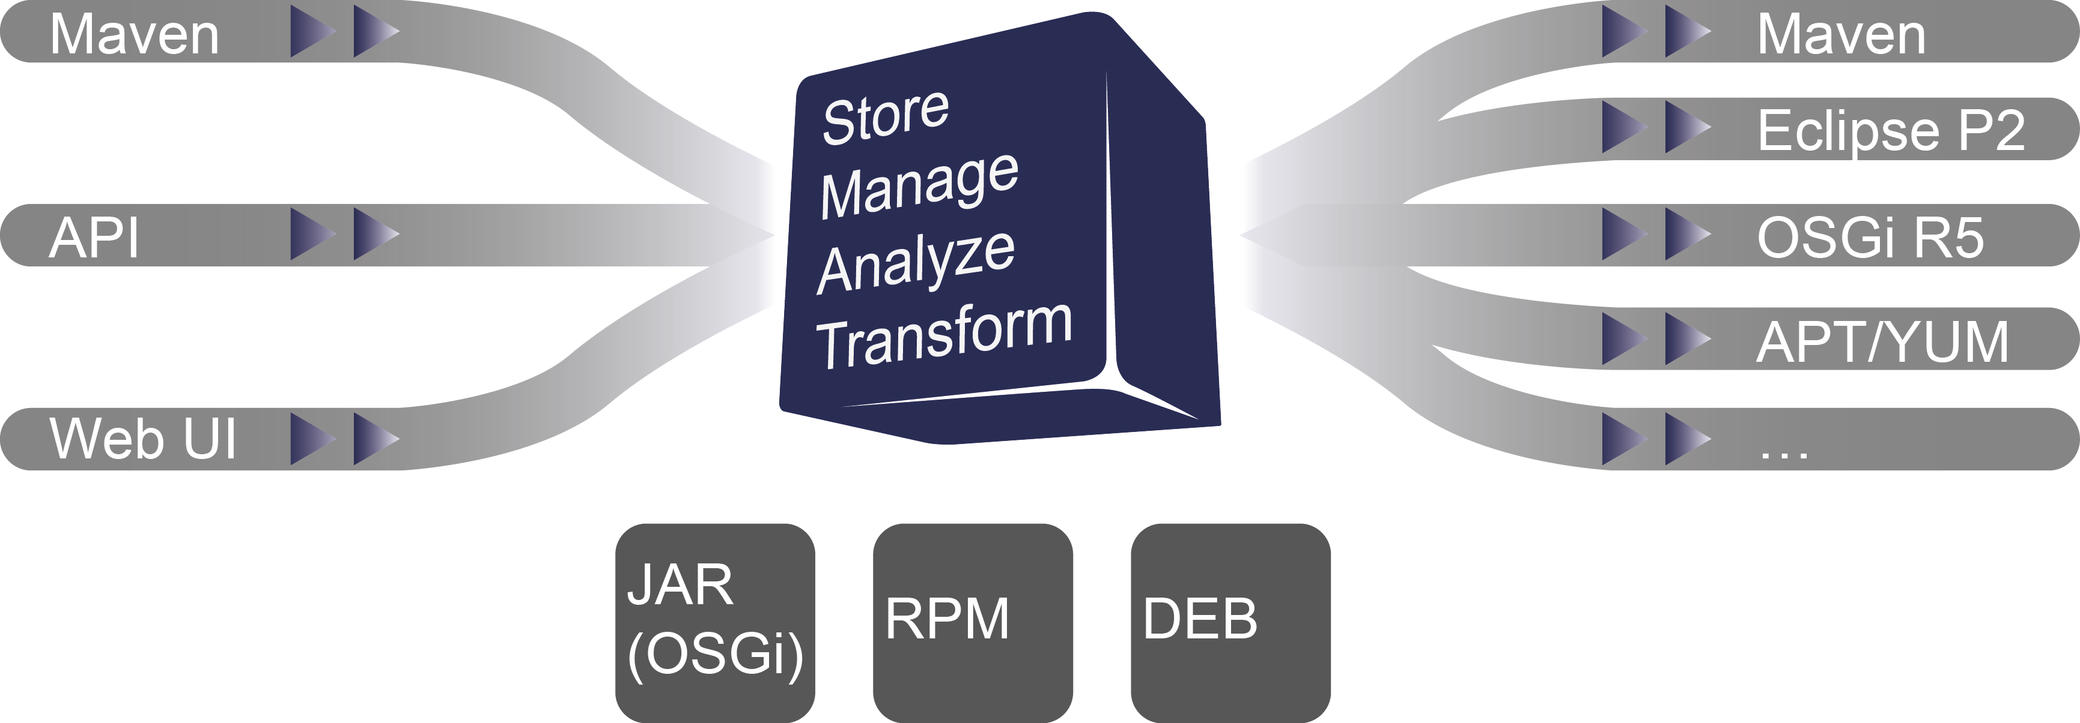
OVERVIEW

Slide 4
WHAT IS NEW?
RELEASE 0.13.0
Trigger System
Re-using zipped P2 meta data
RPM write functionality
Bug fixes

Slide 5
CREATING RPMS
Plain Java library for creating RPM files
Stand alone functionality
  Available on Maven Central
  Available as Maven Plugin – Java RPM builder
    https://ctron.github.io/rpm-builder/
    Creates RPM packages without the need for »rpmbuild« or »gpg«
  Can parse, create and sign RPM packages in plain Java
Planned to be integrated as RPM signing service

Slide 6
DEMO!

Slide 7
WHAT'S NEXT?
RELEASE 0.14.0
REST API
  Based on JAX-RS, Swagger
New Upload API V3 → multi upload
  Updated Jenkins plugin
And whatever will be contributed ;-)

Slide 8
Questions?

