Slide 1

AI-Powered E-Commerce DBMS
Presented by: Shivang shukla
Roll No: 2301331540150
branch ds-iv-a
Presented to : dr. nidhi sharma
ms. Honey singh

Slide 2
Introduction
• E-commerce is reshaping global retail.
• But most platforms rely on static product listings.
• Our project combines modern DBMS with AI to enhance user experience.
• Goal: Improve shopping for both customers and retailers.

Slide 3
Project Objectives
✓ Build a full-stack e-commerce web app
✓ Provide role-based access: Customers & Retailers
✓ Implement AI-driven product recommendations
✓ Manage inventory using MySQL DBMS
✓ Deliver a modern UI with real-time interactions

Slide 4
Technology Stack
Frontend: HTML, CSS, JavaScript
Backend: Flask (Python)
Database: MySQL
AI Logic: Custom Python module
Styling: CSS with responsive layout
Hosting/Local: http://127.0.0.1:5000

Slide 5
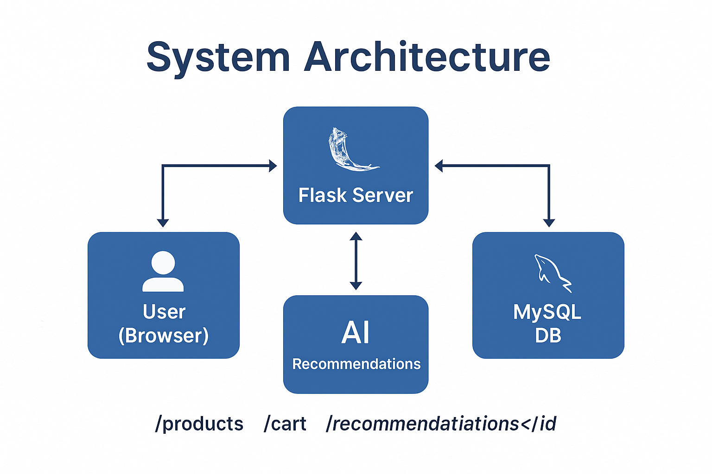
System Architecture

Slide 6
Key Features
👤 User Roles:
- Customer: Browse, Cart, Checkout
- Retailer: Add/Update Products
🧠 AI Recommendations:
- Based on product similarity
🛒 Cart System:
- Live cart and stock update

Slide 7
Database Design (MySQL)
Tables:
- users(user_id, name, email, password, role)
- products(product_id, name, description, price, category, stock, image_url)
- cart(cart_id, user_id, product_id, quantity)
Relationships:
- users → cart (1-to-many)
- products → cart (1-to-many)

Slide 8
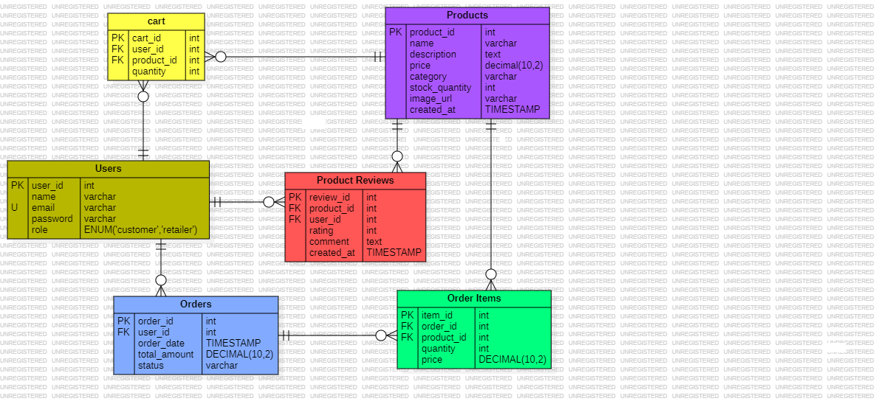
ER-Diagram

Slide 9
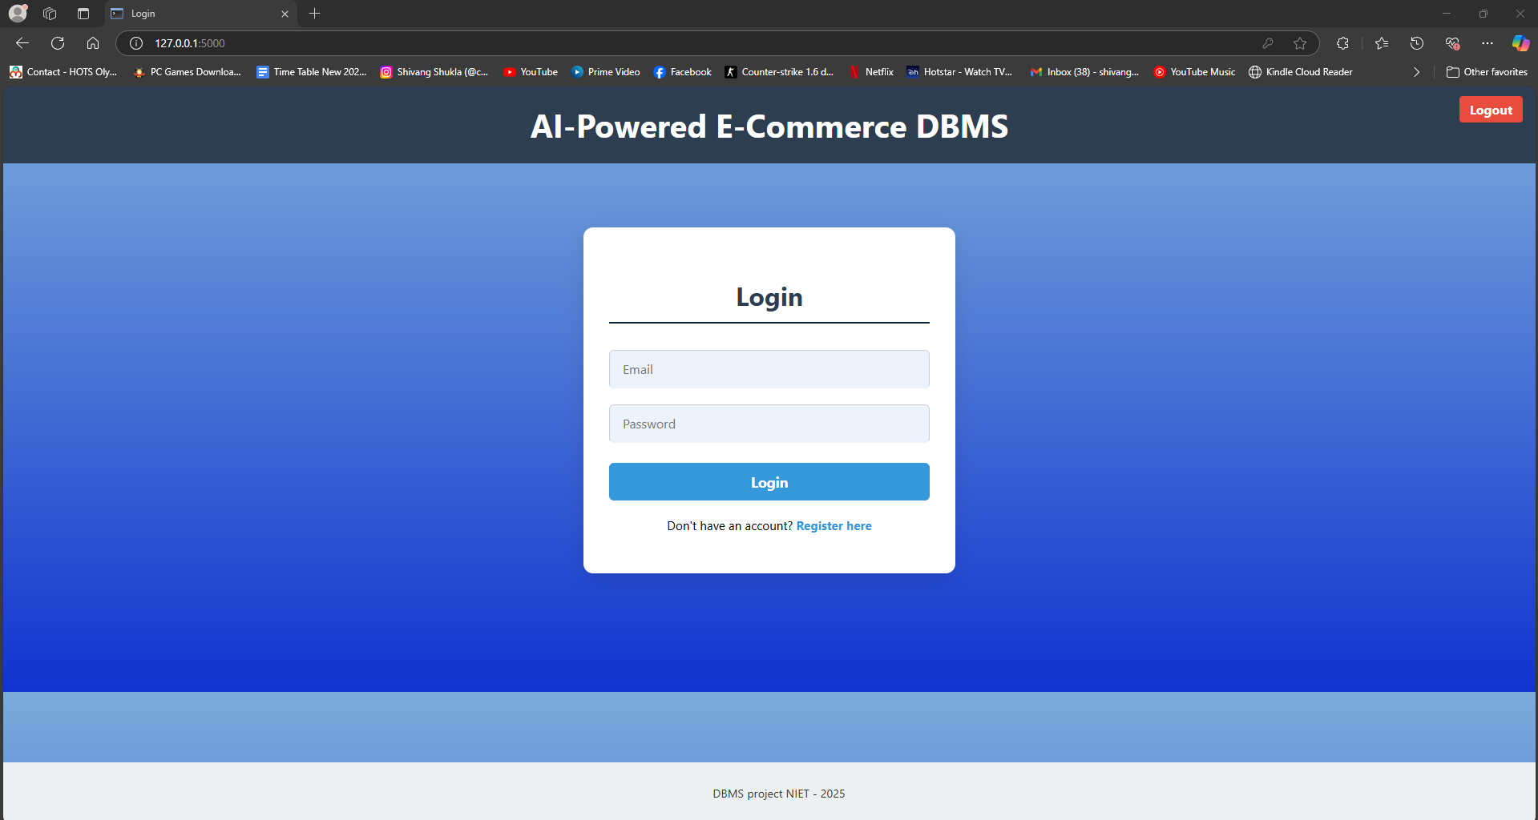
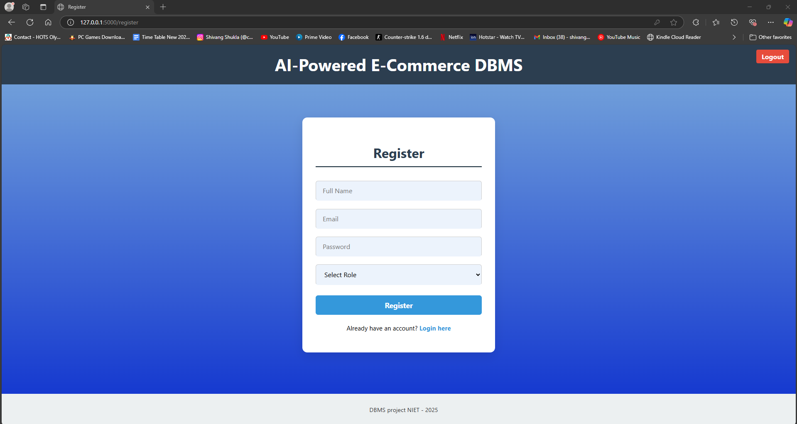
Application Screens
Login/Register Page

Slide 10
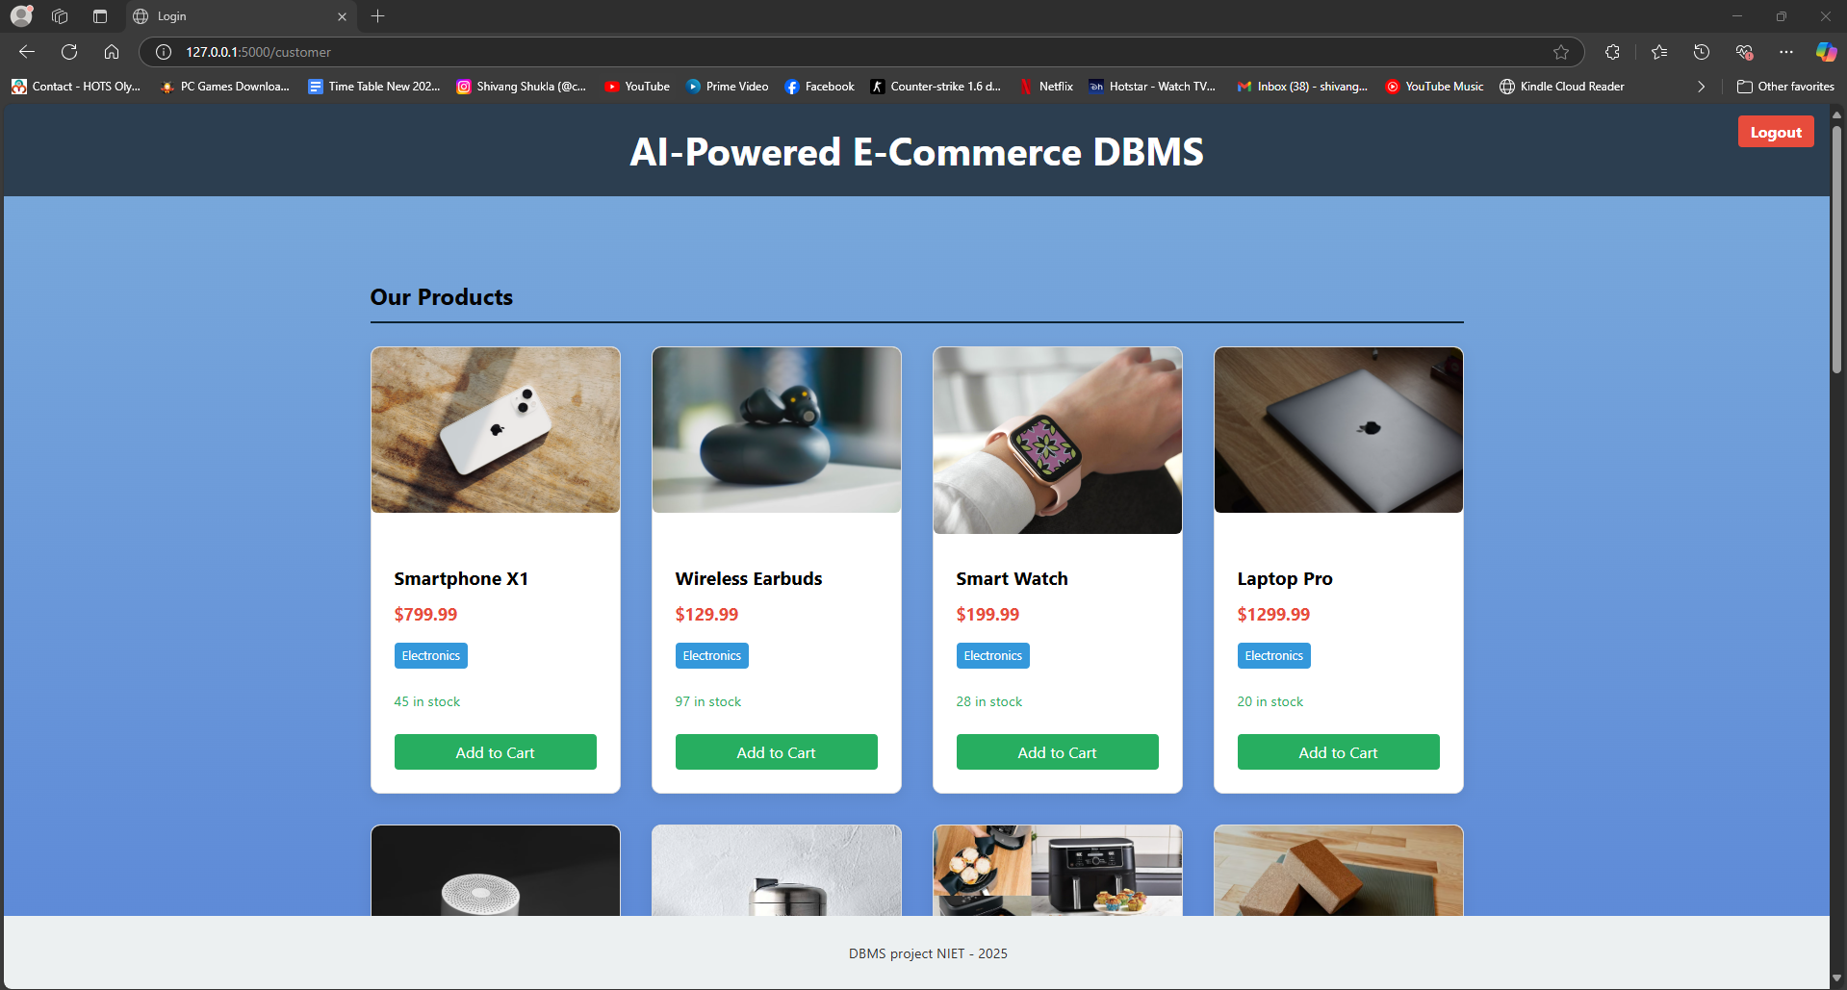

Customer Product View + Cart with checkout

Slide 11
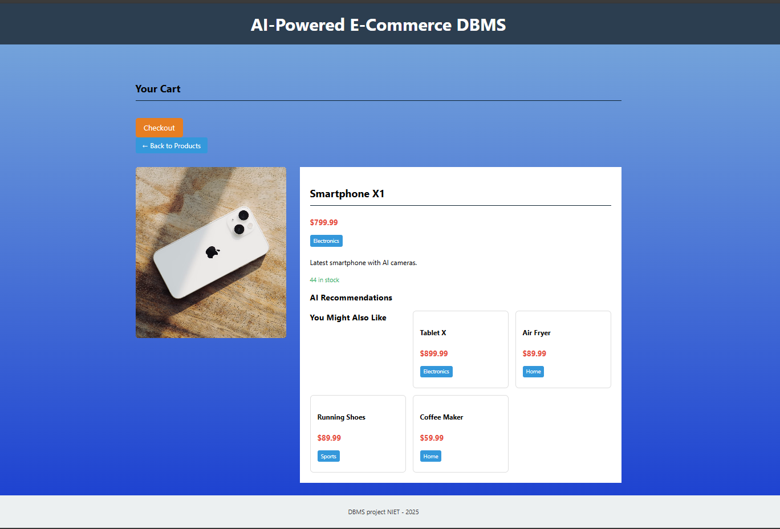
Product Detail with Recommendations

Slide 12
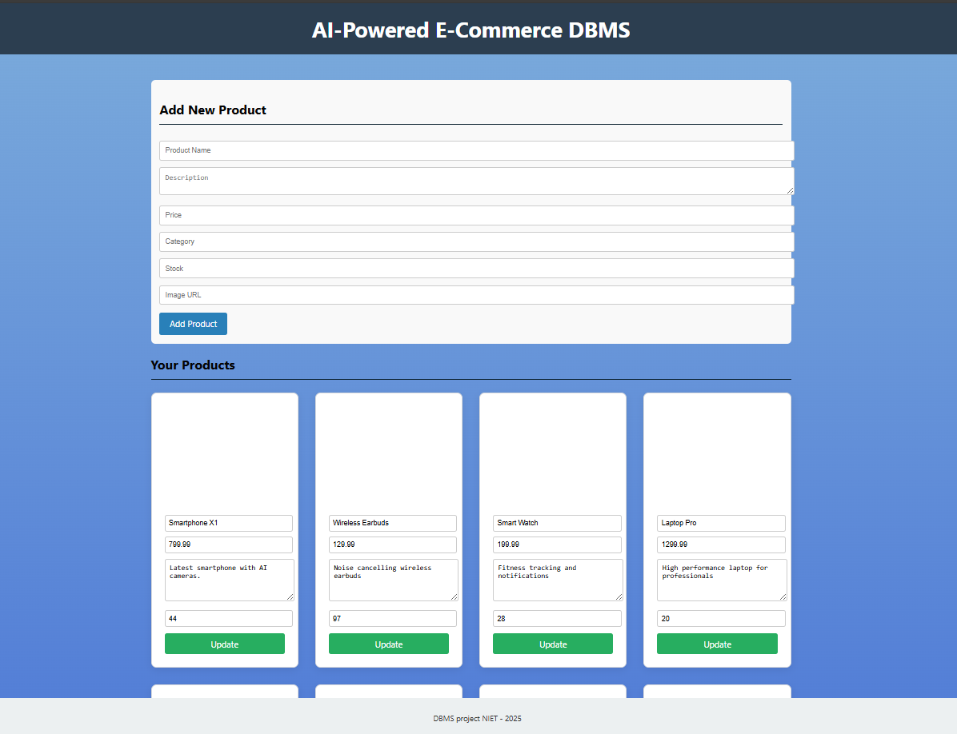
Retailer Dashboard

Slide 13
Challenges & Learnings
Challenges:
- Combining Flask with dynamic JS frontend
- AI logic integration
- Managing cart sessions & stock sync
Learnings:
- Full-stack architecture in practice
- Flask sessions, MySQL queries

Slide 14

Conclusion & Future Scope
Summary:
- AI + DBMS → Smarter e-commerce experience
- Role-based access and inventory control
Future Enhancements:
- Add payment gateway
- Improve AI with ML models
- Admin analytics panel
Thank You! 🙏

