Slide 1
Seeing Ancient Work
Keagen Chapman
Asaf Kedar

Slide 2
Sprint 4 Objectives
Review Summer Developments
Discuss Relevant Changes to development plan
Confirm new development plan for sprints 4-6
Finish incomplete summer work

Slide 3
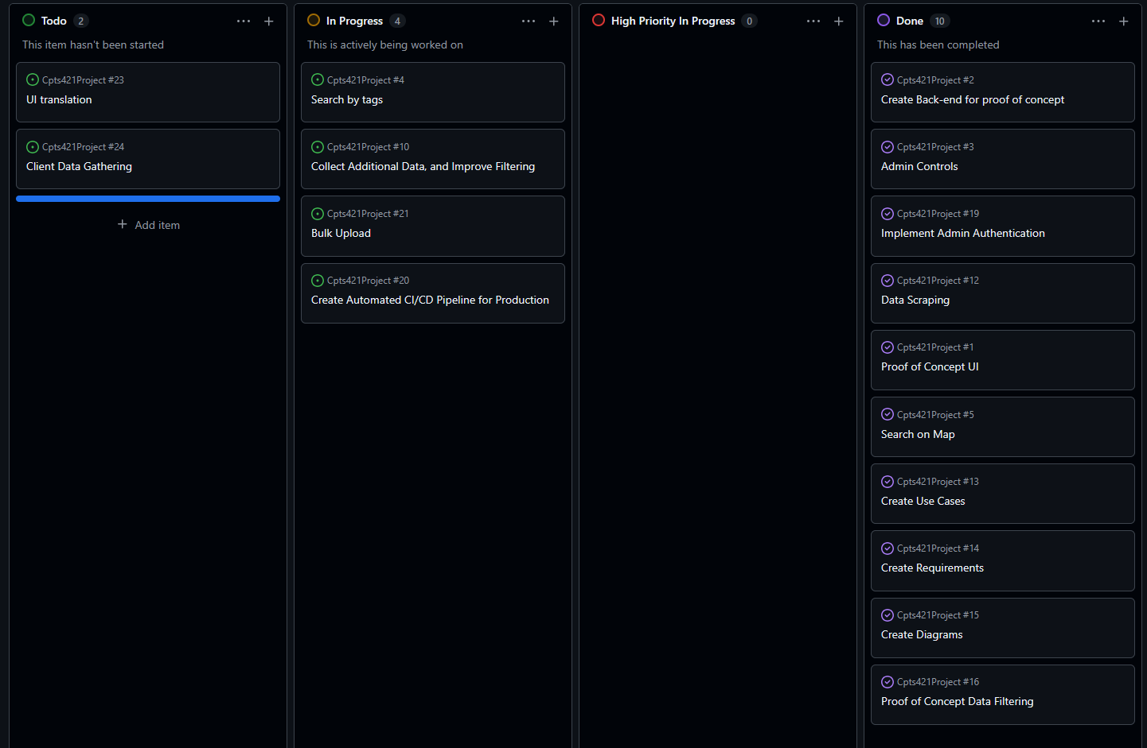
Kanban Board

Slide 4
Achievements and Challenges
Never imported directly from excel before
Lack of knowledge on GUI implementation
Communication

Slide 5
AI Use
Helping to read lengthy docker error messages
Adapt given excel format to our sql schema using our inbuilt create object functionality

Slide 6
Next Steps
Testing and bug fixes
Nice to have features

Slide 7
Conclusion
Thank You Hallie Meredith, and Parteek Kumar

