Slide 1
COMPS413F
Lecture Notes
#02. Layout
COMPS413F Lecture #02

Slide 2
Agenda
Introduction
Android layout hierarchy
Methodology of layout implementation
Declaring layout with XML
Loading of Layout Resource
Designing layout programmatically
Layout designed in XML resources vs. in code
Frequently used layout parameters for views
Common types of layout used in application
Create XML manually vs. Android Studio Layout Editor
Nested layout
Alternate layout
COMPS413F Lecture #02

Slide 3
Introduction
The user interface in an Android application consisted of layout and other UI elements
  Layouts
    Instances of the "android.view.ViewGroups" class
    A container for organizing multiple views and possibly other view groups
    The key function of a view group is to manage the placement, or layout, of its contained components
  Different kinds of UI elements (i.e., widgets)
    Derived from "android.view.View" class
    Arranged and managed by layout
    E.g., button, text view, edit text, …
"ViewGroup" and "View" objects are the basic components for building an user interface
COMPS413F Lecture #02

Slide 4
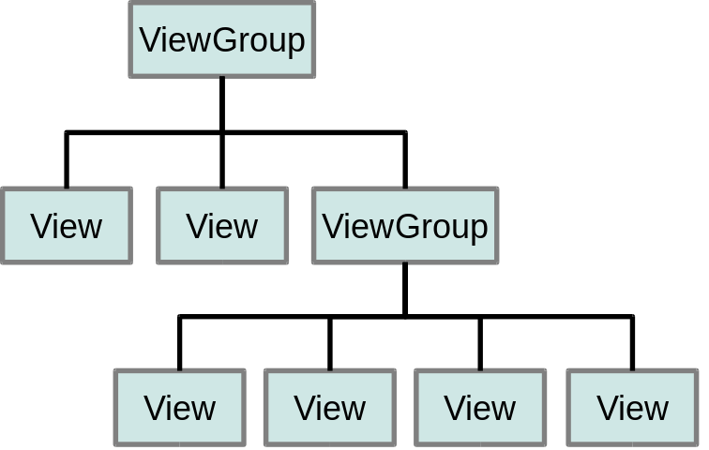
Android layout hierarchy
The UI components of an activity are arranged in a hierarchy of views and view groups
Note:
  For rendering the user interface to the screen, reference of the root node is passed to the method "setContentView" which is needed to be invoked in the activity
  If elements are overlapped on the same region or position, the last one drawn will lie on top of the others that drawn previously
COMPS413F Lecture #02

Slide 5
Methodology of Layout Implementation
Layout can be designed in two approaches
  a. Declarative
    i.e., defined as layout resource in XML resources
    Design a template to specify what should be drawn on the screen
    Concept similar to write a web page with markup language (e.g., html) for present the UI design to users
  b. Procedural
    i.e., created programmatically via Java code
    Similar to implementation of a Swing application written by Java code to organize and manage all the UI elements (e.g., JButton, and JLabel, …)
    Applied if the content of the layout is determined at run time
      E.g., if the layout depends on the content that read from files
Note:
  Both methods can be mixed together for layout design
  But it is advised to use declarative approach as much as possible, because
    It can separate the layout definition from the programming logic
    It is more easier to read, understand, and maintain an XML file than the corresponding Java source code
COMPS413F Lecture #02

Slide 6
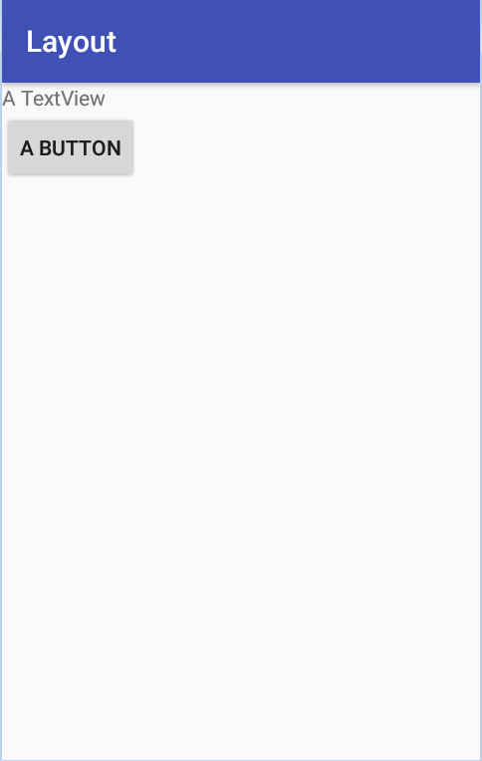
Declaring Layout with XML
Layout resource file should be stored in the folder "/res/layout" which specified the required UI elements and their properties
Note:
  It is recommended to create an individual XML layout resource for each screen in the application
E.g.,
<?xml version="1.0" encoding="utf-8"?>
<LinearLayout xmlns:android="http://schemas.android.com/apk/res/android"
android:layout_width="match_parent"
android:layout_height="match_parent"
android:orientation="vertical" >
<TextView android:id="@+id/atextview"
android:layout_width="wrap_content"
android:layout_height="wrap_content"
android:text="@string/textview_text" />
<Button android:id="@+id/abutton"
android:layout_width="wrap_content"
android:layout_height="wrap_content"
android:text="@string/button_text" />
</LinearLayout>
COMPS413F Lecture #02

Slide 7
Declaring Layout with XML
Root element (LinearLayout)
  "LinearLayout" declared used as the root element of the XML resource
    E.g., <LinearLayout … >
  The layout parameters "layout_width" and "layout_height" of the LinearLayout are both "match_parent", meaning that it should expand to fill the width and height of its parent view (the screen) as much as possible
  Elements of its child are organized in a column
    E.g., android:orientation="vertical"
Child elements (widgets)
  Two child elements (basic UI elements) in the above example are enclosed in the "LinearLayout" (i.e., the screen contains two control elements)
    a. "TextView"
      E.g., <TextView … >
    b. "Button"
      E.g., <Button … >
  The layout parameters "layout_width" and "layout_height" of both text view and button are "wrap_content", it means that the horizontal and vertical spaces are only occupied as the contents need
Note:
  Other types of ViewGroup (e.g., another layout) can also be placed inside the "LinearLayout" for creating a more complex user interface
    i.e., nested structure
COMPS413F Lecture #02

Slide 8
Loading of Layout Resource
During project compilation, the designed XML layout resource is compiled into a "View" resource, which should be loaded by the application code within the "onCreate()" callback method of the activity
E.g.,
  "setContentView" method is used and associated with appropriate input, which is a reference to the layout resource in form of "R.layout.<file_name_of_layout_resource>"
  E.g., R.layout.activity_main
    Assume that the XML layout file is saved as "activity_main.xml"
public void onCreate(Bundle savedInstanceState) {
super.onCreate(savedInstanceState);
setContentView(R.layout.activity_main);
}
COMPS413F Lecture #02

Slide 9
Designing Layout Programmatically
Instead of using the "setContentView" method to load the layout resource declared in an XML file, user interface can also be arranged and created by program code
COMPS413F Lecture #02

Slide 10
Designing Layout Programmatically – Example
public class LayoutInCodeActivity extends Activity {
@Override
public void onCreate(Bundle savedInstanceState) {
super.onCreate(savedInstanceState);
TextView view1 = new TextView(this);
view1.setText("A TextView");
LayoutParams params1 = new LayoutParams(LayoutParams.MATCH_PARENT, LayoutParams.WRAP_CONTENT);
view1.setLayoutParams(params1);
Button button1 = new Button(this);
button1.setText("A Button");
LayoutParams params2 = new LayoutParams(LayoutParams.MATCH_PARENT, LayoutParams.WRAP_CONTENT);
button1.setLayoutParams(params2);
LinearLayout layout = new LinearLayout(this);
LayoutParams params = new LayoutParams(LayoutParams.MATCH_PARENT, LayoutParams.MATCH_PARENT);
layout.setLayoutParams(params);
layout.setOrientation(LinearLayout.VERTICAL);
layout.addView(view1);
layout.addView(button1);
setContentView(layout);
}
}
COMPS413F Lecture #02

Slide 11
Designing Layout Programmatically – Example
Text/label manipulation of TextView/Button
  "setText" method can be used to set the text of text view and button
Layout parameters of text view and button can also be set with the "setLayoutParams" method
Layout manipulation
  Layout parameters are then created and set to the "LinearLayout" using the "setLayoutParams" method
  The orientation of the layout is set to vertical by calling the "setOrientation" method, effectively arranging the components in a column
Adding view to layout
  Text view and button can be added to the layout using the "addView" method
Note:
  Background color of text view can be changed by applying the "setBackgroundResource" method
COMPS413F Lecture #02

Slide 12
Layout Designed in XML Resources vs. in Code
There are a number of advantages of using XML layout resources
  With the layout information externalized to the resource file (.xml file), the program code (in Activity class) is much shorter
    Program readability is increased
  Externalizing layout information in resources separates the look, or view, of an application from its logic, or control
    Aligning with the model-view-controller (MVC) software architecture, this separation makes it easier to develop complex applications
  Like other types of XML resources in Android, layout resources provide convenient support for different device configurations
    E.g., screen sizes, language, and orientations
Conclusion:
  Use XML layout resources if you can
  Build layout in code dynamically if it required to be modified dynamically at run time
COMPS413F Lecture #02

Slide 13
Frequently Used Layout Parameters for Views
Besides the "LinearLayout" illustrated in the previous example, there are different layout mechanisms in Android
Before diving into these layout containers, the frequently used layout parameters are listed and discussed
  a. The "layout_width" and "layout_height" parameters
  b. The "layout_weight" parameter
  c. The "layout_gravity" parameter
  d. The "gravity" parameter
COMPS413F Lecture #02

Slide 14
a. The "layout_width" & "layout_height" Parameters
They are required attributes in most layout containers
Possible value for setting the width and height of the view
  "fill_parent"
    Making this view to be as big as its parent’s width or height, excluding any padding
    i.e., occupy all the available of the container
  "match_parent"
    Same as and replacing "fill_parent"
    Introduced in API level 8
  "wrap_content"
    Making this view to be just large enough for its own content
    i.e., occupy naturally
  A float number
    i.e., absolute value in
      px (pixels)
      dp (density-independent pixels)
      sp (scaled pixels based on preferred font size)
      in (inches)
      mm (millimeters)
  A reference to a "dimen" resource
COMPS413F Lecture #02

Slide 15
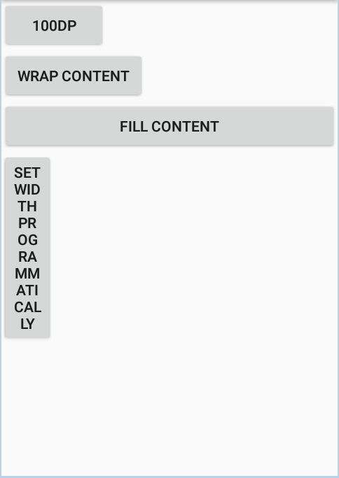
a. The "layout_width" & "layout_height" Parameters – Example 1
E.g., setting the width of the button with the three values
<LinearLayout xmlns:android="http://schemas.android.com/apk/res/android"
android:orientation="vertical"
android:layout_width="match_parent"
android:layout_height="match_parent">
<Button
android:id="@+id/button1"
android:text="100dp"
android:layout_width="100dp"
android:layout_height="wrap_content" />
<Button
android:id="@+id/button2"
android:text=" Wrap Content "
android:layout_width="wrap_content"
android:layout_height="wrap_content" />
<Button
android:id="@+id/button3"
android:text="Fill Content"
android:layout_width="match_parent"
android:layout_height="wrap_content" />
<Button
android:id="@+id/button4"
android:text="Set width programmatically"
android:layout_width="50dp"
android:layout_height="wrap_content" />
</LinearLayout>
COMPS413F Lecture #02

Slide 16
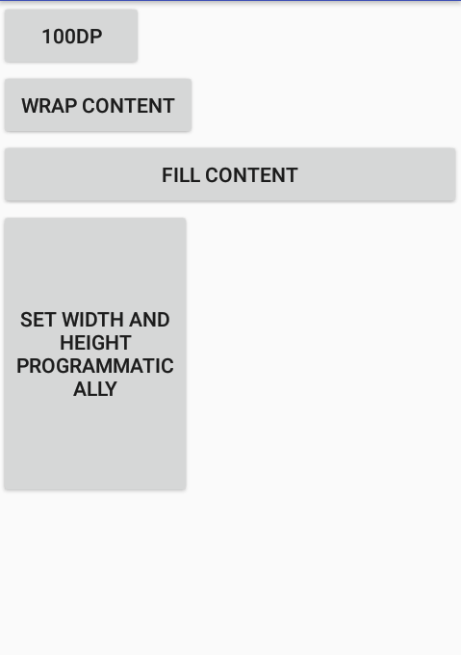
a. The "layout_width" & "layout_height" Parameters – Example 2
Setting width and height programmatically
E.g.
Button aButton=(Button) findViewById(R.id.button4);
aButton.setText("Set width and height programmatically");
// width = 200, height = 300
LayoutParams params = new LayoutParams(200, 300);
aButton.setLayoutParams(params);
COMPS413F Lecture #02

Slide 17
b. The "layout_weight" Parameter
Defines the importance of a view in occupying the free space available in its parent
  i.e., determines the ratio of area occupied by the view within the share space
Possible value
  0
    No stretching on this view for free space
  A float number
    For pro-rated allocations of free space among all views with non-zero weights
COMPS413F Lecture #02

Slide 18
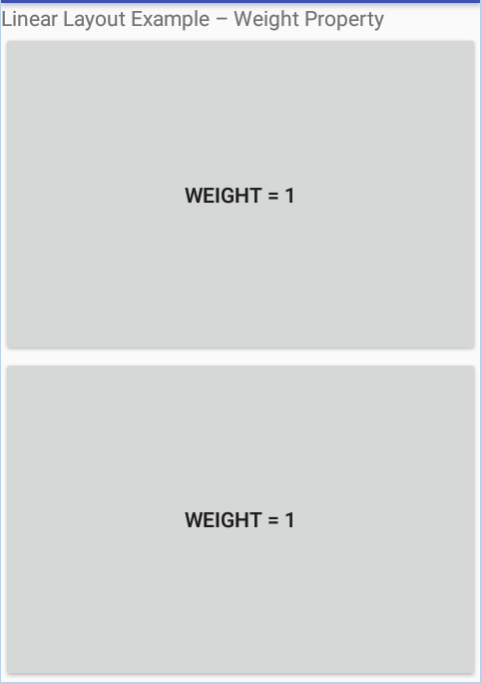
b. The "layout_weight" Parameter – Example 1
<?xml version="1.0" encoding="utf-8"?>
<LinearLayout xmlns:android="http://schemas.android.com/apk/res/android"
android:orientation="vertical"
android:layout_width="match_parent"
android:layout_height="match_parent"
android:id="@+id/linearlayout"
>
<TextView
android:text="Linear Layout Example – Weight Property"
android:layout_width="wrap_content"
android:layout_height="wrap_content"
android:id="@+id/textview"
/>
<Button
android:text="Weight = 1"
android:layout_width="match_parent"
android:layout_height="wrap_content"
android:layout_weight="1"
android:id="@+id/button1"
/>
<Button
android:text="Weight = 1"
android:layout_width="match_parent"
android:layout_height="wrap_content"
android:layout_weight="1"
android:id="@+id/button2"
/>
</LinearLayout>
COMPS413F Lecture #02

Slide 19
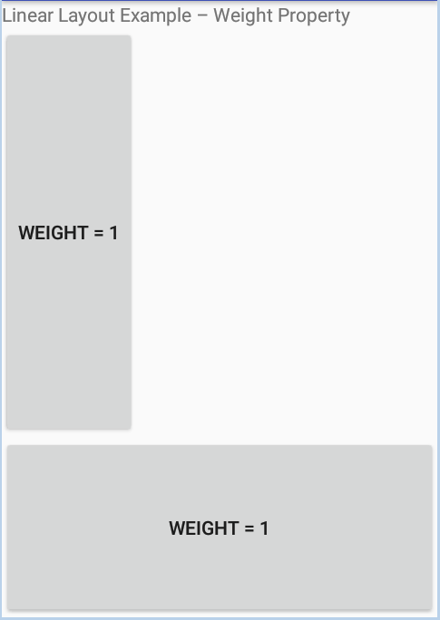
b. The "layout_weight" Parameter – Example 2
Setting "weight" property programmatically
E.g.,
Note:
  There is no method for setting the "weight" property directly
    The "setLayoutParams" method with appropriate "LayoutParams" input parameter should be used instead
Button aButton = (Button) findViewById(R.id.button1);
LayoutParams params = new LayoutParams(
LayoutParams.WRAP_CONTENT,
LayoutParams.WRAP_CONTENT,
3);
aButton.setLayoutParams(params);
COMPS413F Lecture #02

Slide 20
c. The "layout_gravity" Parameter
Defines the alignment of a view within its parent
Possible value:
  E.g.,
    top, bottom, left, right
      Pushing the view to the side of its parent
    center, center_vertical, center_horizontal
      Placing the view in the center of its parent
Note:
  Each UI element is by default located at the top left corner
  One or more of these values separated by ‘|’ (or)
COMPS413F Lecture #02

Slide 21
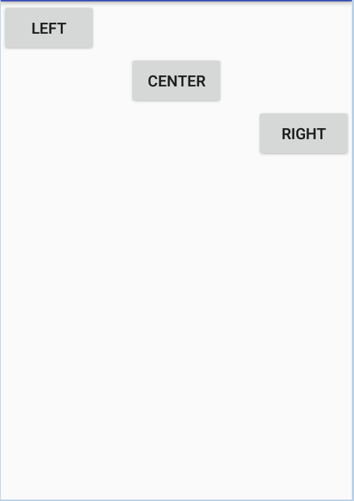
c. The "layout_gravity" Parameter – Example 1
<?xml version="1.0" encoding="utf-8"?>
<LinearLayout xmlns:android="http://schemas.android.com/apk/res/android"
android:orientation="vertical"
android:layout_width="match_parent"
android:layout_height="match_parent"
android:id="@+id/linearlayout"
>
<Button
android:id="@+id/button1"
android:layout_width="wrap_content"
android:layout_height="wrap_content"
android:text="Left"
android:layout_gravity="left"
/>
<Button
android:layout_width="wrap_content"
android:layout_height="wrap_content"
android:text="Center"
android:layout_gravity="center"
/>
<Button
android:layout_width="wrap_content"
android:layout_height="wrap_content"
android:text="Right"
android:layout_gravity="right"
/>
</LinearLayout>
COMPS413F Lecture #02

Slide 22
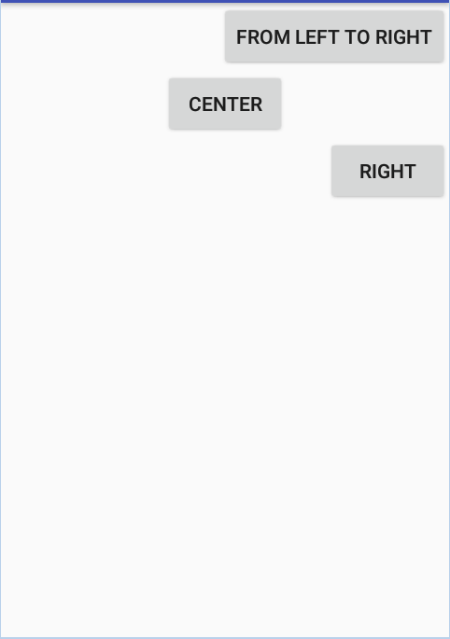
c. The "layout_gravity" Parameter – Example 2
Setting the "layout_gravity" property programmatically
Button aButton = (Button) findViewById(R.id.button1);
aButton.setText("From Left to Right");
LayoutParams params = (LayoutParams) aButton.getLayoutParams();
params.gravity = Gravity.RIGHT;
aButton.setLayoutParams(params);
COMPS413F Lecture #02

Slide 23
d. The "gravity" Parameter
Defines the alignment of the content within a view
  i.e., control the position of the content within the view
  E.g., changing the position of text of a button
Possible value
  Same as the values for "layout_gravity", but for aligning the content within a view
COMPS413F Lecture #02

Slide 24
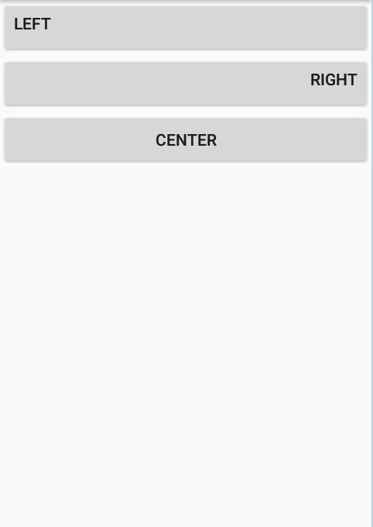
d. The "gravity" Parameter – Example 1
<?xml version="1.0" encoding="utf-8"?>
<LinearLayout xmlns:android="http://schemas.android.com/apk/res/android"
android:layout_width="match_parent"
android:layout_height="match_parent"
android:orientation="vertical" >
<Button
android:id="@+id/button1"
android:layout_width="match_parent"
android:layout_height="wrap_content"
android:gravity="left"
android:text="left" />
<Button
android:layout_width="match_parent"
android:layout_height="wrap_content"
android:gravity="right"
android:text="right" />
<Button
android:layout_width="match_parent"
android:layout_height="wrap_content"
android:gravity="center"
android:text="center" />
</LinearLayout>
COMPS413F Lecture #02

Slide 25
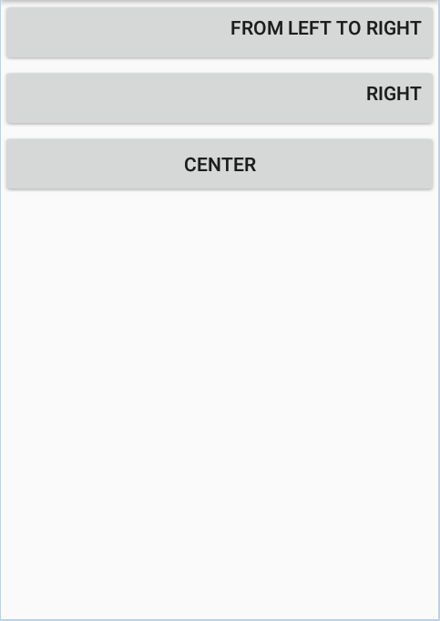
d. The "gravity" Parameter – Example 2
Setting the "gravity" property programmatically
Button aButton = (Button) findViewById(R.id.button1);
aButton.setText("From Left to Right");
aButton.setGravity(Gravity.RIGHT);
COMPS413F Lecture #02

Slide 26
Common Types of Layout Used in Application
The ViewGroup class provides several layout architecture for different application environment, here lists some common types for illustration
  a. LinearLayout
  b. TableLayout
  c. GridLayout
COMPS413F Lecture #02

Slide 27
a. LinearLayout
Elements inside LinearLayout are organized in row or column
  i.e., they are drawn along a single line vertically or horizontally
The direction is determined by the orientation of the layout, which is configured with
  1. "android:orientation" attribute in layout resource file (e.g., main.xml)
  2. "setOrientation()" method in program code
Note:
  The attributes discussed in above section (width, height, weight, and gravity) which used in the UI elements can also be applied to the LinearLayout
COMPS413F Lecture #02

Slide 28
1. Setting Orientation in Layout Resource File
a. Example 1: vertical orientation
b. Example 2: horizontal orientation
<LinearLayout xmlns:android="http://schemas.android.com/apk/res/android"
android:orientation="vertical"
android:layout_width="match_parent"
android:layout_height="match_parent">
…
</LinearLayout>
<LinearLayout xmlns:android="http://schemas.android.com/apk/res/android"
android:orientation="horizontal"
android:layout_width="match_parent"
android:layout_height="match_parent">
…
</LinearLayout>
COMPS413F Lecture #02

Slide 29
2. Setting Orientation Programmatically
a. Example 1: vertical orientation
b. Example 2: horizontal orientation
LinearLayout linearLayout=new LinearLayout(this);
// Vertical orientation
linearLayout.setOrientation(LinearLayout.VERTICAL);
LinearLayout linearLayout=new LinearLayout(this);
// Horizontal orientation
linearLayout.setOrientation(LinearLayout.HORIZONTAL);
COMPS413F Lecture #02

Slide 30
b. TableLayout
Containers are divided into number of rows and columns and represented in forms of table, UI elements are then distributed into the corresponding cell
  The concept is similar to the HTML table design
Note:
  Rows are defined in the layout resource file
    <TableRow> element are use to specify a row in the table
      Each row can contain one or more elements
  The number of columns depends on the row which contains the most number of columns
    E.g., if there are two rows in a table, one has five columns and the other only has three, then the table should has two rows and five columns
  Border lines will not be displayed for each rows and columns
  The "layout_width" and "layout_height" parameters are optional in child views of TableLayout
  In general, each cell holds one object, but "android:layout_span" can be used to specify an element that can occupy more than one column
    E.g., android:layout_span="2"
COMPS413F Lecture #02

Slide 31
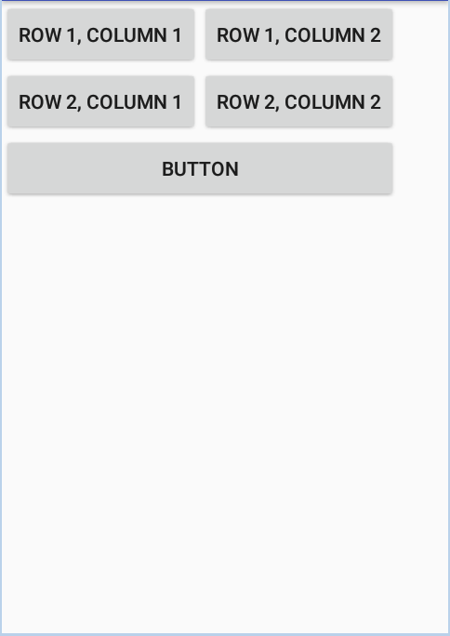
1. Spanning Multiple Column
i. Spanning multiple column in layout resource file
<?xml version="1.0" encoding="utf-8"?>
<TableLayout
xmlns:android="http://schemas.android.com/apk/res/android"
android:layout_height="match_parent"
android:layout_width="match_parent"
android:id="@+id/tablelayout">
<TableRow>
<Button
android:text="Row 1, Column 1" />
<Button
android:text="Row 1, Column 2" />
</TableRow>
<TableRow>
<Button
android:text="Row 2, Column 1" />
<Button
android:text="Row 2, Column 2" />
</TableRow>
<TableRow>
<Button
android:text="Button"
android:layout_span="2" />
</TableRow>
</TableLayout>
COMPS413F Lecture #02

Slide 32
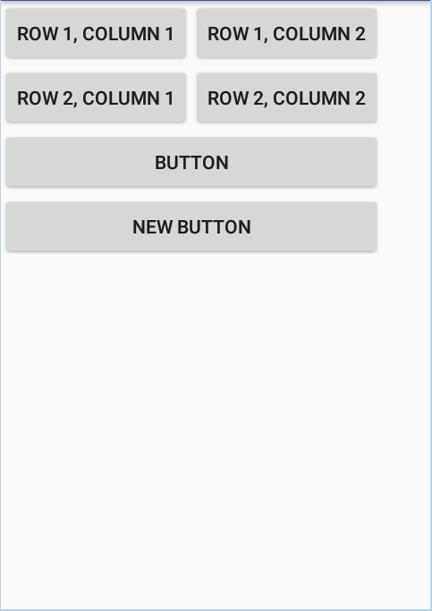
1. Spanning Multiple Column
ii. Spanning multiple column in program code
TableRow.LayoutParams layoutParams = new TableRow.LayoutParams();
layoutParams.span = 2;
Button newButton = new Button(this);
newButton.setText("New Button");
newButton.setLayoutParams(layoutParams);
// Create a new row to be added
TableRow tableRow = new TableRow(this);
// Add button to row
tableRow.addView(newButton);
// Get the TableLayout
TableLayout tl = (TableLayout) findViewById(R.id.tablelayout);
// Add row to the TableLayout
tl.addView(tableRow, new TableLayout.LayoutParams(
LayoutParams.match_parent,
LayoutParams.WRAP_CONTENT));
COMPS413F Lecture #02

Slide 33
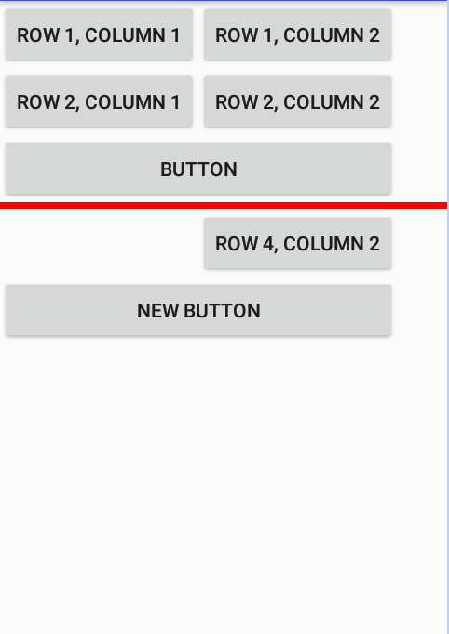
2. Employing Separator
A "View" can be put directly under the <TableRow> element to act as a separator between rows
E.g.,
...
<TableRow>
<Button
android:text="Button"
android:layout_span="2" />
</TableRow>
<View
android:background="#F00"
android:layout_width="match_parent"
android:layout_height="5dp" />
<TableRow>
<Button
android:text="Row 4, Column 2"
android:layout_column="1" />
</TableRow>
</TableLayout>
COMPS413F Lecture #02

Slide 34
c. GridLayout
Views are arranged in a rectangular grid with the "GridLayout"
The "columnCount" and "rowCount" attributes are used to specify the maximum numbers of columns and rows
This layout is added in Android 4.0 (API level 14) for improving the layout and rendering performance of Android applications
Advantage
  It is more flexible than "TableLayout" as it supports the spanning of a child view across multiple rows
Layout parameters for child views of "GridLayout"
  layout_column
    An zero-based index of the column in which this view would be placed
  layout_columnSpan
    The number of columns this view would span
  layout_row
    An zero-based index of the row in which this view would be placed
  layout_rowSpan
    The number of rows this view would span
COMPS413F Lecture #02

Slide 35
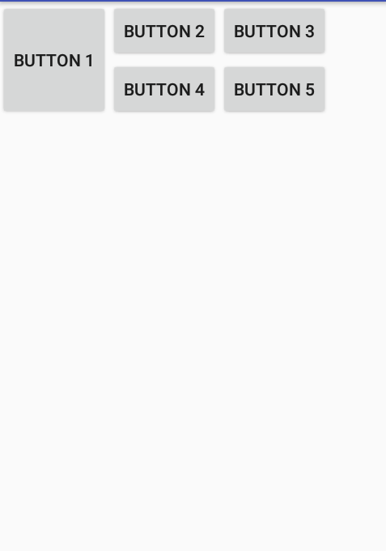
c. GridLayout – Example
<?xml version="1.0" encoding="utf-8"?>
<GridLayout
xmlns:android="http://schemas.android.com/apk/res/android"
android:layout_width="match_parent"
android:layout_height="wrap_content"
android:columnCount="3" >
<Button
android:layout_height="match_parent"
android:layout_gravity="fill_vertical"
android:layout_rowSpan="2"
android:text="Button 1" />
<Button
android:text="Button 2" />
<Button
android:text="Button 3" />
<Button
android:text="Button 4" />
<Button
android:text="Button 5" />
</GridLayout>
COMPS413F Lecture #02

Slide 36
c. GridLayout – Example
The "GridLayout" has at most three columns as specified in the "columnCount" attribute
It has five child views, which are similar except for the first one
  The "layout_rowSpan" attribute of the first red view designates it to span across two rows
Its "layout_height" attribute of "match_parent" and "layout_gravity" attribute of "fill_vertical" are needed for expanding the view to fill the two rows
The remaining four views are placed in the second and third columns of the two rows
COMPS413F Lecture #02

Slide 37
Create XML manually vs. Android Studio Layout Editor
Advantage of design layout visually (design mode)
  Generally quicker
    No need to type in XML
  No need to learn the familiar with property keyword and values of the Android SDK view classes
But no mutually exclusive
  Create user interfaces with design mode
  Performing fine-tuning and layout adjustment by editing the generated XML resources
COMPS413F Lecture #02

Slide 38
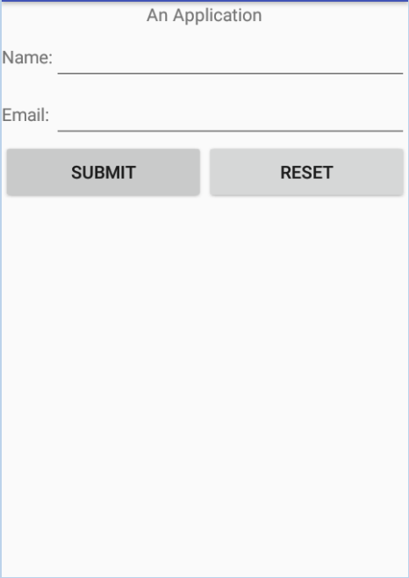
Nested Layout
LinearLayout
TextView
TableLayout
LinearLayout
TextView
EditText
Button
Layout can be nested
E.g., mixing of textview, TableLayout, and LinearLayout
<LinearLayout xmlns:android="http://schemas.android.com/apk/res/android"
android:orientation="vertical"
android:layout_width="match_parent"
android:layout_height="match_parent">
<TextView
android:layout_width="wrap_content"
android:layout_height="wrap_content"
android:layout_gravity="center"
android:text="An Application" />
<TableLayout
android:layout_height="wrap_content"
android:layout_width="match_parent"
android:stretchColumns="1">
<TableRow>
<TextView android:text="Name:" />
<EditText />
</TableRow>
<TableRow>
<TextView android:text="Email:" />
<EditText />
</TableRow>
</TableLayout>
…
…
<LinearLayout
android:layout_width="match_parent"
android:layout_height="wrap_content">
<Button
android:text="Submit"
android:layout_width="match_parent"
android:layout_height="wrap_content"
android:layout_weight="1" />
<Button
android:text="Reset"
android:layout_width="match_parent"
android:layout_height="wrap_content"
android:layout_weight="1" />
</LinearLayout>
</LinearLayout>
COMPS413F Lecture #02

Slide 39
Nested Layout
The main vertical LinearLayout contains thee child components
  A TextView
  A TableLayout
  A horizontal LinearLayout
  i.e., each element are occupied in three rows
The TableLayout contains two rows and filled with one TextView and one EditText
The following LinearLayouts contains two buttons that are located horizontally
COMPS413F Lecture #02

Slide 40
Alternate Layout
Apart from the default resource (in the "/res/layout/" directory), the Android system will automatically check and apply other alternative resource that are created under the "/res" directory with specific naming convention
The Android system will check against the current configuration of the device and apply the corresponding resource automatically
COMPS413F Lecture #02

Slide 41
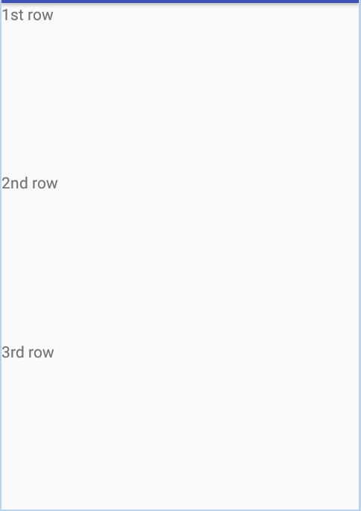
Alternate Layout
Specific UI layout defined in landscape orientation
  Resource file is in the "/res/layout-port/" directory
    E.g., "/res/layout-port/activity_main.xml"
<LinearLayout xmlns:android="http://schemas.android.com/apk/res/android"
android:orientation="vertical"
android:layout_width="match_parent"
android:layout_height="match_parent">
<TextView
android:layout_width="match_parent"
android:layout_height="wrap_content"
android:layout_weight="1"
android:text="1st row" />
<TextView
android:layout_width="match_parent"
android:layout_height="wrap_content"
android:layout_weight="1"
android:text="2nd row" />
<TextView
android:layout_width="match_parent"
android:layout_height="wrap_content"
android:layout_weight="1"
android:text="3rd row" />
</LinearLayout>
COMPS413F Lecture #02

Slide 42
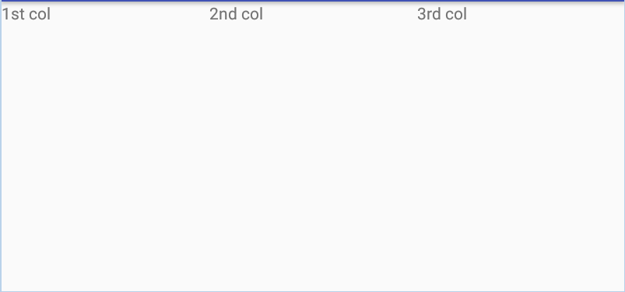
Alternate Layout
Specific UI layout defined in portrait orientation
  Resource file is in the "/res/layout-land/" directory
    E.g., "/res/layout-land/activity_main.xml"
<LinearLayout xmlns:android="http://schemas.android.com/apk/res/android"
android:orientation="horizontal"
android:layout_width="match_parent"
android:layout_height="match_parent">
<TextView
android:layout_width="match_parent"
android:layout_height="wrap_content"
android:layout_weight="1"
android:text="1st col" />
<TextView
android:layout_width="match_parent"
android:layout_height="wrap_content"
android:layout_weight="1"
android:text="2nd col" />
<TextView
android:layout_width="match_parent"
android:layout_height="wrap_content"
android:layout_weight="1"
android:text="3rd col" />
</LinearLayout>
COMPS413F Lecture #02

