Slide 1
COMPS413F
Lecture Notes
#03. Event Handling
COMPS413F Lecture #03
1

Slide 2
Agenda
Introduction
Delegation event model
Event handling
Commonly used event handling APIs of Android
Event handling method specified in XML file
Example – Handling button click event
Example – Handling touching input
COMPS413F Lecture #03

Slide 3
Introduction
An application with a good-looking GUI is worthless if it does not respond to the user’s inputs
  i.e., GUI applications should interact with the user by responding to user actions
    E.g., pressing a button
User actions are translated by the system into events
Event handling, which designates how to respond to user actions, plays a vital role in the development of GUI applications
COMPS413F Lecture #03

Slide 4
Delegation Event Model
Android, like Java SE, uses the delegation event model for event handling
This model consists of the following three concepts:
  1. Event
    An event is an object that describes a user action happening to a component
    E.g.,
      Pressing a key on a text view
      Clicking a button are events
  2. Event source
    An event source is the user interface object that generates an event
    E.g.,
      The text view on which a key is pressed
      The button which is clicked are event sources
COMPS413F Lecture #03

Slide 5
Delegation Event Model
3. Event listener
  An event listener is the object that is registered to process events
  The method, called event handler (or callback methods), of an event listener is invoked by the system to handle events
  E.g.,
    A class that implements the Android interface "View.OnKeyListener" is an event listener
    Its method "onKey" is an event handler
Common event listeners | Common event handlers
View.OnTouchListener | onTouch(View v, MotionEvent event)
View.OnClickListener | onClick(View v)
View.OnKeyListener | onKey(View v, int keyCode, KeyEvent event)
View.OnFocusChangeListener | onFocusChange(View v, boolean hasFocus)
View.OnCreateContextMenuListener | onCreateContextMenu(ContextMenu menu, View v, ContextMenu.ContextMenuInfo menuInfo)
COMPS413F Lecture #03

Slide 6
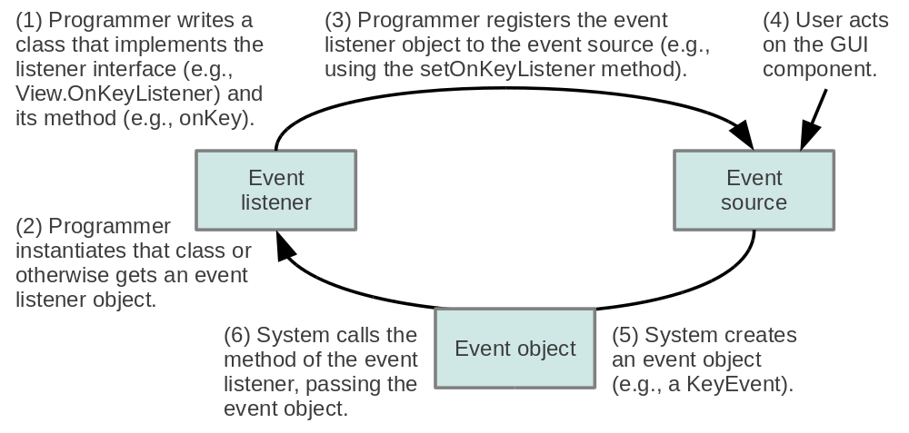
Delegation Event Model
The relationship among the three concepts can be summarized in one sentence
  "An event source sends an event object to an event listener for handling"
The delegation event model is summarized in the following figure
COMPS413F Lecture #03

Slide 7
Event handling
To make use of the delegation event model, the application programs would need to do the following work
  a. Register any desired event with respect to a UI widget
  b. Implements the required event listener interface
  c. Override the corresponding callback method
COMPS413F Lecture #03

Slide 8
a. Register any desired event with respect to a UI widget
Register the event listener object to the event source by invoking the appropriate setter method (e.g., setXXXListener) on the event source
E.g., invoke the "setOnClickListener" method associated with the correspond button object that required to handle the button click event
  Assume a button with ID "abutton" has been defined in the layout file
Button aButton = (Button)findViewById(R.id.abutton);
// Register the onClick listener with the listener implementation object
aButton.setOnClickListener(<an instance of listener implementation>);
COMPS413F Lecture #03

Slide 9
b. Implements the required event listener interface
Create or use a class to implement the appropriate listener interface
  1. Defined the listener as nested class
  2. Defined the listener as an anonymous class
  3. Implements the listener with the Activity/View class
COMPS413F Lecture #03

Slide 10
1. Defined the listener as nested class
A nested class, which implements the listener interface, is defined inside the Activity class
E.g.,
public class ButtonClickActivity extends Activity {
…
// Nested class implementation
private class AnOnClickListener implements OnClickListener {
…
}
…
Button aButton = (Button)findViewById(R.id.abutton);
// Register the onClick listener with the implementation above
aButton.setOnClickListener(new AnOnClickListener());
}
COMPS413F Lecture #03

Slide 11
2. Defined the listener as an anonymous class
All event handling code is written in once place
i. Create and instantiate a listener object within the Activity/View class
  E.g.,
// Create an anonymous implementation of OnClickListener
private OnClickListener onClickListener = new OnClickListener() {
…
};
…
Button aButton = (Button)findViewById(R.id.abutton);
// Register the onClick listener with the implementation above
aButton.setOnClickListener(onClickListener);
COMPS413F Lecture #03

Slide 12
2. Defined the listener as an anonymous class
ii. Create and instantiate a listener object within the parameter list of the "setOnClickListener" method
  E.g.,
Button aButton = (Button)findViewById(R.id.abutton);
// Register the onClick listener with anonymous class
aButton.setOnClickListener(
// Anonymous class implementation
new OnClickListener() {
…
}
);
COMPS413F Lecture #03

Slide 13
3. Implements the listener with the Activity/View class
The class itself is used as the event listener class by implementing the listener interface
E.g.,
Note:
  There is very little practical difference among the different ways of implementing event handling, and the choosing among them is mainly a matter of personal preference
public class ButtonClickActivity extends Activity
implements OnClickListener {
…
Button aButton = (Button)findViewById(R.id.abutton);
// Register the onClick listener
aButton.setOnClickListener(this);
…
}
COMPS413F Lecture #03

Slide 14
c. Override the corresponding callback method within the listener
Implement the callback method corresponding to the appropriate listener interface
The method is the event handler
  E.g., "onClick(View v)" callback method for button click handling
private class AnOnClickListener implements OnClickListener { // OR
// private OnClickListener onClickListener = new OnClickListener() { // OR
// aButton.setOnClickListener( new OnClickListener() { // OR
// public class ButtonClickActivity extends Activity implements OnClickListener {
public void onClick(View v) {
// Respond action if the button is clicked
}
}
COMPS413F Lecture #03

Slide 15
Commonly Used Event Handling APIs of Android
Listener interface | Event handler method | Event type (if present) | Registration methods
View.OnClickListener | void onClick(View v) | N/A | void setOnClickListener (View.OnClickListener l)
View.OnLongClickListener | boolean onLongClick(View v) | N/A | void setOnLongClickListener (View.OnLongClickListener l)
View.OnFocusChangeListener | void onFocusChange (View v, boolean hasFocus) | N/A | void setOnFocusChangeListener (View.OnFocusChangeListener l)
View.OnKeyListener | boolean onKey (View v, int keyCode, KeyEvent event) | KeyEvent | void setOnKeyListener (View.OnKeyListener l)
View.OnTouchListener | boolean onTouch (View v, MotionEvent event) | MotionEvent | void setOnTouchListener (View.OnTouchListener l)
COMPS413F Lecture #03

Slide 16
Event Handling Method Specified in XML File
Instead of employing listener interface and overriding the corresponding method, "android:onClick" attribute can be used in an XML layout to specify a dedicate method which will be invoked accordingly once the button is clicked
E.g., an XML specifies that the method "buttonClicked" will be called if the button is clicked
E.g., "buttonClicked" method with a "View" instance input
Note:
  The "buttonClicked" method should be public and accept only a View object as its input
<Button
...
android:onClick="buttonCicked"
/>
public void buttonCicked(View view) {
// respond action if the button is clicked
}
COMPS413F Lecture #03

Slide 17
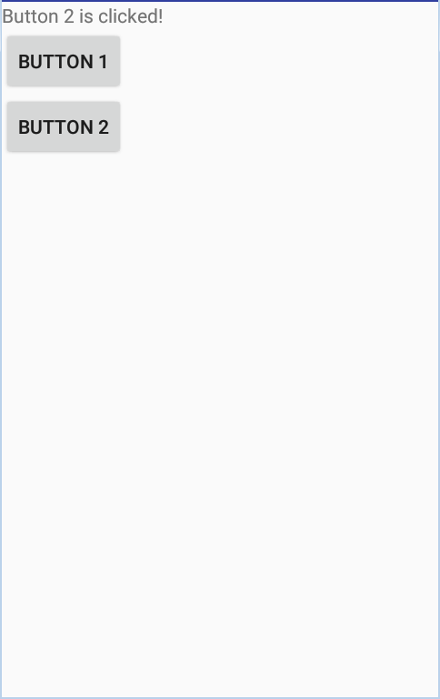
Event Handling Method Specified in XML File – Example
E.g., using the XML layout definition for button click event handling
  "handlerMethod" is the corresponding method defined in Activity class for handling the event invoked by the widget (which responsibility is similar to the "onClick" method)
<LinearLayout xmlns:android="http://schemas.android.com/apk/res/android"
…
<Button
android:id="@+id/button1"
…
android:onClick="handlerMethod"
/>
<Button
android:id="@+id/button2"
…
android:onClick="handlerMethod"
/>
</LinearLayout>
COMPS413F Lecture #03

Slide 18
Event Handling Method Specified in XML File – Example
public class HandleInXmlActivity extends Activity {
/** Called when the activity is first created. */
@Override
public void onCreate(Bundle savedInstanceState) {
super.onCreate(savedInstanceState);
setContentView(R.layout.handle_in_xml);
}
public void handlerMethod(View v) {
TextView textView = (TextView) findViewById(R.id.textview);
switch(v.getId()) {
case R.id.button1:
textView.setText("Button 1 is clicked!");
break;
case R.id.button2:
textView.setText("Button 2 is clicked!");
break;
}
}
}
COMPS413F Lecture #03

Slide 19
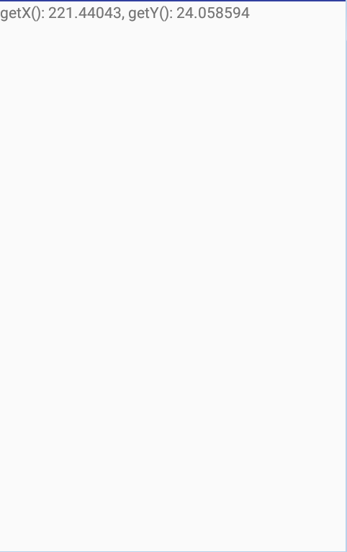
Example – Handling Touching Input
<LinearLayout xmlns:android="http://schemas.android.com/apk/res/android"
android:layout_height="match_parent"
android:layout_width="match_parent"
android:orientation="vertical"
>
<TextView
android:layout_width="match_parent"
android:layout_height="wrap_content"
android:id="@+id/textview"
/>
</LinearLayout>
COMPS413F Lecture #03

Slide 20
Example – Handling Touching Input
HandlingTouchingInputActivity.java
public class HandlingTouchingInputActivity extends Activity
implements OnTouchListener {
/** Called when the activity is first created. */
@Override
public void onCreate(Bundle savedInstanceState) {
super.onCreate(savedInstanceState);
setContentView(R.layout.handling_touching_input);
TextView textView = (TextView) findViewById(R.id.textview);
textView.setOnTouchListener(this);
}
public boolean onTouch(View v, MotionEvent event) {
TextView textView = (TextView) findViewById(R.id.textview);
textView.setText("getX(): " + event.getX() + ", getY(): " + event.getY());
return false;
}
}
COMPS413F Lecture #03

Slide 21
Example – Handling Touching Input
The activity named "HandlingTouchingInputActivity" is built to handle touching input, by implementing the "View.OnTouchListener" interface and its "onTouch" callback method
In the "onTouch" method, TextView is used to show the position of the touch by using the "getX" and "getY" methods of the "MotionEvent" class
Boolean value is returned from the "onTouch" method to indicate whether the listener has consumed this event
  It is because this event can have multiple actions that follow each other
  If false is returned
    It indicates that the event (the "ACTION_DOWN" event) is not consumed and the subsequent actions from this event is also not interested in
    Any further actions will not be called within this event
      E.g., finger gesture, or the eventual "ACTION_UP" action event
COMPS413F Lecture #03

