Slide 1
COMPS413F
Lecture Notes
#04. UI – Control
COMPS413F Lecture #04
1

Slide 2
Agenda
Procedures of referencing UI components declared in XML layout resources
Categories of Android widgets
  a. Text Controls
  b. Image views
  c. Button controls
  d. Selection controls
  e. Adapter views
Dialog
  a. Toasts
  b. AlertDialog
COMPS413F Lecture #04

Slide 3
Procedure of Referencing UI Components Declared in XML Layout Resources
Declare an ID attribute for the element of the desired component in the XML layout resource, e.g.,
  android:id="@+id/atextview"
Declare an instance of the appropriate component type in program code, e.g.,
  TextView aTextView;
Invoke the "findViewById" method with the resource ID of the component, e.g.,
  findViewById(R.id.atextview);
Use the object to access the component, e.g.,
  aTextVew.setText("Label changed!");
COMPS413F Lecture #04

Slide 4
Categories of Android Widgets
a. Text Controls
b. Image views
c. Button controls
d. Selection controls
e. Adapter views
COMPS413F Lecture #04

Slide 5
a. Text Controls
Text component in Android:
  1. TextView
  2. EditText
  Other examples:
    AutoCompleteTextView, MultiCompleteTextView
1. TextView
  The superclass of other text widgets
  TextView is mainly used for displaying text message to user
  Its functionality is similar to label (JLabel class) in Java
  Note:
    "TextView" without an "id" attribute is used for labeling purpose
COMPS413F Lecture #04

Slide 6

1. TextView
E.g., text_view.xml
<?xml version="1.0" encoding="utf-8"?>
<LinearLayout xmlns:android="http://schemas.android.com/apk/res/android"
android:orientation="vertical"
android:layout_width="fill_parent"
android:layout_height="fill_parent" >
<TextView
android:layout_width="fill_parent"
android:layout_height="wrap_content"
android:text="Visit: http://www.hkmu.edu.hk"
android:id="@+id/txtURL"
android:autoLink="web" />
<TextView
android:layout_width="fill_parent"
android:layout_height="wrap_content"
android:text="Email: xxx@yyy.com"
android:autoLink="email" />
</LinearLayout>
COMPS413F Lecture #04

Slide 7
1. TextView – Other Features
According to the above example, it illustrates that "TextView" can highlight the text if it is a URL, an e-mail, or a phone number
  i. Using the "android:autoLink" attribute
    Possible value of "android:autoLink" attribute
      web, email, phone, map, …
  ii. Using program code
    E.g.,
    The "Linkify.addLinks" method is called to activate the link in "textView"
  When the user clicks on the TextView, the default application will launch automatically
    E.g., the browser, the dialer, …
TextView txtURL = findViewById(R.id.txtURL);
Linkify.addLinks(txtURL, Linkify.ALL);
COMPS413F Lecture #04

Slide 8
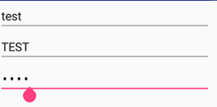
2. EditText
Subclass of TextView
Similar to JTextField in Java
  i.e,. an editable text view for entering and editing text by user
E.g., text_view.xml
<?xml version="1.0" encoding="utf-8"?>
<LinearLayout xmlns:android="http://schemas.android.com/apk/res/android"
android:orientation="vertical"
android:layout_width="fill_parent"
android:layout_height="fill_parent"
>
<EditText
android:layout_width="fill_parent"
android:layout_height="wrap_content"
/>
</LinearLayout>
COMPS413F Lecture #04

Slide 9
2. EditText – Other Features
i. Text correction
  android:inputType="textAutoCorrect"
  Use for correcting some common spelling mistakes
    E.g., "teh" can be corrected to "the" automatically
ii. Letter capitalization
  android:inputType="textCapCharacters"
  android:inputType="textCapWords"
  Use for capitalizing all alphabetic letters or first letter or every word
iii. Password text
  android:inputType="textPassword"
  Use for masking user input
COMPS413F Lecture #04

Slide 10
b. Image Views
An ImageButton can be used for displaying an image
If clicking function of a button is not required, a more appropriate widget for showing images is "ImageView"
Using an "ImageView" is as simple as specifying a drawable image resource in its "src" attribute
COMPS413F Lecture #04

Slide 11
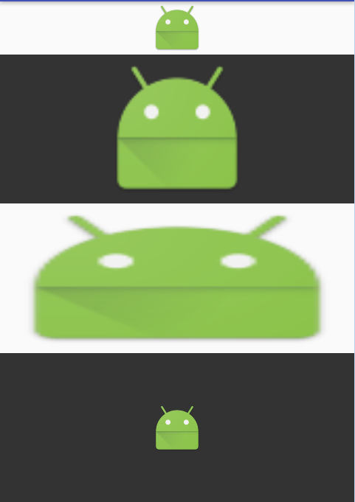
b. Image Views
…
<ImageView
android:layout_width="match_parent"
android:layout_height="wrap_content"
android:layout_weight="0"
android:src="@android:drawable/sym_def_app_icon" />
<ImageView
android:layout_width="match_parent"
android:layout_height="wrap_content"
android:background="#333"
android:layout_weight="1"
android:src="@android:drawable/sym_def_app_icon" />
<ImageView
android:layout_width="match_parent"
android:layout_height="wrap_content"
android:layout_weight="1"
android:scaleType="fitXY"
android:src="@android:drawable/sym_def_app_icon" />
<ImageView
android:layout_width="match_parent"
android:layout_height="wrap_content"
android:background="#333"
android:layout_weight="1"
android:scaleType="center"
android:src="@android:drawable/sym_def_app_icon" />
</LinearLayout>
E.g.,
COMPS413F Lecture #04

Slide 12
b. Image Views
This layout contains four "ImageViews"
  All showing the Android icon from the platform resource of "android:drawable/sym_def_app_icon"
The images look different due to the different sizes and "scaleType" of the ImageViews
  The first "ImageView" is the same height as the image, but the other three are larger to fill the remaining space of the screen
  The first and second "ImageViews" has no "scaleType" attribute and by default their images are scaled proportionally without changing the aspect ratio
  The third "ImageView" has a "scaleType" attribute of "fitXY", scaling it in both dimensions independently to fill the whole ImageView
  The four "ImageView" has a "scaleType" attribute of "center", and its image is not scaled
COMPS413F Lecture #04

Slide 13
c. Button Controls
Different kinds of buttons are defined by Android for providing different functionality
  1. Basic button
  2. ImageButton
  ...
1. Basic button
  A simple push-button widget, typically for performing some action when the user clicks on it
  E.g.,
…
<Button
android:id="@+id/button1"
android:layout_height="wrap_content"
android:layout_width="wrap_content"
android:text="Basic Button"
/>
…
COMPS413F Lecture #04

Slide 14
2. ImageButton
Similar to a simple button, but an image is attached as background and displayed instead of text information
i. E.g., control_button.xml
ii. Specifies the image resource programmatically
  E.g.,
…
<ImageButton
android:id="@+id/button2"
android:layout_height="wrap_content"
android:layout_width="wrap_content"
android:src="@drawable/image1"
/>
…
ImageButton button2 = findViewById(R.id.button2);
button2.setImageResource(R.drawable.anotherimage);
COMPS413F Lecture #04

Slide 15
d. Selection controls
Different kinds of selection controls are defined by Android for providing widget for user marking
  1. CheckBox
  2. RadioButton & RadioGroup
COMPS413F Lecture #04

Slide 16

1. CheckBox
CheckBox can be used for multi-selection purpose
CheckBox has two states
  Checked
  Unchecked
E.g.,
Checking of CheckBox status
  "isChecked" method is used to decide the state of the CheckBox programmatically
  E.g.,
…
<CheckBox
android:layout_width="fill_parent"
android:layout_height="wrap_content"
android:id="@+id/checkbox"
android:text="A CheckBox"
android:checked="true" />
…
CheckBox checkBox = findViewById(R.id.checkbox);
if (checkBox.isChecked()) {
…
}
COMPS413F Lecture #04

Slide 17
1. CheckBox
Event handling is achieved by implementing the "onCheckedChanged" method in the "OnCheckedChangeListener" interface
  E.g.,
  "arg1" is used to check the state of the CheckBox if it is checked or unchecked
CheckBox checkBox = findViewById(R.id.checkbox);
checkBox.setOnCheckedChangeListener(
new OnCheckedChangeListener() {
public void onCheckedChanged(CompoundButton arg0, boolean arg1) {
TextView textView = findViewById(R.id.textview);
if (arg1)
textView.setText("Checked!!!");
else
textView.setText("Unchecked!!!");
}
}
);
COMPS413F Lecture #04

Slide 18
2. RadioButton & RadioGroup
The RadioButton has two states
  Checked
  Unchecked
Different from CheckBox, once a RadioButton is checked, it cannot back to unchecked states
"RadioGroup" is used to group several RadioButton together if only ONE of them can be checked (i.e., checking one of the RadioButton will uncheck all the others)
  RadioButton is therefore normally used in a RadioGroup for enforcing mutual exclusion for several radio buttons
COMPS413F Lecture #04

Slide 19
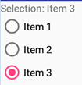
2. RadioButton & RadioGroup
…
<RadioGroup
android:id="@+id/radiogroup"
android:layout_width="fill_parent"
android:layout_height="fill_parent"
>
<RadioButton android:id="@+id/item1"
android:layout_width="wrap_content"
android:layout_height="wrap_content"
android:text="Item 1"
/>
<RadioButton android:id="@+id/item2"
android:layout_width="wrap_content"
android:layout_height="wrap_content"
android:text="Item 2"
/>
<RadioButton android:id="@+id/item3"
android:layout_width="wrap_content"
android:layout_height="wrap_content"
android:text="Item 3"
android:checked="true"
/>
</RadioGroup>
</LinearLayout>
E.g.,
COMPS413F Lecture #04

Slide 20
2. RadioButton & RadioGroup
Event handling is achieved by implementing the "onCheckedChanged" method in the "OnCheckedChangeListener" interface under the RadioGroup class
  "arg1" represents the resource ID of the RadioButton which is just checked by user
RadioGroup radioGroup = findViewById(R.id.radiogroup);
radioGroup.setOnCheckedChangeListener(
new android.widget.RadioGroup.OnCheckedChangeListener() {
public void onCheckedChanged(RadioGroup arg0, int arg1) {
TextView textView = findViewById(R.id.textview);
RadioButton radioButton = findViewById(arg1);
textView.setText("Selection: " + radioButton.getText());
}
}
);
COMPS413F Lecture #04

Slide 21
e. Adapter Views
An adapter view contains multiple children which are typically specified by a data list of items
It is represented by the abstract class "AdapterView"
The following list the three major concrete subclasses of "AdapterView"
  1. ListView
    A vertically scrolling list of items
  Other examples:
    Spinner
      A drop-down list of items
    GridView
      A two-dimensional scrolling grid of items
A key concept in using adapter views is an adapter, which is represented by the Adapter interface
An adapter accommodates a data list of items to views that becomes children of an adapter view
  E.g., use of an "ArrayAdapter" to adapt strings to "TextViews" for display
COMPS413F Lecture #04

Slide 22
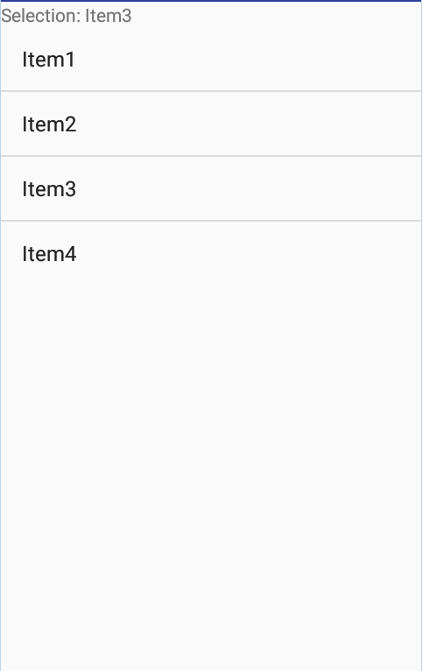
1. ListView
ListView represents a vertical list of scrollable items that can be selected
  i.e., a view that shows items in a vertically scrolling list
E.g., list_view.xml
…
<ListView
android:layout_width="wrap_content"
android:layout_height="wrap_content"
android:id="@+id/listview"
/>
</LinearLayout>
COMPS413F Lecture #04

Slide 23
1. ListView
Assigning list items to ListView
  E.g., ListViewActivity.java
String [] items = new String[]{"Item1", "Item2", "Item3", "Item4"};
// Adapter of data list to view
ArrayAdapter adapter = new ArrayAdapter(this,
android.R.layout.simple_list_item_1,
items);
final ListView listview = findViewById(R.id.listview);
listview.setAdapter(adapter);
COMPS413F Lecture #04

Slide 24
1. ListView
Event handling of ListView, e.g.,
  parent
    The "AdapterView" where the selection happened
    i.e., the "listview" in the above example
  view
    The view representing the selected item within the "AdapterView" that was clicked
    E.g., a TextView
  position
    The position (i.e., the index) of the selected view in the adapter
  id
    The row id of the item that is selected
listview.setOnItemClickListener(
new OnItemClickListener() {
public void onItemClick(AdapterView<?> parent, View view, int position, long id) {
TextView textview = findViewById(R.id.textview);
textview.setText("Selection: " + listview.getItemAtPosition(position).toString());
}
}
);
COMPS413F Lecture #04

Slide 25
1. ListView – Setting the layout of Listview
There are two approach for setting the layout of each item in ListView
  a. Using item designed by Android platform
  b. Defining our own layout file for the ListAdapter
a. Different layout (in form of "android.R.layout.XXX") can be specified when creating the adapter, e.g.,
  i. Simple list display
  ii. List associated with radio button (for single selection)
  iii. List associated with checkbox (for multiple selection)
ArrayAdapter adapter = new ArrayAdapter(this,android.R.layout.simple_list_item_1,items);
ArrayAdapter adapter = new ArrayAdapter(this,android.R.simple_list_item_single_choice,items);
ArrayAdapter adapter = new ArrayAdapter(this,android.R.simple_list_item_multiple_choice,items);
COMPS413F Lecture #04

Slide 26
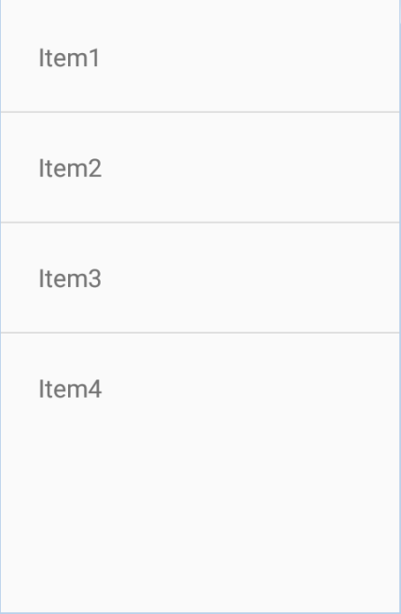
1. ListView – Setting the layout of Listview
b. Instead of using item designs provided by Android, layout of each row of the ListView can be customized
  i.e., defined a layout resource file for representing the layout of each list item
    E.g., customized_layout_of_list_view.xml
      The XML file is saved under the "/res/layout" directory
  Applying the user-defined list layout
    E.g., ListViewOtherConsiderationActivity.java
<?xml version="1.0" encoding="utf-8"?>
<TextView xmlns:android="http://schemas.android.com/apk/res/android"
android:layout_width="fill_parent"
android:layout_height="fill_parent"
android:padding="30dp"
android:textSize="20sp" >
</TextView>
ArrayAdapter adapter=new ArrayAdapter(this, R.layout.customized_layout_of_list_view, items);
COMPS413F Lecture #04

Slide 27
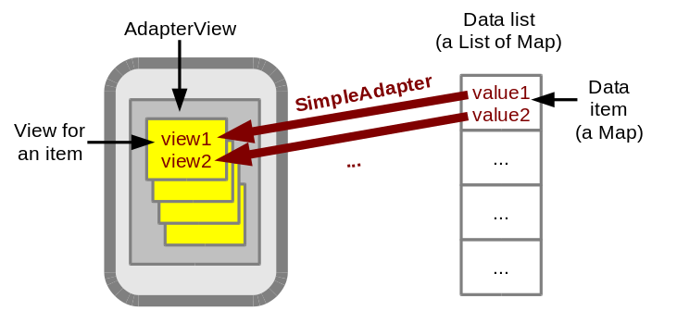
2. SimpleAdapter Class
More complex display can be achieved using a SimpleAdapter
The mechanism of a SimpleAdapter is depicted in the following figure
  An AdapterView contains multiple child views that are associated with the items in a data list (the ‘item views’)
  The item views can be either simple views or view groups
  Each data item is a Map and the data list is a List of Maps
  A "SimpleAdapter" adapts a data item to an item view, and more specifically adapts the entries of a data item Map to the widgets in an item view
COMPS413F Lecture #04

Slide 28
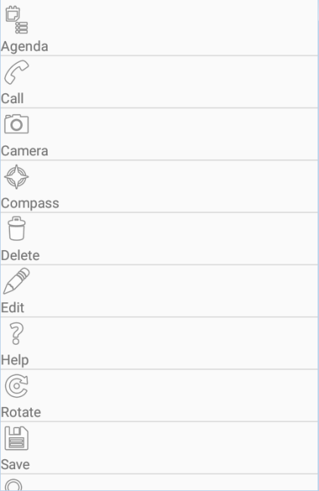
2. SimpleAdapter Class
E.g., each data item is displayed as a combination
of text and an image
  Connect a map entry value of string to a TextView of the item view
  Connect another map entry value of an image resource ID to an ImageView of the item view
The item view with two widgets is defined in a layout resource as shown below (e.g., adapter_item.xml)
  An "ImageView" with ID "adapter_image"
  A "TextView" with ID "adapter_text"
  These IDs and the layout
  resource will be used by a
  "SimpleAdapter" in program
…
<ImageView
android:id="@+id/adapter_image"
android:layout_width="wrap_content"
android:layout_height="wrap_content" />
<TextView
android:id="@+id/adapter_text"
android:layout_width="wrap_content"
android:layout_height="wrap_content" />
…
COMPS413F Lecture #04

Slide 29
2. SimpleAdapter Class
The main layout of the activity is same as the one used in ListView
The activity program which uses the above layout
private List<Map<String, Object>> dataItems = AdapterData.getDataList();
…
public void onCreate(Bundle savedInstanceState) {
…
final ListView listview = findViewById(R.id.listview);
// Adapter of data list to view
SimpleAdapter adapter = new SimpleAdapter(
this,
dataItems, // List of Maps
R.layout.adapter_item, // Layout resource of an item
new String[] { AdapterData.TEXT, AdapterData.IMAGE },
new int[] { R.id.adapter_text, R.id.adapter_image }
);
…
COMPS413F Lecture #04

Slide 30
2. SimpleAdapter Class
/** A utility class for creating a list of adapter data items for testing */
public class AdapterData {
public static String TEXT = "text";
public static String IMAGE = "image";
/** Creates and returns a list of data items (List of Maps) */
public static List<Map<String, Object>> getDataList() {
List<Map<String, Object>> list = new ArrayList<Map<String, Object>>();
list.add(createData("Agenda", android.R.drawable.ic_menu_agenda));
list.add(createData("Call", android.R.drawable.ic_menu_call));
list.add(createData("Camera", android.R.drawable.ic_menu_camera));
list.add(createData("Compass", android.R.drawable.ic_menu_compass));
list.add(createData("Delete", android.R.drawable.ic_menu_delete));
list.add(createData("Edit", android.R.drawable.ic_menu_edit));
list.add(createData("Help", android.R.drawable.ic_menu_help));
list.add(createData("Rotate", android.R.drawable.ic_menu_rotate));
list.add(createData("Save", android.R.drawable.ic_menu_save));
list.add(createData("Search", android.R.drawable.ic_menu_search));
return list;
}
/** Creates and returns a data item (object of Map) */
private static Map<String, Object> createData(String text, Integer imageResID) {
Map<String, Object> map = new HashMap<String, Object>();
map.put(TEXT, text);
map.put(IMAGE, imageResID);
return map;
}
}
COMPS413F Lecture #04

Slide 31
2. SimpleAdapter Class
In the activity program, the "dataItems" instance variable is a List of Maps of the data to be shown in the ListView
  It is initialized by calling the static method "AdapterData.getDataList()"
"AdapterData" is a small utility class and its "getDataList" method returns some fixed data in a List of Maps for testing
  The "TEXT" and "IMAGE" constants of AdapterData are used as keys of the data Maps
COMPS413F Lecture #04

Slide 32
2. SimpleAdapter Class
There are five parameters in the constructor of the SimpleAdapter
  this
    The context for the adapter
  dataItems
    The data items in a List of Maps
  R.layout.adapter_item
    The layout resource ID of the item view
  new String[] { AdapterData.TEXT, AdapterData.IMAGE }
    A String array of the data Map keys whose corresponding values would be shown
  new int[] { R.id.adapter_text, R.id.adapter_image }
    An integer array of the widget IDs in the item view for displaying the data item values
The fourth and fifth parameters together specify that the map entry of AdapterData
  TEXT is displayed in the TextView with ID R.id.adapter_text
  The map entry of AdapterData.IMAGE is displayed in the ImageView with ID R.id.adapter_image
COMPS413F Lecture #04

Slide 33
Dialog
a. Toasts
  Simple text message
b. AlertDialog
Other example
  DatePickerDialog
  TimePickerDialog
COMPS413F Lecture #04

Slide 34
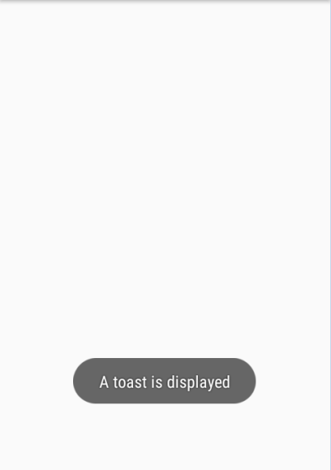
a. Toasts
Toasts
  Transient notification that pop up in front of the current Activity
  Only last for a short period and will disappear after certain time interval
  Best for short text messages
    E.g., "Task completed!", "File saved!", …
  Toast CANNOT receive any user interaction events
E.g., SimpleTextMessageActivity.java
Toast aToast = Toast.makeText(this,
"A toast is displayed",
Toast.LENGTH_SHORT);
aToast.show();
COMPS413F Lecture #04

Slide 35
a. Toasts
Method "makeText(Context context, CharSequence text, int duration)" is used to create and initialize a Toast object
  Input parameters
    context
      The resource that display the toast
      E.g., the current Activity
    text
      Display text message
    duration
      Time period to display the message
      Either "LENGTH_SHORT" or "LENGTH_LONG"
Method "show" is used to display the toast view
COMPS413F Lecture #04

Slide 36
b. AlertDialog
Dialog boxes (or simply dialogs) is a type of window that provide an effective means for communication between user and computing device
  Delivering message (alerting user)
    E.g., progress, warning, or system error notification
  Prompting for response (obtaining input from user)
    E.g., asking for confirmation or login
Similar to JOptionPane in J2SE
A common way of creating an "AlertDialog" is to use a builder, of the "AlertDialog.Builder" class
  This builder class provides various setter methods to set up the dialog, e.g.,
    i. Use the "setTitle" method to define the title of the dialog
    ii. Use the "setMessage" method to add a text message to the dialog
COMPS413F Lecture #04

Slide 37
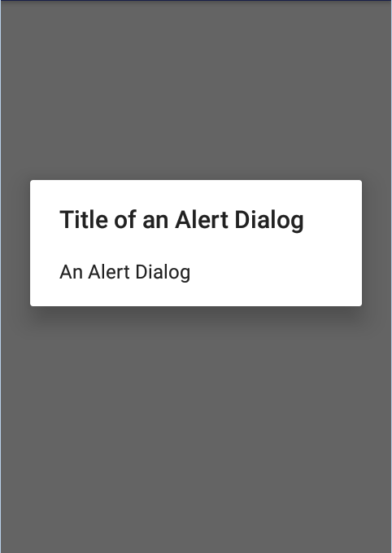
b. AlertDialog
E.g.,
  The "setTitle" and "setMessage" methods set up the title and display message of the dialog respectively
  The "show" method starts and displays the dialog
Note:
  Method-chaining can be used to set the title and message of the dialog, e.g.,
AlertDialog.Builder builder = new AlertDialog.Builder(this);
builder.setTitle("Title of an Alert Dialog"); // i.
builder.setMessage("An Alert Dialog"); // ii.
AlertDialog alertDialog = builder.create();
alertDialog.show();
builder.setTitle("Title of an Alert Dialog")
.setMessage("An Alert Dialog");
COMPS413F Lecture #04

