Slide 1
COMPS413F
Lecture Notes
#05. Menu
COMPS413F Lecture #05
1

Slide 2
Agenda
Introduction
  1. Options menu
  2. Context menu
  3. Submenu
Option menu
  a. Creating an option menu
  b. Manipulating of Grouped Menu Item
  c. Event Handling of Option Menu
Context menu
  a. Register a context menu with a widget
  b. Create the context menu
  c. Event handling of context menu
Submenu
  a. Creation of Submenu Programmatically
  b. Creation of Submenu with XML Resource File
Action bar
COMPS413F Lecture #05

Slide 3
Introduction
Menus provide an useful way to user for selecting one of several functionalities
The menus in mobile systems are quite different from those in personal computer applications
There are three types of menus in Android
  1. Options menu
    Displays information related to the current activity
    Activated by pressing the "Menu" button on the device
  2. Context menu
    Display information related to an UI element (i.e., a view)
    Activated by pressing and holding (also called long-pressing) on an item or view of an activity
  3. Submenu
    Menu items can be grouped and each menu item can have submenu items
Similar to layouts, menus can be set up either as XML resources or in program code
  Menu resources are defined as XML files in the "res/menu" directory of the project, and loaded into an activity using a utility called "MenuInflater"
  There are APIs for setting up menus, including the classes "Menu", "SubMenu", and "MenuItem" in the "android.view" package
COMPS413F Lecture #05

Slide 4
Option Menus
Similar to a global menu (i.e., a single menu for each activity), which can be activated by pressing the "Menu" button for every activity
Contains the primary menu items for an activity
  i.e., basic actions are included in the option menu
    E.g., "Application setting" of an activity can be opened within an option menu
Procedure for option menu implementation
  a. Creating an option menu
    1. Program implementation
    2. XML resource
      i. Defined the menu and menu item in an XML resource file
      ii. Inflating the menu resource (i.e., converting the menu resource into a programmable object)
  b. Manipulating of Grouped Menu Item
  c. Event Handling of Option Menu
    Overriding the "onOptionsItemSelected" method of the Activity class
COMPS413F Lecture #05

Slide 5
a. Creating an Option Menu
Overrides the "onCreateOptionsMenu" callback method (which is called only once) of an activity in order to create an option menu for the first time
The creation of menu can be achieved either by
  1. Program implementation
  2. XML resource
Note:
  The "onPrepareOptionsMenu" method can be overridden afterwards if the menu needed to be modified at runtime
    E.g., adding and removing of menu items
    This method is called every time before the options menu is displayed
  If Android 3.0 or higher version is employed, the "invalidateOptionsMenu" must be called if the menu needed to be updated by requesting the system to call the "onPrepareOptionsMenu" method
COMPS413F Lecture #05

Slide 6

1. Program Implementation
The "add" method can be used to add a menu item to the option menu
E.g.,
Return value of the "onCreateOptionsMenu" method
  Return true
    Menu is visible
  Returns false
    Menu is invisible
public class MenuExample extends Activity {
…
@Override
public boolean onCreateOptionsMenu(Menu menu) {
menu.add("Menu Item 1");
menu.add("Menu Item 2");
return true;
}
}
COMPS413F Lecture #05

Slide 7
2. XML Resource
Two steps to create an option menu with menu resource
  i. Defined the menu and menu item in an XML resource file
  ii. Inflating the menu resource
    i.e., converting the menu resource into a programmable object
COMPS413F Lecture #05

Slide 8
i. Creating an XML file and defining menu components
E.g., "/res/menu/menu_in_xml.xml"
  "menu" element is used to define an option menu
  "item" element is used to define each menu item
<?xml version="1.0" encoding="utf-8"?>
<menu xmlns:android="http://schemas.android.com/apk/res/android">
<item
android:id="@+id/item1"
android:title="Menu Item 1"
/>
<item
android:id="@+id/item2"
android:title="Menu Item 2"
/>
</menu>
COMPS413F Lecture #05

Slide 9
ii. Inflating menu resource in "onCreateOptionsMenu" method
E.g.,
  The above example inflates a menu resource (menu_in_xml.xml) into a "Menu" object
public class MainActivity extends Activity {
…
/** Called once when the options menu is invoked the first time. */
@Override
public boolean onCreateOptionsMenu(Menu menu) {
MenuInflater inflater = getMenuInflater();
inflater.inflate(R.menu.menu_in_xml, menu);
return true;
}
}
COMPS413F Lecture #05

Slide 10
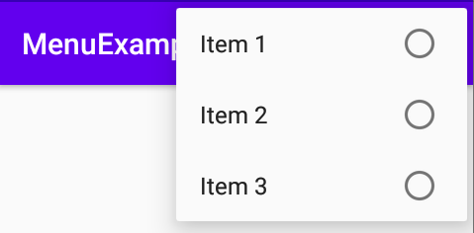
b. Manipulating of Grouped Menu Item
Grouping of menu items that are mutually exclusive, like the grouping of radio buttons
E.g., grouped_menu.xml
<?xml version="1.0" encoding="utf-8"?>
<menu xmlns:android="http://schemas.android.com/apk/res/android" >
<group android:checkableBehavior="single">
<item
android:id="@+id/item1"
android:title="Item 1" />
<item
android:id="@+id/item2"
android:title="Item 2" />
<item
android:id="@+id/item3"
android:title="Item 3" />
</group>
</menu>
COMPS413F Lecture #05

Slide 11
b. Manipulating of Grouped Menu Item
Methods/Attributes that can be applied to group of menu items instead of carrying out on each item one by one
  removeGroup
    Remove all menu items of a particular group
    No corresponding attribute
  setGroupCheckable/android:checkableBehavior
    Display a check mark to a group of menu items
  setGroupEnabled/android:enabled
    Enable or disable a group of menu items
  setGroupVisible/android:visible
    Specifies if the group of menu items is visible or invisible
COMPS413F Lecture #05

Slide 12
c. Event Handling of Option Menu
Overriding the "onOptionsItemSelected" method of the Activity class
  E.g.,
<?xml version="1.0" encoding="utf-8"?>
<menu xmlns:android="http://schemas.android.com/apk/res/android">
<item
android:id="@+id/item1"
android:title="Menu Item 1"
/>
<item
android:id="@+id/item2"
android:title="Menu Item 2"
/>
</menu>
COMPS413F Lecture #05

Slide 13
c. Event Handling of Option Menu
E.g.,
public class MainActivity extends Activity {
…
/** Called when an options menu item is selected. */
@Override
public boolean onOptionsItemSelected(MenuItem item) {
TextView textView = (TextView) findViewById(R.id.textview);
switch (item.getItemId()) {
case R.id.item1:
textView.setText("Selected item: " + item.getTitle());
case R.id.item2:
textView.setText("Selected item: " + item.getTitle());
}
return true;
}
}
COMPS413F Lecture #05

Slide 14
Context Menus
Similar to a "Right-click-menu", which can be opened by pressing and holding (also called long-pressing) on an item or view of any activity
It appears as a floating list of menu items in the middle of the screen
Procedure for context menu implementation
  a. Register a context menu with a widget
  b. Create the context menu
  c. Event handling of context menu
COMPS413F Lecture #05

Slide 15
a. Register a context menu with a widget
Call the "registerForContextMenu" method of Activity with the desired view that you want to have a context menu
It can be done in the "onCreate" method
E.g., register a context menu with a "TextView"
public void onCreate(Bundle savedInstanceState) {
super.onCreate(savedInstanceState);
setContentView(R.layout.main);
TextView textView=(TextView) findViewById(R.id.textview);
registerForContextMenu(textView);
}
COMPS413F Lecture #05

Slide 16
b. Create the context menu
Override the "onCreateContextMenu" method of Activity to defined the content of the context menu
Note:
  Unlike the "onCreateOptionsMenu", this method is called every time before the context menu is invoked and displayed
    Therefore, runtime modification of the context menu may be done in this method
The creation of a context menu can be achieved either by
  1. Program implementation
  2. XML resource
COMPS413F Lecture #05

Slide 17
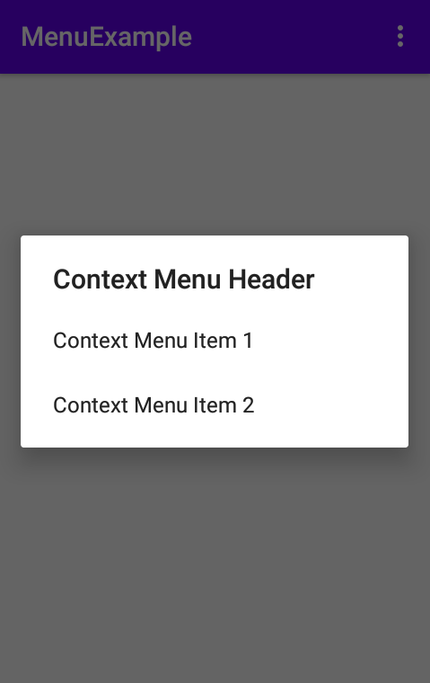
1. Program implementation
E.g.,
public class MenuExample extends Activity {
…
@Override
public void onCreateContextMenu(ContextMenu menu,
View v,
ContextMenuInfo menuinfo) {
super.onCreateContextMenu(menu, v, menuinfo);
menu.add("Context Menu Item 1");
menu.add("Context Menu Item 2");
menu.setHeaderTitle("Context Menu Header");
}
}
COMPS413F Lecture #05

Slide 18
1. Program implementation
Input parameter of "onCreateContextMenu" method
  Context Menu
    An instance of the context menu
  View
    The widget which attached with the context menu
  ContextMenuInfo
    Additional information about the item that create the context menu
    E.g., obtain the correspond ID of a selected list item if a context menu is attached to all list items of a ListView
The "setHeaderTitle" method of the context menu is used to set the display title of the menu header to the "Context Menu Header"
COMPS413F Lecture #05

Slide 19
2. XML resource
Two steps to create a context menu with menu resource
  i. Defined the menu and menu item in an XML resource file
  ii. Inflating the context menu resource
COMPS413F Lecture #05

Slide 20
i. Creating an XML file and defining menu components
E.g., save the XML file in "/res/menu" directory
<?xml version="1.0" encoding="utf-8"?>
<menu xmlns:android="http://schemas.android.com/apk/res/android">
<item
android:id="@+id/item1"
android:title="Context Menu Item 1"
/>
<item
android:id="@+id/item2"
android:title="Context Menu Item 2"
/>
</menu>
COMPS413F Lecture #05

Slide 21
ii. Inflating menu resource in "onCreateContextMenu" method
E.g.,
public class MainActivity extends Activity {
…
@Override
public void onCreateContextMenu(ContextMenu menu,
View v, ContextMenuInfo menuinfo) {
super.onCreateContextMenu(menu, v, menuinfo);
MenuInflater inflater = getMenuInflater();
inflater.inflate(R.menu.context_menu_in_xml, menu);
menu.setHeaderTitle("Context Menu Header");
}
}
COMPS413F Lecture #05

Slide 22
c. Event handling of context menu
Override the "onContextItemSelected" method of Activity to perform operations
It will be invoked if one of the menu item from the context menu is selected by user
E.g.,
public boolean onContextItemSelected(MenuItem item) {
TextView testView=(TextView) findViewById(R.id.textView);
textView.setText("Selected item: " + item.getTitle());
return true;
}
COMPS413F Lecture #05

Slide 23
Submenus
A submenu is a nested menu which is opened when a selected menu item contain a another menu
Advantage
  Facilitate menu items organization and management
    Similar to menu item (File, Edit, View, Help, …) in menu bar
Creation of submenu
  a. Creation of submenu programmatically
  b. Creation of submenu with XML resource file
Note:
  Sub menus do NOT support nested sub menu
    i.e., submenu can be added to any menu item but NOT another submenu
COMPS413F Lecture #05

Slide 24
a. Creation of Submenu Programmatically
Submenu can be added to a menu dynamically with "addSubMenu" method, which will return a submenu object
Submenu item can be added to the submenu by using the "add" method with the returned submenu object
E.g., SubmenuInCodeActivity.java
public class MainActivity extends Activity {
…
@Override
public boolean onCreateOptionsMenu(Menu menu) {
SubMenu sub = menu.addSubMenu("Menu Item 1");
sub.add("Submenu Item 1");
sub.add("Submenu Item 2");
menu.add("Menu Item 2");
return true;
}
}
COMPS413F Lecture #05

Slide 25

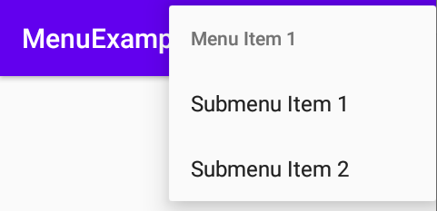
b. Creation of Submenu with XML Resource File
Submenu can be created with menu resource by inserting a "menu" elements as a child which is under an "item" element
E.g.,
<?xml version="1.0" encoding="utf-8"?>
<menu xmlns:android="http://schemas.android.com/apk/res/android">
<item
android:id="@+id/menu_item_1"
android:title="Menu Item 1" >
<menu>
<item
android:id="@+id/submenu_item1"
android:title="Submenu Item 1"
/>
<item
android:id="@+id/submenu_item2"
android:title="Submenu Item 2"
/>
</menu>
</item>
<item
android:id="@+id/menu_item_2"
android:title="Menu Item 2" >
</item>
</menu>
COMPS413F Lecture #05

Slide 26
c. Event Handling of Submenu
…
/** Called when an options menu item is selected. */
@Override
public boolean onOptionsItemSelected(MenuItem item) {
…
switch (item.getItemId()) {
case R.id.menu_item_1:
…
return true;
case R.id.submenu_item1:
…
return true;
case R.id.submenu_item2:
…
return true;
}
return super.onOptionsItemSelected(item);
}
…
COMPS413F Lecture #05

Slide 27
Action Bar
The action bar is closely related to the options menu, which holds the activity title near the top of the screen
Frequently used options menu items can be placed in the action bar as icons or text items for convenient access
Two approaches to place an options menu item to the action bar
  a. Use the "setShowAsAction" method of "MenuItem" in program code
  b. Use the "showAsAction" attribute in menu resources
COMPS413F Lecture #05

Slide 28


Action Bar – Example
<?xml version="1.0" encoding="utf-8"?>
<menu xmlns:app="http://schemas.android.com/apk/res-auto"
xmlns:android="http://schemas.android.com/apk/res/android">
<item
android:id="@+id/menu_alert"
android:icon="@android:drawable/ic_dialog_alert"
android:title="Alert"
app:showAsAction="always" />
<item
android:id="@+id/menu_dialer"
android:icon="@android:drawable/ic_dialog_dialer"
android:title="Dialer"
app:showAsAction="always" />
<item
android:id="@+id/menu_email"
android:icon="@android:drawable/ic_dialog_email"
android:title="Email" />
<item
android:title="Background" >
<menu>
<item
android:id="@+id/menu_red"
android:title="Red" />
<item
android:id="@+id/menu_green"
android:title="Green" />
<item
android:id="@+id/menu_blue"
android:title="Blue" />
</menu>
</item>
</menu>
The first two menu
items are always
placed in the action bar
COMPS413F Lecture #05

