Slide 1
COMPS413F
Lecture Notes
#06. Intents
COMPS413F Lecture #06
1

Slide 2
Agenda
Introduction
Intent structure/object
  Primary attributes
    1. Action
    2. Data
Intent resolution
  Two forms of intents
    a. Implicit intents
    b. Explicit intents
Implicit Intents
Activity stack
Explicit Intents
Communication between the original/parent and the launched/sub activity
  a. Passing data from parent activity to sub activity by using the "extra" attribute
  b. Receiving "extra" data in sub activity
  c. Receiving and handling sub activity results in parent activity
Splash screen
COMPS413F Lecture #06

Slide 3
Introduction
A typical Android application have one or more activities, one of them is the default activity of the application, which is started when the application is launched
Activity can also be started by another activity of the same or other application
  Which is achieved by intent
Class "Intent" can be implemented and perform runtime binding of code between different activities
  i.e., "Intent" can be considered as the interface between activities so that different activity can interact and communicate with each other
Role and responsibility of intent
  Provides an Android activity the capability to launch another activity and execute another task
    E.g., starting a service or activity
  Used by an activity to communicate between activities or hardware components of device which are already installed on the device
    i.e., send or receive data from and to other activities or services, or broadcast that a specific event has happened
COMPS413F Lecture #06

Slide 4
Introduction
E.g., if a browser is called by an activity with "Intent", the information about the URL can be sent to the browser component accordingly
Advantage
  Intents provide a loosely-coupled communication mechanism between activities and applications
    E.g., an activity of a built-in application can be invoked by other activity to do some task in a sense similar to calling a function in a program
Note:
  Method "startActivity" or "startActivityForResult" can be used to launch an activity
  The Android system can determine which component should be used to handle the request according to the information associated with the "Intent" if the corresponding component is not specified explicitly
COMPS413F Lecture #06

Slide 5
Intent structure/object
Regarding to the information of an operation to be performed, two primary attributes are defined in an intent
  1. Action
  2. Data
COMPS413F Lecture #06

Slide 6
1. Action
Named the general action to be performed in string format
There are several action constants have been defined in the Intent class for various action, e.g.,
  ACTION_VIEW
    For displaying different information to user with respect to the associated "data"
    E.g.,
      A web page
      Information of a list of people or a specific person stored in the contact list
  ACTION_EDIT
    E.g., display the information about a specific contact person for editing
  ACTION_DIAL
    E.g., display a phone dialer filled with a particular phone number or phone of a particular contact person
  ACTION_CALL
    E.g., initiate a phone call to a particular phone number or contact person
Methods "setAction" and "getAction" can be used to set and read the action of an Intent object
COMPS413F Lecture #06

Slide 7
2. Data
Represent the URI of the data to be operated, e.g.,
  An URL
    "<url>"
  A particular contact person in contact list for viewing
    "content"//contacts/people/<identifier>"
  A phone number for dialing
    "tel:<phone_number>"
  A list of contact person in contact list for browsing
    "content"//contacts/people/"
Different action should be matched with different types of data accordingly, e.g.,
  Action "ACTION_VIEW" should be paired with an http URI for the browser to download the data and display the content
  Action "ACTION_CALL" should be paired with data field that gives a particular phone number ("tel:<phone_number>) to call
  Action "ACTION_EDIT" should be paired with data field that provides with an URI of a document to be displayed for editing
COMPS413F Lecture #06

Slide 8
Intent resolution
There are two forms of intents
  a. Implicit Intents
    The system can select an appropriate component to perform the operation without specified it explicitly
  b. Explicit Intents
    The component is named explicitly to perform the corresponding operation
      i.e., it requires to specifies which Java class will be called by the system
  Intent resolution is the mechanism to determine which activity or service is appropriate for handling the intent
  If implicit intent is implemented, the system needed to locate a suitable component for carrying out the execution
COMPS413F Lecture #06

Slide 9
Implicit Intents
As it name, there is NO specific name for indicating which activity is associated with the intent given in implicit intents
Instead, a set of information is provided to the system for finding a suitable activity or component to execute the intent, e.g.,
  The "action" should be performed
  The corresponding "data" (optional) used by the action
E.g., viewing of a particular Web page URL would consist of
  The "action" of viewing
    E.g., "ACTION_VIEW"
  The "data" of the Web page URL
    An address of a web page
    E.g., "http://www.hkmu.edu.hk"
  The Android system typically starts a Web browser and loads the page to respond to this intent
Advantage
  The mechanism of implicit intents is very flexible as the system can select the best way to handle an intent
COMPS413F Lecture #06

Slide 10
Implicit Intents – Example
public class MainActivity extends AppCompatActivity {
@Override
public void onCreate(Bundle savedInstanceState) {
super.onCreate(savedInstanceState);
setContentView(R.layout.implicit_intent);
Button webButton = (Button) findViewById(R.id.implicit_button_web);
webButton.setOnClickListener(new View.OnClickListener() {
@Override
public void onClick(View v) {
Uri uri = Uri.parse("http://www.hkmu.edu.hk/");
Intent intent = new Intent(Intent.ACTION_VIEW, uri);
startActivity(intent);
}
});
Button dialButton = (Button) findViewById(R.id.implicit_button_dial);
dialButton.setOnClickListener(new View.OnClickListener() {
@Override
public void onClick(View v) {
Uri uri = Uri.parse("tel:2711-2100");
Intent intent = new Intent(Intent.ACTION_DIAL, uri);
startActivity(intent);
}
});
…
COMPS413F Lecture #06

Slide 11
Implicit Intents – Example
…
Button callButton = (Button) findViewById(R.id.implicit_button_call);
callButton.setOnClickListener(new View.OnClickListener() {
@Override
public void onClick(View v) {
Uri uri = Uri.parse("tel:2711-2100");
Intent intent = new Intent(Intent.ACTION_CALL, uri);
if (ActivityCompat.checkSelfPermission(MainActivity.this,
Manifest.permission.CALL_PHONE) == PackageManager.PERMISSION_GRANTED) {
startActivity(intent);
}
else {
Toast aToast=Toast.makeText(MainActivity.this,
"Permission not Grant",
Toast.LENGTH_SHORT);
aToast.show();
}
}
});
}
}
COMPS413F Lecture #06

Slide 12
Implicit Intents – Example
In the first "onClick" method
  An "android.net.Uri" object for the HKMU’s website is created, using the static method "Uri.parse" to parse a string to create it
  Then, an intent is constructed with a viewing action, which is denoted by the constant "Intent.ACTION_VIEW", and the "Uri" object
  Calling the "startActivity" method on the intent results in starting a Web browser
The intent in the second "onClick" method
  It specifies a dialing action of "Intent.ACTION_DIAL" and the telephone number of HKMU
  It starts the dialer of the phone for the user to confirm calling the number
The intent in the third "onClick" method
  It specifies a calling action of "Intent.ACTION_CALL" and the telephone number of HKMU
  It starts phone calling activity to actually make the phone call
COMPS413F Lecture #06

Slide 13
Implicit Intents – Example – Note
The dialing action does not require any security permission
  But the calling action requires the permission of "android.permission.CALL_PHONE"
This permission request is specified using an "uses-permission" tag in the manifest file of the application
If your app needs a dangerous permission, you must check if that permission has been granted when performing an operation that requires that permission
  E.g.,
<uses-permission android:name="android.permission.CALL_PHONE" />
if (ActivityCompat.checkSelfPermission(MainActivity.this,
Manifest.permission.CALL_PHONE) == PackageManager.PERMISSION_GRANTED) {
COMPS413F Lecture #06

Slide 14
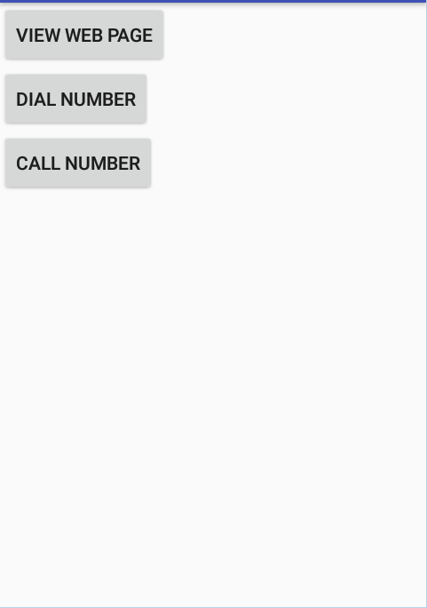

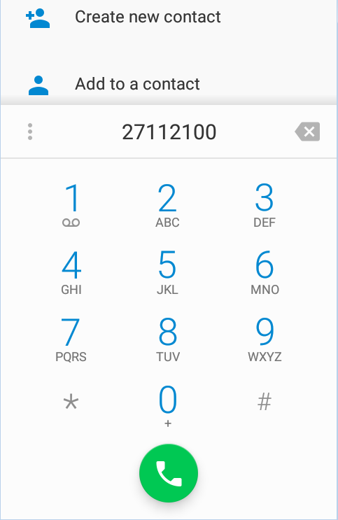
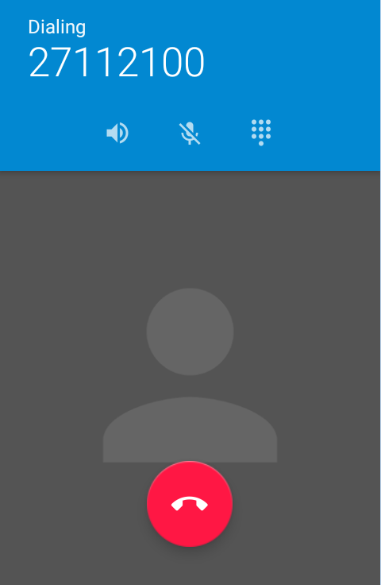
Implicit Intents – Example
COMPS413F Lecture #06

Slide 15
Implicit Intents – Note
Different activities can be launched according to the action and no need to specify any specific application
The original activity will not have any information about the completion of the launched activity
COMPS413F Lecture #06

Slide 16
Activity stack
According to the above example, when user press the "Dial" button in the default activity, dialer application will be started and seen
Pressing the "Back" button will kill the dialer, and the default activity is active and on top again
Pressing the "Back" button again will kill the default activity and the application
Actually, running activities in Android are arranged in an activity stack and the one on top is actively running and being interacted with the user
=> Linear activity flow in an Android app
COMPS413F Lecture #06

Slide 17
Activity stack
Top activity
operated by
user
Top activity
operated by
user
Top activity
operated by
user
Launch application
Dialer
Default activity
Home or launcher
Default activity
Home or launcher
Launch Dialer
Home or launcher
Press "Back"
Press "Back"
Executing the
default activity
Executing the
dialer
COMPS413F Lecture #06

Slide 18
Explicit Intents
Different from implicit intent, an explicit intent can be set up to specify the class of the activity to be started
The class can be specified
  a. As a reference to the Java class object
  b. By its class name in a string
Therefore, the system know exactly which class should be invoked and there is no additional information needed to be given generally
Explicit intents may be used to start an internal activity from the same application
COMPS413F Lecture #06

Slide 19
Explicit Intents
Explicit intent is consisted of two components
  Context
    Reference to the current activity
  Class
    Activity class to be launched by the intent
Explicit intent can specify the class of activity by
  a. Method "setClassName"
  b. Constructor
COMPS413F Lecture #06

Slide 20
Explicit Intents – Example 1
a. Specifies the class of the activity by "setClassName" method
public class MainActivity extends AppCompatActivity {
@Override
public void onCreate(Bundle savedInstanceState) {
super.onCreate(savedInstanceState);
setContentView(R.layout.main);
Button button = (Button) findViewById(R.id.button1);
button.setOnClickListener(new View.OnClickListener() {
public void onClick(View v) {
Intent intent = new Intent();
intent.setClassName(MainActivity.this, getPackageName()
+ ".ExplicitIntentActivity");
startActivity(intent);
}
});
}
}
COMPS413F Lecture #06

Slide 21
Explicit Intents – Example 1
The above listing acts as a the first activity for invoking another (the second) activity of the application
The "onClick" method is invoked when the user click the button
The intent object specified the class of activity by "setClassName" method with two parameters
  1st: An activity instance as the context of the intent
    E.g., "ExplicitIntentActivity.this" refers to the current object of the outer class within the anonymous class
  2nd: The fully qualified class name, which is combine with
    The package name obtained from calling the "getPackageName" method
    A dot (‘.’)
    The class name of the target activity
    E.g., getPackageName() + ".ExplicitIntentActivity"
The intent is then ready and the "startActivity" method is called to start the second activity, the "ExplicitIntentActivity" activity, accordingly
COMPS413F Lecture #06

Slide 22
Explicit Intents – Example 2
b. Specifies the class of the activity by constructor
public class ExplicitIntentActivity extends Activity {
@Override
public void onCreate(Bundle savedInstanceState) {
super.onCreate(savedInstanceState);
setContentView(R.layout.explicit_intent_activity);
Button button = (Button) findViewById(R.id.button2);
button.setOnClickListener(new View.OnClickListener() {
public void onClick(View v) {
Intent intent = new Intent(
ExplicitIntentActivity.this,
ExplicitIntentSubActivity.class);
startActivity(intent);
}
});
}
}
COMPS413F Lecture #06

Slide 23
Explicit Intents – Example 2
The second activity, i.e., "ExplicitIntentActivity“, has a button, which starts another (the third) activity called "ExplicitIntentSubActivity" when clicked
In the "onClick" method, an object of the "Intent" class is created by constructor with two parameters
  1st: The activity instance as the context of the intent
    E.g., "ExplicitIntentActivity.this" refers to the current object of the outer class within the anonymous class
  2nd: The Java object of the activity to be started
    E.g., "ExplicitIntentSubActivity.class"
Finally, the "startActivity" method is called with the intent to start the third "ExplicitIntentSubActivity" activity
COMPS413F Lecture #06

Slide 24
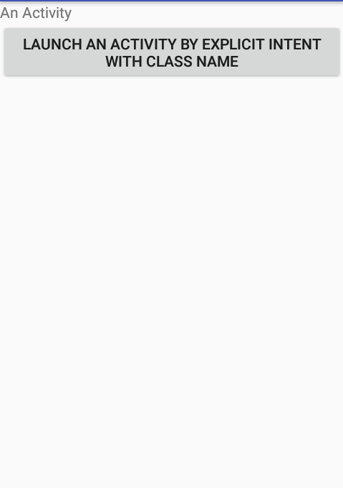
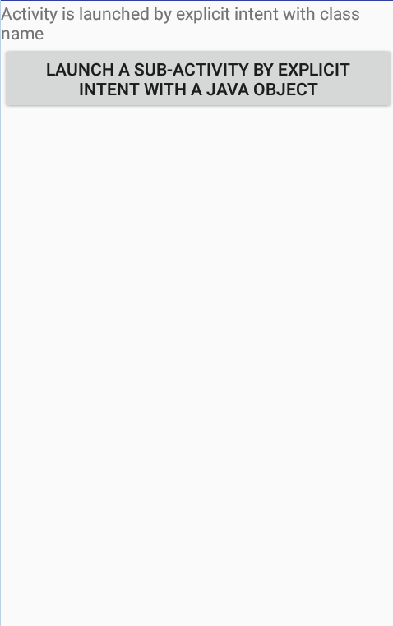
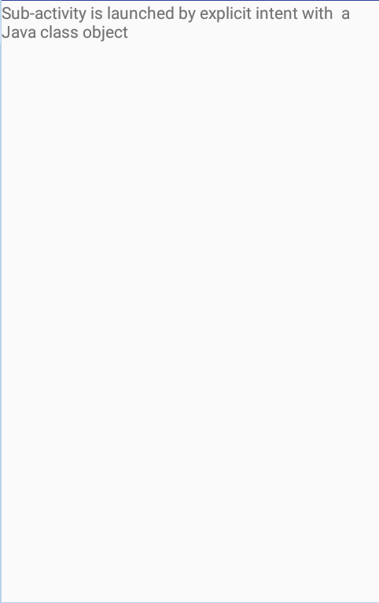
Explicit Intents – Example 1 & 2
Execution of these activities is depicted below
COMPS413F Lecture #06

Slide 25
Explicit Intents – Note
It is necessary to declare the default and ALL other new activities of the application in the manifest file (i.e., "AndroidManifest.xml")
Otherwise, there will be a runtime error when the application is executed
<activity android:label="Explicit Intent Activity"
android:name=".ExplicitIntentActivity"></activity>
<activity android:label="Explicit Intent Sub Activity"
android:name=".ExplicitIntentSubActivity"></activity>
COMPS413F Lecture #06

Slide 26
Communication between the original (parent) and the launched (sub/child) activity
In the previous example, the method "startActivity" is used for launching an activity specified by an intent
  i.e., the parent just invoked the child activity (or sub-activity) and do NOT have any communication mechanism implemented
  In this case, feedback from sub activity is not required by the original activity
  i.e., the original activity will not be informed and provided any result even the sub activity has completed
If communication between activity is required
  E.g., there is a data passing between the parent and the child activity
  Method "startActivityForResult" should be used in order to achieved the activities communication
  Event handler of the parent activity (method "onActivityResult") will be triggered if the sub activity has finished and closed
COMPS413F Lecture #06

Slide 27
Communication between the original (parent) and the launched (sub/child) activity
Actually, intents can be used to pass data to sub activity (delivered from parent activity) and obtained results from sub activity (feedback to parent activity)
General implementation of delivering and receiving data between the parent and sub activity
  a. Passing data from parent activity to sub activity by using the "extra" attribute
  b. Receiving and handling "extra" data in sub activity
  c. Receiving and handling sub activity results in parent activity
COMPS413F Lecture #06

Slide 28
a. Passing data from parent activity to sub activity
Additional information prepared in the parent activity can be delivered to the sub activity with the help of the "extra" attribute of intent
  i.e., "extra" field of intent object can be used to stored the data needed to be delivered to the sub activity
It can be achieved by using the methods "putExtra" and "putExtras" of Intent to add extra information to the intent before starting an activity from it
COMPS413F Lecture #06

Slide 29
a. Passing data from parent activity to sub activity – Example
public class PassingDataToChildActivity extends Activity {
@Override
public void onCreate(Bundle savedInstanceState) {
super.onCreate(savedInstanceState);
setContentView(R.layout.passing_data_to_child);
final EditText edit = (EditText) findViewById(R.id.put_extra_edit);
Button button = (Button) findViewById(R.id.put_extra_button);
button.setOnClickListener(new View.OnClickListener() {
@Override
public void onClick(View v) {
Intent intent = new Intent(PassingDataToChildActivity.this,
GettingDataFromParentActivity.class);
intent.putExtra(GettingDataFromParentActivity.EXTRA_DATA,
edit.getText().toString());
startActivity(intent);
}
});
}
}
COMPS413F Lecture #06

Slide 30
a. Passing data from parent activity to sub activity – Example
The "PassingDataToChildActivity" has
  An "EditText" field for entering data
  A button for starting the sub-activity "GettingDataFromParentActivity"
In the "onClick" event handler of the button, the intent invokes the "putExtra" method
  Syntax
    Intent.putExtra(String Name, String Value)
  This adds a name-value pair to the extra bundle of the intent
    The name is needed as the extra bundle contains multiple entries identified by the names
In this example
  The name is the string "DataKey", defined as the constant "EXTRA_DATA" of the "GettingDataFromParentActivity" class
  The value of the extra data contains the text that the user enters in the EditText field
As a result, the above code launches a sub activity named "GettingDataFromParentActivity" and an extra piece of information (i.e., input typed by user) is passed to it via the "putExtra" method
COMPS413F Lecture #06

Slide 31
b. Receiving and handling "extra" value in sub activity
Once the sub activity has been initiated by an intent which contains "extra" data, this extra piece of data can be extract in the sub activity
In the child activity, method "getIntent" of "Activity" can be used to obtain the intent, and various extra getter methods of "Intent" can then be used to retrieve the information
Implementation procedures
  1. Method "getIntent" can be used to obtain the reference of the intent that invoke the sub activity
  2. Method "getXXXExtras" can be used to obtain the "extra" information from the intent object
COMPS413F Lecture #06

Slide 32
b. Receiving and handling "extra" value in sub activity – Example
public class GettingDataFromParentActivity extends Activity {
public static final String EXTRA_DATA = "DataKey";
/** Called when the activity is first created. */
@Override
public void onCreate(Bundle savedInstanceState) {
super.onCreate(savedInstanceState);
setContentView(R.layout.getting_data_from_parent);
TextView text = (TextView) findViewById(R.id.put_extra_text_sub);
String data = getIntent().getStringExtra(EXTRA_DATA);
text.setText("Data obtained from parent activity: " + data);
}
}
COMPS413F Lecture #06

Slide 33
b. Receiving and handling "extra" value in sub activity – Example
The extra data is retrieved in the child "GettingDataFromParentActivity" class
Its "onCreate" method
  Calls the "getIntent" method to retrieve the intent that has invoked this activity
  Then calls the "getStringExtra" method to obtain the extra information
The parameter to the "getStringExtra" method, the constant "EXTRA_DATA" in this case, identifies the desired extra data in the extra bundle
COMPS413F Lecture #06

Slide 34
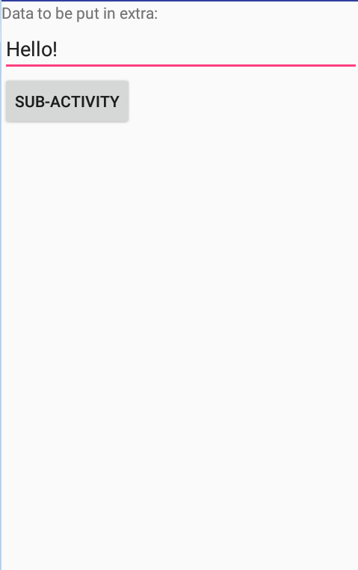
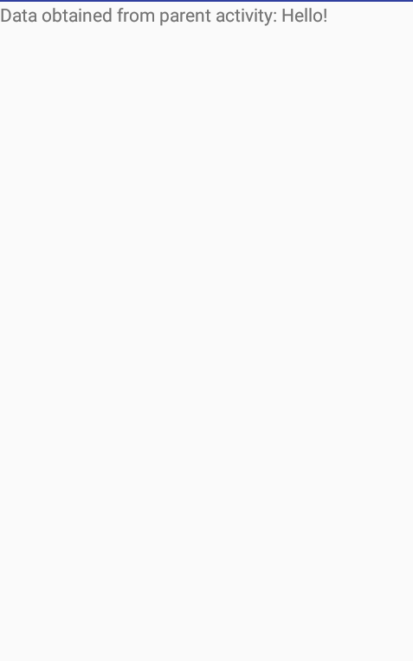
b. Receiving and handling "extra" value in sub activity – Example
The execution of the two activities to pass extra data is shown in the following figure
COMPS413F Lecture #06

Slide 35
c. Receiving and handling sub activity results in parent activity
The method "startActivity" applied in previous example is just used for launching an activity specified by an intent
  In this case, the original activity will NOT be informed and provided any result even the sub activity has completed
Method "startActivityForResult" can be used instead of the "startActivity" method for facilitating the two-way communication between two activities
  i.e., once the corresponding child activity has completed, the results can then be sent back to the parent activity via event triggered mechanism
Syntax: startActivityForResult(Intent intent, int requestCode)
  intent
    The intent going to be started
  requestCode
    An integer identifier for identifying which sub activity has finished its work
COMPS413F Lecture #06

Slide 36
c. Receiving and handling sub activity results in parent activity
General implementation of returning data from child activity
  1. Invoking the "startActivityForResult" method in the parent activity
  2. Overriding the "onActivityResult" method in parent activity
  3. Calling the "setResult" method in child activity
  4. Invoking the "finish" method in child activity
In parent
activity
In child
activity
COMPS413F Lecture #06

Slide 37
1. Invoking the "startActivityForResult" method in the parent activity
In the parent activity, calls the "startActivityForResult" method instead of the "startActivity" method to start a child activity
E.g.,
private static final int SUB_ACTIVITY_ID = 0; // Request code
…
Intent intent = new Intent(GetResultActivity.this,
GetResultSubActivity.class);
startActivityForResult(intent, SUB_ACTIVITY_ID);
…
COMPS413F Lecture #06

Slide 38
2. Overriding the "onActivityResult" method in parent activity
In the parent activity, overrides the "onActivityResult" method to retrieve and process the result from the child activity
E.g.,
@Override
public void onActivityResult(int requestCode,
int resultCode,
Intent data) {
…
}
COMPS413F Lecture #06

Slide 39
3. Using the "setResult" method
In the child activity, calls the "setResult" method to pass data to the parent activity, typically right before the end of its execution
Note:
  The value of result code can either be "RESULT_OK" or "RESULT_CANCELED"
E.g.,
  Similar to the implementation in parent activity, "extra" attribute in intent can be used to the store the feedback result and then sent back to the parent activity
public static final String EXTRA_RESULT = "ResultKey";
…
Intent intent = new Intent();
intent.putExtra(EXTRA_RESULT, "Data back to parent activity");
setResult(RESULT_OK, intent);
…
COMPS413F Lecture #06

Slide 40
4. Invoking the "finish" method
The "finish" method is used for
  Closing the sub activity
  Returning to the parent activity
  Invoking the callback method "onActivityResult" in the parent activity
…
Intent intent=new Intent();
intent.putExtra(EXTRA_RESULT, "Data back to parent activity");
setResult(RESULT_OK, intent);
finish();
…
COMPS413F Lecture #06

Slide 41
c. Receiving and handling sub activity results in parent activity – Example
public class GetResultActivity extends Activity {
private static final int SUB_ACTIVITY_ID = 0;
private TextView textView;
/** Called when the activity is first created. */
@Override
public void onCreate(Bundle savedInstanceState) {
super.onCreate(savedInstanceState);
setContentView(R.layout.get_result);
textView = (TextView) findViewById(R.id.get_result_text);
textView.setText("Before starting child activity");
Button button = (Button) findViewById(R.id.get_result_button);
button.setOnClickListener(new View.OnClickListener() {
public void onClick(View v) {
// 1.
Intent intent = new Intent(GetResultActivity.this,
GetResultSubActivity.class);
startActivityForResult(intent, SUB_ACTIVITY_ID);
}
});
}
…
COMPS413F Lecture #06

Slide 42
c. Receiving and handling sub activity results in parent activity – Example
…
// 2.
/** Called when an activity you launched is finished. */
@Override
protected void onActivityResult(int requestCode,
int resultCode,
Intent data) {
if (resultCode == RESULT_OK && requestCode == SUB_ACTIVITY_ID) {
String str = "Received result from child activity:"
+ "\nRequest code = " + requestCode
+ "\nResult code = " + resultCode
+ "\nIntent extra data = "
+ data.getStringExtra(GetResultSubActivity.EXTRA_RESULT);
textView.setText(str);
}
}
}
COMPS413F Lecture #06

Slide 43
c. Receiving and handling sub activity results in parent activity – Example
The "GetResultActivity" has a button for starting the child activity "GetResultSubActivity"
In the "onClick" event handler of the button, an intent is created for launching the "GetResultSubActivity"
Instead of using the "startActivity" method, it calls the "startActivityForResult" method to obtain the result from the child activity when it finishes
  The second parameter to "startActivityForResult", the constant "SUB_ACTIVITY_ID" in this example, is the request code that identifies the child activity
    It is needed because a parent activity may start multiple child activities across time and the request code is used for identifying the exiting child activity in the "onActivityResult" method
COMPS413F Lecture #06

Slide 44
c. Receiving and handling sub activity results in parent activity – Example
The "onActivityResult" method is called when one of its child activities finishes execution
  Its first parameter is the request code specified when the parent activity starts the child activity, serving as an identification number of the child activity
  The second parameter is the result code that the child activity passes to the parent activity
  The third parameter, of type "Intent", contains additional information from the child activity
In this example, the "onActivityResult" method of "GetResultActivity" checks the request code and result code, and then displays various information from the parameters, including
  Request code
  Result code
  A string data in the extra bundle of the intent passed from the child activity
    The string data is retrieved by calling the "getStringExtra" method of "Intent", with parameter "GetResultSubActivity.EXTRA_RESULT" which is the name that identifies the extra data within that intent
COMPS413F Lecture #06

Slide 45
c. Receiving and handling sub activity results in parent activity – Example
public class GetResultSubActivity extends Activity {
public static final String EXTRA_RESULT = "ResultKey";
/** Called when the activity is first created. */
@Override
public void onCreate(Bundle savedInstanceState) {
super.onCreate(savedInstanceState);
setContentView(R.layout.get_result_sub);
final EditText edit = (EditText) findViewById(R.id.get_result_edit_sub);
Button button = (Button) findViewById(R.id.get_result_button_sub);
button.setOnClickListener(new View.OnClickListener() {
public void onClick(View v) {
// 3.
Intent intent = new Intent();
intent.putExtra(EXTRA_RESULT, edit.getText().toString());
setResult(RESULT_OK, intent);
// 4.
finish();
}
});
}
}
COMPS413F Lecture #06

Slide 46
c. Receiving and handling sub activity results in parent activity – Example
The child activity, "GetResultSubActivity", declares a constant "EXTRA_RESULT" as the name of the extra data in the returning intent
It has a button for finishing execution and returning to its parent activity
The "onClick" event handler of the button first creates an empty result intent and puts a piece of extra data to it
This extra data has a name of "EXTRA_RESULT" and its value is obtained by the text that the user enters in an "EditText" field
After that, it calls the "setResult" method of "Activity" with the result code of "RESULT_OK" and the result intent
  The constant "RESULT_OK" is defined in the "Activity" class to indicate a successful operation
  Another constant is "RESULT_CANCELED" which indicates a cancelled operation
The two parameters of the "setResult" method would be passed to the parent activity when this child finally calls the "finish" method to end its execution
COMPS413F Lecture #06

Slide 47
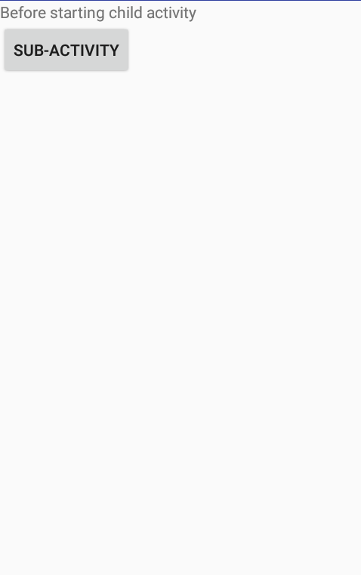
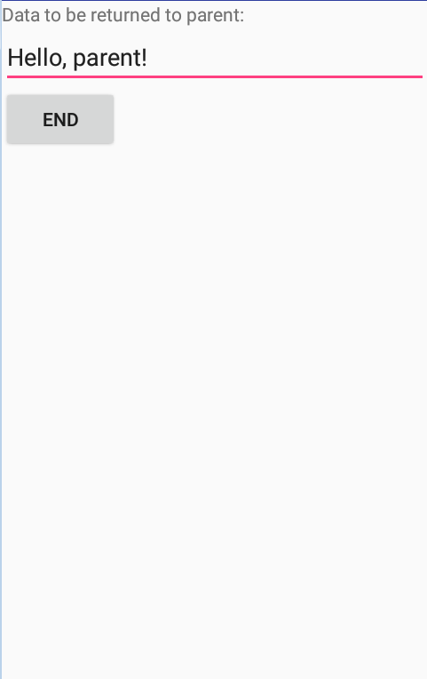
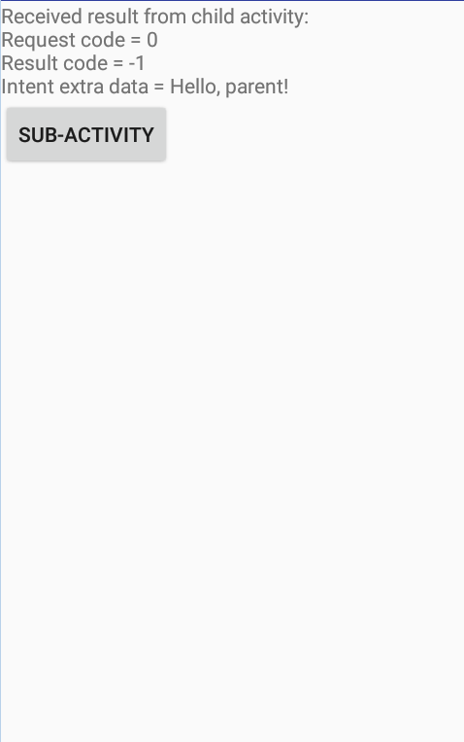
c. Receiving and handling sub activity results in parent activity – Example
The execution of the two activities is shown in the following figure
COMPS413F Lecture #06

Slide 48
Splash Screen
The splash screen is shown by default when the application or game starts
  E.g., it displays
    A message to describe the application or game
    Some animated graphics to welcome the user
    A checkbox for turning on/off the splash screen in the future
Touching on the splash screen (or pressing a button) goes to the screen for the user to operate the application, play the game, or menu screen
COMPS413F Lecture #06

Slide 49
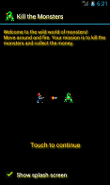
Splash Screen – Example – SplashActivity
The SplashActivity contains the first default screen to welcome the user when the game application is launched
Part of the code of the activity is illustrated in listing below
COMPS413F Lecture #06

Slide 50
Splash Screen – Example – SplashActivity
public class SplashActivity extends Activity {
public void onCreate(Bundle savedInstanceState) {
super.onCreate(savedInstanceState);
setContentView(R.layout.splash);
…
}
…
public boolean onTouchEvent(MotionEvent event) {
if (event.getAction() == MotionEvent.ACTION_DOWN)
showMainMenu();
return true;
}
private void showMainMenu() {
Intent intent = new Intent(this, MenuActivity.class);
startActivity(intent);
finish();
}
}
Note:
  The onTouchEvent method is overridden to go to the MenuActivity when the user touches the screen
COMPS413F Lecture #06

