Slide 1
1. Introduction
HTML is the standard markup language for creating web pages.
HTML是建置網頁的標準標記語言。
https://www.w3schools.com/html/html_intro.asp

Slide 2
What is HTML?
HTML stands for Hyper Text Markup Language
HTML is the standard markup language for creating Web pages
HTML describes the structure of a Web page
HTML consists of a series of elements
HTML elements tell the browser how to display the content
HTML elements label pieces of content such as "this is a heading", "this is a paragraph", "this is a link", etc.

Slide 3
A Simple HTML Document
<!DOCTYPE html> <html> <head> <title>Page Title</title> </head> <body> <h1>My First Heading</h1> <p>My first paragraph.</p> </body> </html>

Slide 4
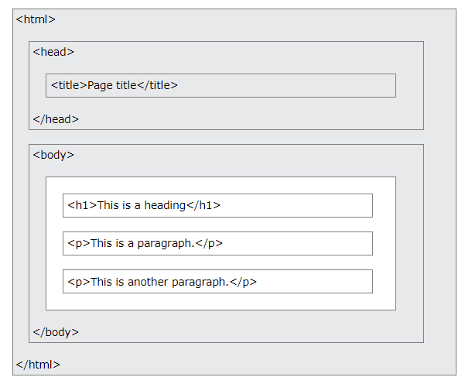
HTML Page Structure
The content inside the <body> section (the white area above) will be displayed in a browser.
The content inside the <title> element will be shown in the browser's title bar or in the page's tab.

Slide 5
Example Explained
The <!DOCTYPE html> declaration defines that this document is an HTML5 document
The <html> element is the root element of an HTML page
The <head> element contains meta information about the HTML page
The <title> element specifies a title for the HTML page (which is shown in the browser's title bar or in the page's tab)
The <body> element defines the document's body, and is a container for all the visible contents, such as headings, paragraphs, images, hyperlinks, tables, lists, etc.
The <h1> element defines a large heading
The <p> element defines a paragraph

Slide 6
What is an HTML Element?
An HTML element is defined by a start tag, some content, and an end tag:
<tagname> Content goes here... </tagname>
The HTML element is everything from the start tag to the end tag:
<h1>My First Heading</h1>
<p>My first paragraph.</p>

Slide 7
HTML tag
Start tag | Element content
<h1> | My First Heading
<p> | My first paragraph.
<br> | none
Note: Some HTML elements have no content (like the <br> element). These elements are called empty elements. Empty elements do not have an end tag!

Slide 8
Web Browsers
The purpose of a web browser (Chrome, Edge, Firefox, Safari) is to read HTML documents and display them correctly.
A browser does not display the HTML tags, but uses them to determine how to display the document:

Slide 9
HTML History 1
Since the early days of the World Wide Web, there have been many versions of HTML:
1989 | Tim Berners-Lee invented www
1991 | Tim Berners-Lee invented HTML
1993 | Dave Raggett drafted HTML+
1995 | HTML Working Group defined HTML 2.0
1997 | W3C Recommendation: HTML 3.2
1999 | W3C Recommendation: HTML 4.01

Slide 10
HTML History 2
2000 | W3C Recommendation: XHTML 1.0
2008 | WHATWG HTML5 First Public Draft
2012 | WHATWG HTML5 Living Standard
2014 | W3C Recommendation: HTML5
2016 | W3C Candidate Recommendation: HTML 5.1
2017 | W3C Recommendation: HTML5.1 2nd Edition
2017 | W3C Recommendation: HTML5.2

