Slide 1
2. Editors
A simple text editor is all you need to learn HTML.
記事本是學習HTML所需要寫程式用的編譯軟體之一。
https://www.w3schools.com/html/html_editors.asp

Slide 2
Learn HTML Using Notepad or TextEdit
Web pages can be created and modified by using professional HTML editors.
However, for learning HTML we recommend a simple text editor like Notepad (PC) or TextEdit (Mac).
Follow the steps below to create your first web page with Notepad or TextEdit.

Slide 3
Step 1: Open Notepad (PC)
Windows 8 or later:
Open the Start Screen (the window symbol at the bottom left on your screen). Type Notepad.

Slide 4
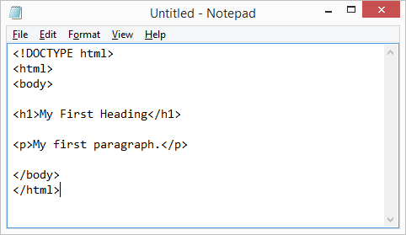
Step 2: Write Some HTML
Write or copy the following HTML code into Notepad:
<!DOCTYPE html> <html> <body> <h1>My First Heading</h1> <p>My first paragraph.</p> </body> </html>

Slide 5
Step 3: Save the HTML Page
Save the file on your computer. Select File > Save as in the Notepad menu.
Name the file "index.htm" and set the encoding to UTF-8 (which is the preferred encoding for HTML files).

Slide 6
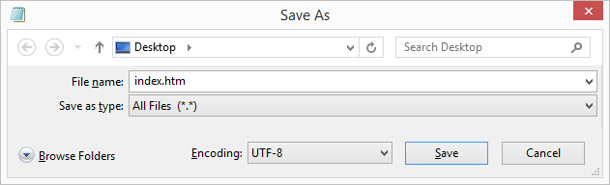
Step 3:
Tip: You can use either .htm or .html as file extension. There is no difference, it is up to you.

Slide 7
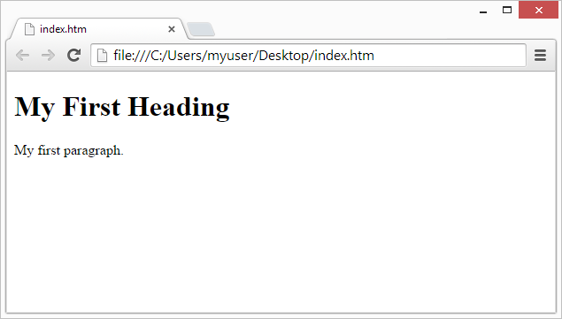
Step 4: View the HTML Page in Your Browser
Open the saved HTML file in your favorite browser (double click on the file, or right-click - and choose "Open with").

Slide 8
W3Schools Online Editor - "Try it Yourself"
With this free online editor, you can edit the HTML code and view the result in your browser.
It is the perfect tool when you want to test code fast. It also has color coding and the ability to save and share code with others.
https://www.w3schools.com/html/default.asp

Slide 9
step 5: 上傳到學校伺服器fs2
利用檔案總管，上傳你的成品。
http://fs3.just.edu.tw/~cc/04_teach/doc/useFTP.htm

Slide 10
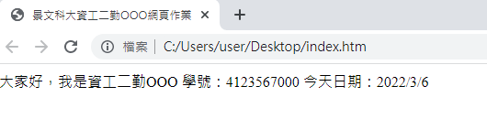
作業2a
請做出以下網頁：
檢查重點：
1.網頁標題
2.網頁內容

Slide 11
作業2b
將作業上傳到學校網站
上傳方式介紹：http://fs3.just.edu.tw/~cc/04_teach/doc/useFTP.htm

Slide 12
作業補充
檔名為HW本週檔名(例如HW2.htm)，請上傳到學校網站。
上傳截止時間：上課次日晚上11.00前。
請在google表單，填入可鏈結網址：例如http://fs2.just.edu.tw/~s123456789/hw2.htm
google表單https://forms.gle/k2w9fWn6vT7JR1Z97
上傳方式介紹：http://fs3.just.edu.tw/~cc/04_teach/doc/useFTP.htm

