Slide 1
3. Basic Examples
we will show some basic HTML examples.
HTML 基本範例。
https://www.w3schools.com/html/html_basic.asp

Slide 2
HTML Documents
All HTML documents must start with a document type declaration: <!DOCTYPE html>.
The HTML document itself begins with <html> and ends with </html>.
The visible part of the HTML document is between <body> and </body>.

Slide 3
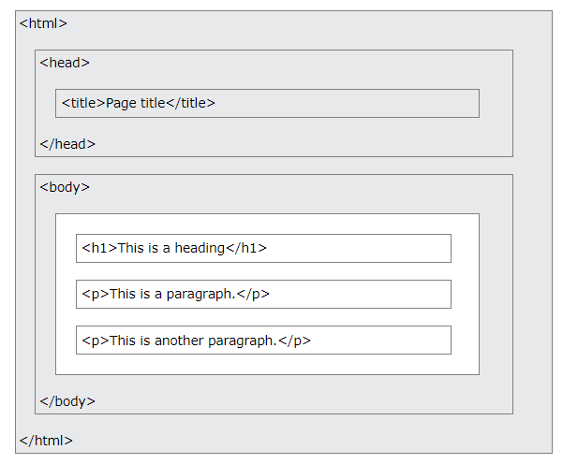
HTML Page Structure
The content inside the <body> section (the white area above) will be displayed in a browser.
The content inside the <title> element will be shown in the browser's title bar or in the page's tab.

Slide 4
Example
<!DOCTYPE html> <html> <body> <h1>My First Heading</h1> <p>My first paragraph.</p> </body> </html>

Slide 5
The <!DOCTYPE> Declaration
The <!DOCTYPE> declaration represents the document type, and helps browsers to display web pages correctly.
It must only appear once, at the top of the page (before any HTML tags).
The <!DOCTYPE> declaration is not case sensitive (跟大小寫無關).
The <!DOCTYPE> declaration for HTML5 is: <!DOCTYPE html>

Slide 6
HTML Headings (標題)
HTML headings are defined with the <h1> to <h6> tags.
<h1> defines the most important heading. (字也愈大)
<h6> defines the least important heading.

Slide 7
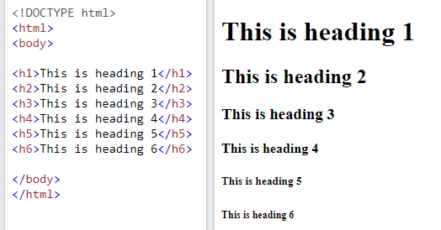
Example (以下指令，在各節也會詳細介紹)
<h1>This is heading 1</h1> <h2>This is heading 2</h2> <h3>This is heading 3</h3>

Slide 8
HTML Paragraphs (段落)
HTML paragraphs are defined with the <p> tag:
<p>This is a paragraph.</p> <p>This is another paragraph.</p>

Slide 9
HTML Links (連結)
HTML links are defined with the <a> tag:
<a href="https://www.w3schools.com">This is a link</a>
The link's destination is specified in the href (hyperlink reference) attribute.
Attributes are used to provide additional information about HTML elements.

Slide 10
HTML Images (圖檔)
HTML images are defined with the <img> tag.
The source file (src), alternative text (alt), width, and height are provided as attributes:
<img src="w3schools.jpg" alt="W3Schools.com" width="104" height="142">

Slide 11
View HTML Source Code(網頁的程式碼)
Right-click in an HTML page and select "View Page Source" (in Chrome) or "View Source" (in Edge), or similar in other browsers. This will open a window containing the HTML source code of the page.

Slide 12
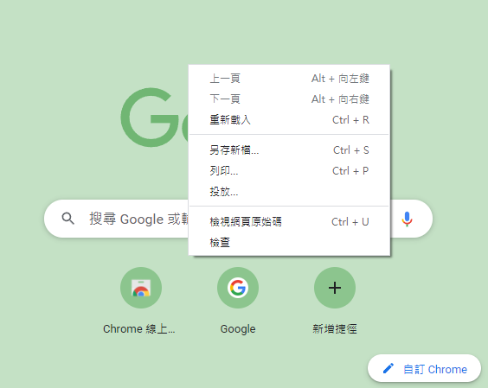
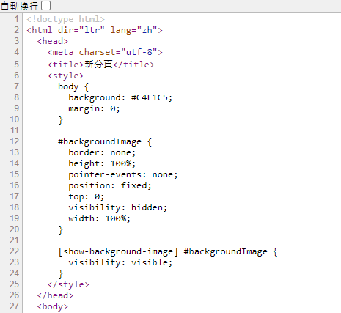
View HTML Source Code

Slide 13
Inspect an HTML Element
Right-click on an element (or a blank area), and choose “Inspect” or “Inspect Element” to see what elements are made up of (you will see both the HTML and the CSS). You can also edit the HTML or CSS on-the-fly (即時) in the Elements or Styles panel that opens.

Slide 14
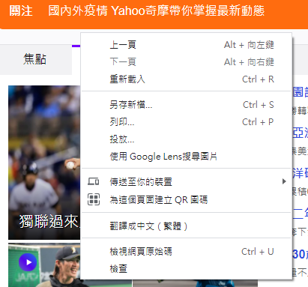
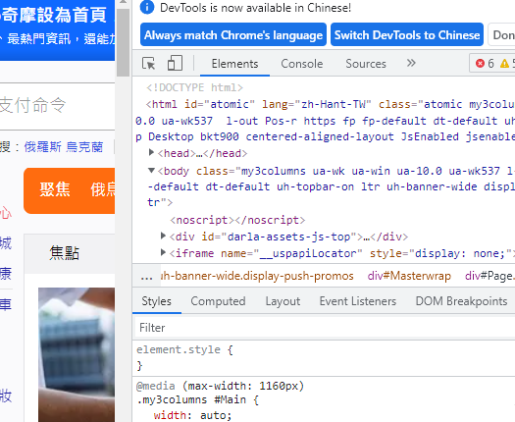
Inspect an HTML Element

Slide 15
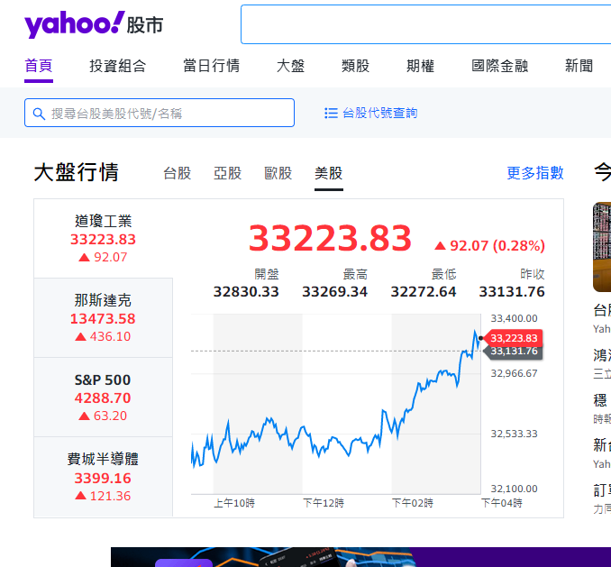
作業3
連結https://tw.stock.yahoo.com/
選擇美股，確認前晚的收盤指數。
(例如：33223.83)
找出這個網頁的程式碼。
利用搜尋，把出現含有「前晚的收盤指數(例如：33223.83)」的那一行指令 COPY起來。(可能有多處出現，都要COPY)
貼到Google 表單。

Slide 16
作業補充
請在google表單，填入答案。
上傳截止時間：上課次日晚上11.00前。
google表單https://forms.gle/k2w9fWn6vT7JR1Z97

