Slide 1
4. Elements
An HTML element is defined by a start tag, some content, and an end tag.
一個HTML元素包含了起始標籤、內容、及結束標籤
https://www.w3schools.com/html/html_elements.asp

Slide 2
HTML Elements
The HTML element is everything from the start tag to the end tag:
<tagname> Content goes here... </tagname>
Examples of some HTML elements:
<h1> My First Heading </h1>
<p> My first paragraph </p>

Slide 3
HTML Elements
Start tag | Element content
<h1> | My First Heading
<p> | My first paragraph.
<br> | none
Note: Some HTML elements have no content (like the <br> element). These elements are called empty elements. Empty elements do not have an end tag.

Slide 4
Nested (巢狀) HTML Elements
HTML elements can be nested (this means that elements can contain other elements).
All HTML documents consist of nested HTML elements.

Slide 5
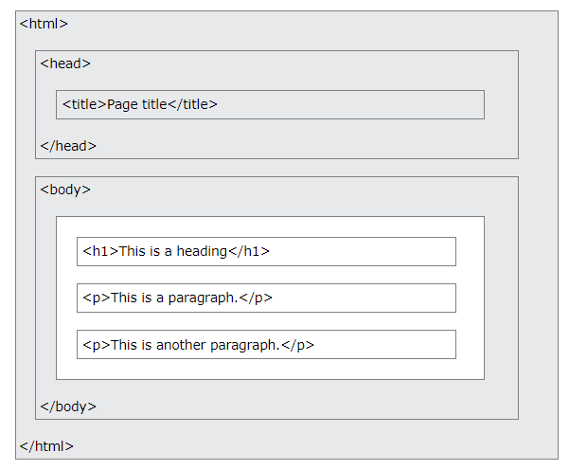
HTML Page Structure
The content inside the <body> section (the white area above) will be displayed in a browser.
The content inside the <title> element will be shown in the browser's title bar or in the page's tab.

Slide 6
Example 1
The following example contains four HTML elements (<html>, <body>, <h1> and <p>):
<!DOCTYPE html> <html> <body> <h1>My First Heading</h1> <p>My first paragraph.</p> </body> </html>
The <html> element is the root (最基本) element and it defines the whole HTML document.
It has a start tag <html> and an end tag </html>.

Slide 7
Example 2
<!DOCTYPE html> <html> <body> <h1>My First Heading</h1> <p>My first paragraph.</p> </body> </html>
The <body> element defines the document's body.
It has a start tag <body> and an end tag </body>.

Slide 8
Example 3
<!DOCTYPE html> <html> <body> <h1>My First Heading</h1> <p>My first paragraph.</p> </body> </html>
The <h1> element defines a heading.
It has a start tag <h1> and an end tag </h1>.

Slide 9
Example 4
<!DOCTYPE html> <html> <body> <h1>My First Heading</h1> <p>My first paragraph.</p> </body> </html>
The <p> element defines a paragraph.
It has a start tag <p> and an end tag </p>.

Slide 10
Never Skip(跳過) the End Tag
Some HTML elements will display correctly, even if you forget the end tag.
However, never rely on this! Unexpected results and errors may occur if you forget the end tag!
<p> This is a paragraph </p>

Slide 11
Empty HTML Elements
HTML elements with no content are called empty elements. (因為沒有內容，所以沒有結束標籤)
The <br> tag defines a line break, and is an empty element without a closing tag:
<p>This is a <br> paragraph with a line break.</p>

Slide 12
HTML is Not Case Sensitive
HTML tags are not case sensitive: <P> means the same as <p>.(與大小寫無關)
The HTML standard does not require lowercase tags, but W3C recommends lowercase in HTML, and demands lowercase for stricter document types like XHTML.

Slide 13
HTML Tag Reference
Tag | Description
<html> | Defines the root of an HTML document
<body> | Defines the document's body
<h1> to <h6> | Defines HTML headings
<br> & <p>

Slide 14
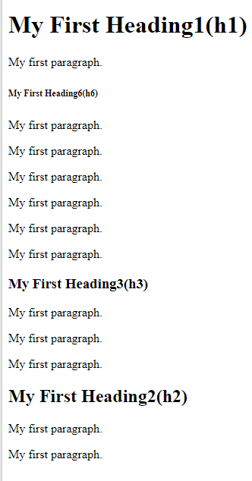
作業4
請利用w3schools html / elements
把My 改成你的學號，，讓輸出結果如右：

Slide 15
作業補充
檔名為HW本週檔名(例如HW2.htm)，請上傳到學校網站。
上傳截止時間：上課次日晚上11.00前。
請在google表單，填入可鏈結網址：例如http://fs2.just.edu.tw/~s123456789/hw2.htm
google表單https://forms.gle/k2w9fWn6vT7JR1Z97
上傳方式介紹：http://fs3.just.edu.tw/~cc/04_teach/doc/useFTP.htm

