Slide 1
5. Attributes
HTML attributes provide additional information about HTML elements.
屬性(attribute)提供html指令的補充說明或選項。
https://www.w3schools.com/html/html_attributes.asp

Slide 2
HTML Attributes
All HTML elements can have attributes
Attributes provide additional information about elements
Attributes are always specified in the start tag
Attributes usually come in name/value pairs like: name="value"

Slide 3
舉例說明
所有指令都會在未來再做介紹

Slide 4
1.The href Attribute
The <a> tag defines a hyperlink. The href attribute specifies the URL of the page the link goes to:
<a href="https://www.w3schools.com">Visit W3Schools</a>

Slide 5
2.The src Attribute
The <img> tag is used to embed an image in an HTML page. The src attribute specifies the path to the image to be displayed:
<img src="img_girl.jpg">
There are two ways to specify the URL in the src attribute:
1. Absolute URL
2. Relative URL

Slide 6
Absolute URL
Links to an external image that is hosted on another website.
Example: src="https://www.w3schools.com/images/img_girl.jpg".
Notes: External images might be under copyright. If you do not get permission to use it, you may be in violation of copyright laws. In addition, you cannot control external images; it can suddenly be removed or changed.

Slide 7
Relative URL
Links to an image that is hosted within the website. Here, the URL does not include the domain name.
Tip: It is almost always best to use relative URLs. They will not break if you change domain.
If the URL begins without a slash, it will be relative to the current page：src="img_girl.jpg".
If the URL begins with a slash, it will be relative to the domain: src="/images/img_girl.jpg".

Slide 8
The width and height Attributes
The <img> tag should also contain the width and height attributes, which specifies the width and height of the image (in pixels):
<img src="img_girl.jpg" width="500" height="600">

Slide 9
3.The alt Attribute
The required alt attribute for the <img> tag specifies an alternate text for an image, if the image for some reason cannot be displayed. This can be due to slow connection, or an error in the src attribute, or if the user uses a screen reader.
<img src="img_girl.jpg" alt="Girl with a jacket">

Slide 10
4.The style Attribute
The style attribute is used to add styles to an element, such as color, font, size, and more.
<p style="color:red;">This is a red paragraph.</p>

Slide 11
5.The lang Attribute
You should always include the lang attribute inside the <html> tag, to declare the language of the Web page. This is meant to assist search engines and browsers.
Country codes can also be added to the language code in the lang attribute. So, the first two characters define the language of the HTML page, and the last two characters define the country.

Slide 12
多數英語系國家(不含美國)
The following example specifies English as the language:
<!DOCTYPE html> <html lang="en"> <body> ... </body> </html>

Slide 13
英語系國家-美國專屬
The following example specifies English as the language and United States as the country:
<!DOCTYPE html> <html lang="en-US"> <body> ... </body> </html>

Slide 14
6.The title Attribute
The title attribute defines some extra information about an element.
The value of the title attribute will be displayed as a tooltip when you mouse over the element:
<p title="I'm a tooltip">This is a paragraph.</p>

Slide 15
We Suggest: Always Use Lowercase Attributes
The HTML standard does not require lowercase attribute names.
The title attribute (and all other attributes) can be written with uppercase or lowercase like title or TITLE.
However, W3C recommends lowercase attributes in HTML, and demands lowercase attributes for stricter document types like XHTML.

Slide 16
We Suggest: Always Quote Attribute Values
The HTML standard does not require quotes around attribute values.
However, W3C recommends quotes in HTML, and demands quotes for stricter document types like XHTML.
Good：<a href="https://www.w3schools.com">Visit HTML</a>
Bad：<a href=https://www.w3schools.com>Visit HTML</a>

Slide 17
Example
Sometimes you have to use quotes. This example will not display the title attribute correctly, because it contains a space:
<p title=About W3Schools>

Slide 18
Single or Double Quotes?
Double quotes around attribute values are the most common in HTML, but single quotes can also be used.
In some situations, when the attribute value itself contains double quotes, it is necessary to use single quotes (以下兩者皆可)
<p title='John "ShotGun" Nelson'>….. </p>
<p title="John 'ShotGun' Nelson">….. </p>

Slide 19
Summary1
All HTML elements can have attributes
The href attribute of <a> specifies the URL of the page the link goes to
The src attribute of <img> specifies the path to the image to be displayed
The width and height attributes of <img> provide size information for images

Slide 20
Summary2
The alt attribute of <img> provides an alternate text for an image
The style attribute is used to add styles to an element, such as color, font, size, and more
The lang attribute of the <html> tag declares the language of the Web page
The title attribute defines some extra information about an element

Slide 21
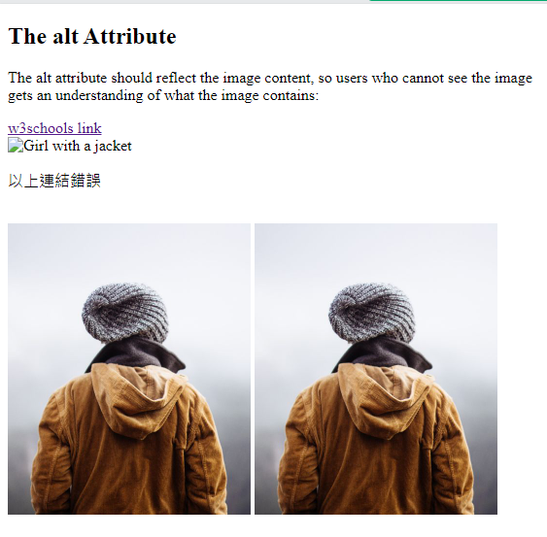
作業5參考資料(請在w3school做)
<!DOCTYPE html>
<html>
<body>
<h2>The alt Attribute</h2>
<p>The alt attribute should reflect the image content, so users who cannot see the image gets an understanding of what the image contains:</p>
<a href="https://www.w3schools.com"> w3schools link
</a>
<br>
<img src="https://www.w3schools.com/images/img_girl.jpg" alt="Girl with a jacket">
<p> 以上連結錯誤 </p>
<br>
<img src="img_girl.jpg" width="250" height="300">
<img src="img_girl.jpg" width="250" height="300">
</body>
</html>

Slide 22
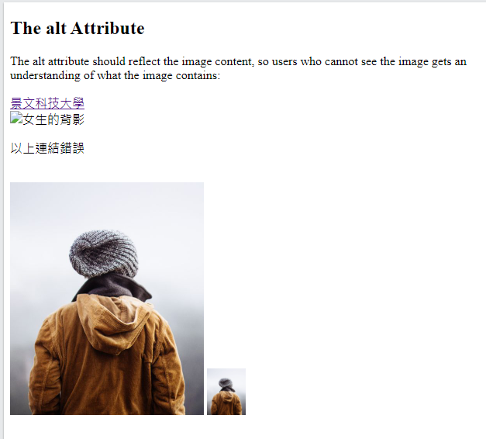
作業5(利用下頁資料)
1.改成景文科技大學 王OO
2.連結為www.just.edu.tw
3.圖片無法顯示，改為女生的背影
4. 第2張圖片大小為第1張圖片大小20%。

Slide 23
作業補充
檔名為HW本週檔名(例如HW5.htm)，請上傳到學校網站。
上傳截止時間：上課次日晚上11.00前。
請在google表單，填入可鏈結網址：例如http://fs2.just.edu.tw/~s123456789/hw5.htm
google表單https://forms.gle/k2w9fWn6vT7JR1Z97
上傳方式介紹：http://fs3.just.edu.tw/~cc/04_teach/doc/useFTP.htm

