Slide 1
6. Headings
HTML headings are titles or subtitles that you want to display on a webpage.
HTML的標題文字。
https://www.w3schools.com/html/html_headings.asp

Slide 2
HTML Headings (標題)
HTML headings are defined with the <h1> to <h6> tags.
<h1> defines the most important heading. (字也愈大)
<h6> defines the least important heading.
Note: Browsers automatically add some white space (a margin) before and after a heading.

Slide 3
Heading
<h1>Heading 1</h1> <h2>Heading 2</h2> <h3>Heading 3</h3> <h4>Heading 4</h4> <h5>Heading 5</h5> <h6>Heading 6</h6>

Slide 4
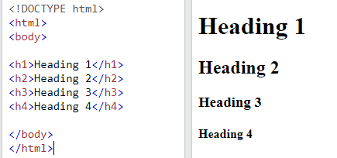
Example
Note: Browsers automatically add some white space (空白) (a margin(邊際)) before and after a heading.

Slide 5
Headings Are Important
Search engines use the headings to index the structure and content of your web pages.
Users often skim a page by its headings. It is important to use headings to show the document structure.
<h1> headings should be used for main headings, followed by <h2> headings, then the less important <h3>, and so on.
Note: Use HTML headings for headings only. Don't use headings to make text BIG or bold.

Slide 6
Bigger Headings
Each HTML heading has a default size. However, you can specify the size for any heading with the style attribute, using the CSS font-size property:
<h1 style="font-size:60px;">Heading 1</h1>

Slide 7
HTML Tag Reference
Tag | Description
<html> | Defines the root of an HTML document
<body> | Defines the document's body
<h1> to <h6> | Defines HTML headings

Slide 8
作業6(繳交方式：google表單)
請找出h1~h6，大約是多少px？
(提示)：請利用新指令(未來會再教)，去測試h1~h6的大小：
<h1 style="font-size:60px;">Heading 1</h1>
本週作業上傳google表單即可。

Slide 9
作業補充
請在google表單，填入答案
上傳截止時間：上課次日晚上11.00前。
google表單https://forms.gle/k2w9fWn6vT7JR1Z97

