Slide 1
7. Paragraphs
A paragraph always starts on a new line, and is usually a block of text.
段落是包含一個區域的文字，通常從新的一行開始。
https://www.w3schools.com/html/html_paragraphs.asp

Slide 2
HTML Paragraphs
The HTML <p> element defines a paragraph.
A paragraph always starts on a new line, and browsers automatically add some white space (a margin) before and after a paragraph.
<p>This is a paragraph.</p> <p>This is another paragraph.</p>

Slide 3
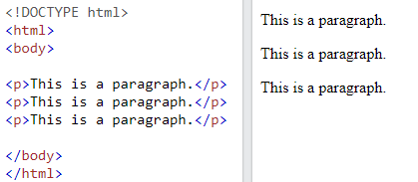
Example

Slide 4
HTML Display
You cannot be sure how HTML will be displayed.
Large or small screens, and resized windows will create different results.
With HTML, you cannot change the display by adding extra spaces or extra lines in your HTML code.

Slide 5
HTML Display(結果一樣)
The browser will automatically remove any extra spaces and lines when the page is displayed:
<p> This paragraph contains a lot of lines in the source code, but the browser ignores it. </p>
<p> This paragraph contains a lot of spaces in the source code, but the browser ignores it. </p>

Slide 6
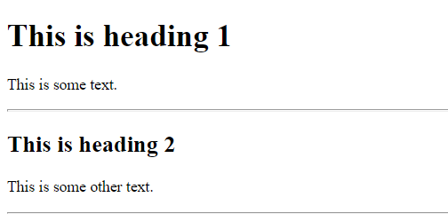
HTML Horizontal Rules
The <hr> tag defines a thematic (主題) break in an HTML page, and is most often displayed as a horizontal rule.
<h1>This is heading 1</h1> <p>This is some text.</p> <hr> <h2>This is heading 2</h2> <p>This is some other text.</p> <hr>

Slide 7
HTML Line Breaks
The HTML <br> element defines a line break.
Use <br> if you want a line break (a new line) without starting a new paragraph:
<p>This is <br>a paragraph<br> with line breaks.</p>

Slide 8
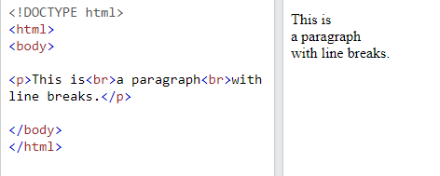
Example

Slide 9
The HTML <pre> Element
The HTML <pre> element defines preformatted text.
The text inside a <pre> element is displayed in a fixed-width font (usually Courier), and it preserves both spaces and line breaks:

Slide 10
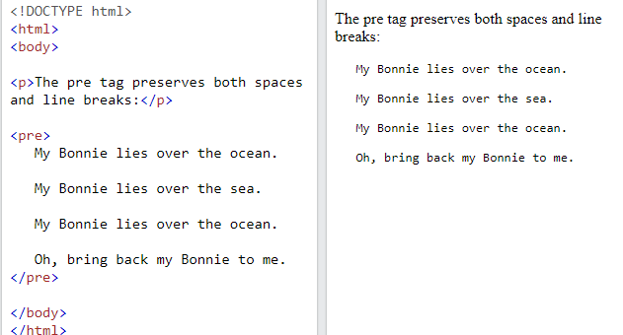
Example

Slide 11
Paragraphs Summary
The HTML <p> element defines a paragraph.
The <hr> tag defines a thematic break in an HTML page, and is most often displayed as a horizontal rule.
The HTML <br> element defines a line break.
The HTML <pre> element defines preformatted text.

Slide 12
Summary
Tag | Description
<p> | Defines a paragraph
<hr> | Defines a thematic change in the content
<br> | Inserts a single line break
<pre> | Defines pre-formatted text

Slide 13
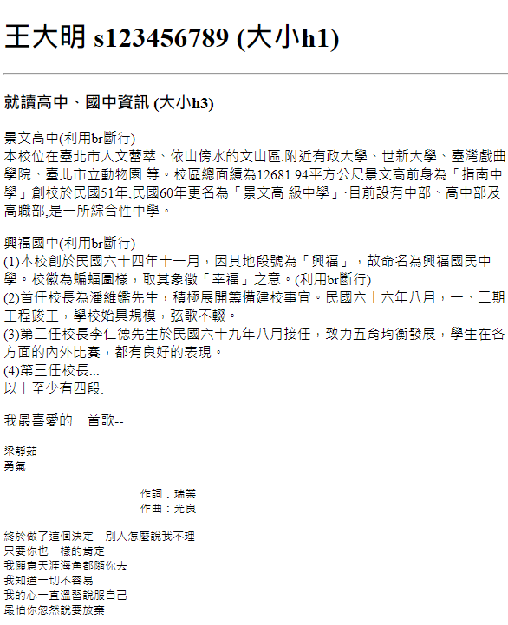
作業7
請利用<p>、<br>、<hr>、<pre>製作如右圖的自我介紹。
請上傳到學校網站，檔名為hw7.htm
請在google表單，填入可鏈結網址：例如http://fs2.just.edu.tw/~s123456789/hw7.htm
上傳截止時間：上課次日11.00前。
google表單https://forms.gle/k2w9fWn6vT7JR1Z97

