Slide 1
8. Styles
The HTML style attribute is used to add styles to an element, such as color, font, size, and more.
Styles通常是將元素依照所需，改變它的外觀形式。
https://www.w3schools.com/html/html_styles.asp

Slide 2
The HTML Style Attribute
Setting the style of an HTML element, can be done with the style attribute.
The HTML style attribute has the following syntax:
<tagname style="property:value;">

Slide 3
Background Color
The CSS background-color property defines the background color for an HTML element.
<body style="background-color:powderblue;"> <h1>This is a heading</h1> <p>This is a paragraph.</p> </body>
<body> <h1 style="background-color:powderblue;">This is a heading</h1> <p style="background-color:tomato;">This is a paragraph.</p> </body>
←主體的背景顏色
←h1的背景顏色
←該段落的背景顏色

Slide 4
Text Color
The CSS color property defines the text color for an HTML element:
<h1 style="color:blue;">This is a heading</h1> <p style="color:red;">This is a paragraph.</p>
←h1的文字顏色
←p的文字顏色

Slide 5
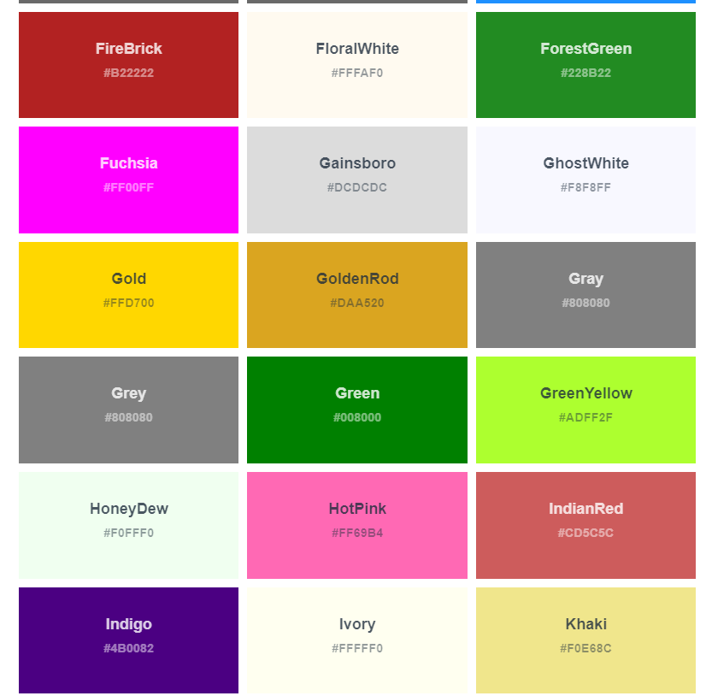
Color Name
<h1 style="color:gold;">Gold</h1>
<h1 style="color:#FFD700;">Gold</h1>
上述兩種效果一樣
https://www.w3schools.com/colors/colors_names.asp

Slide 6
Fonts
The CSS font-family property defines the font to be used for an HTML element:
<h1 style="font-family:verdana;">This is a heading</h1> <p style="font-family:courier;">This is a paragraph.</p>

Slide 7
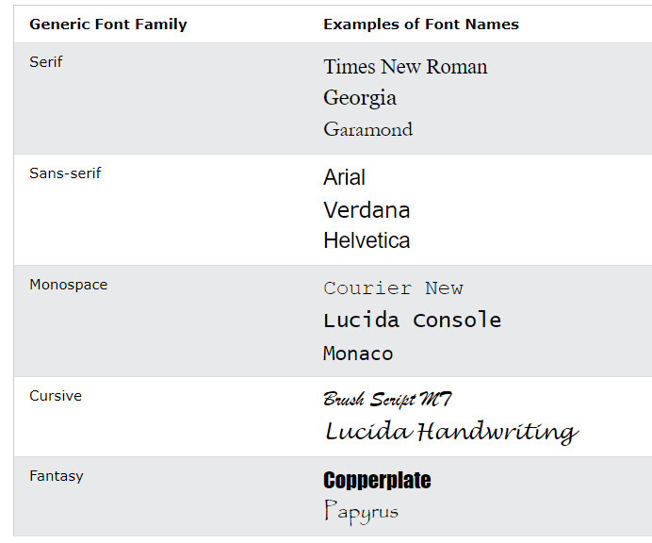
Example

Slide 8
通用字體系列(Generic Font Families)
在 CSS 中有五個通用字體系列
襯線字體(Serif)在每個字母的邊緣都有一個小筆劃。它們營造出一種正式和優雅的感覺。
無襯線字體(Sans-serif)有乾淨的線條（沒有附加小筆劃）。他們營造出現代簡約的外觀。
等寬字體(Monospace)- 這裡所有字母都具有固定寬度。他們創造了一種機械的外觀。
草書字體(Cursive)模仿人類的筆跡。
幻想字體(Fantasy)是裝飾/俏皮的字體。
所有不同的字體名稱都屬於通用字體系列之一。https://www.w3schools.com/css/css_font.asp

Slide 9
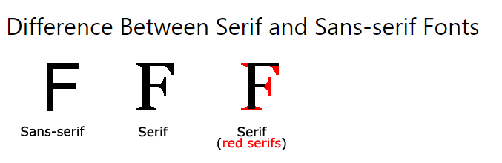
Example

Slide 10
Best web safe fonts for HTML and CSS
Arial (sans-serif)
Verdana (sans-serif)
Helvetica (sans-serif)
Tahoma (sans-serif)
Trebuchet MS (sans-serif)
Times New Roman (serif)
Georgia (serif)
Garamond (serif)
Courier New (monospace)
Brush Script MT (cursive)
其餘字型，請參考：https://www.w3schools.com/howto/howto_google_fonts.asp
https://www.w3schools.com/cssref/css_websafe_fonts.asp

Slide 11
Text Size
The CSS font-size property defines the text size for an HTML element:
<h1 style="font-size:300%;">This is a heading</h1> <p style="font-size:160%;">This is a paragraph.</p>

Slide 12
font-size
font-size: 15px;
font-size: large;
font-size: 150%;

Slide 13
font-size 1
Value | Description
medium | Sets the font-size to a medium size. This is default
xx-small | Sets the font-size to an xx-small size
x-small | Sets the font-size to an extra small size
small | Sets the font-size to a small size
large | Sets the font-size to a large size
x-large | Sets the font-size to an extra large size
xx-large | Sets the font-size to an xx-large size

Slide 14
font-size 2
Value | Description
smaller | Sets the font-size to a smaller size than the parent element
larger | Sets the font-size to a larger size than the parent element
length | Sets the font-size to a fixed size in px, cm, etc.
% | Sets the font-size to a percent of the parent element's font size
initial | Sets this property to its default value.
inherit | Inherits this property from its parent element.

Slide 15
Text Alignment
The CSS text-align property defines the horizontal text alignment for an HTML element:
<h1 style="text-align:center;">Centered Heading</h1> <p style="text-align:center;">Centered paragraph.</p>

Slide 16
Alignment
Value | Description
left | Aligns the text to the left
right | Aligns the text to the right
center | Centers the text
justify | Stretches the lines so that each line has equal width (like in newspapers and magazines)
initial | Sets this property to its default value.
inherit | Inherits this property from its parent element.

Slide 17
Chapter Summary
Use the style attribute for styling HTML elements
Use background-color for background color
Use color for text colors
Use font-family for text fonts
Use font-size for text sizes
Use text-align for text alignment

Slide 18
作業8A
若以Font-size: medium 為基準，請問大約等於 Font-size: ?? px;
若以Font-size: xx-large 為基準，請問大約等於 Font-size: ?? px;
請在google表單，填入可鏈結網址：例如http://fs2.just.edu.tw/~s123456789/hw7.htm
上傳截止時間：上課次日晚上11.00前。
google表單https://forms.gle/k2w9fWn6vT7JR1Z97

Slide 19
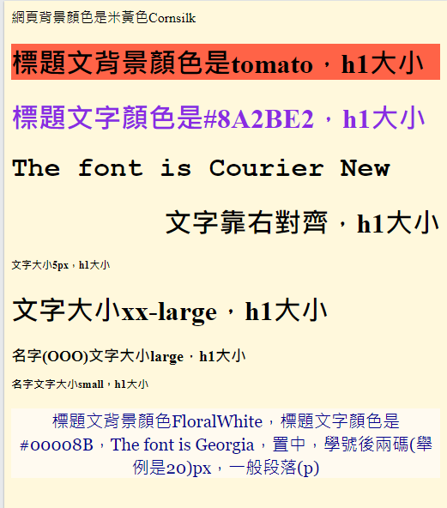
作業8B
請做出下列網頁：
參考文字：標題文背景顏色FloralWhite，標題文字顏色是#00008B，The font is Georgia，置中，學號後兩碼(舉例是20)px，一般段落
上傳截止時間：上課次日晚上11.00前。

Slide 20
作業8B補充
檔名為HW本週檔名(例如HW8.htm)，請上傳到學校網站。
請在google表單，填入可鏈結網址：例如http://fs2.just.edu.tw/~s123456789/hw8.htm
上傳截止時間：上課次日晚上11.00前。
google表單https://forms.gle/k2w9fWn6vT7JR1Z97
上傳方式介紹：http://fs3.just.edu.tw/~cc/04_teach/doc/useFTP.htm

