Slide 1
9. Text Formatting
HTML Contains Several Elements For Defining Text With A Special Meaning.
HTML字體的各種變化
https://www.w3schools.com/html/html_formatting.asp

Slide 2
HTML Formatting Elements
Formatting elements were designed to display special types of text:
<b> - Bold text
<strong> - Important text
<i> - Italic text
<em> - Emphasized text
<mark> - Marked text
<small> - Smaller text
<del> - Deleted text
<ins> - Inserted text
<sub> - Subscript text
<sup> - Superscript text

Slide 3
HTML <b> and <strong> Elements
The HTML <b> element defines bold text, without any extra importance.
<b>This text is bold</b>
The HTML <strong> element defines text with strong importance. The content inside is typically displayed in bold.
<strong>This text is important!</strong>

Slide 4
HTML <i> and <em> Elements
The HTML <i> element defines a part of text in an alternate voice or mood. The content inside is typically displayed in italic.
Tip: The <i> tag is often used to indicate a technical term, a phrase from another language, a thought, a ship name, etc.
<i>This text is italic</i>
The HTML <em> element defines emphasized text. The content inside is typically displayed in italic.
Tip: A screen reader will pronounce the words in <em> with an emphasis, using verbal stress.
<em>This text is emphasized</em>

Slide 5
HTML <small> and <mark> Element
The HTML <small> element defines smaller text:
<small>This is some smaller text.</small>
The HTML <mark> element defines text that should be marked or highlighted:
<p>Do not forget to buy <mark>milk</mark> today.</p>

Slide 6
HTML <del> Element
The HTML <del> element defines text that has been deleted from a document. Browsers will usually strike a line through deleted text:
<p>My favorite color is <del>blue</del> red.</p>

Slide 7
HTML <ins> Element
The HTML <ins> element defines a text that has been inserted into a document. Browsers will usually underline inserted text:
<p>My favorite color is <del>blue</del> <ins>red</ins>.</p>

Slide 8
HTML <sub> Element
The HTML <sub> element defines subscript text. Subscript text appears half a character below the normal line, and is sometimes rendered in a smaller font. Subscript text can be used for chemical formulas, like H₂O:
<p>This is <sub>subscripted</sub> text.</p>

Slide 9
HTML <sup> Element
The HTML <sup> element defines superscript text. Superscript text appears half a character above the normal line, and is sometimes rendered in a smaller font. Superscript text can be used for footnotes, like WWW:
<p>This is <sup>superscripted</sup> text.</p>

Slide 10
Summary1
Tag | Description
<b> | Defines bold text
<em> | Defines emphasized text
<i> | Defines a part of text in an alternate voice or mood - Italic
<small> | Defines smaller text
<strong> | Defines important text -strong

Slide 11
Summary2
Tag | Description
<sub> | Defines subscripted text
<sup> | Defines superscripted text
<ins> | Defines inserted text
<del> | Defines deleted text
<mark> | Defines marked/highlighted text

Slide 12
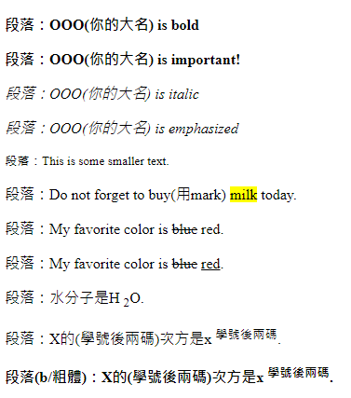
作業9
請做出下列網頁：
均用段落
上傳截止時間：上課次日晚上11.00前。

Slide 13
作業9補充
檔名為HW本週檔名(例如HW9.htm)，請上傳到學校網站。
請在google表單，填入可鏈結網址：例如http://fs2.just.edu.tw/~s123456789/hw9.htm
上傳截止時間：上課次日晚上11.00前。
google表單https://forms.gle/k2w9fWn6vT7JR1Z97
上傳方式介紹：http://fs3.just.edu.tw/~cc/04_teach/doc/useFTP.htm

