Slide 1
10. Quotation and Citation Elements
We will go through the <blockquote>,<q>, <abbr>, <address>, <cite>, and <bdo> HTML elements.
HTML特定使用或引用資料的格式
https://www.w3schools.com/html/html_quotation_elements.asp

Slide 2
HTML <blockquote> for Quotations
The HTML <blockquote> element defines a section that is quoted from another source.
Browsers usually indent(縮排) <blockquote> elements.

Slide 3
Example
<p>Here is a quote from WWF's website:</p> <blockquote cite="http://www.worldwildlife.org/who/index.html"> For 50 years, WWF has been protecting the future of nature. The world's leading conservation organization, WWF works in 100 countries and is supported by 1.2 million members in the United States and close to 5 million globally. </blockquote>

Slide 4
HTML <q> for Short Quotations
The HTML <q> tag defines a short quotation.
Browsers normally insert quotation marks (單引號) around the quotation.
<p>WWF's goal is to: <q>Build a future where people live in harmony with nature.</q></p>

Slide 5
HTML <abbr> for Abbreviations
The HTML <abbr> tag defines an abbreviation or an acronym, like "HTML", "CSS", "Mr.", "Dr.", "ASAP", "ATM".
Marking abbreviations can give useful information to browsers, translation systems and search-engines.
Tip: Use the global title attribute to show the description for the abbreviation/acronym when you mouse over the element.

Slide 6
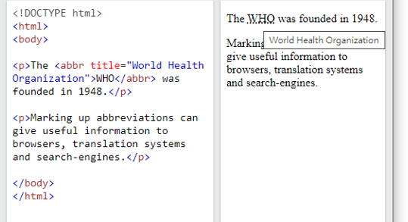
Example
<p>The <abbr title="World Health Organization">WHO</abbr> was founded in 1948.</p>

Slide 7
HTML <address> for Contact Information
The HTML <address> tag defines the contact information for the author/owner of a document or an article.
The contact information can be an email address, URL, physical address, phone number, social media handle, etc.
The text in the <address> element usually renders in italic, and browsers will always add a line break before and after the <address> element.

Slide 8
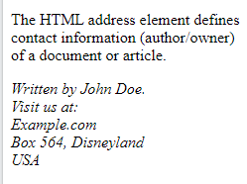
Example
<address> Written by John Doe.<br> Visit us at:<br> Example.com<br> Box 564, Disneyland<br> USA </address>

Slide 9
HTML <cite> for Work Title
The HTML <cite> tag defines the title of a creative work (e.g. a book, a poem, a song, a movie, a painting, a sculpture, etc.).
Note: A person's name is not the title of a work.
The text in the <cite> element usually renders in italic.
<p><cite>The Scream</cite> by Edvard Munch. Painted in 1893.</p>

Slide 10
補充
Cite，可用，也可以不寫。
最主要是讓網路整體統計用，計算引用該網站的總次數。
文字會縮排。
此指令通常是給程式設計者參考用，對於網頁使用者，並無太大的幫助。

Slide 11
HTML <bdo> for Bi-Directional Override
BDO stands for Bi-Directional Override.
The HTML <bdo> tag is used to override the current text direction:
<bdo dir="rtl">This text will be written from right to left</bdo>

Slide 12
Summary
Tag | Description
<abbr> | Defines an abbreviation or acronym - 加入全名資訊，便於搜尋 (例如：just代表 Jinwen University.......)
<address> | Defines contact information for the author/owner of a document - italic
<bdo> | Defines the text direction
<blockquote> | Defines a section that is quoted from another source - 縮排
<cite> | Defines the title of a work - italic
<q> | Defines a short inline quotation. (短引號")

Slide 13
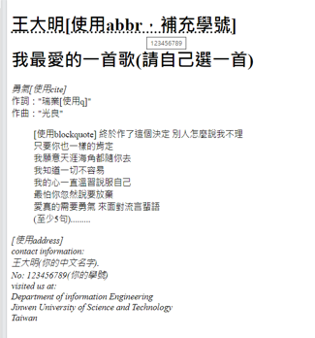
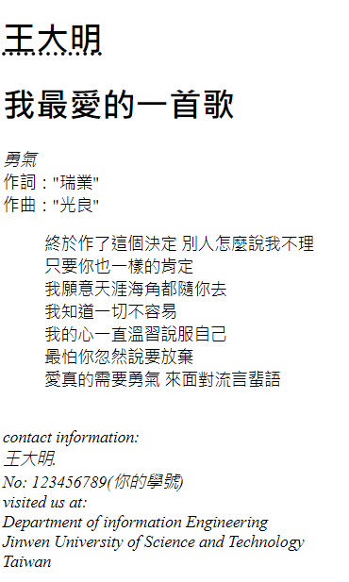
作業10
請做出下列網頁：
參考文字：[使用address]
contact information:
王大明(你的中文名字).
No: 123456789(你的學號)
visited us at:
Department of information Engineering
Jinwen University of Science and Technology
Taiwan
上傳截止時間：上課次日晚上11.00前。

Slide 14
作業10補充
檔名為HW本週檔名(例如HW10.htm)，請上傳到學校網站。
請在google表單，填入可鏈結網址：例如http://studyweb.just.edu.tw/~s123456789/hw10.htm
上傳截止時間：上課次日晚上11.00前。
google表單https://forms.gle/k2w9fWn6vT7JR1Z97

