Slide 1
11.HTML Comments
HTML comments are not displayed in the browser, but they can help document your HTML source code.
註釋(comment)是幫助程式設計者了解整個程式的架構
https://www.w3schools.com/html/html_comments.asp

Slide 2
Comment Tag
Add Comments
Hide Content
Hide Inline Content

Slide 3
HTML Comment Tag
You can add comments to your HTML source by using the following syntax:
<!-- -->
<!-- Write your comments here -->

Slide 4
CSS comment
/* CSS comments */
<!– HTML comments -->

Slide 5
幾個詞
<!-- 幾個詞 -->
<!-- Write your comments here -->
<p>This <!-- great text --> is a paragraph.</p>

Slide 6
一句指令
<!-- 一句指令 -->
<p>This is a paragraph.</p> <!-- <p>This is another paragraph </p> --> <p>This is a paragraph too.</p>

Slide 7
一段指令
<!-- 暫時不用的一段指令 -->
<p>This is a paragraph.</p> <!-- <p>Look at this cool image:</p> <img border="0" src="pic_trulli.jpg" alt="Trulli"> --> <p>This is a paragraph too.</p>

Slide 8
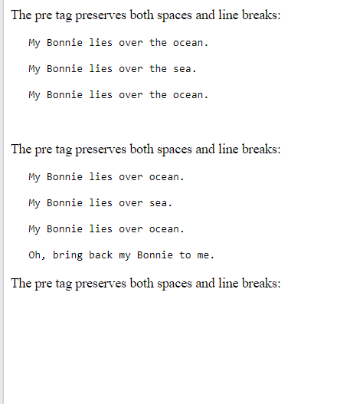
作業11
在不能刪減原始程式的條件下，請利用加入<!--、-->，輸出右圖的結果。
原始程式碼在下頁。
請上傳到學校網站，檔名為hw11.htm
請在google表單，填入可鏈結網址：例如http://fs2.just.edu.tw/~s123456789/hw11.htm
上傳截止時間：上課次日晚上11.00前。
google表單https://forms.gle/k2w9fWn6vT7JR1Z97

Slide 9
作業11
<!DOCTYPE html>
<html>
<body>
<p>The pre tag preserves both spaces and line breaks:</p>
<pre>
My Bonnie lies over the ocean.
My Bonnie lies over the sea.
My Bonnie lies over the ocean.
Oh, bring back my Bonnie to me.
</pre>
<p>The pre tag preserves both spaces and line breaks:</p>
<pre>
My Bonnie lies over the ocean.
My Bonnie lies over the sea.
My Bonnie lies over the ocean.
Oh, bring back my Bonnie to me.
</pre>
<p>The pre tag preserves both spaces and line breaks:</p>
<pre>
My Bonnie lies over the ocean.
My Bonnie lies over the sea.
My Bonnie lies over the ocean.
Oh, bring back my Bonnie to me.
</pre>
</body>
</html>

Slide 10
作業補充
檔名為HW本週檔名(例如HW11.htm)，請上傳到學校網站。
上傳截止時間：上課次日晚上11.00前。
請在google表單，填入可鏈結網址：例如http://studyweb.just.edu.tw/~s123456789/hw11.htm
google表單https://forms.gle/k2w9fWn6vT7JR1Z97

