Slide 1
13. CSS
CSS stands for Cascading Style Sheets.
Cascading Style Sheets (CSS) is used to format the layout of a webpage.
CSS通常用於網頁設計。
https://www.w3schools.com/html/html_css.asp

Slide 2
CSS
The word cascading means that a style applied to a parent element will also apply to all children elements within the parent. So, if you set the color of the body text to "blue", all headings, paragraphs, and other text elements within the body will also get the same color (unless you specify something else)!

Slide 3
CSS
CSS can be added to HTML documents in 3 ways:
Inline - by using the style attribute inside HTML elements
Internal - by using a <style> element in the <head> section
External - by using a <link> element to link to an external CSS file

Slide 4
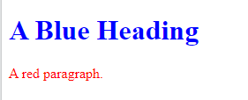
Inline CSS
An inline CSS is used to apply a unique style to a single HTML element.
An inline CSS uses the style attribute of an HTML element.
<!DOCTYPE html>
<html>
<body>
<h1 style="color:blue;">A Blue Heading</h1>
<p style="color:red;">A red paragraph.</p>
</body>
</html>

Slide 5
Internal CSS
An internal CSS is used to define a style for a single HTML page.
An internal CSS is defined in the <head> section of an HTML page, within a <style> element.

Slide 6
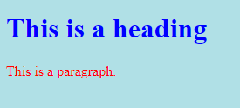
Example 1
<!DOCTYPE html>
<html>
<head>
<style>
body {background-color:powderblue;}
h1 {color: blue;}
p {color: red;}
</style>
</head>
<body>
<h1>This is a heading</h1>
<p>This is a paragraph.</p>
</body>
</html>

Slide 7
External CSS
An external style sheet is used to define the style for many HTML pages.
To use an external style sheet, add a link to it in the <head> section of each HTML page:

Slide 8
Example 2 (external & internal）
styles.css
body {
background-color: powderblue;
}
h1 {
color: blue;
}
p {
color: red;
}
<!DOCTYPE html>
<html>
<head>
<link rel="stylesheet" href="styles.css">
</head>
<body>
<h1>This is a heading</h1>
<p>This is a paragraph.</p>
</body>
</html>

Slide 9
CSS Colors, Fonts and Sizes
Here, we will demonstrate some commonly used CSS properties. You will learn more about them later.
The CSS color property defines the text color to be used.
The CSS font-family property defines the font to be used.
The CSS font-size property defines the text size to be used.

Slide 10
<style>
h1 {
color: blue;
font-family: verdana;
font-size: 300%;
}
p {
color: red;
font-family: courier;
font-size: 160%;
}
</style>

Slide 11
CSS Border
The CSS border property defines a border around an HTML element.
Tip: You can define a border for nearly all HTML elements.

Slide 12
CSS Padding
The CSS padding property defines a padding (space) between the text and the border.

Slide 13
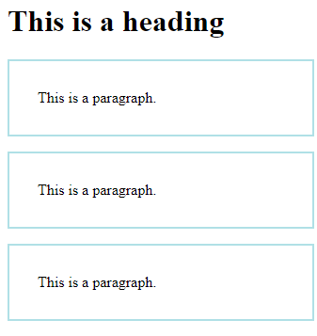
CSS Margin
The CSS margin property defines a margin (space) outside the border.
p {
border: 2px solid powderblue;
margin: 50px;
padding: 30px;
}

Slide 14
Link to External CSS
External style sheets can be referenced with a full URL or with a path relative to the current web page.
<link rel="stylesheet" href="https://www.w3schools.com/html/styles.css">
<link rel="stylesheet" href="/html/styles.css">
<link rel="stylesheet" href="styles.css">

Slide 15
Chapter Summary
Use the HTML style attribute for inline styling
Use the HTML <style> element to define internal CSS
Use the HTML <link> element to refer to an external CSS file
Use the HTML <head> element to store <style> and <link> elements
Use the CSS color property for text colors
Use the CSS font-family property for text fonts
Use the CSS font-size property for text sizes
Use the CSS border property for borders
Use the CSS padding property for space inside the border
Use the CSS margin property for space outside the border

Slide 16
HTML Style Tags
Tag | Description
<style> | Defines style information for an HTML document
<link> | Defines a link between a document and an external resource

Slide 17
作業13
請簡單做一個自我介紹，至少200字以上。網頁第1行標題為大名與學號。
請利用Inline、 Internal、 External的方式，美化這個段落。
在最後一段，貼上你用External的CSS程式碼。
網頁的title註明：CSS介紹-王大明(你的名字) 製

Slide 18
作業補充
檔名為HW本週檔名(例如HW13.htm)，請上傳到學校網站。
請在google表單，填入可鏈結網址：例如http://fs2.just.edu.tw/~s123456789/hw13.htm
上傳截止時間：上課次日晚上11.00前。
google表單https://forms.gle/k2w9fWn6vT7JR1Z97
上傳方式介紹：http://fs3.just.edu.tw/~cc/04_teach/doc/useFTP.htm

