Slide 1
14. Links
Links are found in nearly all web pages.
Links allow users to click their way from page to page.
Link讓網頁互相連結
https://www.w3schools.com/html/html_links.asp

Slide 2
HTML Links - Hyperlinks
HTML links are hyperlinks.
You can click on a link and jump to another document.
When you move the mouse over a link, the mouse arrow will turn into a little hand(變成一隻小手).

Slide 3
HTML Links – Syntax 1
The HTML <a> tag defines a hyperlink. It has the following syntax:
<a href="url">link text</a>
The most important attribute of the <a> element is the href attribute, which indicates the link's destination .
href = hyperlink reference

Slide 4
HTML Links – Syntax 2
By default, links will appear as follows in all browsers:
An unvisited link is underlined and blue
A visited link is underlined and purple
An active link is underlined and red

Slide 5
HTML Links - The target Attribute
By default, the linked page will be displayed in the current browser window. To change this, you must specify another target for the link.
The target attribute can have one of the following values
attribute | 新畫面
_self | 出現在點擊的網頁或子網頁 (預設值)，若本網頁有其他frame，仍會存在。
_blank | 全新的視窗網頁
_parent | 出現在本網頁的主頁
_top | 全新的視窗網頁，但在本網頁的主頁出現。若本網頁有其他frame，會被取代。

Slide 6
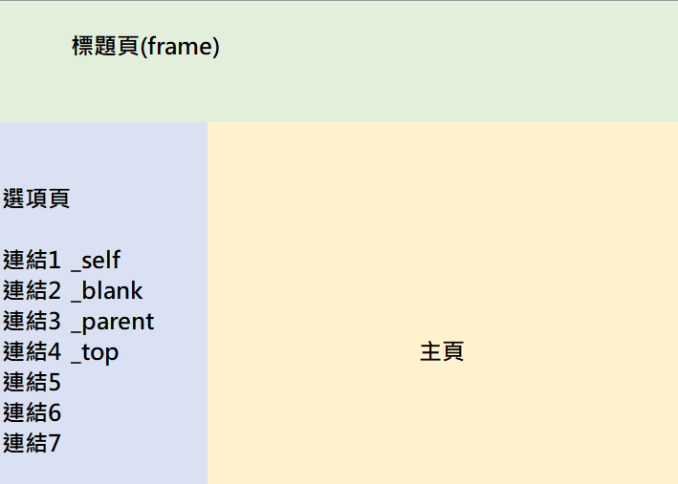
範例
_self：淺藍色區域
_blank：新網頁
_parent：米色區域
_top：米色區域(擴大，淺藍、綠色區域都不見)

Slide 7
Absolute URLs vs. Relative URLs
absolute URL (外部連結)
(a full web address) in the href attribute.
A local link (a link to a page within the same website) is specified with a relative URL (內部連結)
(without the "https://www."):

Slide 8
Absolute URLs vs. Relative URLs
<h2>Absolute URLs</h2>
<p><a href="https://www.w3.org/">W3C</a></p>
<p><a href="https://www.google.com/">Google</a></p>
<h2>Relative URLs</h2>
<p><a href="html_images.asp">HTML Images</a></p>
<p><a href="/css/default.asp">CSS Tutorial</a></p>

Slide 9
HTML Links - Use an Image as a Link
To use an image as a link, just put the <img> tag inside the <a> tag:
<a href="default.asp">
<img src="smiley.gif" alt="no show " style="width:42px">
</a>

Slide 10
Link to an Email Address
Use mailto: inside the href attribute to create a link that opens the user's email program (to let them send a new email):
<a href="mailto:someone@example.com">Send email</a>
https://css-tricks.com/snippets/html/mailto-links/

Slide 11
Example
設定主旨 <a href="mailto:xx@yy.tw?subject=我的意見">
郵件副本 <a href="mailto:xx@yy.tw?cc=abc@mail.com">
密件副本 <a href="mailto:xx@yy.tw?bcc=abc@mail.com">
郵件內容開頭文字 <a href="mailto:xx@yy.tw?body=我要參加">

Slide 12
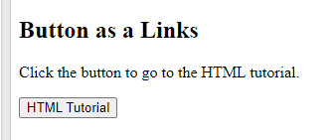
Button as a Link
To use an HTML button as a link, you have to add some JavaScript code.
<button onclick="document.location='default.asp'">
HTML Tutorial </button>

Slide 13
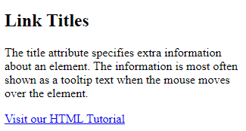
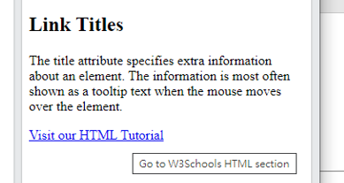
Link titles(當游標移到時，補充說明)
The title attribute specifies extra information about an element. The information is most often shown as a tooltip text when the mouse moves over the element.
<a href="https://www.w3schools.com/html/" title="Go to W3Schools HTML section">Visit our HTML Tutorial</a>

Slide 14
Summary 1
• Use the <a> element to define a link
• Use the href attribute to define the link address
• Use the target attribute to define where to open the linked document
• Use the <img> element (inside <a>) to use an image as a link
• Use the mailto: scheme inside the href attribute to create a link that opens
the user's email program

Slide 15
HTML Link Tags
Tag | Description
<a> | Defines a hyperlink

Slide 16
作業14a
請設計一網頁，存成為：index html
內容包含：
你的名字與你的學號、出生月、學校的LOGO 、資訊工程系、私房菜、信箱圖案。
從學校LOGO圖片，設計一連結，點選圖片，可連結到學校網址。
點選系名文字，可連結到系上網頁。
點選私房菜，可以連結到：https://www.youtube.com/watch?v=TbbNsQJeJ7I
點選信箱圖案，可以寄信給你，主旨是「來自網頁訪客的問題，寄給(你的學號)」。

Slide 17
作業14a
呈上題，請依序(由上至下)做下列的連結(紅色為檔案名稱，均為小寫，副檔名均為html)：
期中考練習1(m1)、期中考練習2(m2)
期中考1(midterm1)、期中考2(midterm2)
期末考練習1(f1)、期末考練習2(f2)
期末考1(final1)、期末考2(final2)
作業7-30(hw7-hw30)

Slide 18

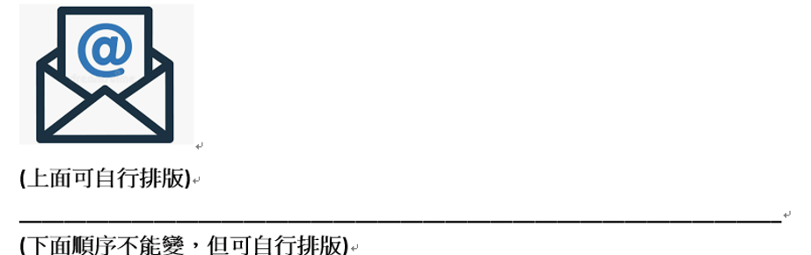
私房菜

Slide 19
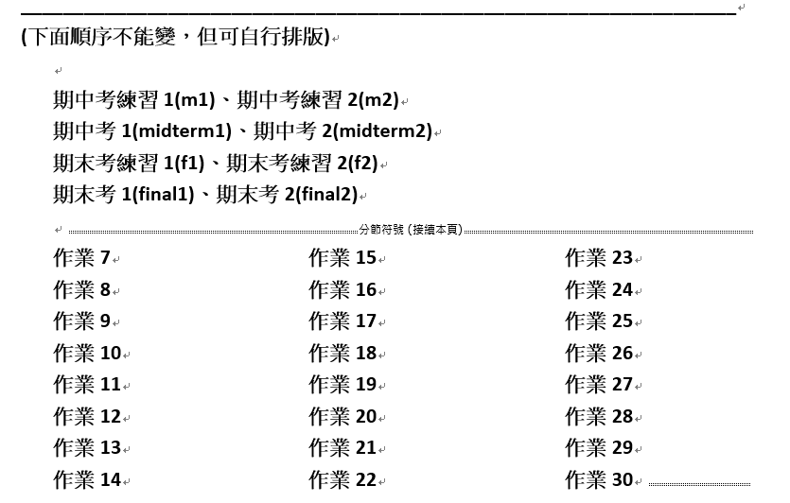

Slide 20
作業補充
檔名為index.html，請上傳到學校網站。
上傳截止時間：上課次日晚上11.00前。
http://studyweb.just.edu.tw/~s123456789/index.html

Slide 21
14a. Links - Different Colors
An HTML link is displayed in a different color depending on whether it has been visited, is unvisited, or is active page.
連結點的顏色變化
https://www.w3schools.com/html/html_links.asp

Slide 22
HTML Link Colors-1
By default, a link will appear like this (in all browsers):
An unvisited link is underlined and blue
A visited link is underlined and purple
An active link is underlined and red(按下那一瞬間)

Slide 23
Example 1
You can change the link state colors, by using CSS:
<style>
a:link {
color: green;
background-color: transparent;
text-decoration: none;
}
a:visited {
color: pink;
background-color: transparent;
text-decoration: none;
}

Slide 24
Example 2
a:hover {
color: red;
background-color: transparent;
text-decoration: underline;
}
a:active {
color: yellow;
background-color: transparent;
text-decoration: underline;
}
</style>

Slide 25
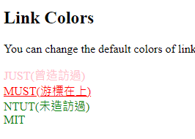
HTML Link Colors-1
items | text-decoration | color
visited | none | pink
hover | underlined | red
unvisited | none | green
active | underlined | yellow

Slide 26
Link Buttons
A link can also be styled as a button, by using CSS:
<style> a:link, a:visited { background-color: #f44336; color: white; padding: 15px 25px; text-align: center; text-decoration: none; display: inline-block; }
a:hover, a:active { background-color: red; } </style>

Slide 27
14b. Links - Create Bookmarks
HTML links can be used to create bookmarks, so that readers can jump to specific parts of a web page.
利用書籤可以做同一網頁彼此之間的連結
https://www.w3schools.com/html/html_links_bookmarks.asp

Slide 28
Create a Bookmark in HTML
Bookmarks can be useful if a web page is very long.
To create a bookmark - first create the bookmark, then add a link to it.
When the link is clicked, the page will scroll down or up to the location with the bookmark.

Slide 29
Example
First, use the id attribute to create a bookmark:
<h2 id="C4">Chapter 4</h2>
Then, add a link to the bookmark ("Jump to Chapter 4"), from within the same page:
<a href="#C4">Jump to Chapter 4</a>
You can also add a link to a bookmark on another page: <a href="html_demo.html#C4"> Jump to Chapter 4</a>

Slide 30
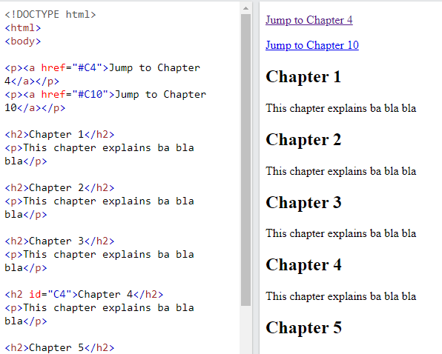
<p><a href="#C4">Jump to Chapter 4</a></p>
<h2 id="C4">Chapter 4</h2>

Slide 31
Summary 2
Use the id attribute (id="value") to define bookmarks in a page
Use the href attribute (href="#value") to link to the bookmark

Slide 32
作業14b
請設計另外一網頁，內容包含：
你過去3學期所修的課程，分為3個區塊。
在最上面，設計3個連結，按連結利用id，可以自動跳到該學期所修課程之介紹。

Slide 33
作業補充
檔名為HW本週檔名(例如HW14a 和 HW14b.htm)，請上傳到學校網站。
上傳截止時間：上課次日晚上11.00前。
請在google表單，填入可鏈結網址：例如http://fs2.just.edu.tw/~s123456789/hw14a.htm
google表單https://forms.gle/k2w9fWn6vT7JR1Z97
上傳方式介紹：http://fs3.just.edu.tw/~cc/04_teach/doc/useFTP.htm

